Slide 1

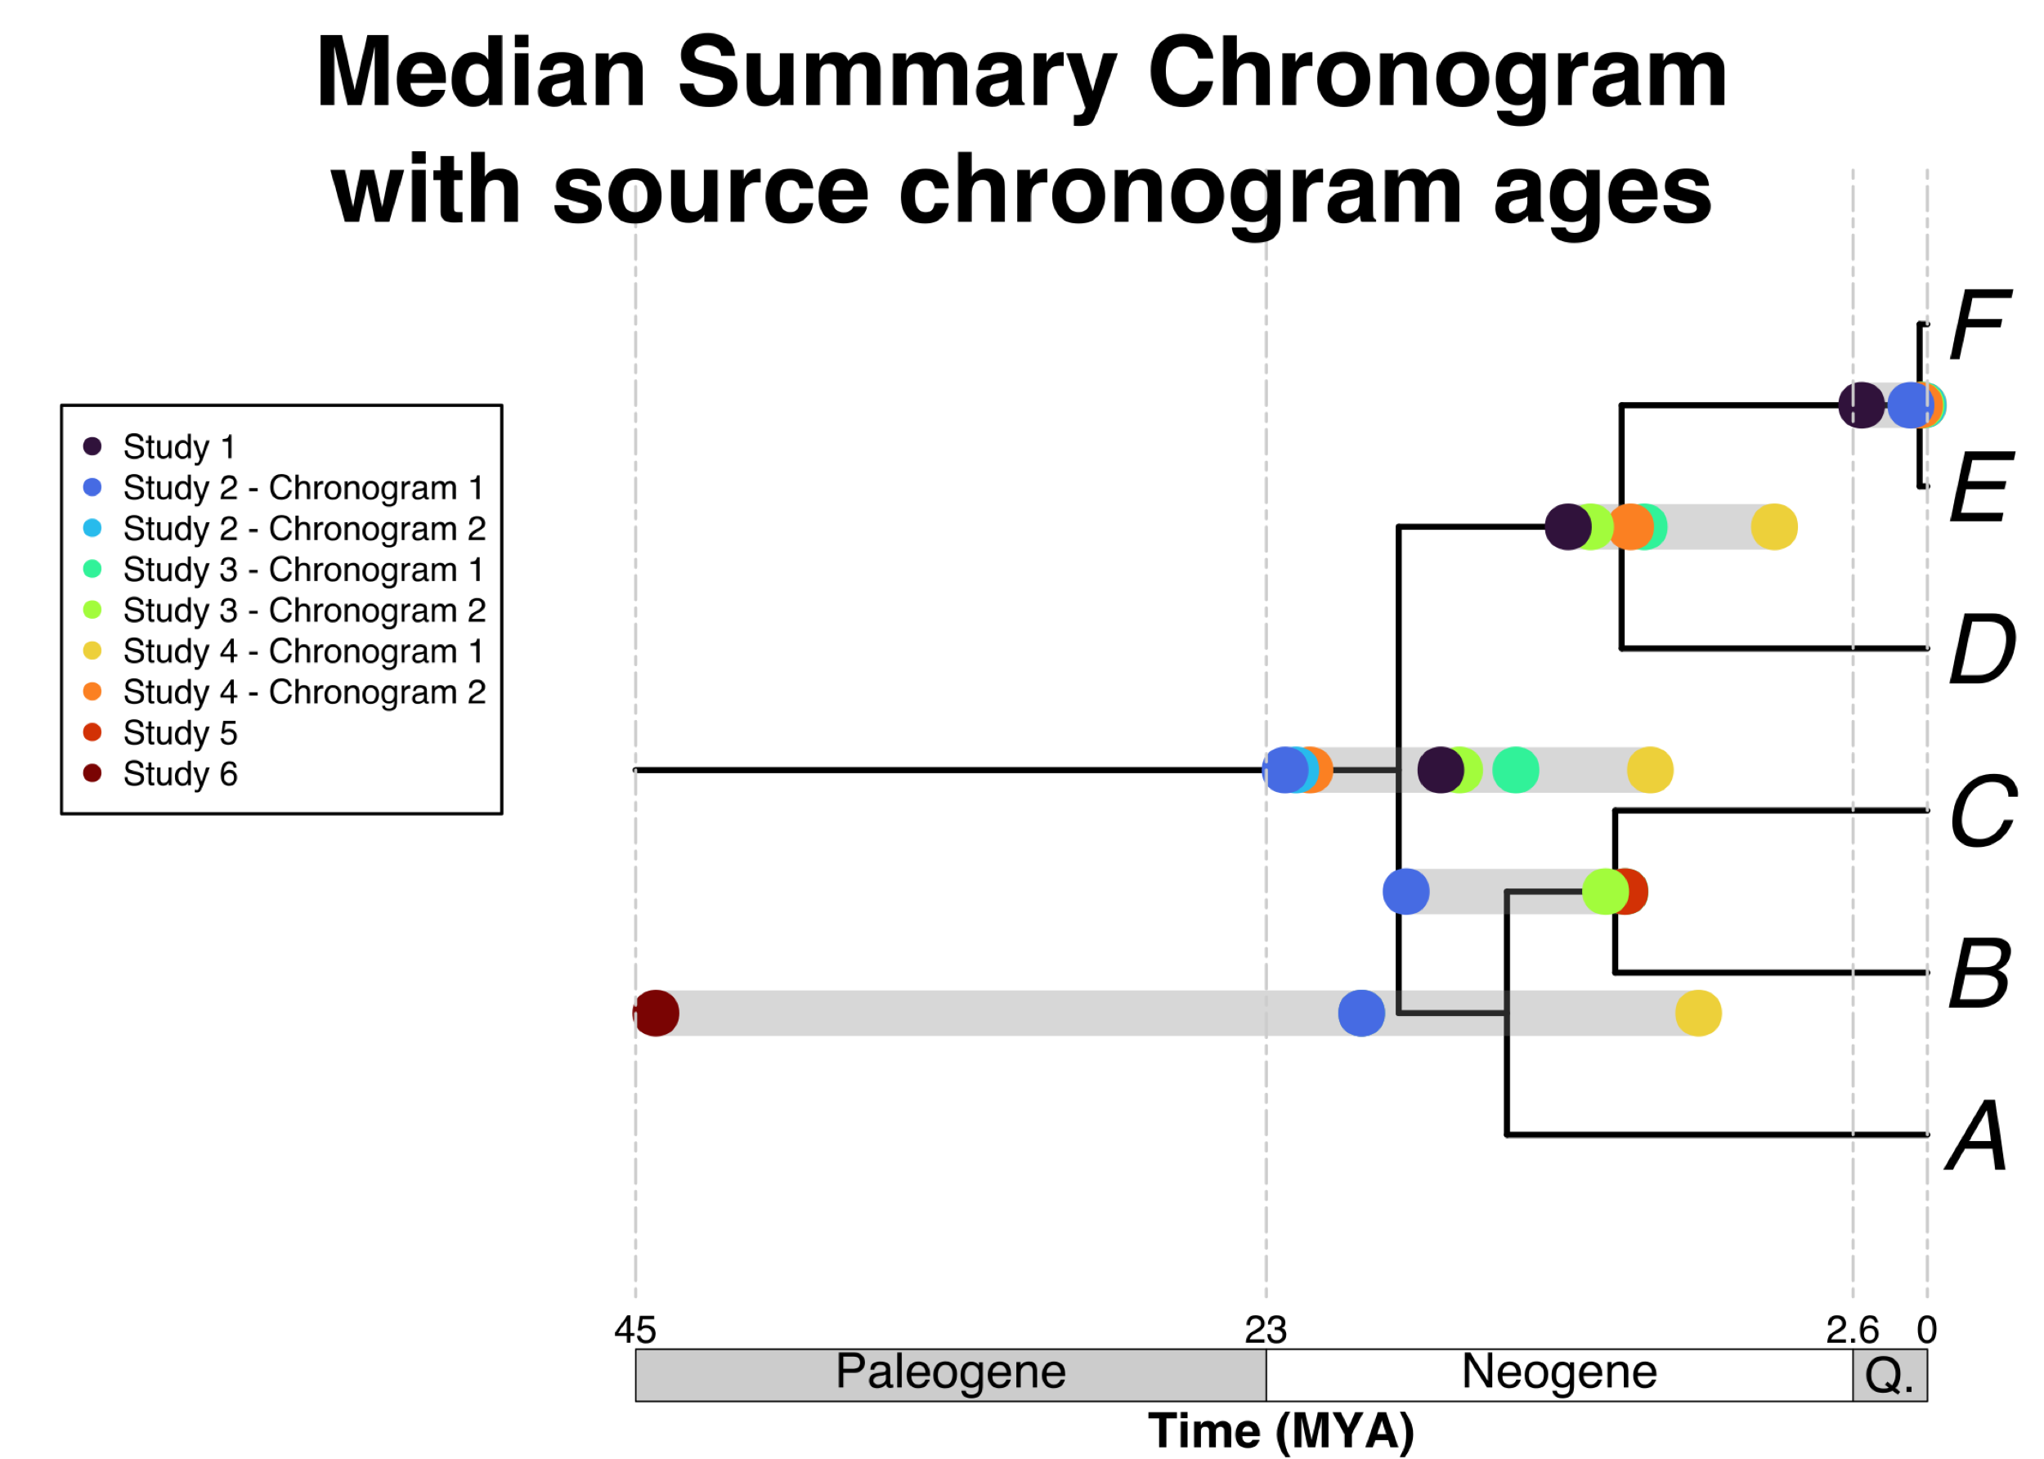
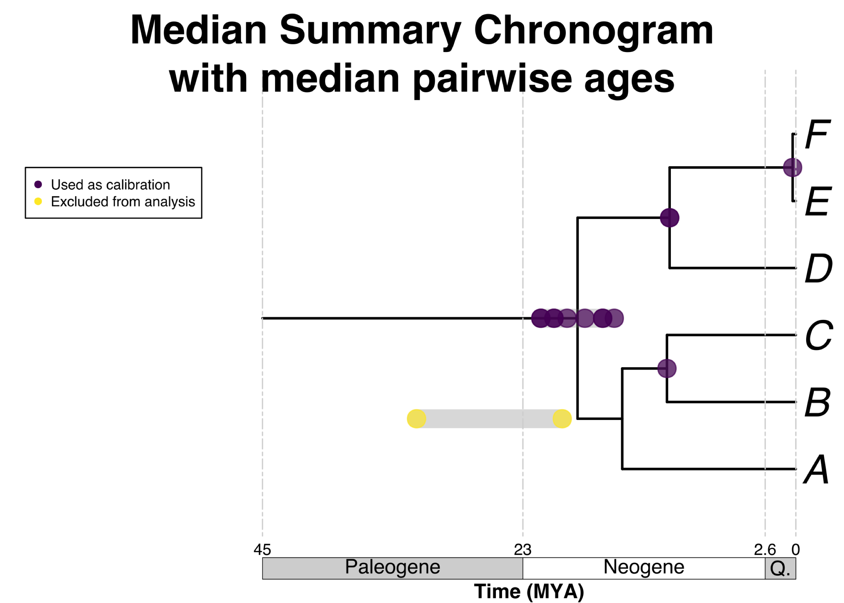
Input taxa
Input tree
X
B
C
T
A
A₁
D
E
F
Z

