Slide 1
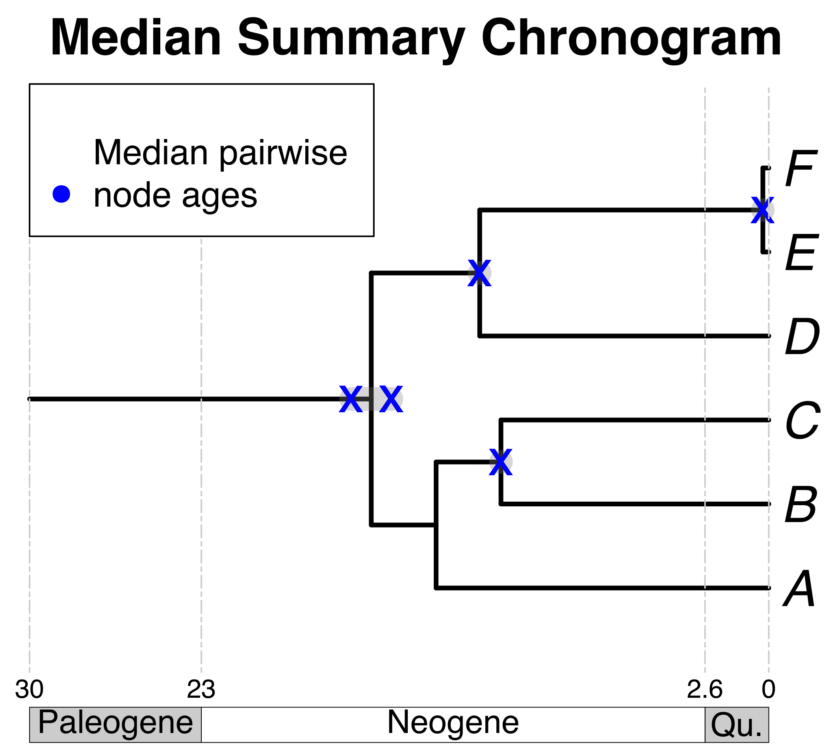

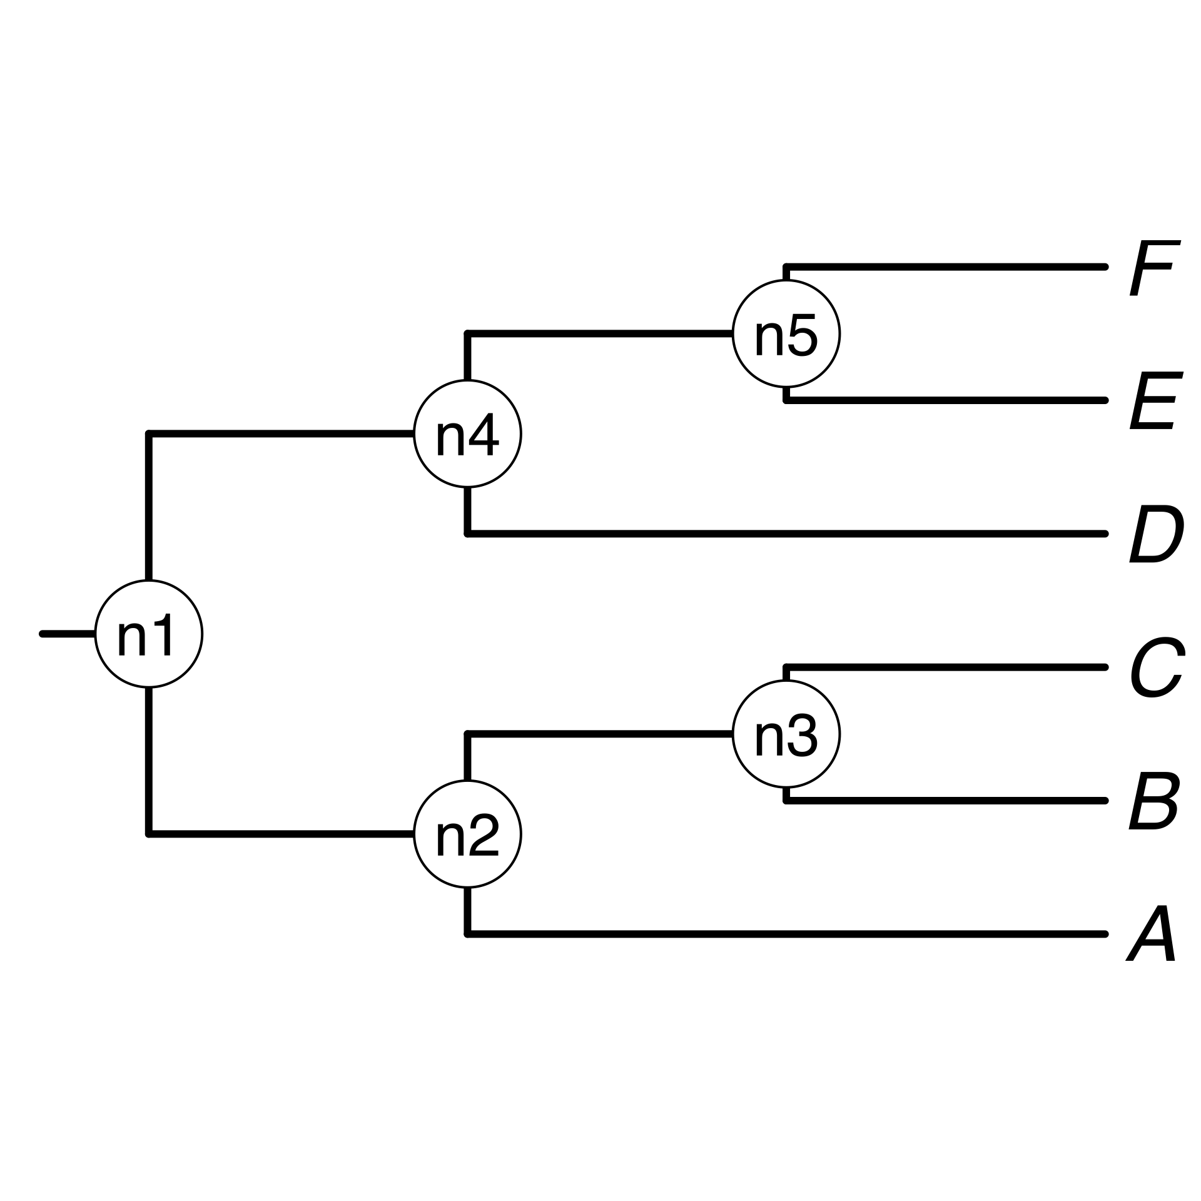

B₁
E
F_{x}
B
E
Pruned source
chronograms
C
F
A
C
D
A
D
Some taxa
of interest
Standardize taxon names to database
Search chronogram database and prune
Use summary pairwise ages to date the tree topology
Choose a tree topology
Bar Code of Life Data System
A tree from the
literature
Your own tree
Map pruned source chronogram ages unto nodes of tree topology
Calculate summary pairwise ages per node

