Slide 1

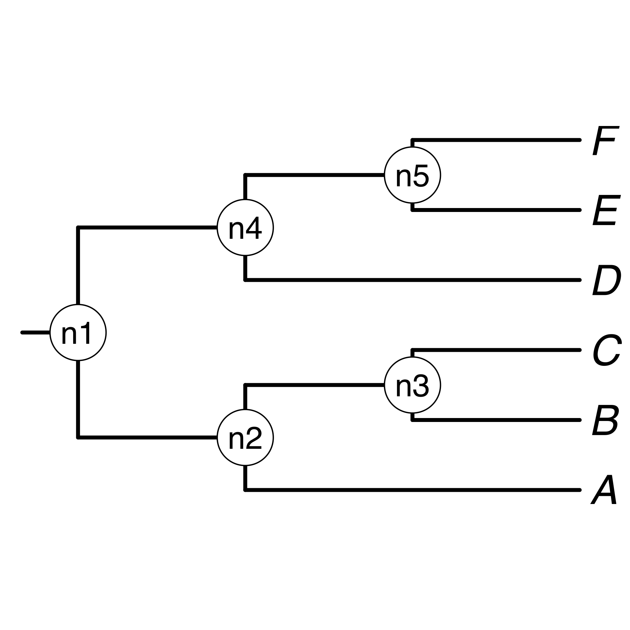
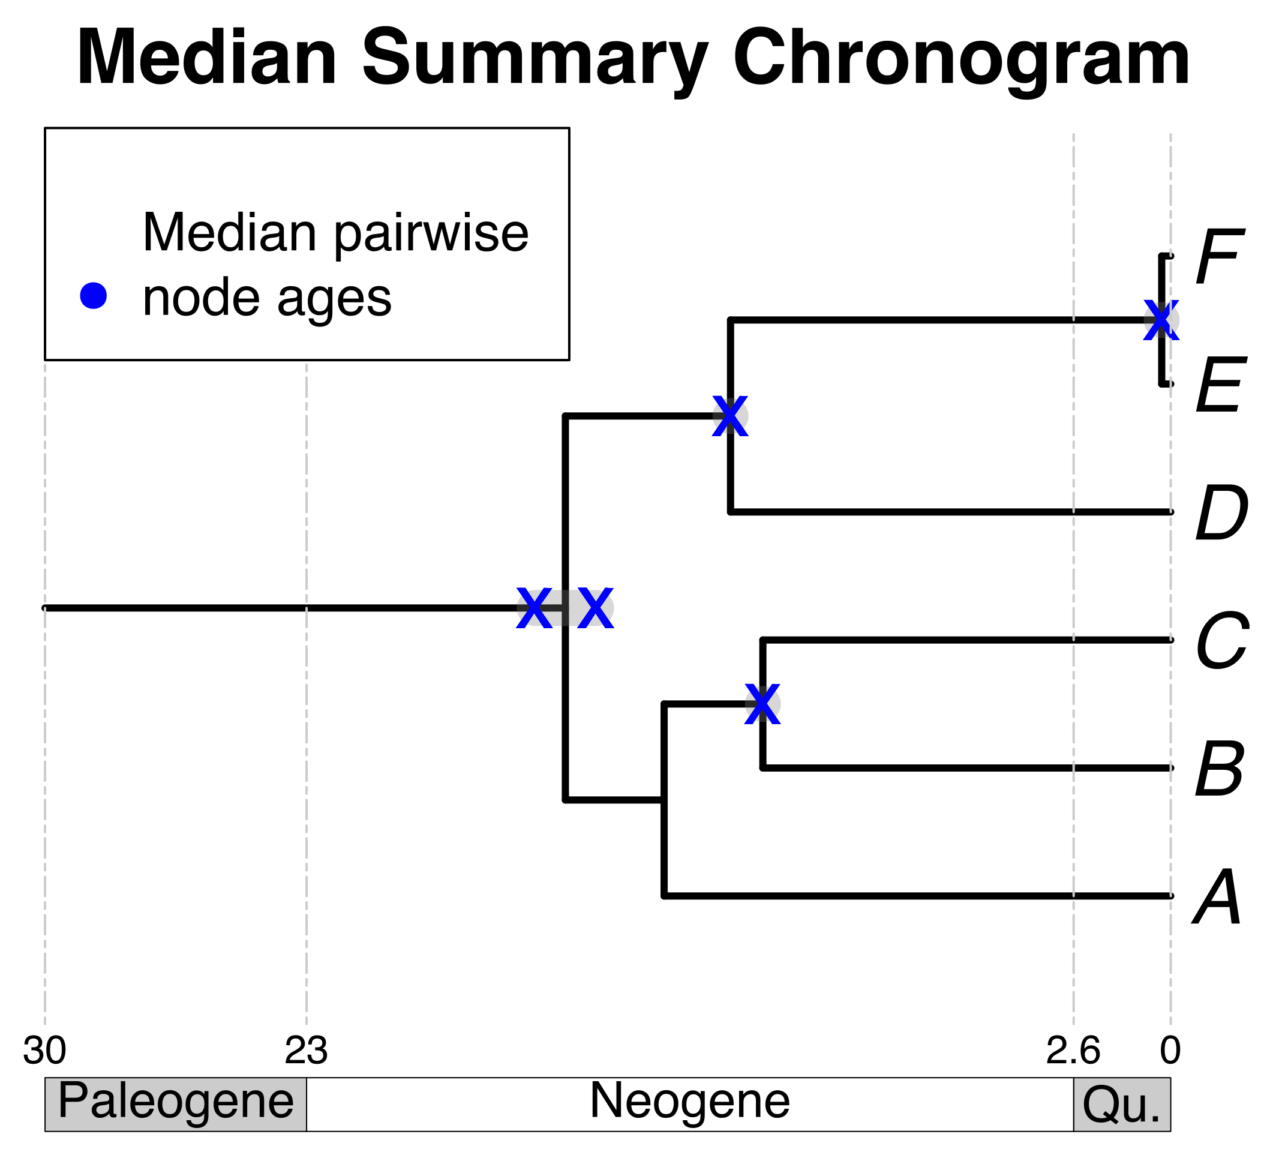
B₁
E
Standardize taxon names
Search chronogram database and prune
Choose a tree topology
Some taxa
of interest
C
F_{x}
A
E
A tree from the
literature
D
B
Pruned source
chronograms
C
F
+
A
D
Bar Code of Life Data System
Your own tree
Map pruned source chronogram ages unto nodes on a tree topology
Calculate summary pairwise ages per node
Use summary pairwise ages to date the tree topology

Slide 2

B₁
E
B
E
Some taxa
of interest
C
F_{x}
F
Pruned source
chronograms
C
A
D
A
D
Standardize taxon names to database
Search chronogram database and prune
Choose a tree topology
Bar Code of Life Data System
Calculate summary pairwise ages per node
Use summary pairwise ages to date the tree topology
A tree from the
literature
Your own tree
Map pruned source chronogram ages unto nodes on a tree topology

Slide 3
B₁
E
F_{x}
B
E
Pruned source
chronograms
C
F
A
C
D
A
D
Some taxa
of interest
Standardize taxon names to database
Search chronogram database and prune
Use summary pairwise ages to date the tree topology
Choose a tree topology
Bar Code of Life Data System
A tree from the
literature
Your own tree
Map pruned source chronogram ages unto nodes of tree topology
Calculate summary pairwise ages per node

Slide 4
B
E
C
F
A
Standardize taxon names to database
Search chronogram database and prune
D
B₁
E
Pruned source
chronograms
Some taxa
of interest
C
F_{x}
A
D
Choose a tree topology
Bar Code of Life Data System
A tree from the
literature
Your own tree
Map pruned source chronogram ages unto nodes on a tree topology
Calculate summary pairwise ages per node
Use summary pairwise ages to date the tree topology

