Slide 1

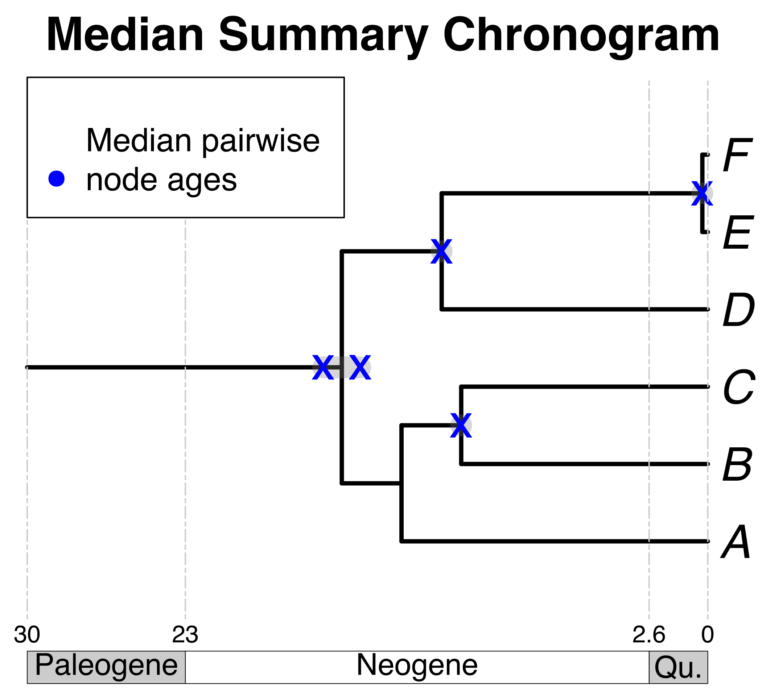


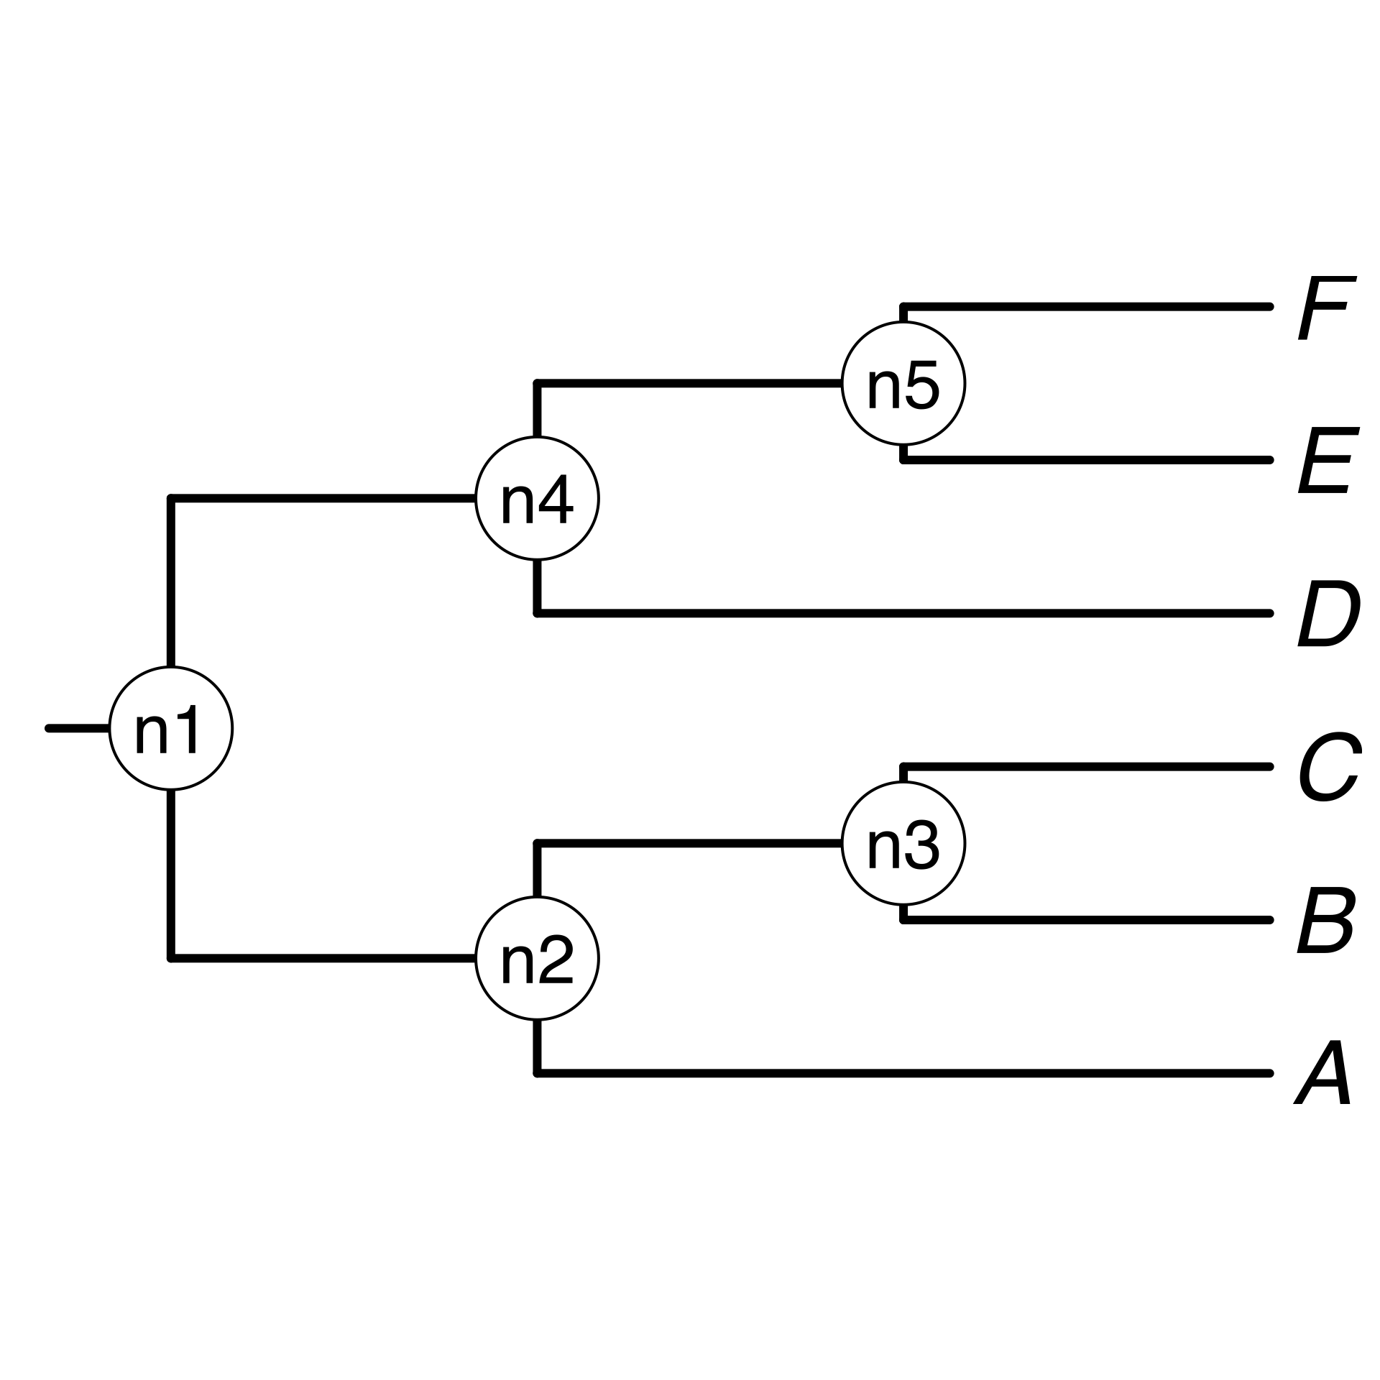
1) A list of taxon names provided by the user
B₁ , A, C, E, F_{x} , D
2) Processing taxon names with TNRS and standardizing them to a taxonomy
3a) Search processed taxon names in chronogram database
3b) prune matching chronograms = source chronograms
A B C D E F
4) Choose tree topology
A tree from the
literature
The largest source chronogram
Your own
tree
6) Use ages of congruent nodes to date a tree topology
5) Congruify source chronogram nodes to nodes of tree topology

