Slide 1
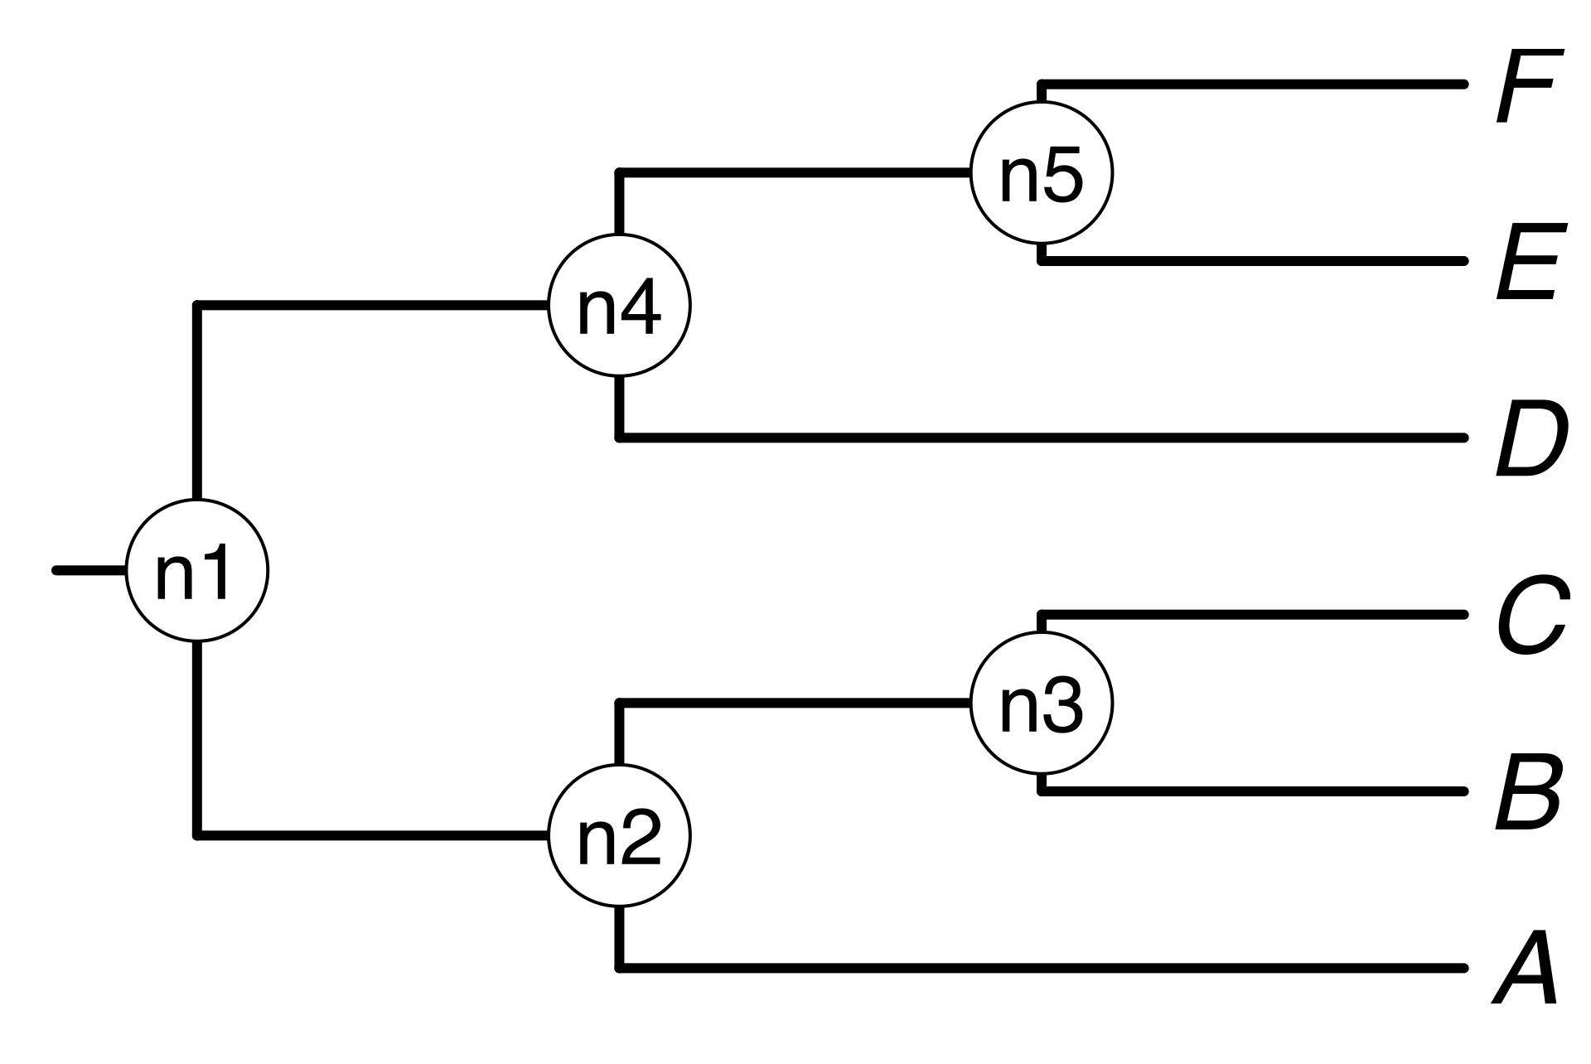


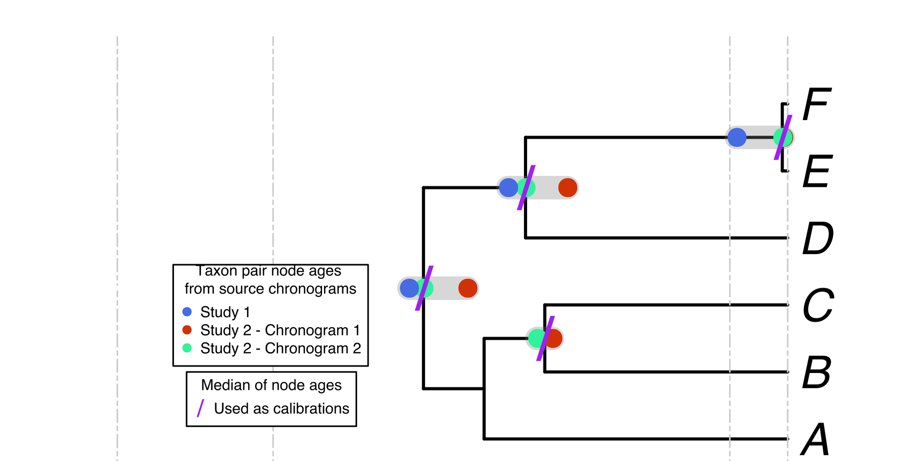
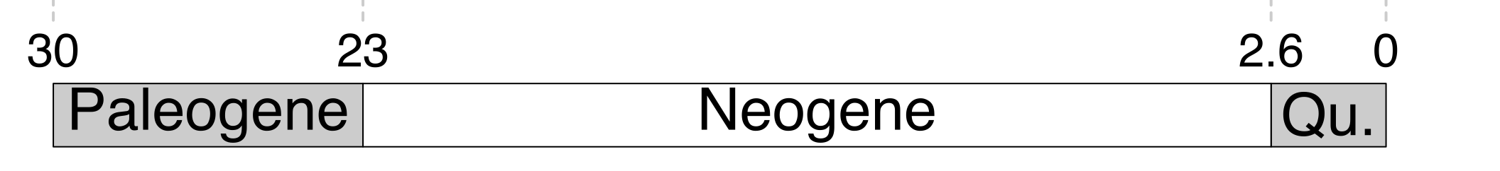
a)
d)
a, B₁ , C, D, Ee, F_{x}
A tree from
the literature
Your own
tree
b)
A, B, C, D, E, F
The largest source
chronogram
c)
e)
f)
g)

