Slide 1
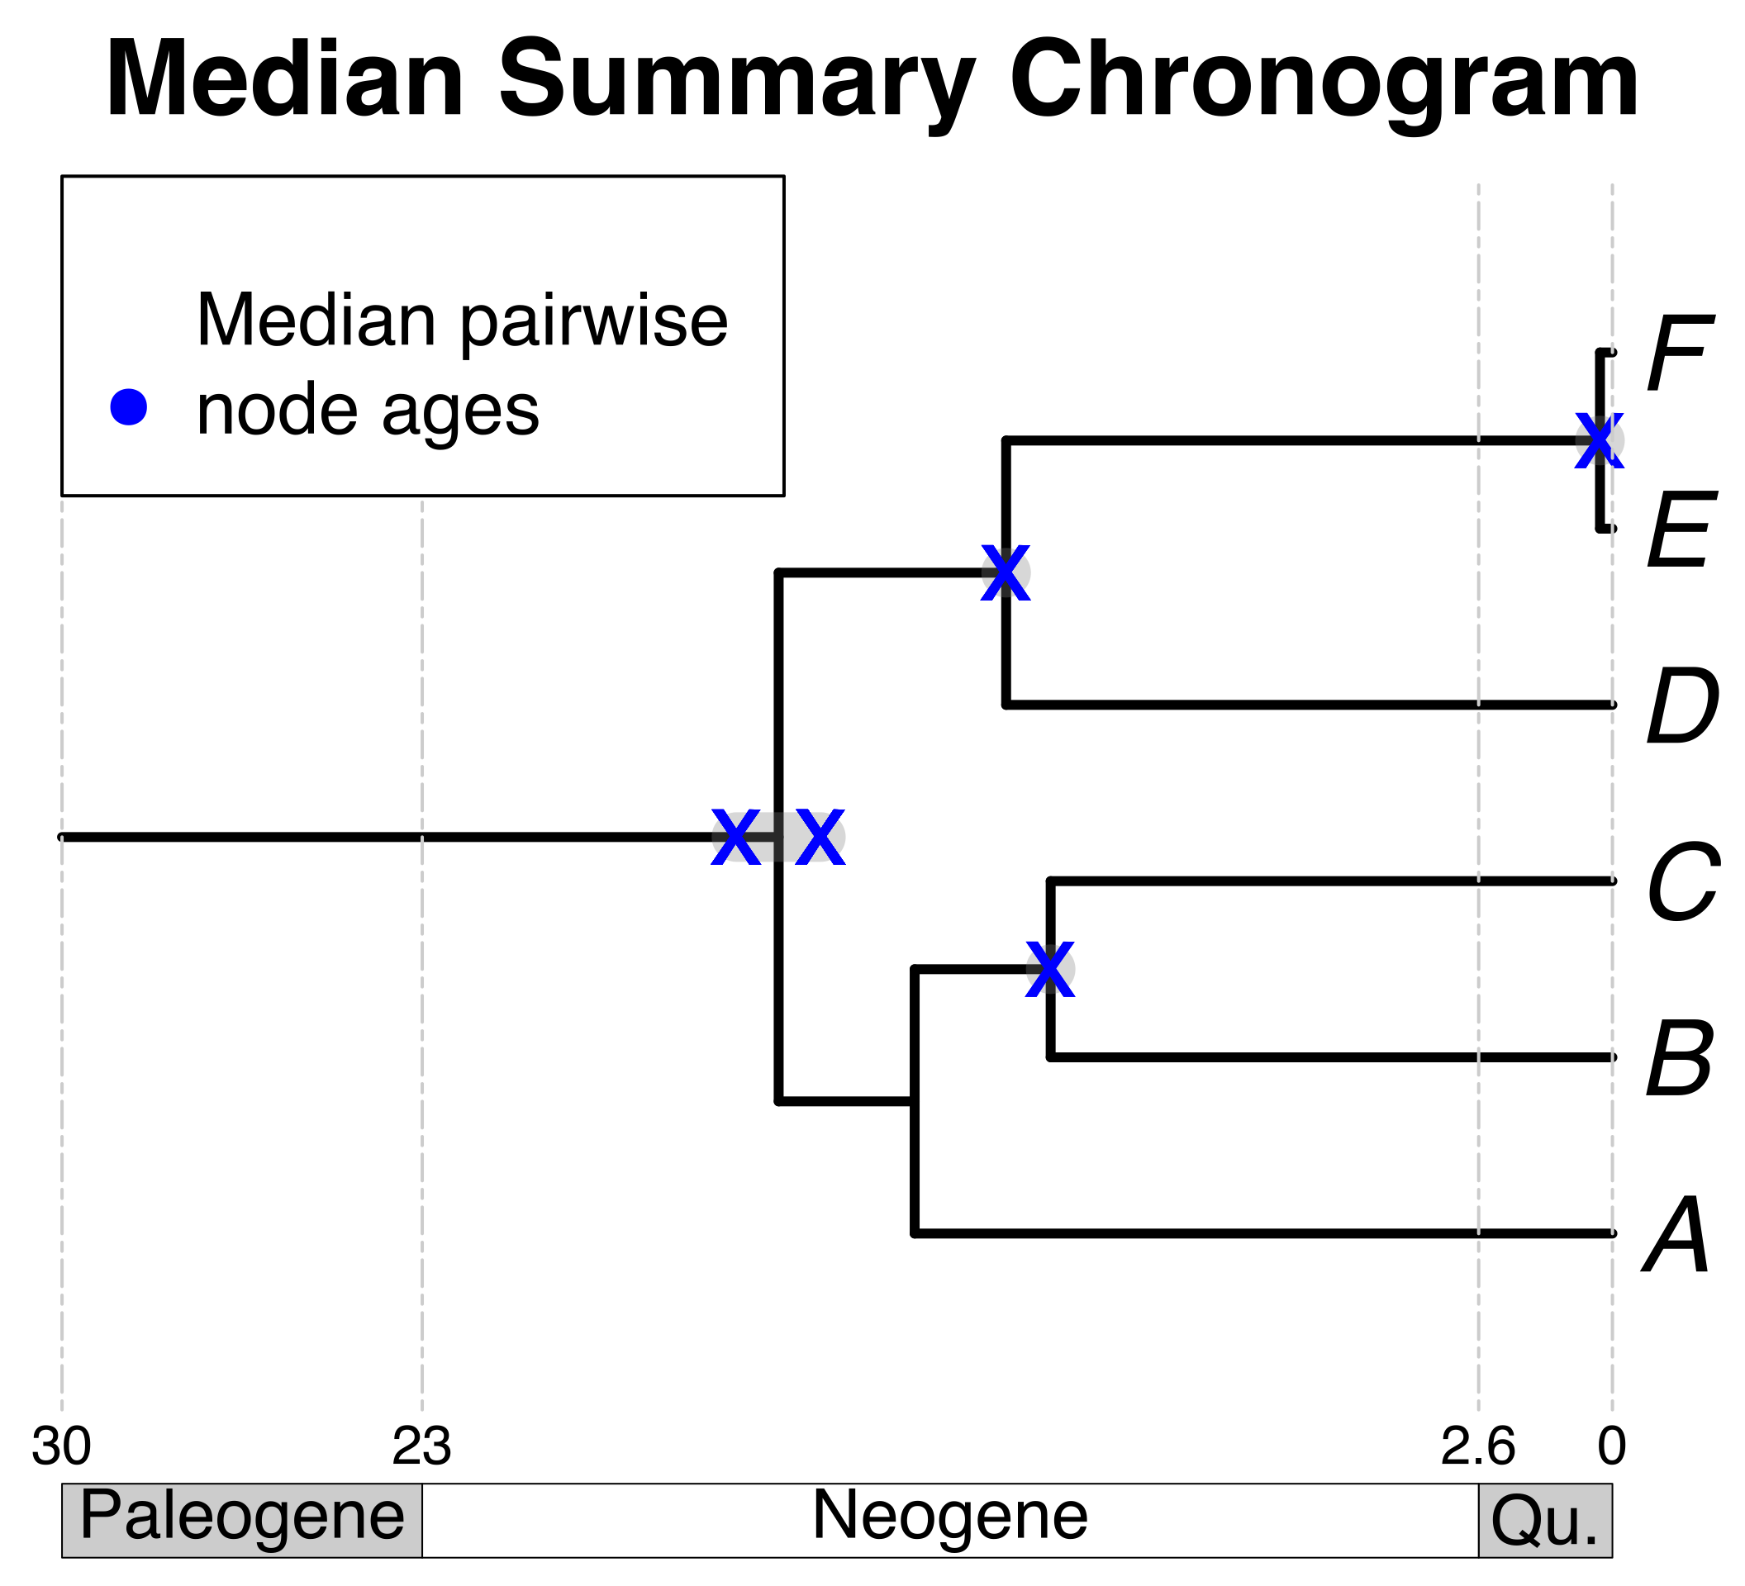


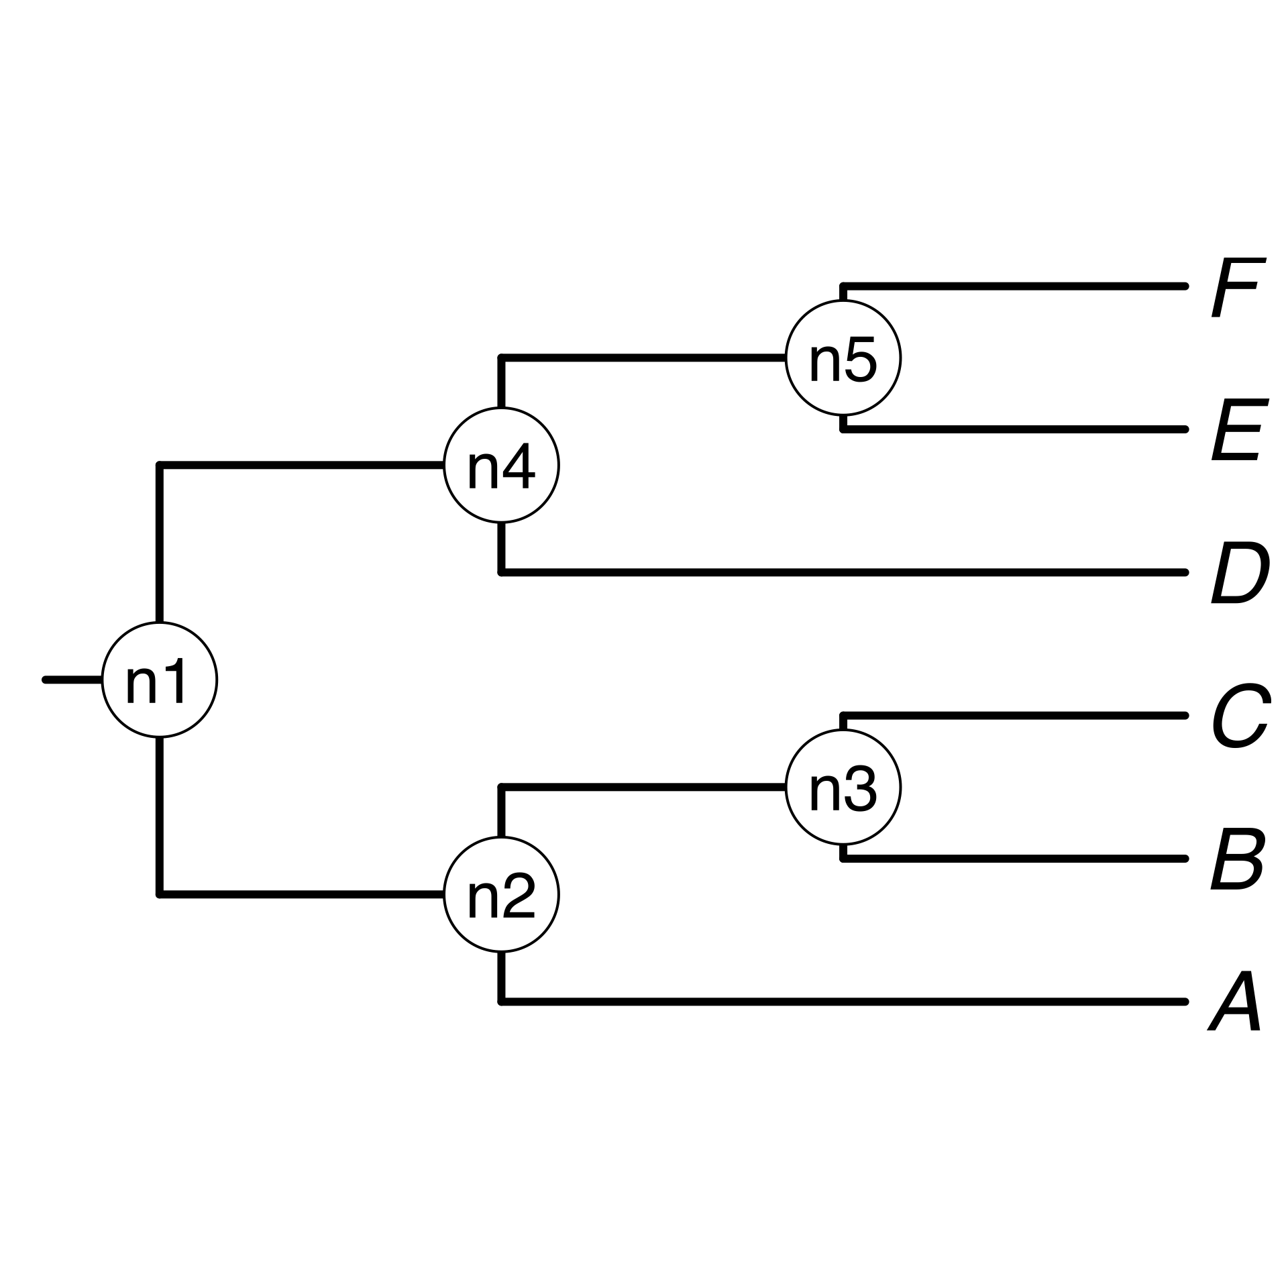
a) Creating a DateLife search query
b) Searching DateLife’s chronogram database
b2) Prune matching chronograms and save as source chronograms.
a1) User provides a list of taxon names, as a character string or as a tree.
b1) Search processed taxon names in chronogram database and identify (*).
a, B₁ , C, D, Ee, F_{x}
*
A B C D E F
*
a2) Process taxon names with TNRS and standardize to a taxonomy.
*
c3) Use ages of congruent nodes to date a tree topology.
c2) Congruify source chronogram nodes to nodes of tree topology.
c) Summarizing DateLife’s search results
c1) Choose a tree topology.
The largest source chronogram
A tree from the
literature
Your own
tree

