Slide 1
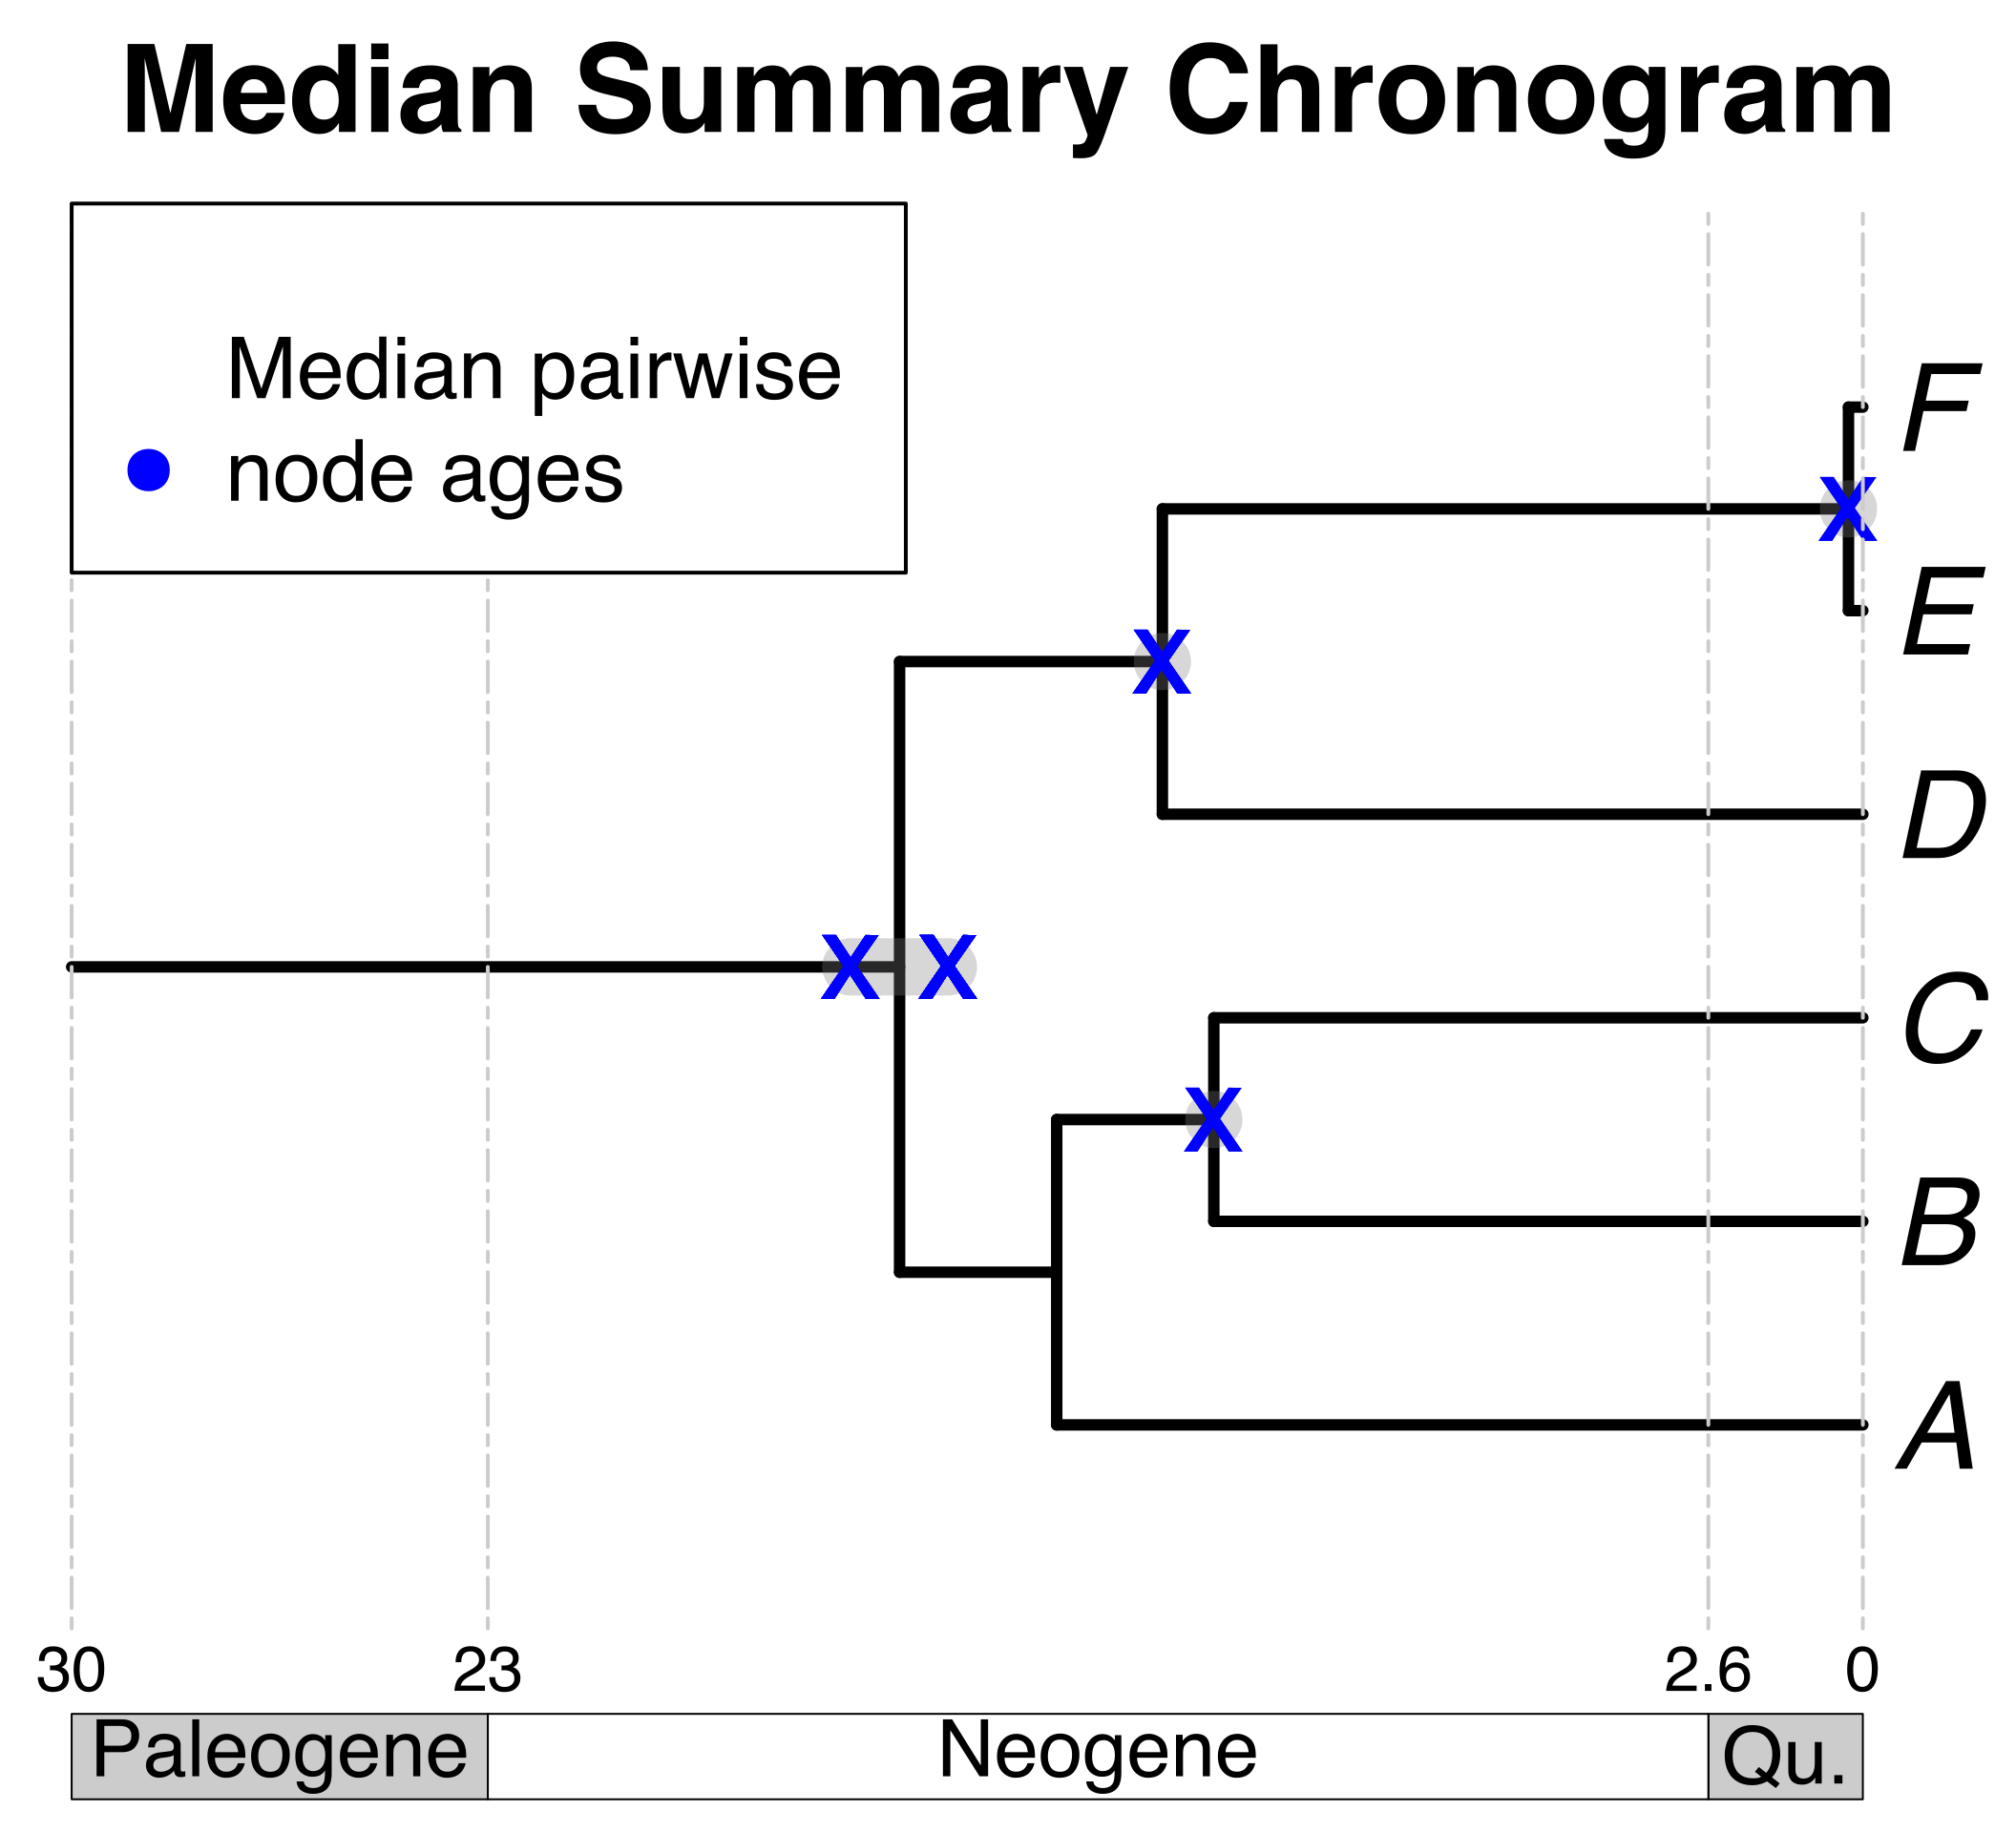

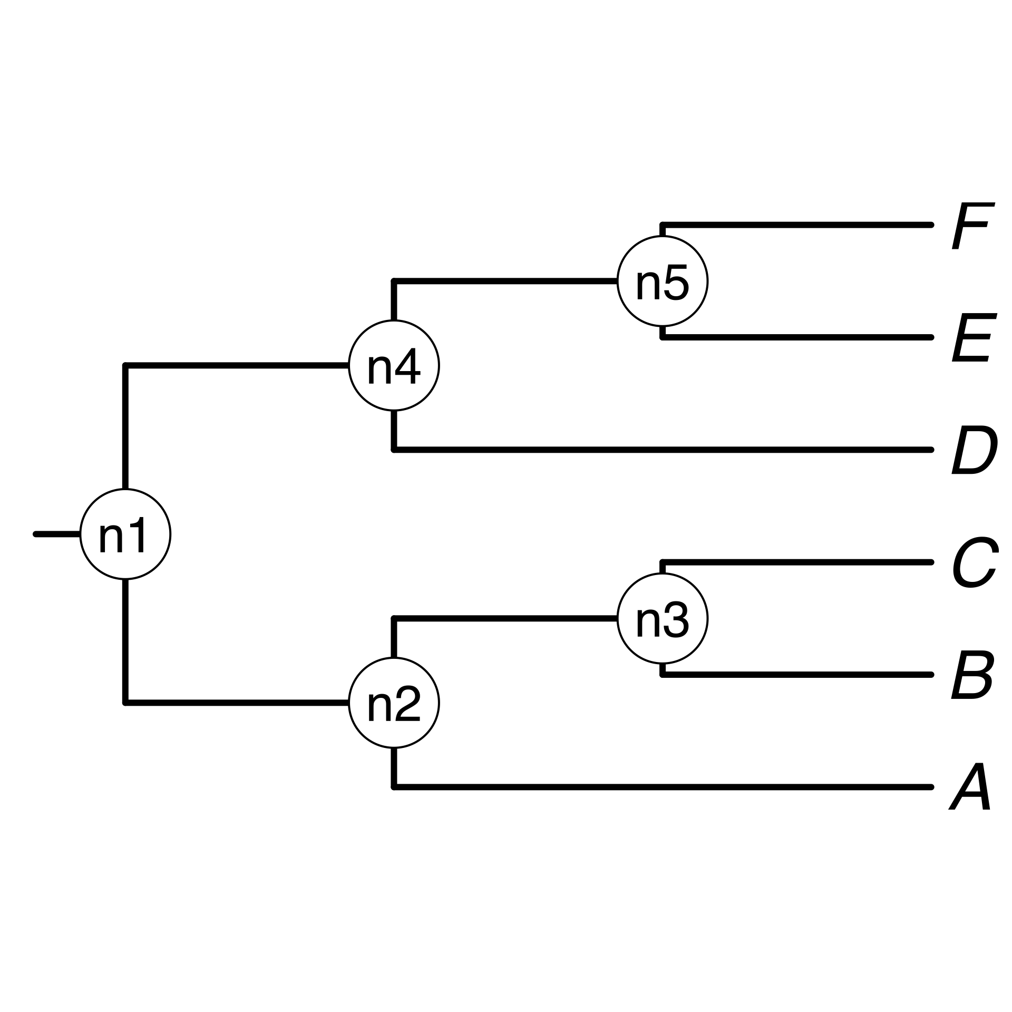

1a) A list of taxon names provided by the user.
*
*
a, B₁ , C, D, Ee, F_{x}
*
A B C D E F
1b) Processing taxon names with TNRS and standardizing them to a taxonomy.
2a) Match processed taxon names to chronogram database and identify (*).
2b) Prune matching chronograms (source chronograms).
A tree from the
literature
The largest source chronogram
3a) Choose tree topology
Your own
tree
3c) Use ages of congruent nodes to date a tree topology
3b) Congruify source chronogram nodes to nodes of tree topology

