Slide 1


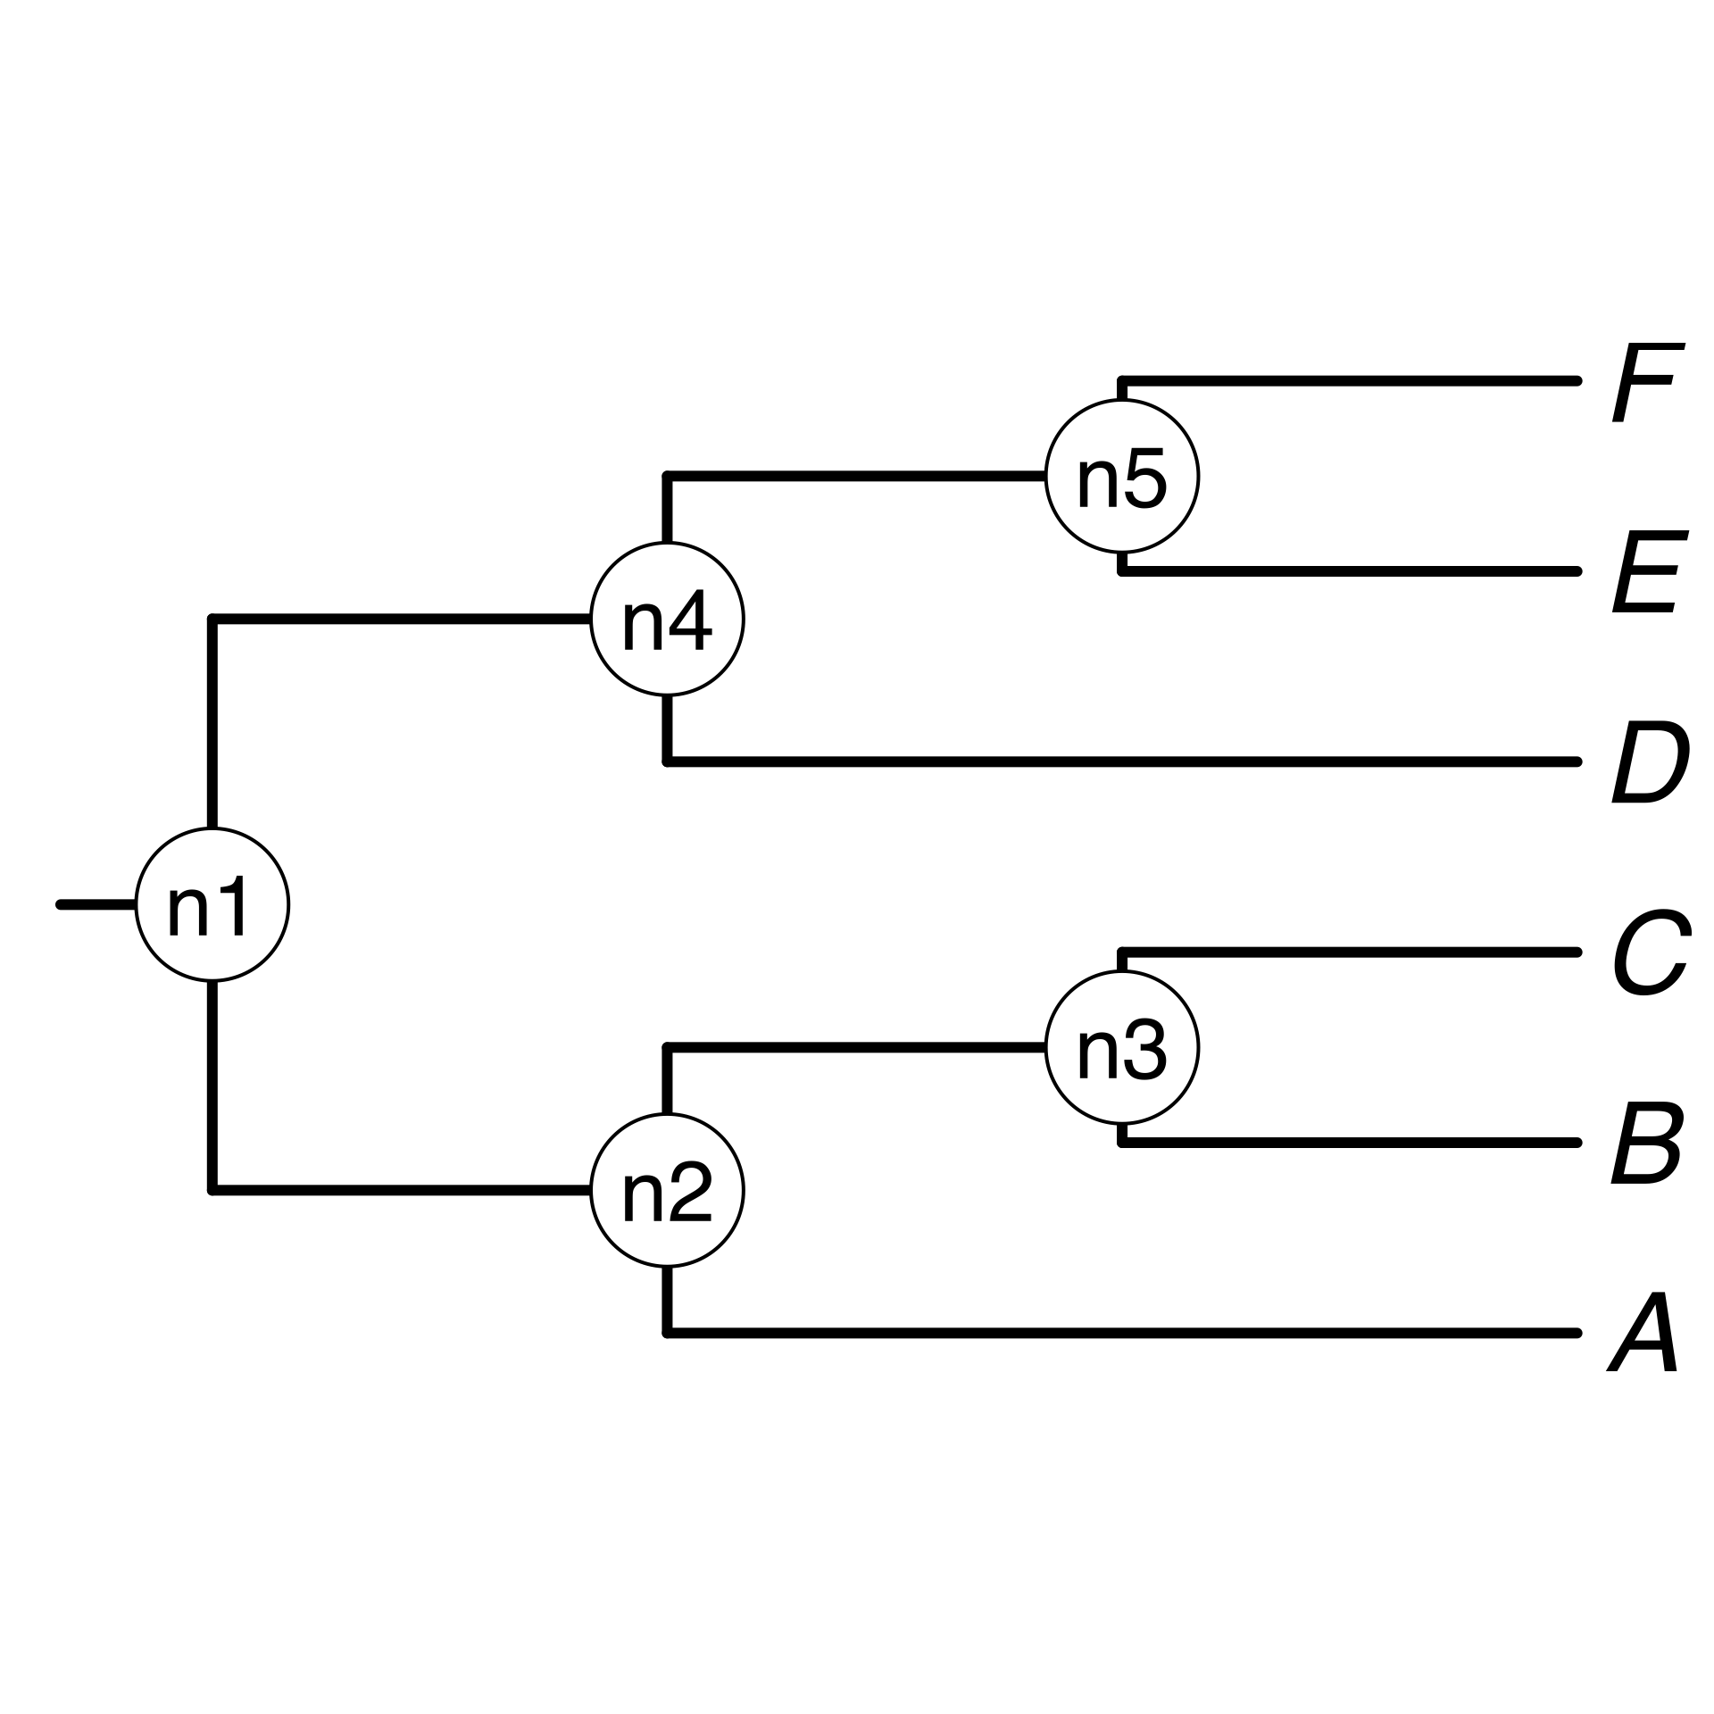
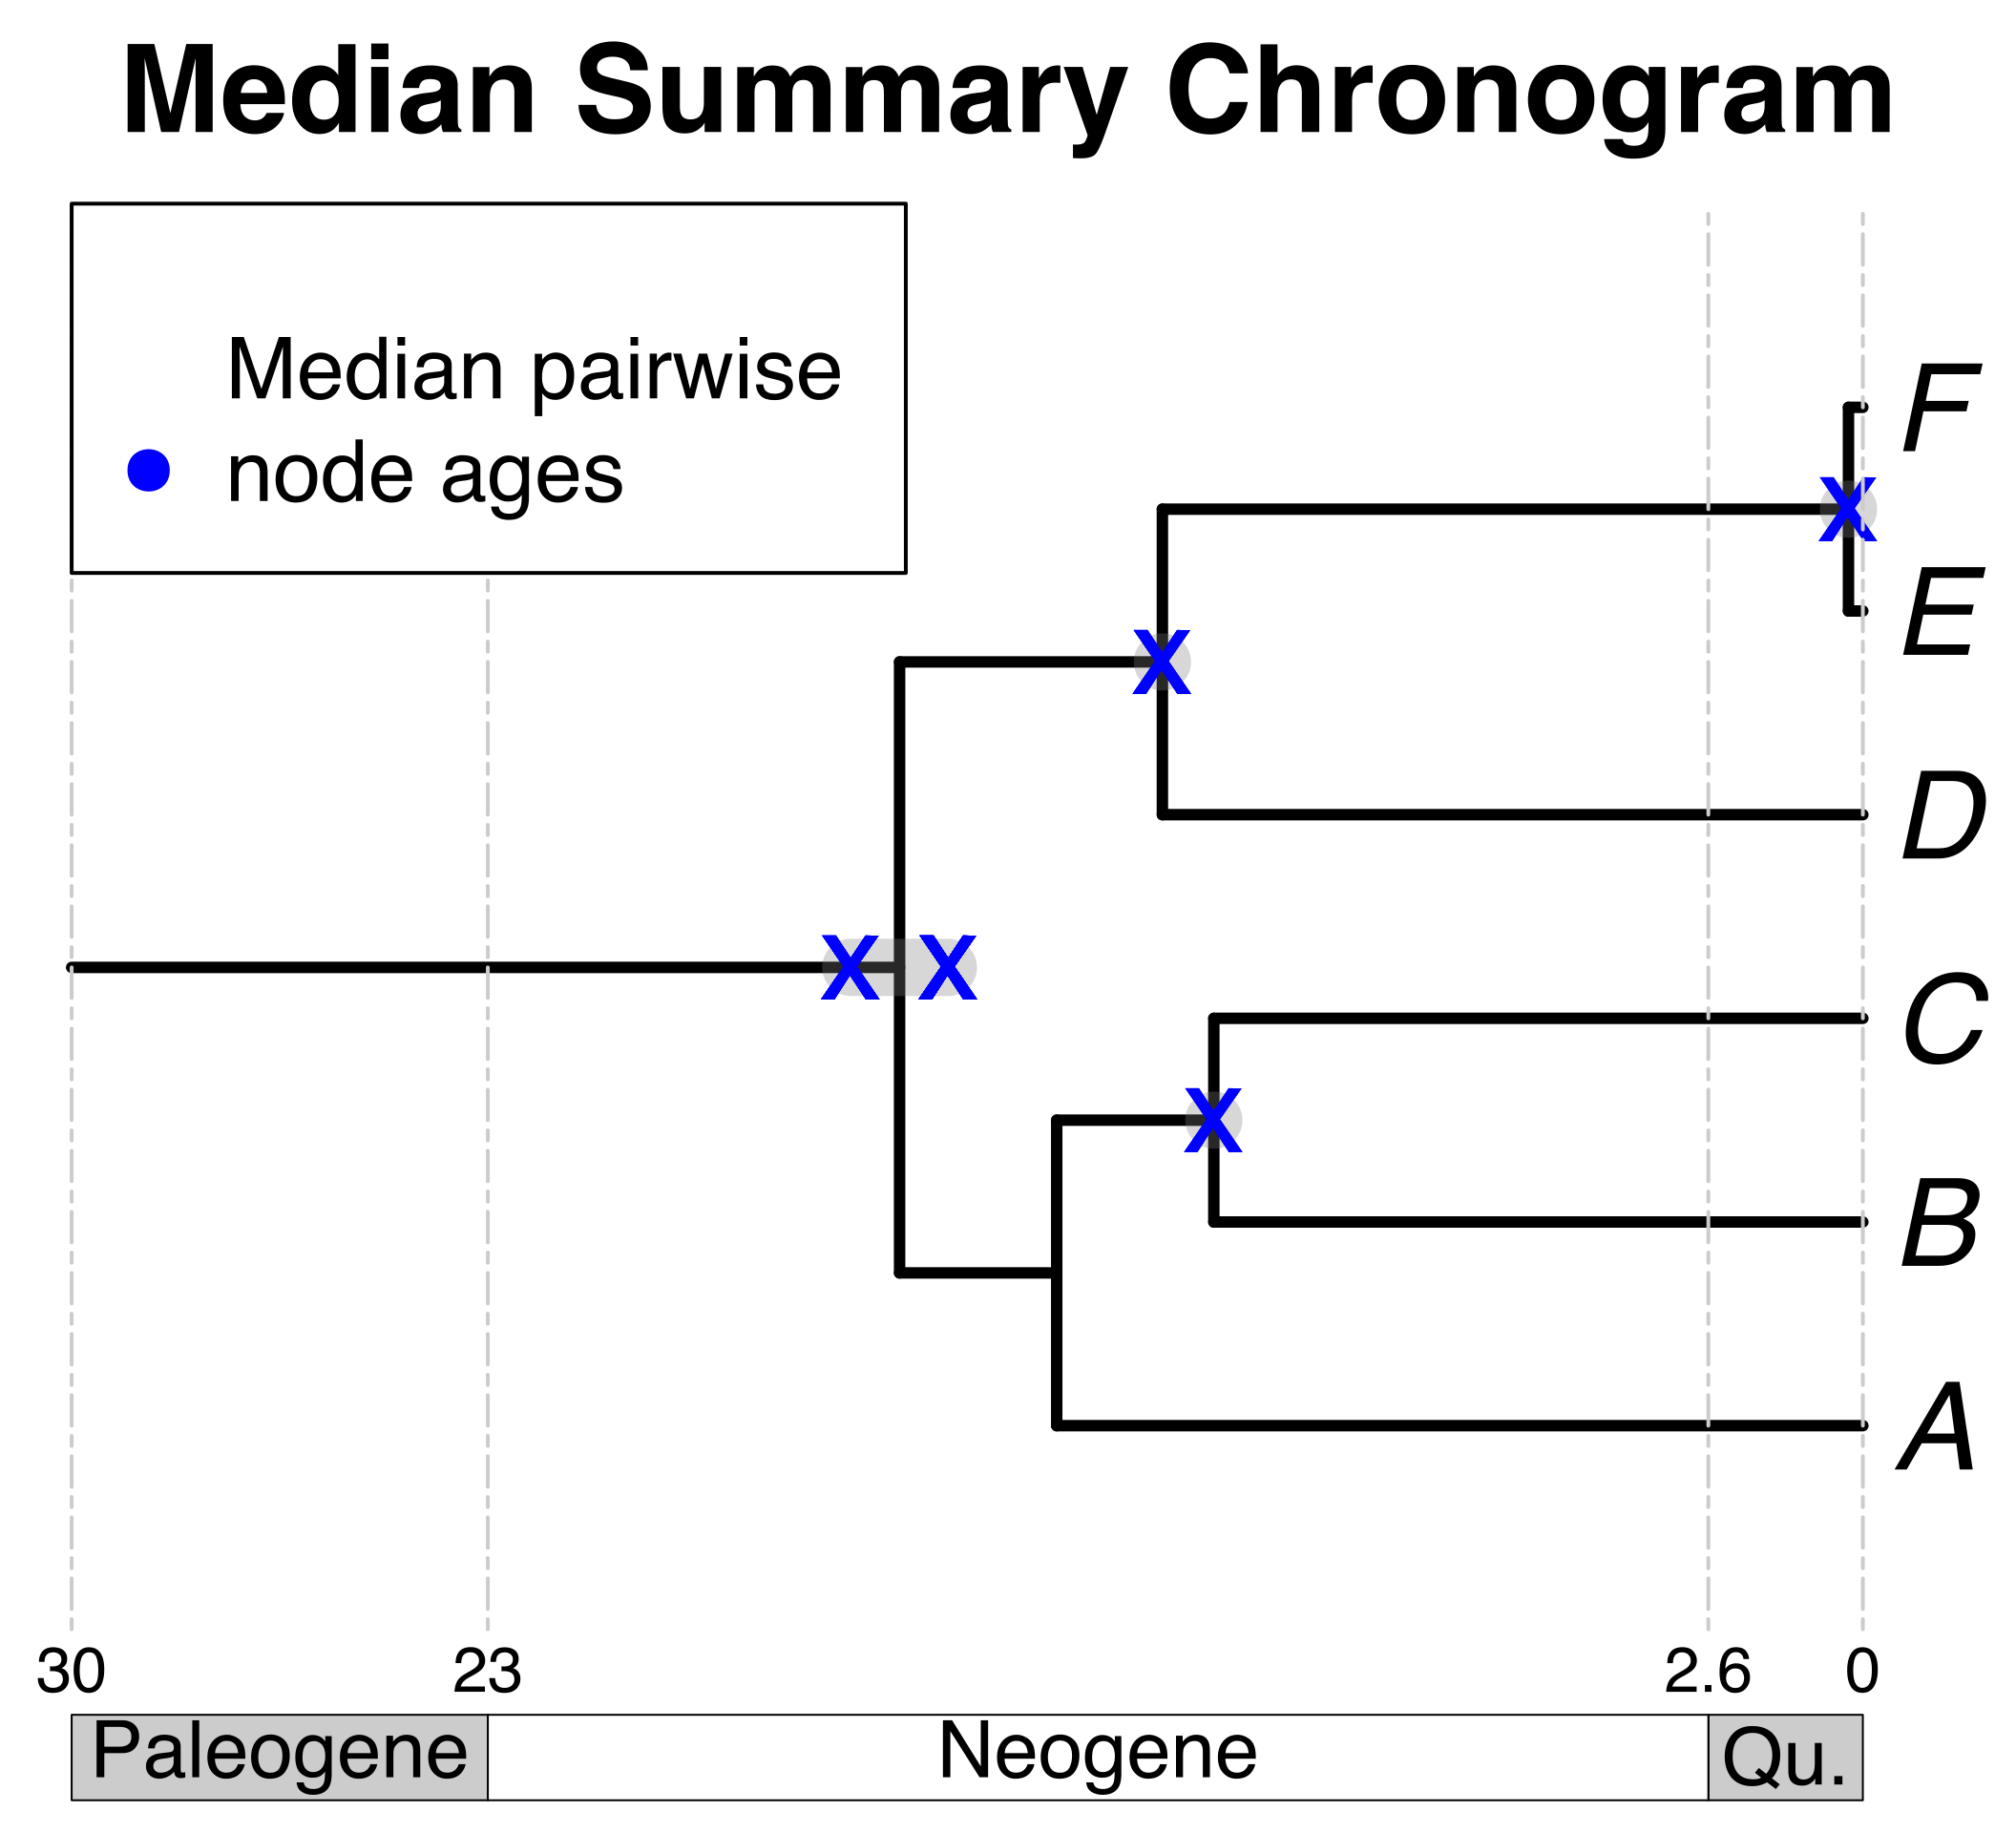
1. Creating a DateLife search query
2. Searching DateLife’s chronogram database
3. Summarizing DateLife’s search results
1a) User provides a list of taxon names, as a character string or as a tree.
2a) Match processed taxon names to chronogram database and identify (*).
3a) Choose a tree topology.
a, B₁ , C, D, Ee, F_{x}
The largest source chronogram
*
A B C D E F
*
Your own
tree
1b) Process taxon names with TNRS and standardize to a taxonomy.
A tree from the
literature
*
2b) Prune matching chronograms and save as source chronograms.
3d) Use ages of congruent nodes
to date a tree topology.
3d) Use ages of congruent nodes
to date a tree topology.
3b) Congruify source chronogram ages to nodes of tree topology.

