Slide 1

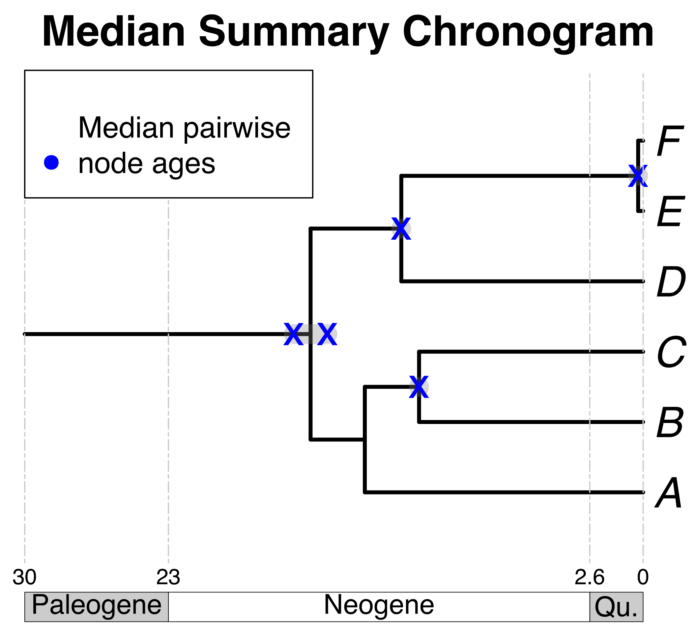

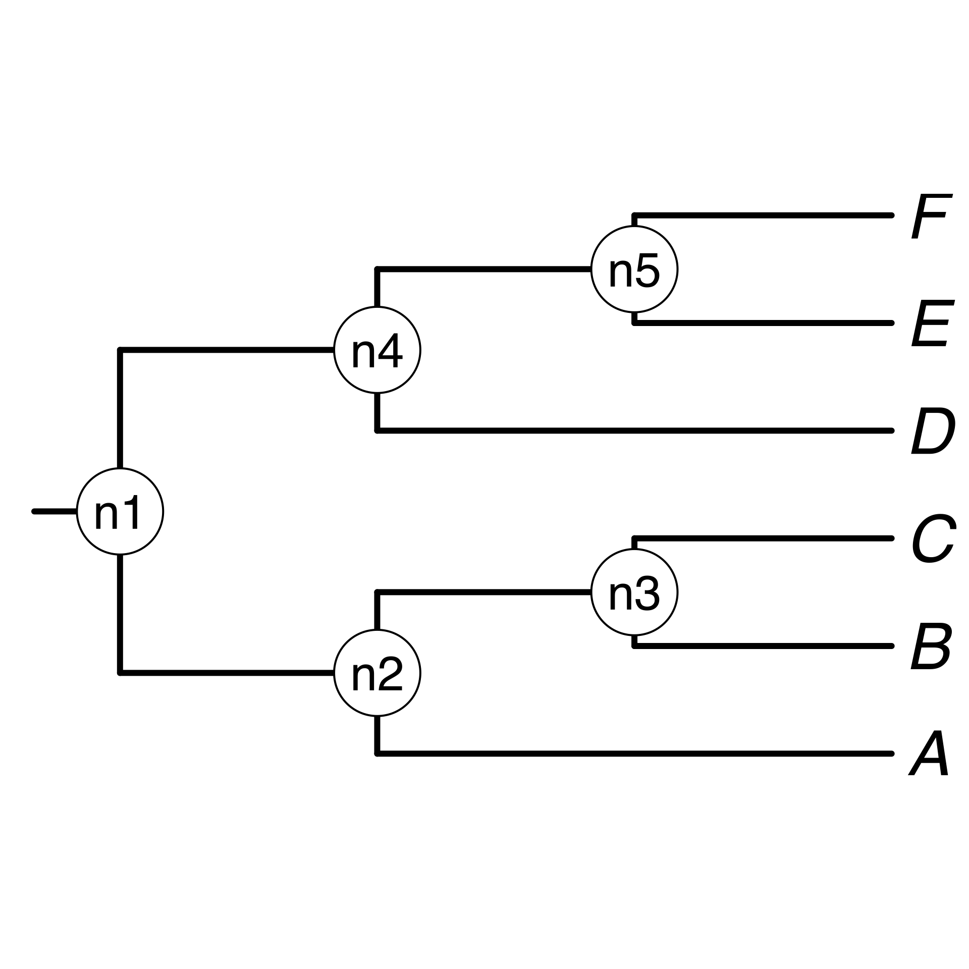
Barcode of Life Data (BOLD) System
A list of
scientific names
A tree from a
database
A tree from
the literature
Your own tree
B₁
E
E
C
F_{x}
B
F
Pruned source
chronograms
A
D
C
A
D
Some taxa
of interest
Standardize taxon names to database
Search chronogram database and prune
Use summary pairwise ages to date the tree topology
Choose a tree topology
Bar Code of Life Data System
A tree from the
literature
Your own tree
Map pruned source chronogram ages unto nodes of tree topology
Calculate summary pairwise ages per node

Slide 2
Some taxon names of interest as input
B₁
A
C
E
F_{x}
D
Standardize taxon names as query
A
B
C
D
E
F
Search query taxon names in chronogram database and prune
Pruned source
chronograms

Slide 3
Search query taxon names in chronogram database
Prune down matching chronograms tips to query taxa

Slide 4
Choose a tree topology
Map pruned chronogram node ages unto nodes of chosen tree topology

Slide 5
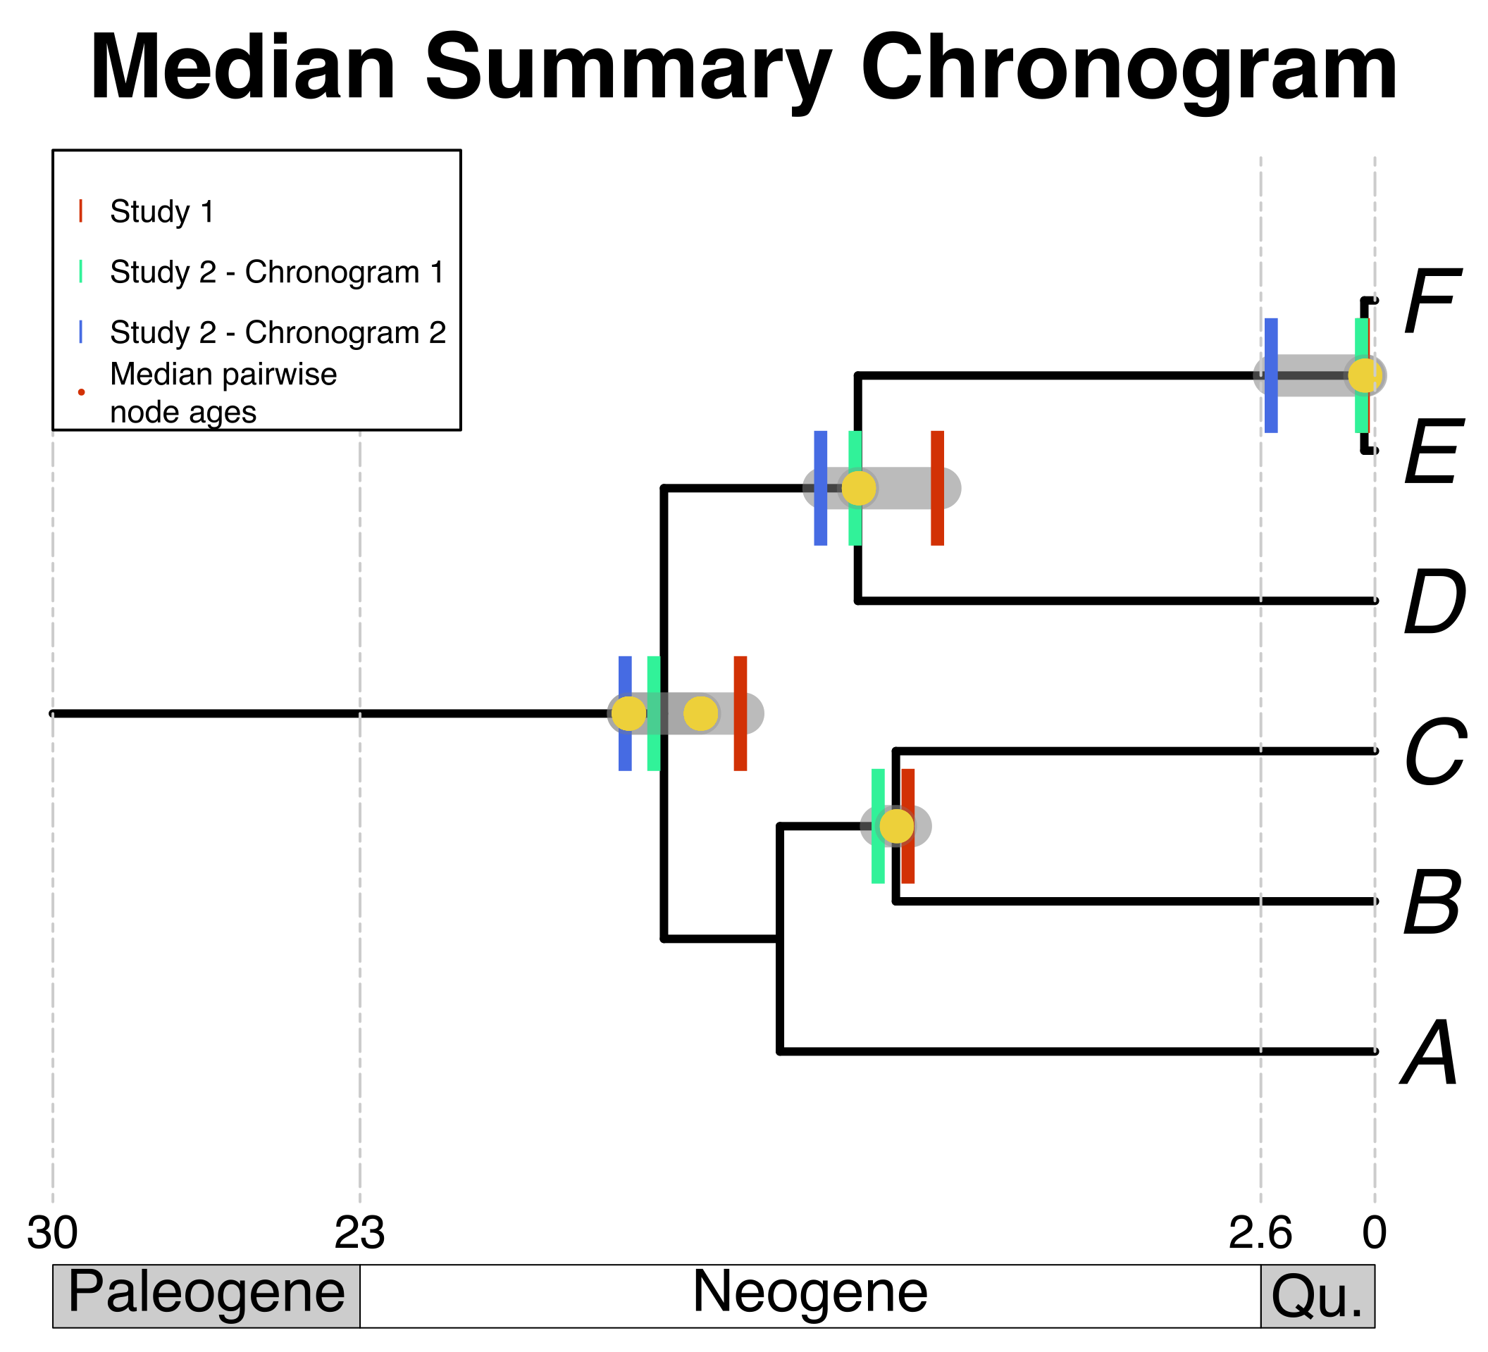
Calculate summary pairwise ages per node
Use summary pairwise ages to date chosen tree topology

