Slide 1
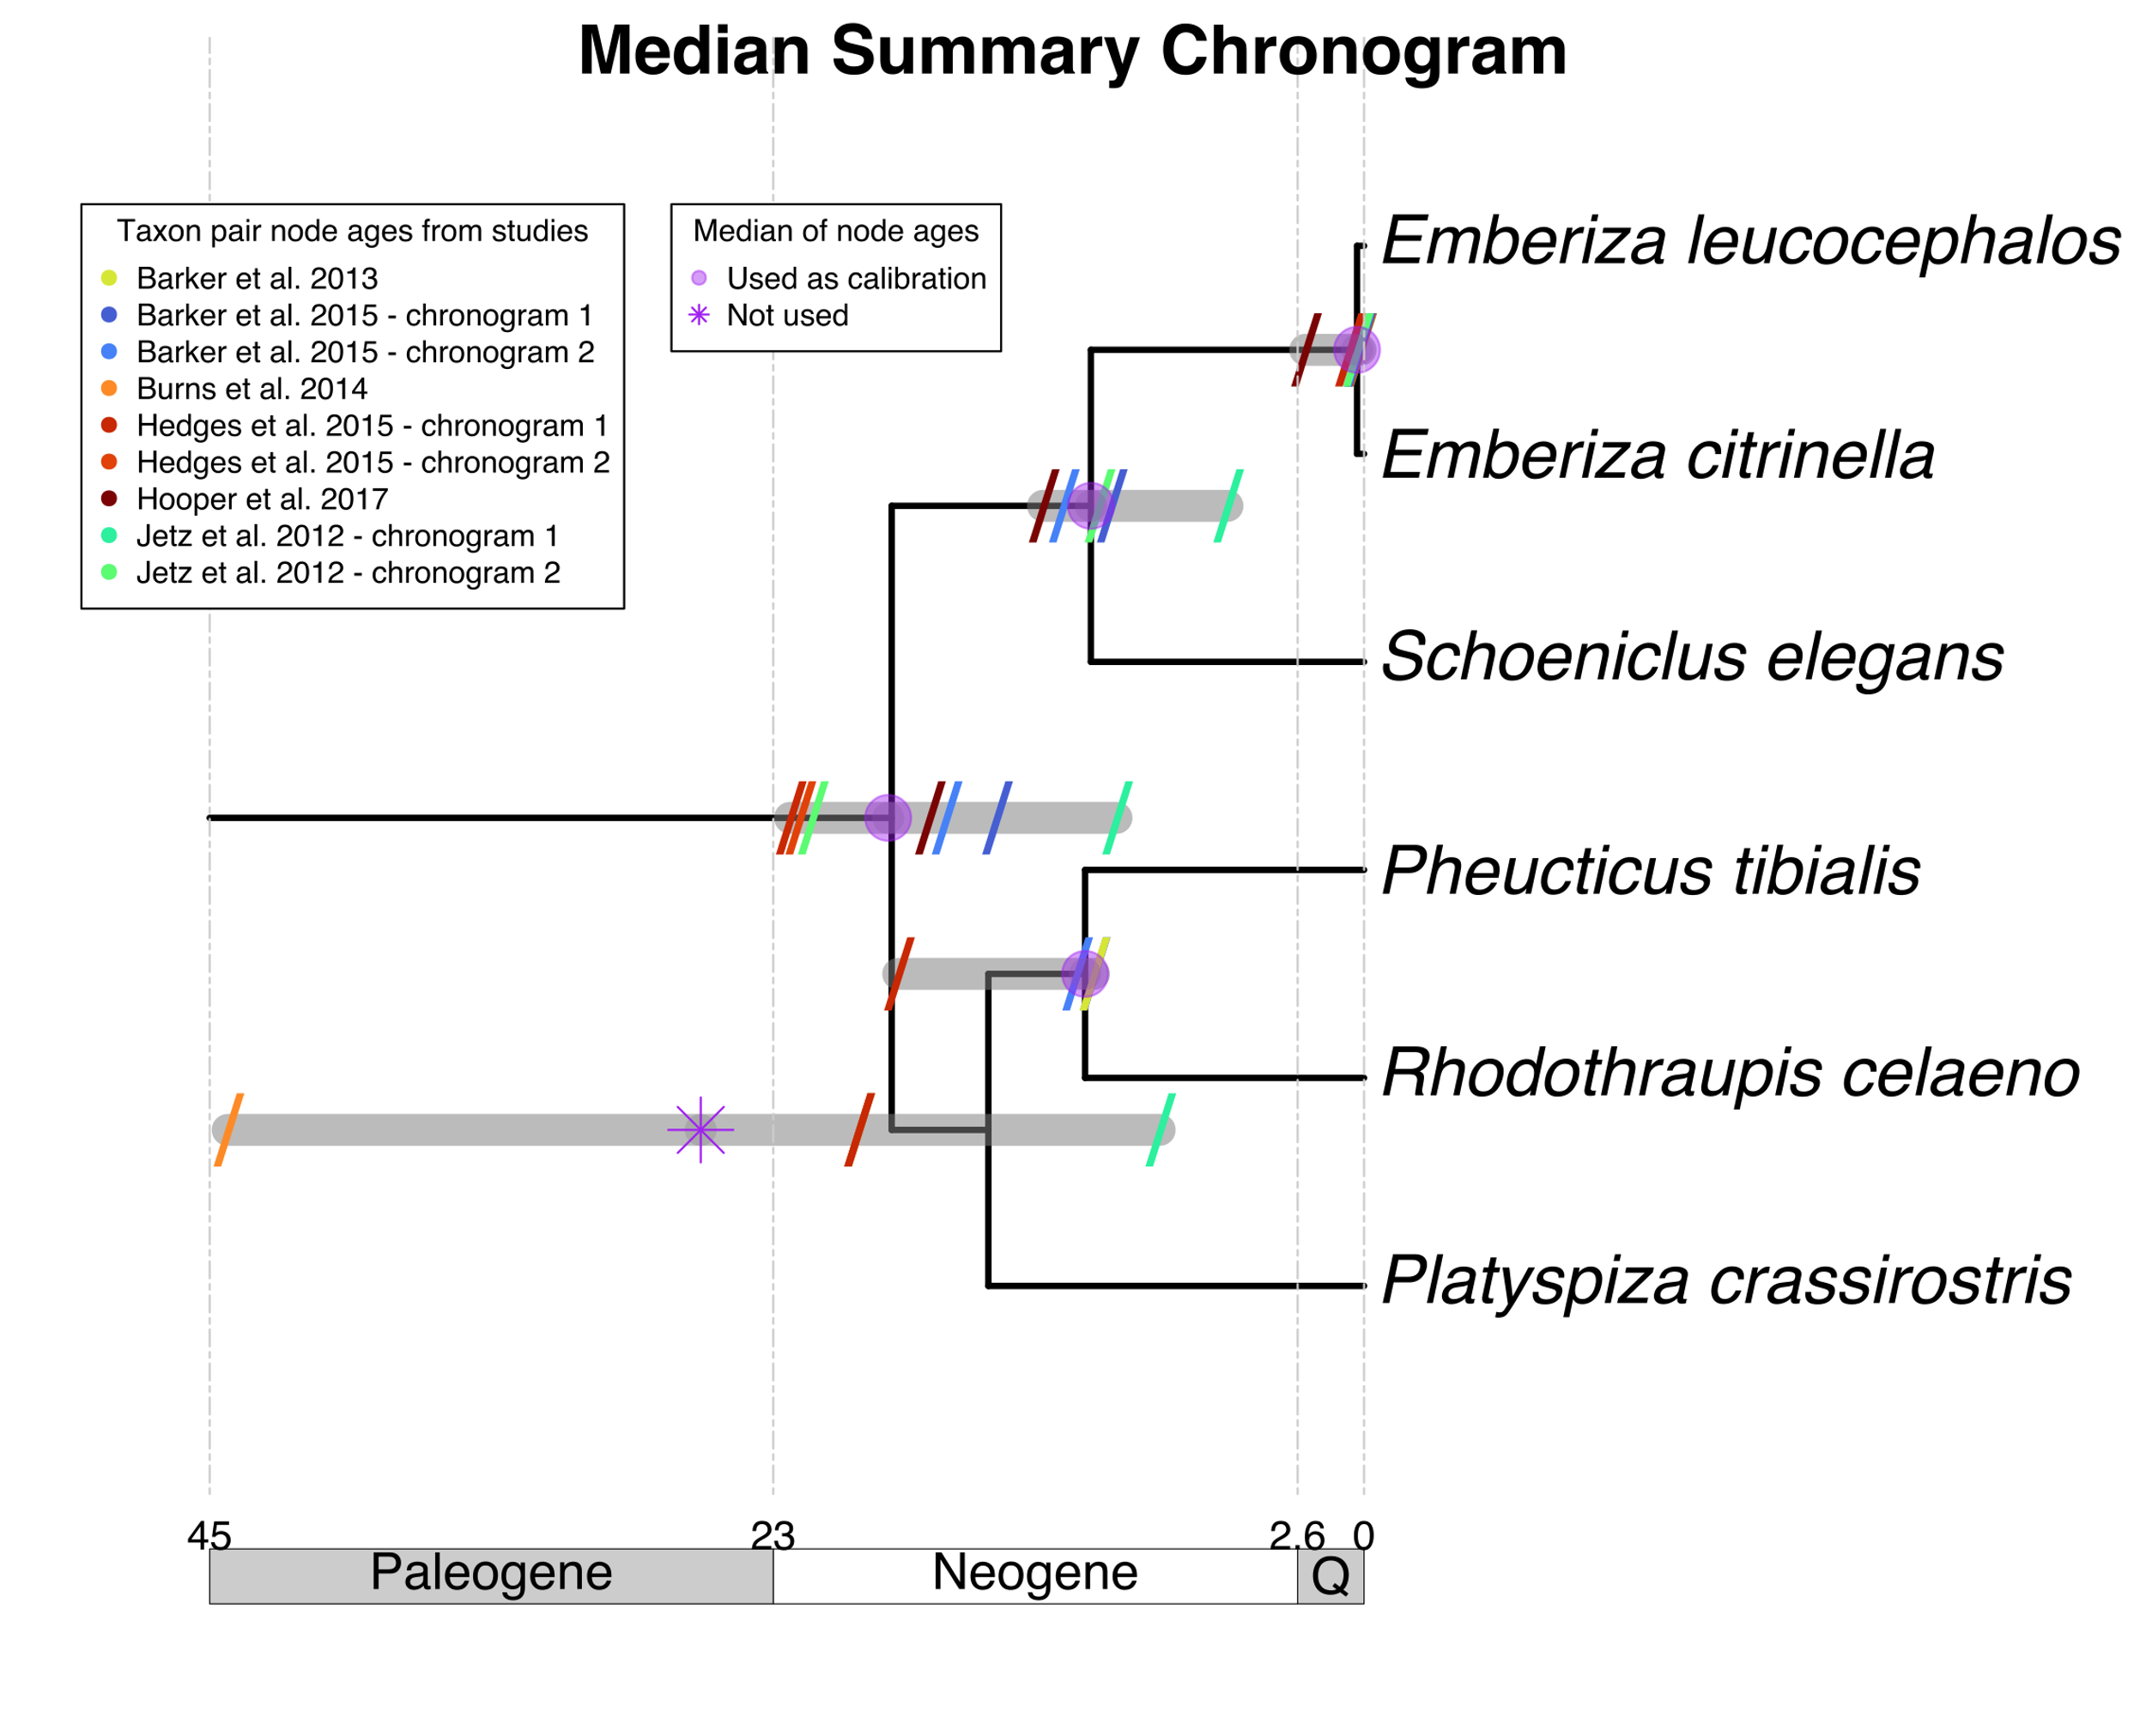
Summary of mapped taxon pair age data
Calibrate

