Slide 1

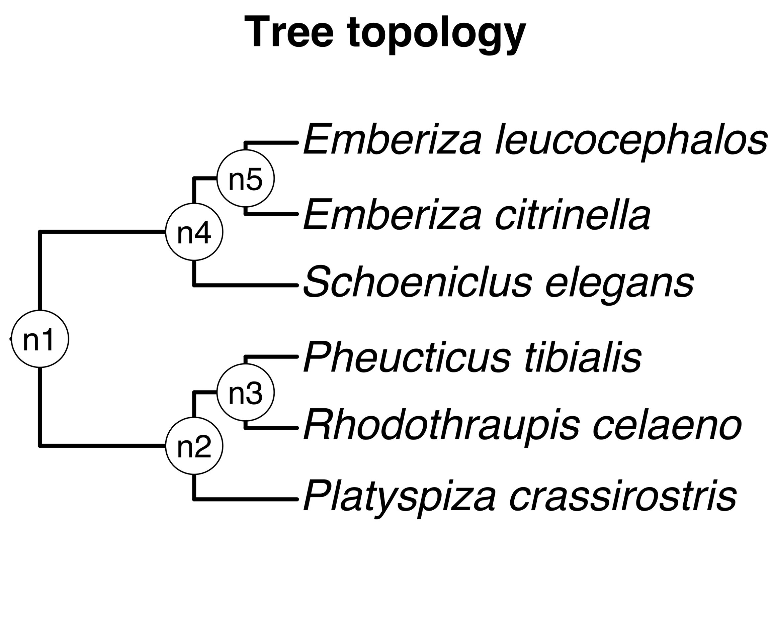
Taxon pair ages mapped to nodes of tree topology
Input taxa
X
B
C
T
A
A₁
D
E
F
Z
Source
chronograms
+
To summary

Slide 2
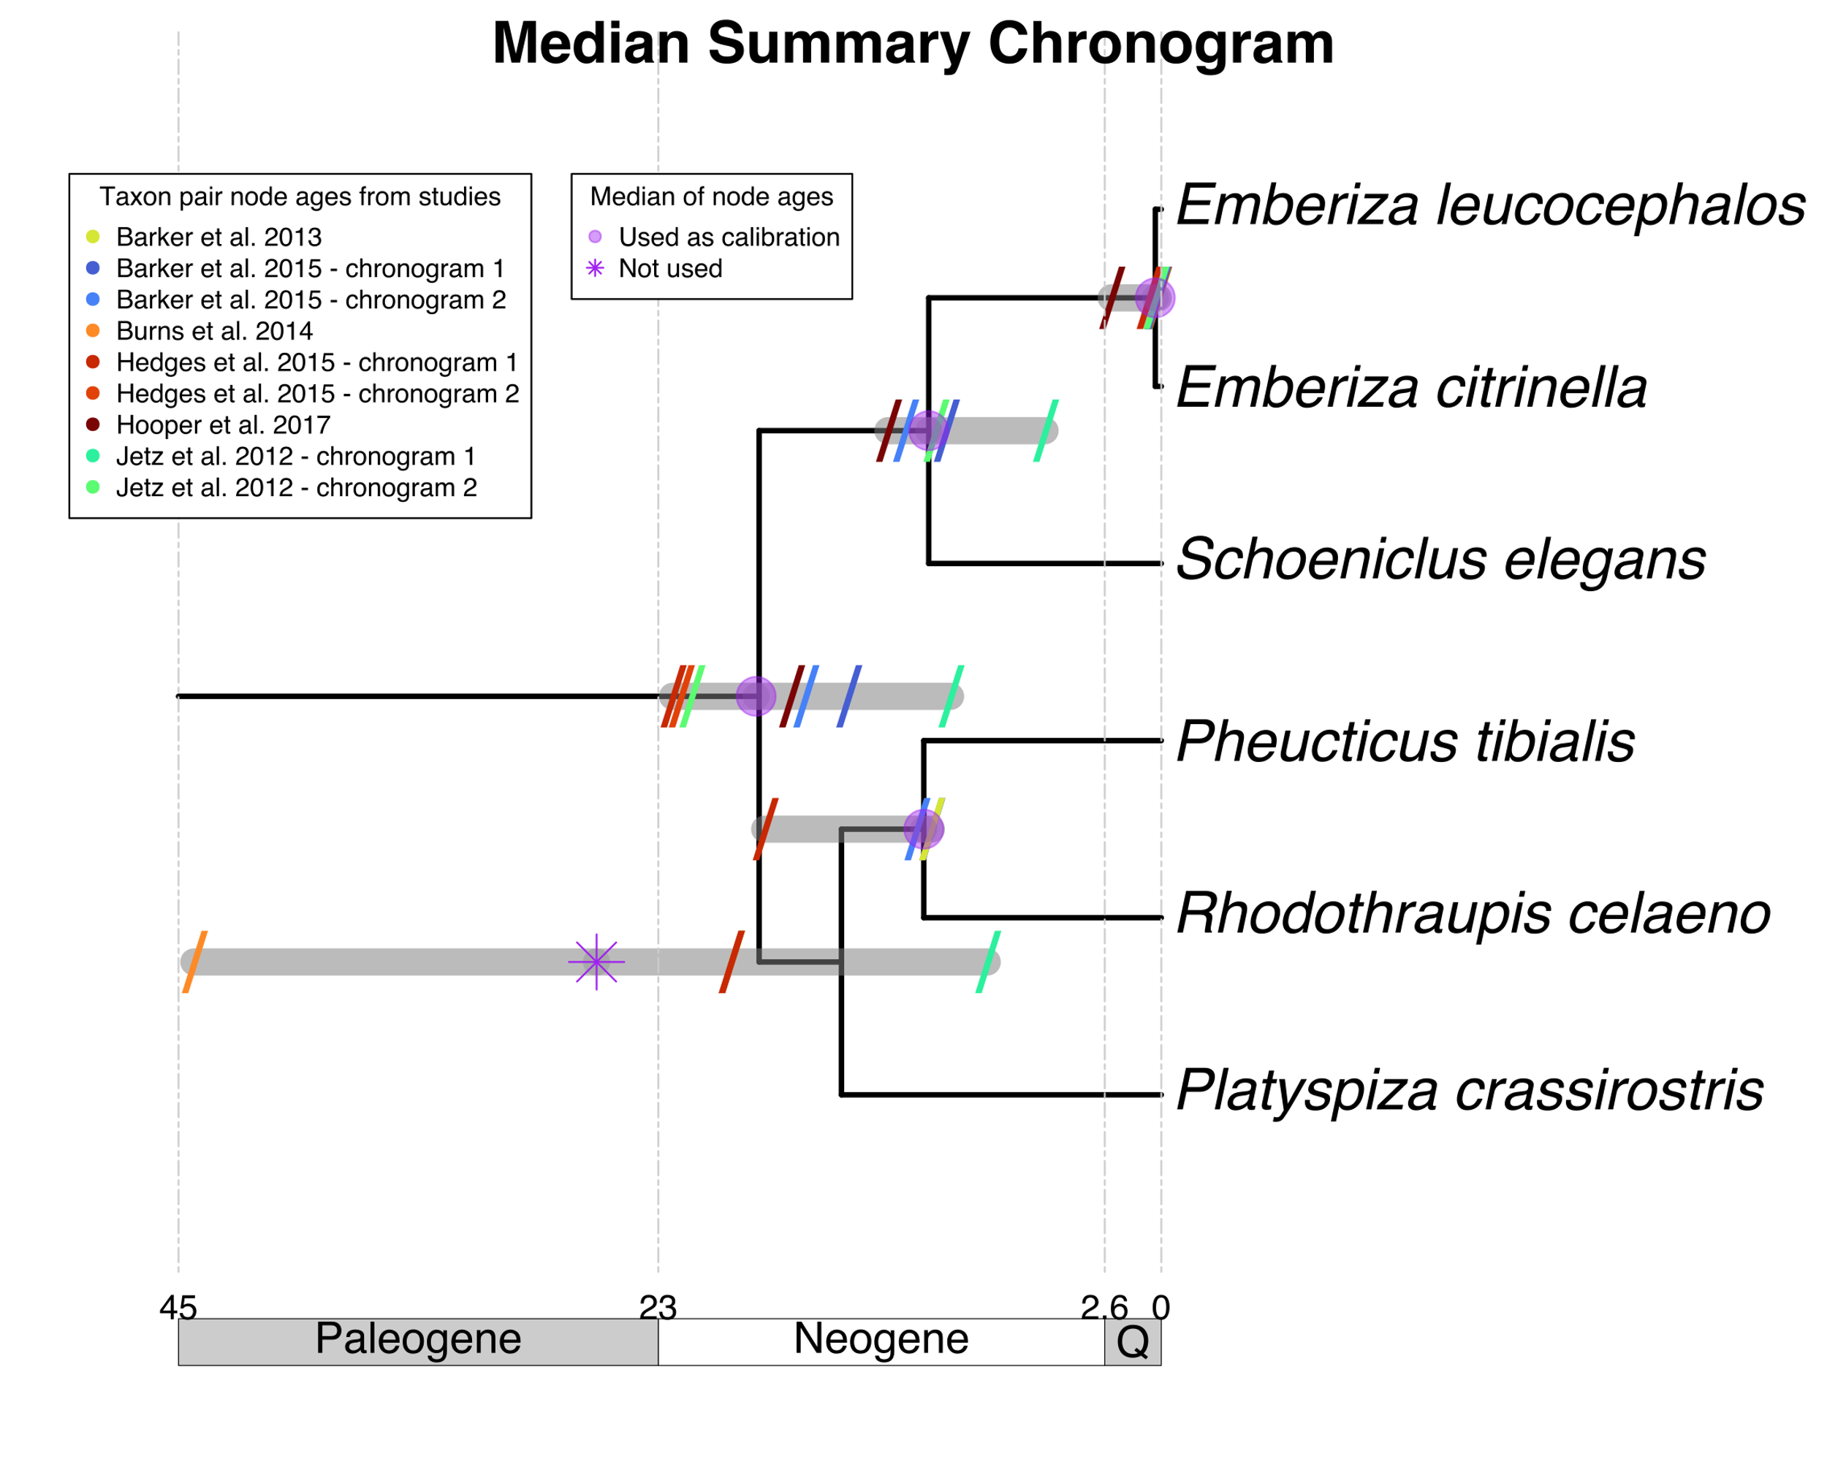
Summary of mapped taxon pair ages

