Slide 1
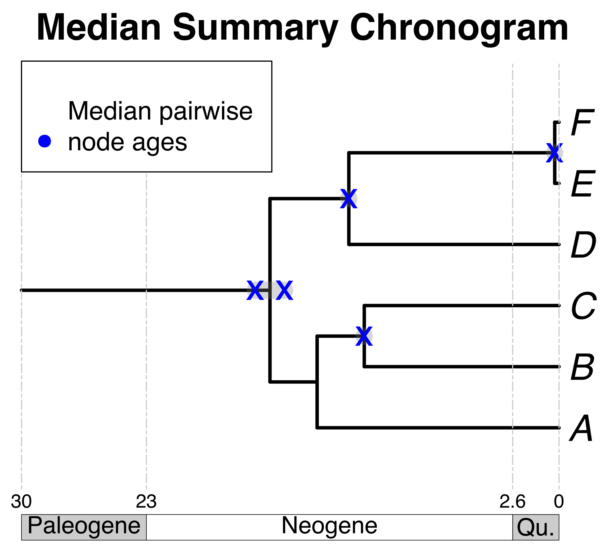

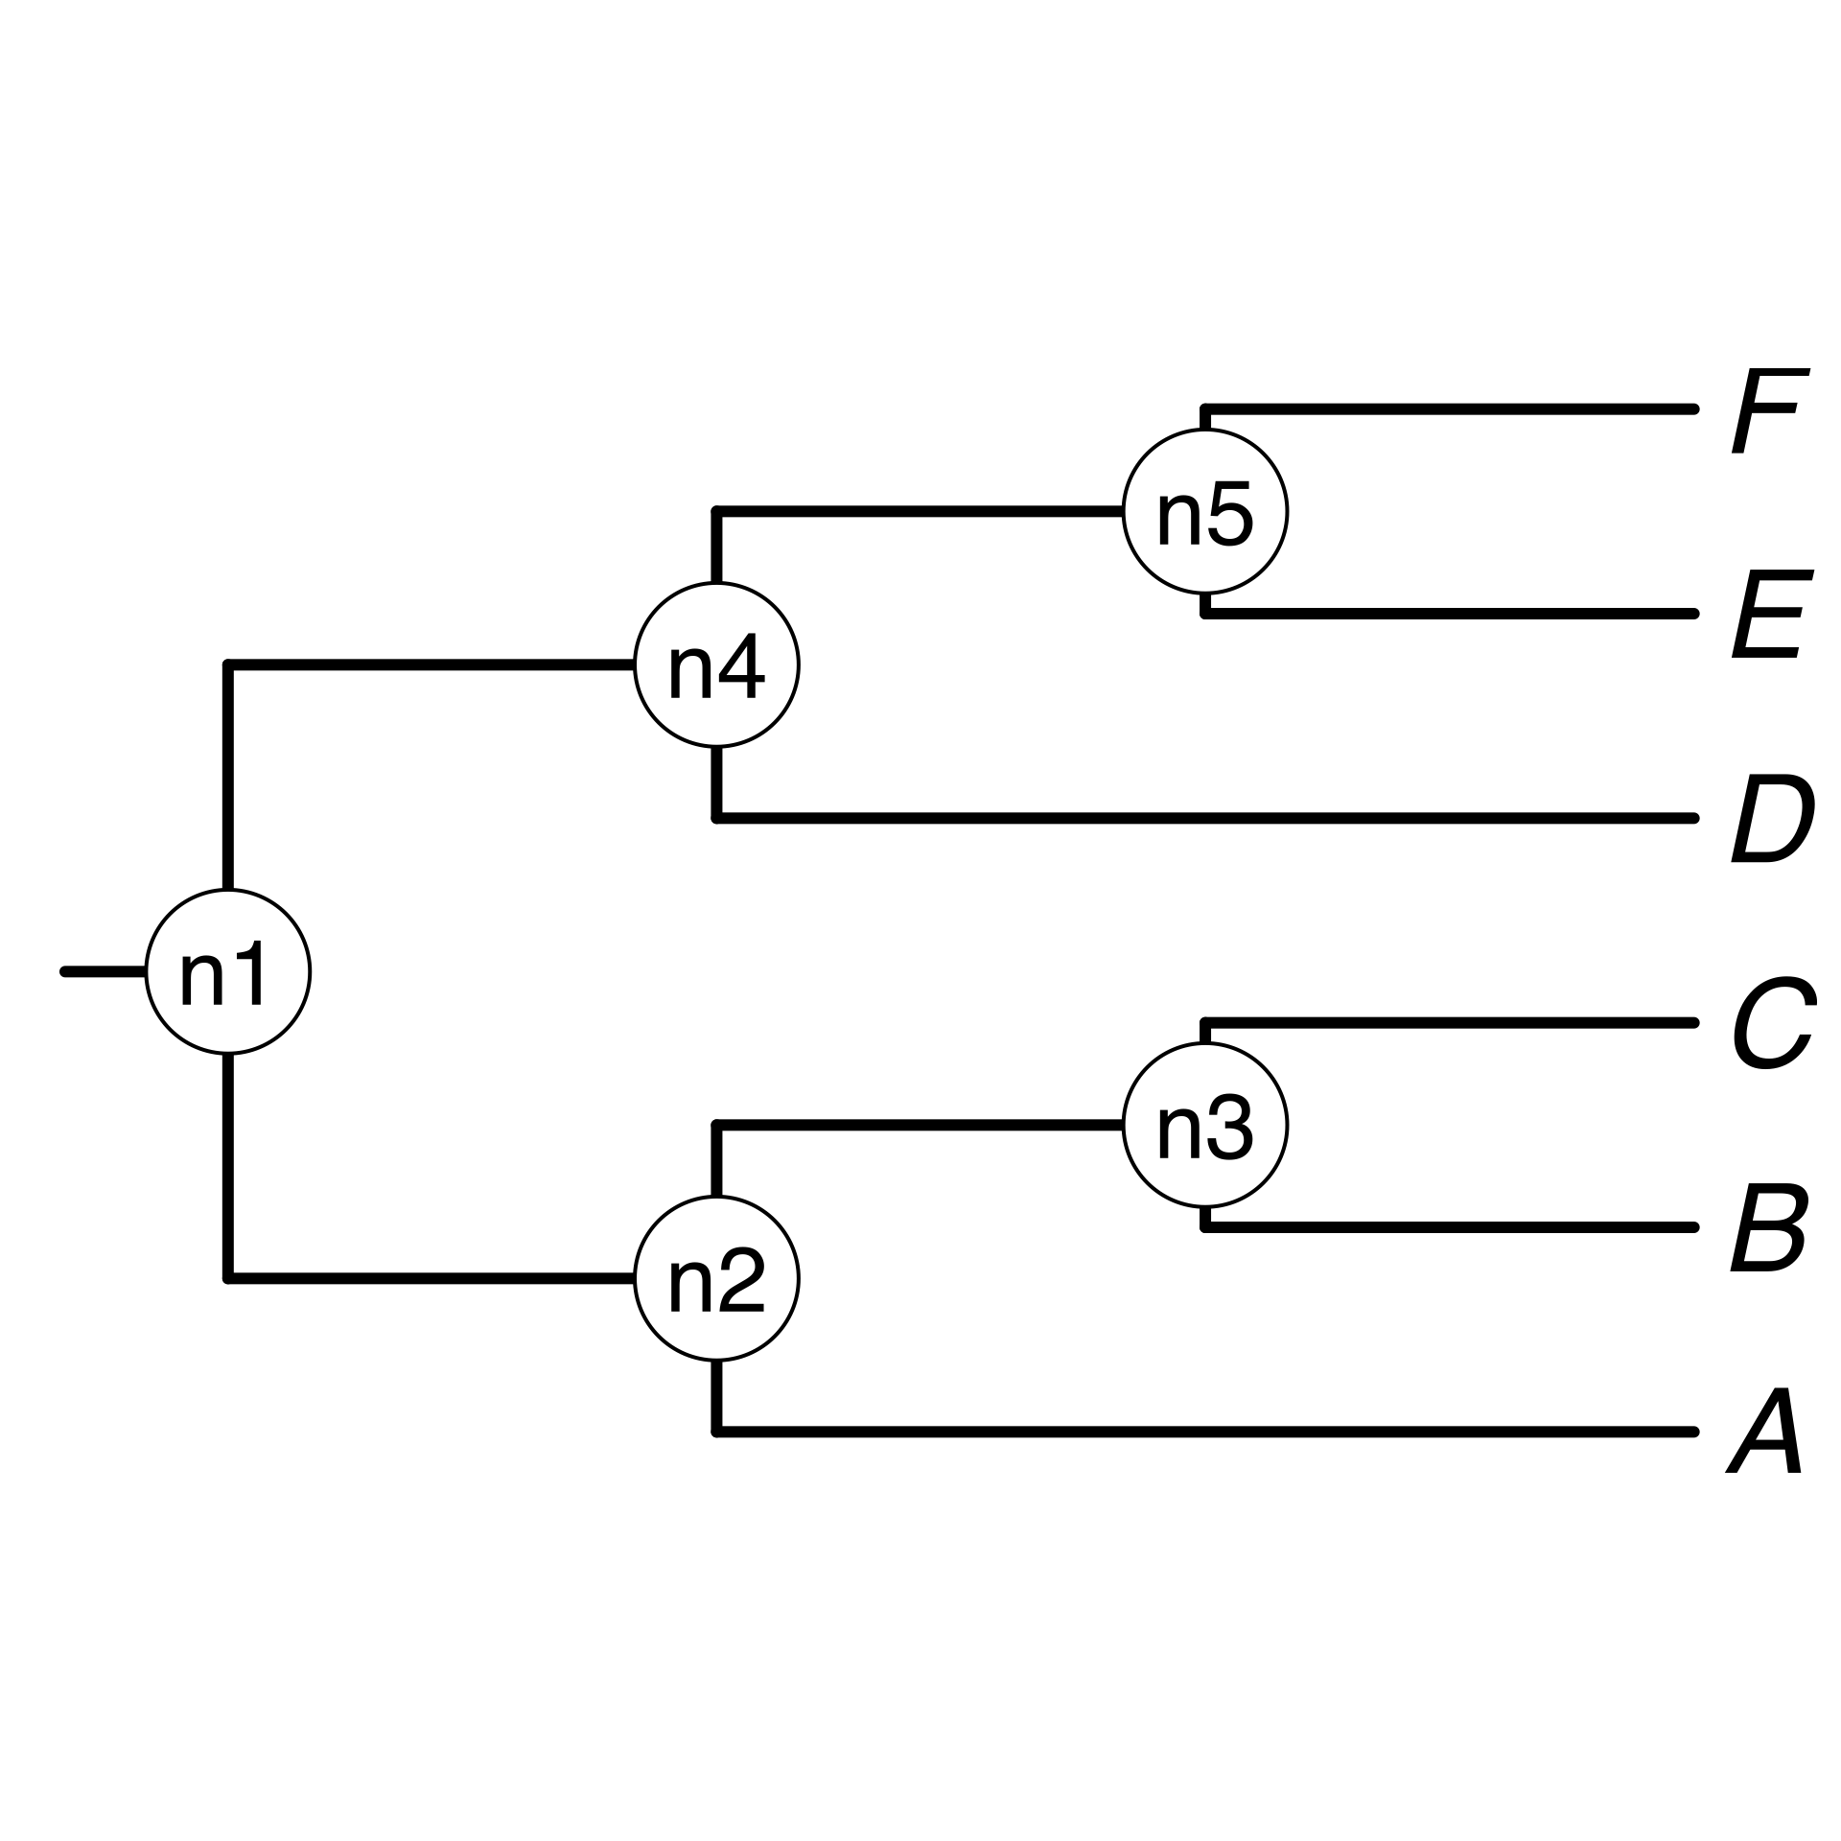

1a) A list of taxon names provided by the user
*
*
A, B₁ , C, D, E, F_{x}
*
1b) Processing taxon names with TNRS and standardizing them to a taxonomy
2b) prune matching chronograms = source chronograms
A B C D E F
2a) Search processed taxon names in chronogram database and identify*
3) Choose tree topology
The largest source chronogram
A tree from the
literature
Your own
tree
5) Use ages of congruent nodes to date a tree topology
4) Congruify source chronogram nodes to nodes of tree topology

