Slide 1
Boston Happiness Index
ADVISOR: PROFESSOR ERIC KOLACZYK
STUDENT RESEARCHERS: SHAN SHAN; XIANG ZHAO; XUECHUN LIU; YAQI HUANG; YING LI
Dec 8 2017

Slide 2
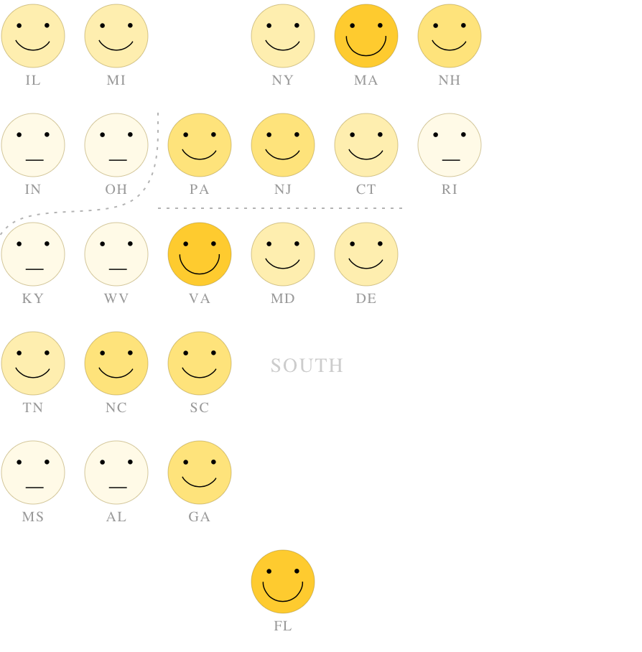
The Image of Happiness
Today, Boston is in a uniquely powerful position to create quality jobs, strengthen our competitive economy, add the housing our city needs to become more affordable, and prepare for climate change.
Image Boston 2030
World Happiness Report 2017 (global level research)
(in the support of the UN High Level Meeting on happiness and well-being)
World Bank (Bhutan, country level)
Santa Monica (city level)
Pix source: National Geography
Notes:
Definition of happiness

Slide 3
Project Workflow
Data Collection
BHI Measurement
Shiny
Collected relevant data source
Define BHI as a five to six categories with three spatial resolutions
Research definition of Happiness
Package a web-based app: Shiny

Slide 4
What is happiness?
Sociologist:
the social context of well-being and a way to measure the quality of society
“No living being can be happy or even exist unless his needs are sufficiently proportioned to his means.” (Émile Durkheim)
Reproduction in education, society and culture (Bourdieu, P)
Psychologist: the fulfillment of man's instincts (Sigmund Freud)
Economist: general welfare; basic needs; living standards; quality of life (Happiness economics)
Holmes, Bob (7 September 2010). "Money can buy you happiness – up to a point". New Scientist.
Ecologist and nature scientists: How nature is good for our health and happiness
BBC: a scientifically significant increase in people’s health, happiness, connection to nature and active nature behaviors

Slide 5
Prototype of Boston Happiness Index
BHI=AVG(HW+ES+C+CD+EC+SC)
Happiness measurement of Boston | Sub-Indicators of Boston | Data source
Health and Wellness | “Total Disability”, “Mental illness” | Analyze Boston United States Census Bureau
Economic Status | “Low to no income” | Analyze Boston United States Census Bureau
Communication (culture and education) | “Limited of English proficiency” | Analyze Boston
Community Development | “Social disorder and sensitivity to disorder” | Analyze Boston Harvard World Map
Ecological Influence | “PM 2.5” | Analyze Boston Harvard World Map
Safety Concern | “Crime incident report” | Analyze Boston Harvard World Map

Slide 6
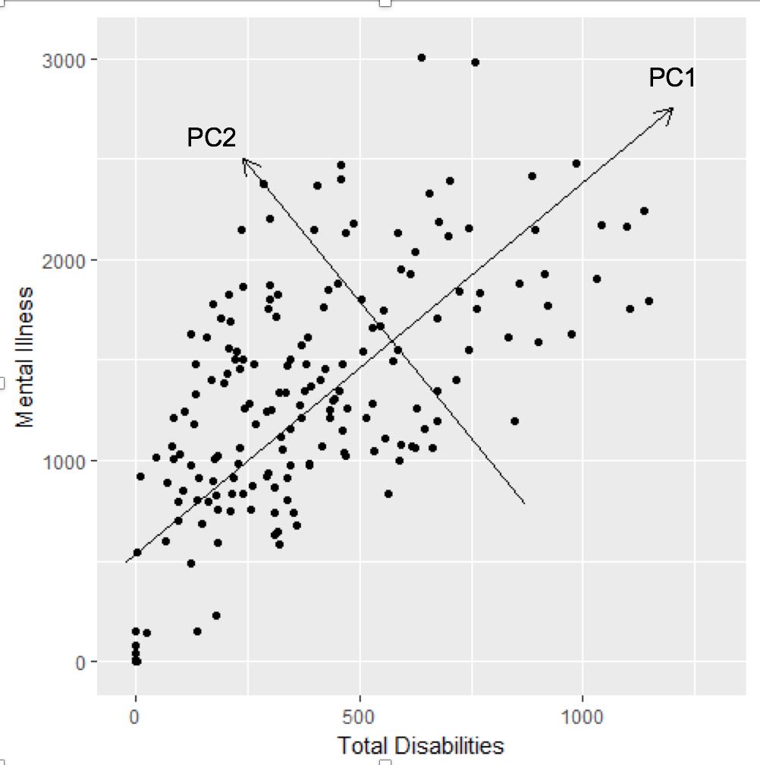
The method of PCA and the Related Output
PCA is a methodology coined in 1901 by mathematician Karl Pearson
It helps us to convert a two observations of possibly correlated variables ”total disability” and “mental illness” into a set of value “PC1” with 80.6% explanation power to represent

Slide 7
EDA and Shiny App
Shiny is an R package that produces an interactive, web-based app to let users interact with data and analysis.
What we did allows you to:
Read the daily changes of Boston Happiness Index (BHI) in three spatial resolutions.
Choose Happiness indicators to see the information of the BHI components.
Explore data in details by zooming in, zooming out, and clicking on the map.
Link: https://lunaxc.shinyapps.io/boston_happiness_index/

Slide 8
Beyond the Prototype
The definition of “happiness” : what happiness is? Which characteristics should we use?
Validation：”Design, data science methods can be deeply nebulous, predicting the future with historical data inevitably biased in some way” (Commentary, Data Science DC)
Data challenges: data ethics, privacy, data sharing, and decision-making.
Notes:
Com-positive variable

Slide 9
Q&A
Thank You!

