Slide 1
Built environment
Demographic
Socioeconomic
Transit
Spatiotemporal patterns of drug activity in Chicago
Luna Zhiyue Xia

Slide 2
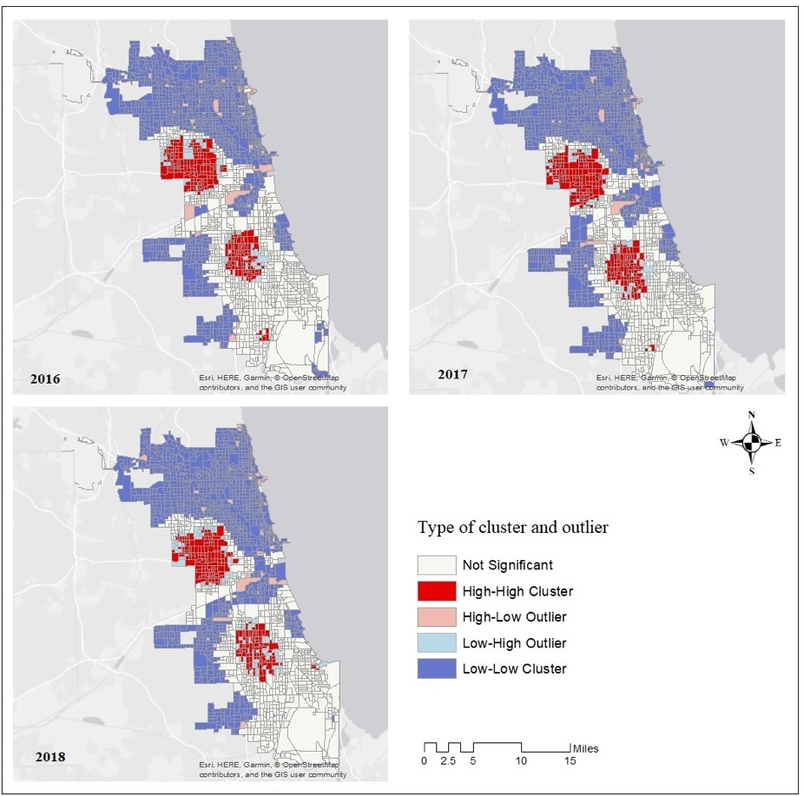
Background quick go through
Project data overview
Visualization and ESDA
Next steps
Hotspots of drug arrest in Chicago 2016, 2017, 2018
The results from previous research. The spatial patterns of drug arrests will be compared with the spatial patterns of opioid related deaths in this project.

Slide 3
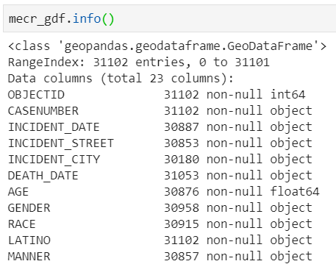
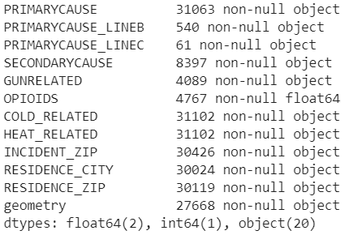
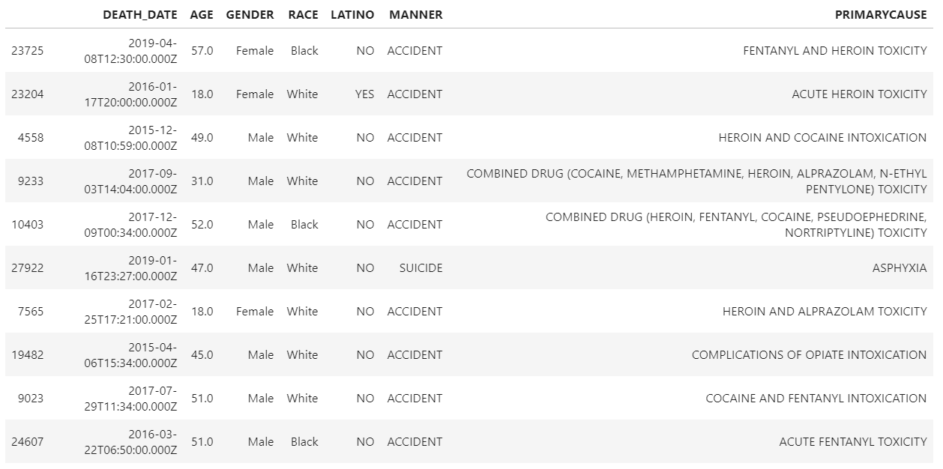
Overview of Medical Examiner Case Archive
Primary cause of death

Slide 4
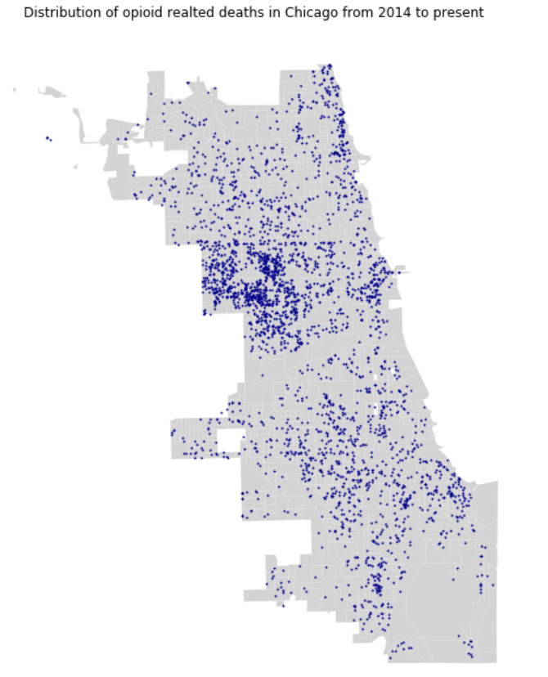
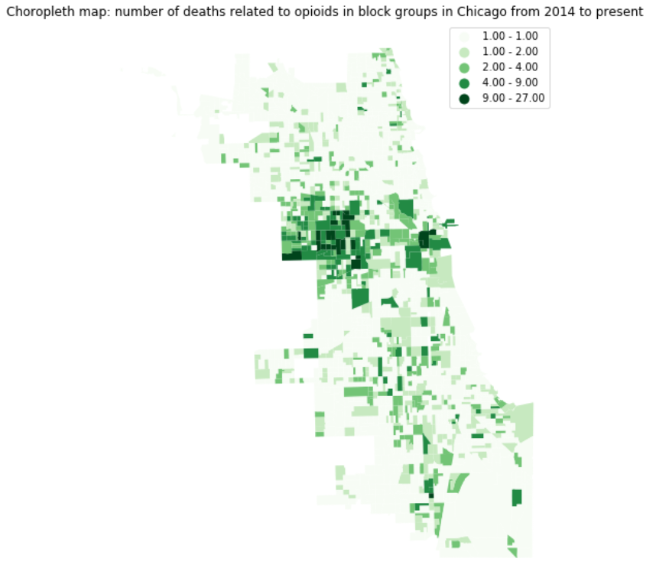
Visualization

Slide 5
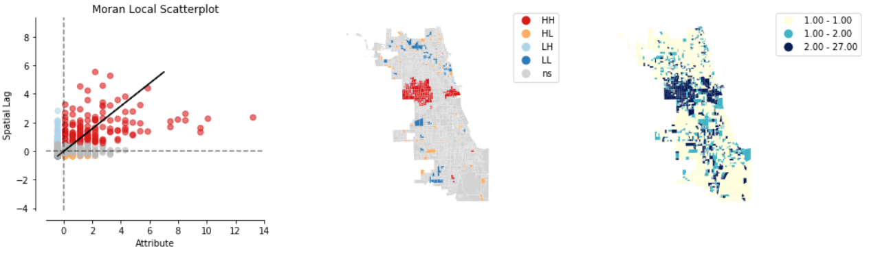
EDSA

Slide 6
Next steps
Spatial Modeling
GWR model and MGWR model
May adding time series analysis
Investigate the patterns of arrests and death and what drives the differences

