Slide 1
Built environment
Demographic
Socioeconomic
Transit
Spatiotemporal patterns of drug activity in Chicago
Luna Zhiyue Xia

Slide 2
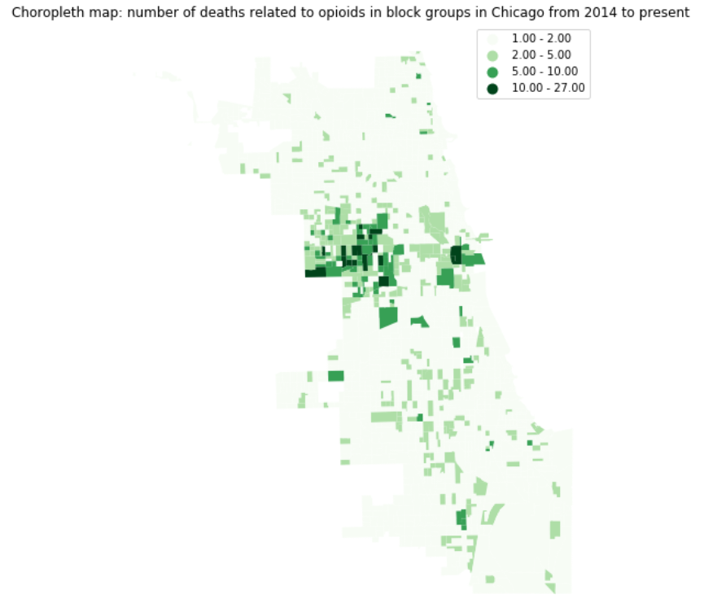
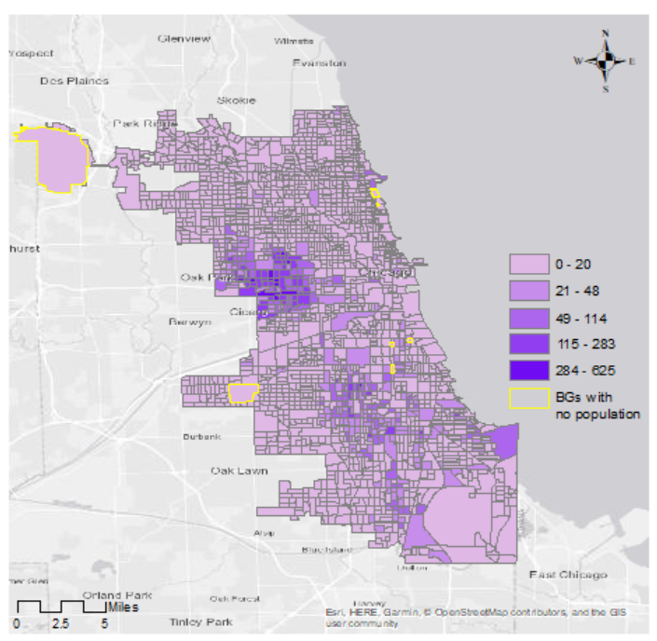
Three hypothesizes:
The spatial patterns of drug activities in city areas are significantly clustered (tested by ESDA and reported in last update)
2) Drug arrests (which record times and locations) can be used as a proxy of drug activities
3) The spatial patterns of drug activities are correlated with built environment, demographic and socioeconomic.
Bivariate Moran Statistic
Bivariate ESDA between
Opioids related death and
Drug arrest

Slide 3
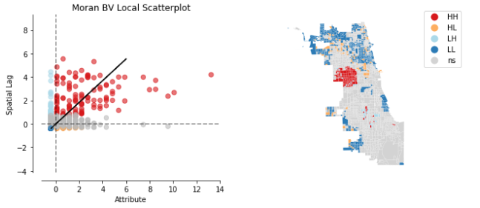
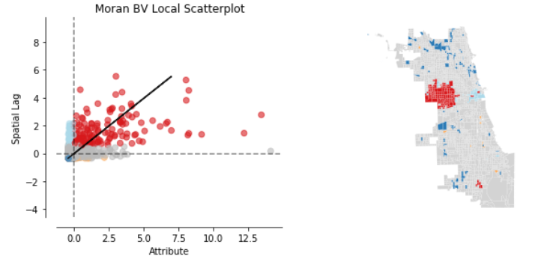

Bivariate Moran Statistic
Global bivariate Moran’s I is 0.42 with p-value smaller than 0.001
→ Positive correlation between Death and Arrest in nearby areas
Bivariate analysis: Death surrounded by arrest
HH cluster indicate high death rate surrounded by high drug arrest
Arrest surrounded by death
HH cluster indicate high frequency of arrest surrounded by high death rate

Slide 4
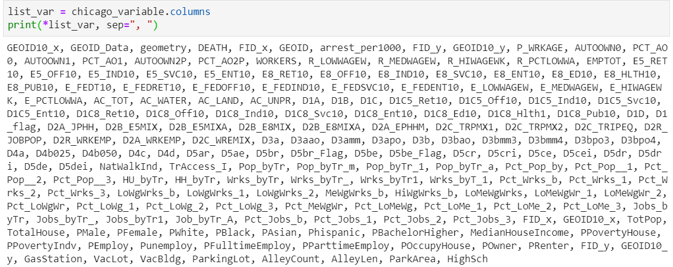
GWR and MGWR
Background quick go through
Variables:
Total number: 182
Sources: EPA, ACS, ESRI Business, Chicago open data portal
Using Random Forest to select 5 important variables to predict frequency of drug arrests
Model : frequency of drug arrest per 1000 population ~ VacantLot + ParkingLot + PBachelorHigher + Pct_LoMeWg + D5ar
Pct_LoMeWg: percent of low-medium wage workers have accessibility to public transit
D5ar: jobs accessible by 45 min transit

Slide 5
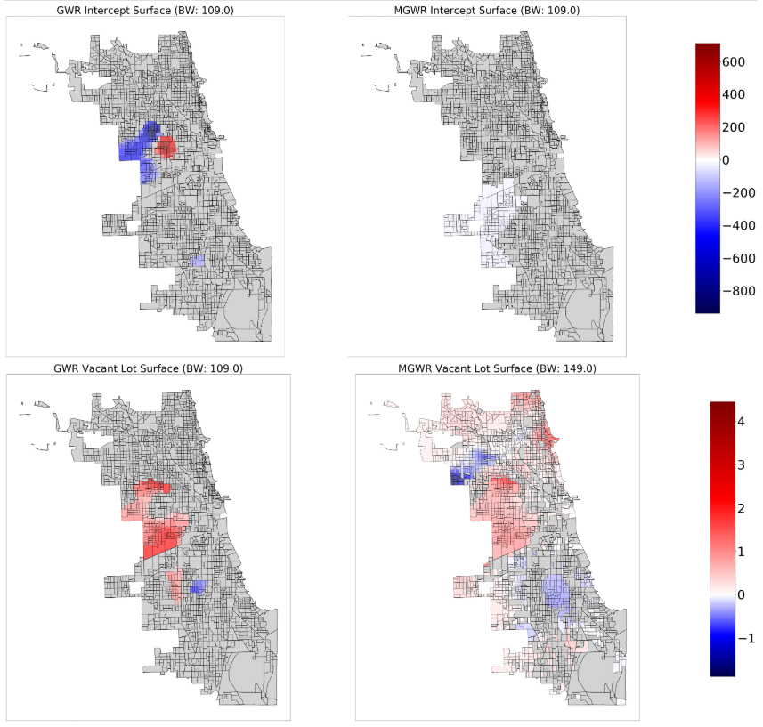
GWR and MGWR

Slide 6
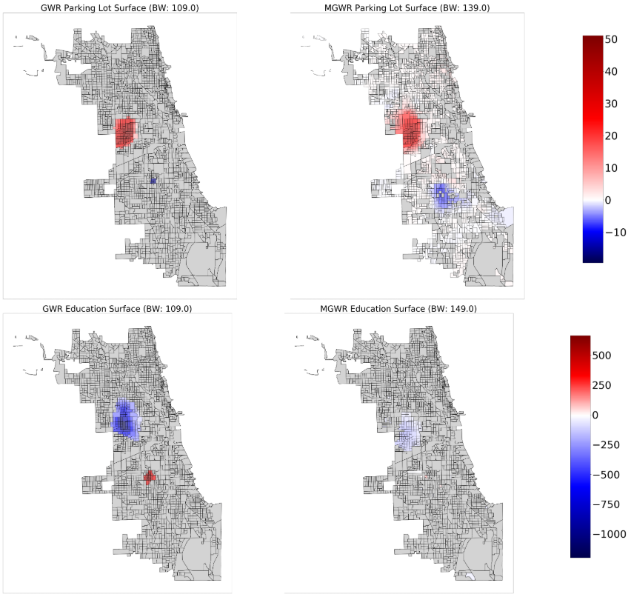
GWR and MGWR

Slide 7
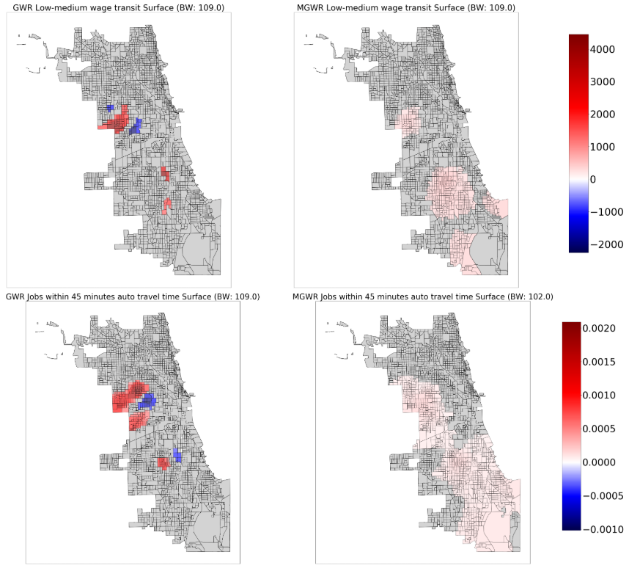

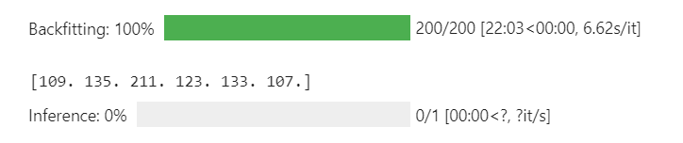
GWR and MGWR

Slide 8
Use random forest to predict hotspots
Time series analysis
3 type of additional variables create
Spatiotemporal lag variables – nb ( time lag = 1, 2, 3)
No. of block groups in neighborhood (Queen adjacency) that belonged to a hotspot in the past time periods (6 mos)
Temporal autocorrelation variables – hotspot ( time lag = 1, 2, 3)
Was this block group in a hotspot in the past time periods? Y/N
Trend variables – nb_trend, hotspot_trend
Difference between ‘nb’ for different time lag (eg. ‘nb_t-1’ – ‘nb_t-2’)
Difference between ‘hotspot’ for different time lag (eg. ‘hotspot_t-2’ – ‘hotspot_t-3’)

Slide 9
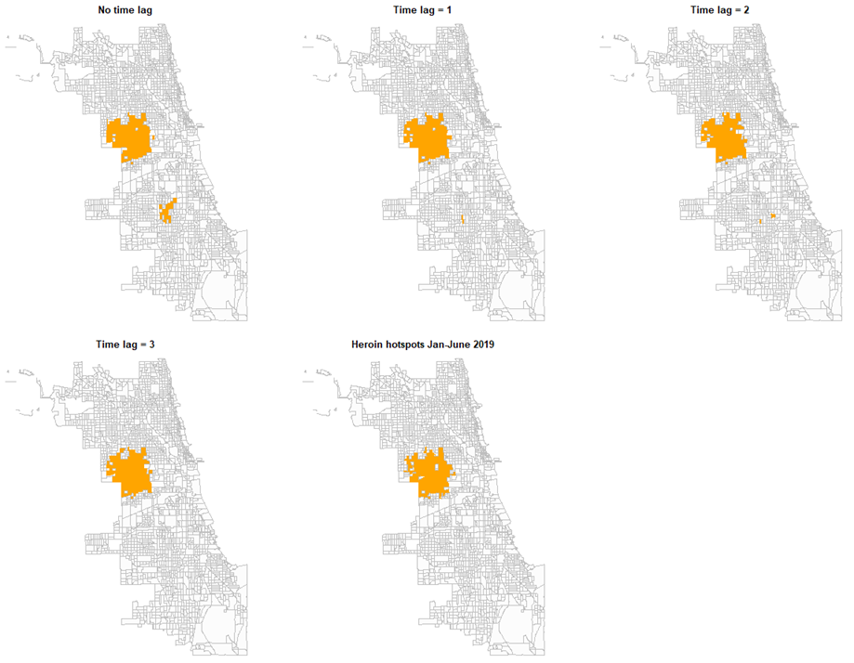
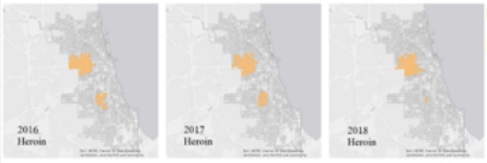
Time series analysis
Train Random Forest model using data between 2016 and 2018
Predict in 2019

Slide 10
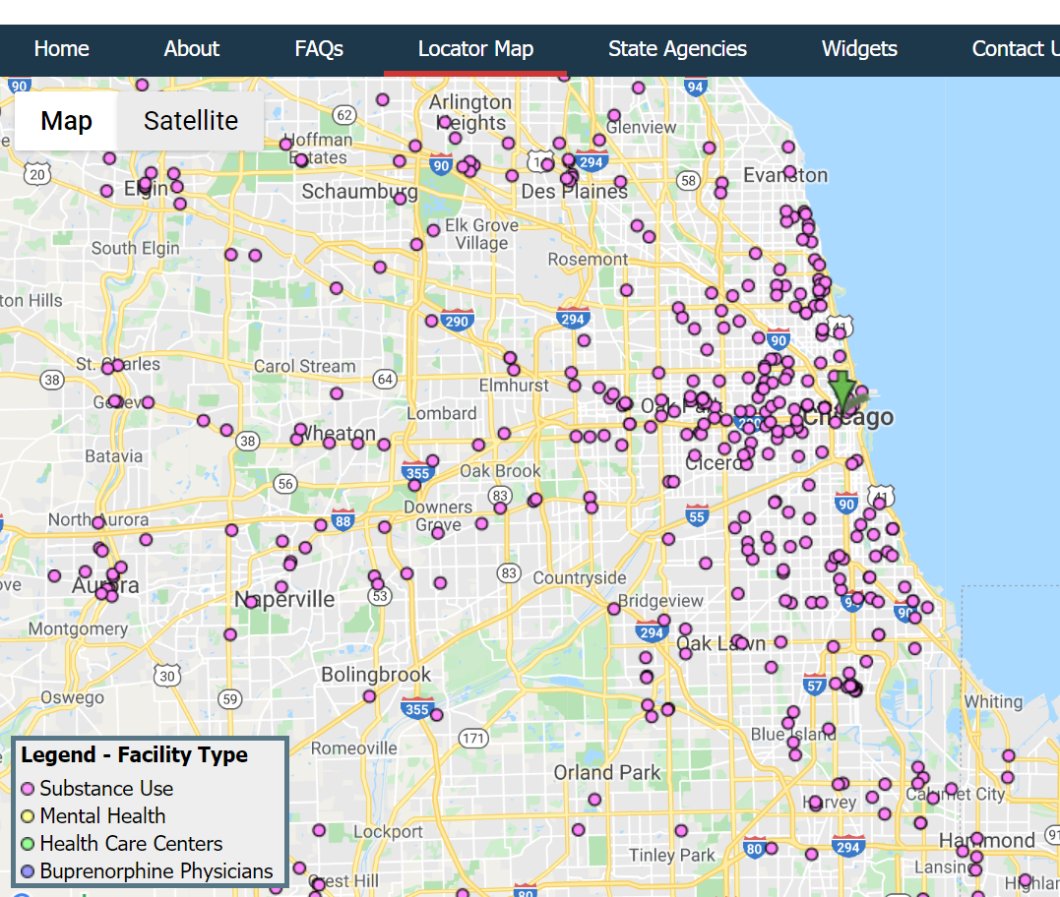
Next steps
Try Geographical Random Forest (package ‘spatialML’ only in R CRAN, any python package?)
(potential) estimate the accessibility to opioid treatment center

