Slide 1

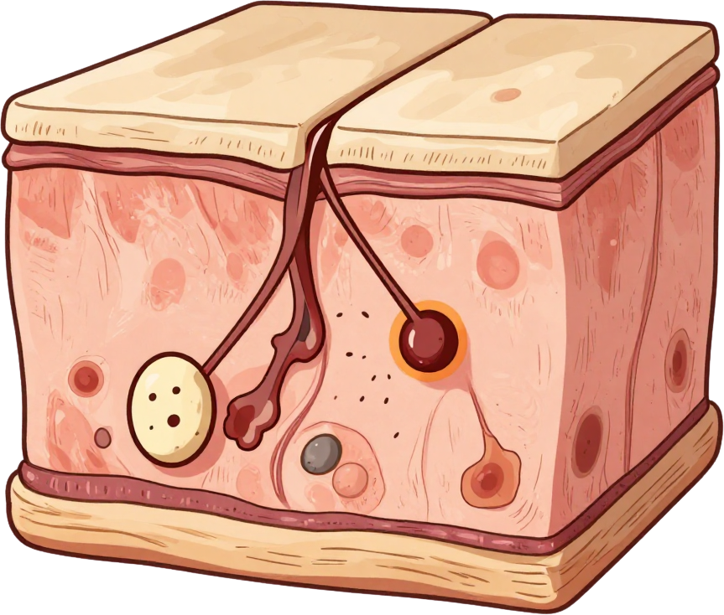


MELANOMA SKIN LESION CLASSIFICATION
( A Deep Learning Image Classification System )
By Luna Yahya | BinX Tech

Slide 2
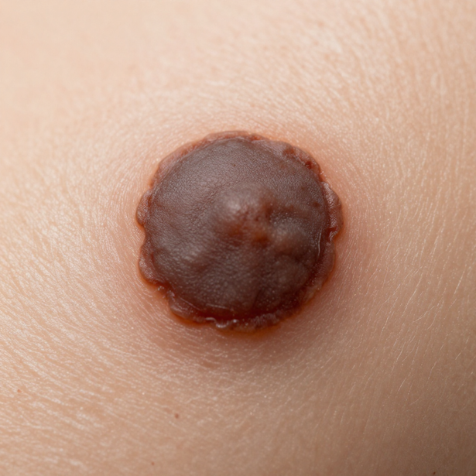

The Problem
Melanoma is one of the most serious and deadly forms of skin cancer, requiring early and accurate detection.
• Goal: Classify skin-lesion images as Benign or Malignant using deep learning.
• The system outputs a malignant probability score to support clinical prediction.
• Early classification can significantly improve patient outcomes.
02

Slide 3
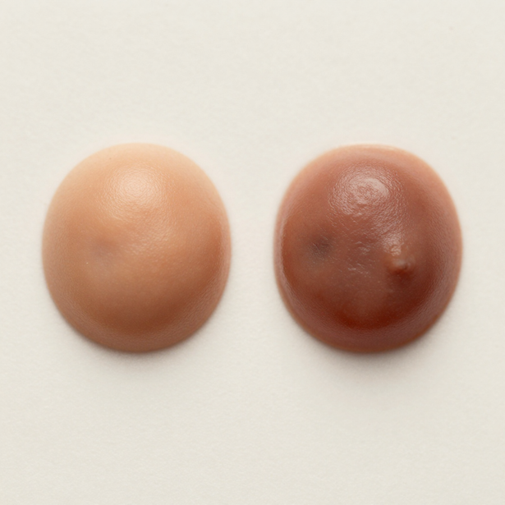
Dataset Overview
Two classes: Benign and Malignant. Evaluation set contains 2,000 images, evenly balanced — 1,000 Benign and 1,000 Malignant samples.
Consistent preprocessing and careful evaluation are essential. Image classification requires standardized pipelines to ensure reliable and reproducible results.
03

Slide 4
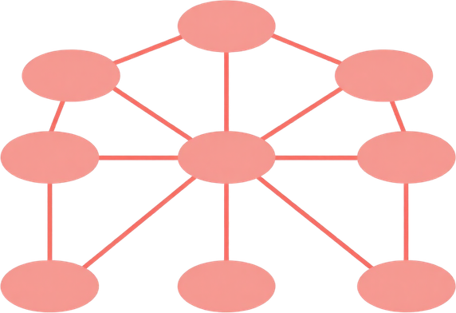
From Image
to Prediction
IInput Image
↓
OpenCV
↓
RGB Conversion
↓
128 × 128 Resize
↓
Normalization /255
↓
CNN
↓
Malignant Probability
↓
Threshold = 0.35
↓
Benign / Malignant
04

Slide 5
Model & Methodology
End-to-End Pipeline
Preprocessing
  Image decoding
  RGB conversion
  Resize → 128×128
  Normalization
Model
  CNN
  Binary classification
  Trained model: melanoma_cnn.keras
Post-processing
  Probability
  Classification threshold
  Final prediction
05
Seed = 42

Slide 6
Threshold 0.50
Key Metrics
Accuracy: 87.55%
Malignant Precision: 92.43%
Malignant Recall: 81.80%
ROC-AUC: 95.17%
PR-AUC: 94.45%
Malignant F1 Score: 86.79%
False Negatives: 182
Strong precision at default threshold. High AUC scores confirm excellent discriminative ability across all classification boundaries.
06

Slide 7
Threshold 0.50
Threshold 0.35
• Accuracy: 87.55%
• Precision: 92.43%
• Recall: 81.80%
• F1 Score: 86.79%
• Accuracy: 89.15% ↑
• Precision: 87.46% ↓
• Recall: 91.40% ↑
• F1 Score: 89.39% ↑
• False Negatives: 182
• False Positives: 67
• False Negatives: 86 ↓
• False Positives: 131 ↑
Threshold ↓
↓
More images classified as Malignant
↓
Recall ↑
↓
False Negatives ↓
07

Slide 8
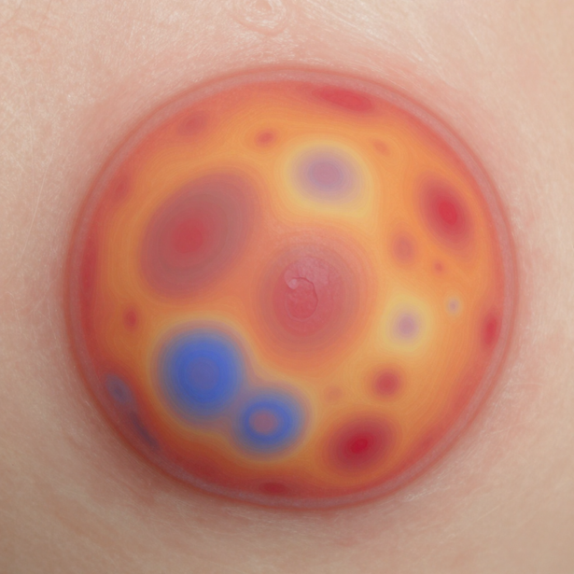
Explainability with SHAP
Understanding Model Predictions
SHAP Explainability
  Used SHAP to investigate model behavior.
  Generated visual explanations for image predictions.
  Helps us inspect which image regions/features influence predictions.
SHAP explanations do not guarantee medically valid reasoning.
08

Slide 9
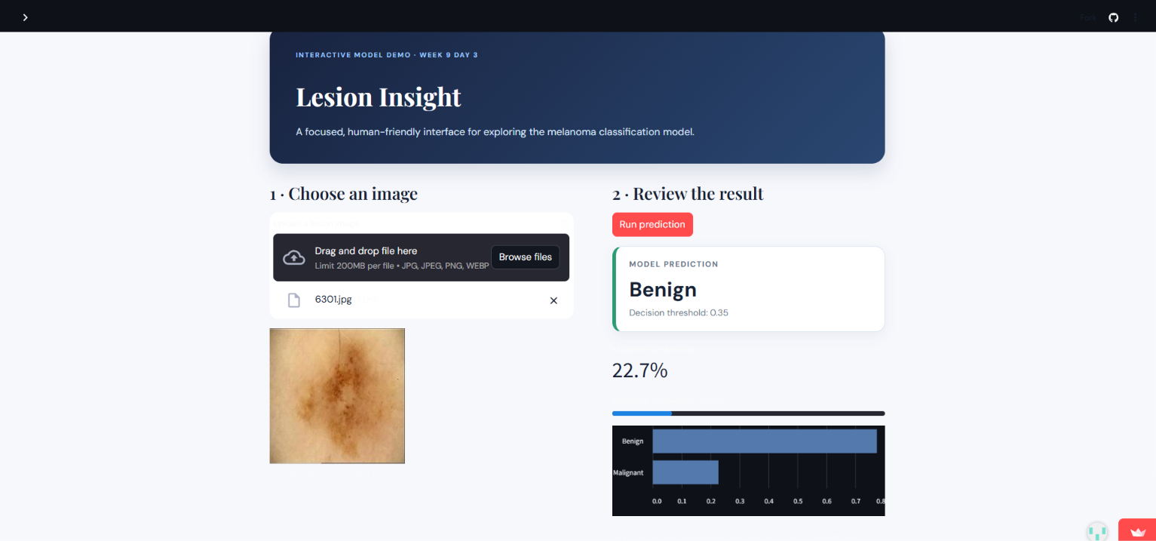
Live Demo
Simply upload a skin lesion image and receive an instant classification result with a malignant probability score.
https://ai-training-mipxqexmw7lfuh84hevpb2.streamlit.app/
09

Slide 10
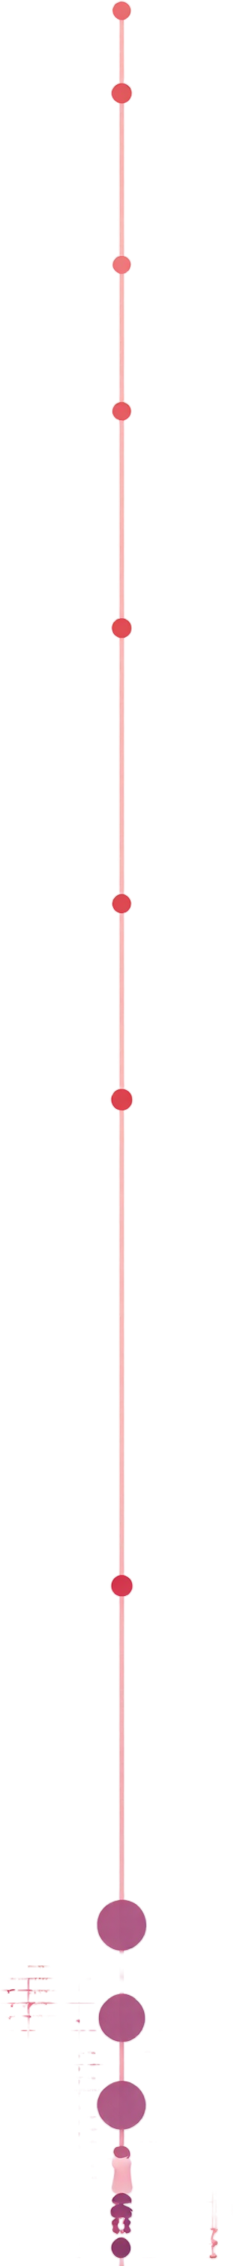
Case 1 & Case 2
Case 3 — Edge Case
🔬 Case 1 — Benign Prediction:
Benign Prediction: Benign
Malignant Probability: 22.7%
Correct Prediction.
🔬 Case 3 — Malignant Prediction: Malignant Prediction: Malignant
Malignant Probability: 59.3%
Correct Prediction.
🔬 Case 2 —High-Confidence Malignant Prediction:
Malignant Prediction: Malignant
Malignant Probability: 100%
Correct Prediction — High Confidence.
10

Slide 11

Limitations & Future Work
Limitations:
• Dataset-specific model; generalization concerns.
• False positives and false negatives exist.
• Threshold trade-offs affect error types.
• Educational tool, not a clinical diagnostic.
Future Work:
• Larger, more diverse training datasets.
• External validation and transfer learning.
• Robustness to image quality variations.
• Systematic hyperparameter tuning.
• Deployment monitoring and enhanced explainability.
11

Slide 12
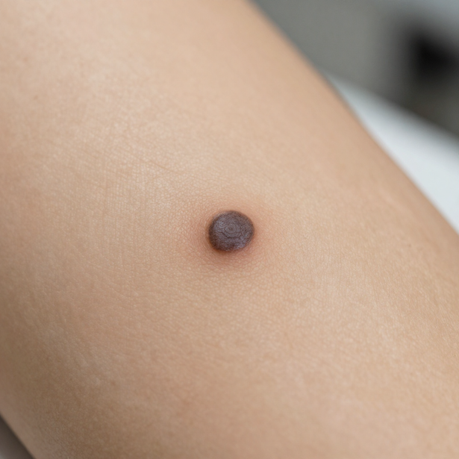
Conclusion & Questions
Problem: classify skin-lesion images as Benign or Malignant.
Approach: Preprocessing → CNN → Evaluation → Explainability (SHAP) → Streamlit Deployment. An end-to-end deep learning pipeline built for real-world usability.
Results at Threshold 0.35: 89.15% Accuracy · 91.40% Malignant Recall · 89.39% Malignant F1 · Only 86 False Negatives.
Final Outcome
A complete end-to-end image-classification pipeline was developed and deployed using Streamlit.
12

Slide 13
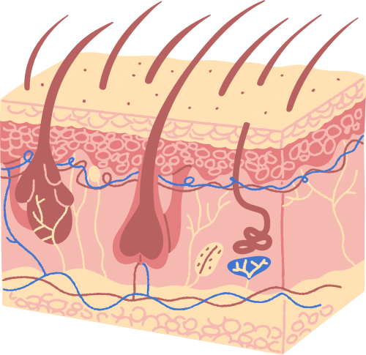
THANK YOU!
QUESTIONS?

