Slide 1
Exercise in thinking in Objects
The world is just a large group of objects!

Slide 2
Pick something, anything!
You could pick
A door
A cat
A zebra
Grass
A cog factory
A booger

Slide 3
Write down what properties it could have
Example: door
Color
Height
Width
Material
Knob Type
Has Lock
Is Locked
Is Open
Etc.

Slide 4
Write down what methods it could have
Example: door
Open
Close
Lock
Unlock
Use Peephole

Slide 5
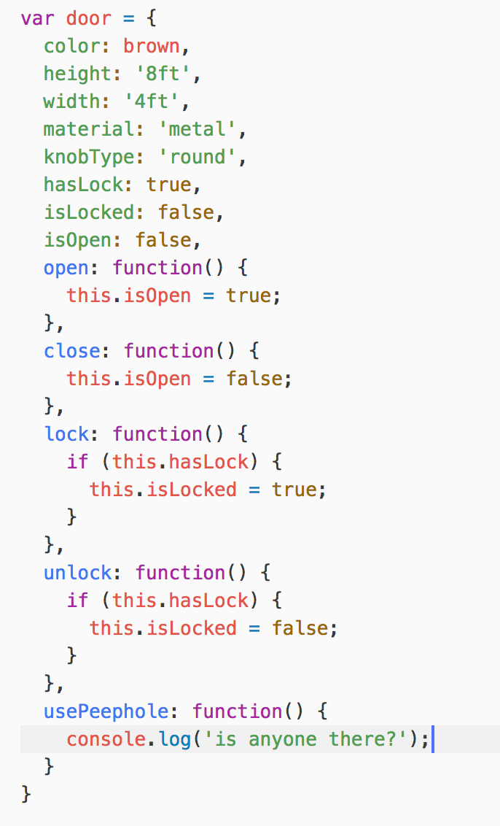
Write up a simple object
Example: door

Slide 6
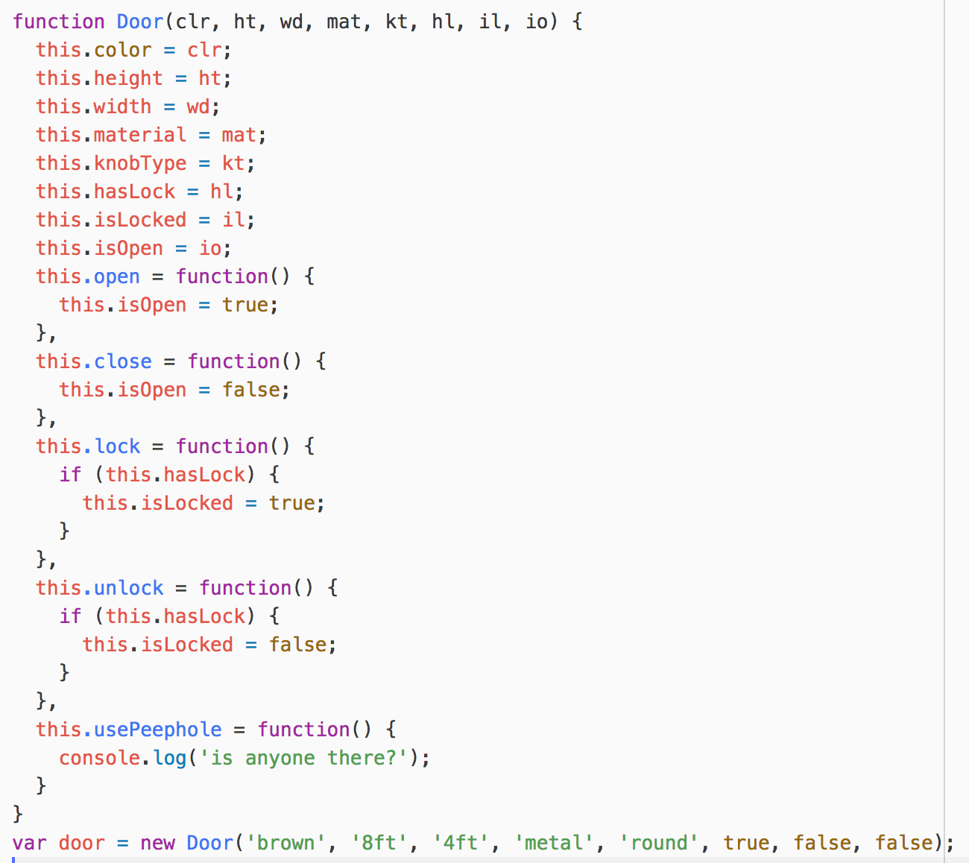
Write up a constructor
Example: door

Slide 7
Do this in your code often!
This is one part of making your code ”modularized” and when your code is modularized you will be happy!

