Slide 1
FoodHub
By Meme Teme
Justin Chow
Theodore Walton
Brandon Pierce
Aneesh Nazar
Michael Lu

Slide 2
Why FoodHub?
Problem:
Marketing, social aspect
Solution:
Integration between merchants and consumers

Slide 3
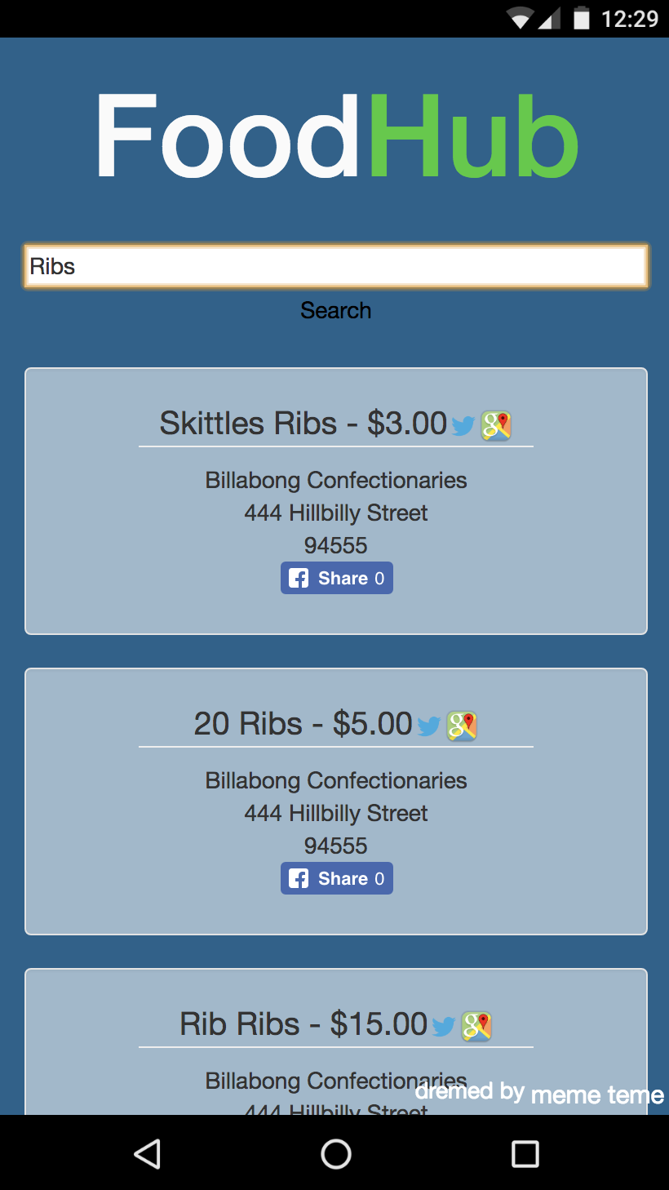
About FoodHub
Ease of use
Find food easily
Simple for merchants
Pleasing for consumers
Market Audience

Slide 4


Scalability
Flexibility, Monetization
Expand to multiple POS
Increase client and branding
Ease of additional functions

Slide 5



Future Optimization
Popular Page
Monetization
Account Services
Location

Slide 6
Thank You
Q&A

