Slide 1
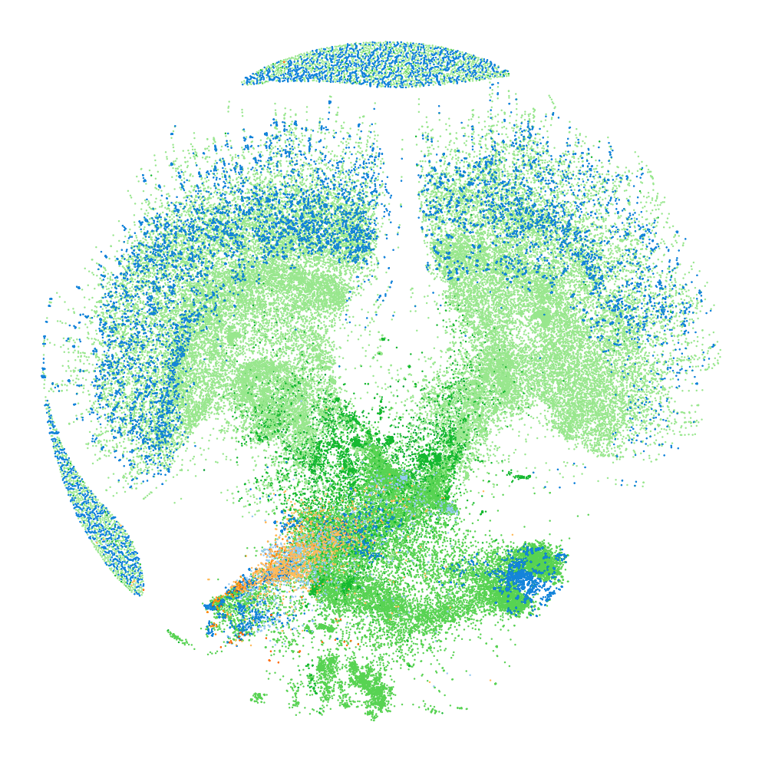



FlyGM
AIAS+ 2026 · ORAL PRESENTATION
Whole-Brain Connectomic Graph Model for Whole-Body Locomotion Control
Zehao Jin, Yaoye Zhu, Chen Zhang, Yanan Sui
Tsinghua University · LNS Group
Demo
page
Notes:
Target time: 30 seconds.
Good morning. Our work asks a simple question: can the wiring diagram of an animal's brain be used to build a controller for its body? We study the fruit fly, because it is the one animal for which we now have both a complete brain connectome and a detailed whole-body physics simulator. FlyGM turns that connectome into the architecture of a learned controller. I will explain why this question is timely, how FlyGM works, what the results say about the value of the real wiring, and where this could go next.

Slide 2
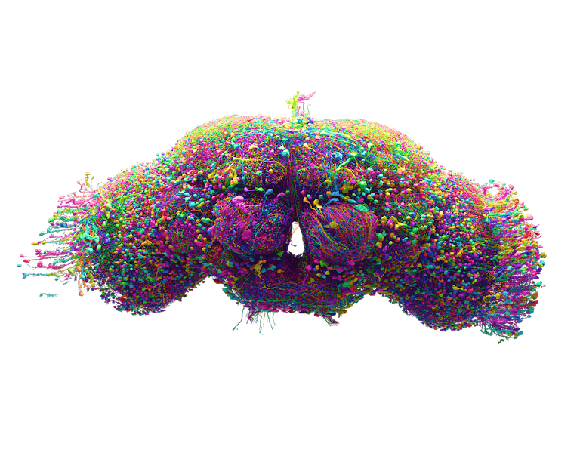
The fly brain and the fly body are now both digital
WHY NOW
2024
FlyWire: a complete adult brain
Synapse-resolution wiring diagram of one female fly, proofread by a global community [2, 3]
2024
Connectome-constrained models
Predict visual-system activity [5] and whole-brain sensorimotor responses [4]
2025
flybody: a whole-body fly in physics
Anatomically detailed MuJoCo body; learned controllers walk and fly [7]; see also NeuroMechFly v2 [6]
2026
Male CNS: brain + nerve cord
139,255
54.5 M
8,453
166,700 neurons, brain and ventral nerve cord joined at the neck [8]
neurons
synapses
cell types
Brain rendering: FlyWire [2]. Statistics: FlyWire v783 [2, 3]; male CNS v1.0 release [8].
#
Notes:
Target time: 60 seconds.
Why now? In 2024 the FlyWire consortium published the first complete wiring diagram of an adult brain: an adult female fruit fly, 139,255 neurons, about 54.5 million synapses, and more than eight thousand annotated cell types. Within months, connectome-constrained models showed that this wiring can predict neural activity in the visual system and sensorimotor responses across the brain.
At the same time, the body became digital too. flybody, published in Nature in 2025, provides an anatomically detailed fly in the MuJoCo physics engine, with learned controllers that walk and fly; NeuroMechFly v2 is a complementary platform. And this year the male central nervous system connectome added the ventral nerve cord, the fly's equivalent of the spinal cord.
So, for the first time, one animal has both a complete brain map and a whole-body simulator. The obvious next question is how to connect them.

Slide 3



Can a wiring diagram, by itself, drive a body?
THE 2026 DEBATE
WHAT WENT VIRAL
WHAT THE WIRING DIAGRAM LEAVES OUT
“We’ve uploaded a fruit fly.”
Synaptic strength and sign in vivo
Eon Systems, March 2026 [9]
The connectome gives possible paths, not how strongly neurons actually influence each other [12].
A connectome-based LIF brain model [4] coupled to a NeuroMechFly body [6]: it walks, grooms and feeds.
Neuron dynamics
“No, we haven’t uploaded a fly yet.”
Emulations assume simplified, largely uniform neuron models for very different cell types [4].
A. Zeleznikow-Johnston, LessWrong, March 2026 [10]
Asks for evidence beyond a video: data, a write-up, known neural signatures.
The interface to the body
“Deconstructing viral fly sims”
In the demo, a few hand-picked neurons drive the body model's built-in locomotion and feeding controllers [9, 11].
P. Mineault, NeuroAI, 2026 [11]
Most of the behavior comes from the body model's built-in controllers, not the connectome.
OPEN QUESTION
How should a connectome control a whole body?
Public discussion summarized from the sources cited; quotes are headlines of [9–11].
#
Notes:
Target time: 60 seconds.
This combination has already caught the public imagination. In March 2026, the startup Eon Systems announced "We've uploaded a fruit fly": a connectome-based leaky integrate-and-fire brain model, from Shiu and colleagues, coupled to the NeuroMechFly body. The video of a virtual fly walking, grooming and feeding went viral.
The response from neuroscientists was quick. Essays such as "No, we haven't uploaded a fly yet" and Patrick Mineault's "Deconstructing viral fly sims" pointed out what the wiring diagram leaves out. First, synapse counts tell us which paths exist, not how strongly neurons influence each other in the living animal; that is the effectome argument of Pospisil and colleagues. Second, the neuron models are simplified. Third, and most relevant for us, the interface to the body: according to Eon's own write-up, a few hand-picked descending neurons switch pre-built walking, grooming and feeding programs in the body model.
So the open question is not whether we have the wiring. It is how a connectome should be used to control a whole body.

Slide 4
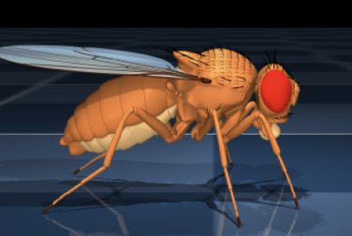
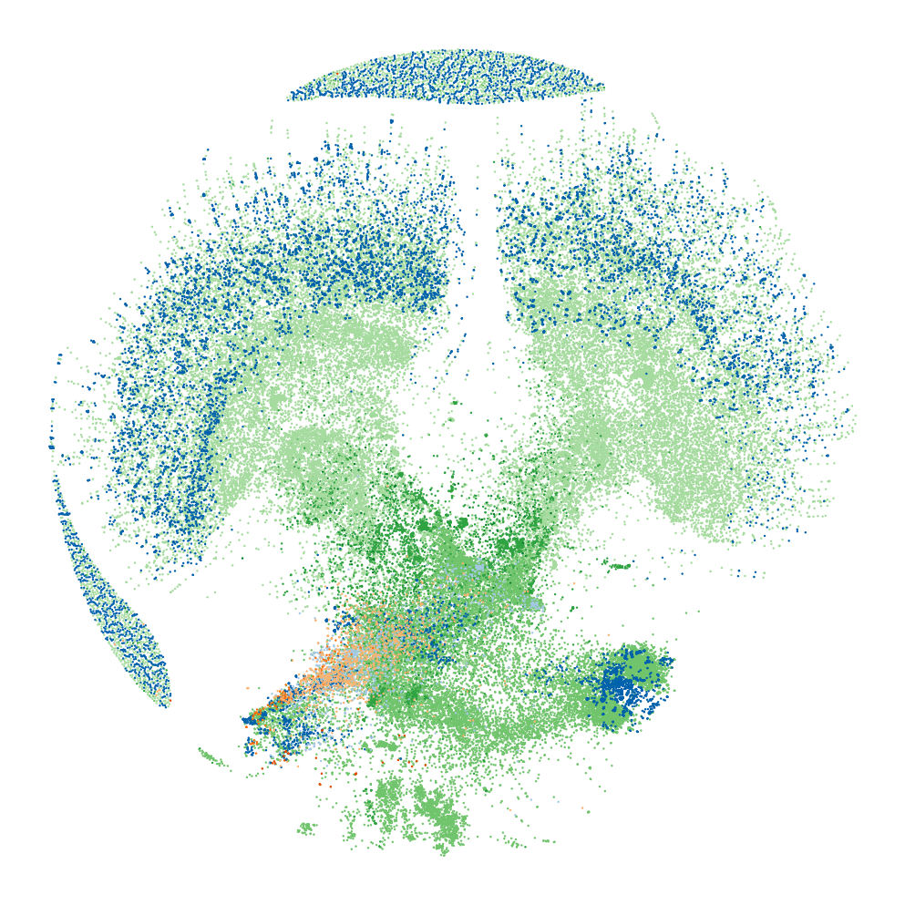



FlyGM: use the wiring as the controller's architecture
OUR APPROACH
Emulate the wiring
Learn a generic network
FlyGM (ours)
+ Biological connectome, no training
− Generic neuron models
− Body control handed to built-in controllers
+ Realistic whole-body walking and flight
− Architecture unrelated to the brain
− Hard to relate to biological circuits
+ Motor commands pass through the 139k-neuron connectome
+ Trained end-to-end on whole-body tasks
→ Tests whether real wiring helps
e.g. [4, 9]
e.g. flybody [7]
RESEARCH QUESTION
Can whole-brain wiring serve as a useful structural prior for whole-body control?
Images: FlyWire brain [2]; flybody fly model [7]; FlyGM force-directed connectome layout [1].
#
Notes:
Target time: 60 seconds.
There are two common ways to connect a brain map to behavior. The first is to emulate the wiring: put a simple spiking neuron at every node and run it. This keeps the biology and needs no training, but the neuron models are generic, and the body is usually driven by hand-designed controllers. The second is to learn a generic controller with deep reinforcement learning. flybody does this very well, producing realistic walking and flight, but the network is a multilayer perceptron with no relation to the brain.
FlyGM sits in between. We keep the wiring as the architecture: every motor command flows through the 139-thousand-neuron connectome. But we let learning supply what the connectome does not specify, and we train the whole system end to end on whole-body tasks. This framing gives us a clean scientific question: can whole-brain connectivity serve as a useful structural prior for whole-body control? And because the architecture is explicit, we can test it against controls with the same size but different wiring.

Slide 5
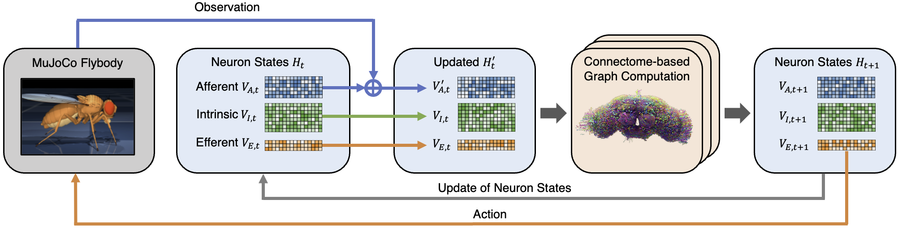
FlyGM closes the sensorimotor loop
METHOD
1
Observe
2
Propagate and update
3
Act
Proprioception, touch and binocular vision (1,253-D) are encoded and injected into afferent neurons.
Messages flow along the synapses of ~139k neurons, M = WH; a shared MLP updates each neuron with its own descriptor.
Efferent states are decoded into 59 actuator commands for legs, adhesion, head and abdomen in MuJoCo.
FlyGM [1]: Fig. 1 and §2.1. Walking configuration shown; flight uses a 104-D input and 12 actions. Simulator: flybody [7] in MuJoCo [14].
#
Notes:
Target time: 60 seconds.
Here is the full loop. At every control step, the simulated fly produces an observation: proprioception, touch and, for walking, binocular vision; 1,253 numbers in total. A light encoder compresses this observation and injects it into the afferent, or input-facing, neurons of the connectome.
Information then propagates along the real synapses. Each neuron aggregates the states of its presynaptic partners through the connectome weight matrix, M equals W times H, and a shared update network, conditioned on a learned descriptor for that neuron, computes its new state. This is repeated for four message-passing layers.
Finally, the efferent, or output-facing, neurons are decoded into 59 actuator commands for the legs, adhesion pads, head and abdomen. The body moves in MuJoCo, and the next observation closes the loop. The important design choice is that the connectome determines which neurons can communicate; the encoder, decoder and update rule are learned.

Slide 6
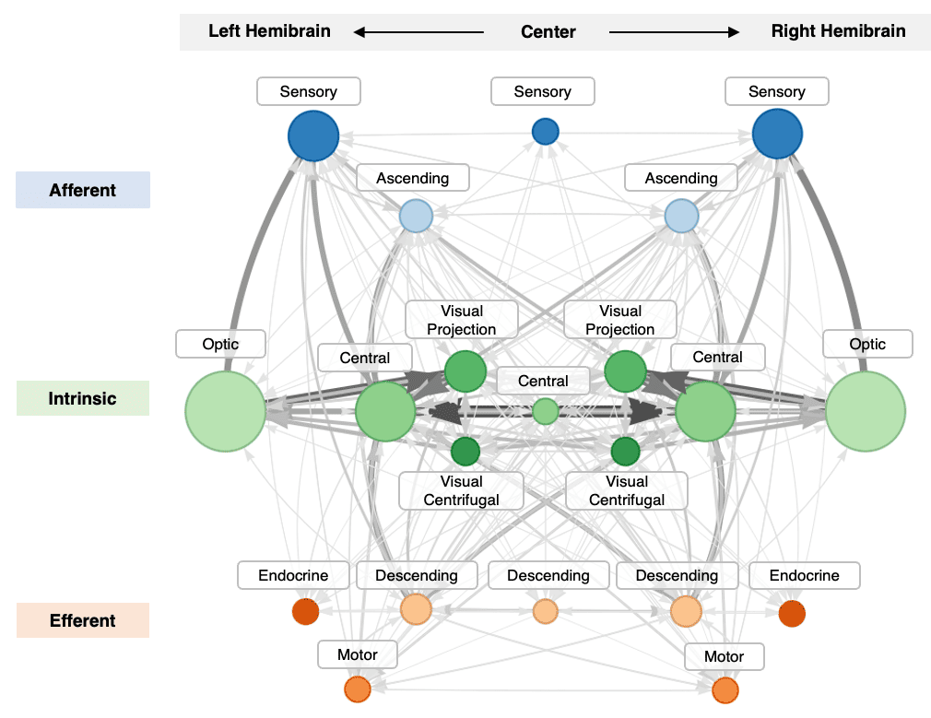
The wiring is fixed; the computation is learned
METHOD
FIXED from the connectome
Directed topology: who can talk to whom
Signed weights: W_{vu} = N_{exc} − N_{inh} (ACh, DA +; GABA, Glu, 5-HT, OA −) [12, 13]
Flow types: afferent → intrinsic → efferent
LEARNED by training
Observation encoder and action decoder
Per-neuron descriptor η_{v} (e.g. excitability, gain)
Shared state-update network f_{ψ}
FlyWire neurons grouped by superclass and flow type; edges show aggregated synapse counts.
M_{t} = W H_{t} H_{t+1} [v] = f_{ψ}( M_{t} [v] ‖ η_{v} )
FlyGM [1]: §2.1 and Appendix E. Latent states are learned vectors, not firing rates; signed weights are a modeling convention.
#
Notes:
Target time: 50 seconds.
It helps to separate what is fixed from what is learned. Fixed, from the connectome: the directed topology, meaning who can talk to whom; an approximate signed weight for every connection, computed as excitatory minus inhibitory synapse counts using neurotransmitter predictions from electron microscopy; and FlyWire's partition into afferent, intrinsic and efferent neurons. The figure on the left shows this structure aggregated by superclass.
Learned, by training: the observation encoder and action decoder, a descriptor for every neuron that can capture properties such as excitability or gain that the connectome does not record, and one shared update network.
Two caveats keep the claim precise. The latent states are learned vectors, not measured firing rates. And the signed weights are a modeling convention, not a receptor-level account of physiology. FlyGM is a connectome-structured policy; its biological fidelity is a separate question.

Slide 7
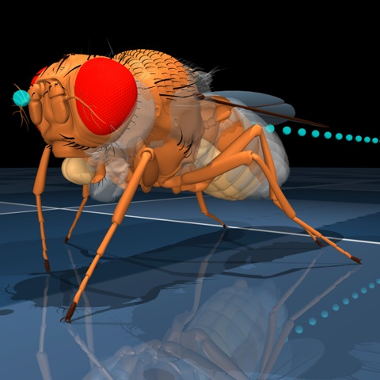
Imitation gives a head start; PPO refines it
TRAINING
1
2
Expert behavior
Imitation learning
FlyGM policy
PPO refinement
Task interaction
flybody MLP policy [7]; rollouts kept if > 100 steps
Match the expert's action distribution: KL + annealed MSE
Connectome-structured controller, initialized
Optimize task reward in MuJoCo [15]; MLP value network, parallel rollouts
Walking, turning and flight tasks
Same IL + PPO pipeline for every controller we compare
Walking and flight use separately trained policies
FlyGM [1]: §2.2 and Appendix B. Expert policies and environments from flybody [7].
#
Notes:
Target time: 50 seconds.
Training has two stages. First, we roll out the existing flybody expert, an MLP policy, and keep successful episodes longer than one hundred steps. FlyGM is trained to match the expert's action distribution with a KL objective plus an annealed mean-squared-error term. This gives the connectome-structured policy stable walking and flight quickly.
Second, we fine-tune with proximal policy optimization on the task reward in MuJoCo, using an MLP value network and parallel rollouts, so the policy can improve beyond the demonstrations.
Two points matter for interpreting the results. Every controller we compare goes through exactly the same imitation-plus-PPO pipeline, so the comparisons isolate the architecture. And walking and flight are separately trained policies; we do not claim one policy switches between them.

Slide 8
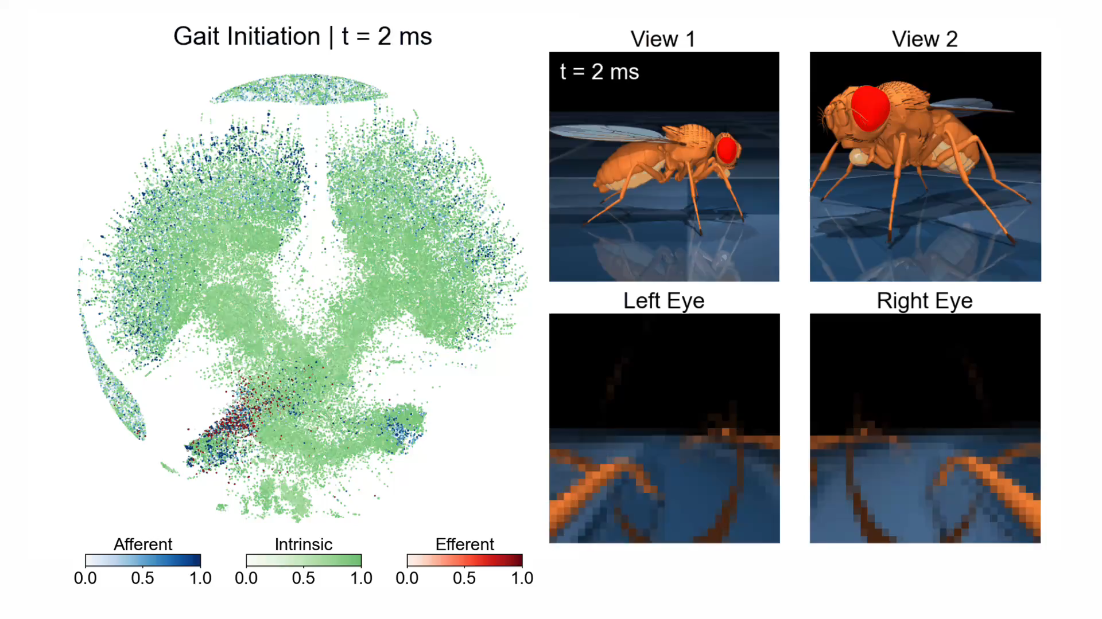
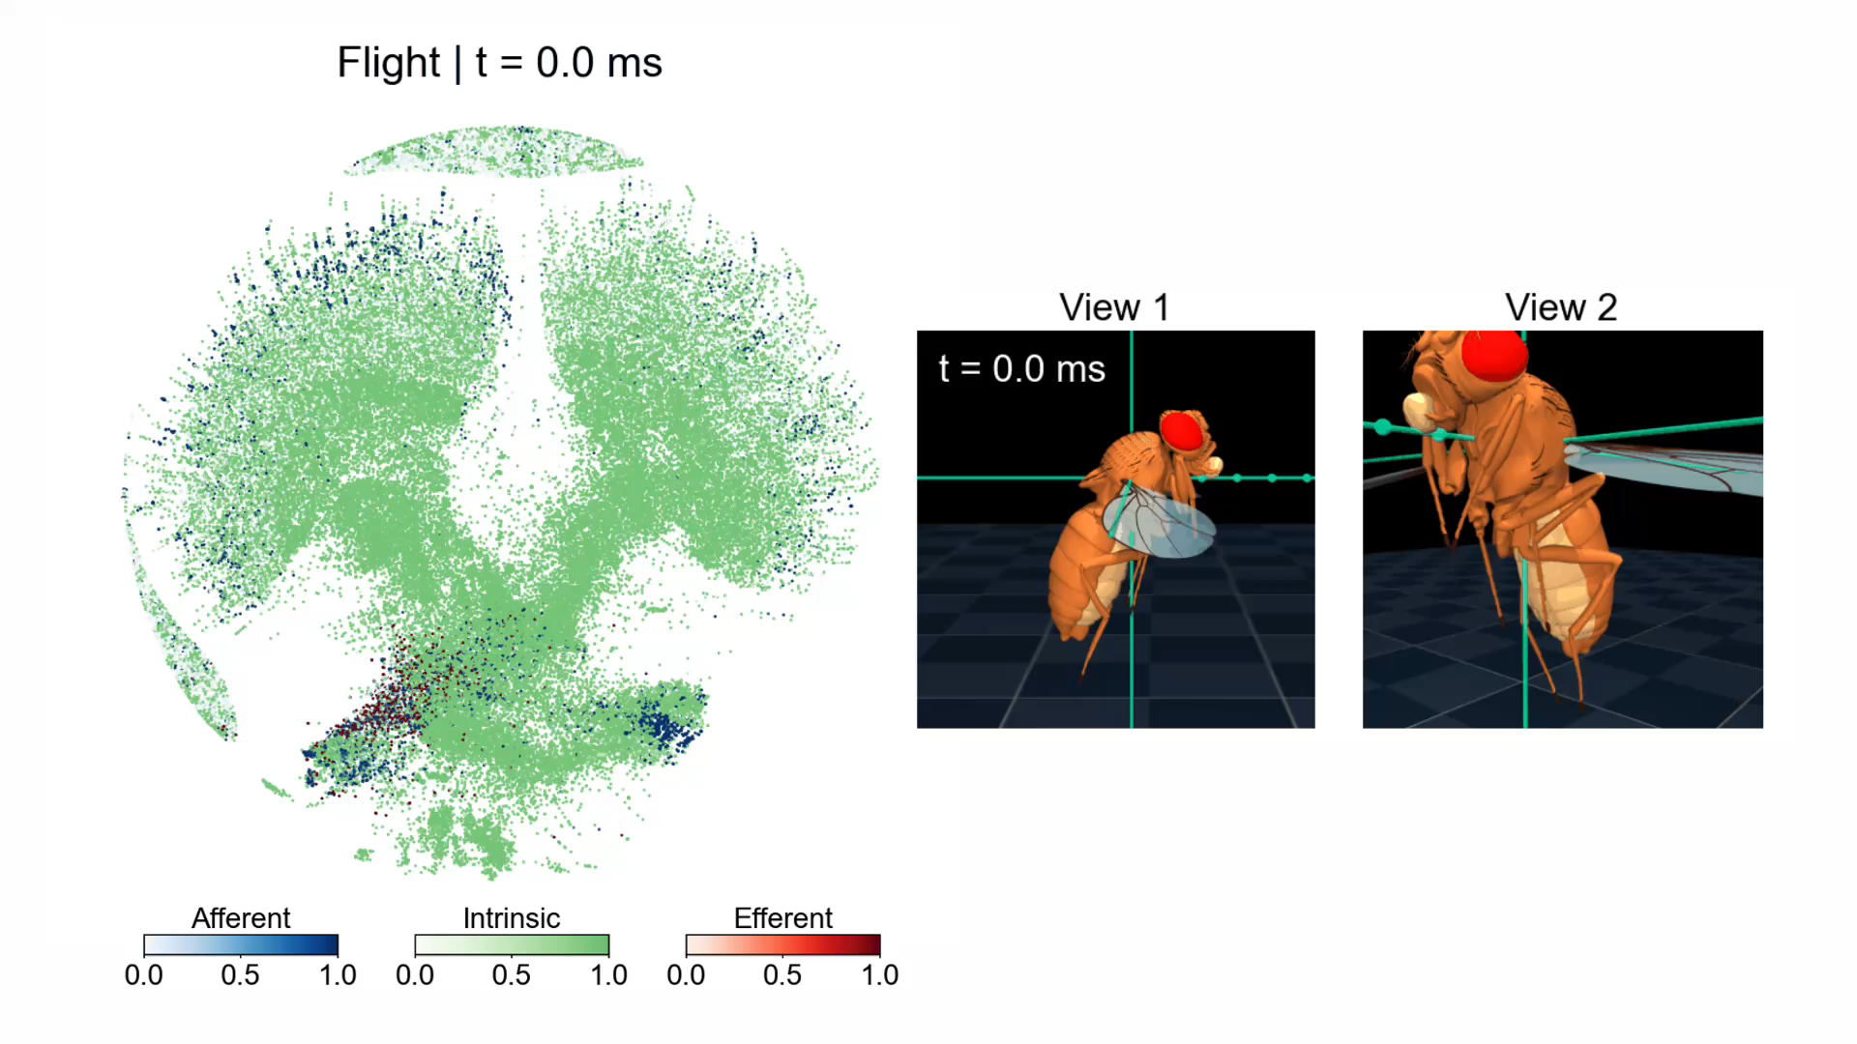
FlyGM drives coordinated walking, turning and flight
BEHAVIOR
Walking policy
Flight policy (trained separately)
Gait onset ≈ 80 ms
Tripod gait 3 cm/s
Turns 10 rad/s
Forward flight 20 cm/s
Wing-beat generator modulation
Click a video to play. Playback is slowed for viewing; read the simulation timestamps.
FlyGM [1]: §3.2, Figs. 3–4. Left panels: force-directed connectome layout with afferent, intrinsic and efferent activity.
#
Notes:
Target time: 60 seconds.
Before the numbers, here is what the policies do. On the left is the walking policy. From rest, it initiates a gait within roughly the first 80 milliseconds, irregular steps quickly giving way to rhythmic stepping. During straight walking at 3 centimeters per second it produces the classic alternating tripod gait, and it turns at 10 radians per second by shortening the strides on the inner side, without any turn-specific rules.
On the right is a separately trained flight policy. It modulates the wing-beat pattern generator to keep stable forward flight at 20 centimeters per second while holding the body aligned with the target direction.
In both videos, the left panel shows the connectome in a force-directed layout, colored by afferent, intrinsic and efferent activity. The layout reflects connectivity, not the physical anatomy. The videos are slowed down, so the simulation timestamps are the right timescale. The next question is whether the specific wiring is what makes this work.

Slide 9
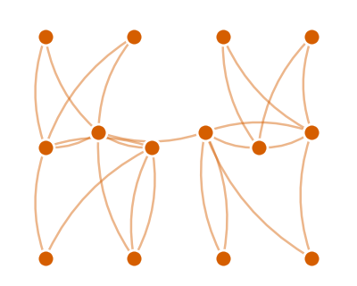
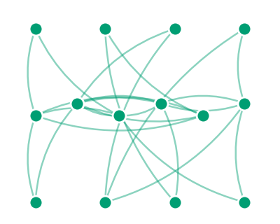
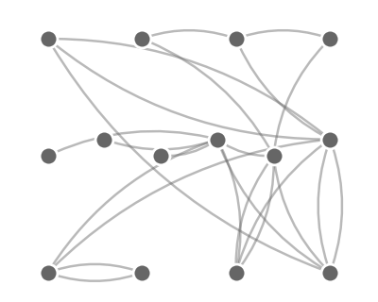
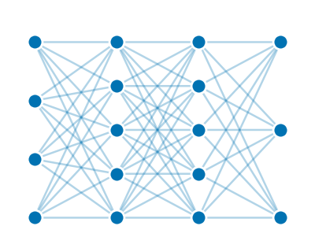
The real wiring learns faster and steers more accurately
RESULTS · DOES THE WIRING MATTER?
FlyGM
DP-Rewired
ER-Random
MLP
Real FlyWire wiring with signed weights
Same in/out-degree per neuron, shuffled partners
Same numbers of neurons and edges
4 × 512 layers; more parameters than FlyGM
Imitation: error to the expert's actions
After IL + PPO: heading-angle error (°)
125 ↑
Lowest error in all 4 conditions
22–39% below the best baseline
2.6× fewer updates
FlyGM reaches the MLP's final error after ~9k of 23k steps
FlyGM [1]: Fig. 2a (one training trace per model, EMA) and Table 1 (10 evaluation rollouts of a fixed checkpoint; v in cm/s, ψ in rad/s).
#
Notes:
Target time: 90 seconds.
This is the central result. To test whether the specific wiring matters, we compare FlyGM with three controls, color-coded at the top. A degree-preserving rewiring keeps every neuron's number of inputs and outputs but shuffles its partners. An Erdos-Renyi random graph keeps only the number of neurons and edges. And an MLP has no graph at all, with more parameters than FlyGM. All four go through the identical imitation-plus-PPO pipeline.
On the left is imitation learning: the error between each model's actions and the expert's, on a log scale. FlyGM drops fastest and ends lowest. A simple way to read it: FlyGM reaches the MLP's final error after about nine thousand of the twenty-three thousand updates, roughly 2.6 times fewer. Both rewired and random graphs lag throughout.
On the right is control after the full pipeline: heading-angle error across speeds and turning rates. FlyGM has the lowest error in every condition, 22 to 39 percent below the best baseline. The gap grows with turning rate: at 7 radians per second the rewired graph has 13.6 degrees and the random graph fails with 125 degrees, against 8.3 for FlyGM.
Two honest caveats: the training curves are one trace per model, and the error bars come from ten evaluation rollouts of one checkpoint, not from independently trained seeds.

Slide 10
The gain holds up under ablations and GNN baselines
RESULTS · WHAT DRIVES THE GAIN?
Generic GNN layers fall short
Five standard GNNs on the same FlyWire neurons: average reward after IL + PPO
Every connectome variant beats the controls
Ablations at the hardest condition (v = 3 cm/s, ψ = 7 rad/s): angle error (°)
2.3× the reward of the best standard GNN (PNA). A spiking network with the MLP layout never learns a stable gait.
Topology carries most of the prior; signed weights help most where control is hardest (8.3° vs 11.0° unweighted).
FlyGM [1]: Tables 2–4 (Appendix). GNNs [16–20] use the largest width and depth that fit one A100 80 GB; reward table repetitions not verified.
#
Notes:
Target time: 50 seconds. Optional slide: skip if short on time.
Two follow-up questions. First, is the gain simply from using a graph neural network? On the left, we put five standard GNN layers, GCN, EdgeCNN, GraphSAGE, GAT and PNA, on the same FlyWire neurons and the same pipeline. None comes close: FlyGM earns 2.3 times the reward of the best one. A spiking network with the MLP layout never learns a stable gait. A caveat: the GNNs were sized to the largest configuration that fits one A100, so some are narrower than FlyGM.
Second, which part of FlyGM matters? On the right are ablations at the hardest condition, fast turning. Removing signed weights or per-neuron descriptors costs accuracy, and signed weights help most here: 8.3 versus 11.0 degrees. But every connectome variant, even unweighted and without descriptors, stays below the rewired graph and the MLP. That points to the topology itself as the main source of the prior.

Slide 11
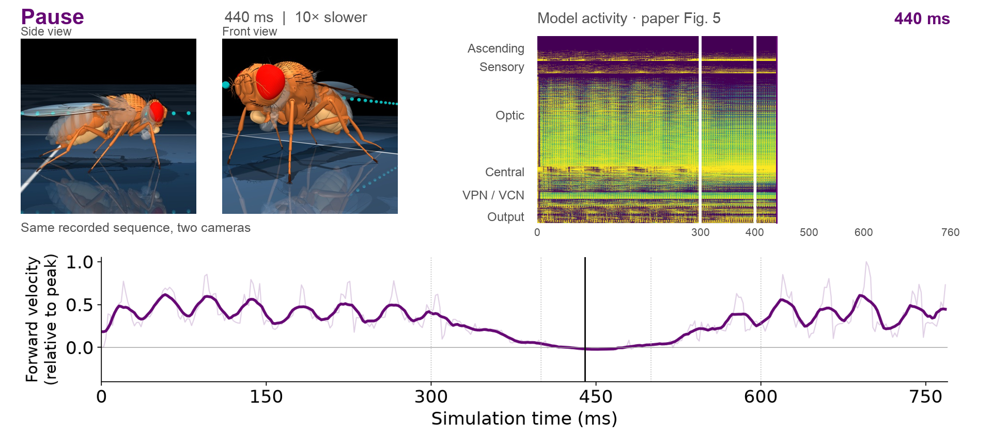
One rollout links walking, pausing and turning
INSIDE THE MODEL
Original rollout: 0–768 ms · click to play at 10× slow motion · illustrative archived recording; activity panel from FlyGM [1] Fig. 5.
#
Notes:
Target time: 75 seconds.
This composite recording shows two synchronized camera views and the measured forward-velocity signal below. The sequence covers 0 to 768 milliseconds of simulation time and plays ten times slower for inspection. Notice the velocity approaching zero during the pause, followed by renewed motion and the turn. The upper-right panel reveals the published Figure 5 neural representation from left to right using a white mask, with its own millisecond counter and time-axis labels. The mask follows the presentation clock across the published 0–760 ms axis; the archived movie continues to 768 ms. This is a presentation animation of the published model-activity image, not a new analysis or measured EEG. It uses the paper’s PCA processing and is not recalculated from this archived recording. We discuss this figure on the next slide. The archived illustrative rollout has 139,246 recorded nodes and two state channels, rather than the final quantitative experiment’s 32-channel checkpoint. Source: THU_A100 /data/jzh/Documents/flygnn_v2/neuro_rollout.pkl; submission31_revised, Figure 5. Time alignment uses record indices at 2 ms per step. Cameras follow the environment step while observations precede it, giving a possible 2 ms offset. The lower trace shows forward velocity normalized to its absolute peak; the bold line uses an 11-sample (22 ms) moving average.

Slide 12
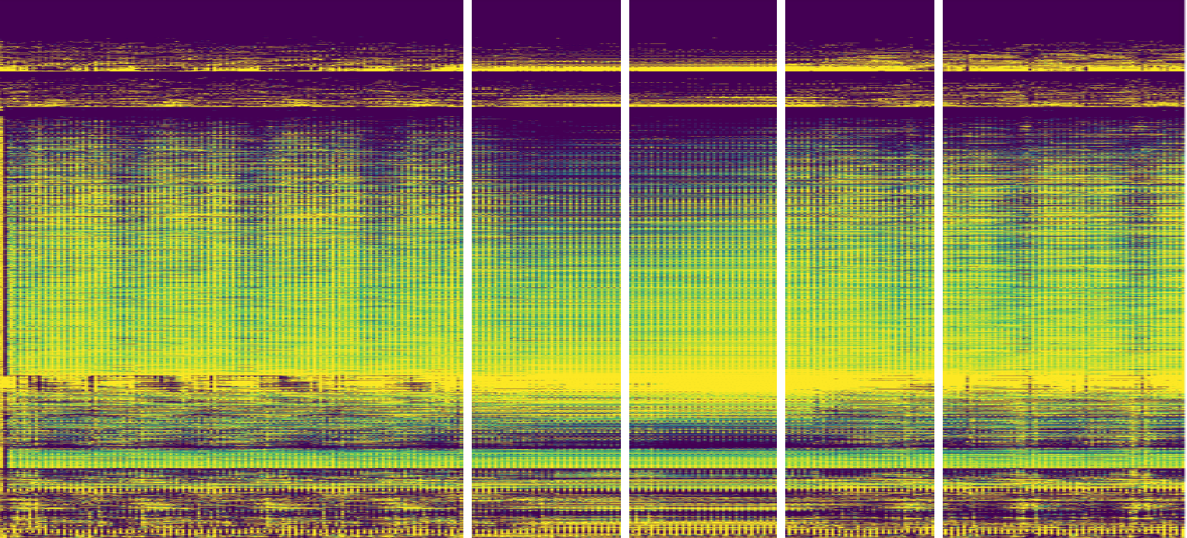
Latent responses differ across neuron classes
INSIDE THE MODEL
Walk
Slow down
Pause
Speed up
Turn
Ascending
PCA
intensity
Sensory
1
Optic
Central
VPN / VCN
0
Output classes
0
150
300
450
600
750
ms
Qualitative latent structure; physiological correspondence remains untested
FlyGM [1]: Fig. 5 and Appendix F (PCA, class grouping, within-class ordering); random-graph control in Fig. 8. Cf. [21, 22].
#
Notes:
Target time: 60 seconds.
The same sequence lets us inspect the model’s internal representations. The visualization compresses the multichannel state with PCA, groups neurons by superclass, and orders similar responses together within each class. The resulting patterns differ across classes and phases. A random-graph control processed with the same pipeline shows less clear class-wise differentiation. This is suggestive evidence that wiring shapes the learned computation. However, it is qualitative. Grouping, normalization and sorting all affect what is easy to see. We do not have a quantitative segregation test or validation against recorded neural activity here. I would describe the result as structured latent dynamics, rather than biological function recovered from anatomy. Source: submission31_revised, Figure 5 and representation-analysis appendix.

Slide 13
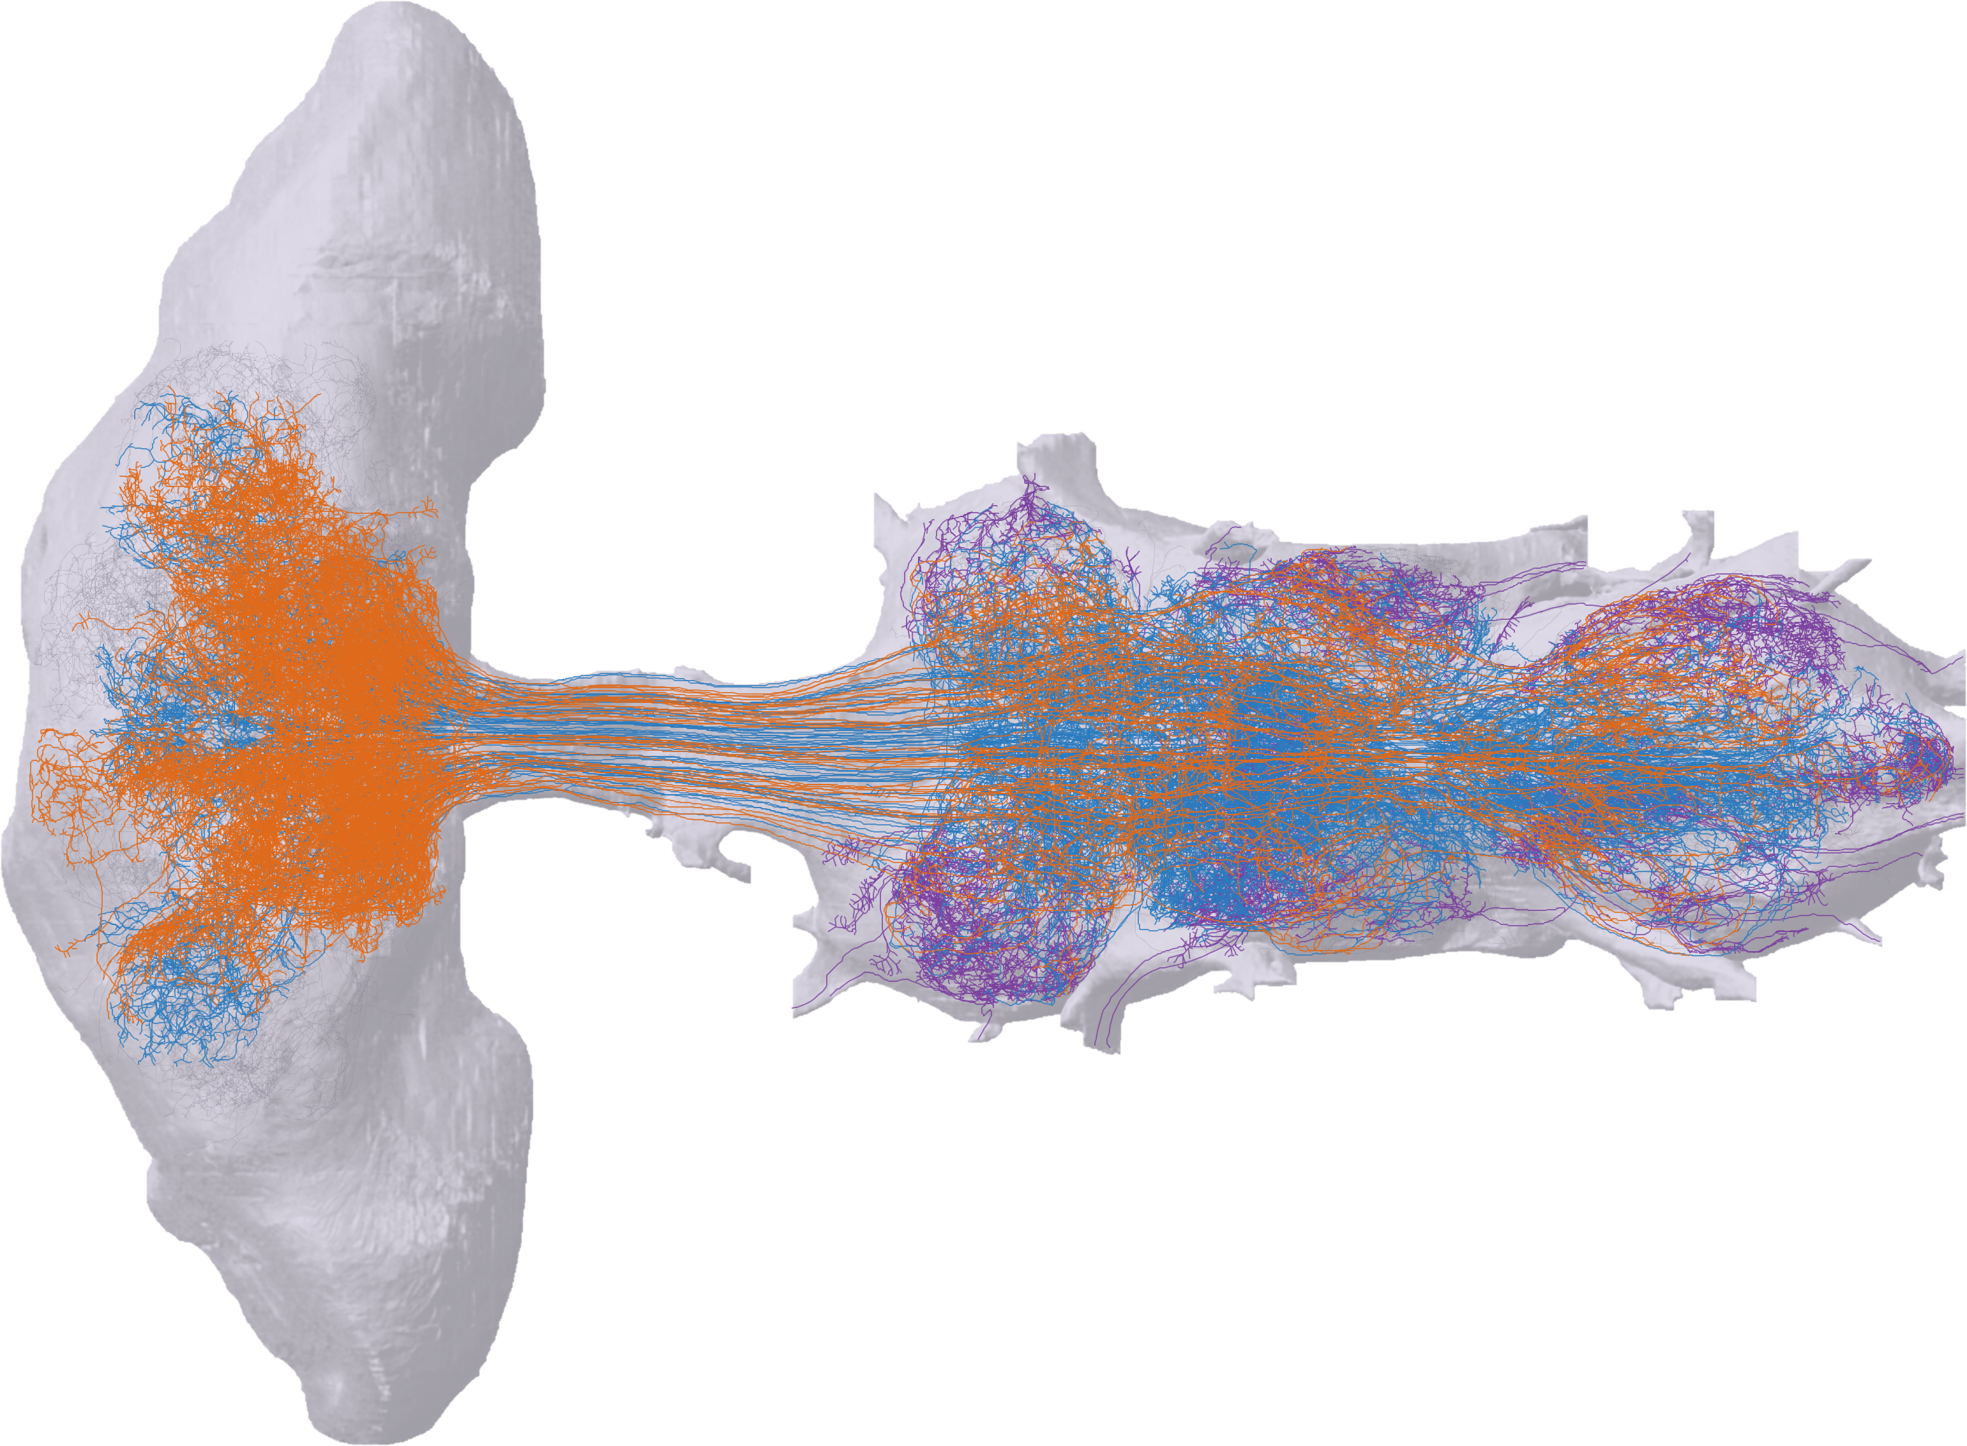
Next: from a brain-only graph to brain + nerve cord
OUTLOOK
BRAIN
166,700
VENTRAL NERVE CORD
neurons in the first complete male central nervous system: brain and ventral nerve cord [8]
1,314 descending · 1,846 ascending neurons
NECK
WHAT IT WOULD ADD TO FLYGM
Real premotor and motor circuits between descending neurons and the legs
Ascending feedback from legs and wings through measured pathways
Richer annotations: updated synapses [23], sex-specific cell types [24]
Next tests longer sequences · perturbation recovery · navigation
Descending (brain → VNC)
Ascending (VNC → brain)
VNC motor neurons
Outlook, not a FlyGM result. Rendered from the public FlyEM male CNS v1.0 release: brain/VNC shells and ~280 sampled neurons [8].
#
Notes:
Target time: 50 seconds.
Where next? FlyGM currently uses the female brain connectome. The brain does not control the legs directly: descending neurons send commands through the neck to the ventral nerve cord, where premotor and motor circuits generate the actual leg and wing movements. In FlyGM, that last step is played by a learned decoder.
This image is rendered from the public male CNS release published this year: the brain on the left, the ventral nerve cord on the right, joined at the neck. In orange are a sample of the 1,314 descending neurons, in blue ascending neurons that carry feedback from the body back to the brain, and in purple motor neurons. The full dataset has 166,700 neurons.
For FlyGM, this would replace part of the learned decoder with measured premotor and motor wiring, and route body feedback through real ascending pathways. Together with updated synapse detections and sex-specific annotations, it would let us test connectome-based control on longer sequences, recovery from perturbations, and navigation. These are directions, not results.

Slide 14



Brain wiring is a useful prior for whole-body control
TAKEAWAYS
1
2
3
Wiring as architecture
The real wiring matters
Structured dynamics
The 139k-neuron FlyWire graph becomes a trainable whole-body controller for walking, turning and flight.
Faster imitation and lower steering error than rewired, random and MLP controls; 2.3× the reward of standard GNNs.
Neuron classes show distinct, behavior-locked latent patterns that a random graph lacks (qualitative).
Not an upload, but a testable, connectome-structured controller.
Open: biological fidelity of the learned dynamics · learning without demonstrations · other bodies and simulators
FlyGM [1]. Comparisons use the shared IL + PPO pipeline; representation analysis is qualitative (Appendix H).
#
Notes:
Target time: 45 seconds.
To summarize. First, a whole-brain connectome can serve as the architecture of a controller: FlyGM turns the 139-thousand-neuron FlyWire graph into a trainable policy that walks, turns and flies a detailed simulated body. Second, the real wiring matters: under the same training pipeline it learns faster and steers more accurately than rewired, random and MLP controls, and than five standard GNNs. Third, its internal dynamics are structured by neuron class, which a random graph does not show, though this analysis is qualitative.
To come back to the debate: this is not an upload of a fly. It is something more modest but testable, a connectome-structured controller whose assumptions are explicit. What remains open is the biological fidelity of the learned dynamics, learning without expert demonstrations, and transfer to other bodies and simulators.

Slide 15
Thank you
STILLS FROM THE DEMO VIDEOS
Questions are welcome.
SEE THE DEMOS
lnsgroup.cc/research/FlyGM
Gait initiation and walking
Flight
Walking, turning and flight videos with live connectome activity.
Zehao Jin, Yaoye Zhu,
Chen Zhang, Yanan Sui
Tsinghua University · LNS Group
Walk → pause → turn, with model activity
Notes:
Target time: 15 seconds.
Thank you. The demo page, at lnsgroup.cc slash research slash FlyGM, has the walking, turning and flight videos with live connectome activity; the QR code links there. I am happy to take questions.

Slide 16
References and resources
BACKUP
DEMO PAGE
lnsgroup.cc/research/FlyGM
PAPER (PREPRINT)
arXiv:2602.17997
CONNECTOME DATA
codex.flywire.ai · male-cns.janelia.org
BODY SIMULATOR
github.com/TuragaLab/flybody
[1] Z. Jin, Y. Zhu, C. Zhang, Y. Sui. Whole-brain connectomic graph model enables whole-body locomotion control in fruit fly. AIAS+ 2026; arXiv:2602.17997.
[2] S. Dorkenwald et al. Neuronal wiring diagram of an adult brain. Nature 634, 124–138 (2024).
[3] P. Schlegel et al. Whole-brain annotation and multi-connectome cell typing of Drosophila. Nature 634, 139–152 (2024).
[4] P. K. Shiu et al. A Drosophila computational brain model reveals sensorimotor processing. Nature 634, 210–219 (2024).
[5] J. K. Lappalainen et al. Connectome-constrained networks predict neural activity across the fly visual system. Nature 634, 1132–1140 (2024).
[6] S. Wang-Chen et al. NeuroMechFly v2: simulating embodied sensorimotor control in adult Drosophila. Nat. Methods 21, 2353–2362 (2024).
[7] R. Vaxenburg et al. Whole-body physics simulation of fruit fly locomotion. Nature 643, 1312–1320 (2025).
[8] S. Berg et al. Sexual dimorphism in the complete connectome of the Drosophila male central nervous system. Cell 189, 5504–5526 (2026).
[9] Eon Systems. “We’ve uploaded a fruit fly”; “How the Eon team produced a virtual embodied fly”. eon.systems/updates (Mar 2026).
[10] A. Zeleznikow-Johnston. No, we haven’t uploaded a fly yet. LessWrong (Mar 2026).
[11] P. Mineault. Deconstructing viral fly sims. NeuroAI, neuroai.science (2026).
[12] D. A. Pospisil et al. The fly connectome reveals a path to the effectome. Nature 634, 201–209 (2024).
[13] N. Eckstein et al. Neurotransmitter classification from electron microscopy images at synaptic sites in Drosophila melanogaster. Cell 187, 2574–2594 (2024).
[14] E. Todorov, T. Erez, Y. Tassa. MuJoCo: a physics engine for model-based control. IROS, 5026–5033 (2012).
[15] J. Schulman et al. Proximal policy optimization algorithms. arXiv:1707.06347 (2017).
[16] T. N. Kipf, M. Welling. Semi-supervised classification with graph convolutional networks. ICLR (2017).
[17] Y. Wang et al. Dynamic graph CNN for learning on point clouds. ACM Trans. Graph. 38, 1–12 (2019).
[18] W. Hamilton, Z. Ying, J. Leskovec. Inductive representation learning on large graphs. NeurIPS 30 (2017).
[19] P. Veličković et al. Graph attention networks. ICLR (2018).
[20] G. Corso et al. Principal neighbourhood aggregation for graph nets. NeurIPS 33, 13260–13271 (2020).
[21] B. E. Brezovec et al. Mapping the neural dynamics of locomotion across the Drosophila brain. Curr. Biol. 34, 710–726 (2024).
[22] E. S. Schaffer et al. The spatial and temporal structure of neural activity across the fly brain. Nat. Commun. 14, 5572 (2023).
[23] S.-C. Yu et al. New synapse detection in the whole-brain connectome of Drosophila. bioRxiv (2025).
[24] D. Deutsch et al. Sexually-dimorphic neurons in the Drosophila whole-brain connectome. Research Square (2025).
#
Notes:
Backup slide.
Numbered references cited on the slides. [1] is our paper; the demo page is lnsgroup.cc/research/FlyGM. [9]-[11] are the 2026 public discussion of the Eon Systems fly demo. GNN baselines [16]-[20] correspond to GCN, EdgeCNN (DGCNN), GraphSAGE, GAT and PNA. The male CNS rendering on the outlook slide was produced from the public FlyEM v1.0 release (gs://flyem-male-cns).

