Slide 1



FlyGM
Whole-Brain Connectomic Graph Model
for Whole-Body Locomotion Control
Zehao Jin, Yaoye Zhu, Chen Zhang, Yanan Sui
AIAS+ 2026
Notes:
Target time: 30 seconds.
Good morning. Our work asks whether a map of an animal’s brain can help us design a controller for its body. We study the fruit fly, where a whole-brain wiring diagram and a detailed biomechanical simulator are both available. FlyGM uses that wiring diagram to structure a learned policy. I will first explain what the connectome gives us, then show the control results, and finish with the opportunities and limits of this approach.

Slide 2
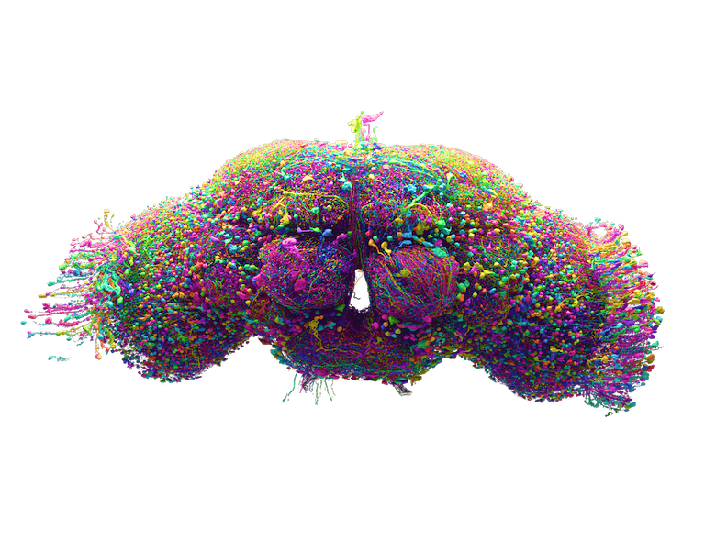
FlyWire maps an adult fly brain
139,255
neurons
54.5 million
synapses
Connectome = neurons and their directed connections
Dorkenwald et al., Nature (2024) • Adult female brain
2
Notes:
Target time: 70 seconds.
A connectome is a wiring diagram: neurons are the nodes, and synaptic connections are the directed edges. FlyWire reconstructed the brain of an adult female fruit fly at synaptic resolution. The published reconstruction contains 139,255 neurons and about 54.5 million synapses. Electron microscopy supplies the images, computational reconstruction traces the cells, and extensive proofreading improves the map. This is unusually useful for embodied intelligence because the same small animal can walk, turn and fly. But a wiring diagram is a structural description. It does not tell us the complete dynamics of each neuron, the state of the animal, or how to turn incoming observations into appropriate movement. That gap is the starting point of FlyGM. Source: Dorkenwald et al., Nature 634, 124–138 (2024), https://doi.org/10.1038/s41586-024-07558-y. Brain rendering reused from supplied FlyGM presentation.

Slide 3
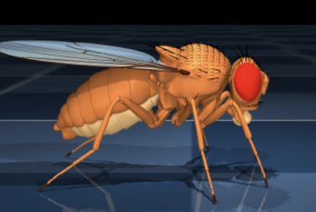
Can brain wiring improve a learned controller?
Anatomical wiring
Embodied control
Use connectivity to constrain the policy architecture
FlyGM, AIAS revised manuscript • flybody: Vaxenburg et al. (2025)
3
Notes:
Target time: 50 seconds.
Our research question is deliberately computational: can whole-brain connectivity provide a useful architectural prior for movement control? We connect two resources. On one side is the biological wiring diagram. On the other is flybody, a physics-based model of the fly in MuJoCo. The controller must transform observations into coordinated actions, receive the resulting sensory feedback, and repeat. We do not assume that anatomy alone solves control. Instead, anatomy constrains the routes of computation, while learning supplies the transformations needed for the task. This lets us test the contribution of wiring using structural controls. Source: AIAS submission31_revised, Introduction and Method; flybody, Vaxenburg et al. (2025).

Slide 4
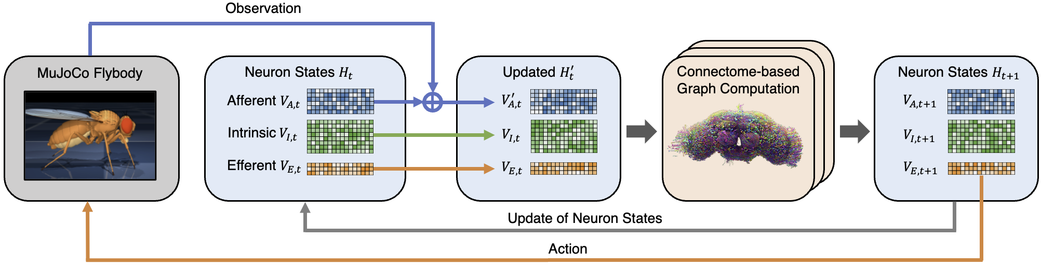
FlyGM closes the sensorimotor loop
Observe
Propagate and update
Act
FlyGM, revised manuscript, Fig. 1 • Encoder, graph dynamics and decoder are learned components
4
Notes:
Target time: 75 seconds.
Here is the complete loop. An encoder compresses the observation and injects it into afferent, or input-facing, neurons. Directed connections then propagate information through the network. A shared update function transforms the incoming messages, conditioned on a learned descriptor for each neuron. Finally, a decoder reads the efferent, or output-facing, states and produces continuous motor actions for the body. The body moves in the simulator and supplies the next observation. The afferent, intrinsic and efferent partition gives the graph an explicit input-to-output organization. The important design choice is that the connectome determines which neurons can communicate. The rest of the architecture makes that structure usable as a trainable controller. Source: submission31_revised, Figure 1 and Section 2.1.

Slide 5
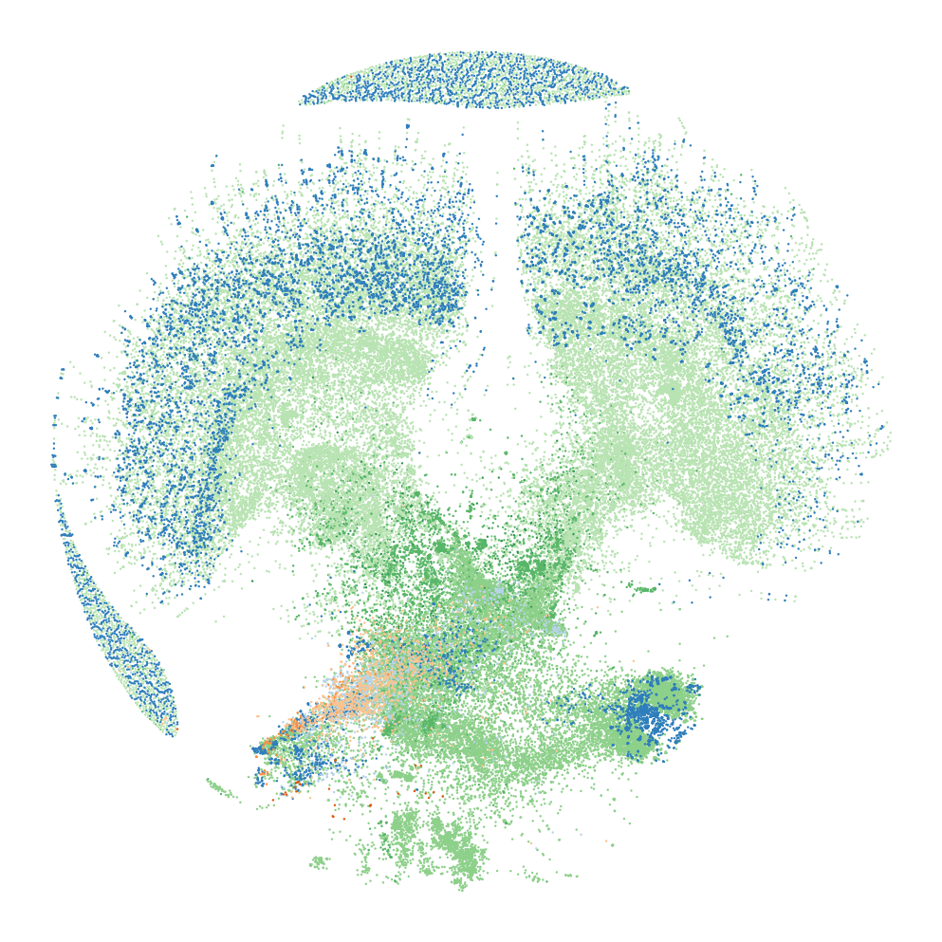
Biological wiring constrains learned dynamics
Fixed routing
Directed connectivity
Approximate signed weights
Learned transformations
Encoder and decoder
Neuron descriptors
Shared state update
M = W H
FlyGM, Section 2.1 • Graph layout represents connectivity, not physical anatomy
5
Notes:
Target time: 60 seconds.
It helps to separate what is fixed from what is learned. The directed topology comes from the connectome. Synapse counts and neurotransmitter annotations supply an approximate signed-weight convention. The observation encoder, per-neuron descriptors, shared state update and action decoder are trainable. The central operation is a sparse weighted aggregation: each node receives a combination of its presynaptic partners’ latent states. Those states are learned vectors, not measured firing rates. Likewise, the signed weights are a modeling convention, not a receptor-specific account of physiology. This distinction makes the claim precise: FlyGM is a connectome-structured policy, and its biological computational fidelity remains a separate question. Source: submission31_revised, Section 2.1.

Slide 6
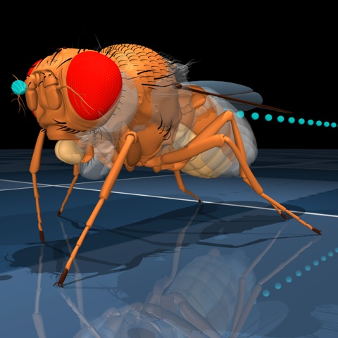
Expert imitation initializes control; PPO refines it
Expert behavior
FlyGM policy
Task interaction
1 Imitation learning
2 PPO refinement
Match expert action distributions
Improve actions through task rewards
FlyGM, Section 2.2 • Separate walking and flight policies; common pipeline for comparisons
6
Notes:
Target time: 60 seconds.
The training pipeline has two stages. First, we roll out the existing flybody expert and train the student policy to match its action distribution. This is imitation learning, using a KL objective with an annealed regularizer. Second, we refine the controller with proximal policy optimization, or PPO, using task rewards from the simulator. We apply the same pipeline when comparing architectures. This matters for interpreting the results: the demonstrations already contain behavioral information. We are testing how effectively different policy structures use that information and subsequent reinforcement learning. Walking and flight use separate trained policies with different interfaces. We are not claiming that a single policy switches between walking and flight. Source: submission31_revised, Section 2.2 and Appendix training details.

Slide 7
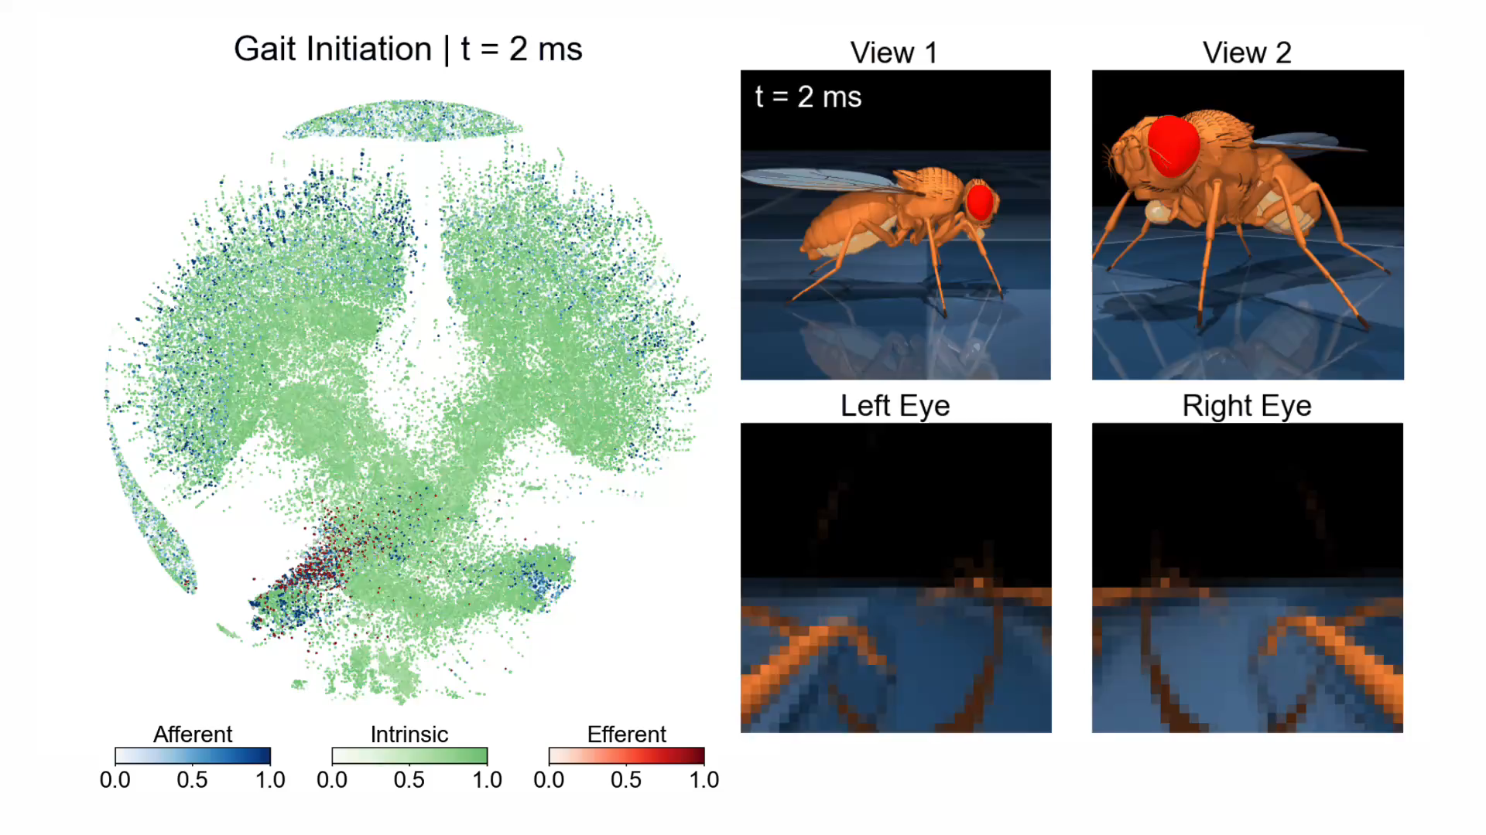
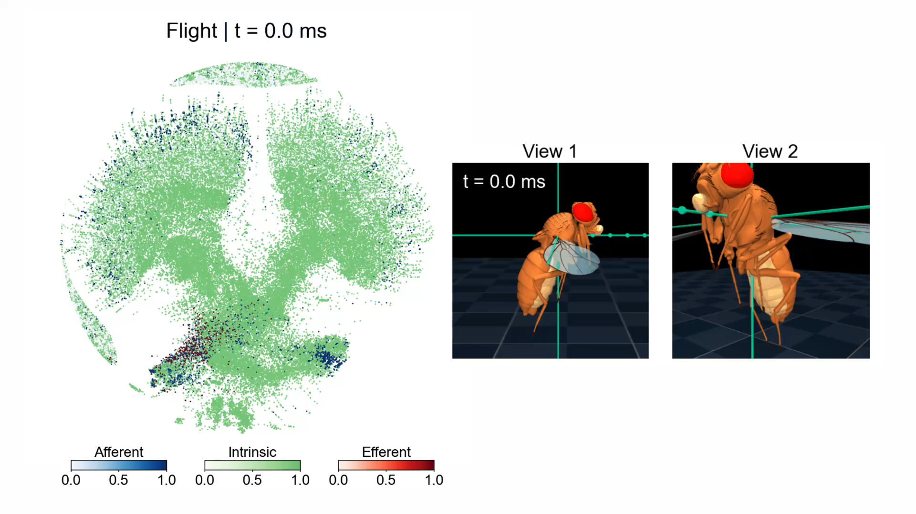
The policies generate coordinated locomotion
Walking, gait initiation and turns
Flight: separate policy
Click either demonstration to play
FlyGM locomotion demonstrations • Slow-motion playback; see simulation timestamps
7
Notes:
Target time: 75 seconds.
Let me show the behaviors before the numerical comparisons. The walking policy initiates a gait, maintains straight walking, and turns. The paper reports gait initiation within roughly the first 80 milliseconds and coordinated tripod-like stepping during walking. A separately trained flight policy stabilizes and steers the flying model. The demonstrations pair the moving body with a visualization of the graph’s latent states. The graph layout is a force-directed view of connectivity, not the physical geometry of the brain. The videos are slowed for viewing, so the simulation timestamps are the appropriate timescale. These examples establish that the policy can drive a detailed articulated body. The next question is whether the specific wiring improves performance. Source: submission31_revised, Section 3.2. Videos reused from supplied presentation, audio removed.

Slide 8
Structural controls test the contribution of wiring
Controller | What the control retains
FlyGM | Biological connections
Degree-preserving rewiring | In-degree and out-degree
Random graph | Node and edge counts
MLP | Larger parameter count
Shared training pipeline; unweighted FlyGM tests topology
FlyGM, Section 3.1 and ablation appendix
8
Notes:
Target time: 55 seconds.
We compare FlyGM with three important alternatives. Degree-preserving rewiring retains each neuron’s incoming and outgoing connection counts, while changing its partners. The random graph retains the numbers of nodes and edges. The MLP removes the graph structure and has more parameters than FlyGM. Graph models use the same latent dimension, and all use the same imitation-plus-PPO training pipeline. The non-connectome graphs use unit edge weights. Therefore the weighted comparison alone does not isolate topology perfectly. The unweighted FlyGM ablation is particularly informative: it retains the real topology while removing signed synaptic weights. Together, these controls ask whether the identity of connections matters beyond graph size or degree counts. Source: submission31_revised, Section 3.1 and edge-weight ablations.

Slide 9
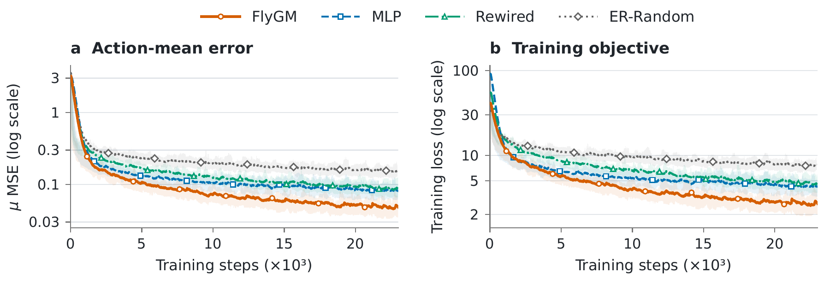
FlyGM matches the expert in fewer updates
Fewer gradient updates during imitation learning
FlyGM, Fig. 2 • One trace/model; bands show local fluctuations, not across-seed uncertainty
10
Notes:
Target time: 60 seconds.
The imitation-learning traces provide a complementary view. FlyGM reaches a lower action-mean error and training objective, and does so in fewer gradient updates than the non-connectome baselines. Both vertical axes are logarithmic, which makes the early training phase visible. These are recorded traces, one per model. The bands show local fluctuations within each trace, not uncertainty across training seeds. So the supported statement is faster convergence during imitation learning. We should not turn that into a claim about fewer online environment interactions or shorter wall-clock training. The graph itself is more expensive per step than an MLP. The advantage demonstrated here concerns how the architecture fits the expert under the specified pipeline. Source: submission31_revised, Figure 2 and plotting-protocol appendix.

Slide 10
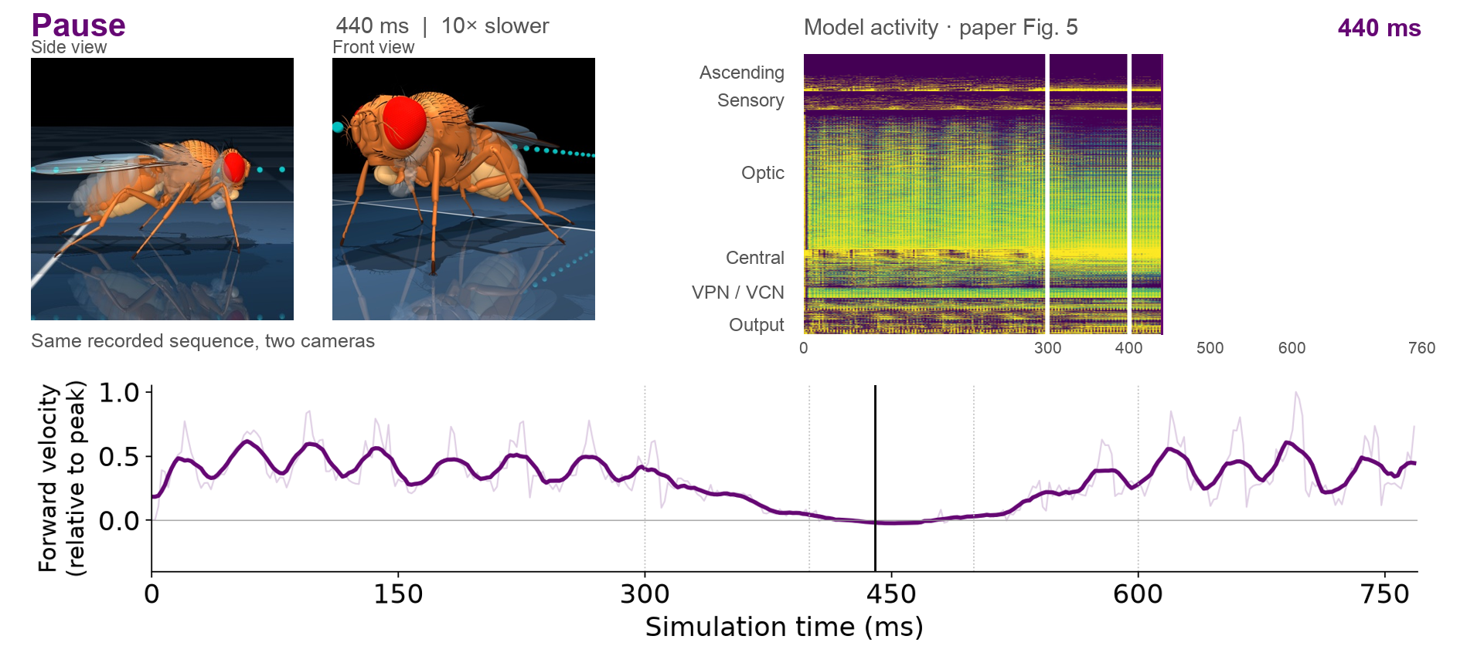
One rollout links walking, pausing and turning
Original rollout: 0–768 ms • Click to play at 10× slow motion • Illustrative archived recording
11
Notes:
Target time: 75 seconds.
This composite recording shows two synchronized camera views and the measured forward-velocity signal below. The sequence covers 0 to 768 milliseconds of simulation time and plays ten times slower for inspection. Notice the velocity approaching zero during the pause, followed by renewed motion and the turn. The upper-right panel reveals the published Figure 5 neural representation from left to right using a white mask, with its own millisecond counter and time-axis labels. The mask follows the presentation clock across the published 0–760 ms axis; the archived movie continues to 768 ms. This is a presentation animation of the published model-activity image, not a new analysis or measured EEG. It uses the paper’s PCA processing and is not recalculated from this archived recording. We discuss this figure on the next slide. The archived illustrative rollout has 139,246 recorded nodes and two state channels, rather than the final quantitative experiment’s 32-channel checkpoint. Source: THU_A100 /data/jzh/Documents/flygnn_v2/neuro_rollout.pkl; submission31_revised, Figure 5. Time alignment uses record indices at 2 ms per step. Cameras follow the environment step while observations precede it, giving a possible 2 ms offset. The lower trace shows forward velocity normalized to its absolute peak; the bold line uses an 11-sample (22 ms) moving average.

Slide 11
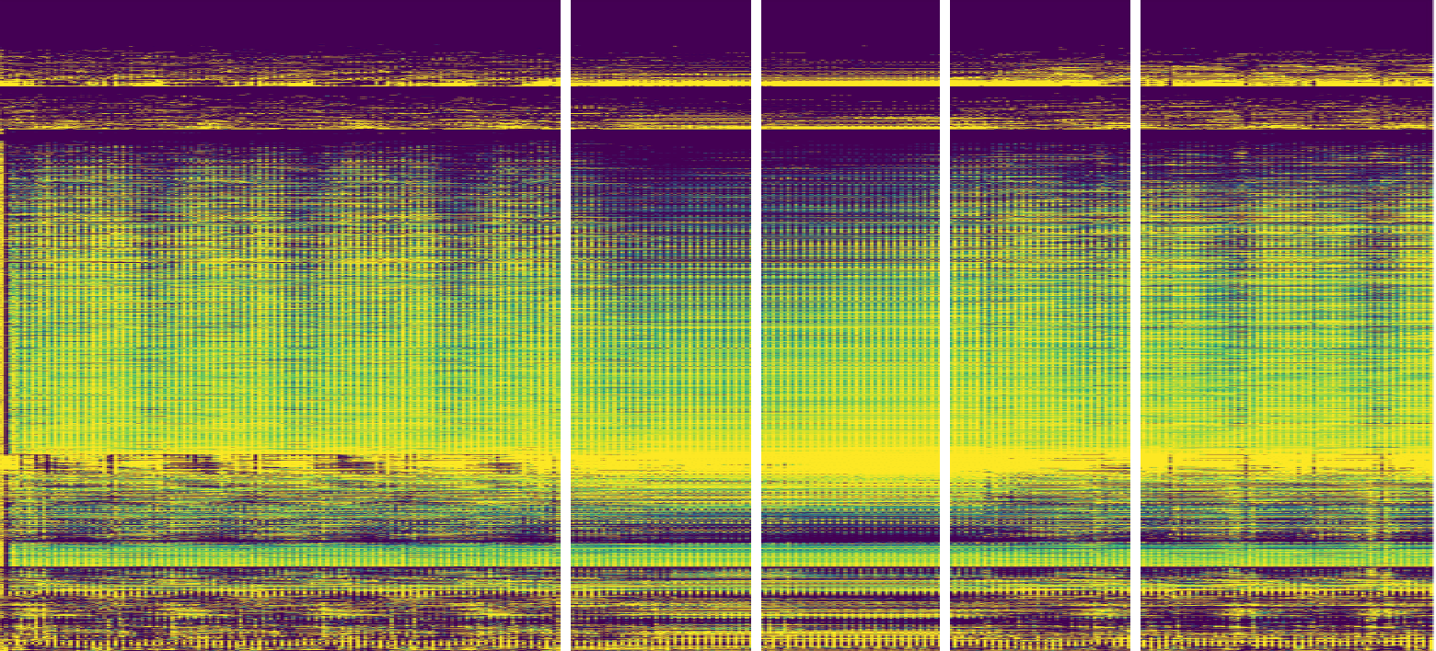
Latent responses differ across neuron classes
Walk
Slow down
Pause
Speed up
Turn
Ascending
PCA
intensity
Sensory
1
Optic
Central
VPN / VCN
0
Output classes
0
150
300
450
600
750
ms
Qualitative latent structure; physiological correspondence remains untested
FlyGM, Fig. 5 • PCA, class grouping and within-class ordering
12
Notes:
Target time: 60 seconds.
The same sequence lets us inspect the model’s internal representations. The visualization compresses the multichannel state with PCA, groups neurons by superclass, and orders similar responses together within each class. The resulting patterns differ across classes and phases. A random-graph control processed with the same pipeline shows less clear class-wise differentiation. This is suggestive evidence that wiring shapes the learned computation. However, it is qualitative. Grouping, normalization and sorting all affect what is easy to see. We do not have a quantitative segregation test or validation against recorded neural activity here. I would describe the result as structured latent dynamics, rather than biological function recovered from anatomy. Source: submission31_revised, Figure 5 and representation-analysis appendix.

Slide 12
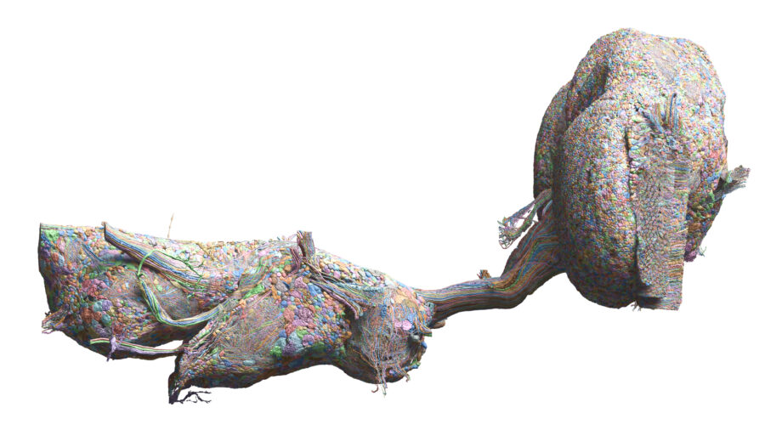
Male CNS opens a route to brain-and-cord models
Brain + ventral
nerve cord
More complete
sensorimotor wiring
Next tests: longer sequences, recovery and navigation
Outlook, not a FlyGM result • Berg et al., Cell (2026); rendering: P. Schlegel / MRC LMB
13
Notes:
Target time: 40 seconds.
A short outlook is the male central nervous system connectome. It includes the brain and ventral nerve cord linked through the neck, extending the structural resource closer to the complete sensorimotor pathway. This is relevant because much locomotor circuitry lies outside the brain itself. For FlyGM, a natural next experiment is to incorporate this more complete wiring and ask whether it improves control and its mechanistic interpretation. Another next step is to evaluate longer sequences, perturbation recovery and navigation with explicit quantitative benchmarks. These are research directions, not results established by the present paper. Source: Berg et al., Cell 189, 5504–5526.e15 (2026), https://doi.org/10.1016/j.cell.2026.08.015. Rendering: Philipp Schlegel, MRC LMB and University of Cambridge; data: FlyEM, Cambridge Connectomics, MRC LMB and Google Research.

Slide 13
Whole-brain wiring is a useful policy prior
Connectome as architecture
Whole-brain wiring supports learned whole-body control
Structural controls support a useful topology prior
Biological fidelity and longer-horizon generality remain open
Code and demos: sites.google.com/view/flygm
14
Notes:
Target time: 45 seconds.
The main takeaway is that whole-brain wiring can serve as a useful architectural prior for embodied control. FlyGM turns a static connectome into a trainable controller for coordinated movement in a simulated fly. Structural comparisons and the unweighted ablation support the contribution of topology under the shared training pipeline. The internal states also provide an organized view of learned dynamics, although their physiological meaning still needs validation. The broader opportunity is to use increasingly complete connectomes to design and test embodied models with explicit structural assumptions. Thank you. I would be happy to take questions. The project page contains the demonstration video and code. Source: submission31_revised; https://sites.google.com/view/flygm.

Slide 14
References and resources
FlyGM. Whole-Brain Connectomic Graph Model Enables Whole-Body
Locomotion Control in Fruit Fly. AIAS final revised manuscript.
Dorkenwald et al. Neuronal wiring diagram of an adult brain.
Nature 634, 124–138 (2024). doi:10.1038/s41586-024-07558-y
Vaxenburg et al. Whole-body physics simulation of fruit fly locomotion.
Nature 643, 1312–1320 (2025).
Berg et al. Sexual dimorphism in the complete Drosophila male
central nervous system connectome. Cell 189, 5504–5526.e15 (2026).
doi:10.1016/j.cell.2026.08.015
19
Notes:
Backup slide.
Primary content source: submission31_revised.pdf, AIAS final revised manuscript supplied by the authors. Author names follow the supplied original PPT, because the manuscript is anonymized. External background sources are cited on the relevant slides. Sources for extracted rollouts and media are retained in the delivery notes.

