Slide 1


Functions and Real-Life Applications
Welcome, Team Lumos, to our presentation on the fascinating world of functions! In this session, we'll explore both the mathematical elegance of functions and their profound impact on real-world applications. We will cover injective, surjective, and bijective functions, and recap the significance in computing, networking, and more. From cryptography to QR codes, we'll uncover how these abstract concepts drive tangible technologies.
SAJJAD HOSSAIN
Mr. AADIL
ID: 242-16-040
ID: 242-26-025
Presented By
TEAM LUMOS

Slide 2
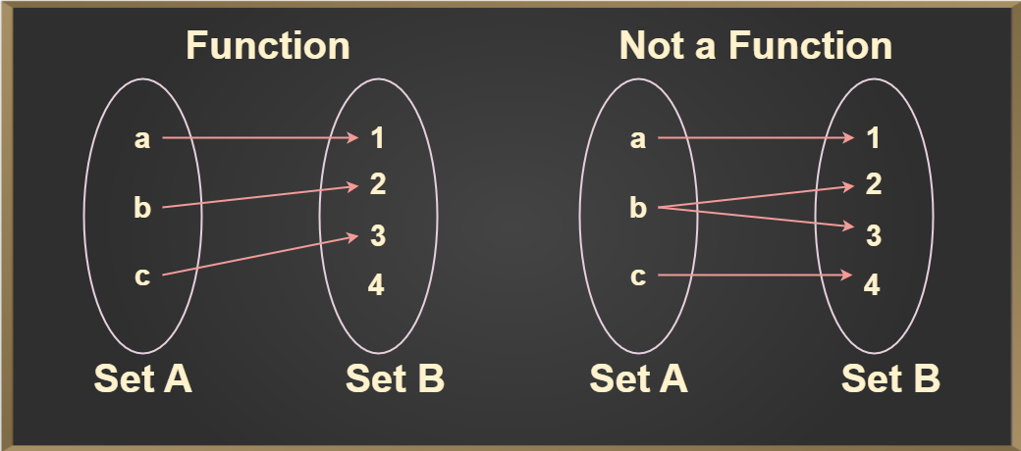
Understanding Functions Mathematically
Basic Properties
Definition
Domain: All possible input values (x).
A function is a rule that assigns each input exactly one output.
Codomain: All possible output values (y).
Range: The actual output values (y) that the function produces.
For example: y = 2x. If x = 1, y = 2; if x = 2, y = 4, etc. Each x value corresponds to only one y value.

Slide 3
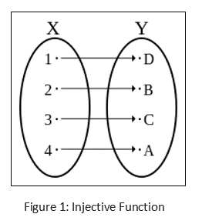
Injective Functions (One-to-One)
1
Definition
2
Mathematical Condition
3
Example
An injective function (one-to-one) ensures that different inputs always have different outputs. No two inputs map to the same output.
If f(a) = f(b), then a = b. This means if two outputs are equal, then the inputs must also be equal.
f(x) = x + 3 is an injective function. Each x gives a unique y. For instance, f(1) = 4, and no other x will produce 4.

Slide 4



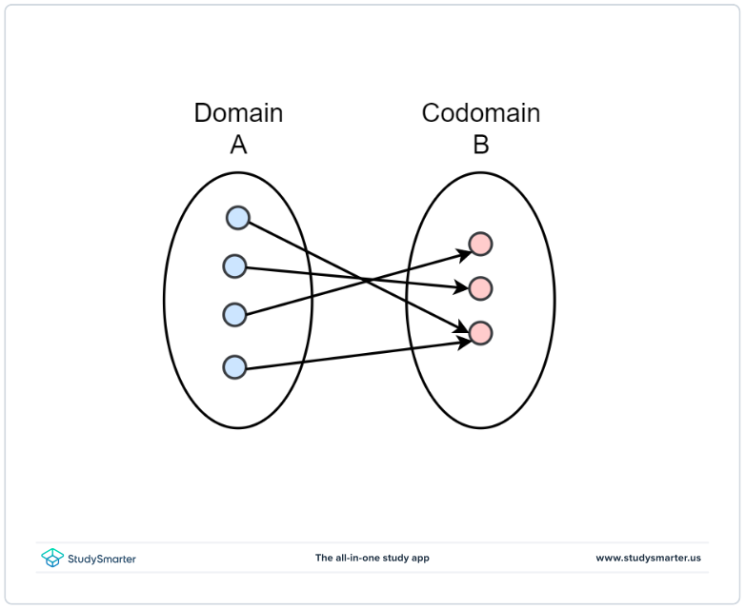
Surjective Functions (Onto)
Definition
Mathematical Condition
Example
A surjective function (onto) ensures that every element in the codomain has at least one preimage in the domain. It covers the entire codomain.
For every y in the codomain, there is an x in the domain such that f(x) = y. Every possible output is achieved.
f(x) = x² where the codomain is non-negative numbers. Every non-negative number has a square root.

Slide 5



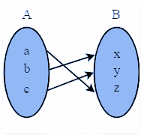
Bijective Functions (One-to-One and Onto)
Mathematical Property
Definition
A bijective function has an inverse function. This means we can reverse the mapping and go from the output back to the unique input.
A bijective function is both injective and surjective, meaning each input has a unique output and covers the entire codomain. It is a perfect one-to-one and onto mapping.
2
1
Example
f(x) = x + 1 is bijective. Each input has a unique output, and every possible output is covered. Its inverse is f⁻¹(y) = y - 1.
3

Slide 6




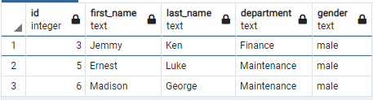
Real-Life Applications of Injective Functions
Database Indexing
Ensures unique IDs for efficient data retrieval. Each record in the database has a unique identifier, making data retrieval fast and reliable.
MAC Addressing
Every device has a unique MAC address, preventing duplication. This ensures that network communications are correctly routed to the intended device.

Slide 7

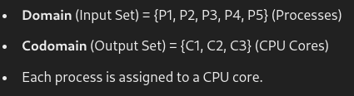
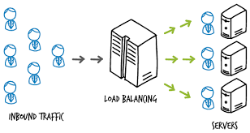
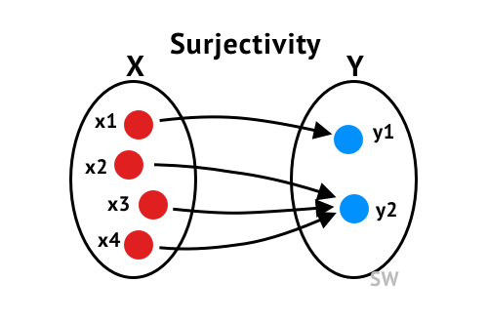
Real-Life Applications of Surjective Functions
Load Balancing :
Task Scheduling :

Slide 8

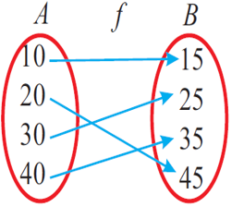
Real-Life Example of Bijective Functions
Matching Employees to Desks:
If there are 5 employees and 5 desks, and each employee is assigned to a unique desk, with no desk being assigned to more than one employee and no desk left empty, this is a bijective function:
Injective: No employee shares a desk.
Surjective: Every desk is occupied by one employee.

Slide 9

Q/ A

Slide 10
THANK YOU !

