Slide 1

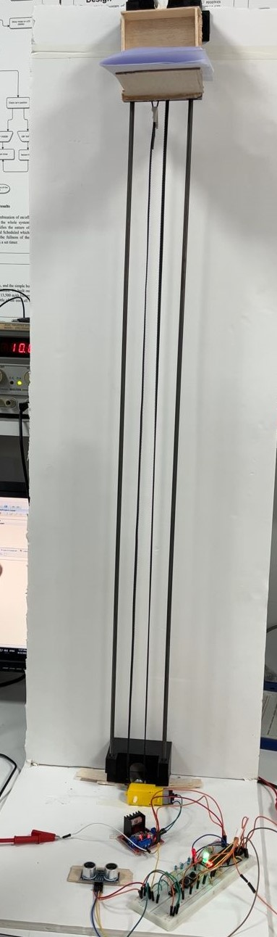
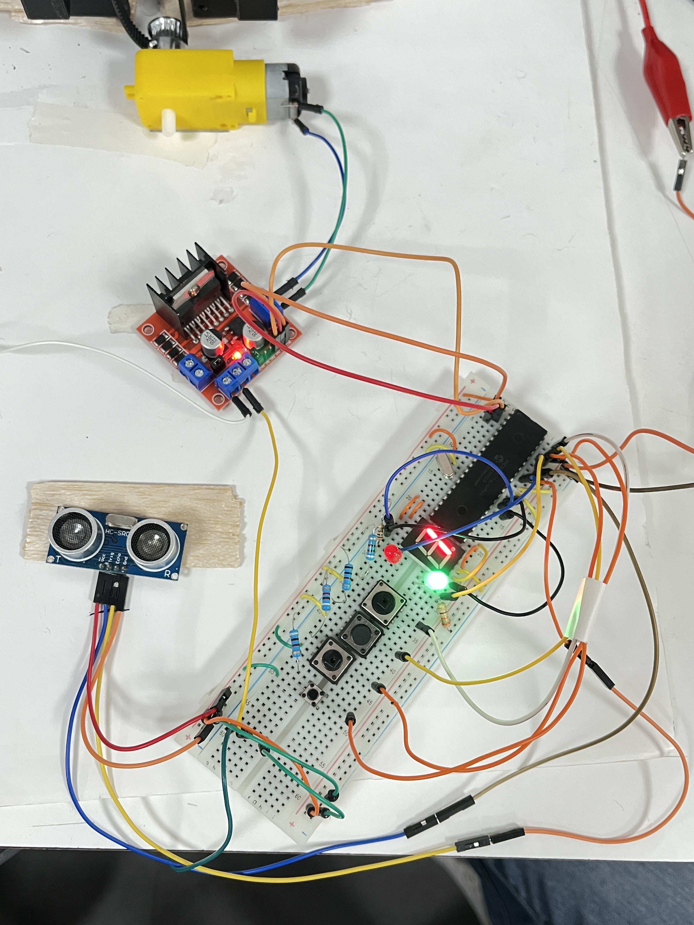
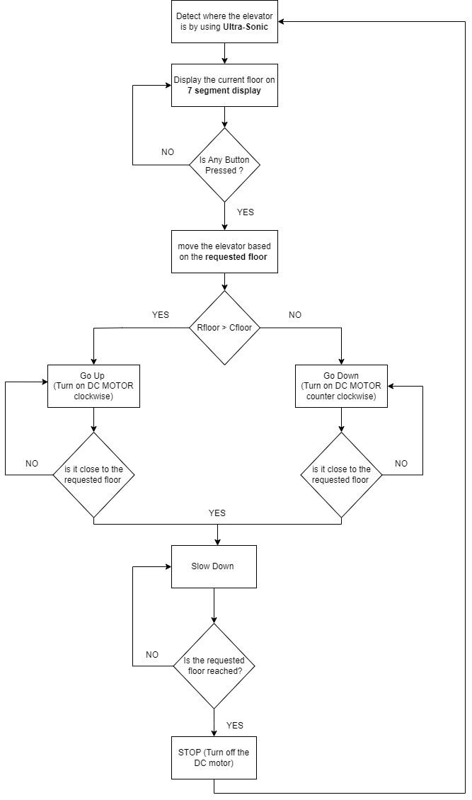
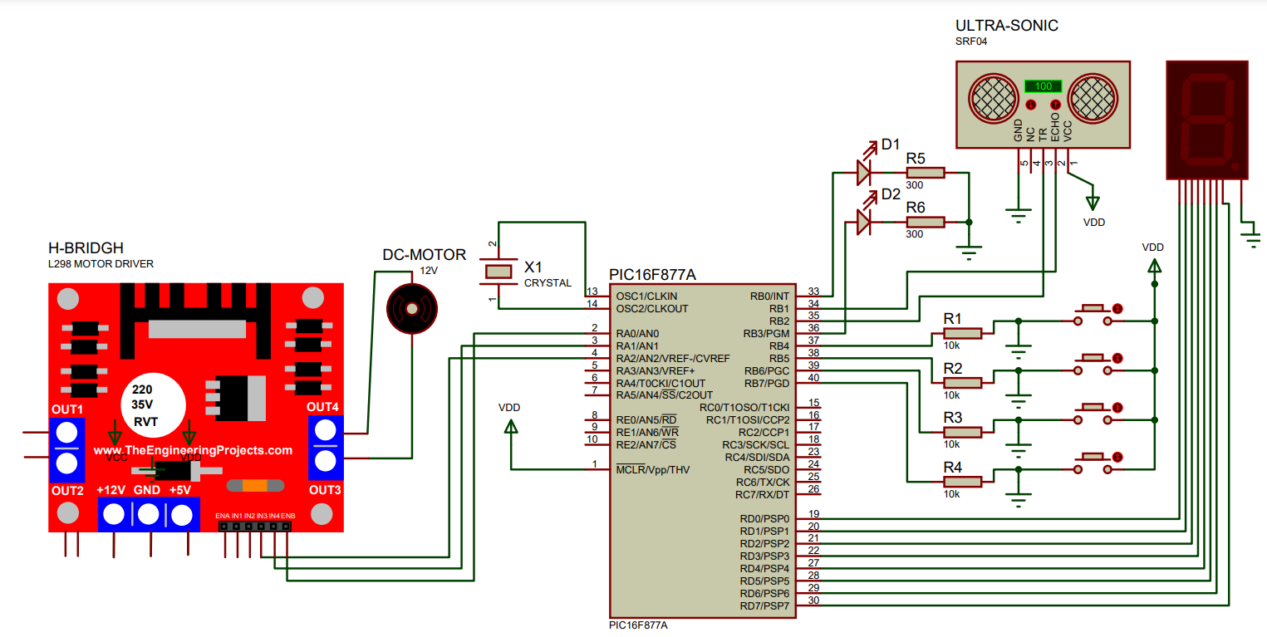
4-Story Elevator
L. Salameh , M. Oweis, K. Abu-rubaia
Supervisor: Dr. Belal Sababha
Embedded Systems Final Design Project, Spring 2023
King Abdullah II School of Engineering
Princess Sumaya University for Technology
Introduction
The focus on embedded system has grown in the last decades because of its benefits and flexibility, an embedded system plays an essential role in controlling any system and make it more reliable and sophisticated in real time.
This projects aims to design and implement system with the ability to Lift an Elevator which has 4 floors, we will be using in this design a DC Motor to move the elevator Up and Down, Ultra-Sonic sensor to measure the distance of the elevator and to detect in which floor is the elevator in, L298N Motor Driver, PWM to control the speed of it, 7 segment display to show at which floor is the elevator at, and lastly PIC16F877A which will be programmed according to our design.
Results
In the following Figure, you can see our model design, as expected from our embedded system design, our elevator have moved between floors efficiently in both ways (Up and Down), knowing that when the elevator moves between floors it slows down its speed once it is close to the desired destination, by measuring the Distance where the elevator is continuously to detect where it is located, moreover when the elevator move and change its destination, we used the 7 segment display in order to show in which floor is the elevator currently in.
4
Figure 2: Hardware Design.
In the following figure, you can see the schematic part of our embedded system design, which shows how we connected our components with each other clearly.
Figure 3: Schematic Design.
Design
We have designed a 4-story elevator, which will be moving between floors in various speeds depending on the distance between each the requested floor and the current floor, firstly the elevator will be moving in its normal speed but once it is close to the requested floor it will slow down its speed until it reaches the requested floor. The Following Flow Chart will show More details about the functionality of how our embedded System work:
Figure 1: Flow chart.
Conclusion
This poster presents an outline of the hardware and software elements employed in constructing an elevator using the PIC16F877A microcontroller, DC motor, DC drivers (L298N), and Ultra-Sonic sensor. The PIC16F877A microcontroller effectively controls the DC motor and DC driver, which are responsible for upward and downward movement of the elevator, providing the necessary voltage to ensure the desired functionality of our embedded design.
In summary, this well-planned system project incorporates numerous advanced features and technologies. It successfully takes good use of existing technologies such as the PIC16F877A microcontroller and PWM to create an efficient embedded system. Notably, the use of the Ultra-Sonic sensor for measuring the elevator's distance adds significant value to our project. Overall, this project represents a scaled-down design implementation that closely resembles real-life elevators.

