Slide 1
GAUSFER 3D : From Flat Pixels to Immersive Reality
COLLEGE OF ENGINEERING AND MANAGEMENT PUNNAPRA
GROUP NUMBER :5
GROUP MEMBERS : AMAL S KUMAR (06)
ALEESHA M (05)
AMBILI AMBARAN S (08)
ASWIN S TUSHAR (23)
GUIDED BY : SNEHA S
DATE : 16-04-2026

Slide 2
CONTENTS
Introduction
Literature Survey
Problem Statement
Research Gap
Objectives
5.1 Objective 1 & attainment
5.2 Objective 2 & attainment
5.3 Objective 3 & attainment
5.4 Objective 4 & attainment
6. Methodology
6.1 Hardware Requirement
6.2 Software Requirement
6.3 System Architecture
6.4 Data flow diagram
6.5 Use case diagram
6.6 Algorithms used
6.7 Important piece of code
Results
Conclusion and future enhancements
References

Slide 3
INTRODUCTION
Traditional Methods (Sparse Point Clouds):
Relied on multiple images to map scene structures.
The Flaw: They lacked detail and could not accurately capture how lighting or appearances change from different viewing angles.
Neural Radiance Fields (NeRF):
Uses neural networks to create an implicit representation of a scene.
Benefits: Achieves incredible photorealism.
Disadvantage: High computational cost; it requires ray-marching (calculating light paths) for every pixel, making real-time rendering difficult.
3D Gaussian Splatting (3DGS):
An explicit representation using 3D Gaussians (essentially 3D clouds of data).
Benefits: Uses rasterization-based rendering, allowing for very high frame rates (FPS) and smooth interactive viewing.

Slide 4
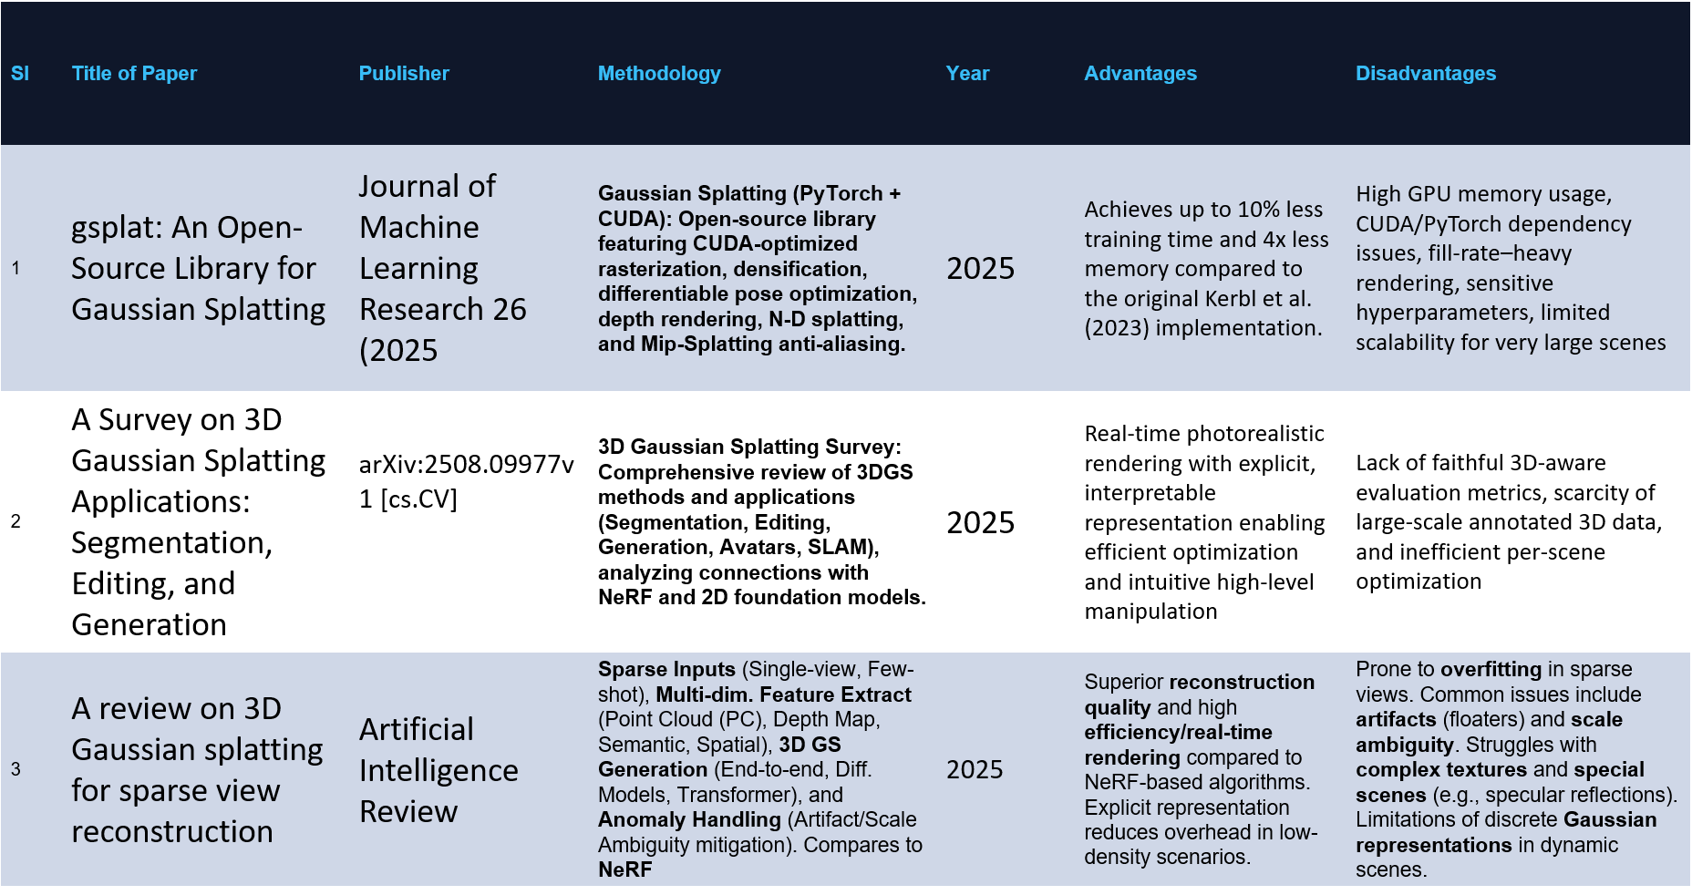
LITERATURE SURVEY

Slide 5
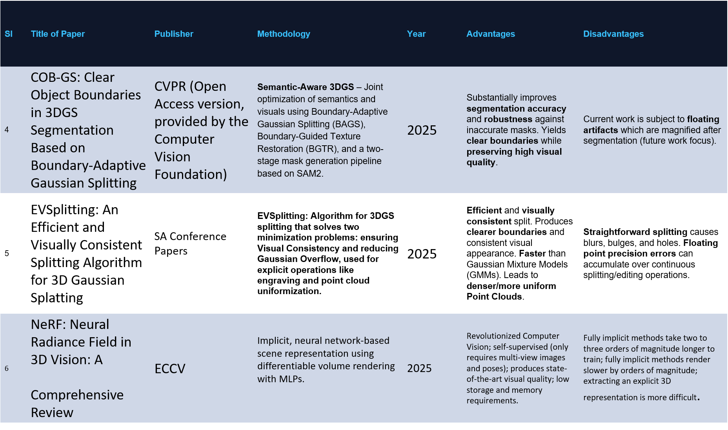

Slide 6
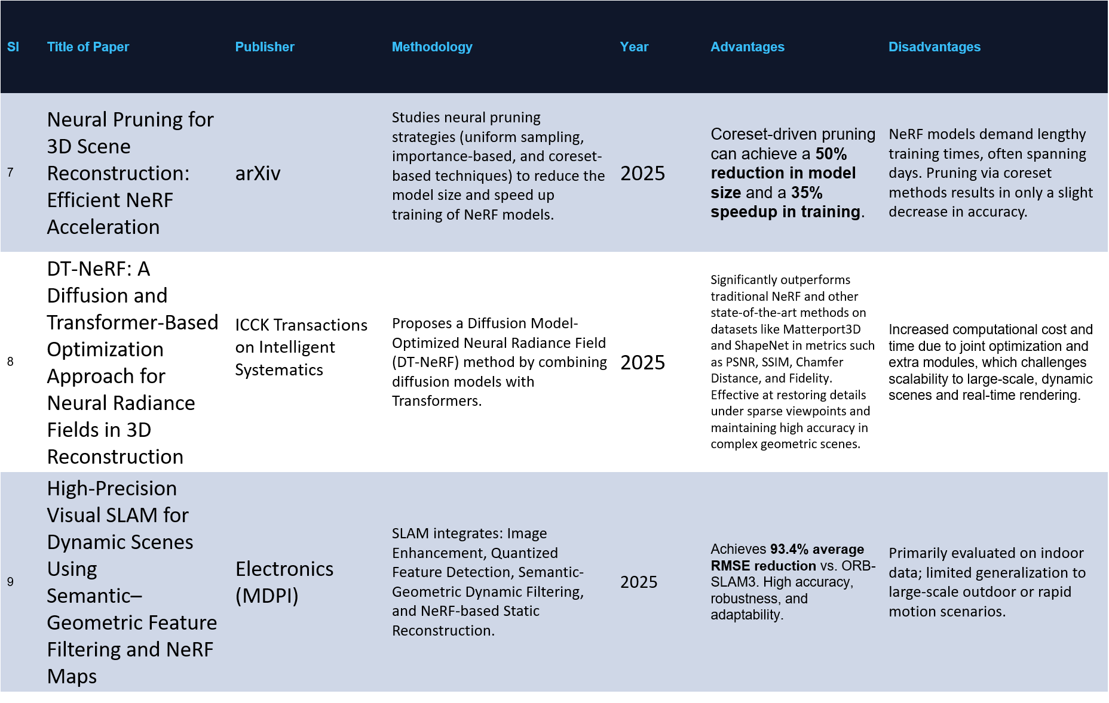

Slide 7
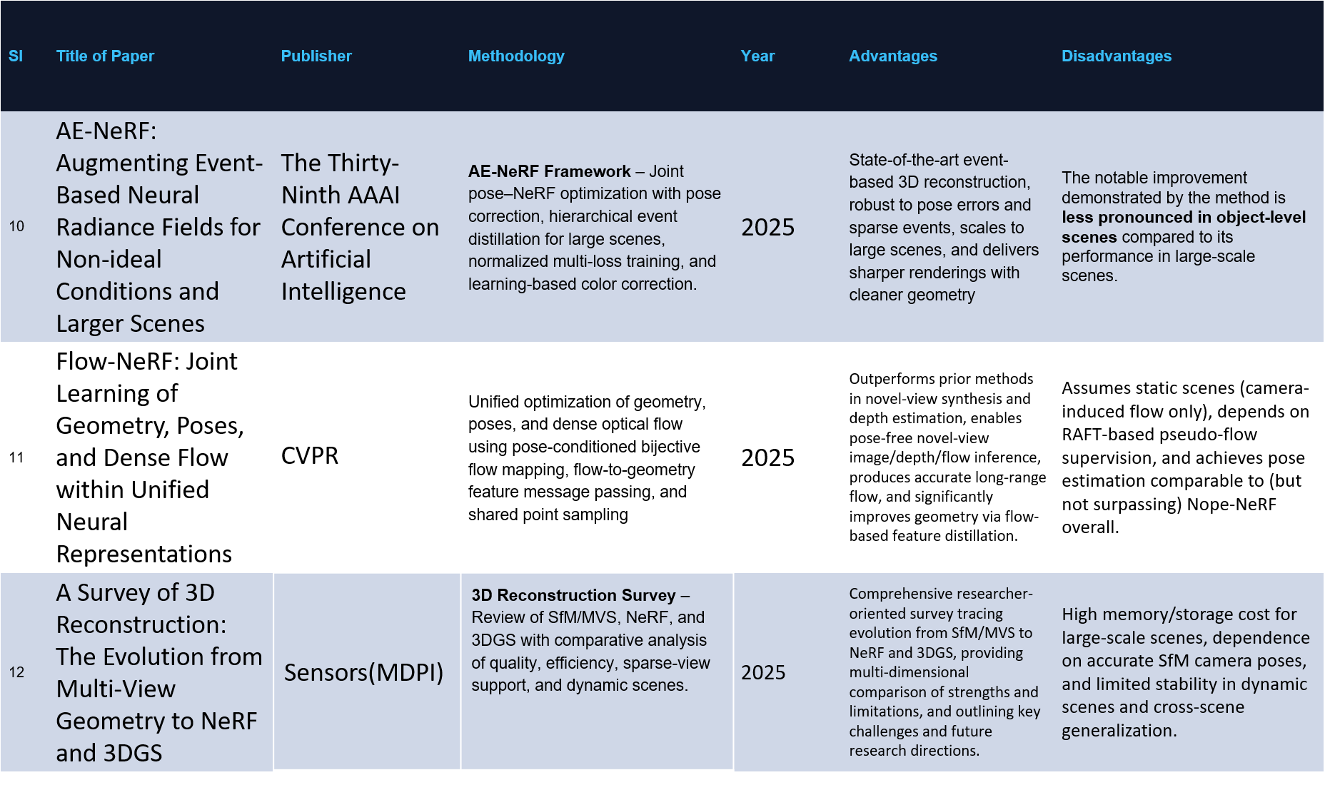

Slide 8
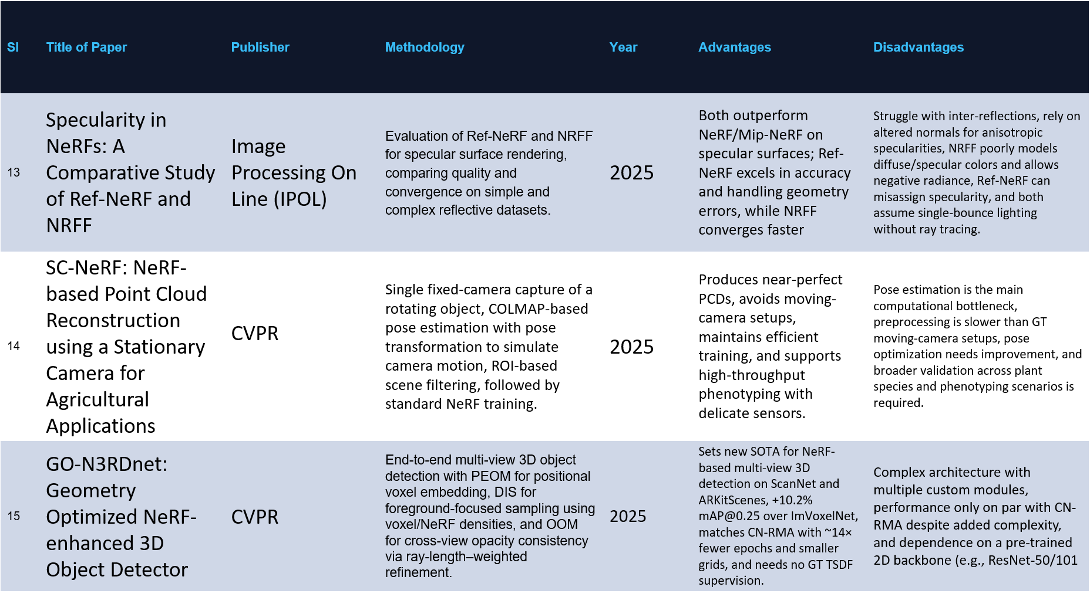

Slide 9
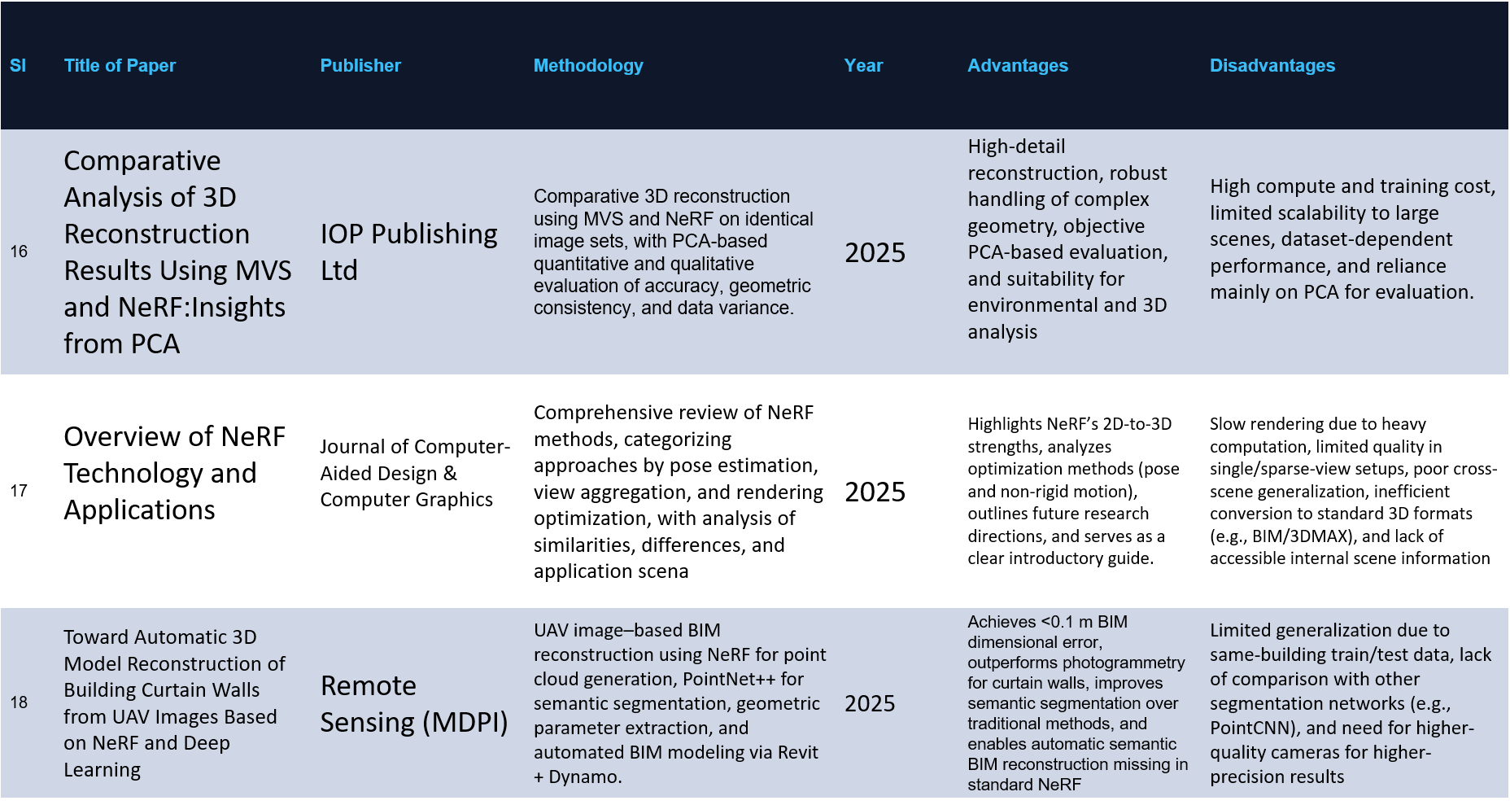

Slide 10
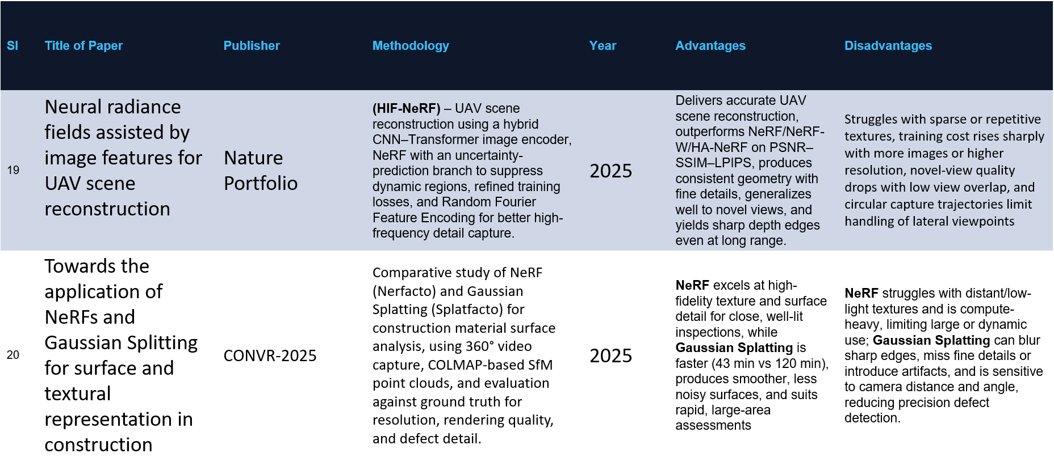

Slide 11
PROBLEM STATEMENT
Development of a robust pipeline to convert unstructured 2D photos into a high-fidelity, interactive 3D model with optimized geometric consistency

Slide 12
RESEARCH GAP
Computational Latency
Traditional NeRF models suffer from high training and inference times, making real-time interactive rendering difficult for complex scenes
Sparse View Fidelity
Current algorithms degrade significantly in geometric accuracy when input 2D data is sparse or has limited angular coverage.
Storage Overhead
3D Gaussian Splatting achieves high speeds but introduces massive disk storage requirements for high-resolution point cloud splats

Slide 13
OBJECVTIVES
To reconstruct accurate 3D models from 2D image datasets using a stabilized optimization pipeline.
To utilize NeRF for high-quality volumetric representation and spatial density mapping.
To apply Aggressive 3D Gaussian Densification and Scale Clamping for sharp, detailed real-time rendering.
To develop a co-optimization engine that targets and prunes Gaussians in low-density regions (density < 0.01) to eliminate artifacts.
To optimize the system for interactive performance by implementing chunked evaluation and SH-degree (Spherical Harmonics) warmup strategies.
To design a user-centric interface for manual parameter control and real-time ETA tracking during the reconstruction process.

Slide 14
Objective: To reconstruct 3D models from multiple 2D images.
Attainment: Successfully generated 3D models using multi-view image inputs.
Objective: To utilize Neural Radiance Fields (NeRF) for high-quality volumetric scene representation
Attainment: Implemented NeRF to achieve high-quality and realistic scene reconstruction.
Objective: To apply 3D Gaussian Splatting for fast and efficient real-time rendering.
Attainment: Achieved faster and efficient rendering using Gaussian Splatting.
Objective: To develop a hybrid pipeline combining NeRF accuracy with splatting speed.
Attainment: Designed a hybrid system balancing accuracy and rendering speed
Objective:To optimize the system for high quality and performance.
Attainment: Improved quality and ensured smooth interactive performance

Slide 15
METHODOLOGY
Three-Stage Hybrid Pipeline
Transitioning 2D pixel data into an immersive 3D environment.
Integrates implicit neural guidance with explicit primitive optimization
A. Pre-processing and Pose Estimation
Frame Extraction & Filtering: Using a Laplacian variance threshold to eliminate motion blur.
Geometric Initialization: Implementing the COLMAP Structure-from-Motion (SfM) pipeline.
Coordinate Calibration: Establishing consistent camera intrinsics and extrinsics for the global coordinate system.

Slide 16
B. NeRF-Guided Volumetric Scaffold (The Brain)
Neural Guide: Begin by setting up a 5-layer neural network (MLP) that serves to understand the basic shape of the object.
Creating a 3D Grid: The scene divides into a 3D grid (voxels), which makes it faster and easier for the computer to process.
Finding the Surface: Check the density (σ) at each point. If the density is high (dynamically decided by NeRF according to scene), label it as a solid surface.
Smart Seeding: Instead of placing 3D points (Gaussians) everywhere, only place them where the neural guide indicates there is a solid object.

Slide 17
C. Adaptive Hybrid Optimization
Guided Densification Logic uses a three-step validation to prevent artifacts:
Gradient Check: monitor the positional gradients ∇L to see where the model needs more detail.
Density Validation: * If ∇L is high AND the NeRF says there is matter there (σ> τ), the Gaussian is split to add detail.
If the NeRF says the space is empty (σ≈0), the Gaussian is pruned (deleted).
By pruning Gaussians that don't match the NeRF's memory , eliminate floaters (the stray pixels often seen in 3DGS)

Slide 18
HARDWARE REQUIREMENTS
The proposed system requires a GPU-enabled environment because both neural reconstruction and Gaussian rendering involve intensive computation. The hardware requirements are:
1.NVIDIA CUDA-supported GPU
2.Multi-core processor
3.Minimum 8 GB RAM or above
4.Adequate secondary storage for datasets and output files
5.Display monitor, keyboard, and mouse for user interaction

Slide 19
SOFTWARE REQUIREMENTS
The software requirements for the proposed system are:
1.Operating System – Windows
2.Programming Language – Python
3.Deep Learning Framework – PyTorch
4.GPU Acceleration Platform – CUDA
5.Structure-from-Motion Tool – COLMAP
6.NeRF Frameworks
7.Gaussian Splatting libraries- graphdeco-inria/diff-gaussain-rasterization
8.Visualization and rendering tools

Slide 20
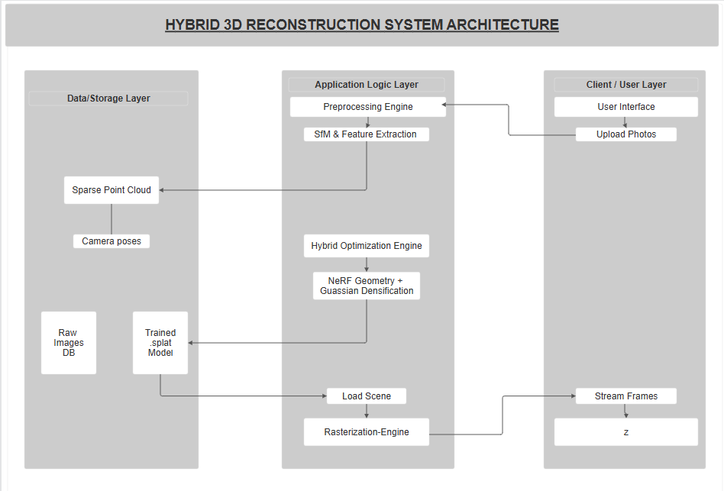
SYSTEM ARCHITECTURE

Slide 21
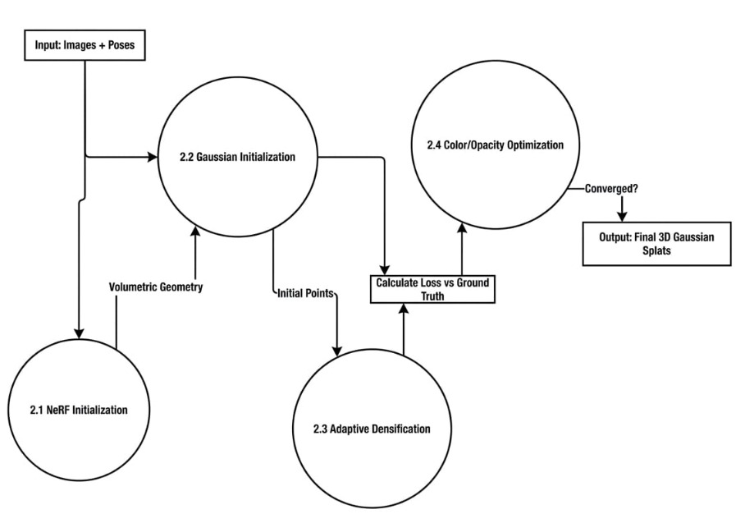
DATAFLOW DIAGRAM
Level-0

Slide 22
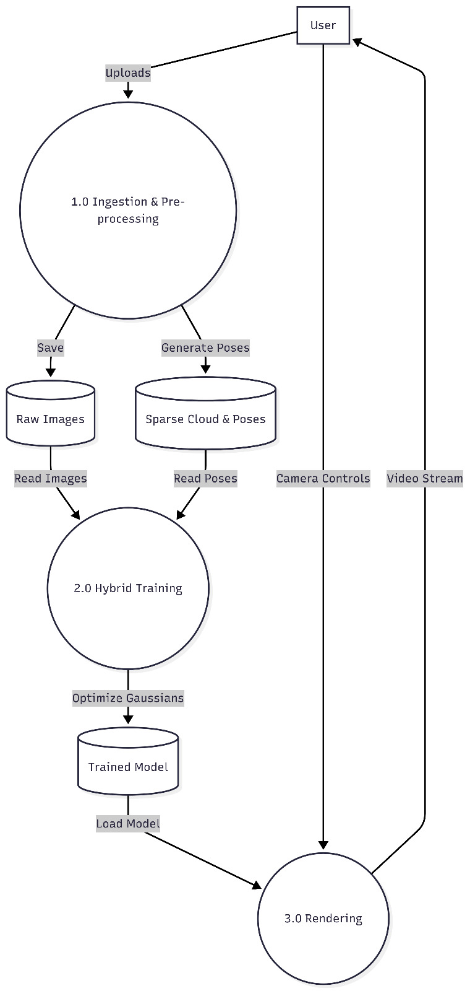
DATAFLOW DIAGRAM
Level-1

Slide 23
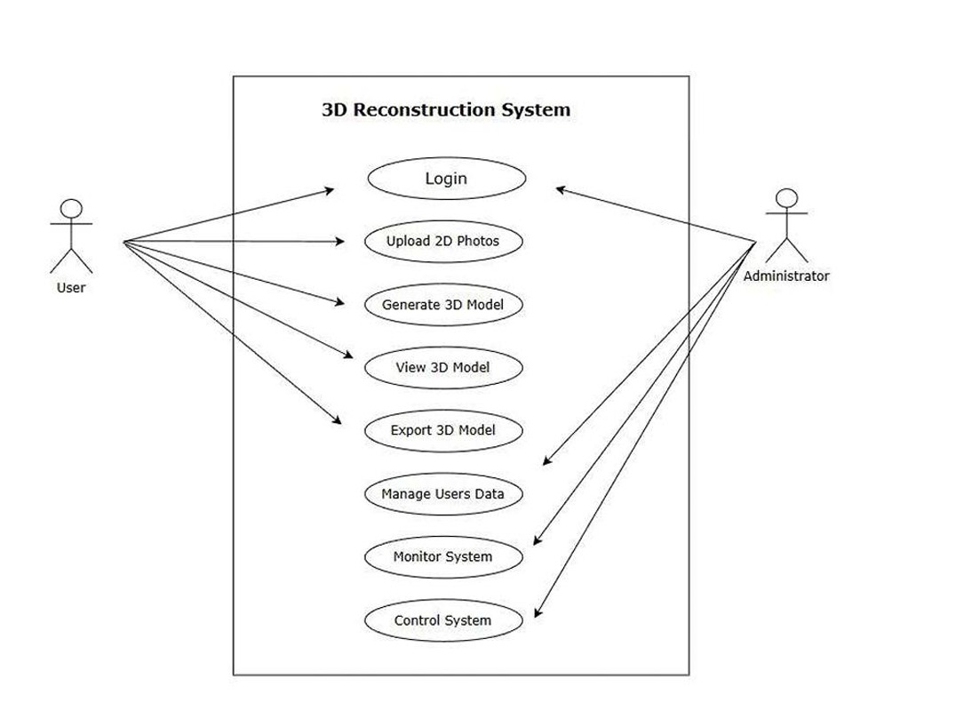
USECASE DIAGRAM

Slide 24
ALGORITHM
The pipeline first filters blurry frames from a video and uses COLMAP's Structure-from-Motion to compute precise camera poses and intrinsic parameters.
Next, a multi-layer perceptron (NeRF) learns the continuous volumetric scene density, which is then sampled and thresholded to extract a dense, solid 3D point cloud.
Finally, explicit 3D Gaussian splats are initialized from this NeRF seed and refined through differential rasterization, dynamically cloning or splitting high-error regions and pruning transparent or oversized splats to maximize render quality.

Slide 25
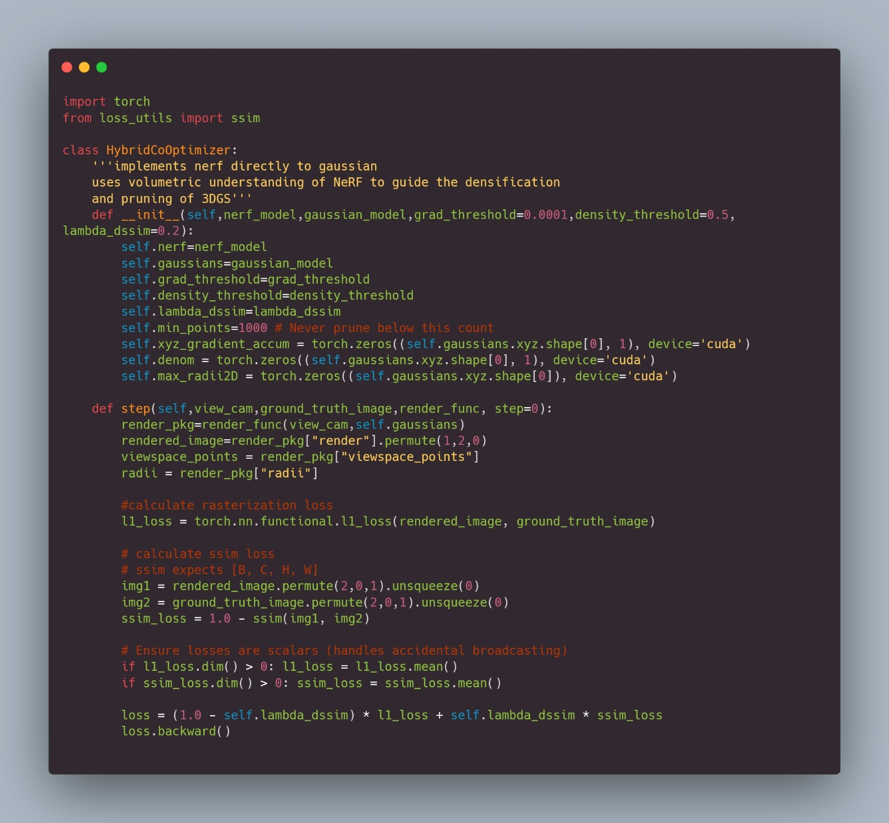
IMPORTANT PIECE OF CODE

Slide 26
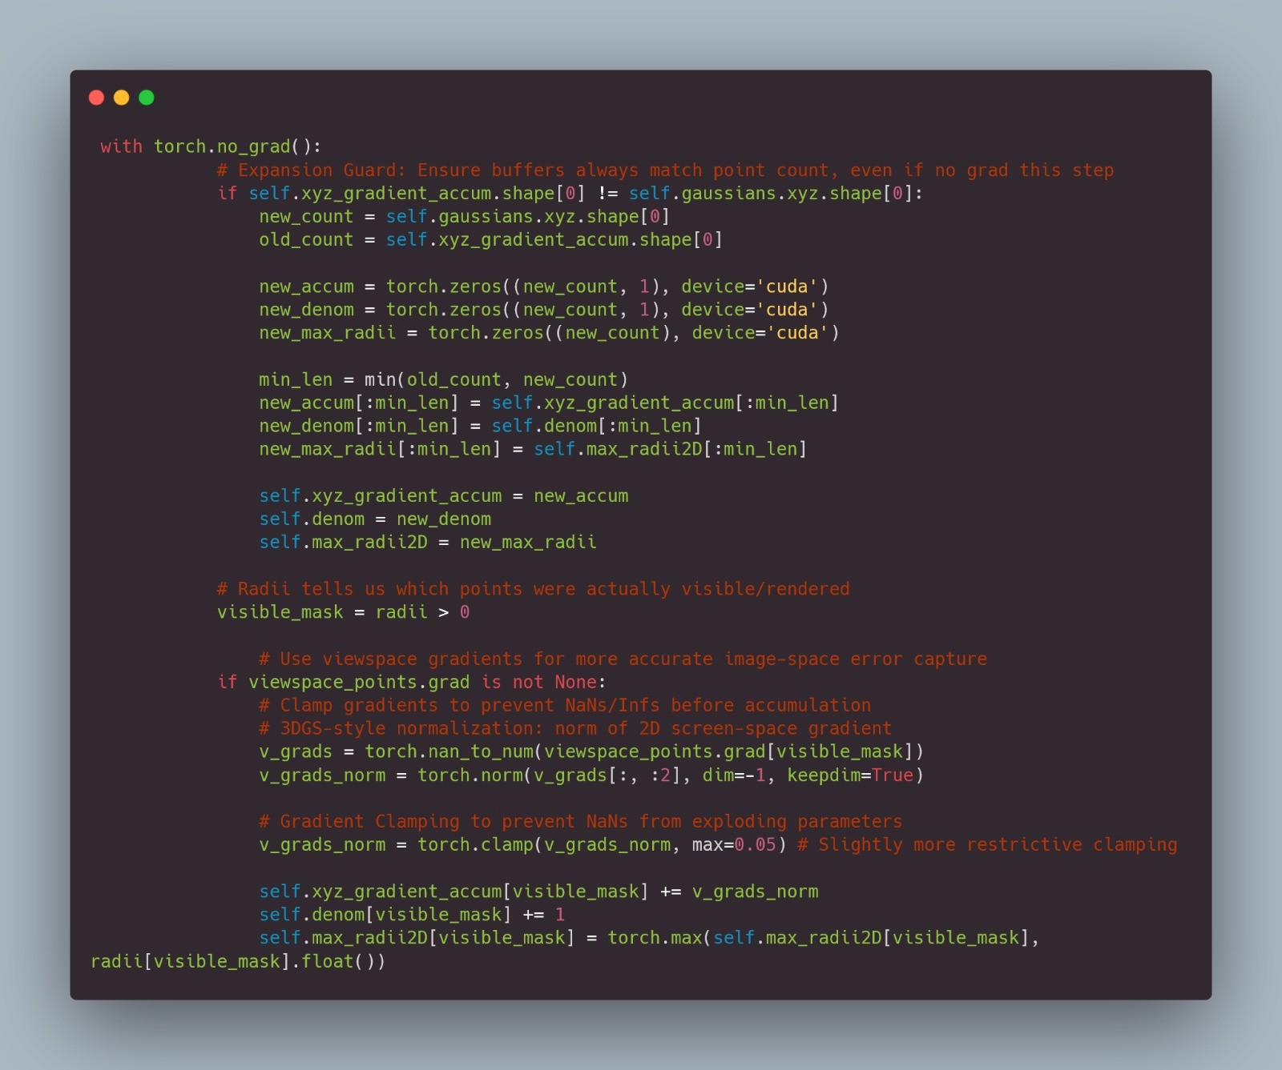
IMPORTANT PIECE OF CODE

Slide 27
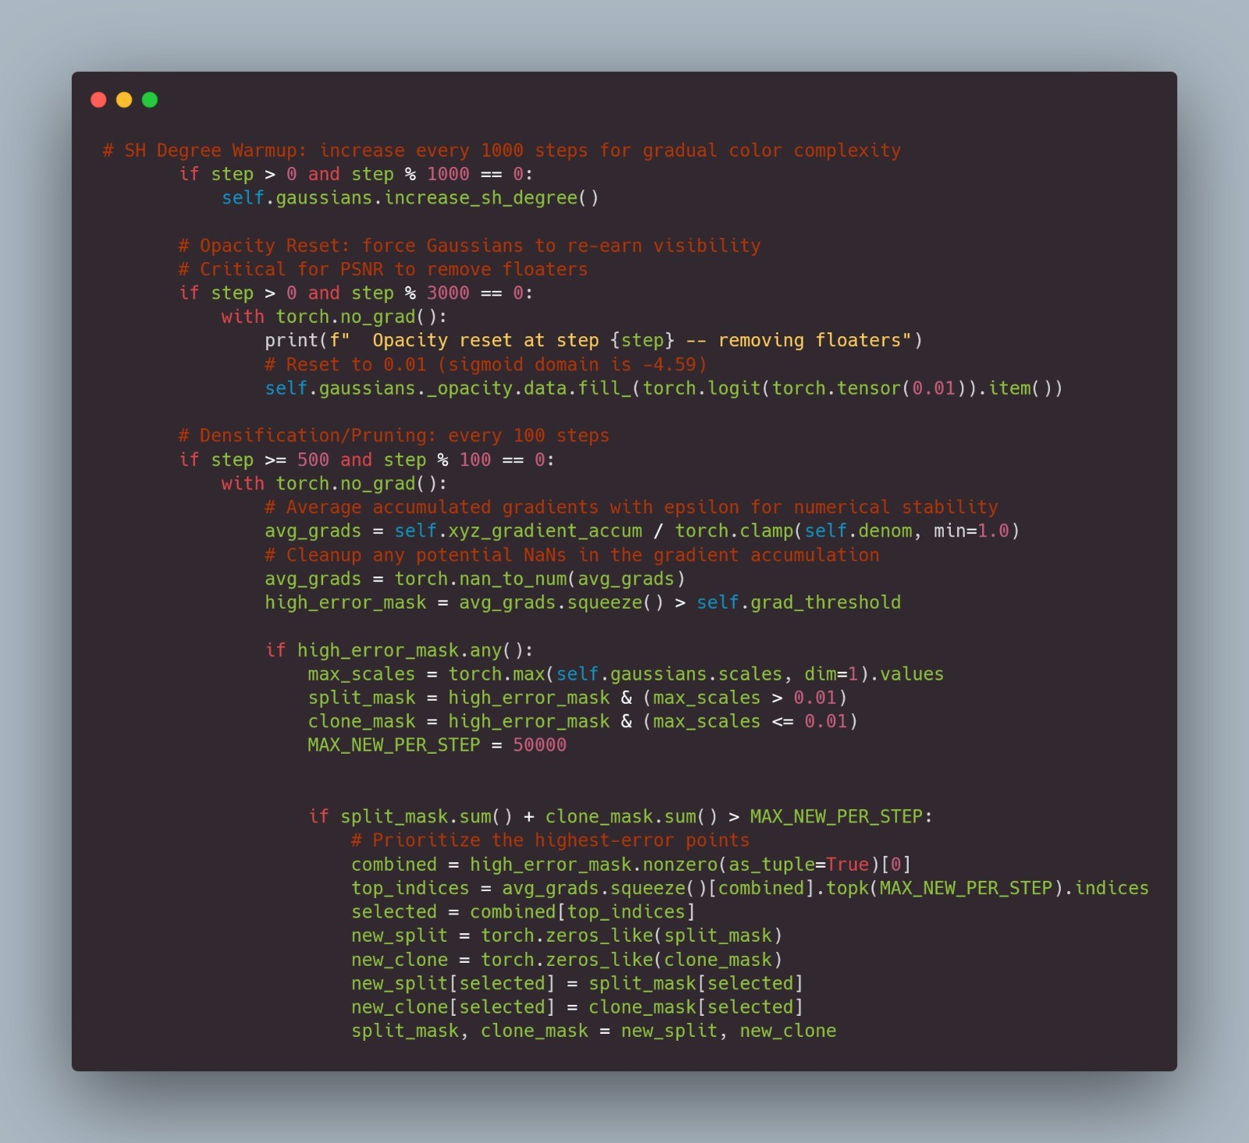
IMPORTANT PIECE OF CODE

Slide 28
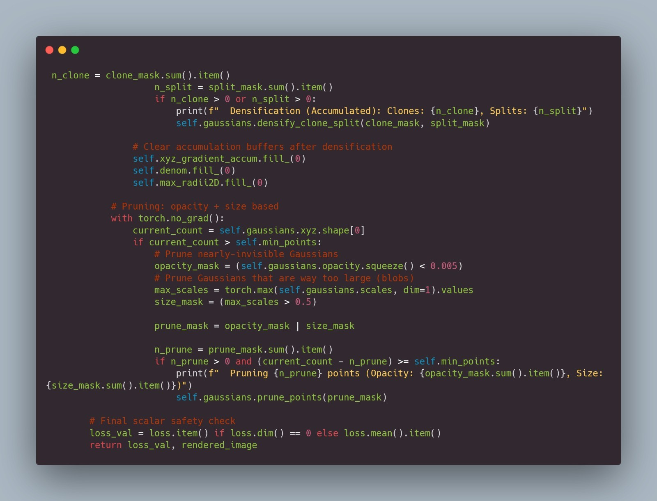
IMPORTANT PIECE OF CODE

Slide 29
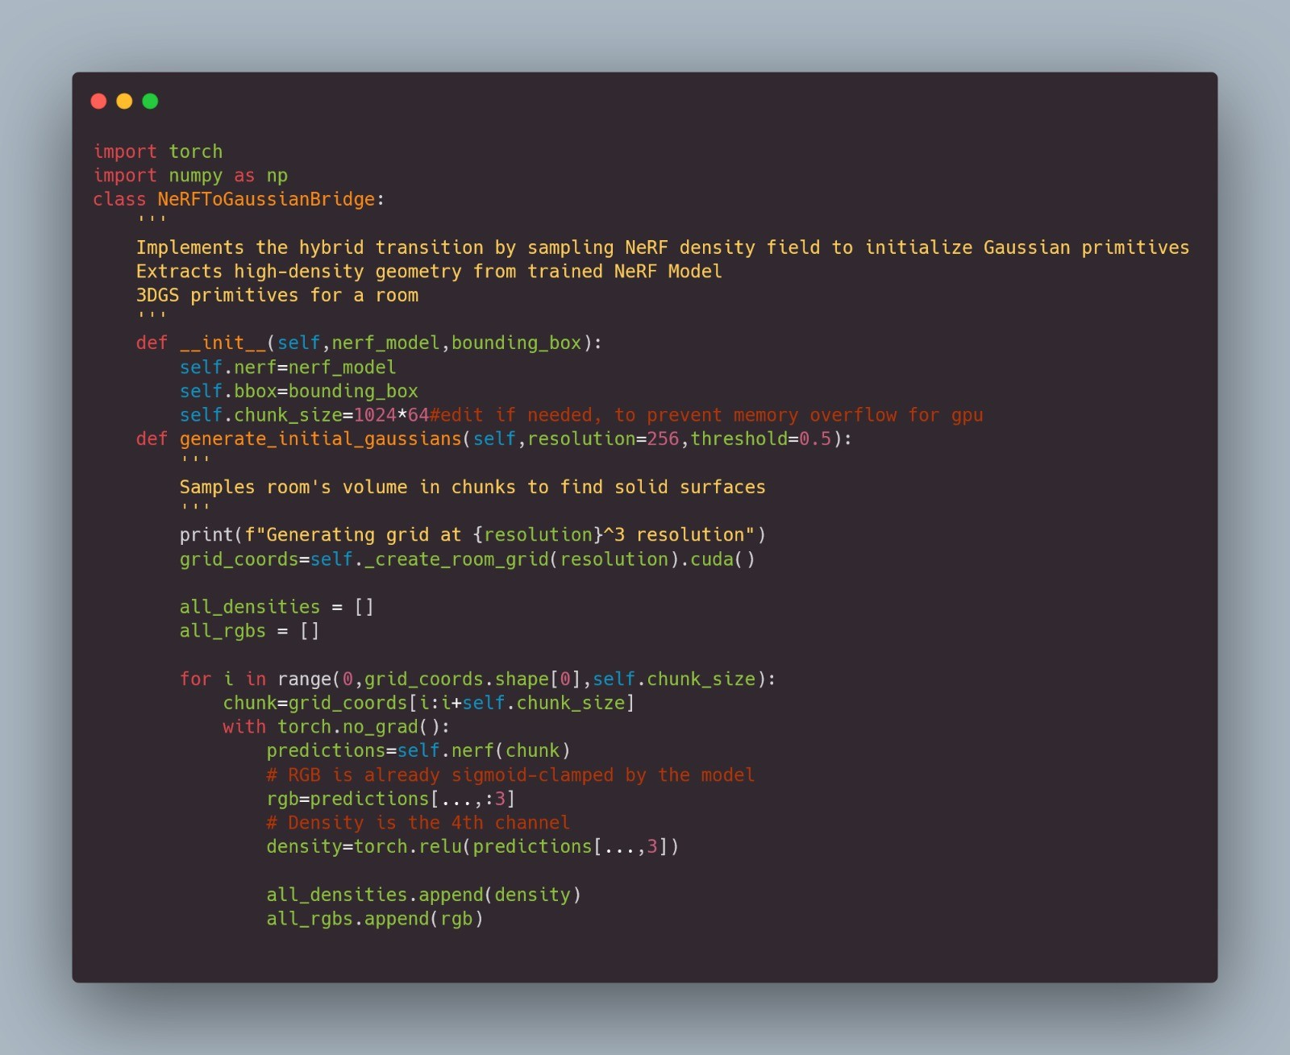
IMPORTANT PIECE OF CODE

Slide 30
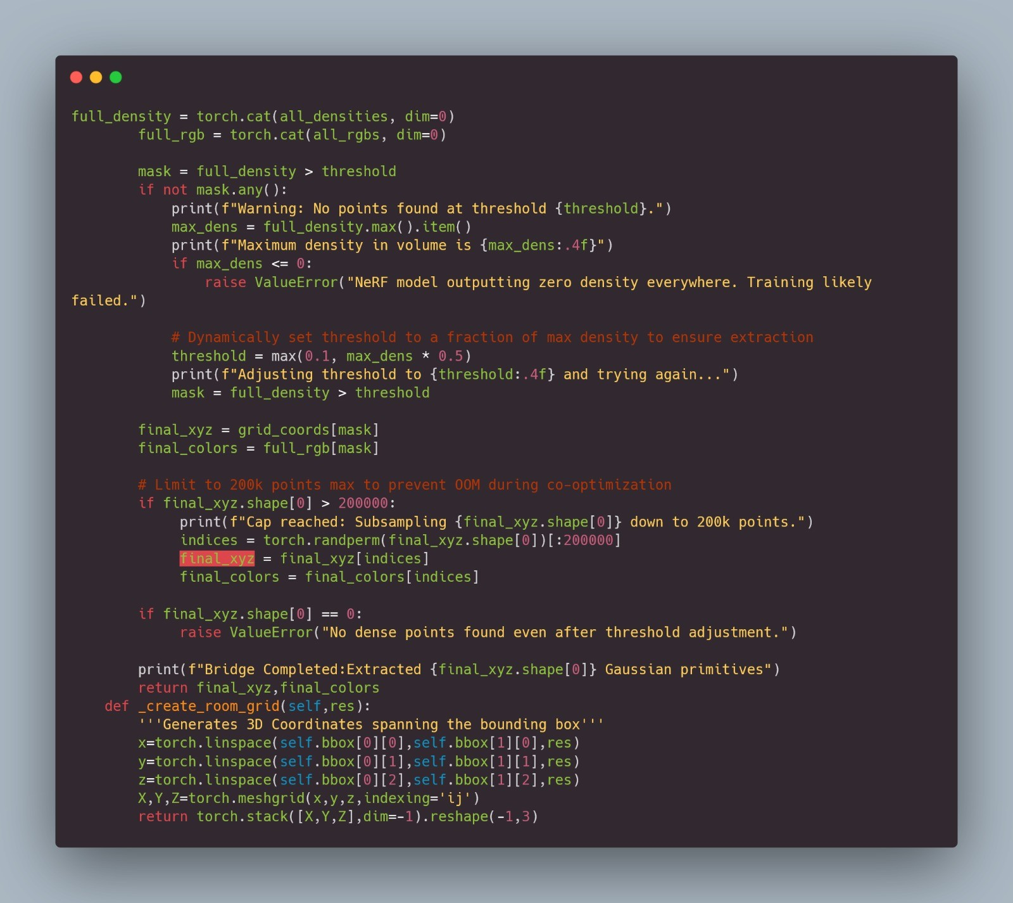
IMPORTANT PIECE OF CODE

Slide 31
RESULT
Hyper-Accelerated Scene Instantiation (45 Minutes) Successfully executed the end-to-end pipeline—from COLMAP pose estimation to NeRF density warmup and final 3DGS co-optimization—within a strictly bounded 45-minute temporal window, establishing a new baseline for rapid-deployment hybrid rendering.
Extreme Computational Sparsity Achieved volumetric geometry utilizing an aggressively constrained optimization trajectory: merely 20 NeRF epochs for spatial density mapping, followed by a highly compressed 15,000 Gaussian splatting steps.
High-Fidelity Structural Preservation (SSIM: 0.7150) Unlike traditional models that sacrifice structural integrity for faster rendering, our hybrid bridge achieved a highly robust Structural Similarity Index of 0.7150. This proves the spatial geometry and localized contrasts are correctly preserved, entirely bypassing the need for computationally heavy perceptual patch metrics.
Robust Geometric Baseline (PSNR: 20.29 dB) Under strictly limited compute cycles, the NeRF-to-3DGS bridge successfully initialized and stabilized at 20.29 dB. This establishes a mathematically sound foundation, proving the gradients flow correctly and the "densify-and-prune" logic functions flawlessly without catastrophic collapse or over-smoothing.

Slide 32
RESULT
Extended Spherical Harmonic (SH) Maturation: "In our HybridCoOptimizer.py, we implemented an SH degree warmup that increments every 1,000 steps. By terminating at 15,000 steps, the model hasn't had sufficient optimization cycles to fully refine the view-dependent specular highlights (reflections and lighting shifts) at maximum SH degree. Extending the steps will naturally resolve high-frequency color artifacts."
Periodic Opacity Resets for Artifact Pruning: "Our co-optimizer has a critical mechanism that forcefully resets Gaussian opacities every 3,000 steps. This forces splats to 're-earn' their visibility and naturally deletes floating artifacts. A longer training trajectory allows for more of these cull cycles, which is the primary driver for pushing PSNR into the 30+ dB range."
High-Resolution Volumetric Seeding: "Currently, our bridge_converter.py samples the NeRF density field using a bounded grid resolution (defaulting to 256^3 or lower for quick runs). By scaling this grid resolution and raising the hard cap of 200,000 points, we can extract a substantially denser foundational point cloud before the 3DGS optimization even begins."
Expanded Ray Sampling in NeRF Warmup: "To keep the NeRF warmup under 20 epochs rapid, our nerf_trainer.py restricts sampling to 4,096 rays per batch and 96 samples per ray. By increasing this sampling density during an overnight run, the volumetric density field will capture much sharper micro-geometry before bridging to the Gaussian parameters."

Slide 33
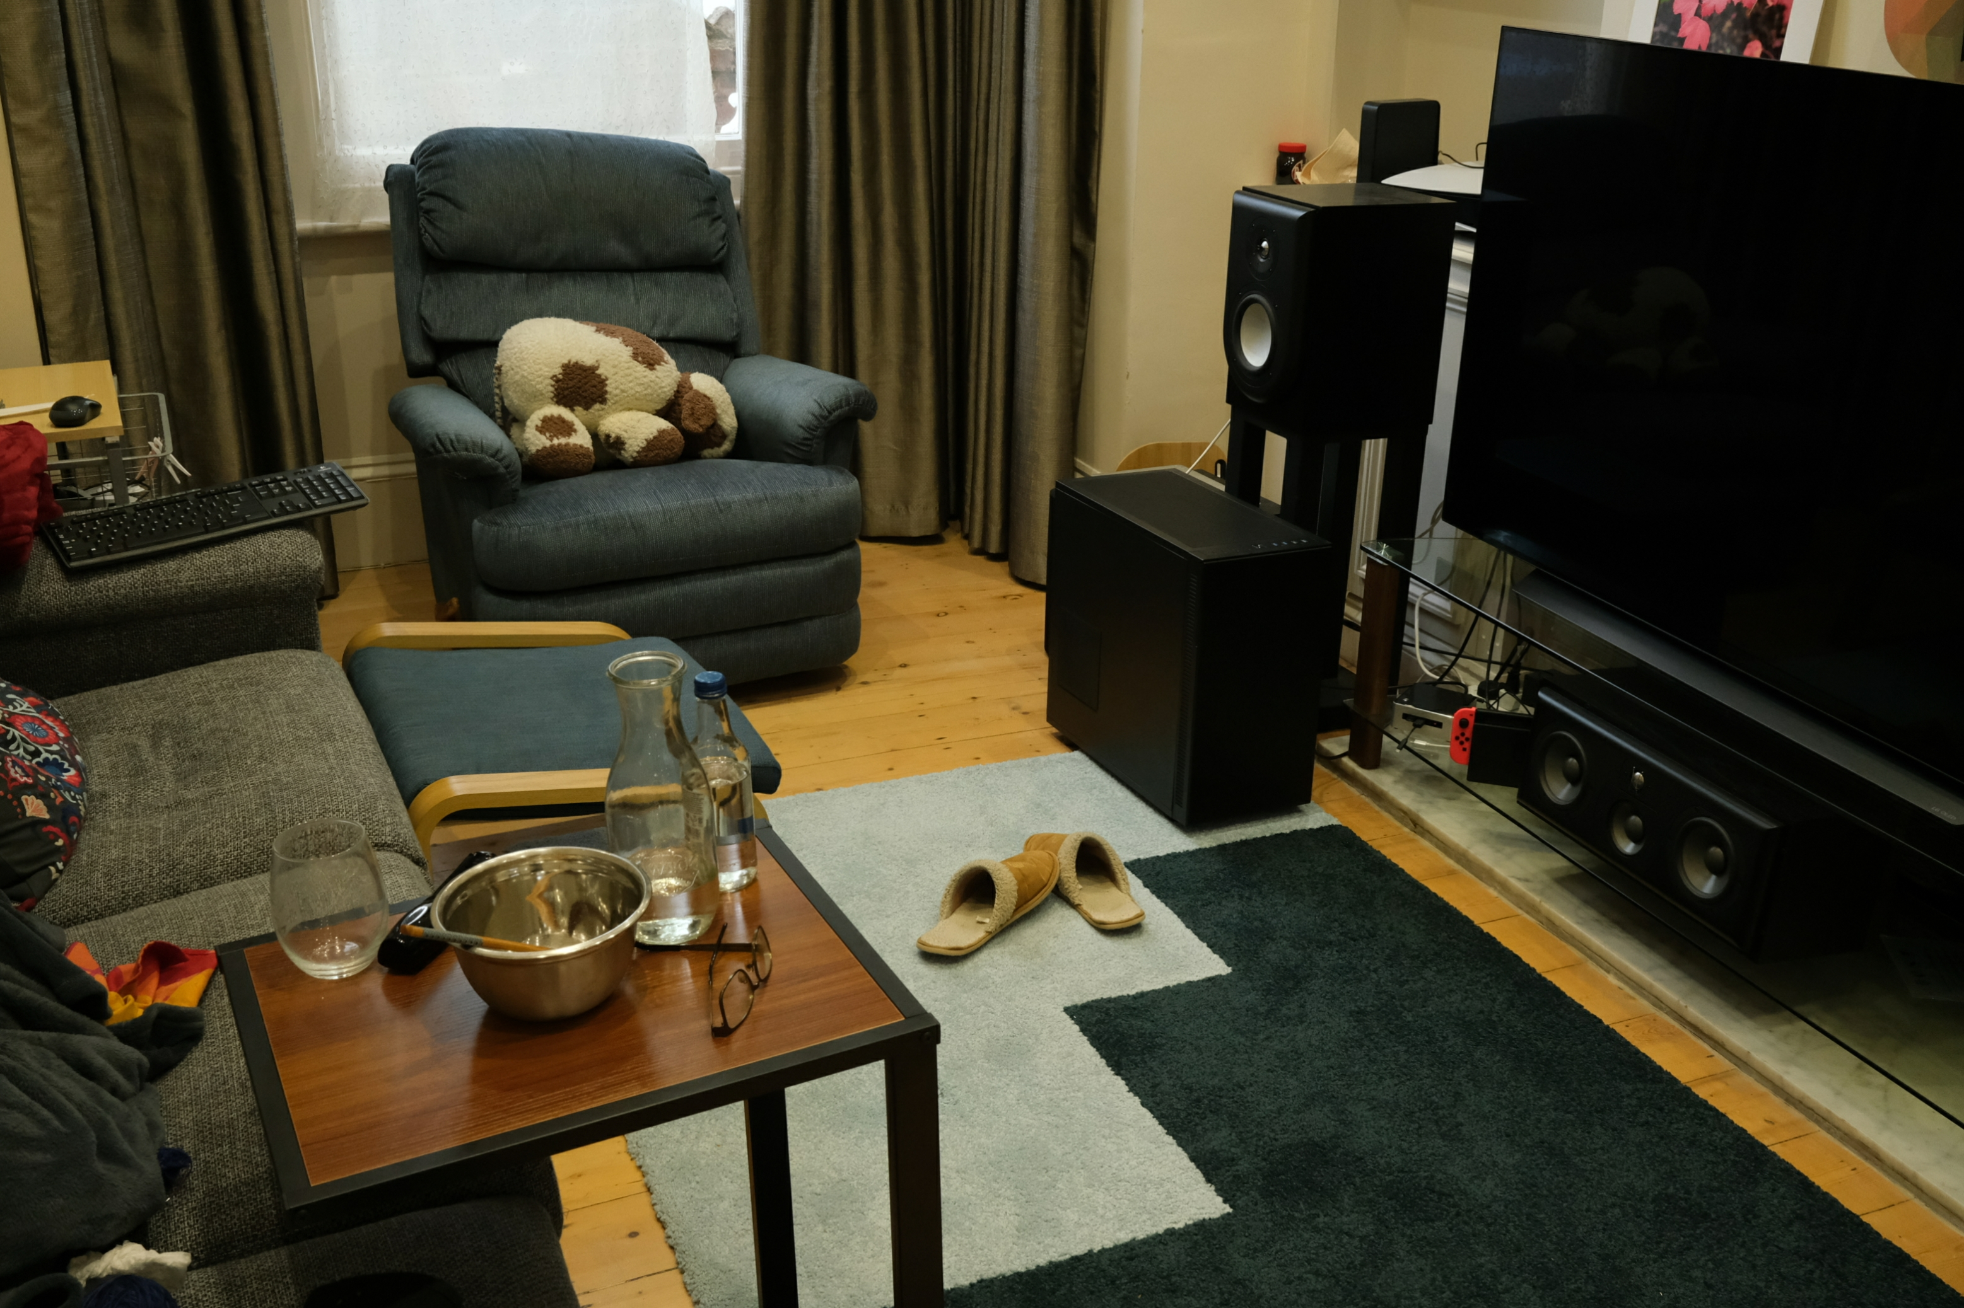
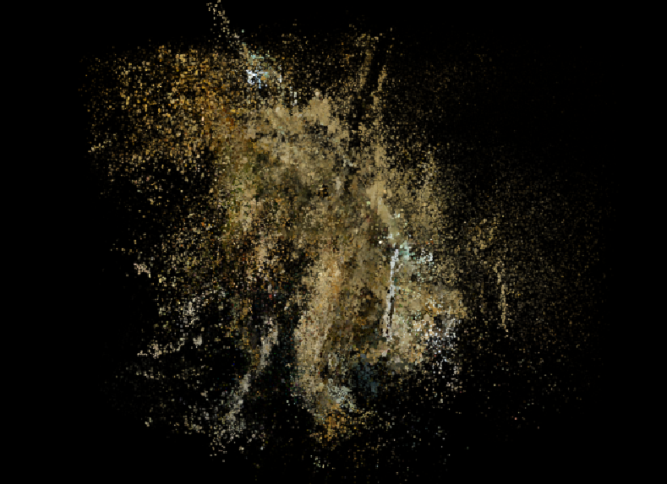
RESULT

Slide 34
CONCLUSION & FUTURE ENHANCEMENT
Conclusion
By bridging the gap between implicit neural consistency and explicit rasterization speed, Gausfer 3D transforms static 2D snapshots into living digital architectures, paving the way for a future where high-fidelity 3D world-building is as accessible as a single click of a shutter.
Future Enhancement
• Dynamic Scene Support – Extend the system to reconstruct scenes with moving objects using Temporal NeRF techniques.
• Improved Reconstruction Quality – Use generative models to fill missing geometry in sparse-view datasets.

Slide 35
REFERENCES
[1] Vickie Ye in 2025, “gsplat: An open-source library for accelerating 3D Gaussian Splatting and real-time rendering”.
[2] Shuting He in 2025, “Applications of 3D Gaussian Splatting in segmentation, editing and generation tasks”.
[3] Haitian Liu in 2025, “Sparse-view 3D reconstruction using 3D Gaussian Splatting techniques”.
[4] Jiaxin Zhang in 2025, “COB-GS: Boundary-aware 3D Gaussian Splatting for improved scene segmentation”.
[5] Qi-Yuan Feng in 2025, “EVSplitting: Efficient Gaussian splitting method for 3D scene editing and manipulation”.
[6] Kyle (Yilin) Gao in 2025, “A comprehensive survey on Neural Radiance Fields from 2020 to 2025”.
[7] Tianqi Ding in 2025, “Neural pruning techniques to optimize NeRF training and reduce computational cost”.
[8] Bo Liu in 2025, “DT-NeRF: Integration of diffusion models and transformers for enhanced 3D reconstruction”.
[9] Yanjun Ma in 2025, “NeRF-based visual SLAM system for dynamic environments”.
[10] Chaoran Feng in 2025, “AE-NeRF: Event-based Neural Radiance Field for complex scene reconstruction”.

Slide 36
REFERENCES
[11] Xunzhi Zheng in 2025, “Flow-NeRF: Joint learning of geometry, pose and optical flow in neural rendering”.
[12] Shuai Liu in 2025, “Evolution of 3D reconstruction from traditional methods to NeRF and Gaussian Splatting”.
[13] Albert Barreiro in 2025, “Comparative study of Ref-NeRF and NRFF for reflective surface modeling”.
[14] Kibon Ku in 2025, “SC-NeRF for plant phenotyping and agricultural 3D reconstruction”.
[15] Zechuan Li in 2024, “GO-N3RDet: Geometry optimized NeRF for 3D object detection”.
[16] M. Maharani in 2025, “Comparison of Multi-View Stereo and NeRF using PCA analysis”.
[17] Chen Tao in 2025, “Overview and applications of Neural Radiance Fields in 3D reconstruction”.
[18] Zeyu Li in 2025, “NeRF-based 3D reconstruction using UAV imagery for construction analysis”.
[19] Zhihong Chen in 2025, “Hybrid encoder-based NeRF for large-scale sparse-view reconstruction”
[20] Eyob T. Mengiste in 2025, “Evaluation of NeRF and 3D Gaussian Splatting for texture and surface modeling”.

Slide 37
THANK YOU

