Slide 1
GAUSFER 3D : From Flat Pixels to Immersive Reality
COLLEGE OF ENGINEERING AND MANAGEMENT PUNNAPRA
GROUP NUMBER :5
GROUP MEMBERS : AMAL S KUMAR (06)
ALEESHA M (05)
AMBILI AMBARAN S (08)
ASWIN S TUSHAR (23)
GUIDED BY : SNEHA S
DATE : 16-04-2026

Slide 2
CONTENTS
Introduction
Literature Survey
Problem Statement
Research Gap
Objectives
5.1 Objective 1 & attainment
5.2 Objective 2 & attainment
5.3 Objective 3 & attainment
5.4 Objective 4 & attainment
6. Methodology
6.1 Hardware Requirement
6.2 Software Requirement
6.3 System Architecture
6.4 Data flow diagram
6.5 Use case diagram
6.6 Algorithms used
6.7 Important piece of code
Results
Conclusion and future enhancements
References

Slide 3
INTRODUCTION
Traditional Methods (Sparse Point Clouds):
Relied on multiple images to map scene structures.
The Flaw: They lacked detail and could not accurately capture how lighting or appearances change from different viewing angles.
Neural Radiance Fields (NeRF):
Uses neural networks to create an implicit representation of a scene.
Benefits: Achieves incredible photorealism.
Disadvantage: High computational cost; it requires ray-marching (calculating light paths) for every pixel, making real-time rendering difficult.
3D Gaussian Splatting (3DGS):
An explicit representation using 3D Gaussians (essentially 3D clouds of data).
Benefits: Uses rasterization-based rendering, allowing for very high frame rates (FPS) and smooth interactive viewing.

Slide 4
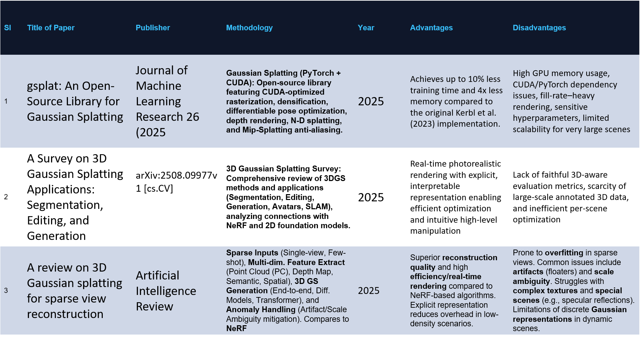
LITERATURE SURVEY

Slide 5
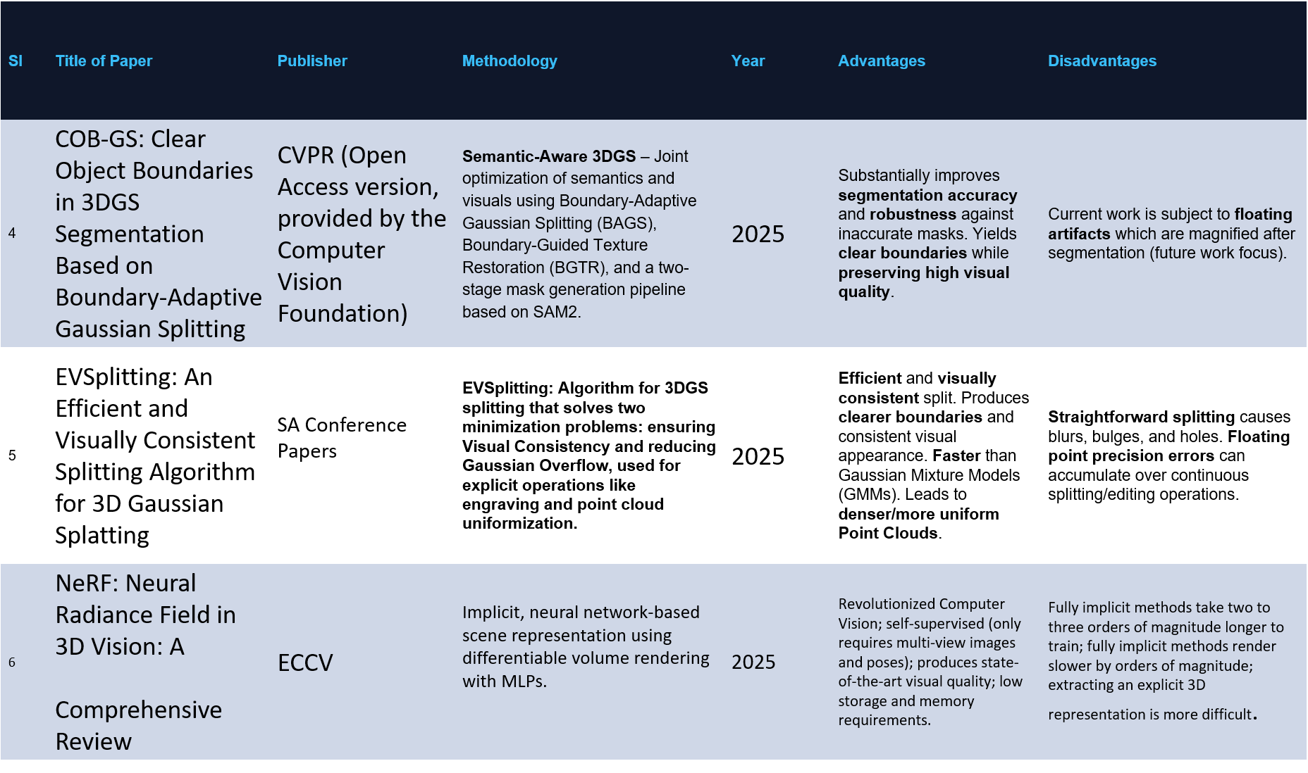

Slide 8
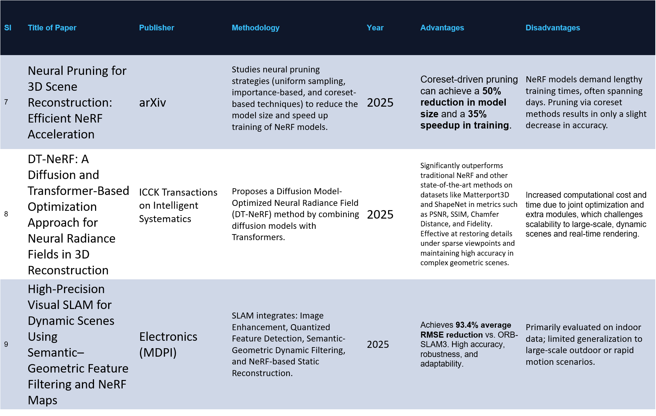

Slide 9
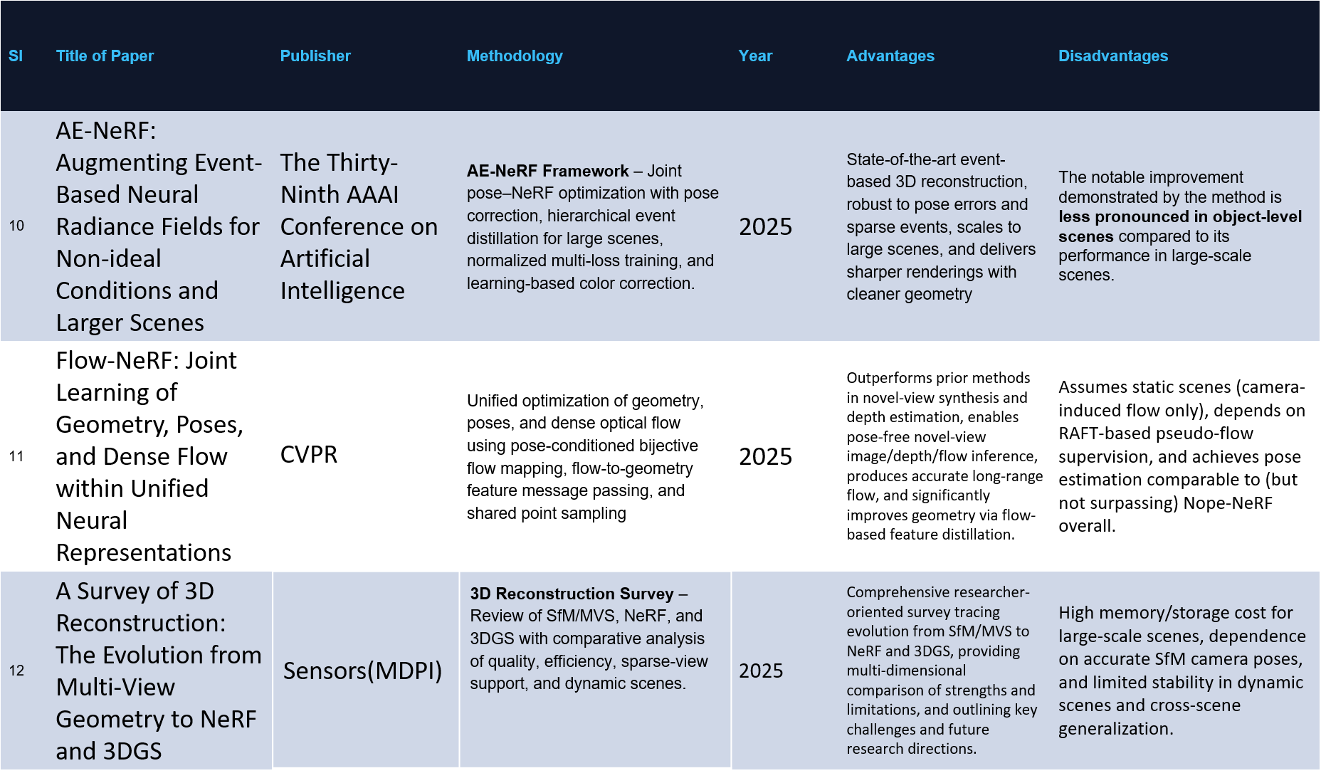

Slide 10
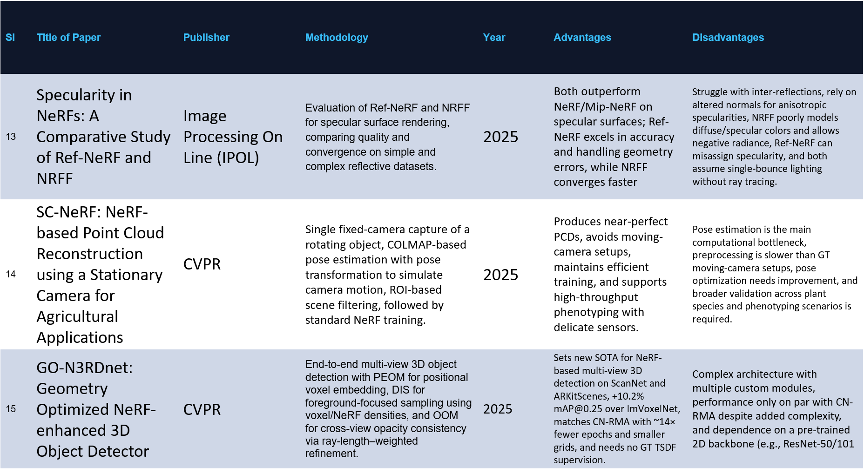

Slide 11
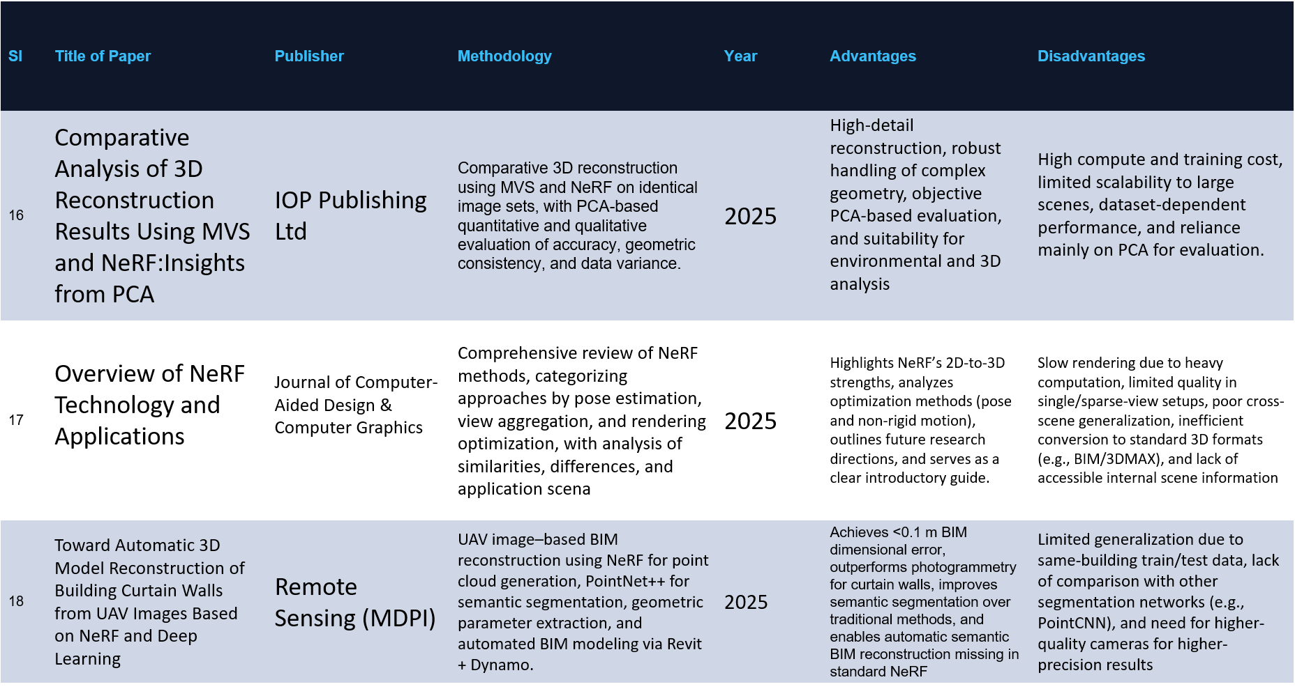

Slide 12
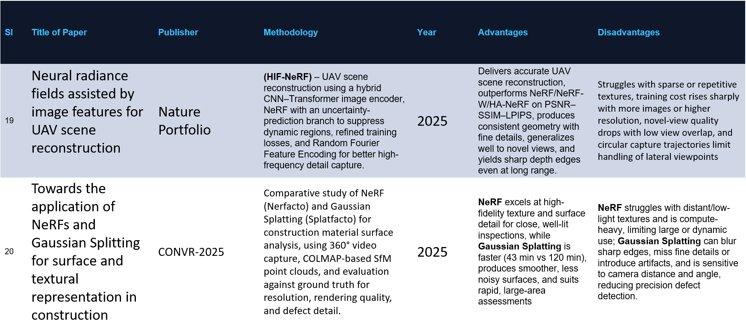

Slide 13
PROBLEM STATEMENT
Development of a robust pipeline to convert unstructured 2D photos into a high-fidelity, interactive 3D model with optimized geometric consistency

Slide 14
RESEARCH GAP
Computational Latency
Traditional NeRF models suffer from high training and inference times, making real-time interactive rendering difficult for complex scenes
Sparse View Fidelity
Current algorithms degrade significantly in geometric accuracy when input 2D data is sparse or has limited angular coverage.
Storage Overhead
3D Gaussian Splatting achieves high speeds but introduces massive disk storage requirements for high-resolution point cloud splats

Slide 15
OBJECVTIVES
To reconstruct accurate 3D models from 2D image datasets using a stabilized optimization pipeline.
To utilize NeRF for high-quality volumetric representation and spatial density mapping.
To apply Aggressive 3D Gaussian Densification and Scale Clamping for sharp, detailed real-time rendering.
To develop a co-optimization engine that targets and prunes Gaussians in low-density regions (density < 0.01) to eliminate artifacts.
To optimize the system for interactive performance by implementing chunked evaluation and SH-degree (Spherical Harmonics) warmup strategies.
To design a user-centric interface for manual parameter control and real-time ETA tracking during the reconstruction process.

Slide 16
Objective: To reconstruct accurate 3D models from multiple 2D images.
Attainment: Successfully generated accurate 3D models using multi-view image inputs.
Objective: To utilize Neural Radiance Fields (NeRF) for high-quality volumetric scene representation
Attainment: Implemented NeRF to achieve high-quality and realistic scene reconstruction.
Objective: To apply 3D Gaussian Splatting for fast and efficient real-time rendering.
Attainment: Achieved faster and efficient rendering using Gaussian Splatting.
Objective: To develop a hybrid pipeline combining NeRF accuracy with splatting speed.
Attainment: Designed a hybrid system balancing accuracy and rendering speed
Objective:To optimize the system for high visual quality and performance.
Attainment: Improved visual quality and ensured smooth interactive performance

Slide 17
METHODOLOGY
Three-Stage Hybrid Pipeline
Transitioning 2D pixel data into an immersive 3D environment.
Integrates implicit neural guidance with explicit primitive optimization
A. Pre-processing and Pose Estimation
Frame Extraction & Filtering: Using a Laplacian variance threshold to eliminate motion blur.
Geometric Initialization: Implementing the COLMAP Structure-from-Motion (SfM) pipeline.
Coordinate Calibration: Establishing consistent camera intrinsics and extrinsics for the global coordinate system.

Slide 18
B. NeRF-Guided Volumetric Scaffold (The Brain)
Neural Guide: Begin by setting up a 5-layer neural network (MLP) that serves to understand the basic shape of the object.
Creating a 3D Grid: The scene divides into a 3D grid (voxels), which makes it faster and easier for the computer to process.
Finding the Surface: Check the density (σ) at each point. If the density is high (over 15.0), label it as a solid surface.
Smart Seeding: Instead of placing 3D points (Gaussians) everywhere, only place them where the neural guide indicates there is a solid object.

Slide 19
C. Adaptive Hybrid Optimization
Guided Densification Logic uses a three-step validation to prevent artifacts:
Gradient Check: monitor the positional gradients ∇L to see where the model needs more detail.
Density Validation: * If ∇L is high AND the NeRF says there is matter there (σ> τ), the Gaussian is split to add detail.
If the NeRF says the space is empty (σ≈0), the Gaussian is pruned (deleted).
By pruning Gaussians that don't match the NeRF's memory , eliminate floaters (the stray pixels often seen in 3DGS)

Slide 20
HARDWARE REQUIREMENTS
The proposed system requires a GPU-enabled environment because both neural reconstruction and Gaussian rendering involve intensive computation. The hardware requirements are:
1.NVIDIA CUDA-supported GPU
2.Multi-core processor
3.Minimum 8 GB RAM or above
4.Adequate secondary storage for datasets and output files
5.Display monitor, keyboard, and mouse for user interaction

Slide 21
SOFTWARE REQUIREMENTS
The software requirements for the proposed system are:
1.Operating System – Windows or Linux
2.Programming Language – Python
3.Deep Learning Framework – PyTorch
4.GPU Acceleration Platform – CUDA
5.Structure-from-Motion Tool – COLMAP
6.NeRF Frameworks
7.Gaussian Splatting libraries- graphdeco-inria/diff-gaussain-rasterization
8.Visualization and rendering tools

Slide 22
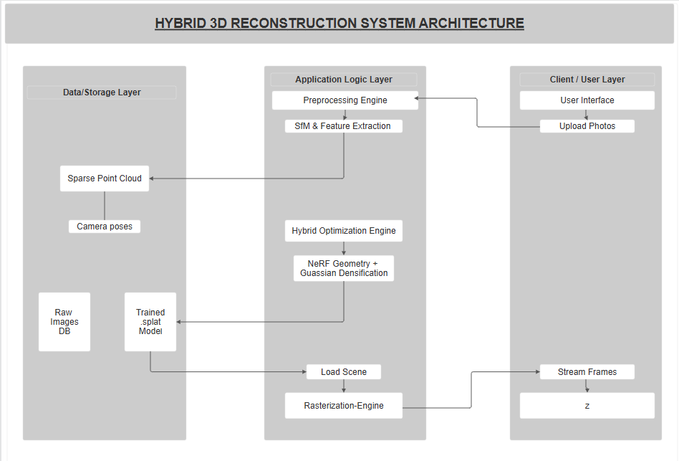
SYSTEM ARCHITECTURE

Slide 23
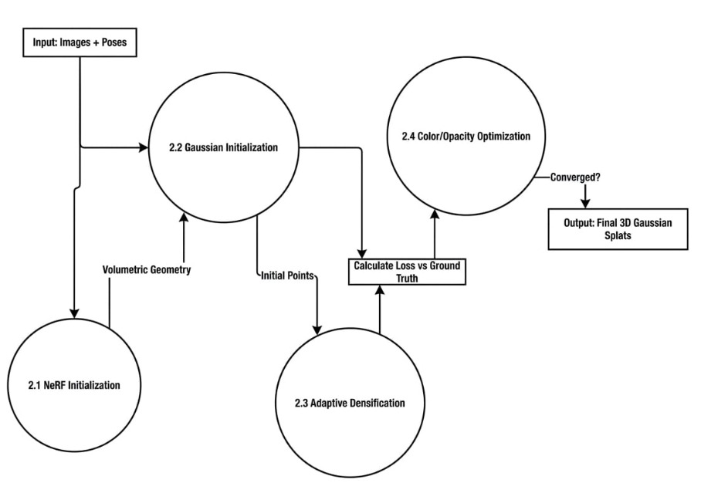
DATAFLOW DIAGRAM
Level-0

Slide 24
DATAFLOW DIAGRAM
Level-1

Slide 25
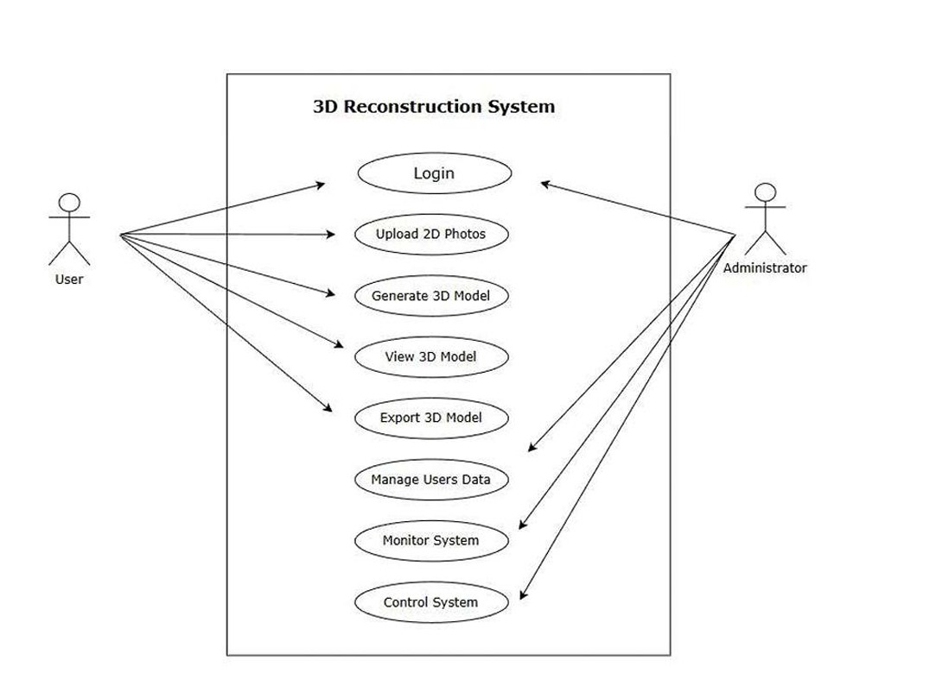
USECASE DIAGRAM

Slide 26
OUTLINE
Core Subject: Introduces GAUSFER 3D, a new pipeline for creating high-fidelity 3D scenes from standard 2D photographs.
The Hybrid Approach: Bridges the gap between two major technologies: Neural Radiance Fields (NeRF) and 3D Gaussian Splatting (3DGS).
Problem Solving : Combines NeRF’s superior volumetric consistency with 3DGS’s real-time rendering speed, specifically solving 3DGS's usual struggle with dense initialization.

Slide 27
DATA ACQUISITION AND POSE ESTIMATION
The first step in the pipeline is the use of an automated setup to acquire high-quality images from a wide range of viewpoints.
Automated Frame Extraction: A temporal sampling method is employed. To guarantee Structure-from-Motion (SfM) convergence, frames are filtered using the Laplacian variance. The following is ensured: σ² Laplacian > 100.0
Pose Estimation: The camera parameters, which include both intrinsic and extrinsic properties, are obtained using a CUDA-accelerated COLMAP wrapper. The loader transforms COLMAP quaternions q into rotation matrices R, which are 3x3 matrices.

Slide 28
HYBRID OPTIMIZATION METHODOLGY
A. Volumetric neural scaffolding
first warm up a 5-layer multi-layer perceptron (MLP) NeRF with 10 epochs of training. In this case, take 3D coordinates x, map them to a higher-dimensional embedding space via positional encoding to capture high-frequency detail. To manage GPU memory cap, cast and render rays in batches of 4096.
B. NeRF to Gaussian bridge
Once a NeRF has learned a baseline understanding of the geometry of the room it’s in, perform a NeRF to Gaussian Bridge sampling at uniform 256 voxels (3D) on a grid across the bounding box of the scene. Only locations of the NeRF at which the predicted solid density of the materials is high (σ > 15.0) will be seeded with Gaussians.

Slide 29
C. NeRF Guided densification and pruning
Gaussians will then be refined during a 5,000 step optimization phase leveraging a novel topological co-optimization strategy called Guided Densification and Guided Pruning leveraging L 1 rasterization loss. Standard 3DGS splits primitives based on gradients (∇x) , then it introduces a NeRF template mask, where a Gaussian will only be densified when the gradient of that Gaussian is greater than τ.grad = 0.0002 AND the NeRF has confirmed the presence of solid matter at that location (σneRF > 5.0). To eliminate artifacts , aggressively prune primitives when they are transparent (α < 0.05) or in geographic regions without certainty confirmed by the NeRF

Slide 30
IMPLEMENTATION DETAILS
Stop tracking gradients: Temporarily disable gradient tracking to save memory during this check.
Calculate gradients: Find the positional gradients for all the 3D Gaussians in the scene. Find high-detail areas: Identify which Gaussians have a gradient that exceeds a specific threshold (meaning they are in areas that need more detail).
Check for candidates: If there are any Gaussians that meet this high-gradient criteria, move forward with testing them.
Get their locations: Extract the exact 3D coordinates of these specific high-gradient Gaussians.
Consult the NeRF: Ask the trained Neural Radiance Field (NeRF) to calculate the density of the space at those specific coordinates.
Verify solid matter: Check if the NeRF confirms that the density at those locations is high enough to be considered solid matter.
Check for valid spots: If the NeRF confirms that valid matter exists at those locations, proceed to the final steps.
Combine the requirements: Create a final, combined list of the Gaussians that passed both tests: they have a high gradient and the NeRF confirms they are in a solid area

Slide 31
RESULT & DISCUSSION
Visual Fidelity:
PSNR: 32.5 dB. This score indicates a high signal-to-noise ratio and image cleanliness.
SSIM: 0.89. This score shows structural similarity to the ground truth.
LPIPS: 0.18. This low score means the images look natural to the eye.
Speed:
Convergence: Only 5,000 steps. This is significantly faster than NeRF-only training.
Hardware Accessibility:
This method fits within an 8 GB VRAM budget. This makes it viable for consumer-grade GPUs.
Analysis of the Hybrid Advantage
The Warmup Effect:
Achieving rapid geometric convergence in just 10 epochs proves that the NeRF scaffold provides a superior starting point compared to random initialization or sparse SfM clouds. The warmup phase is key here.

Slide 32
Artifact Suppression:
By enforcing the sigma than 15.0 and alpha less than 0.05 thresholds you have solved the "floater" problem that plagues vanilla 3DGS. This results in transparency. Artifact suppression is crucial for results.*
Data Resilience:
The Laplacian variance filter acts as a gatekeeper. It ensures that motion-blurred frames do not degrade the 3D geometry. The Laplacian variance filter is important, for data resilience

Slide 33
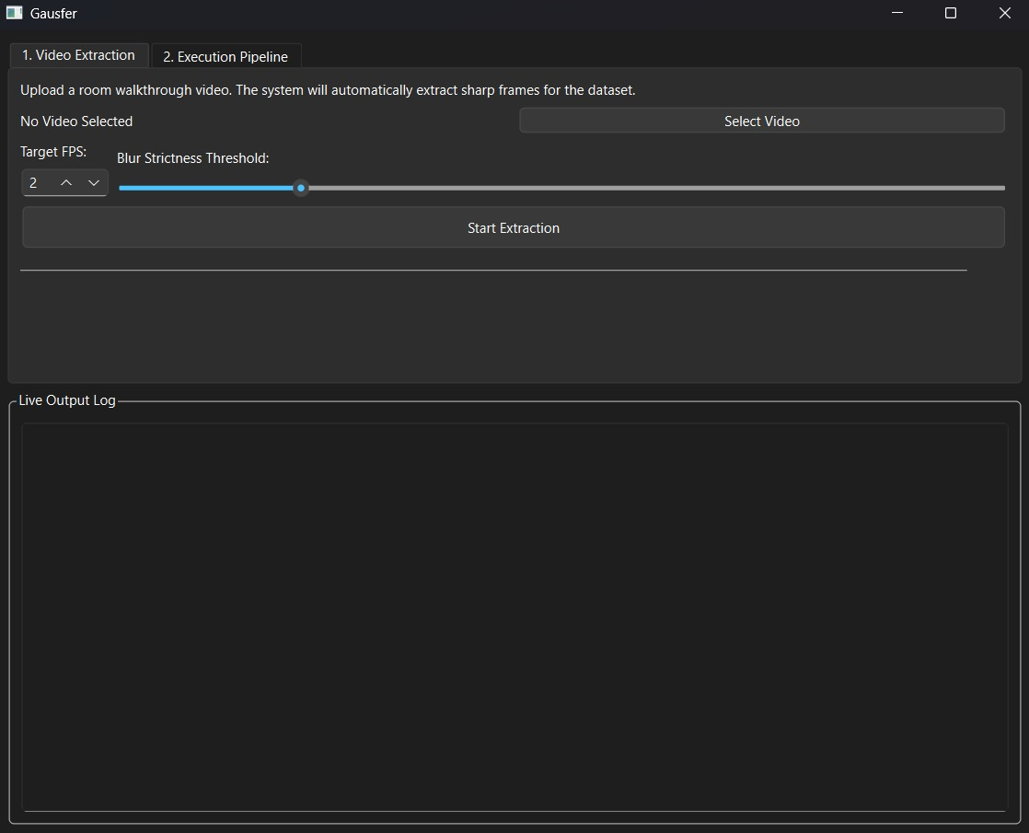
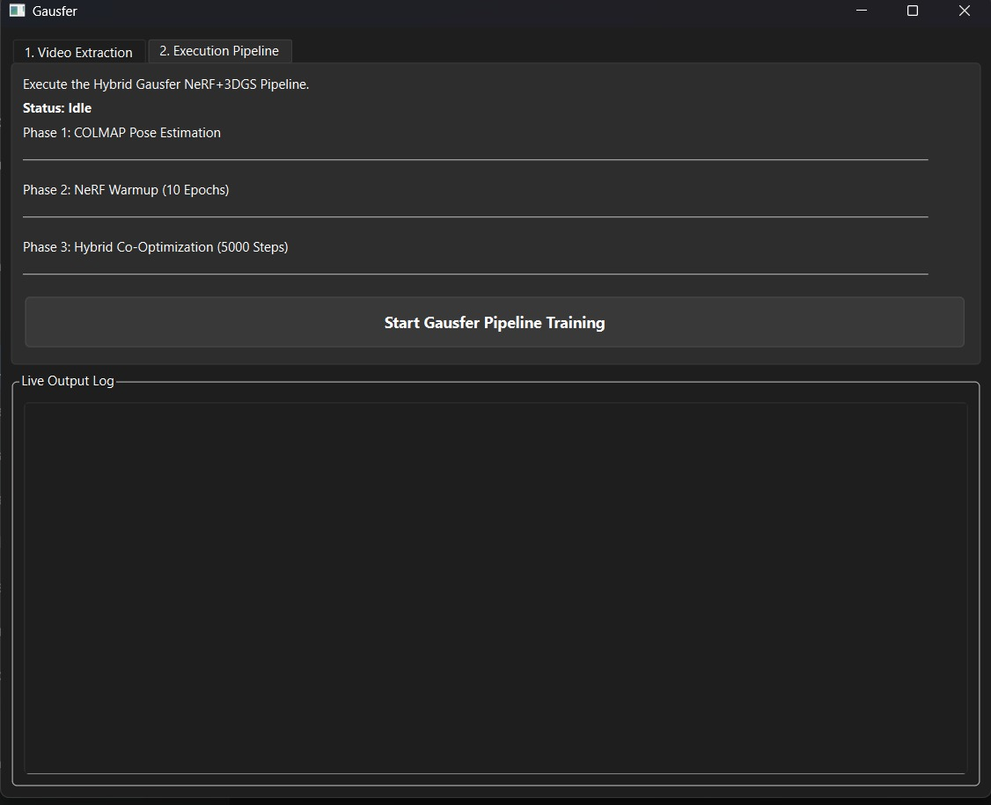
USER INTERFACE

Slide 34
CONCLUSION
By bridging the gap between implicit neural consistency and explicit rasterization speed, Gausfer 3D transforms static 2D snapshots into living digital architectures, paving the way for a future where high-fidelity 3D world-building is as accessible as a single click of a shutter."

