Slide 1
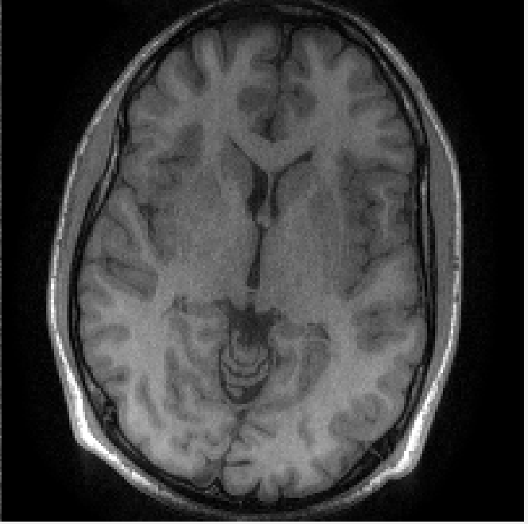
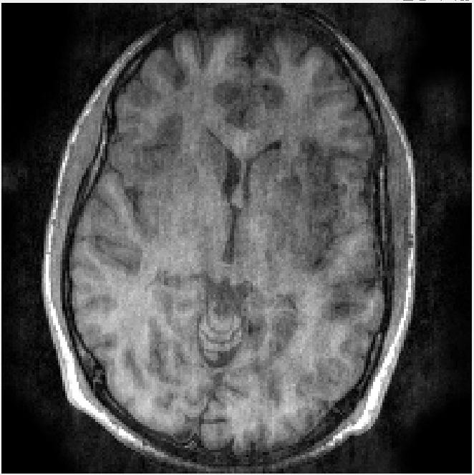
SAKE demo
SAKE nufft

Slide 2
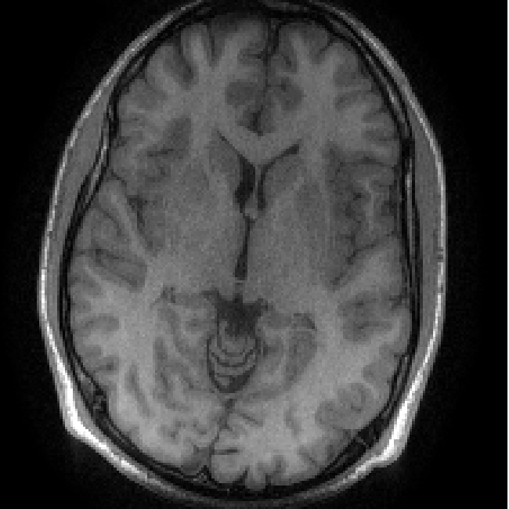
SAKE demo
Kernel size 5*5 instead of 6*6

Slide 3
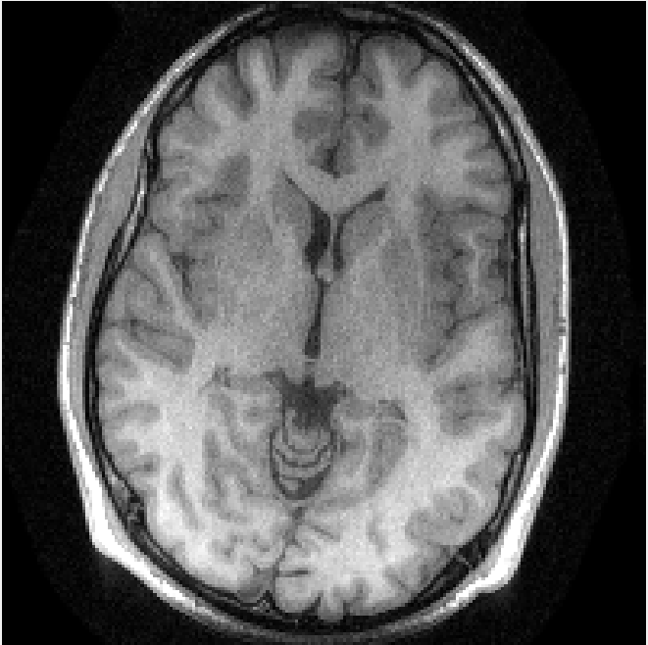
SAKE demo
cgL1ESPIRiT instead of cgESPIRiT

Slide 4
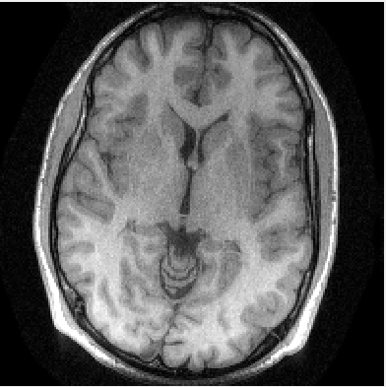
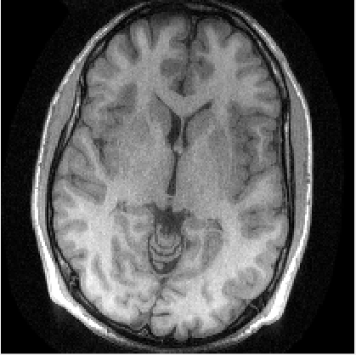
cgL1ESPIRiT nufft instead of cgESPIRiT; SAKE_nufft
cgL1ESPIRiT nufft instead of cgESPIRiT
SAKE demo

