Slide 1

DEPARTMENT OF COMPUTER SCIENCE AND ENGINEERING
Project name : Smart Water Management
Team name : Proj_224784_Team_3
Team members :
YUVARAJ K(113321104119)
GOWTHAMCHANDRAN J(113321104301)
KISHAN KANTH DS(113321104302)

Slide 2
PROJECT DEFINITION
Implementing an IoT-based system to optimize water distribution, monitor quality, and reduce wastage for sustainable and efficient water management in urban areas.
Deploying sensor networks and predictive analytics to proactively detect leaks, enhance water conservation, and ensure the longevity of water infrastructure.
Leveraging smart meters and user-friendly apps to empower consumers with real-time data, encouraging responsible water consumption and promoting sustainability.

Slide 3
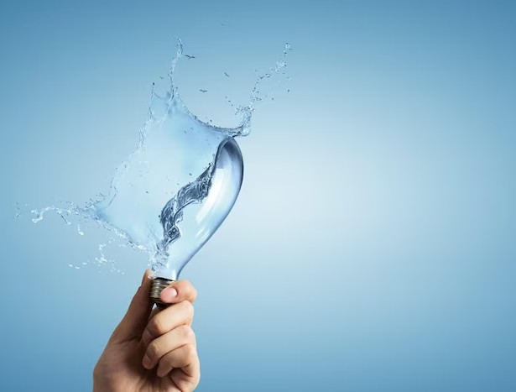
OBJECTIVES
Efficient Water Distribution: Optimize the distribution of water resources by implementing IoT sensors and control systems to monitor and adjust water flow in real-time, reducing inefficiencies and ensuring equitable access.
Water Quality Assurance: Continuously monitor and manage water quality parameters through automated sensors to promptly detect contaminants, pH levels, and turbidity, ensuring safe and clean drinking water for communities.
Leak Detection and Reduction: Develop algorithms and sensor networks to swiftly identify and locate water leaks in the distribution network, minimizing water loss and reducing maintenance costs.

Slide 4
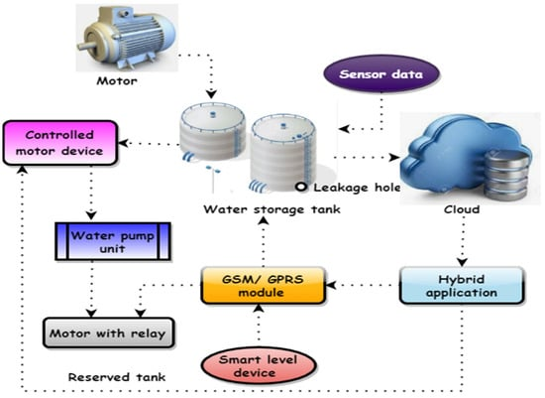
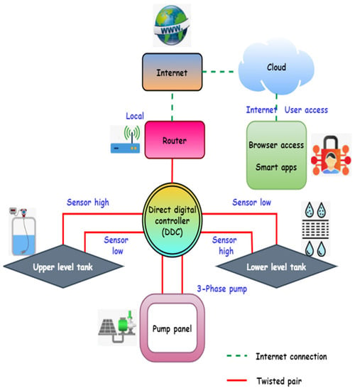
IOT DESIGN
Smart water tank using IOT
IOT-based smart water management systems

Slide 5
Real-Time Transit Information Platform
Objective:
Develop a real-time transit information platform to efficiently manage water resources.
Key Features:
IoT Sensors: Install sensors across the water distribution network to monitor flow rates, pressure, and water quality.
Data Integration: Collect and integrate data from various sources, including sensors, weather forecasts, and historical usage data.
Predictive Analytics: Utilize advanced analytics to forecast water demand, identify anomalies, and trigger alerts.
User Interface: Create a user-friendly web or mobile app for consumers and utilities to access real-time data and receive alerts.
Leak Detection: Implement algorithms to detect leaks promptly and pinpoint their location.
Automation: Enable automated control of water distribution to optimize flow and reduce waste.
Sustainability Initiatives: Promote water conservation through consumer engagement and educational campaigns.
Benefits:
Efficient water management
Reduced water wastage
Improved water quality
Cost savings for utilities
Enhanced customer engagement
Timely leak detection and repair
Stakeholders:
Water utilities
Local government agencies
Consumers and communities
Technology vendors
Environmental organizations
Timeline: Estimated project completion within 18-24 months.
Budget: To be determined during the planning phase

Slide 6
INTEGRATION APPROACH
Data Sources Integration:
  Collect data from IoT sensors placed in the water distribution network.
  Integrate data from weather forecasts to anticipate water demand based on climate conditions.
  Gather historical usage data to identify consumption patterns.
Data Processing and Storage:
  Process incoming data to extract relevant information.
  Store data in a centralized database or cloud platform for easy access and analysis.
Analytics and Prediction:
  Utilize predictive analytics algorithms to forecast water demand.
  Identify anomalies or irregularities in water flow and quality data.
User Interface Development:
  Create a user-friendly web or mobile application for consumers and utility operators.
  Integrate the application with the data processing system.
Alerting System:
  Implement an alerting system that sends notifications to users and utility operators in real-time.
  Alerts can include information on water quality issues, leaks, or abnormal usage patterns.
Automation and Control:
  Enable automated control of water distribution based on real-time data and predictions.
  Use control systems to adjust flow rates, pressure, and valve positions as needed to optimize water distribution.
Leak Detection:
  Integrate leak detection algorithms and sensors to identify leaks promptly.
  Pinpoint the exact location of leaks within the distribution network

Slide 7
INTEGRATION APPROACH
8.Consumer Engagement:
  Connect the user interface with sustainability initiatives.
  Engage consumers through the application by providing real-time usage data, conservation tips, and progress reports.
9.Monitoring and Reporting:
  Establish monitoring mechanisms to continuously assess the system's performance.
  Generate regular reports on water usage, quality, leak detection, and conservation efforts.
10.Stakeholder Collaboration:
  Ensure seamless communication and collaboration among stakeholders, including water utilities, local government agencies, technology vendors, and environmental organizations.
11.Security and Data Privacy:
  Implement robust security measures to protect sensitive data.
  Comply with data privacy regulations and guidelines.
12.Scalability and Flexibility:
  Design the integration architecture to be scalable, allowing for future expansion and addition of new sensors or features.
13.Testing and Optimization:
  Thoroughly test the integrated system to identify and resolve any issues.
  Continuously optimize the system for efficiency and accuracy.
14.Training and Support:
  Provide training to users and operators on how to effectively use and maintain the system.
  Offer ongoing technical support and updates.
15.Feedback Mechanism:
  Establish a feedback loop for users and utility operators to report issues or suggest improvements.

Slide 8
INTEGRATION BENEFITS
Efficiency Improvement: Integration streamlines data flow and communication between different parts of the system, reducing manual efforts and increasing operational efficiency. It allows for better coordination and decision-making in managing water resources.
Real-Time Insights: By integrating data sources and analytics, stakeholders gain access to real-time information on water distribution, quality, and usage. This enables timely responses to issues like leaks or spikes in demand.
Cost Savings: Efficient water distribution and timely leak detection result in reduced water wastage, which can lead to substantial cost savings for water utilities. Optimization also reduces energy consumption and maintenance costs.
Enhanced Sustainability: Integration enables better control over water resources, promoting sustainable usage and conservation. It supports the long-term viability of water supplies, benefiting both current and future generations.
Improved Water Quality: Integration allows for continuous monitoring of water quality parameters, helping to maintain safe and clean drinking water. Quick detection of contaminants or deviations from quality standards leads to faster remediation actions.
Consumer Engagement: Integrated systems often include user-friendly apps that provide consumers with real-time data on their water usage. This engagement encourages responsible water consumption and empowers consumers to make informed decisions.
Reduced Downtime: Integration facilitates proactive maintenance and repair of water infrastructure. Quick response to leaks and other issues minimizes service disruptions, ensuring uninterrupted water supply to communities

Slide 9
INTEGRATION BENEFITS
8.Data-Driven Decision-Making: Integration provides decision-makers with comprehensive data for informed choices in resource allocation, infrastructure planning, and sustainability initiatives.
9.Environmental Impact: By reducing water wastage and promoting conservation, integrated systems contribute to a smaller environmental footprint. This is crucial for mitigating the impact of water scarcity and climate change.
10.Regulatory Compliance: Integration helps water utilities and authorities meet regulatory requirements and reporting obligations related to water quality and distribution, reducing the risk of non-compliance.
11.Scalability: Integrated systems are often designed with scalability in mind, allowing for the addition of new sensors, features, or geographic expansion as needed.
12.Operational Resilience: Integration can enhance the resilience of water infrastructure by providing redundancy, automated failover, and backup systems in case of emergencies or system failures.
13.Data Security: Integration also includes robust security measures to protect sensitive water-related data, ensuring it remains confidential and secure.

Slide 10
CONCLUSION
Smart water management is essential for creating a sustainable future for our planet. By using innovative approaches such as smart water meters, rainwater harvesting, and greywater recycling, we can make every drop count. Let's work together to conserve water and create a more sustainable world.

Slide 11





Thanks!
Do you have any questions?
gowthamchandran.j@gmail.com
9566314162

