Slide 1
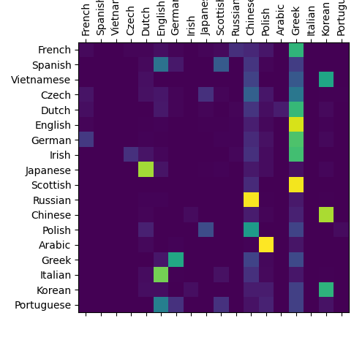
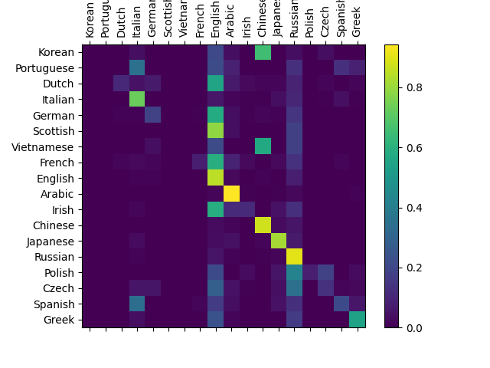
With lowercase transformation
Without lowercase transformation
This is Accuracy matrix. More brightness on the diagonal means more Actual being <Lang> and predicted as <Lang>

