Slide 1
Information Science
GSCI1801A
Lecture 0: Introduction
Asst. Prof. Chawanat Nakasan | 2020-10-05

Slide 2




About Me
Bachelor of Engineering
(Computer Engineering)
Kasetsart University, Thailand
Doctor of Engineering
(Information Science)
Nara Institute of Science and Technology

Slide 3
About Me
Currently working at Emerging Media Initiative (学術メディア創成センター)
Research and work topics:
Multipath networking
Information security
Computer science education
Favorite school subjects:
Computers
Physics
English

Slide 4

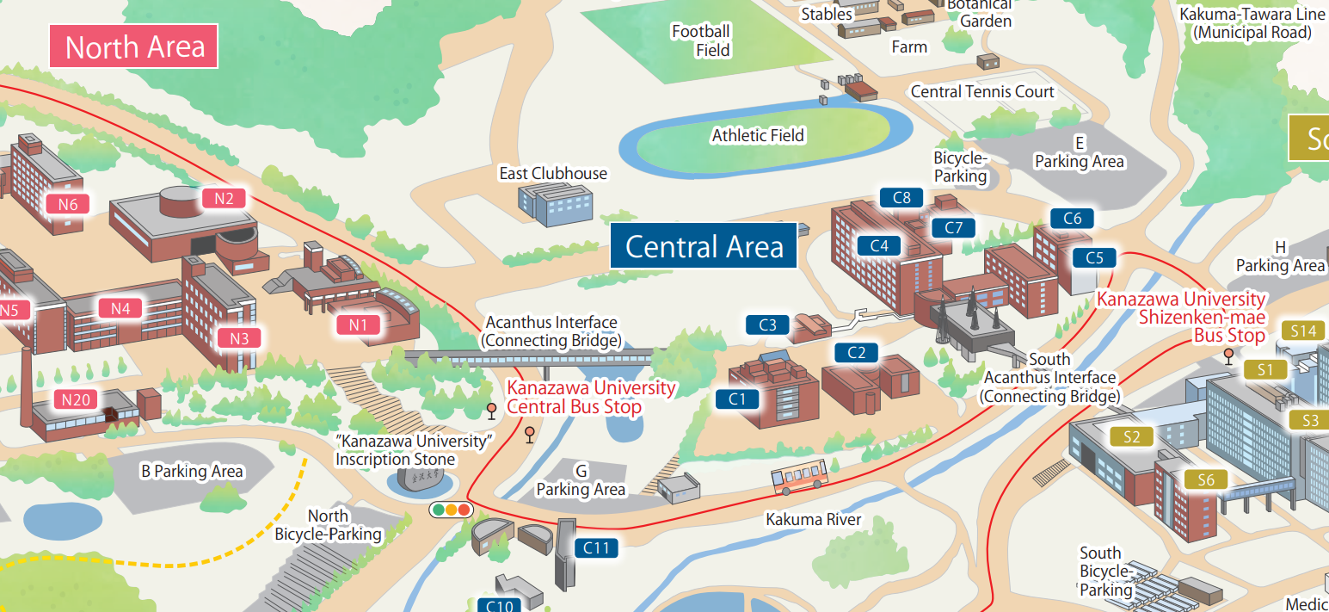
Class Time & Location
Tuesdays Period 3
Room B4
Location may change based on today’s attendance.

Slide 5
Welcome to the World of Computers
Computer Architecture
Problem Solving
Algorithms
Artificial Intelligence
Computer Networks
Databases
Security
Ethics
Arithmetic and Logic

Slide 6
Schedule
Class Content
Report (2-pages)
Exam
Roughly follows the previous slide!
One report due after Week 4, another due right after Week 8.
Exam is on Week 8. May be canceled due to Coronavirus or class logistics.
Current plan is up to 40 minutes, with 5 big questions.
Topic is flexible. We’ll talk later.

Slide 7
Weekly Schedule
Week/Date | Content | Activities
1 (2020-10-05) | Computer & Architecture
2 (2020-10-12) | Problem Solving & Algorithms
3 (2020-10-19) | Problem Solving & Algorithms
4 (2020-10-26) | Artificial Intelligence | Report #1 Announced
5 (2020-11-02) | Computer Networks
6 (2020-11-09) | Databases | Report #1 DUE
7 (2020-11-16) | Information Security & Computer Ethics | Report #2 Announced
8 (2020-11-30) | Review, Free Discussion (if exam held) (A video review will be uploaded if exam is not held. In this case, the class will be cancelled.) | Examination (if held) & Report #2 DUE

Slide 8
Difference from the Japanese Version
It’s in English!
More emphasis on problem solving
Quicker, more exciting, more engaging, and more fun!
This class is 100% in English.
This is one most important skill in computer science, and we will refine on it a lot.
This class is done OUR way, not MY way.

Slide 9
Contact
chawanat@ staff.kanazawa-u.ac.jp
Emerging Media Initiative 学術メディア創成センター
Room A202
Office Hours Tue 0900 -- 1200 Except some weeks!
Contact directly using E-mail. Use LMS for report submission.
Appointment not necessary but recommended.
Notes:
This is how I can be contacted. Please be careful with my email address: It’s my first name, and the part behind the @ sign is “staff” not IMC like some other professors.
When coming to IMC, please knock on my door at Room A202. If I’m not present, please leave me an email or message.

Slide 10







Coronavirus Prevention
Maintain Social Distancing
No-Contact Class Activities
Reduced Classroom Occupancy
Classroom B4 is limited to 50 persons.
Online Attendance is always allowed.
Hygiene
Masks (Mandatory)
Mitsu-no-Mi (3つの密) / Three C’s (MHLW)
Use the Hand Gel/Alcohol
Drinking water is OK. Avoid eating food.
Class Evaluation Changes
Online Participation Gives Credits (LMS, forums, chatroom, etc.)
All quizzes online!
Graphics: Google Material Design Icons

Slide 11
Online Attendance
Available at: https://knzw-univ.webex.com/knzw-univ/j.php?MTID=mba9fa634d2ad0019d31958670c0cffc9
(Link is also available in the LMS.)
If password is needed, it is “informationsci” (all small letters, no spaces, no quotes).
If the password is not accepted, then it’s not class or office hours.
Online attendance is also open to limited audience outside Kanazawa University (at my discretion).

Slide 12


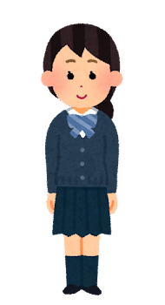
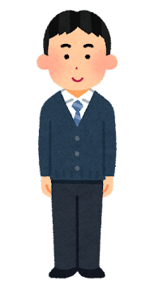
Public Offering
This class is also being offered worldwide to non-KU students.
Do not share official class material across two communities.
(Due to copyright and Google TOS.)
Download material only from your designated LMS.
KU students MUST use KU LMS.
General public MUST use Google LMS.
Graphics: いらすとや

Slide 13
For Non-Student Guests
Due to COVID-19 precautions, please do not come to the physical class if you are not officially registered.
Please do not interrupt the class. Questions should be asked through the chat system, not by opening your microphone.
Due to LMS structure and content licensing, I cannot make quizzes or official material available to non-students. (My slides are available publicly.)

Slide 14
I believe in talking! Let me know if:
I make errors
Quiz questions are outside course syllabus
You do not understand something
There are any comments
Something else is wrong

Slide 15
Grading Policy
Grading Levels
Breakdown (exam/no-exam)
Classroom (5%/10%)
Report (45%/90%)
Exam (50%/0%)
Participation 5%/10%
Quiz 5%/10%
Midterm 20%/45%
Final 25%/45%
Final Exam 50%/0%
S
A
B
C
90%
80%
70%
Participation + Quiz are added together and up to 5%/10% is used towards the final grade.
60%
KU General Studies may check your attendance.
Repeated absence is not recommended even if it is not scored.

Slide 16
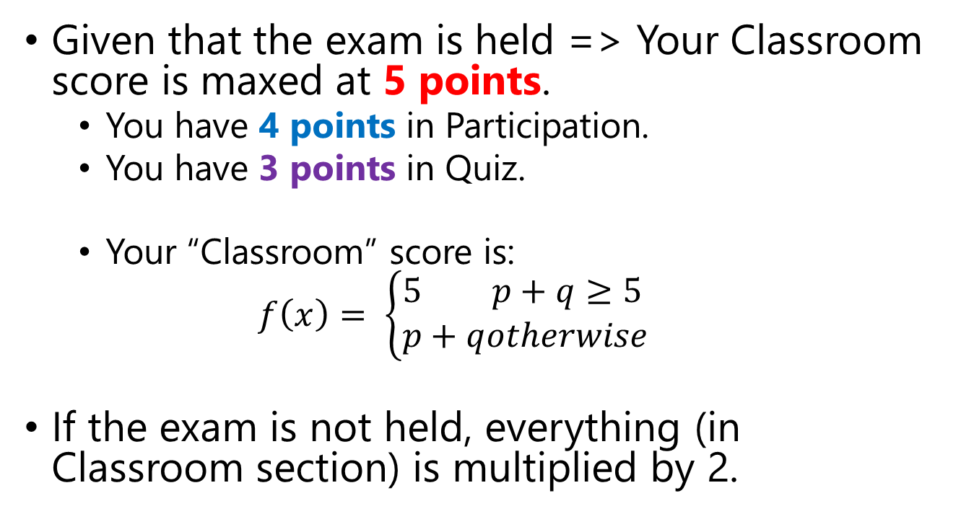
Grading Policy: Detailed Explanation
Given that the exam is held => Your Classroom score is maxed at 5 points.
You have 4 points in Participation.
You have 3 points in Quiz.
Your “Classroom” score is:
$$f\left(x\right)= \left\{\begin{aligned}&5&p+q≥5 \\ &p+q&otherwise\end{aligned}\right.$$
If the exam is not held, everything (in Classroom section) is multiplied by 2.

Slide 17
Pre-Lesson Quiz
Held every beginning of class (13:15 ~ 13:25).
You MUST sincerely attempt all questions.
Online students: This is the only way to get marked as present.※
At Home: LMS Only
In Class: LMS or Paper
※ You may still be marked absent if you do the quiz on LMS, but I can’t find you online or in classroom.

Slide 18
Pre-Lesson Quiz: Can’t use PC?
Due to Novel Coronavirus situation …
Quiz submission method may change as the class progresses.
If you cannot use your PC for any reason (including accessibility), please do your quiz on a piece of paper. Grading will be the same. Please understand that this is an alternative method.
* Japanese Name (if available) * English Name (last name in CAPITALS)
* Full Student ID Number
角間 あざみ
KAKUMA Azami
205XXXXXXX
Write your answers in the paper.
紙に書いてください。
Use pen only (do not use pencil), except diagrams and figures.
ペンのみ使ってください。図はえんぴつもＯＫです。
SINCERELY attempt all questions, or your quiz will not be scored.
本気じゃないで答える場合は、クイズを採点しません。
TIME LIMIT: 10 MINUTES AFTER CLASS STARTS!
授業開始後10分まで！

Slide 19
Pre-Lesson Quiz: Question Types
PRE-TEST
GRADED
Graded Questions
QUESTIONNAIRE
Pre-Test and Questionnaire
Affects your score.
Refers to past lessons.
Today we will not have graded questions.
No score.
Refers to today’s class or asks for your comments.
SINCERELY attempt all questions, or your quiz will not be scored.
クイズを本気で答えない場合は、採点しません。
All questions must be answered unless it is marked OPTIONAL.
問題に[OPTIONAL]をつけてると、答えなくてもいいです。

Slide 20
Pre-Lesson Quiz: Not Answering?
QUESTIONNAIRE
1. ………
2. ………
3. ………
OPTIONAL
You may answer:
---
No opinion. 特になし
“Prefer not to Answer”
QUESTIONNAIRE
OPTIONAL
QUESTIONNAIRE
OPTIONAL
SINCERELY attempt all (other) questions, or your quiz will not be scored.
クイズを本気で答えない場合は、採点しません。
All questions must be answered unless it is marked OPTIONAL.
問題に[OPTIONAL]をつけてると、答えなくてもいいです。

Slide 21
Report
There will be two reports.
You can choose the topic for each report.
Deadline will be listed together with the announcement.
Submit all reports by LMS.

Slide 22
Class Rules (Syllabus Item 20.1)
Substandard Information Security Behavior
Displaying your Kanazawa University ID (account name),
or clicking suspicious links (if I see you do it), etc.
Fine: 2% off final score. 81/100 ➔ 79/100. A ➔ B!!!
This cannot push you from C to fail.
Plagiarism / 盗作
ZERO TOLERANCE
INSTANT, PERMANENT, FINAL, EPIC FAIL.
ALWAYS reference sources!
Do not copy from friends or other sources. Think and write your own reports!
Check the other rules in the hard-copy syllabus. (On LMS)

Slide 23
Get ready for the class!

Slide 24
Fair Use Indicator & License (If you want to copy my slides for personal use)
If the slide number is gray, all content (text, pictures, etc.) is mine.
If the number is blue, some content belongs to Kanazawa University. It might be okay for personal use.
If the number is red, some content belongs to non-KU entity. Copy with caution.
This presentation incorporates Google Material Design Icons and clip arts provided through Microsoft Office Design Ideas.
This presentation incorporates 4 instances of 4 clip art illustrations from いらすとや, out of 20 permitted for noncommercial use (link goes to archived いらすとや terms of use).

