Slide 1
Information Science
GSCI1801A
Lecture 1: Computer and Architecture, and Basic Operations in Computer Science
Asst. Prof. Chawanat Nakasan | 2021-10-05

Slide 2
Agenda
What’s a computer?
What’s inside a computer?
Explanation of various components
Computer Architecture
Binary Number System
Arithmetic Operations
Logical Operations

Slide 3
What’s a computer?
a machine that can be programmed to manipulate symbols. Its principal characteristics are:
It responds to a specific set of instructions in a well-defined manner.
It can execute a prerecorded list of instructions (a program).
It can quickly store and retrieve large amounts of data.
https://www.cs.cmu.edu/~fgandon/lecture/uk1999/computers_types/

Slide 4
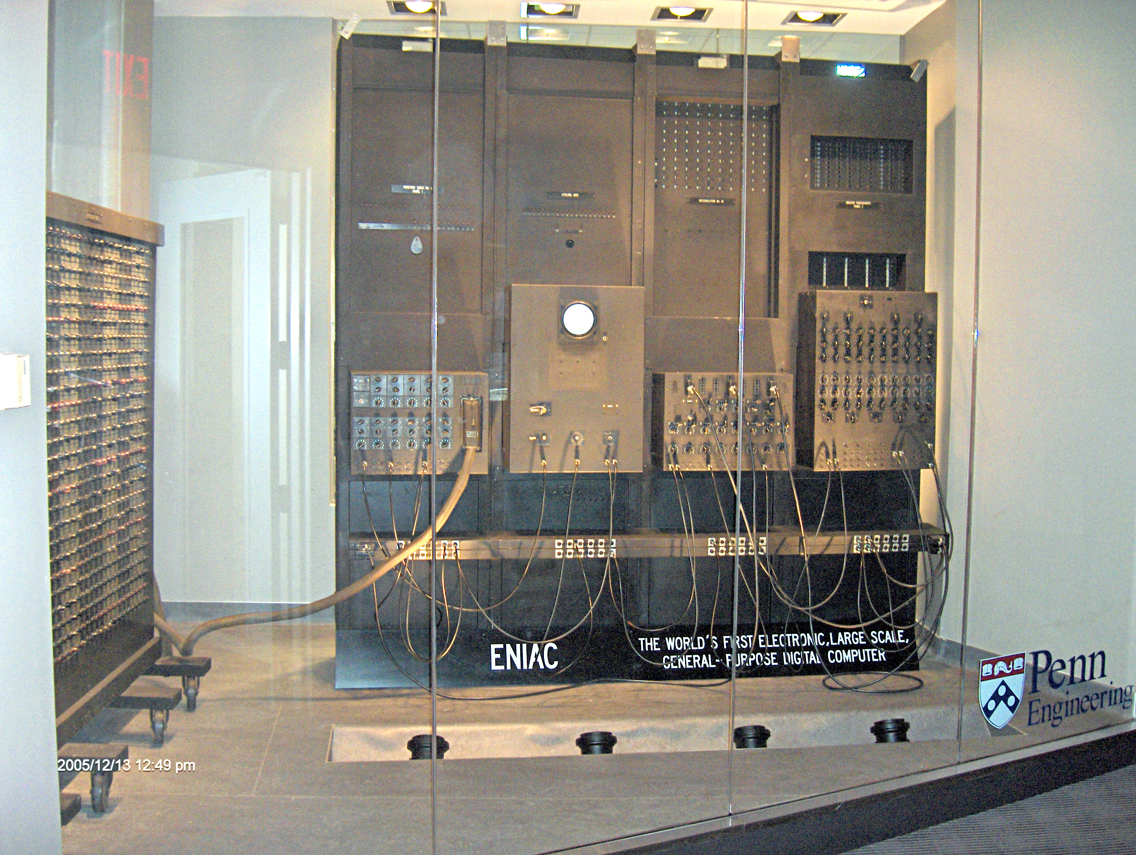
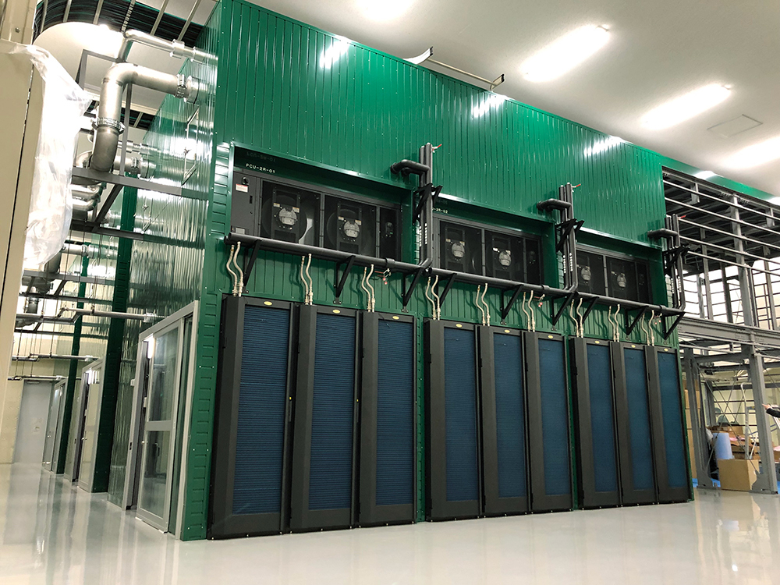
How fast is a computer?
ENIAC, 1945 (USA)
Speed: 5,000 cycles per second
ABCI, 2018 (Japan)
Speed: 37 PFLOPS (high precision real numbers)
In less than a century, world-leading computers got faster by at least 7 billion-fold.

Slide 5
What’s in a (typical) computer?
Heatsink & Fan
Primary Memory
(RAM)
I/O
USB Ports
Network Interface
Sound Jack
etc.
CPU
Motherboard
Power Supply
Expansion (PCI)
GPU(s)
SSDs (card type)
Extra I/O
Extra Network
Secondary Memory: SATA Ports
HDDs & SSDs (cable type)
Other devices (BD, DVD, …)
Notes:
Secret Question:
Can you have multiple GPUs? How do they work?
Can you have multiple network interfaces? How do they work?

Slide 6
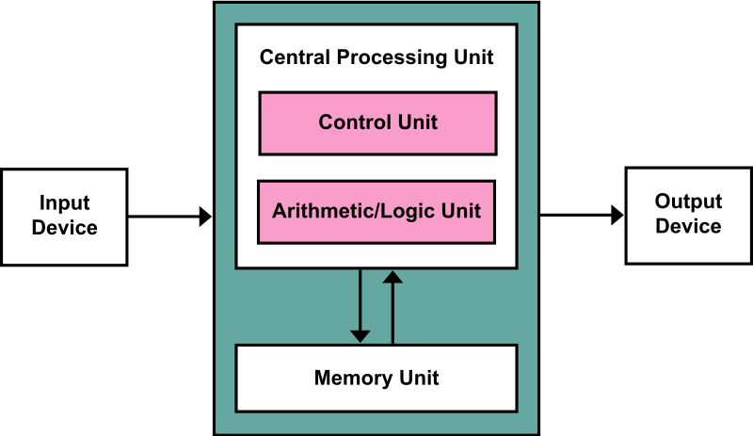
Basic Computer Architecture [[von Neumann Architecture]]
Examples of Output: Display Sound Printer Network Interface*
Processor (“CPU”)
Input Devices
Control Unit (CU)
Output Devices
Arithmetic Logic Unit (ALU)
Registers and Cache (considered as storage on CPU)
Examples of Input: Keyboard Mouse Network Interface*
Storage
(May be on or off motherboard)
Examples of Storage: RAM Hard Drives Removable Storage
*Network Interface is a funny oddball and will be greatly explained later!

Slide 7
Memory Hierarchy
faster, smaller, more expensive
Register
In CPU
Cache
RAM
Solid-State Drives (SSD) (card type)
On Board
Solid-State Drives (SSD) (cable type)
In Enclosure
Hard-Disk Drive
Removable Media Back-Up Drives Networked Storage
External / Removable
slower, larger more affordable

Slide 8
Binary number system

Slide 9
Binary Number System
Conversion from/to Decimal
Representing negative numbers
Why it’s easier than decimal?
Binary systems in the nature

Slide 10
What is decimal number?
4,482,692,653
4,000,000,000
400,000,000
80,000,000
2,000,000
600,000
90,000
2,000
600
50
3
4×10⁹
4×10⁸
8×10⁷
2×10⁶
6×10⁵
9×10⁴
2×10³
6×10²
5×10¹
3×10⁰

Slide 11
Now, what is binary number?
11101010
>> This part is decimal
10000000
1000000
100000
00000
1000
000
10
0
1×2⁷ = 128
1×2⁶ = 64
1×2⁵ = 32
0×2⁴ = 0
1×2³ = 8
0×2² = 0
1×2¹ = 2
0×2⁰ = 0
234

Slide 12
Indicating Numbers by Bases
Using Subscripts
10001101₂
10001101₁₀
0b10001101
10001101
Programming Style
Binary Numbers (“bin”)
Decimal Numbers (“dec”)

Slide 13
A Bit and a Byte
Bit is the smallest digital information possible.
This is a bit.
10001101₂
8 bits make a byte.
A lot more meaningful data in computers are in bytes, such as characters (1 or 2 bytes) and numbers (1-8 bytes).
Files are almost never stored by individual bits.
Notes:
Note that a byte used to consist of more or less than 8 bits. Nowadays, it is commonly accepted that 8 bits make a byte, and a character (ASCII. We might get to learn about Unicode later.) is encoded on a per-byte basis.

Slide 14
Conversion Methods
Binary to Decimal
Decimal to Binary
Position value method (earlier)
Short division method
Position value method
Notes:
The position value method is just math we showed earlier. The fun method is the short division.

Slide 15
Decimal to Binary by Short Division
Remainder
2
223
112 1
223 = ?₂

Slide 16
Decimal to Binary by Short Division
Remainder
2
2
223
112 1
56 0
223 = ?₂
Please continue dividing until you reach 1.
The first student to show their work gets a participation point.
In-class: Raise your hand.
Online: Use “raise hand” function in WebEx.

Slide 17
Decimal to Binary by Short Division
Remainder
2
2
2
2
2
2
2
2
223
112 1
56 0
28 0
14 0
7 0
4 1
2 0
1
223 = ?₂
10100001₂
Read back upwards

Slide 18
Quick Detour Binary’s brothers: the oct and the hex
10001101₂
215₈
8C₁₆
0b10001101
0215
0x8C
Binary Numbers (“bin”)
Octal (“oct”)
Hexadecimal (“hex”)
Notes:
In the world of engineering and computing, there are also two more important number bases, the octal system (0-7) and the hexadecimal system (0-F).
The octal system is not much used, but it can appear sometimes if you’re working with triplets of binary data. On the other hand, hex is widely used everywhere especially to compact binary numbers.

Slide 19
Quick Detour Binary’s brothers: the oct and the hex
bin ⬄ hex and bin ⬄ oct conversion is very easy!
16 = 2⁴ so one digit in oct = 4 digits in bin.
8C₁₆
10001101₂
215₈
8 = 2³ so one digit in oct = 3 digits in bin.

Slide 20
Analog and Digital … where binary is used, a lot.
Computers are actually trillions of electronic switches and signals.
Electronic systems can work on either:
Voltage (V)
Voltage (V)
Time
Time
Analog System
Digital System
Conversion from A=>D involves sampling and quantization.
Notes:
It’s much easier to operate on digital signals than analog ones.
While circuits that work with digital signals are more complex and require more engineering, operating and programming with digital circuits is much easier to understand. I can show you my transcript for undergraduate, and let’s hope we agree on this one :(

Slide 21
Discussion
Are digital computers “accurate”?
How do they work with natural information like noise and light?

Slide 22
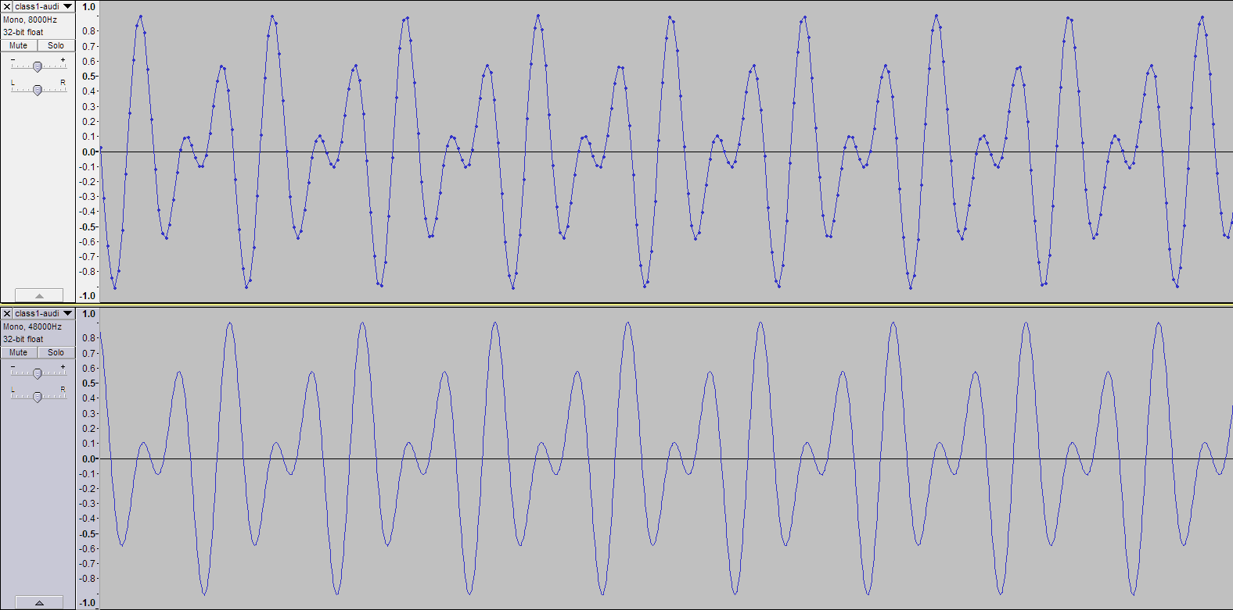
Sampling Example
Accurate quantization and sampling requires more bits.
8 kbps, 8000 Hz sampling
320 kbps, 48000 Hz sampling
Software used: Audacity 2.1.2 © Audacity Team; Data: generated using this software.

Slide 23
Arithmetic Operations
Addition
Subtraction
Multiplication
Division and Modulo (same operation!)
Note: We’ll discuss addition and multiplication today.
It doesn’t end like you think …

Slide 24
Addition
36 + 29 = 100110₂ + 011101₂
100110₂
+011101₂
₂
Learn More:
https://www.sciencedirect.com/topics/computer-science/binary-addition

Slide 25
Two kinds of operations in adding
Carrying
1
11₂
+01₂
Adding
0₂

Slide 26
Discussion
Is binary arithmetic easier than decimal? Why?

Slide 27
Negative Numbers in Digital Logic: 2’s Complement
There are no minus signs in digital logic, so John von Neumann invented something cool: Two’s Complement.
81 =
01010001₂
Flip all bits
10101110₂
For this to work, we need another zero bit up front.
Then add 1
10101111₂
= -81 … ?

Slide 28
2’s Complement (cont.) Now try it.
01010001₂
+10101111₂
100000000₂
Participation Point! Can someone help me add this?
Disregard this bit. If we are working with 8-bit computer, it has no place.

Slide 29
Why computers do not really have subtraction?
Addition = Add and Carry operations
Subtraction (arithmetic) = Subtract and Borrow operations
Subtraction (computer) = 2’s Complement and Addition {Add & Carry}!

Slide 30
Multiplication: Decimal
22
×34
88
66
22×4
22×3
748

Slide 31
Multiplication: Binary
1001₂
×1011₂
Filtering Operation
1001
Σ
Add Operation
1001
0000
Shifting Operation
1001
1100011₂
EASIER than decimal multiplication!

Slide 32
Logical Operations
Work on each bit at a time.
Good for signal control and manipulation.
Integrated Circuit full of Different Operations and Stuff ※
1100 1100 0101 0010
0011 0011 1010 1101
Input A
Output X
Input B
Output Y
1111 0000 1111 0000
1100 0000 0101 0000
Bonus point!: What are Output X and Y, logically?
※ This is traditionally called a black box. Black in this case means “cannot see the inside.”

Slide 33
Logical Operators and Logic Gates
A
A
X
X
B
B
AND Gate
OR Gate
A | B | X = A ∧ B
0 | 0 | 0
0 | 1 | 0
1 | 0 | 0
1 | 1 | 1
A | B | X = A ∨ B
0 | 0 | 0
0 | 1 | 1
1 | 0 | 1
1 | 1 | 1
※ You can also use “X = A AND B” and “X = A OR B” respectively.

Slide 34
Logical Operators and Logic Gates
A
A
X
X
B
XOR Gate
Inverter (“NOT”)
A | B | X = A ⊕ B
0 | 0 | 0
0 | 1 | 1
1 | 0 | 1
1 | 1 | 0
A | X = ¬A
0 | 1
1 | 0

Slide 35
NAND, NOR, and XNOR
They provide opposite results from AND, OR, XOR respectively.
A
A
A
B
X
B
X
B
X
NAND Gate
NOR Gate
XNOR Gate
A | B | X = ¬(A ∧ B)
0 | 0 | 1
0 | 1 | 1
1 | 0 | 1
1 | 1 | 0
A | B | X = ¬(A ∨ B)
0 | 0 | 1
0 | 1 | 0
1 | 0 | 0
1 | 1 | 0
A | B | X = ¬(A ⊕ B)
0 | 0 | 1
0 | 1 | 0
1 | 0 | 0
1 | 1 | 1

Slide 36
Multiple-Input Gates
Both logical math and logic gates can extend to more than two operands (where it makes sense).
A
B
X
C
A | B | C | X = A ∧ B ∧ C
0 | 0 | 0 | 0
0 | 0 | 1 | 0
0 | 1 | 0 | 0
0 | 1 | 1 | 0
1 | 0 | 0 | 0
1 | 0 | 1 | 0
1 | 1 | 0 | 0
1 | 1 | 1 | 1

Slide 37
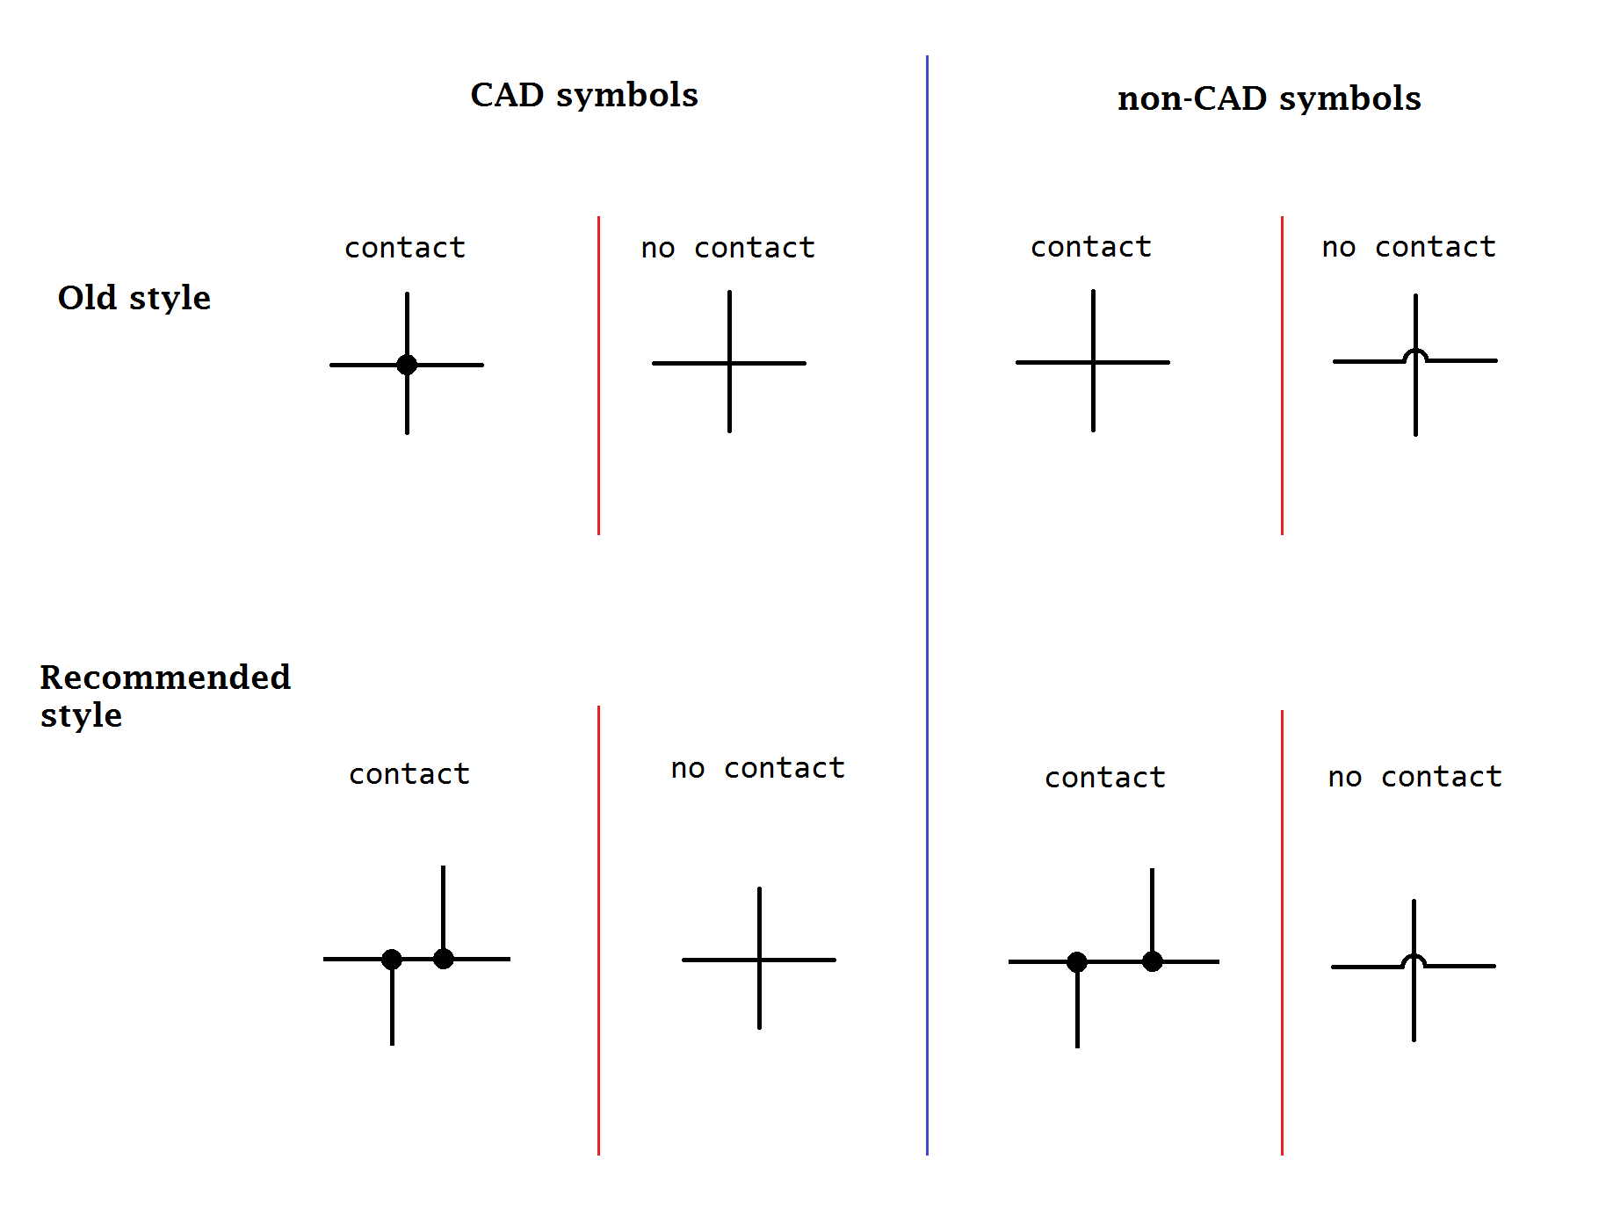
4-way crossovers in Electrical Diagrams
This is how to correctly draw 4-way crossovers in electrical diagrams (and logic gate diagrams).
This class follows either old or recommended style.
Jumping is always better than no-dot crossing, but sometimes it is inconvenient in most drawing tools.
(Three-way junctions should also have dots, but PPT can’t draw them automatically.)
https://en.wikipedia.org/wiki/Circuit_diagram#/media/File:Wire_Crossover_Symbols_for_Circuit_Diagrams.png

Slide 38
Combining them together, we can achieve a lot of results.
Output W
Input A
Output X
Input B
Output Y
Input C
Output Z
Bonus Point: What is this circuit? Explain in human language!

Slide 39
Hint: Trace one output at a time.
Output W
Input A
Output X
Input B
Output Y
Input C
Output Z
W = (A ∧ B) ∧ C

Slide 40
Hint: Trace one output at a time.
Output W
Input A
Output X
Input B
Output Y
Input C
Output Z
Download the slide from LMS and try later from your home ☺

Slide 41
Logic Gate Simulation
You can try various tools for logic gate simulation if you want to understand them better.
We’ll be using many kinds of simulators throughout the class, and you can also use them for your reports too. Get used to them ☺
https://circuitverse.org/simulator
https://academo.org/demos/logic-gate-simulator/

Slide 42
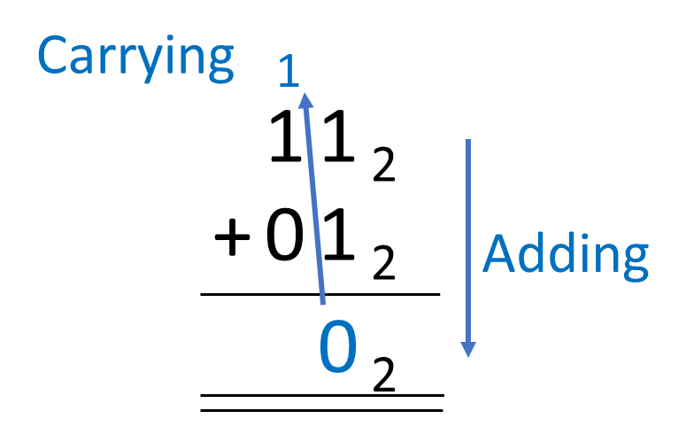
Logic to Arithmetic: Half Adders
Input A
Sum
Input B
Carry
A | B | C = A ∧ B | S = A ⊕ B
0 | 0 | 0 | 0
0 | 1 | 0 | 1
1 | 0 | 0 | 1
1 | 1 | 1 | 0
Circuit contains both adding and carrying!

Slide 43
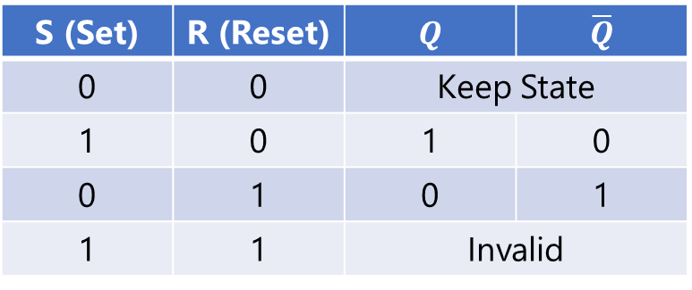
Logic to Operations: SR Latch
S (Set) | R (Reset) | $$Q$$ | $$\overline{Q}$$
0 | 0 | Keep State
1 | 0 | 1 | 0
0 | 1 | 0 | 1
1 | 1 | Invalid
※ The official KU textbook uses the term “RS Flip-Flop” which is the same.
The difference is that the textbook illustrates a NAND SR Latch. Here we use NOR SR Latch.
They both achieve same results.

Slide 44
Wait! Is that memory?
0/1
A Little Bit!
We just (re)discovered 1 bit of memory!
Achievement Unlocked!
It took humanity about 300 years from the first definition of electricity by William Gilbert to creating the first flip-flop.
(A modern smartphone with 256 GB memory contains about 2,048,000,000,000 bits.)

Slide 45
In-Class Activity
Create a circuit diagram and a truth table for the following expression:
X = (A ∧ B) ∨ C

Slide 46
In-Class Activity
X = (A ∧ B) ∨ C

Slide 47
In-Class Activity
X = (A ∧ B) ∨ C
Input A
Input B

Slide 48
In-Class Activity
X = (A ∧ B) ∨ C
Input A
Input B
Output X
Input C

Slide 49
In-Class Activity
X = (A ∧ B) ∨ C
A | B | C | A ∧ B | (A ∧ B) ∨ C
0
0
0
0
1
1
1
1
A
B
X
C
Copy Here
Paste Here

Slide 50
In-Class Activity
X = (A ∧ B) ∨ C
A | B | C | A ∧ B | (A ∧ B) ∨ C
0 | 0
0 | 0
0 | 1
0 | 1
1 | 0
1 | 0
1 | 1
1 | 1
A
B
X
C

Slide 51
In-Class Activity
X = (A ∧ B) ∨ C
A | B | C | A ∧ B | (A ∧ B) ∨ C
0 | 0 | 0
0 | 0 | 1
0 | 1 | 0
0 | 1 | 1
1 | 0 | 0
1 | 0 | 1
1 | 1 | 0
1 | 1 | 1
A
B
X
C

Slide 52
In-Class Activity
If C is 1, then X is immediately 1.
X = (A ∧ B) ∨ C
A | B | C | A ∧ B | (A ∧ B) ∨ C
0 | 0 | 0
0 | 0 | 1 |  | 1
0 | 1 | 0
0 | 1 | 1 |  | 1
1 | 0 | 0
1 | 0 | 1 |  | 1
1 | 1 | 0
1 | 1 | 1 |  | 1
A
B
X
C

Slide 53
In-Class Activity
Fill in the logic for A AND B.
X = (A ∧ B) ∨ C
A | B | C | A ∧ B | (A ∧ B) ∨ C
0 | 0 | 0 | 0
0 | 0 | 1 | 0 | 1
0 | 1 | 0 | 0
0 | 1 | 1 | 0 | 1
1 | 0 | 0 | 0
1 | 0 | 1 | 0 | 1
1 | 1 | 0 | 1
1 | 1 | 1 | 1 | 1
A
B
X
C

Slide 54
In-Class Activity
Compute the rest of the logic.
X = (A ∧ B) ∨ C
A | B | C | A ∧ B | (A ∧ B) ∨ C
0 | 0 | 0 | 0 | 0
0 | 0 | 1 | 0 | 1
0 | 1 | 0 | 0 | 0
0 | 1 | 1 | 0 | 1
1 | 0 | 0 | 0 | 0
1 | 0 | 1 | 0 | 1
1 | 1 | 0 | 1 | 1
1 | 1 | 1 | 1 | 1
A
B
X
C

Slide 55
In-Class Activity
Done.
X = (A ∧ B) ∨ C
A | B | C | A ∧ B | (A ∧ B) ∨ C
0 | 0 | 0 | 0 | 0
0 | 0 | 1 | 0 | 1
0 | 1 | 0 | 0 | 0
0 | 1 | 1 | 0 | 1
1 | 0 | 0 | 0 | 0
1 | 0 | 1 | 0 | 1
1 | 1 | 0 | 1 | 1
1 | 1 | 1 | 1 | 1
A
B
X
C

Slide 56
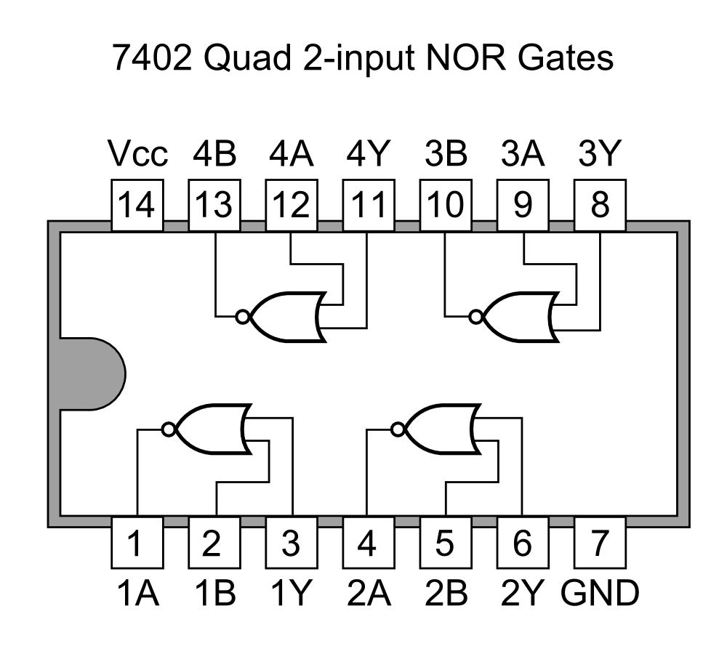
Logic gates in ICs
This is the 7400 IC.
You may notice the dot at the end of OR. This is the NOR gate.
There are hundreds of millions of these gates in a CPU.
By Tosaka - Author's original, CC BY 3.0, https://commons.wikimedia.org/w/index.php?curid=6518691

Slide 57
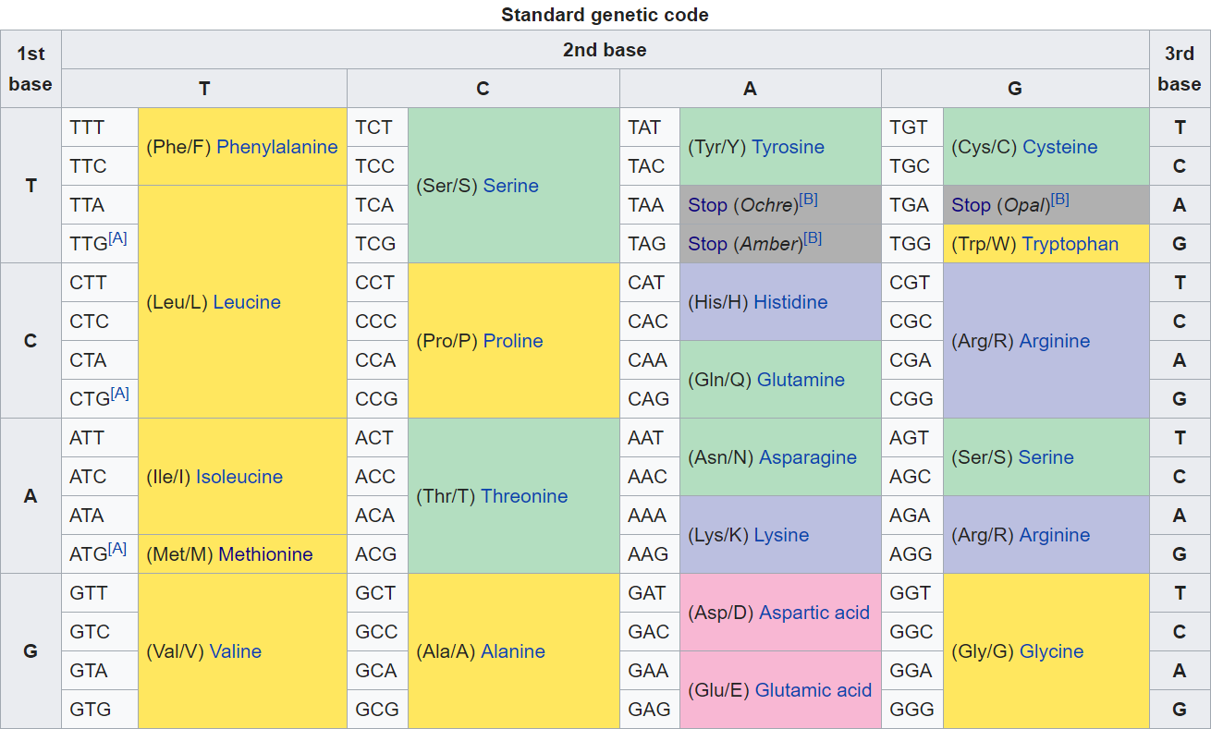
Binary in the Nature
There is one important that work “similar” to binary. It’s actually our DNA.
https://en.wikipedia.org/wiki/DNA_codon_table

Slide 58
Wait, what?
There are 4 bases, right? We can try to represent:
DNA Base | Binary
T | 00
C | 01
A | 10
G | 11
Note: This is a simplification.

Slide 59
Store DNA information in binary!
※
atgagagcggtccatctccttgcggtgagc
30 bases
60 bits = ~ 8 bytes
DNA Base | Binary
T | 00
C | 01
A | 10
G | 11
100011 101110 110111 110001 011000 010001 010000 110111 110011 101101
Human Genome = 3 BILLION bases => 750 Megabytes PER PERSON AT LEAST. (Just the data)
NOTE AGAIN: This is just a sample hypothetical case!
Download human genome at https://www.gencodegenes.org/human/
(FASTA file for ALL regions = 800+ MB compressed)

Slide 60
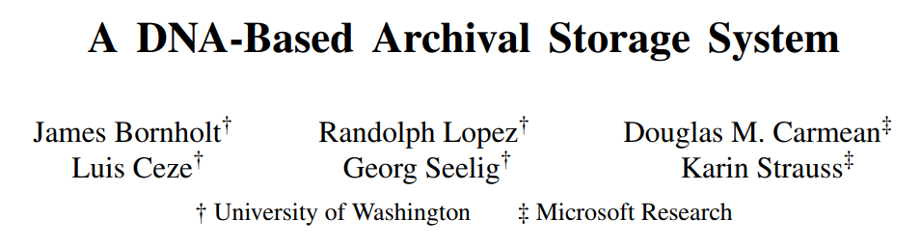
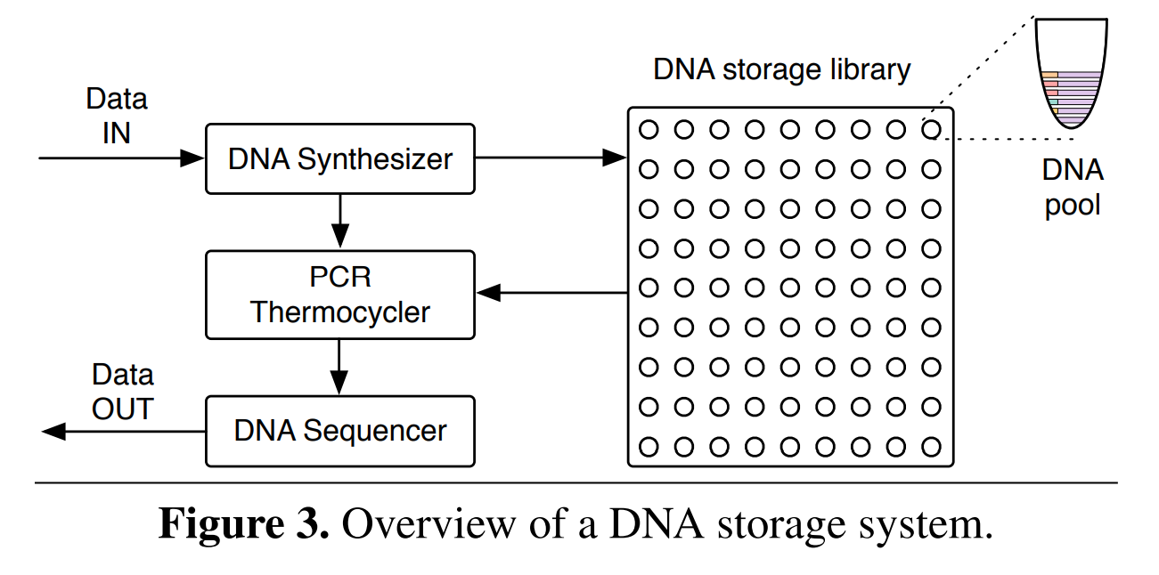
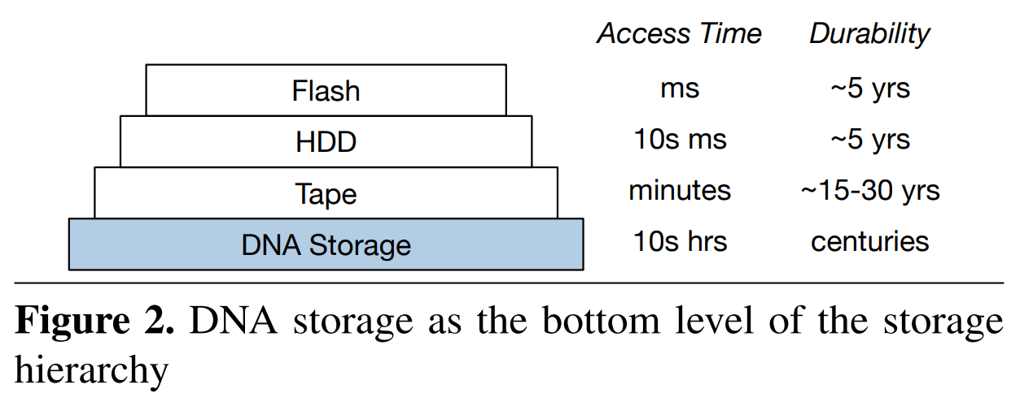
And, store binary information in DNA …

Slide 61
Discussion
How can we represent other things in binary form?
What do you think about using DNA as data storage?

