Slide 1
Information Science
GSCI1801A
Lecture 2: Flowcharts, Data, and Algorithms (Part 1)
Asst. Prof. Chawanat Nakasan | 2021-10-12

Slide 2
Agenda
Flowcharts & Flow Control
Branching (Decision; if/if-else)
Loops (Iteration; while/do-while/for)
Data & Data Types
Primitive Data Types
Data Encoding
Composite Data Types
Algorithms
Time Complexity of Algorithms
(Next Class) Types of Algorithms
(Next Class) Problem Solving

Slide 3
Where are we in the CS curriculum?
Year 1
Year 2
Year 3
Year 4
Programming
Architecture
Operating System
Security
GS classes
Algorithms
Data Communication
Ethics
General Data Science Lectures
Data Types
Networks
Advanced Networks
This is from CS curricula in general, not specific to Kanazawa University.

Slide 4
2.1. Flowcharts & Flow Control

Slide 5
Flowcharts?
Flowchart SIMPLE
Start
Walk to the Counter
Show how something is done.
A rounded rectangle (“capsule”) represents the beginning and the end of the process.
A (right-angle) rectangle represents individual steps of the process.
Order Something
Walk to the Cashier
Pay
Walk to the Table
Eat
Clean Up
Full standard for flowcharts is written in ISO 5807:1985.
(ISO papers are expensive, so we usually don’t buy them.)
Finish

Slide 6
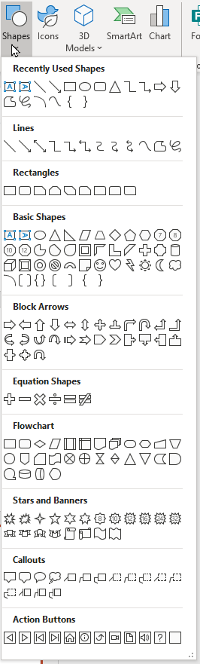
How to draw flowcharts? (This might be useful for your homework!)
Paper: you can use rulers and plastic templates to help!
General-purpose vector graphics software (InkScape, etc.)
Dedicated diagramming software (draw.io, MS Visio, etc.)
You can also draw using general-purpose office applications like MS Word and PowerPoint.
MS PowerPoint:
Use these symbols
※ You can use any method for your report as long as it is submitted in PDF.

Slide 7
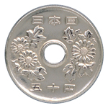
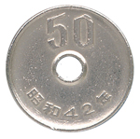
Branching (or Decisions)
Flowchart COINFLIP
Start
Flip a coin!
Where should I eat today?
Use the rhombus (diamond) shape to indicate decisions.
Decisions should only be YES or NO. Use more diamonds to create complex decision trees.
Note 1: Vocabulary:
表 = (omote) Obverse Side
裏 = (ura) Reverse Side
Note 2: A coin may also land on the edge, but it is usually ignored in probability discussions.
Heads?
YES (Heads)
NO (Tails)
Cafeteria
Office
Finish
Coin image: Ministry of Finance

Slide 8
Loops (Iterations) Repeating the same action many times.
Flowchart PAPERS
Start
I need to grade papers, each labeled i, and record them as pass/fail.
In programming and maths, variable “i” is usually used to indicate index of things.
If you need more indices (indexes), use “j” and “k”.
Any Papers?
NO
YES
Grade the i^{th} Paper
Pass?
1 PASS
2 FAIL
…
n
Papers
Papers
Papers
Write: <i> PASS
Write: <i> FAIL
Papers
Papers
Use this symbol for input/output.
Participation Point
I’m missing something in this flowchart.
Finish

Slide 9
Flowcharts in daily life!
Flowchart TARTAR
Start
Anything left in the menu?
NO
I hate tartar sauce.
I read the menu until I find one that does not include tartar sauce.
What’s your process for choosing what to eat?
Is this accurate? What am I missing? (Hint: No, and it’s not in the flowchart. It’s a “business logic” problem.)
YES
Read next item
YES
Tartar Sauce?
NO
Buy and eat it!
Get something from the Co-Op
Finish
Notes:
One possible answer: I did not account for the possibility that the Co-Op might also carry tartar sauce items, or worse, only tartar sauce items.

Slide 10


Loops within Loops
Flowchart TABLECOPY
Start
Let i=1
$$i≤n$$
NO
Sometimes you have many levels of operations, such as iterating through a table.
This flowchart shows how to copy and multiply values from Table A to Table B.
YES
Let j=1
$$j≤n$$
NO
YES
 | 1 | 2 | … | n
1 | 5 | 3 | … | 2
2 | 7 | 5 | … | 2
 | ⋮ | ⋮ | ⋱ | ⋮
n | 1 | 7 | … | 5
 | 1 | 2 |  | n
1 | 50 | 30 | … | 20
2 | 70 | 50 | … | 20
 | ⋮ | ⋮ | ⋱ | ⋮
3 | 10 | 70 | … | 50
B[i, j] = A[i, j] * 10
Increment j
Increment i
Table A
Table B
Finish

Slide 11
Essence of Loops
Flowchart BOSSFIGHT
Start
A loop consists of four elements:
Initialization
Condition
Action
Modification
Repetition
(Only Repetition is necessary to make a loop.)
In programming, there are many ways to apply these elements.
But, if you understand what loops are, you can write them in any language! ☺
Set Boss HP = 200
Boss HP > 0?
NO
YES
Attack it.
HP decreases by some amount.
Finish

Slide 12
Summary of Flow Control
Branching splits your procedure into two paths.
Loops create repetition allowing you to do the same (or similar) thing many times.
These two concepts are extremely important for algorithm studies, coming right ahead!

Slide 13
2. Data Types

Slide 14
Data Types
Primitive Data Type
Composite Data Type
Usually just one thing, like a single number.
Consists of many primitive data elements together.

Slide 15
Data Types
True
False
1
-200
‘a’
Primitive Data Type
3.141592
Usually just one thing, like a single number.
2021/10/02 13:15:00

Slide 16
Primitive Data Types
Boolean Values
True or False
Characters
Numeric Data Types
Integers: already discussed
Real Numbers

Slide 17
Encoding gives meaning to data
Computers understand only zeroes and ones.
So, it is up to us to give data meaning.
Number 0
Power Off
False
No
Black Pixel
???
Number 1
Power On
True
Yes
White Pixel
???
0
1

Slide 18
Using more bits, we can have a range of values.
0
0
0
0
0
0
0
0
0
1
1
1
1
1
1
1
1
255
0
1
0
0
0
0
0
1
65

Slide 19
We can also assign them specific meaning.
0
1
0
0
0
0
0
1
65
Binary | Octal | Decimal | Hexadecimal | Character
100 0001₂ | 101₈ | 65 | 41₁₆ | A
100 0010₂ | 102₈ | 66 | 42₁₆ | B
100 0011₂ | 103₈ | 67 | 43₁₆ | C
100 0100₂ | 104₈ | 68 | 44₁₆ | D
100 0101₂ | 105₈ | 69 | 45₁₆ | E
100 0110₂ | 106₈ | 70 | 46₁₆ | F
ASCII code table representation reproduced from https://en.wikipedia.org/wiki/ASCII

Slide 20
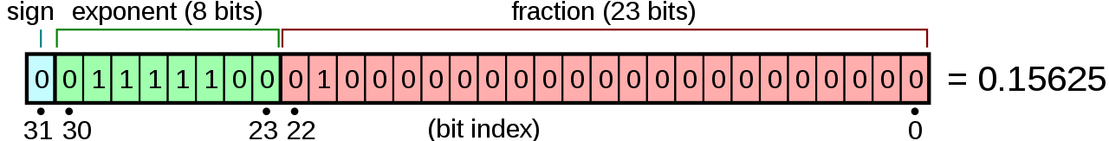
Real numbers are also made from bits and integers.
Picture of IEEE 754 representation of a number, https://en.wikipedia.org/wiki/IEEE_754
Graphics: Stannered / Wikipedia

Slide 21
Composite Data Types
Array:
many of the same primitives, each of them are individual
Record:
many of potentially different primitives, collectively forming a larger thing
There are many other terms like lists, but today we’ll discuss the most key terms.

Slide 22
Arrays: many of the same primitives
65, 90, 65, 77, 73
Dec | Char | Dec | Char
65 | A | 78 | N
66 | B | 79 | O
67 | C | 80 | P
68 | D | 81 | Q
69 | E | 82 | R
70 | F | 83 | S
71 | G | 84 | T
72 | H | 85 | U
73 | I | 86 | V
74 | J | 87 | W
75 | K | 88 | X
76 | L | 89 | Y
77 | M | 90 | Z
can be translated to
‘A’, ‘Z’, ‘A’, ‘M’, ‘I’
This is called an “array”.
An array of characters is usually called a “string”.
ASCII code table representation reproduced from https://en.wikipedia.org/wiki/ASCII

Slide 23
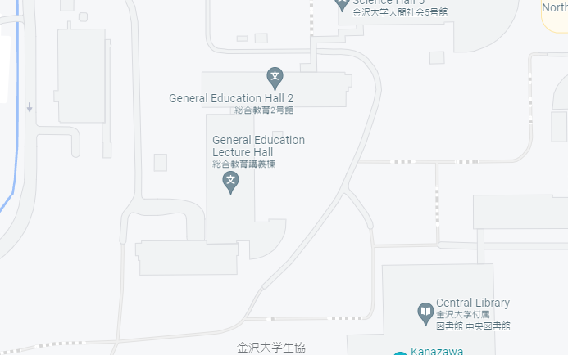
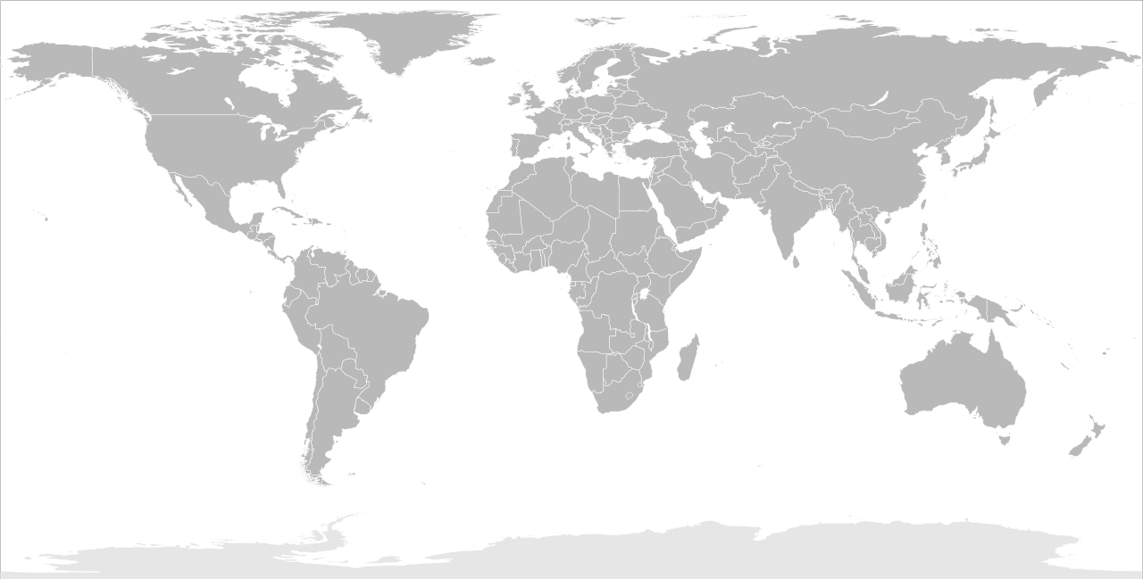
Lots of things in life can be translated to a set of values.
36.5495581,136.7096057
Coordinates can be represented using two real numbers.
Graphic Sources (excluding previously cited): https://commons.wikimedia.org/wiki/File:BlankMap-World.svg; Google Maps
Image of floating-point representation is not accurate and used for presentation only.

Slide 24
Different types of data can be recorded together.
Suppose we want to describe a food item at the cafeteria. This might be how it works:
A string
{
"name": "katsudon",
"price": 400,
"allergens": ["egg"],
"restrictions": ["meat", "nonvegan", "pork"],
"picture": "https://example.com/food/image.png"
}
An integer
Arrays of strings
Another string, but this is a URL.
These braces { } group all the data into a single record.
This data format is called JSON (JavaScript Object Notation). You can learn more from https://www.json.org/

Slide 25
3. Algorithms
And analysis of time complexity

Slide 26
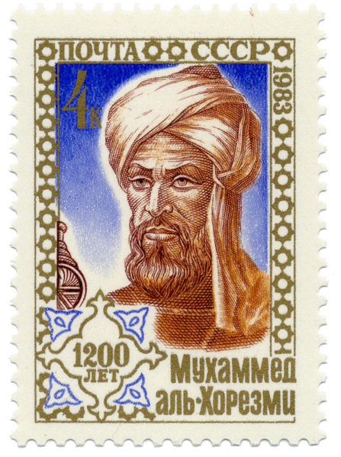
What is Algorithm?
“a set of mathematical instructions or rules that, especially if given to a computer, will help to calculate an answer to a problem”
– Cambridge Dictionary
“a procedure for solving a mathematical problem (as of finding the greatest common divisor) in a finite number of steps that frequently involves repetition of an operation” – Merriam-Webster
“a list of rules to follow in order to solve a problem” – BBC
Muhammad ibn Musa al-Khwarizmi,
the mathematician namesake of “Algorithm”.
Depicted on a Soviet stamp in 1983.

Slide 27
What is Algorithm?
procedures, instructions, or rules
finite number of steps
“given to a computer”

Slide 28
Important points:
If you can draw it in a flowchart, it’s already probably an algorithm.
Algorithms can be expressed in many different ways.
Time complexity analysis presented here will be very simple, intended for quick glimpses.

Slide 29
Suppose that we want to copy a string:
Algorithm 3-1 (refer to the English textbook of Information Science)
The textbook (Weng, 2021) example:
The very same algorithm written as Python code:
Start
Input n
n = int(input().strip())
s = 0
i = 1
while i <= n:
s = s + i
i = i + 1
print(s)
s = 0
s = s + i
i = 1
i = i + 1
i > n
Flowcharts and program codes have different purposes. These two represent the same algorithm.
Output s
End

Slide 30
This loop here can run many times.
Algorithm 2-4 (refer to the English textbook of Information Science)
Start
Input n
s = 0
s = s + i
We run the instructions (reach each box) 3n + 4 times in total.
This algorithm takes linearly increasing time to run compared to the size of n.
i = 1
i = i + 1
i > n
Output s
End

Slide 31
Describing Time Complexity
Time complexity is popularly described using the “Big O Notation”.
This is basically just the largest part of the time expression, without the multiplier in front.
In our case, the previous algorithm is O(n), because our time expression is 3n+4.

Slide 32
O(n²) example
Flowchart TABLECOPY
Start
i=1
$$i≤n$$
NO
Instructions are run n² + n + 1 times.
YES
j=1
$$j≤n$$
NO
YES
 | 1 | 2 | … | n
1 | 5 | 3 | … | 2
2 | 7 | 5 | … | 2
 | ⋮ | ⋮ | ⋱ | ⋮
n | 1 | 7 | … | 5
 | 1 | 2 |  | n
1 | 50 | 30 | … | 20
2 | 70 | 50 | … | 20
 | ⋮ | ⋮ | ⋱ | ⋮
3 | 10 | 70 | … | 50
B[i, j] = A[i, j] * 10
j = j + 1
i = i + 1
Table A
Table B
Finish

