Slide 1
Information Science
GSCI1801A
Lecture 3: Algorithms (Part 2) and Problem Solving
Asst. Prof. Chawanat Nakasan | 2021-10-19

Slide 2
Agenda
Flowcharts & Flow Control
Data & Data Types
Algorithms
Time Complexity of Algorithms (Cont.)
Types of Algorithms
Examples of Algorithms
Problem Solving

Slide 3
Where are we in the CS curriculum?
Year 1
Year 2
Year 3
Year 4
Programming
Architecture
Operating System
Security
GS classes
Algorithms
Data Communication
Ethics
General Data Science Lectures
Data Types
Networks
Advanced Networks
This is from CS curricula in general, not specific to Kanazawa University.

Slide 4
Time Complexity Analysis

Slide 5
Importance: An algorithm can be implemented quickly or slowly!
Model example:
Prime Number Determination (IsPrime)
“Is this number a prime number?”

Slide 6
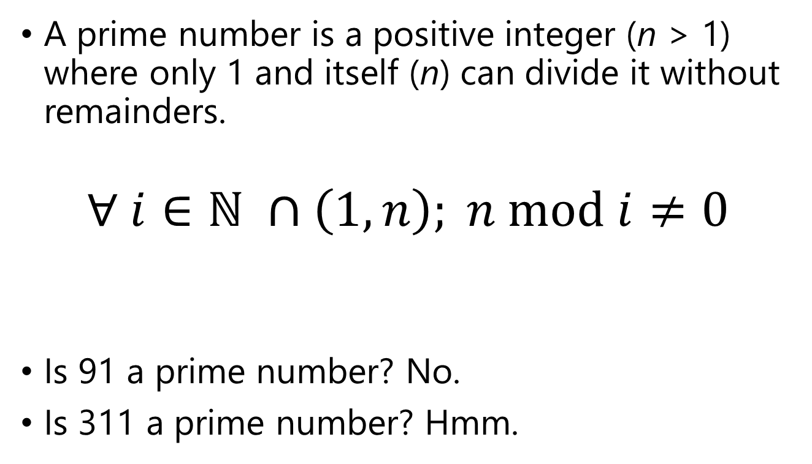
IsPrime
A prime number is a positive integer (n > 1) where only 1 and itself (n) can divide it without remainders.
$$∀ i∈ℕ ∩\left(1, n\right); n mod i≠0$$
Is 91 a prime number? No.
Is 311 a prime number? Hmm.
Example of mod (modulo):
10 / 3 = 3 R 1
∴ 10 mod 3 = 1
20 / 4 = 5 R 0
∴ 20 mod 4 = 0

Slide 7
IsPrime method 1: Naïve Brute-Forcing Every Number
Test every divisor from 2 to n.
311 mod 2 = ?
311 mod 3 = ?
311 mod 4 = ?
…
311 mod 310 = ?
You must perform at least n-2 calculations.
This means the time complexity of this method is O(n).
Start
receive input n
let i = 2
i ≤ n-1?
NO
YES
n mod i == 0?
YES
answer “prime”
NO
i++
answer “not prime”
End

Slide 8
IsPrime method 1: Naïve Brute-Forcing Every Number
Flowcharts are getting a little unwieldy at this point, so I’ll start writing algorithm in text instead.
Start
receive input n
Input: integer n where n > 1
for i ← 2…(n-1):
if n mod i = 0:
answer “not prime”
end if
i++
end for
answer “prime”
let i = 2
i ≤ n-1?
NO
YES
n mod i == 0?
YES
answer “prime”
NO
i++
answer “not prime”
This algorithm in text is equivalent to the flowchart on the right.
End

Slide 9
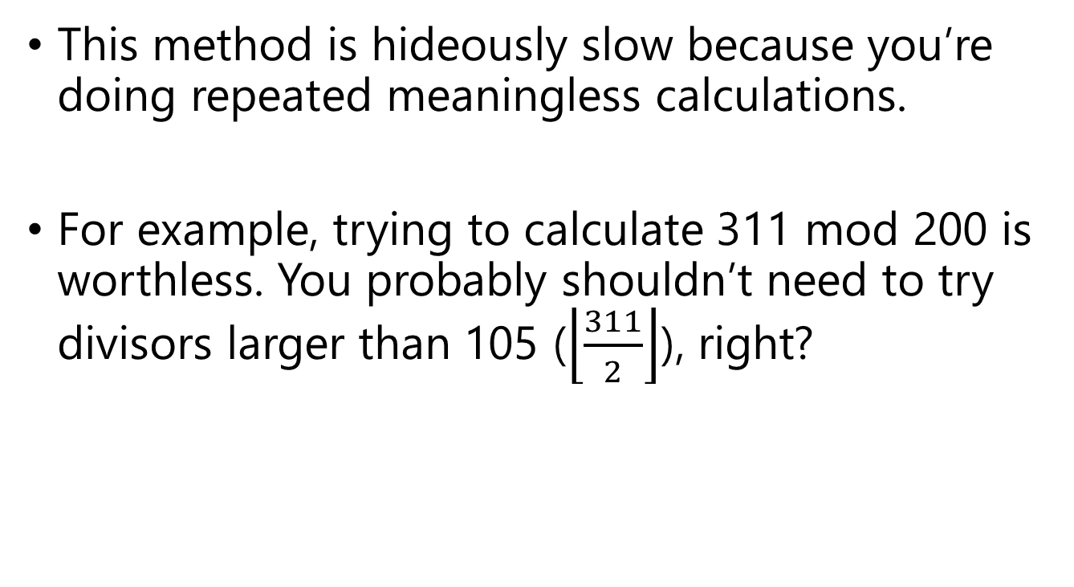
IsPrime method 1: Naïve Brute-Forcing Every Number
This method is hideously slow because you’re doing repeated meaningless calculations.
For example, trying to calculate 311 mod 200 is worthless. You probably shouldn’t need to try divisors larger than 105 ($\left\lfloor \frac{311}{2}\right\rfloor$), right?

Slide 10
IsPrime method 1.2: Naïve Brute-Forcing Every Number
half of the range
Start
Input: integer n where n > 1
for i ← 2…((n-1)/2):
if n mod i = 0:
answer “not prime”
end if
i++
end for
answer “prime”
receive input n
let i = 2
i ≤ (n-1)/2?
NO
YES
n mod i == 0?
YES
answer “prime”
NO
i++
answer “not prime”
End

Slide 11
IsPrime method 1.2: Naïve Brute-Forcing Every Number
half of the range
You still must perform about (n-1)/2 operations.
Time complexity remains O(n).
Input: integer n where n > 1
for i ← 2…((n-1)/2):
if n mod i = 0:
answer “not prime”
end if
i++
end for
answer “prime”

Slide 12
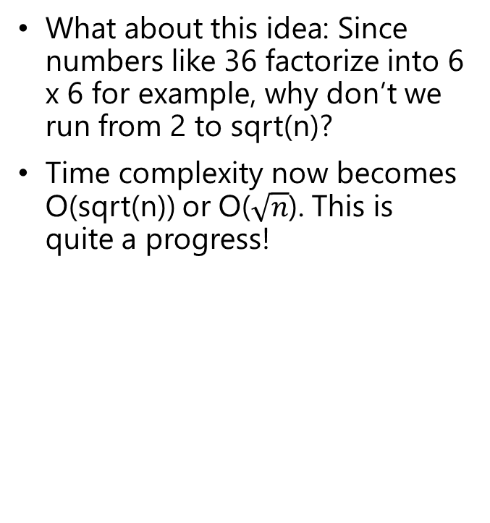
IsPrime method 2: Brute-Force from 2 to sqrt(n)
What about this idea: Since numbers like 36 factorize into 6 x 6 for example, why don’t we run from 2 to sqrt(n)?
Time complexity now becomes O(sqrt(n)) or O($\sqrt{n}$). This is quite a progress!
Input: integer n where n > 1
for i ← 2…sqrt(n):
if n mod i = 0:
answer “not prime”
end if
i++
end for
answer “prime”

Slide 13
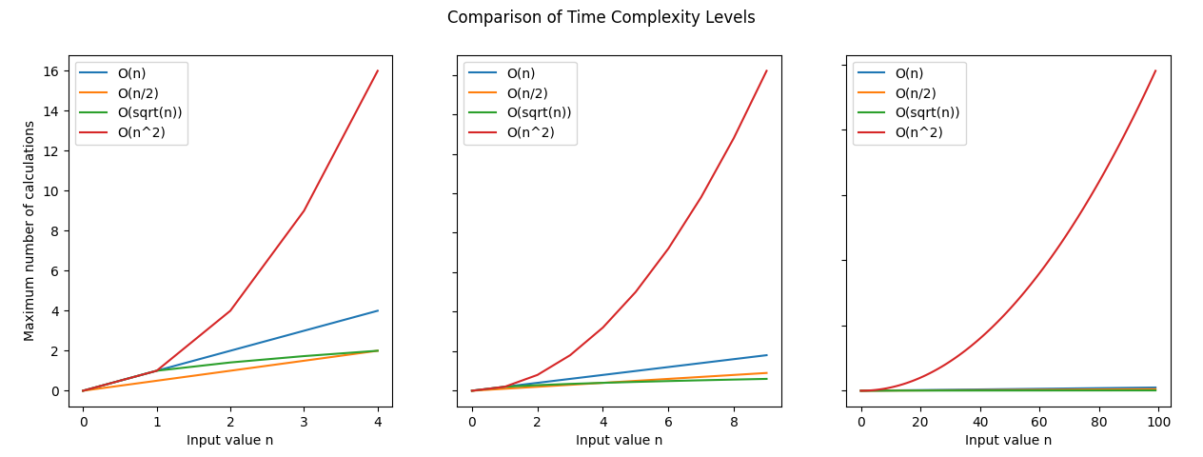
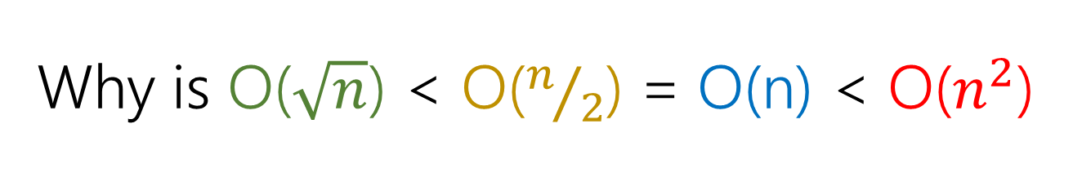
Why is O($\sqrt{n}$) < O($n/2$) = O(n) < O($n^{2}$)
Knowing a bit about number factors!
Linear Brute-Force
Remember TableCopy from last week?

Slide 14
Conclusion
We have learned about the nature of some simple time complexity levels.
We will continue to use time complexity levels in our lectures.
Efficient algorithm design helps improve performance and conserve computation power.

Slide 15
Types and Examples of Algorithms

Slide 16
Notes
This is not meant to be an exhaustive list of all possible algorithms.
I’ll list only algorithms that have nice and useful philosophy which can be adapted for near-future problem solving, in this class or in your life.
You are not limited to using these types of algorithms to solve real-world problems.

Slide 17
Recursion Algorithms
Recursion in algorithms is the definition of problem in a way that refers to the smaller version of the problem.

Slide 18
Why is recursion important?
Many real-world problems can be solved by solving a smaller version of the problem, then doing a little extra work.
Many real-world phenomena exhibit some degree of recursion.

Slide 19

Recursion: Factorial
$$n!= \left\{\begin{aligned}1& if n=0 \\ n×\left(n−1\right)!& otherwise\end{aligned}\right.$$

Slide 20


Recursion: Factorial
$$n!= \left\{\begin{aligned}1& if n=0 \\ n∙\left(n−1\right)!& otherwise\end{aligned}\right.$$
Example:
$$3!=3∙\left(3−1\right)!$$
$$=3∙2!$$
$$=3∙2∙\left(2−1\right)!$$
$$=3∙2∙1!$$
$$=3∙2∙1∙\left(1−1\right)!$$
$$=3∙2∙1∙0!$$
$$=3∙2∙1∙1$$
$$=6$$

Slide 21
Real-world examples of factorials
How many ways can you arrange these three shapes?

Slide 22
Real-world examples of factorials
3 possible shapes

Slide 23
Real-world examples of factorials
3 possible shapes
2 possible shapes

Slide 24
Real-world examples of factorials
3 possible shapes
2 possible shapes
1 possible shape
3 x 2 x 1 = 6

Slide 25
Expand this to “n” boxes:
n
(n-1)
(n-2)
…
1
= n!
This is called permutation.
Number of possible permutations when we have n boxes to contain n different things is n!
(There are other, more specific cases, but you will learn that in discrete mathematics.)

Slide 26
Recursion: Sorting
Recursion is also very useful for sorting.
How do you normally sort numbers?
TASK: Sort the following number from smallest to largest.
5
4
12
2
6
7
1

Slide 27
Sorting: Selection Sort:
Let A be the data array.
min?
min?
min?
A
5
4
12
2
6
7
1
A₀
A₁
A₂
A₃
…
A_{n-2}
A_{n-1}
Swap the value at anchor with the lowest value.
Remember: Computers are not very smart!

Slide 28
Sorting: Selection Sort :
Let A be the data array.
min?
min?
A
1
4
12
2
6
7
5
A₀
A₁
A₂
A₃
…
A_{n-2}
A_{n-1}
Remember: Computers are not very smart!

Slide 29
Sorting: Selection Sort :
Let A be the data array.
min?
A
1
2
12
4
6
7
5
A₀
A₁
A₂
A₃
…
A_{n-2}
A_{n-1}
Remember: Computers are not very smart!

Slide 30
Sorting: Selection Sort :
Let A be the data array.
min?
min?
A
1
2
4
12
6
7
5
A₀
A₁
A₂
A₃
…
A_{n-2}
A_{n-1}
Remember: Computers are not very smart!

Slide 31
Sorting: Selection Sort :
Let A be the data array.
A
1
2
4
5
6
7
12
A₀
A₁
A₂
A₃
…
A_{n-2}
A_{n-1}
Remember: Computers are not very smart!

Slide 32
Sorting: Selection Sort :
Let A be the data array.
A
1
2
4
5
6
7
12
A₀
A₁
A₂
A₃
…
A_{n-2}
A_{n-1}
Remember: Computers are not very smart!

Slide 33
Sorting: Selection Sort :
Let A be the data array.
A
1
2
4
5
6
7
12
A₀
A₁
A₂
A₃
…
A_{n-2}
A_{n-1}
Remember: Computers are not very smart!

Slide 34
Sorting: Selection Sort :
The algorithm is very simple, yes, but very cumbersome.
For every position i (an O(n) task), we have to scan the whole range (except what we’ve already done.) Scanning the whole range is an O(n) job.
An O(n) job stacked in another O(n) job results in O(n²) total time complexity.
Input array A containing n numeric values
for i ← 0 … (n-2):
let MIN ← ∞, MININDEX ← 0
for j ← i+1 … (n-1):
if A_{i} < MIN:
MIN ← A_{i}
MININDEX ← I
swap A_{i}, A_{j}
return A (as answer)
Outer loop (select anchor and swap)
Inner loop
(scan for min value)
Don’t worry if you don’t get it right now. When you get home, grab some playing cards and mimic what we’ve done.

Slide 35
Sorting: Quicksort: What is
Quicksort is a recursive algorithm. It is notably much faster, and algorithmically simpler than selection sort.

Slide 36
Sorting: Quicksort: How to
To quicksort:
If the range to sort has 1 value, do nothing.
If the range to sort has 2 values, swap them if needed.
Otherwise:
Select the last element as the pivot. ※
Partition the array into left side (values less than pivot) and right side (values greater than pivot).
Move pivot in between the left and right sides.
Quicksort the left side of the pivot.
Quicksort the right side of the pivot.
※ There are many ways to select a pivot.

Slide 37
Sorting: Quicksort Example (1)
Select Pivot
P
A
5
4
12
2
6
7
1
Arrange the array.
A
1
5
4
12
2
6
7
Sort the left side: there is no left side.
Sort the right side: there are 6 values, so we must go deeper.

Slide 38
Sorting: Quicksort Example (2)
Select Pivot
P
A
1
5
4
12
2
6
7
Arrange the array.
A
1
5
4
2
6
7
12
Sort the left side: there are 4 elements.
Sort the right side: right side has 1 element ➔ do nothing

Slide 39
Sorting: Quicksort Example (3)
Select Pivot
P
A
1
5
4
2
6
7
12
Arrange the array.
A
1
5
4
2
6
7
12
Sort the left side: there are 3 elements.
Sort the right side: right side has 0 elements → do nothing.

Slide 40
Sorting: Quicksort Example (4)
Select Pivot
P
A
1
5
4
2
6
7
12
Arrange the array.
A
1
2
5
4
6
7
12
A
1
2
4
5
6
7
12
Sort the left side: there are 0 elements → do nothing.
Sort the right side: right side has 2 elements → swap if needed.

Slide 41
Time Complexity of Quicksort
Quicksort really depends on luck and pivot selection choice. However, no matter what happens, it at least ensures that almost all value “visits” are meaningful.
5
4
12
2
6
7
1
1
5
4
12
2
6
7
Best case: log₂(n) layers
Worst case: n layers
5
4
2
6
7
12
5
4
2
6
In each layer, all values are visited once → O(n)
Total time complexity for quicksort is O(n log n) best case, or O(n²) worst case.

Slide 42
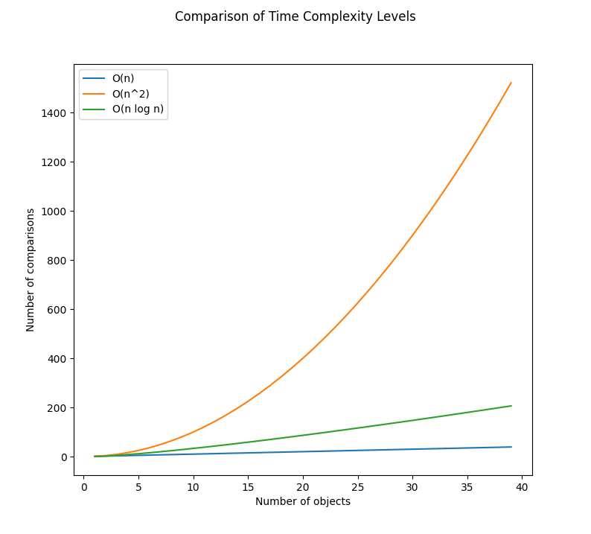
Time Complexity of Quicksort
Average case for selection sort
Worst case for quicksort
Average case for quicksort

Slide 43
Advantages of Quicksort
Very easy to write and implement compared to other O(n log n) algorithms. (This is why I chose to present Quicksort today.)
Smaller memory footprint compared to Merge Sort (you might want to look into this if you want to do report on algorithms – hint hint!).
Almost always faster than Selection Sort (naïve sort).

Slide 44
Limitations of Quicksort
Quicksort can slow down if pivot selection is suboptimal (bad choice of pivot, or just being unlucky). This is still usually faster than Selection Sort.
Recursions causes your operating system to keep track of individual function calls using the stack memory.
This is not a problem in most modern computers, but Quicksort may run into memory trouble in microprocessor programming.
You will learn about this further if you take a course in operating systems or system software programming.

Slide 45
Recursion: Tree Structure
root node
R
A tree consists of nodes.
The root node has no parents.
Other nodes have one parent. For example, node R is the parent of nodes A and B.
You can see that a hierarchy can be created, with a smaller tree inside a larger tree. For example, the B-C-D structure is itself a tree.
B
A
subtree
C
D

Slide 46
Tree structure is very important for:
Anything with Hierarchies: file systems, etc.
C
Windows
Users
Program Files
UserA
UserB
Documents
Pictures
Documents
Pictures
ProgramX
ProgramY
ProgramZ
System32
SysWOW64

Slide 47
Tree structure is very important for:
State hierarchy (board games, etc.)
 | X
 | O
 | X
 |  | O
 | X
 |  | X
 |  | X
 |  | O
 |  | X
 |  | O
 |  | X
 |  | X
 | O
 |  | X
O

Slide 48
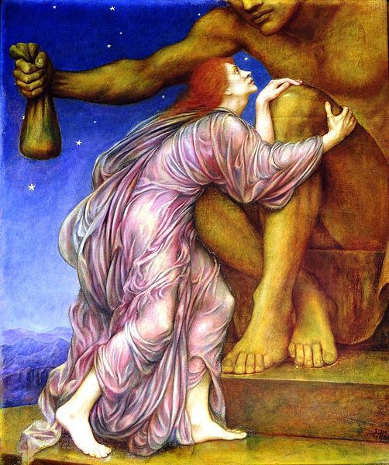
Greedy Algorithms
Greedy algorithms focus on obtaining immediately better results without focusing on long-term (global) results.
Many times, you don’t need the best solution. You need good enough solution. Greedy algorithms are great for this.
The Worship of Mammon (Evelyn De Morgan, c1909). This picture illustrates a person who, beyond simply money, worships the idea of money itself, leading to her own doom.

Slide 49
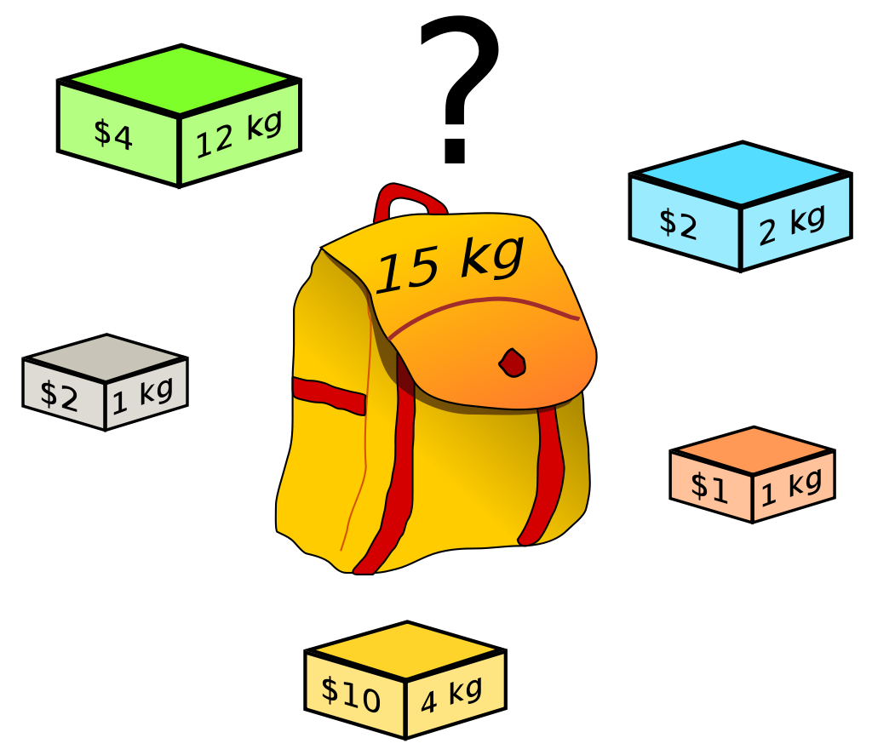
Knapsack Problem
You have a backpack. It fits 15 kg.
There are five objects, each with different weight (w_{i}) and value (v_{i}).
You must fill your backpack with the greatest value possible, but without overloading yourself.
How do you solve this problem?
Image Source: https://en.wikipedia.org/wiki/Knapsack_problem

Slide 50
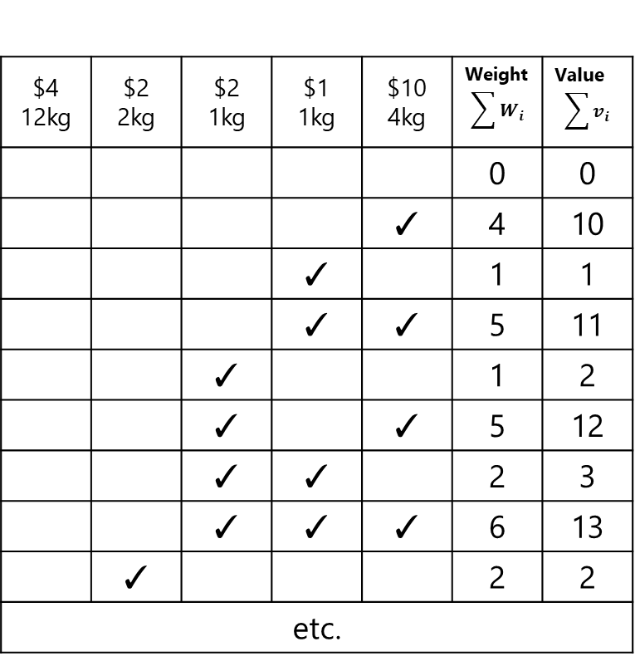
Knapsack Problem: Brute-Force?
$4 12kg | $2 2kg | $2 1kg | $1 1kg | $10 4kg | Weight $$\sum{W_{i}}$$ | Value $$\sum{v_{i}}$$
 |  |  |  |  | 0 | 0
 |  |  |  | ✓ | 4 | 10
 |  |  | ✓ |  | 1 | 1
 |  |  | ✓ | ✓ | 5 | 11
 |  | ✓ |  |  | 1 | 2
 |  | ✓ |  | ✓ | 5 | 12
 |  | ✓ | ✓ |  | 2 | 3
 |  | ✓ | ✓ | ✓ | 6 | 13
 | ✓ |  |  |  | 2 | 2
etc.
Image Source: https://en.wikipedia.org/wiki/Knapsack_problem

Slide 51
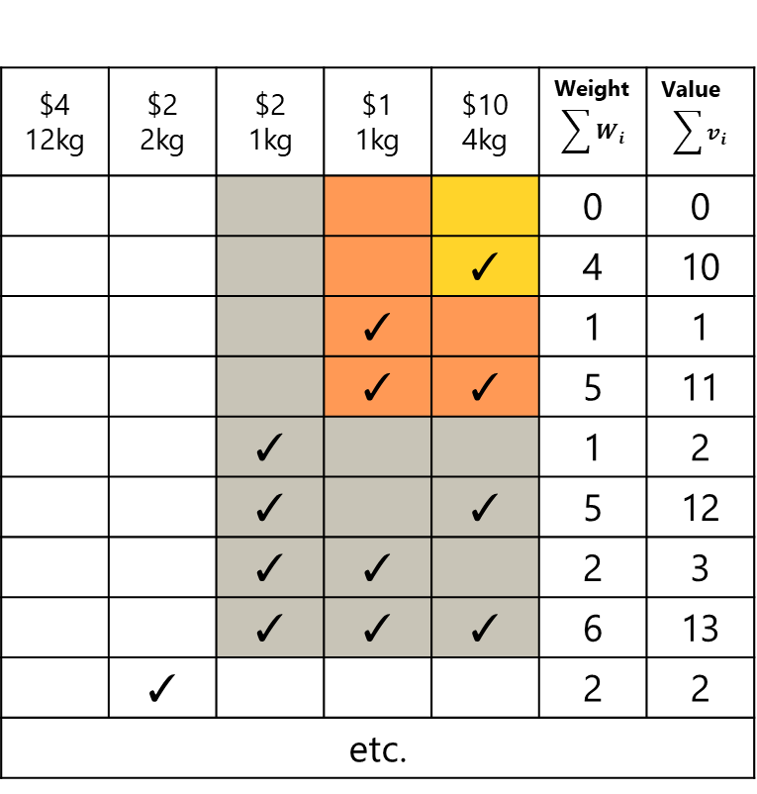
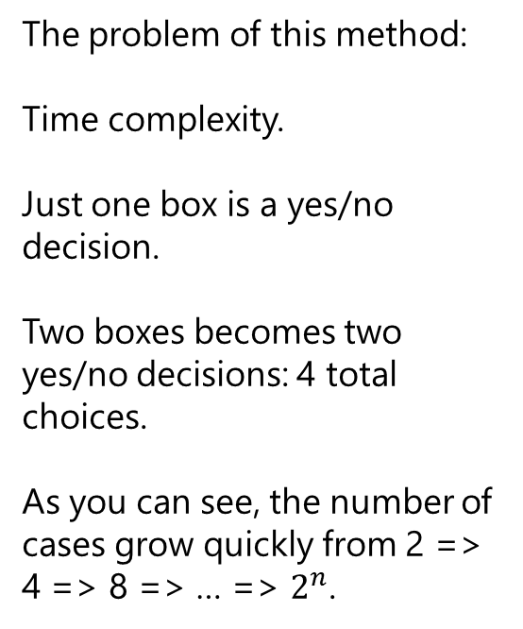
Knapsack Problem: Brute-Force?
$4 12kg | $2 2kg | $2 1kg | $1 1kg | $10 4kg | Weight $$\sum{W_{i}}$$ | Value $$\sum{v_{i}}$$
 |  |  |  |  | 0 | 0
 |  |  |  | ✓ | 4 | 10
 |  |  | ✓ |  | 1 | 1
 |  |  | ✓ | ✓ | 5 | 11
 |  | ✓ |  |  | 1 | 2
 |  | ✓ |  | ✓ | 5 | 12
 |  | ✓ | ✓ |  | 2 | 3
 |  | ✓ | ✓ | ✓ | 6 | 13
 | ✓ |  |  |  | 2 | 2
etc.
The problem of this method:
Time complexity.
Just one box is a yes/no decision.
Two boxes becomes two yes/no decisions: 4 total choices.
As you can see, the number of cases grow quickly from 2 => 4 => 8 => … => $2^{n}$.
Image Source: https://en.wikipedia.org/wiki/Knapsack_problem

Slide 52
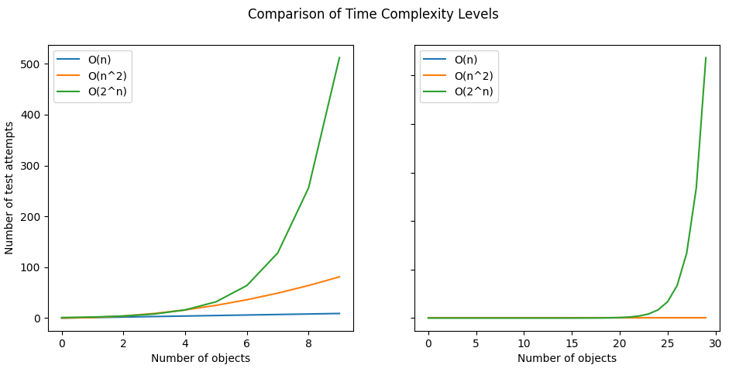

How big is O($2^{n}$)?
ERRATA
Y axis is required for the right subfigure.
2^64 is the largest number that the CPU can process natively (without extra steps).
There are about 2^(26~28) stars in our galaxy (assuming 100 billion stars).
(Estimated) Number of stars in Milky Way Galaxy
This is why algorithms other than brute-force are important.

Slide 53
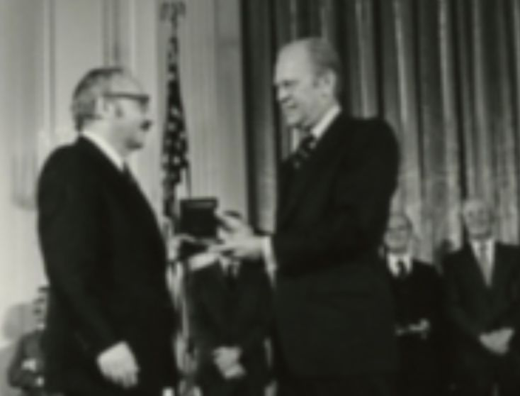
Value/Weight Ratio
Dantzig says we should use value-weight ratio, which makes sense because we want to pack valuable but light objects first.
V W | $4 12kg | $2 2kg | $2 1kg | $1 1kg | $10 4kg
V/W | 0.33 | 1.00 | 2.00 | 1.00 | 2.50
Pack Order | 5 | 3 | 2 | 4 | 1
George Dantzig (1914-2005) receiving the National Medal of Science Awards from President Gerald Ford (1913-2006).
(The award was given for contribution to linear programming field.)
Final Solution:
8 kg, $15
Can you do better?
Image Source: https://en.wikipedia.org/wiki/George_Dantzig

Slide 54
Analysis of Value/Weight Ratio method
ERRATA
Algorithm should be revised to be based on sorting.
Input
n objects, each object having properties v (value) and w (weight)
MW, the maximum weight for the backpack
let VW be an array of real numbers
let CW ← 0
let BAG be an empty array of objects
for each object i:
VW_{i} ← v_{i}/w_{i}
while CW ≤ MW:
go through VW:
find and add the item with highest VW_{i} to BAG
answer with BAG

Slide 55
Why Knapsack is important?
Knapsack problem is an early, simple constraint problem.
If you can solve this kind of problem, you can learn to solve many practical problems like mathematics, industrial engineering, business modeling, and hardware design.
It also helps when you want to pack items into a box to send to your home. You want to send high-value merchandise but low weight to cut down on shipping costs.

Slide 56
Problem Solving

Slide 57
General Problem-Solving Method
Determine the input and output information.
See possible patterns between the input and output.
Implement an algorithm to solve the problem.
Write a program (if necessary). You can also use other methods.

Slide 58
Example: Transpose
Given a matrix A of size (m,n), produce its transpose A^{T} (should be size n,m).
A^{T}_{ij} = A_{ji}
1 | 2
3 | 4
5 | 6
1 | 3 | 5
2 | 4 | 6
m
n
m
n
A
A^{T}

Slide 59
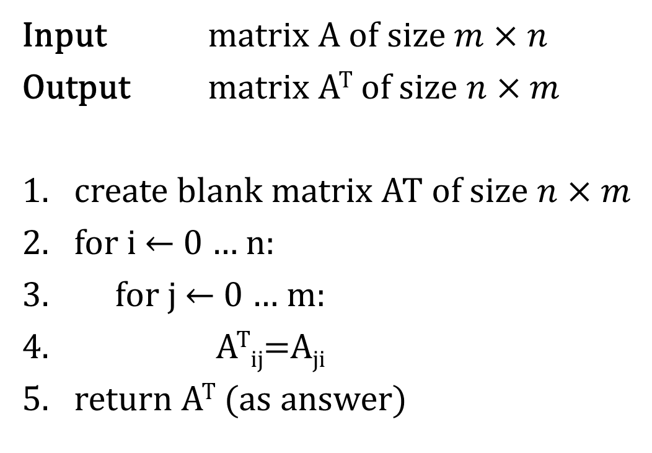
Example: Transpose
Input matrix A of size $m×n$
Output matrix A^{T} of size $n×m$
create blank matrix AT of size $n×m$
for i ← 0 … n:
for j ← 0 … m:
A^{T}_{ij}=A_{ji}
return A^{T} (as answer)

Slide 60
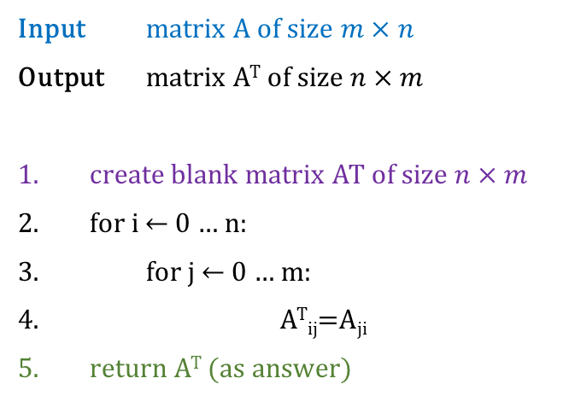
Example: Transpose (in Python)
Algorithm (Previous Slide)
Python Program
Input matrix A of size $m×n$
Output matrix A^{T} of size $n×m$
create blank matrix AT of size $n×m$
for i ← 0 … n:
for j ← 0 … m:
A^{T}_{ij}=A_{ji}
return A^{T} (as answer)
m = 3
n = 2
A = [[1,2],[3,4],[5,6]]
AT = [[0 for j in range(m)] for i in range(n)]
for i in range(n):
for j in range(m):
AT[i][j] = A[j][i]
print(AT)

Slide 61
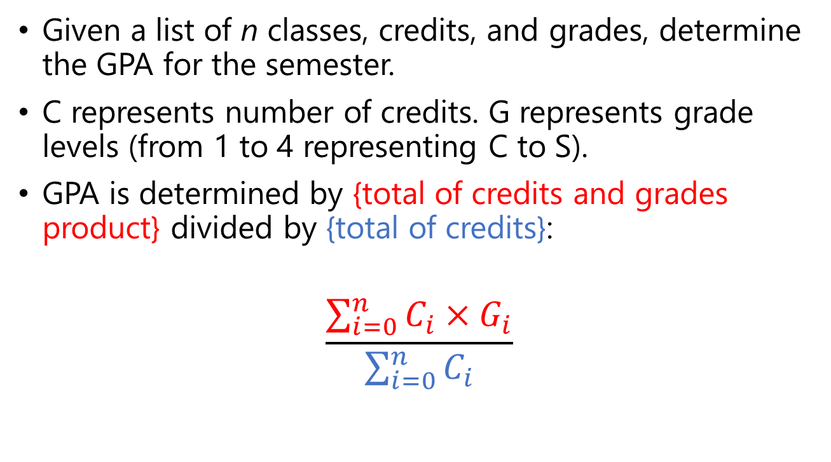
Example: GPA
Given a list of n classes, credits, and grades, determine the GPA for the semester.
C represents number of credits. G represents grade levels (from 1 to 4 representing C to S).
GPA is determined by {total of credits and grades product} divided by {total of credits}:
$$\frac{\sum_{i=0}^{n}{C_{i}×G_{i}}}{\sum_{i=0}^{n}{C_{i}}}$$

Slide 62
Example: GPA
Input grades table
Output GPA (a real number)
let TotalCredits ← 0
let TotalGradePoint ← 0
for i ← 0 … n:
TotalCredits += C_{i}
TotalGradePoint += C_{i} * G_{i}
return TotalGradePoint/TotalCredits
Class | Credits | Grade
Mathematics | 3 | 2
Physics | 3 | 3
Programming | 3 | 4
Lab Practice | 1 | 4
Communication | 2 | 3

Slide 63
Example: GPA … do you actually need to code?
Class | Credits | Grade
Mathematics | 3 | 2
Physics | 3 | 3
Programming | 3 | 4
Lab Practice | 1 | 4
Communication | 2 | 3
You can spend 3 minutes writing a program to compute your GPA, or just open Excel and type:
=SUMPRODUCT(B2:B6,C2:C6)/SUM(B2:B6)

Slide 64
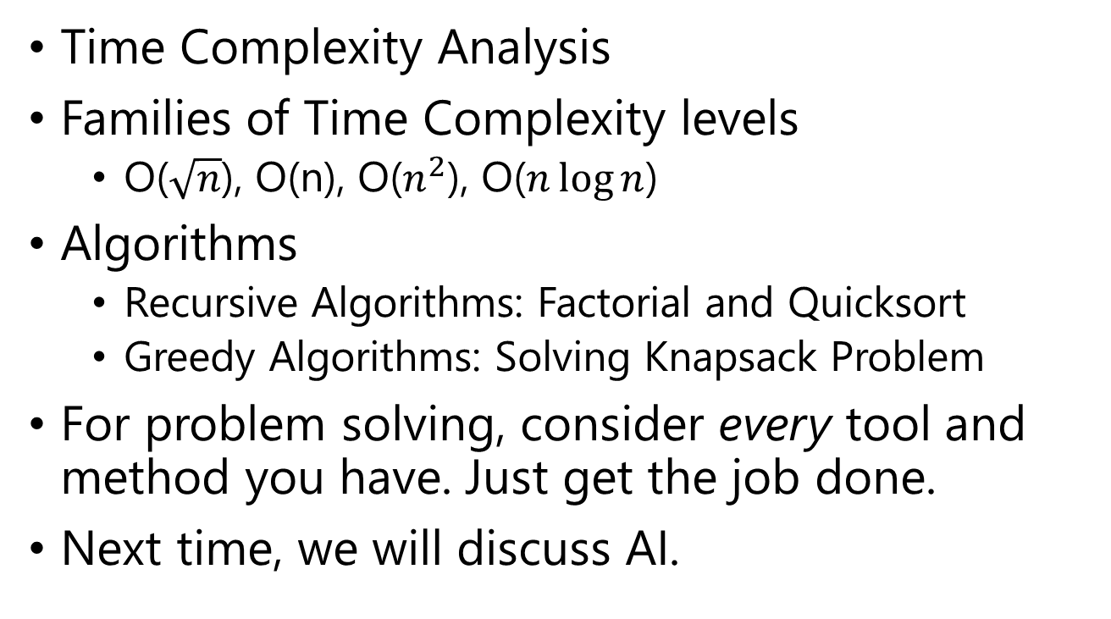
Today’s Summary
Time Complexity Analysis
Families of Time Complexity levels
O($\sqrt{n}$), O(n), O($n^{2}$), O($n\log{n}$)
Algorithms
Recursive Algorithms: Factorial and Quicksort
Greedy Algorithms: Solving Knapsack Problem
For problem solving, consider every tool and method you have. Just get the job done.
Next time, we will discuss AI.

