Slide 1
Information Science
GSCI1801A
Lecture 6: Databases
Asst. Prof. Chawanat Nakasan | 2021-11-09

Slide 2
Agenda
Databases
Types of Databases
Relational Databases
Keys
Relational Database Normalization
Non-Relational Databases
Database Management System (DBMS)
Relational DBMS (MySQL/MariaDB, SQLite, etc.)
Non-Relational DBMS (MongoDB, Redis, etc.)

Slide 3
Database
“an organized collection of structured information, or data, typically stored electronically in a computer system” – Oracle Corporation
“a collection of data that is stored in a computer and that can easily be used and added to” – Collins Dictionary
collection of data
structured
electronic storage (computer system)
managed, searchable, retrievable
“a usually large collection of data organized especially for rapid search and retrieval (as by a computer)” – Merriam-Webster Dictionary
“A logical collection of information that is interrelated and that is managed and stored as a unit” -- OECD

Slide 4
How do we organize data?
Documents
Tables
Ledgers
Index Cards
Paper
Tell stories about who owns each coin?

Slide 5
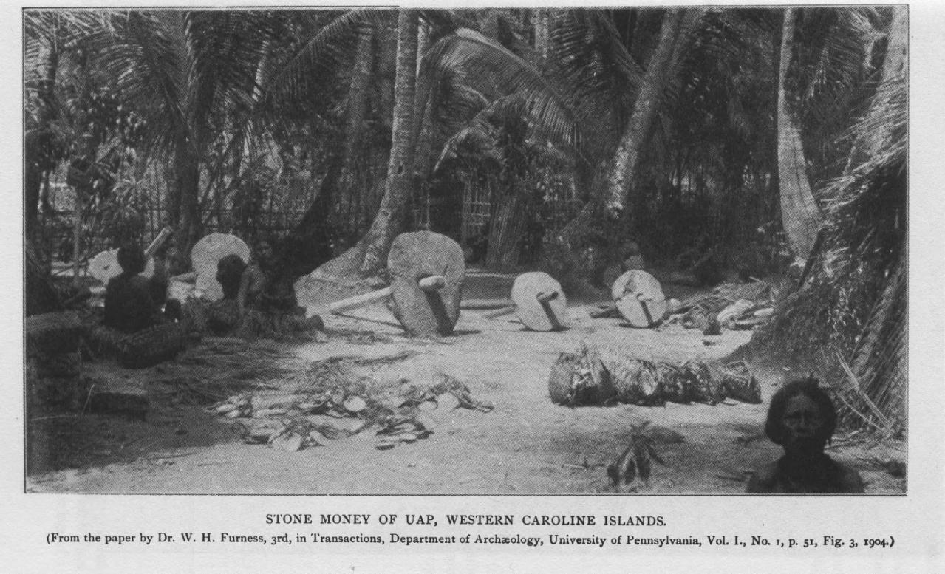
I kid you not. This was a real data management system.
Image via Wikipedia

Slide 6
Databases are divided into two major categories.
Relational Database
Non-Relational Database
Based on relations (math word for table)
Based on other forms of data management: document, hierarchy (tree), network (graph), etc.

Slide 7
Relational Databases

Slide 8
Relation, a.k.a., Table
A relation needs to have a name.
Each header column here is called an attribute or a field.
LabMembers
id | firstname | lastname | office
550052 | Noble | Tillman | 7087
361144 | Ella | Joseph | 6983
576086 | Magee | Wilson | 1976
484862 | Daniel | Levine | 8810
772473 | Xandra | Green | 3726
Each row here is also called a tuple or record.
This whole table is called a relation.

Slide 9


Relation Set Operators: Union
LabMembers
Committee
id | firstname | lastname | office
550052 | Noble | Tillman | 7087
361144 | Ella | Joseph | 6983
576086 | Magee | Wilson | 1976
484862 | Daniel | Levine | 8810
772473 | Xandra | Green | 3726
id | firstname | lastname | office
484862 | Daniel | Levine | 8810
772473 | Xandra | Green | 3726
621923 | Nero | Thompson | 7891
513722 | Ava | Malone | 4475
152384 | Alea | Downs | 8627
$$∪$$
$$LabMembers∪Committee=$$
id | firstname | lastname | office
550052 | Noble | Tillman | 7087
361144 | Ella | Joseph | 6983
576086 | Magee | Wilson | 1976
484862 | Daniel | Levine | 8810
772473 | Xandra | Green | 3726
621923 | Nero | Thompson | 7891
513722 | Ava | Malone | 4475
152384 | Alea | Downs | 8627
Rows from LabMembers
Rows from Committee

Slide 10


Relation Set Operators: Intersect
LabMembers
Committee
id | firstname | lastname | office
550052 | Noble | Tillman | 7087
361144 | Ella | Joseph | 6983
576086 | Magee | Wilson | 1976
484862 | Daniel | Levine | 8810
772473 | Xandra | Green | 3726
id | firstname | lastname | office
484862 | Daniel | Levine | 8810
772473 | Xandra | Green | 3726
621923 | Nero | Thompson | 7891
513722 | Ava | Malone | 4475
152384 | Alea | Downs | 8627
$$∩$$
$$LabMembers∩Committee=$$
id | firstname | lastname | office
484862 | Daniel | Levine | 8810
772473 | Xandra | Green | 3726

Slide 11


Relation Set Operators: Difference
LabMembers
Committee
id | firstname | lastname | office
550052 | Noble | Tillman | 7087
361144 | Ella | Joseph | 6983
576086 | Magee | Wilson | 1976
484862 | Daniel | Levine | 8810
772473 | Xandra | Green | 3726
id | firstname | lastname | office
484862 | Daniel | Levine | 8810
772473 | Xandra | Green | 3726
621923 | Nero | Thompson | 7891
513722 | Ava | Malone | 4475
152384 | Alea | Downs | 8627
$$−$$
$$LabMembers−Committee=$$
id | firstname | lastname | office
550052 | Noble | Tillman | 7087
361144 | Ella | Joseph | 6983
576086 | Magee | Wilson | 1976

Slide 12
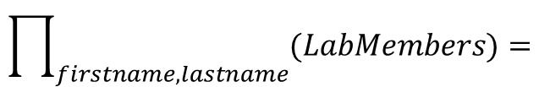
Projection
LabMembers
id | firstname | lastname | office
550052 | Noble | Tillman | 7087
361144 | Ella | Joseph | 6983
576086 | Magee | Wilson | 1976
484862 | Daniel | Levine | 8810
772473 | Xandra | Green | 3726
$$\prod_{firstname,lastname}{(LabMembers)}=$$
firstname | lastname
Noble | Tillman
Ella | Joseph
Magee | Wilson
Daniel | Levine
Xandra | Green

Slide 13
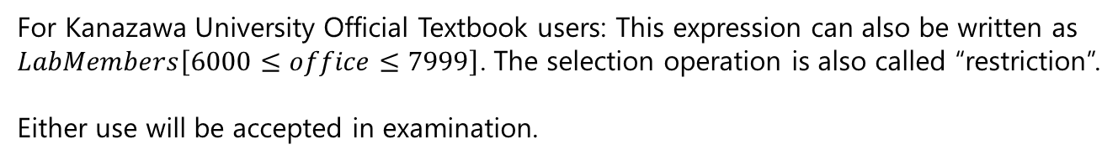

Selection
LabMembers
id | firstname | lastname | office
550052 | Noble | Tillman | 7087
361144 | Ella | Joseph | 6983
576086 | Magee | Wilson | 1976
484862 | Daniel | Levine | 8810
772473 | Xandra | Green | 3726
$$σ_{6000≤office≤7999}(LabMembers)=$$
id | firstname | lastname | office
550052 | Noble | Tillman | 7087
361144 | Ella | Joseph | 6983
For Kanazawa University Official Textbook users: This expression can also be written as $LabMembers\left[6000≤office≤7999\right]$. The selection operation is also called “restriction”.
Either use will be accepted in examination.

Slide 14
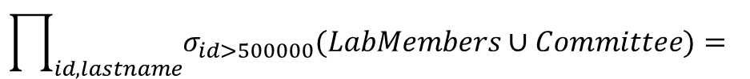
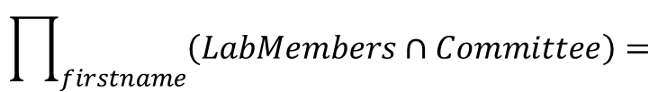
These can be combined.
LabMembers
Committee
id | firstname | lastname | office
550052 | Noble | Tillman | 7087
361144 | Ella | Joseph | 6983
576086 | Magee | Wilson | 1976
484862 | Daniel | Levine | 8810
772473 | Xandra | Green | 3726
id | firstname | lastname | office
484862 | Daniel | Levine | 8810
772473 | Xandra | Green | 3726
621923 | Nero | Thompson | 7891
513722 | Ava | Malone | 4475
152384 | Alea | Downs | 8627
$$\prod_{firstname}{\left(LabMembers∩Committee\right)}=$$
firstname
Daniel
Xandra
$$\prod_{id,lastname}{σ_{id>500000}(LabMembers∪Committee)= }$$
id | lastname
550052 | Tillman
576086 | Wilson
772473 | Green
513722 | Malone

Slide 15
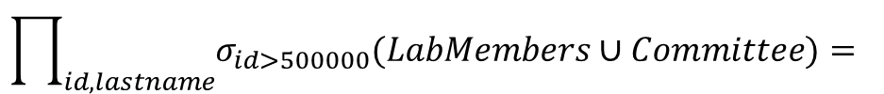
You can also rename the attributes.
$$\prod_{id,lastname}{σ_{id>500000}(LabMembers∪Committee)= }$$
id | lastname
550052 | Tillman
576086 | Wilson
772473 | Green
513722 | Malone
$$ρ_{name/lastname}\prod_{id,lastname}{σ_{id>500000}(LabMembers∪Committee)= }$$
id | name
550052 | Tillman
576086 | Wilson
772473 | Green
513722 | Malone
Rename “lastname” to “name”

Slide 16
Here be dragons.
Everything from this point is not covered by the official textbook.
Don’t forget to save the slides in LMS.
If you have any questions, ask me now, after class, through WebEx, or in LMS.
You can use any media during exam. (You are not allowed to generate communication or send signals, but you can read online references and read slides/textbooks.)

Slide 17
Join Operations
Joining puts data from two or more tables together, extending the meaning of the data.
Personnel
Gamers
firstname | lastname | email
Davis | Burgess | dburgess@nan.sus.xs
Colton | Bullock | cbullock@mat.sus.xs
Colleen | Bowers | cbowers@gra.sus.xs
Alexis | Hampton | ahampton@geo.sus.xs
Rina | Parker | rparker@ast.sus.xs
email | character | level
dburgess@nan.sus.xs | Frodo | 14
cbullock@mat.sus.xs | Aragorn | 8
rparker@ast.sus.xs | Shelob | 11
stewart@sarktech.xs | Lancelot | 10
bowen3@cortalc.co.xs | Magnus | 14
Explanation:
Personnel is a list of people at Sarkhan University of Science (sus.xs).
Gamers is a list of players on a game server. In this scenario, there are SUS members and employees from nearby companies SarkTech and Cortano Alchemy.

Slide 18
Inner Join
comparing these
Personnel
Gamers
firstname | lastname | email
Davis | Burgess | dburgess@nan.sus.xs
Colton | Bullock | cbullock@mat.sus.xs
Colleen | Bowers | cbowers@gra.sus.xs
Alexis | Hampton | ahampton@geo.sus.xs
Rina | Parker | rparker@ast.sus.xs
email | character | level
dburgess@nan.sus.xs | Frodo | 14
cbullock@mat.sus.xs | Aragorn | 8
rparker@ast.sus.xs | Shelob | 11
stewart@sarktech.xs | Lancelot | 10
bowen3@cortalc.co.xs | Magnus | 14
firstname | lastname | personnel.email* | gamers.email* | character | level
Davis | Burgess | dburgess@nan.sus.xs | dburgess@nan.sus.xs | Frodo | 14
Colton | Bullock | cbullock@mat.sus.xs | cbullock@mat.sus.xs | Aragorn | 8
Rina | Parker | rparker@ast.sus.xs | rparker@ast.sus.xs | Shelob | 11
$$Personnel⋈_{Personnel.email=Gamers.email}Gamers$$
*tablename.attributename to disambiguate (make non-confusing) same attribute names

Slide 19
There are other kinds of join.
Natural Join (actually a specific kind of inner join)
Left Join
Right Join
Outer Join
Full Join
Anti-Join
But most of these are not very important and won’t be used in exams. (Most DB applications support only natural join.)

Slide 20
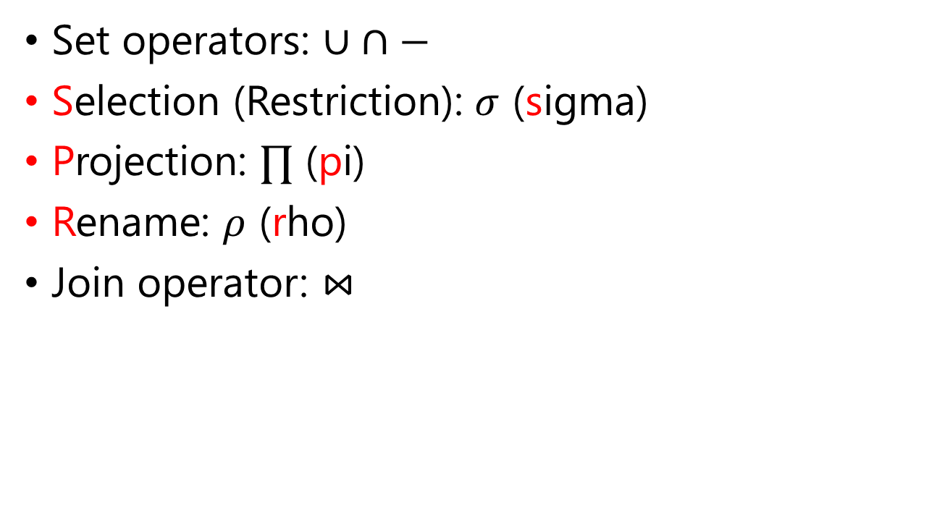
Summary of Operators
Set operators: $∪ ∩−$
Selection (Restriction): $σ$ (sigma)
Projection: $∏$ (pi)
Rename: $ρ$ (rho)
Join operator: $⋈$

Slide 21
SQL (Structured Query Language)
SQL is a database query language.
SQL is based directly on relational algebra.
Will be demonstrated later in this class.

Slide 22
Keys

Slide 23
Keys allow you to identify data.
What uniquely identifies an employee?
id | firstname | lastname | office | phone | affiliation | email | home_zipcode
550052 | Noble | Tillman | 7087 | 075-610-5211 | School of Astronomy | ntillman@ast.sus.xs | 99769
361144 | Ella | Joseph | 6983 | 051-493-8214 | School of Physics | ejoseph@phy.sus.xs | 99769
629586 | Blaze | Clark | 8810 | 011-657-3256 | Administration | bclark@adm.sus.xs | 96943
484862 | Daniel | Levine | 8810 | 091-589-8389 | Administration | dlevine@adm.sus.xs | 33732
772473 | Xandra | Green | 3726 | Null | School of Astronomy | xgreen@ast.sus.xs | 17241
241566 | Wyatt | Goodman | 4721 | 059-867-5427 | School of Geology | wgoodman@geo.sus.xs | 42865
181555 | Wyatt | Welch | 4051 | 052-534-4395 | Administration | wwelch@adm.sus.xs | 24436
No Phone
Neighbors – Same Zipcode
Same Name
Same Room

Slide 24
Super Key
A super key is a set of attributes that sufficiently identify unique records.
Example:
firstname, office, and home_zipcode are NG because there are repeats.
phone is also NG because Xandra doesn’t seem to have a phone.
id is OK because it’s unique for each employee.
(firstname, lastname) is OK because there are no repeats when both firstname and lastname are combined.
id | firstname | lastname | office | phone | affiliation | email | home_zipcode
550052 | Noble | Tillman | 7087 | 075-610-5211 | School of Astronomy | ntillman@ast.sus.xs | 99769
361144 | Ella | Joseph | 6983 | 051-493-8214 | School of Physics | ejoseph@phy.sus.xs | 99769
629586 | Blaze | Clark | 8810 | 011-657-3256 | Administration | bclark@adm.sus.xs | 96943
484862 | Daniel | Levine | 8810 | 091-589-8389 | Administration | dlevine@adm.sus.xs | 33732
772473 | Xandra | Green | 3726 | Null | School of Astronomy | xgreen@ast.sus.xs | 17241
241566 | Wyatt | Goodman | 4721 | 059-867-5427 | School of Geology | wgoodman@geo.sus.xs | 42865
181555 | Wyatt | Welch | 4051 | 052-534-4395 | Administration | wwelch@adm.sus.xs | 24436

Slide 25
Candidate Key
Good super key, but a bit overkill: (id, firstname, lastname, office).
We can reduce it to:
(id)
(firstname, lastname)
Valid super key, but is it too much?
id | firstname | lastname | office | phone | affiliation | email | home_zipcode
550052 | Noble | Tillman | 7087 | 075-610-5211 | School of Astronomy | ntillman@ast.sus.xs | 99769
361144 | Ella | Joseph | 6983 | 051-493-8214 | School of Physics | ejoseph@phy.sus.xs | 99769
629586 | Blaze | Clark | 8810 | 011-657-3256 | Administration | bclark@adm.sus.xs | 96943
484862 | Daniel | Levine | 8810 | 091-589-8389 | Administration | dlevine@adm.sus.xs | 33732
772473 | Xandra | Green | 3726 | Null | School of Astronomy | xgreen@ast.sus.xs | 17241
241566 | Wyatt | Goodman | 4721 | 059-867-5427 | School of Geology | wgoodman@geo.sus.xs | 42865
181555 | Wyatt | Welch | 4051 | 052-534-4395 | Administration | wwelch@adm.sus.xs | 24436
(id), (firstname, lastname), (email) are some of the good candidate keys!
By the way, (firstname, lastname) is a composite key because it has multiple attributes.

Slide 26
Primary Key (PK)
Among the many candidate keys, we now choose one logically best to become the primary key (PK).
There is only one PK per table (relation).
These are all good candidate keys, but which would be the PK?
id | firstname | lastname | office | phone | affiliation | email | home_zipcode
550052 | Noble | Tillman | 7087 | 075-610-5211 | School of Astronomy | ntillman@ast.sus.xs | 99769
361144 | Ella | Joseph | 6983 | 051-493-8214 | School of Physics | ejoseph@phy.sus.xs | 99769
629586 | Blaze | Clark | 8810 | 011-657-3256 | Administration | bclark@adm.sus.xs | 96943
484862 | Daniel | Levine | 8810 | 091-589-8389 | Administration | dlevine@adm.sus.xs | 33732
772473 | Xandra | Green | 3726 | Null | School of Astronomy | xgreen@ast.sus.xs | 17241
241566 | Wyatt | Goodman | 4721 | 059-867-5427 | School of Geology | wgoodman@geo.sus.xs | 42865
181555 | Wyatt | Welch | 4051 | 052-534-4395 | Administration | wwelch@adm.sus.xs | 24436

Slide 27
Foreign Key (FK)
Foreign keys allow one table to reference another and keep data linked together.
Personnel
Beacon
Checkin
id | firstname | lastname
550052 | Noble | Tillman
361144 | Ella | Joseph
629586 | Blaze | Clark
484862 | Daniel | Levine
772473 | Xandra | Green
id | location
15 | Administration
42 | Cafeteria
49 | Library
61 | Lecture Hall 1 (1F)
74 | Lecture Hall 2 (4F)
datetime | beacon_id | user_id
2021-11-08 09:04:02 | 15 | 629586
2021-11-08 09:18:40 | 15 | 361144
2021-11-08 10:02:00 | 49 | 629586
2021-11-09 08:13:17 | 61 | 772473
2021-11-09 08:59:59 | 61 | 550052
FOREIGN KEY (beacon_id) REFERENCES beacon(id)
Meaning: every value in checkin.beacon_id must exist in beacon.id
FOREIGN KEY (user_id) REFERENCES personnel(id)
Meaning: every value in checkin.user_id must exist in personnel.id

Slide 28
What happens when we change data?
This is called “propagation”.
There are five kinds of propagation:
CASCADE: When changes happen in reference table, also update it in dependent table.
RESTRICT: Don’t allow changes at all.
NO ACTION: Similar to RESTRICT (changes will be apparent when you learn triggers system, but we won’t discuss it here)
SET NULL and SET DEFAULT: When changes happen in the reference table, set the corresponding value in the dependent table to Null or the default value.
Propagation can be set differently, like “ON UPDATE CASCADE ON DELETE SET NULL”.

Slide 29
Relational Database Normalization

Slide 30
Here be dragons (again).
Normalization is a rather difficult topic.
It is extremely important for proper development of databases, so I’m going to teach it anyway.
But, this (just this topic) won’t be graded in exam. As stated in the syllabus:
Solve relational algebra operations (union, join, and so on).
There are many normal forms, but today I’ll only teach 1NF and 3NF, which are major steps of practical database design.

Slide 31
Why Normalize?
Because this is not a good idea:
In this scenario, there are classrooms taught by three professors. However, you can see that all the professor IDs are crammed into a single box.
Lecture
class | lecturer_id | room | day | period
CS101.1 | 186346 894324 245350 | LH1-102 | Thu | 1
CS101.2 | 186346 894324 245350 | LH1-102 | Thu | 2

Slide 32
1NF: First Normal Form
Each “cell” must have only one value.
Each record must be unique.
Lecture
Lecture (1NF)
class | lecturer_id | room | day | period
CS101.1 | 186346 894324 245350 | LH1-102 | Thu | 1
CS101.2 | 186346 894324 245350 | LH1-102 | Thu | 2
class | lecturer_id | room | day | period
CS101.1 | 186346 | LH1-102 | Thu | 1
CS101.1 | 894324 | LH1-102 | Thu | 1
CS101.1 | 245350 | LH1-102 | Thu | 1
CS101.2 | 186346 | LH1-102 | Thu | 2
CS101.2 | 894324 | LH1-102 | Thu | 2
CS101.2 | 245350 | LH1-102 | Thu | 2
Unnormalized Form
First Normal Form (1NF)

Slide 33
3NF: Third Normal Form
(room, day, period) defines each instance of lecture.
This means class depends on (room, day, period).
However, since one lecturer can be only in one class at a time, lecturer_id depends on class.
This creates a transitive dependency:
lecturer_id ➔ class ➔ (room, day, period).
LectureTeam (3NF)
lecturer | class
186346 | CS101.1
894324 | CS101.1
245350 | CS101.1
186346 | CS101.2
894324 | CS101.2
245350 | CS101.2
Lecture (1NF)
class | lecturer_id | room | day | period
CS101.1 | 186346 | LH1-102 | Thu | 1
CS101.1 | 894324 | LH1-102 | Thu | 1
CS101.1 | 245350 | LH1-102 | Thu | 1
CS101.2 | 186346 | LH1-102 | Thu | 2
CS101.2 | 894324 | LH1-102 | Thu | 2
CS101.2 | 245350 | LH1-102 | Thu | 2
Classroom (3NF)
room | day | period | class
LH1-102 | Thu | 1 | CS101.1
LH1-102 | Thu | 2 | CS101.2
First Normal Form (1NF)
3NF

Slide 34
What about other NFs?
2NF depends on having composite PKs. Since most modern DB productions tend to use singular PKs, it is usually avoided.
Higher NFs contribute little to compared to 3NF.

Slide 35
Non-Relational Databases

Slide 36
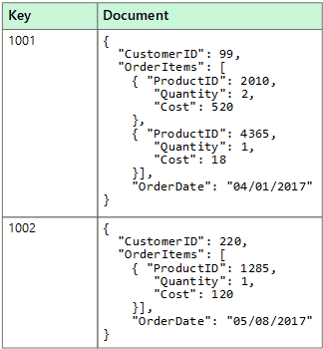
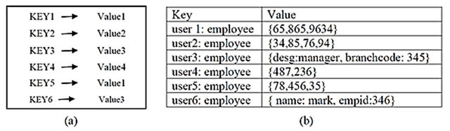
Also known as NoSQL, these are just types of databases that don’t rely on strict relational tables.
Key-Value Store
(figure by Ramzan et al., 2019)
Document-based database
(Microsoft Azure)

Slide 37
Database Management Systems (DBMS)

Slide 38
DBMS is a program implementation to build and manage databases.
Relational:
SQLite
MySQL
MariaDB (open-source version of MySQL)
PostgreSQL
Non-Relational:
MongoDB
Redis
Today I’ll walk through SQLite and maybe MySQL. You can learn other DBMSes as needed.

