Slide 1
Computer Science and Information Processing
GSCI1801A
Lecture 0: Introduction
Asst. Prof. Chawanat Nakasan | 2019-06-11

Slide 2

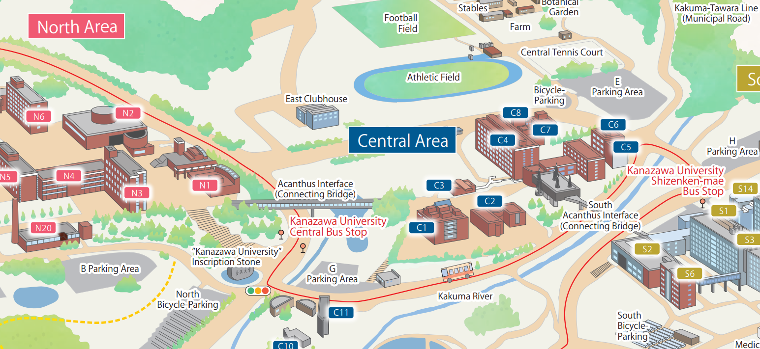
Class Time & Location
Tuesdays Period 3
Location changed to Information Media Center Multipurpose Classroom
(総合メディア基盤センター多目的教室)

Slide 3
Class Time & Location
Tuesdays Period 3
This class is strictly online. Officially, I work at Information Media Center (IMC / 総合メディア基盤センター), C2 in the map.
Currently, direct visit to IMC is prohibited. For this class, Office Hours is strictly for students with physical (hardware) projects.

Slide 4
Welcome to the World of Computers
Computer Architecture
Problem Solving
Algorithms
Artificial Intelligence
Computer Networks
Databases
Security
Ethics
Arithmetic and Logic

Slide 5
Schedule
Class Content
Report (2-pages)
Exam
Roughly follows the previous slide!
One report due after Week 4, another due right after Week 8.
Exam is on Week 8.
Current plan is up to 40 minutes, with 5 big questions.
Topic is flexible. We’ll talk later.

Slide 6
Difference from the Japanese Version
It’s in English!
More emphasis on problem solving
Quicker, more exciting, more engaging, and more fun!
This class is 100% in English.
This is one most important skill in computer science, and we will refine on it a lot.
This class is done OUR way, not MY way.

Slide 7
Contact
chawanat@ staff.kanazawa-u.ac.jp
Information Media Center 総合メディア基盤センター
Room A202
Office Hours Tue 0900 -- 1200 Except some weeks!
Contact directly using E-mail. Use LMS for report submission.
Appointment not necessary but recommended.
Notes:
This is how I can be contacted. Please be careful with my email address: It’s my first name, and the part behind the @ sign is “staff” not IMC like some other professors.
When coming to IMC, please knock on my door at Room A202. If I’m not present, please leave me an email or message.

Slide 8
I believe in talking! Let me know if:
I make errors
Quiz questions are outside course syllabus
You do not understand something
There are any comments
Something else is wrong

Slide 9
Grading Policy
Grading Levels
Breakdown
Classroom (Up to 5%)
Report (45%)
Exam (50%)
Participation 5%
Quiz 5%
Midterm 20%
Final 25%
Final Exam 50%
S
A
B
C
90%
80%
70%
Participation + Quiz are added together and up to 5% is used towards the final grade.
60%
Although attendance is not part of the grading system, it is still checked by KU General Studies, so don’t forget to drop by.

Slide 10
Pre-Lesson Quiz: How To
Write your name * Kanji if you have one * English (first-last or last-first okay, but please write last name in CAPITALS)
* Full Student ID Number
角間 あざみ
KAKUMA Azami
195XXXXXXX
Write your answers in the paper.
紙に書いてください。
Use pen only (do not use pencil), except diagrams and figures.
ペンのみ使ってください。図はえんぴつもＯＫです。
SINCERELY attempt all questions, or your quiz will not be scored.
本気じゃないで答える場合は、クイズを採点しません。
I may use your answer during class, but will not say whose answer it is.
あなたの答えを授業に使いますが、誰かのことは言えない。
TIME LIMIT: 5 MINUTES AFTER CLASS STARTS!
時間: 授業開始後5分まで！

Slide 11
Pre-Lesson Quiz: How To (Cont.)
PRE-TEST
GRADED
Graded Questions
QUESTIONNAIRE
Pre-Test and Questionnaire
Affects your score.
Refers to past lessons.
Today we will not have graded questions.
No score.
Refers to today’s class, or ask for your comments.
SINCERELY attempt all questions, or your quiz will not be scored.
クイズを本気で答えない場合は、採点しません。
All questions must be answered unless it is marked OPTIONAL.
問題に[OPTIONAL]をつけてると、答えなくてもいいです。

Slide 12
Fair Use Indicator (If you want to copy my slides for personal use)
See slide number below.
If the number is gray, you are okay. All content (text, pictures, etc.) is mine.
If the number is blue, some content belongs to Kanazawa University. It might be okay for personal use.
If the number is red, some content belongs to non-KU entity. Copy with caution.
This includes Microsoft icons and clip-arts, but not shapes, fonts, and styles that come with PowerPoint itself.
If a slide contains both blue and red content, the number will be red.

