Slide 1

"HyperLocal AQV for
Campus, Industries”
Project Presentation
ADT23SOCB0084 – Advait Nagar 03
ADT23SOCB0718 - Payal Gavhane 29
ADT23SOCB0861 - Rohak Thakur 37
Guided by
Prof. Dr. Jayshree Prasad (HOD, AIA)
Prof. Mayuresh Gulame (Mentor)
Department of Computer Science & Engineering, MITSoC, Loni Kalbhor

Slide 2
Outline
Introduction
Problem Statement
Objectives
Concepts & Methods
Literature Review
Tools and Language
Process and Architecture
Identification of gaps & scope of work
Implementation
Reference
Department of Computer Science & Engineering, MITSoC, Loni Kalbhor

Slide 3
Introduction
Air pollution has become one of the leading environmental threats to human health and sustainability. According to the World Health Organization (WHO), exposure to elevated levels of pollutants such as particulate matter (PM₂.₅, PM₁₀), nitrogen dioxide (NO₂), carbon monoxide (CO), and sulfur dioxide (SO₂) contributes to millions of premature deaths annually. While urban-scale monitoring systems provide valuable citywide air quality data, they often lack the spatial granularity required to detect micro-environmental variations within confined zones such as university campuses, hospitals, and research institutions. These environments accommodate large populations and continuous human activity, where localized emissions from laboratories, vehicular traffic, and nearby construction can cause significant fluctuations in air quality that go unnoticed by regional AQI systems.
To address this challenge, the concept of hyperlocal air quality monitoring has emerged, focusing on smaller geographical regions to provide real-time, context-aware environmental intelligence. This research aims to develop an Intelligent Hyperlocal Air Quality Monitoring and Forecasting System tailored for campus-level deployment, capable of capturing fine-grained air quality data and predicting pollution trends with high accuracy.
Department of Computer Science & Engineering, MITSoC, Loni Kalbhor

Slide 4
Introduction (Continue)
The system employs a combination of low-cost IoT sensors to collect real-time environmental data. The PMS5003 sensor is used to measure particulate matter (PM₂.₅ and PM₁₀) concentrations, which are crucial indicators of air pollution levels. The MQ-series sensors (such as MQ-135, MQ-7, and MQ-2) detect gaseous pollutants including carbon monoxide (CO), ammonia (NH₃), nitrogen dioxide (NO₂), and volatile organic compounds (VOCs). The DHT22 sensor provides temperature and humidity readings to support environmental context calibration, as these factors significantly influence pollutant dispersion and AQI calculations. Together, this sensor network provides high-resolution, real-time environmental data, forming the foundation for accurate modeling and forecasting.
The collected data, combined with historical AQI datasets, is processed and analyzed using multiple machine learning algorithms to enhance forecasting performance and reliability. Models such as Random Forest (RF), Decision Tree (DT), Logistic Regression (LR), Long Short-Term Memory (LSTM), Gradient Boosting, Support Vector Machine (SVM), K-Nearest Neighbors (KNN), and Artificial Neural Network (ANN) are employed for pollutant prediction, trend detection, and air quality forecasting. Each model is evaluated based on performance metrics such as mean squared error (MSE) and R² score to determine the most effective approach for hyperlocal AQI prediction.
To visualize and interpret the data effectively, a web-based interactive dashboard has been developed. It displays real-time AQI levels, historical trends, and forecasted data, along with advisory alerts for unsafe air conditions. The dashboard also provides contextual insights and preventive recommendations to help campus residents make informed health-related decisions.
Department of Computer Science & Engineering, MITSoC, Loni Kalbhor

Slide 5
Problem Statement
Several large-scale Air Quality Index (AQI) systems provide regional data for cities; they often fail to capture micro-level variations in pollution that can occur within confined environments such as university campuses, hospitals, and residential institutions. These areas house dense populations that spend long hours in shared outdoor spaces, making localized and continuous air quality monitoring critical for health management, awareness, and sustainability initiatives.
This PPT presents an Intelligent Hyperlocal Air Quality Monitoring and Forecasting System specifically designed for campus-level deployment.
The system features a web-based dashboard that visualizes real-time data, historical patterns, and predictive insights, while also generating context-aware advisories and alerts to inform users about potential health risks.
Objectives
This PPT presents an Intelligent Hyperlocal Air Quality Monitoring and Forecasting System specifically designed for campus-level deployment. The system integrates low-cost IoT-based sensors to measure pollutants in real time. Collected sensor data is processed using advanced Machine Learning Algorithms to perform trend analysis and short-term air quality forecasting.
Department of Computer Science & Engineering, MITSoC, Loni Kalbhor

Slide 6
4. Concepts and Methods
4. Concepts
4.1 Air Quality and AQI
Air Quality Index (AQI) is a composite indicator that quantifies the level of air pollution based on the concentration of various pollutants such as PM2.5, PM10, CO, NH₃, SO₂, and O₃. The index categorizes air quality into qualitative bands like Good, Moderate, Poor, etc.
4.2 HyperLocal Monitoring
“HyperLocal” AQI monitoring refers to capturing air quality data at a small geographic scale, such as within a campus, street, or neighborhood, instead of relying solely on large city-wide stations.
4.3 Internet of Things (IoT) in Environmental Sensing
IoT enables the collection, transmission, and visualization of real-time environmental data. The project integrates:
Sensors: For pollutant detection.
Microcontroller/Single-board Computer: For data acquisition and processing.
Dashboard: For visualization and prediction.
4.4 Machine Learning for AQI Prediction
Machine learning algorithms help predict AQI from sensor readings by learning patterns between pollutants and air quality levels. Different models suit different data characteristics
Department of Computer Science & Engineering, MITSoC, Loni Kalbhor

Slide 7
5. Literature Survey
Sr. no | Literature Title | Author | Findings
1. | Hyperlocal air pollution in an urban environment – measured with low-cost sensors | Louise Bøge Frederickson, Hugo Savill Russell, Dafni Fessa, Jibran Khan, Johan Albrecht Schmidt, Matthew Stanley Johnson, and Ole Hertel | The study assessed low-cost sensor (LCS) devices for monitoring nitrogen dioxide (NO₂), ozone (O₃), and particulate matter (PM₂.₅) in Copenhagen, Denmark. Results showed that LCSs can accurately capture fine-scale spatial variations in urban air pollution, achieving calibration R² values up to 0.79. The study concluded that low-cost sensors are effective tools for personal exposure assessment and hyperlocal pollution mapping, especially when combined with proper calibration and deployment methods.
2. | Low-Cost IoT Air Quality Monitoring Station Using Cloud Platform and Blockchain Technology | Ahmed K. Hassan, Mohamed S. Saraya, Amr M. T. Ali-Eldin, and Mohamed M. Abdelsalam | This research proposed an IoT-based air quality monitoring system integrated with blockchain technology to ensure data transparency and reliability. Using DHT11, MQ7, and MQ135 sensors. Data are transmitted to a cloud platform for real-time monitoring. The study demonstrated that combining IoT and blockchain can create a secure, scalable, and low-cost environmental monitoring solution, supporting sustainable urban development and smart city initiatives.
Department of Computer Science & Engineering, MITSoC, Loni Kalbhor

Slide 8
5. Literature Survey (Continue)
Sr. no | Literature Title | Author | Findings
1. | AirNet: Predictive Machine Learning Model for Air Quality Forecasting Using Web Interface | Md. Mahbubur Rahman, Md. Emran Hussain Nayeem, Md. Shorup Ahmed, Khadiza Akther Tanha, Md. Shahriar Alam Sakib, Khandaker Mohammad Mohi Uddin, and Hafiz Md. Hasan Babu | This study developed AirNet, a web-based air quality forecasting system using machine learning models (Random Forest, Decision Tree, SVM, KNN, Logistic Regression, etc.). Using global data from 23,463 cities, the Random Forest and Decision Tree models achieved the highest accuracy (100%) in predicting air quality indices (AQI). The system provides real-time air quality alerts through a Django-based web interface, enabling early detection of pollution and aiding public health and policy decisions.
Department of Computer Science & Engineering, MITSoC, Loni Kalbhor

Slide 9
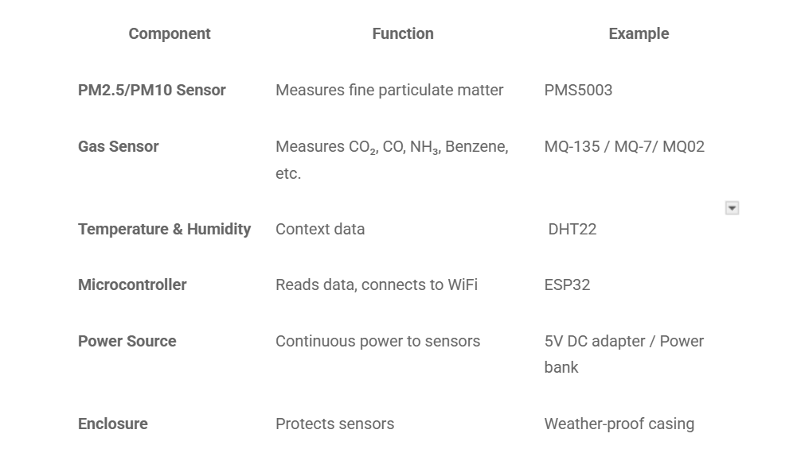
6. Tools and Languages
Department of Computer Science & Engineering, MITSoC, Loni Kalbhor

Slide 10
6. Tools and Languages
Software Components
Software | Function
Arduino IDE / Python (Raspberry Pi) | For data acquisition and sensor communication.
Flask / Node.js / MQTT | For sending data to the cloud or dashboard.
MySQL / Firebase | Database for storing historical data.
Python (Pandas, Scikit-learn, Matplotlib) | Data preprocessing, model training, and evaluation.
Dash / Plotly / Power BI / Grafana | Dashboard visualization.
Department of Computer Science & Engineering, MITSoC, Loni Kalbhor

Slide 11
6. Tools and Languages (Continue)
Algorithms and Their Necessity in AQI Prediction
Algorithm | Purpose | Advantage
K-Nearest Neighbors (KNN) | Predicts AQI class based on nearest sensor data points. | Simple and effective for non-linear patterns.
Logistic Regression (LR) | Classifies AQI category based on pollutants. | Interpretable and fast for linearly separable data.
Support Vector Machine (SVM / SVC) | Finds optimal boundary between AQI levels. | Good for high-dimensional data.
Decision Tree (DT) | Builds rule-based model from sensor readings. | Interpretable; handles mixed-type data.
Random Forest (RF) | Ensemble of Decision Trees. | Reduces overfitting, high accuracy.
Gradient Boosting / Radiant Boost | Sequentially corrects previous errors. | High predictive performance.
IQR (Interquartile Range) | Outlier detection for sensor anomalies. | Improves data quality before model training.
Regression Trees (RT) | Predicts continuous AQI index. | Handles non-linearity and missing data well.
Department of Computer Science & Engineering, MITSoC, Loni Kalbhor

Slide 12
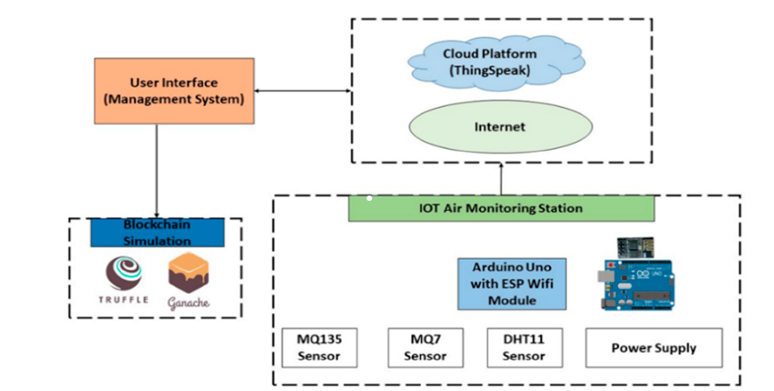
7. Process and Architecture
Data Sent to Cloud
Department of Computer Science & Engineering, MITSoC, Loni Kalbhor

Slide 13
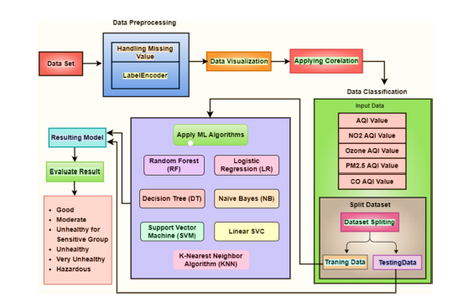
7. Process and Architecture (Continue)
From Cloud
Real-time Data
Department of Computer Science & Engineering, MITSoC, Loni Kalbhor

Slide 14
8. Implementation
Stepwise Implementation
Step 1: Hardware Setup
Connect sensors (PMS5003, MQ-series, DHT22) to Arduino.
Test each sensor individually using Arduino IDE.
Calibrate MQ sensors using clean air and polluted air samples.
Step 2: Data Acquisition
Collect readings at intervals (e.g., every 10 seconds).
Store raw data (CO, PM2.5, temp, humidity, etc.) in CSV/SQL format.
Timestamp each entry for time-based trend analysis.
Step 3: Data Preprocessing
Handle missing values and outliers using IQR method.
Normalize/scale data for model compatibility.
Label AQI category using CPCB/US EPA standards.
Step 4: Feature Engineering
Derive AQI from pollutants using formula or trained model.
Add features like “humidity-adjusted PM2.5” or “temperature-weighted CO”.
Department of Computer Science & Engineering, MITSoC, Loni Kalbhor

Slide 15
8. Implementation (Continue)
Step 5: Model Training
Split dataset into training (80%) and testing (20%).
Train multiple models (KNN, RF, SVM, etc.).
Evaluate using metrics like R², MAE, RMSE, Accuracy.
Step 6: Model Selection
Compare model performance.
Choose best model based on accuracy and interpretability.
Optionally ensemble top models.
Step 7: Dashboard Design
Create real-time dashboard using Flask + Chart.js / Dash + Plotly.
Show parameters:
  Live AQI
  Pollutant levels
  Historical trends
  Model-predicted AQI category
Step 8: Deployment
Host dashboard on Raspberry Pi (local) or cloud (AWS/Heroku).
Automate data updates via cron job or real-time MQTT stream.
Department of Computer Science & Engineering, MITSoC, Loni Kalbhor

Slide 16
8. Implementation (Continue)
Step 9: Validation
Compare predicted AQI with official CPCB data.
Evaluate performance across time, sensor drift, and weather conditions.
Step 10: Optimization
Calibrate sensors periodically.
Update model with more data to improve accuracy.
Integrate GPS for dynamic mapping.
Department of Computer Science & Engineering, MITSoC, Loni Kalbhor

Slide 17
Identification of gaps & Expected Outcomes
Hyperlocal campus deployments are under-represented in high-quality calibration studies versus city-scale monitors; micro-scale patterns (near classrooms, canteens) deserve focused work.
Comparative ML benchmarking for a small, dense campus network (many nodes, short distances) — e.g., which models best exploit spatial correlations — remains an open empirical question.
Practical edge deployment: assessing which models are feasible for on-device inference (Arduino/RPi) versus server-side is practical and underreported. Your proposed experiment (sensors listed + multiple ML methods + dashboard) addresses these gaps
🔹 Expected Outcomes
Real-time AQI dashboard for the college campus.
Predictive alerts for pollution spikes.
Sensor-driven data insights on how campus activities affect air quality.
Foundation for smart city environmental monitoring systems
Department of Computer Science & Engineering, MITSoC, Loni Kalbhor

Slide 18
10. Conclusion and Future Work
The sensor suite you selected (PMS5003 + MQ-series + DHT22) is a widely used, low-cost combination amenable to dense campus deployment, provided you apply calibration and humidity compensation. For modeling, start with interpretable baselines (LR, DT, KNN), proceed to ensemble methods (RF), and use Gradient Boosting as the likely best performer for accuracy—while using IQR and other preprocessing as necessary to remove sensor noise.
Finally, pair the pipeline with a web/dashboard (map + time series) for actionable hyperlocal visibility.
Department of Computer Science & Engineering, MITSoC, Loni Kalbhor

Slide 19
References
Plantower, “Digital universal particle concentration sensor — PMS5003 Manual (v2.3)”, AQMD, datasheet. (AQMD)
Plantower, “PMS5003 — Laser PM2.5 Sensor”, product spec page. (plantower.com)
Adafruit, “PM2.5 Air Quality Sensor (PMS5003) – Adafruit Learning System”, datasheet & guide. (cdn-learn.adafruit.com)
SparkFun, “Technical data MQ-7 Gas Sensor”, datasheet. (SparkFun Electronics)
Olimex, “SNS-MQ135 Gas Sensor Technical Data”, datasheet. (Olimex)
SparkFun, , “DHT22 Sensor (AM2302) — datasheet”, PDF. (cdn.sparkfun.com)
RandomNerdTutorials, “ESP32 with DHT11 / DHT22 Temperature and Humidity Sensor”, web tutorial. (Random Nerd Tutorials)
The Engineering Projects, “MQ135 Air Quality Sensor: Datasheet, Pinout & Working”, web article. (The Engineering Projects)
ResearchGate, “Capable of Gas Sensor MQ-135 to Monitor the Air Quality with Arduino Uno”, conference / article. (ResearchGate)
ScienceDirect, “Air quality prediction by machine learning models”, journal article. (ScienceDirect)
Department of Computer Science & Engineering, MITSoC, Loni Kalbhor

Slide 20
References (Continue)
Wikipedia, “Gradient boosting”, general algorithm description. (Wikipedia)
Wikipedia, “LightGBM”, as a variant of gradient boosting. (Wikipedia)
Copernicus / ACP, “Improving 3-day deterministic air pollution forecasts using machine learning”, comparing RF, XGB, LSTM in AQ tasks. (ACP)
MDPI / environmental systems research, “AirNet: predictive machine learning model for air quality forecasting”. (SpringerOpen)
Research on hybrid feature selection + ML in AQ (BPSO/BWAO + RF) for performance gains. (PMC)
Department of Computer Science & Engineering, MITSoC, Loni Kalbhor

Slide 21
Thank You
Department of Computer Science & Engineering, MITSoC, Loni Kalbhor

