Slide 1
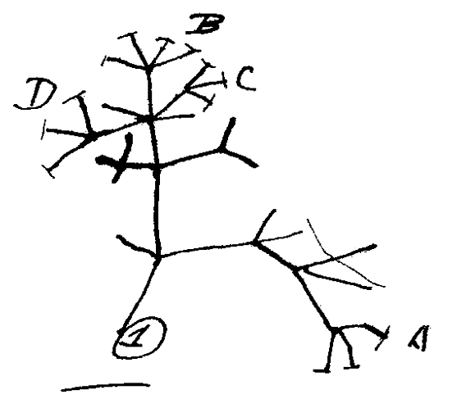
Phylogenetic trees
The effect of concatenating multiple markers
Onno den Boon
Luna van der Loos

Slide 2
Concatenation
Marker 1
Marker 2
Marker 1
Marker 2

Slide 3
Goal
Goal: comparing phylogenetic tree based on multiple markers vs. trees based on single markers
Basic requirements:
Retrieve .fasta files
Alignment
Maximum likelihood analysis
Save the tree

Slide 4
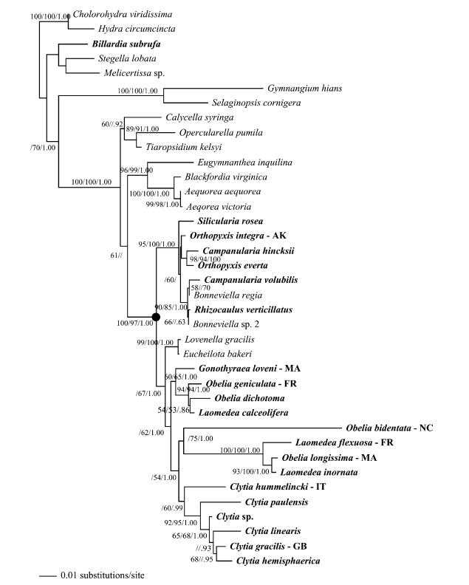
Detailed plan
Plan:
Number of species: ± 30
Multiple markers per species: 5 markers
Rooted tree optional
Nice lay-out (at least acceptable)

Slide 5
Workflow
Retrieve sequences
Describe sequences
Align sequences
ML analysis sequences
Root tree
Format tree
Repeat for every marker
Concatenate sequences
Make concatenated tree
Compare concatenated sequence vs. single marker trees
Notes:
Edirect: retrieve from the internet
For species 1
check how many sequences
Fuse (chapter 11) all sequences per species together
Also give information:
How many sequences
How many species

