Slide 1
Welcome to
Scala 2
Foundation

Slide 2
Course Introduction

Slide 3

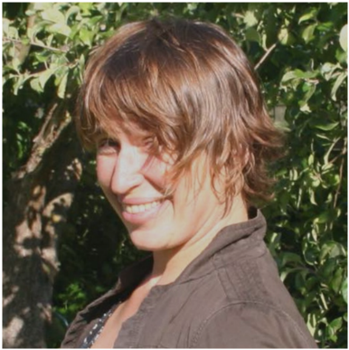
Instructor Presentation
A short introduction
Agata Przybyszewska
PhD (Mathematics, Computer Science)
Enterprise Architect
Instructor at Lund&Bendsen
Lecturer at IT University of Copenhagen
Specialist in integration architecture, security, SOA and REST
Mail: agata@lundogbendsen.dk

Slide 4


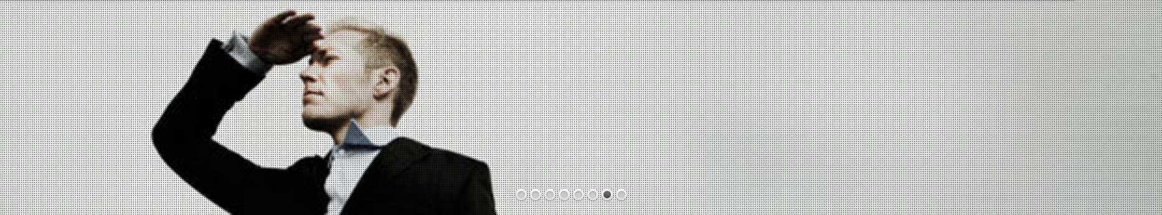
About Lund&Bendsen A/S
Our core business is delivering expertise to ambitious IT projects and project owners including custom competency development of developers as well as your whole team.
Training and Coaching
Consulting and Mentoring
Architectural Analysis and Code Reviews
Application and System Development
Programme and Project Management
Web page:
www.lundogbendsen.dk
Training portal:
www.kursusportal.it
Contact:
info@lundogbendsen.dk
(+45) 33 861 861

Slide 5

Practical Information
2 day course, 09-16 - Lunch break 12-13
Course content on Github: https://github.com/LundOgBendsen/LBE2921-Scala
USB with course software: Eclipse + Scala plugin, gradle, sbt etc
Expect interaction - small games, quizzes, team exercises
If you are unable to attend or have a question, please contact us at:
    Call us at (+45) 33 861 861
    Email us at courses@lundogbendsen.dk

Slide 6

Course Abstract
Introductory course
Scala programming language
Functional design patterns
The participants will learn how to use the Scala language, and how to best benefit from the functional programming style
The course is taught workshop style, where theory and slides are mixed with lots of practical hands-on exercises
Emphasis is put on design thinking and group exercises
We challenge the students with games and role playing exercises, to reinforce key concepts

Slide 7


Prerequisites
The participants are proficient in Java or C#, and have a basic knowledge of object oriented programming and object oriented design patterns.
Every participant has a computer with internet access, on which the following is installed:
JDK 8
Scala 2.12
Eclipse with the Scala plugin
Gradle
Git client

Slide 8
Learning Objectives
The participants can understand Scala code
The partiipants can identify and apply basic functional patterns
The participants can write, build, test and execute programs written in Scala
The participants can process data by using the Scala Collection API
The participants can extend existing class hierarchies by the use of Traits
The participants can compose programs using higher order functions, recursion and pattern matching
The participants can use Scala and Java in a hybrid environment

Slide 9
Topics Covered
Scala language basics - control structures, classes and objects, basic types
Using the REPL
Unit testing
Building (sbt and gradle)
Interoperability with Java
Functional objects, Functions and Closures
Composition and Inheritance, Traits
Pattern matching, case classes
Type inference, conversions
Higher order functions
Collection API
OO meets functional programming - patterns and best practices
Mutable vs. immutable
Pure vs. Side Effects

Slide 10
Let’s Get Started
Open the Scala REPL
Type a few expressions - what is 1+1 today?
:q to quit
# open a shell and type
Agatas-MacBook-Pro:learning_scala agatanoair$ scala
Welcome to Scala 2.12.4 (Java HotSpot(TM) 64-Bit Server VM, Java 1.8.0_74).
Type in expressions for evaluation. Or try :help.
scala>

Slide 11
Expressions
Primitive: 1, true, “Hello”
Compound: 1+2
Evaluation: left -> right
scala> "Hello"
res3: String = Hello
scala> 1+2
res0: Int = 3

Slide 12

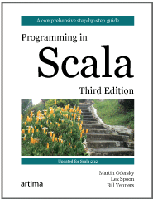
Recommended Reading
Online tutorial:
  https://docs.scala-lang.org/tour/tour-of-scala.html
Book: Programming in scala, 3rd edition
Coursera:
  https://www.coursera.org/learn/progfun1/home/welcome
Twitter’s Scala School:
  https://twitter.github.io/scala_school/
Scala koans:
  http://www.scalakoans.org/

Slide 13

Lab 00
Inspect the tools:
JDK
Scala
Eclipse
REPL
sbt
gradle
# Check out the course content from the USB
Lab 00

