Slide 1

Hello World
First Steps & Intro

Slide 2

If Scala was …
What animal
Object oriented
Functional
Everything is an object

Slide 3



Hello, Scala!
Scala is a modern multi-paradigm programming language designed to express common programming patterns in a concise, elegant, and type-safe way.
It smoothly integrates features of object-oriented and functional languages.

Slide 4

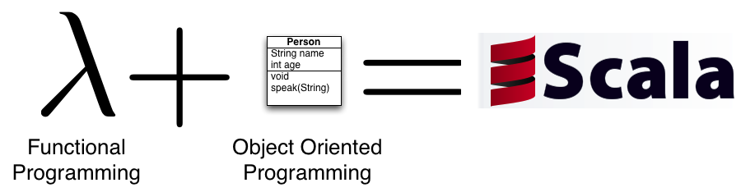
Why Is Scala So Cool?
Object Oriented
Functional Programming
Statically Typed
JVM Language

Slide 5
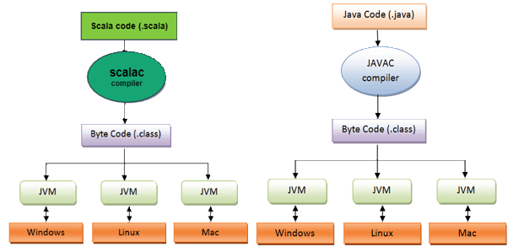
Why Is Scala So Cool?
Lives in the JVM eco system

Slide 6
Object Oriented
Scala is a pure object-oriented language in the sense that every value is an object
Types and behavior of objects are described every classes and traits
Classes are extended by subclassing and a flexible mixin-based composition mechanism as a clean replacement for multiple inheritance

Slide 7
Functional
Scala is also a functional language in the sense that every function is a value
Scala provides a lightweight syntax for defining anonymous functions, it supports higher-order functions, it allows functions to be nested, and supports currying
Scala’s case classes and its built-in support for pattern matching model algebraic types used in many functional programming languages
Singleton objects provide a convenient way to group functions that aren’t members of a class

Slide 8

Statically Typed
A type can be thought of as a category that a value (typically at run-time) can fall into. For example, the number 12 would have type Int, and its corresponding value would be 12
A language can be “statically typed” versus “dynamically checked” - or “strong” versus “weak”
Scala is strongly statically typed, but it additionally stands out amongst other statically typed
languages as having a particularly advanced type system
Strong static typing has many benefits:
  Correctness
  Performance
  Scalability
A helpful way to think about Scala’s type system is to approach it, as if types are boundaries that you erect for yourself to safeguard against wrong behavior
Sophisticated type inference system that lets you omit almost all type information that is usually considered as annoying
val x = new HashMap[Int, String]()
val x: Map[Int, String] = new HashMap()

Slide 9
Scalable Language
The name Scala stands for “scalable language”
New types will feel like built in types
Add your own control structures that feel native
var capital = Map("US" -> "Washington", "France" -> "Paris")
capital += ("Japan" -> "Tokyo")
println(capital("France")) // Paris

Slide 10
Scala - a Citizen of the JVM
Seamless interoperability with Java - Scala programs compile to JVM bytecodes
Heavily re-uses Java types
Scala’s Ints are represented as Java primitive integers of type int, Floats are represented as floats, Booleans as booleans, etc …
Scala re-uses Java’s types, and also “dresses them up” to make them nicer
Scala lets you define implicit conversions, which are always applied when types would not normally match up
Scala code can be invoked from Java code

Slide 11
Mandatory Hello World
Minimalistic runnable program - should be familiar to Java programmers!
One method called main, which takes the command line arguments, an array of strings, as parameter
Body of the main method consists of a single call to the predefined method println with the friendly greeting as argument
Main method does not return a value (it is a procedure method) - not necessary to declare a return type
object HelloWorld {
def main(args: Array[String]) {
println("Hello, world!” )
}
}

Slide 12
Reading from Input Stream
val - means value (unmutable)
scala.io.stdin - library for handling the standard input
val name = scala.io.StdIn.readLine("What is your name?")

Slide 13
Compile
Let us try to compile using the scala compiler - scalac
This will generate a few class files in the current directory
One of them will be called HelloWorld.class
HelloWorld.class can be directly executed using the scala command
Normally we use a build script, and keep source and classes in seperate folders!
Agatas-MacBook-Pro:helloworld_01 agatanoair$ scalac HelloWorld.scala

Slide 14
Run
Once compiled, a Scala program can be run using the Scala command
Usage is very similar to the Java command
Accepts the same options as Java
Agatas-MacBook-Pro:helloworld_01 agatanoair$ scala dk.lundogbendsen.scala.labs.helloworld_01.HelloWorld
What is your name?Agata
Hello, world! Hi to, Agata

Slide 15
Call Java Code
Very easy to interact with Java code
Classes from the java.lang package are imported by default, others need to be imported explicitly
We want to obtain and format the current date according to the conventions used in Denmark - or Romania
Java’s class libraries define powerful utility classes, such as Date and DateFormat
We can simply import the classes of the corresponding Java packages
import java.time.ZoneId
// …
val ro = ZoneId.of("Europe/Bucharest")

Slide 16
Demo Time helloworld01/CallJavaFromScala

Slide 17
Use sbt
Build, test and run
Powerful tool, made for Scala
Convention over configuration
Read more at: https://www.scala-sbt.org/1.x/docs/Hello.html
Agatas-MacBook-Pro:scala_examples agatanoair$ sbtsbt:scala_examples> run
Multiple main classes detected, select one to run:
[1] class_hierarchies.helloWorld
[2] helloworld_01.WorldTimes
[3] polymorphism.use
Enter number: 2
[info] Running helloworld_01.WorldTimes
2018-03-14T00:58:04.381+01:00[Europe/Copenhagen]
2018-03-14T00:58:04.381+02:00[Europe/Bucharest]
[success] Total time: 2 s, completed Mar 14, 2018 12:58:04 AM

Slide 18

Lab Time! hello_world_01

