Slide 1
Scala workshop

Slide 2
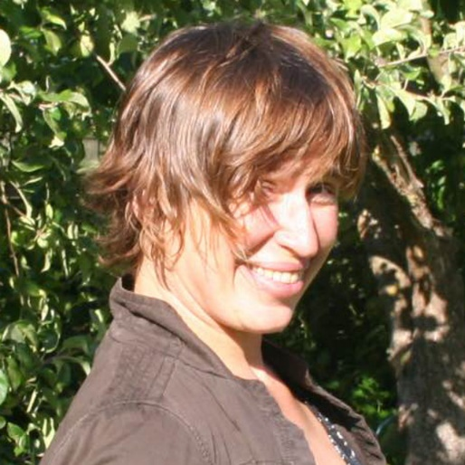
whoami
Agata Przybyszewska
PhD (Mathematics, Computer Science)
Enterprise Architect
Instructor at Lund&Bendsen, lecturer at IT University of Copenhagen
Email: agata@lundogbendsen.dk
Specialist in integration architecture, security, SOA og REST.

Slide 3
About
Introductory course
Scala programming language
Functional design patterns
The participants will learn how to use the Scala language, and how to best benefit from the functional programming style.
The course is taught workshop style, where theory and slides are mixed with lots of practical hands-on exercises.
Emphasis is put on design thinking and group exercises.
We challenge the students with games and role playing exercises, to reinforce key concepts.

Slide 4
Course Contents
Scala language basics - control structures, classes and objects, basic types
Using the REPL
Unit testing
Building (sbt and gradle)
Interoperability with Java
Functional objects, Functions and Closures
Composition and Inheritance, Traits
Pattern matching, case classes
Type inference, conversions
Higher order functions
Collection API
OO meets functional programming - patterns and best practices
Mutable vs immutable
Pure vs Side Effects

Slide 5
Practicalities
2 day course, 09-16
Lunch break 12-13
Course content on Github: https://github.com/LundOgBendsen/LBE2921-Scala
USB with course software: Eclipse + Scala plugin, gradle, sbt etc
Expect interaction - small games, quizzes, team exercises

Slide 6
Let’s get started
Open the Scala REPL
Type a few expressions - what is 1+1 today?
:q to quit
# open a shell and type
Agatas-MacBook-Pro:learning_scala agatanoair$ scala
Welcome to Scala 2.12.4 (Java HotSpot(TM) 64-Bit Server VM, Java 1.8.0_74).
Type in expressions for evaluation. Or try :help.
scala>

Slide 7
Expressions
Primitive: 1, true, “Hello”
Compound: 1+2
Evaluation: left -> right
scala> "Hello"
res3: String = Hello
scala> 1+2
res0: Int = 3

Slide 8
Recommended reading
Online tutorial: https://docs.scala-lang.org/tour/tour-of-scala.html
Book: Programming in scala, 3rd edition
Coursera: https://www.coursera.org/learn/progfun1/home/welcome
Twitter’s Scala School: https://twitter.github.io/scala_school/
Scala koans: http://www.scalakoans.org/

Slide 9
Lab 00
Inspect the tools:
JDK
Scala
Eclipse
REPL
sbt
gradle
# Check out the course content from the USB
Lab 00

