Slide 1

Scala Basics
what is this all about?

Slide 2
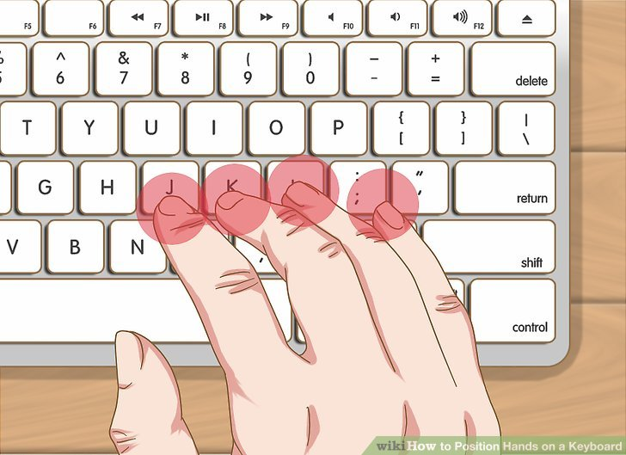
Semicolons ;
Look ma, no semicolon! (in most cases optional)
Use if you want several definitions in one line
How about long expressions?
use parantheses ()
write operator as last element of first line

Slide 3
Expressions
Expressions are computable statements
Primitive: 1, true, “Hello”
Compound: 1+2
You can output results of expressions using println
Evaluation: left -> right
println(1 + 1) // 2
println("Hello!") // Hello!

Slide 4
Values
You can name results of expressions with the val keyword
Named results, such as x here, are called values. Referencing a value does not re-compute it.
Values cannot be re-assigned.
Types of values can be inferred, but you can also explicitly state the type
val x = 1 + 1
println(x) // 2
val y: Int = 1 + 1

Slide 5
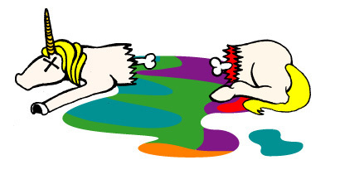
Variables
Variables are like values, except you can re-assign them
You can define a variable with the var keyword
Type is inferred, or can be explicit
Everytime you use var in a functional language, a unicorn dies
var x = 1 + 1
x = 3
println(x * x)

Slide 6
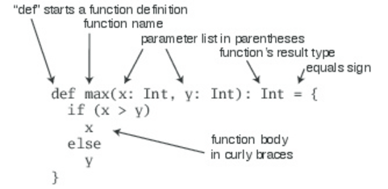
Functions
Functions are expressions that take parameters.
Functions can be named, or anonymous
You can define an anonymous function (i.e. no name) that returns a given integer plus one
(x: Int) => x + 1
On the left of => is a list of parameters. On the right is an expression involving the parameters.
You can also name functions.
val addOne = (x: Int) => x + 1
Functions may take multiple parameters
Or, no parameters at all
val getTheAnswer = () => 42

Slide 7
Methods
Methods look and behave very similar to functions, but there are a few key differences between them.
Methods are defined with the def keyword
def is followed by a name, parameter lists, a return type, and a body.
def add(x: Int, y: Int): Int = x + y
println(add(1, 2)) // 3

Slide 8
Parametrized Definition
So, a method is a parametrized definition
When you use the keyword def, what is on the right hand side of = is evaluated whenever the method is called
A method can be parametrized
The last expression in the body is the method’s return value
Contrast to val - evaluated when created
scala> def square(d:Double) = d*d
square: (d: Double)Double
scala> square(4)
res0: Double = 16.0
scala> def sumOfSquares(d:Double, e:Double) = square(d) + square(e)
sumOfSquares: (d: Double, e: Double)Double
scala> sumOfSquares(3,4)
res1: Double = 25.0

Slide 9
Value definitions
def - by name - evaluated when used
val - by value - evaluated at the point of definition, the name refers to the value

Slide 10
Function Calls & Lambda Calculus
Evaluate from left to right
Replace name by right hand side value
Replace formal parameters by actual arguments
Substitution model - reduce expression to value
lambda calculus
equivalent to Turing machine (Elonzo Church)
only substitutions without side effects (c++)
termination: does every expression reduce to a value (finite no of steps)? no

Slide 11
Main Method
Like in Java, the main method is an entry point of a program
The Java Virtual Machine requires a main method to be named main and take one argument, an array of strings
object Main {
def main(args: Array[String]): Unit =
println("Hello, Scala developer!")
}

Slide 12
Value Types
There are nine predefined value types and they are non-nullable
Double, Float, Long, Int, Short, Byte, Char, Unit, and Boolean
Unit is a value type which carries no meaningful information. There is exactly one instance of Unit which can be declared literally like so: ()
val list: List[Any] = List(
"a string",
732, // an integer
'c', // a character
true, // a boolean value
() => "an anonymous function returning a string"
)
list.foreach(element => println(element))

Slide 13
Decisions
Use the if-else expression
Scala is an expression language (not statements like in java) -everything is an expression - also the if-else
//what is the value ?
val exp = if( 2 == 3) false else true

Slide 14
Iterations
To iterate over a collection, you call the foreach method and pass in a function
In this case, you're passing in a function literal that takes one parameter named arg.
The body of the function is println(arg)
If a function literal consists of one statement that takes a single argument, you need not explicitly name and specify the argument.
args.foreach(arg => println(arg))
//or
args.foreach(println)

Slide 15
You can also loop
… but beware of dead unicorns, this is imperative, not functional style
var i = 0
while (i < args.length) {
if (i != 0)
print(" ")
print(args(i))
i += 1
}

Slide 16
Recursion
Always state explicit return type (not required for non-recursive functions)
Make sure it returns at some point!
Note that the recursive call is the last thing that happens in the evaluation of function approximate's body.
Functions like approximate, which call themselves as their last action, are called tail recursive.
The Scala compiler detects tail recursion and replaces it with a jump back to the beginning of the function, after updating the function parameters with the new values
Tail recursion is good - it is reusing stack frames - you don’t run out of stack space
Often, a recursive solution is more elegant and concise than a loop-based one. If the solution is tail recursive, there won't be any runtime overhead to be paid.
def approximate(guess: Double): Double =
if (isGoodEnough(guess)) guess
else approximate(improve(guess))

Slide 17
Blocks
Blocks define a lexical scope for
nesting functions
definitions and expressions
definitions in block only visible from block
definitions in block shadow definitions outside the block
Blocks have a value!
Last expression is the “value” of the block
println({
val x = 1 + 1
x + 1
}) // 3

Slide 18
REPL basics
Read - Evaluate - Print - Loop
The Scala REPL is a tool for evaluating expressions in Scala
Useful commands
:help
:t, :type - finds the type
:t function_name _ - finds type of function
:q, :quit
Agatas-MacBook-Pro:~ agatanoair$ scala
Welcome to Scala 2.12.4 (Java HotSpot(TM) 64-Bit Server VM, Java 1.8.0_74).
Type in expressions for evaluation. Or try :help.
scala>

Slide 19

Lab Time !
language_basics_02

