Slide 1

Functional Programming
bend your mind

Slide 2
Imperative
Imperative programming is about
modifying mutable variables
using assignments
using control structures such as if-then-else, loops, break, continue, return.
The most common informal way to understand imperative programs is as instruction sequences for a Von Neumann computer.

Slide 3
This maps well to computers
Mutable variables ≈ memory cells
Variable dereferences ≈ load instructions
Variable assignments ≈ store instructions
Control structures ≈ jumps
Problem? Scaling up

Slide 4
Von Neuman bottleneck
In the end, pure imperative programming is limited by the “Von Neumann” bottleneck: One tends to conceptualize data structures word-by-word.
We need other techniques for defining high-level abstractions such as collections, polynomials, geometric shapes, strings, documents. Ideally: Develop theories of collections, shapes, strings, …

Slide 5
Theories?
A theory consists of
one or more data types
operations on these types
laws that describe the relationships between values and operations
Normally, a theory does not describe mutations!

Slide 6
functional
In a restricted sense, a functional programming language is one which does not have mutable variables, assignments, or imperative control structures.
In a wider sense, a functional programming language enables the construction of elegant programs that focus on functions.
In particular, functions in a FP language are first-class citizens.
they can be defined anywhere, including inside other functions
like any other value, they can be passed as parameters to functions and returned as results
as for other values, there exists a set operators to compose functions

Slide 7
Functional paradigm
The two defining features of the functional paradigm are that
all computations are treated as the evaluation of a function
you avoid changing state and mutable data.
But there are some additional common features of functional programming:
First-class functions: functions can serve as arguments and results of functions.
Recursion as the primary tool for iteration.
Heavy use of pattern matching.
Lazy evaluation, which makes possible the creation of infinite sequences.

Slide 8
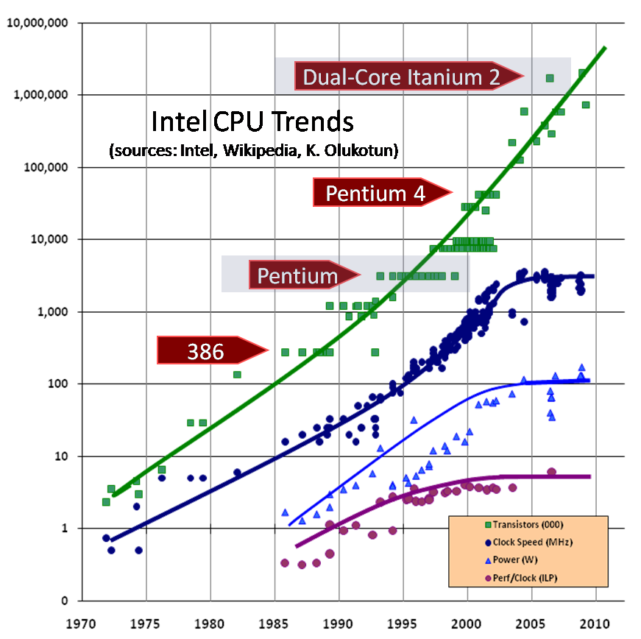
parallel
Functional Programming is becoming increasingly popular because it offers an attractive method for exploiting parallelism for multicore and cloud computing.

Slide 9
Why is FP good for parallel?
FP’s recognized good fit for concurrency appeals to people writing multi-processor apps, high-availability apps, web servers for the social network, and more.
FP’s higher-level abstractions appeal to those looking for faster development time or more understandable code.
FP’s emphasis on immutability has a strong appeal for anyone concerned about reliability.

Slide 10
Language history
1959 Lisp 1975-77 ML, FP, Scheme
1978 Smalltalk 1986 Standard ML
1990 Haskell, Erlang 1999 XSLT
2000 OCaml
2003 Scala, XQuery
2005 F#
2007 Clojure

Slide 11
Pure vs Impure
At its core, functional programming is about programming with pure, side-effect-free functions.
a function that doesn’t rely on mutating state is called a pure function
a function,that is mutating state, that may be shared across many pieces of a program is called and impure function
//Pure
​public​ ​int​ incrementCounter(​int​ counter) {
​return​ counter++;
}
//Impure
private​ ​int​ counter = 0;
​public​ ​void​ incrementMutableCounter() {
counter++;
}

Slide 12
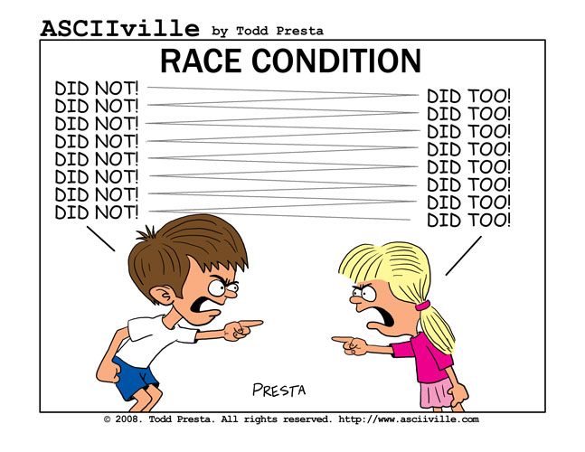
Threads ?
Race Conditions?
think and dicuss

Slide 13
A simple program
​public​ List<Integer> filterOdds(List<Integer> list) {
​
List<Integer> filteredList = ​new​ ArrayList<Integer>();
​
​
​for​(Integer current : list) {
​
​if​(1 == current % 2) {
​
filteredList.add(current);
​
}
​
}
​
​return​ filteredList;
​
}

Slide 14
A bit of refactoring
​public​ List<Integer> filterOdds(List<Integer> list) {
​
List<Integer> filteredList = ​new​ ArrayList<Integer>();
​
​for​ (Integer current : list) {
​
​if​ (isOdd(current)) {
​
filteredList.add(current);
}
​
}
​
​return​ filteredList;
​
}
​
​private​ ​boolean​ isOdd(Integer integer) {
​
​return​ 1 == integer % 2;
​
}

Slide 15
Requirements can change
But … what if we need evens?
​for​ (Integer current : list) {
​if​ (isEven(current)) {
filteredList.add(current);
}
}
​return​ filteredList;
}
​
​private​ ​boolean​ isEven(Integer integer) {
​
​return​ 0 == integer % 2;
​
}

Slide 16

DRY Principle
Don’t Repeat Yourself

Slide 17
Let’s isolate the piece, that can change
​public​ ​interface​ Predicate {
​
​public​ ​boolean​ evaluate(Integer argument);
​
}

Slide 18
We use higher order functions
​public​ List<Integer> filter(List<Integer> list, Predicate predicate) {
List<Integer> filteredList = ​new​ ArrayList<Integer>();
​for​ (Integer current : list) {
​if​ (predicate.evaluate(current)) {
filteredList.add(current);
}
}
​return​ filteredList;
}
​class​ isEven ​implements​ Predicate {
​public​ ​boolean​ evaluate(Integer argument) {
​return​ 0 == argument % 2;
}
}
​class​ isOdd ​implements​ Predicate {
​public​ ​boolean​ evaluate(Integer argument) {
​return​ 1 == argument % 2;
}
​
}

Slide 19
Demo
Rewrite from imperative style

Slide 20

Lab
functional_prog_intro_03

