Slide 1
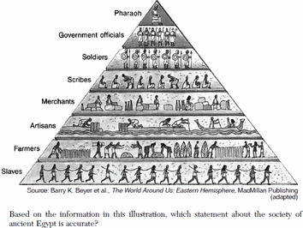
Class Hierarchies
Structure and organization

Slide 2
Abstract classes
Can not be instantiated!
Use abstract keyword
Use extends keyword to define a subclass
The abstract class is a superclass of the realizations - baseclass
Can have undefined methods
The implementing class has to add method implementations
abstract class Animal(name: String)

Slide 3
Dynamic binding
Dynamic method dispatch - which code will be called?
In object oriented languages, the code invoked by method call depends on the runtime type of the object
empty contains 1

Slide 4
Overriding
Redefine functionality
Use the keyword override
In Scala, override is mandatory
override def toString() = "."

Slide 5
Object definition
Represents a singleton
Singleton objects are values
Reference - only one can exist
Reference by name
Can not have generic types (huh?? future lesson!)
object Empty extends IntSet {
def contains(n: Int) = false
def include(n: Int) = new NonEmpty(n, Empty, Empty)
override def toString() = "."
}

Slide 6

Persistent data structures
On change, the old structure still exists

Slide 7
What about multiple inheritance?
We can build large class hierachies
Scala is a single inheritance language - a class can only have one superclass
What if a class has several natural supertypes?
What if we want to inherit code from several types?
Example:
Platypus is a mammal, but lays eggs
Credit card is an editable card, but should also have some security settings

Slide 8
Packages
Stay organized - use packages
Fully qualified class name is packagename.classname
Think of this as last name + first name!
package dk.lundogbendsen.scala.hello
object Hello{ …}
//
dk.lundogbendsen.scala.hello.Hello

Slide 9
Import
Use import to avoid typing the fully qualified class name
Named import
Wildcard import
import dk.lundogbendsen.hello.Hello // imports just Hello
import dk.lundogbendsen.hello.{Hello,Bye}//imports Hello and Bye
import dk.lundogbendsen.hello._ // wildcard imports all

Slide 10
Automatic imports
Scala automatically imports members from the following packages
scala
java.lang
scala.Predef
Checkout scaladocs at: www.scala-lang.org/api/current
Int scala.Int
Boolean scala.Boolean
Object java.lang.Object
require scala.Predef.require
assert scala.Predef.assert

Slide 11
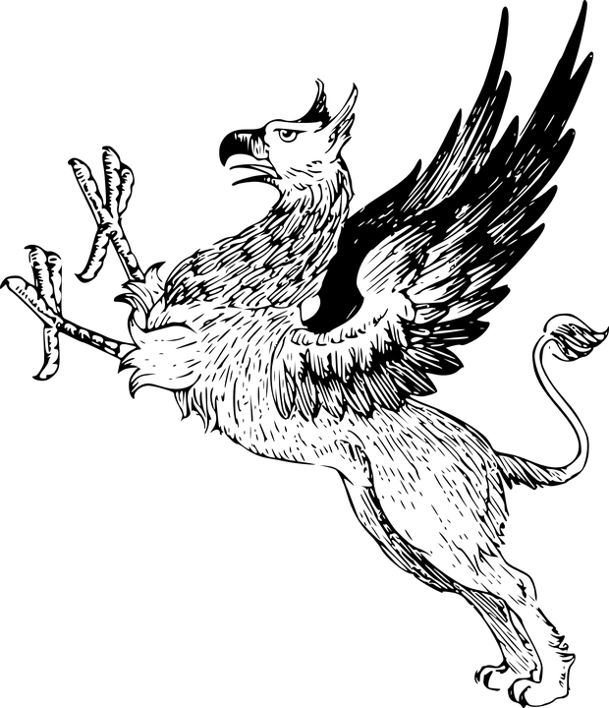
Traits in Scala
Composing functionality across class hierarchies

Slide 12
Class parameters
You can define a class with parameters (primary constructor)
Primary constructor parameters with val and var are public
prefix parameters with: var, val or nothing
var - can be modified
val - is a value
nothing - private values to the class
Defines at the same time parameters and fields of a class
Parameters without val or var are private values, visible only within the class
class Point(val x: Int, val y: Int)
val point = new Point(1, 2)
println( point.x)
point.x = 3 // <-- does not compile

Slide 13
Trait
You can use traits, to inherit functionality from several places
Classes, objects and traits can inherit from at most one class but arbitrary many traits
Can’t have constructor parameters
A trait is declared like an abstract class, just with trait instead of abstract class
When a class extends a trait, it uses the extends or with keywords
When extending one trait, use extends
When extending several traits, use with
trait BaseSoundPlayer {
def play
def close
def pause
def stop
def resume
}
class Mp3SoundPlayer extends BaseSoundPlayer { ...
class Foo extends BaseClass with Trait1 with Trait2 { ...

Slide 14
Class vs trait
Traits resemble interfaces in Java, but are more powerful
Traits can contains fields and concrete methods.
Traits cannot have (value) parameters, only classes can.

Slide 15
What is the difference?
Abstract class vs Trait ???

Slide 16
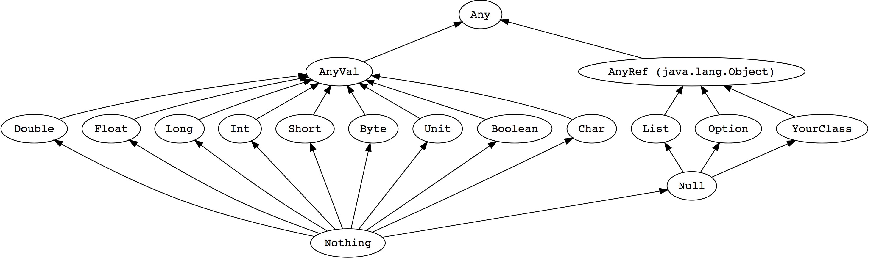
Scala Type Hierarchy

Slide 17
Top Types
In Scala, all values have a type, including numerical values and functions
Any - the base of all types. Contains methods like ==, !=, equals, hashCode, toString
AnyRef - The base type of all reference types; Alias of ‘java.lang.Object‘
AnyVal - The base type of all primitive types
9 predefined value types and they are non-nullable: Double, Float, Long, Int, Short, Byte, Char, Boolean, Unit
Unit is a value type which carries no meaningful information. There is exactly one instance of Unit which can be declared literally like so: ().
All functions must return something so sometimes Unit is a useful return type.
val list: List[Any] = List(
"a string",
732, // an integer
'c', // a character
true, // a boolean value
() => "an anonymous function returning a string"
)
list.foreach(element => println(element))

Slide 18
Bottom types
Nothing is a subtype of all types, also called the bottom type. There is no value that has type Nothing
signal abnormal termination
en element type of empty collection
Null is a subtype of all reference types (i.e. any subtype of AnyRef).
It has a single value identified by the keyword literal null.
Null is provided mostly for interoperability with other JVM languages
should almost never be used in Scala code
Every reference class type also has null as a value. The type of null is Null.
Null is a subtype of every class that inherits from Object; it is incompatible with subtypes of AnyVal (non - nullable)

Slide 19
Nothing is useful for Exception handling
exception handling is similar to Java
The expression throw Exc aborts evaluation with the exception Exc
The type of throw Exc is Nothing
def error(msg:String) = throw new Error(msg)
//> error: (msg: String)Nothing

Slide 20
Demo time!
Let’s have a look at the types

Slide 21

Lab time!
class_hierarchies_06

