Slide 1
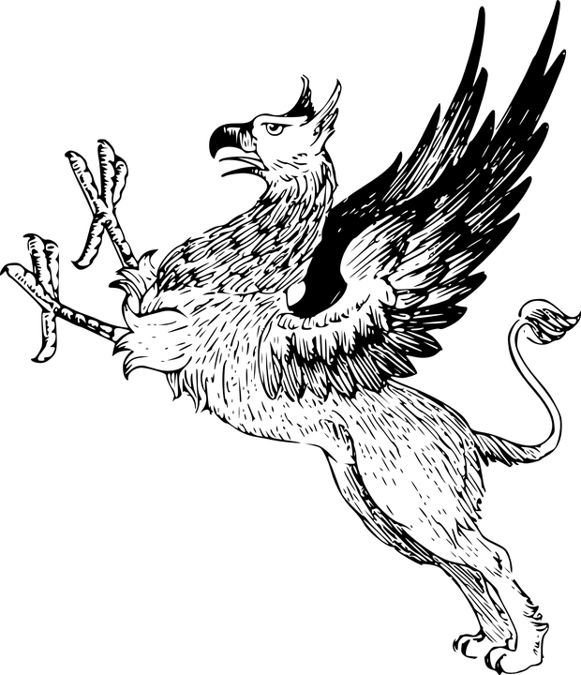
Polymorphism in Scala

Slide 2
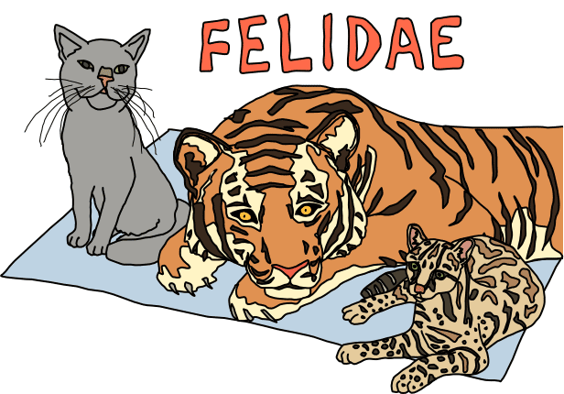
What is polymorphism?
Polymorphism means “many forms”
function can have arguments of “many types”
type can have instances of “many types”
subtyping (OOP): instances of a subclass can be passed to a base class
generics (FP): instances of class or function are created by type parametrization

Slide 3
Generic Types
Generic types are types (classes, traits) which take a type as a parameter
Useful for collection classes
Generic classes take a type as a parameter within square brackets []
Subtyping of generic types is invariant,
Stack[A] is only a subtype of Stack[B] if and only if B = A
class Stack[A] {
private var elements: List[A] = Nil
def push(x: A) { elements = x :: elements }
def peek: A = elements.head
def pop(): A = {
val currentTop = peek
elements = elements.tail
currentTop
}
}

Slide 4
Demo Cons-list
head
tail
head
tail
head
Nil
polymorphism.List.scala

Slide 5
Polymorphic methods
Like classes and traits, functions can have type parameters
Ie, functions can be parameterized by type as well as value
Type parameters are enclosed in square brackets, while value parameters are enclosed in parentheses
Type can be implicit in call (type inference)
Type erasure - only there at compile time, erased at runtime
def listOfDuplicates[A](x: A, length: Int): List[A] = {
if (length < 1)
Nil
else
x :: listOfDuplicates(x, length - 1)
}
scala> listOfDuplicates[String](“miaw!",4) //List[String] = List(miaw!, miaw!, miaw!, miaw!)
scala> listOfDuplicates(“moooh!",4) //List[String] = List(moooh!, moooh!, moooh!, moooh!)

Slide 6

Lab time!
polymorphism_07

