Slide 1
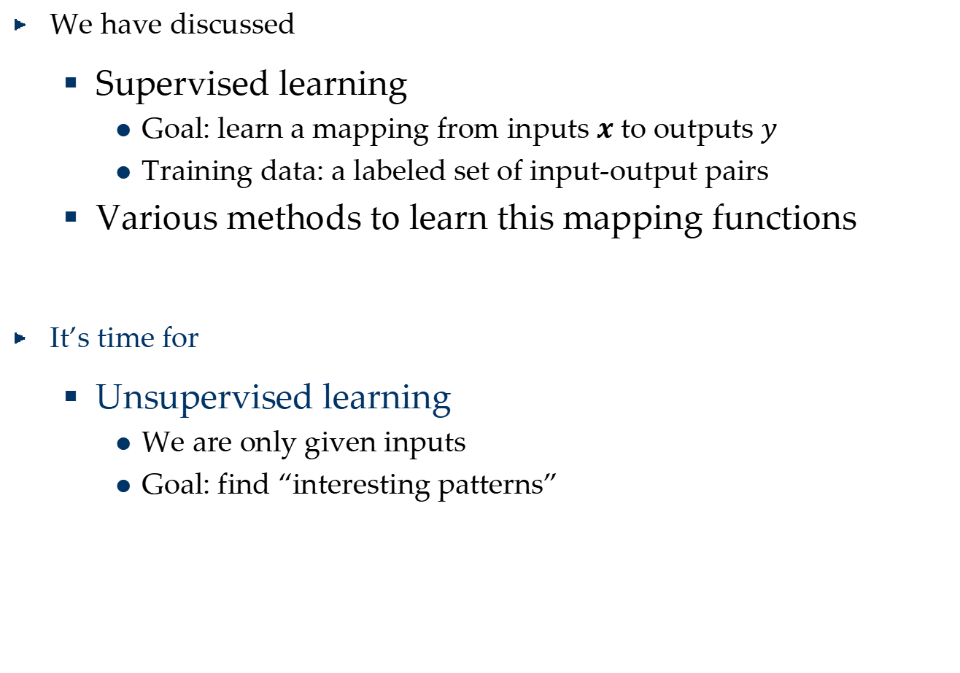
So Far…
We have discussed
Supervised learning
Goal: learn a mapping from inputs $x$ to outputs $y$
Training data: a labeled set of input-output pairs
Various methods to learn this mapping functions
It’s time for
Unsupervised learning
We are only given inputs
Goal: find “interesting patterns”

Slide 2
Discovering clusters: Clustering

Slide 3
What is Clustering and Why?
Cluster: A collection of data objects
similar (or related) to one another within the same group
dissimilar (or unrelated) to the objects in other groups
Clustering
Finding similarities between data according to the characteristics found in the data and grouping similar data objects into clusters
Unsupervised learning: no predefined classes
Typical applications
As a stand-alone tool.
Image segmentation, News clustering
As a preprocessing step for other algorithms

Slide 4


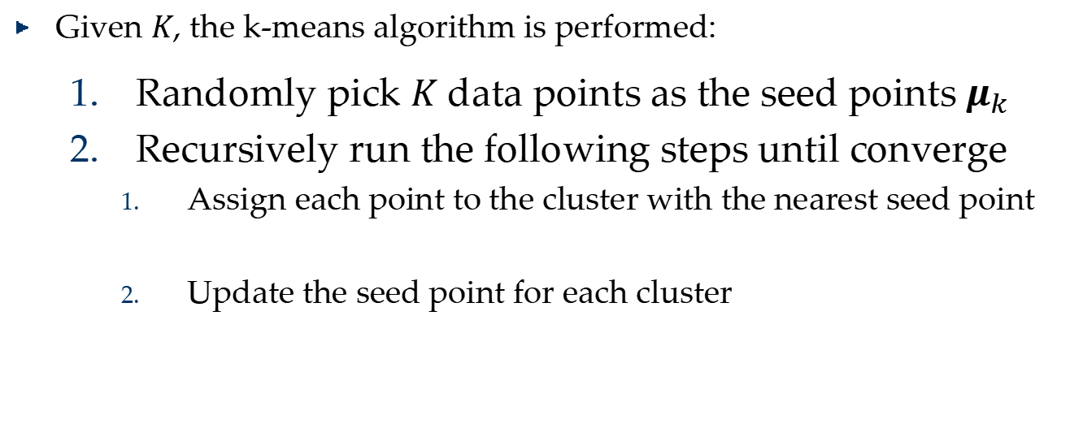
The K-Means Algorithm (MacQueen’67)
Given $K$, the k-means algorithm is performed:
Randomly pick $K$ data points as the seed points $μ_{k}$
Recursively run the following steps until converge
Assign each point to the cluster with the nearest seed point
Update the seed point for each cluster
$$z_{i}=\arg{\min_{k}{{\left\|x_{i}−μ_{k}\right\|}^{2}}}$$
$$μ_{k}=\frac{1}{N_{k}}\sum_{i=1}^{N_{k}}{x_{i}^{\left(k\right)}}$$

Slide 5
K-Means Example

Slide 6



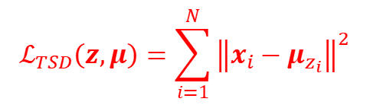
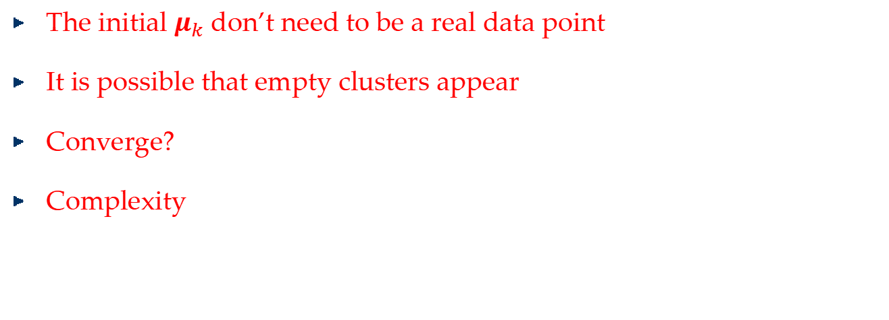


The K-Means Algorithm (MacQueen’67)
Given $K$, the k-means algorithm is performed:
Randomly pick $K$ data points as the seed points $μ_{k}$
Recursively run the following steps until converge
Assign each point to the cluster with the nearest seed point
Update the seed point for each cluster
$$t$$
$$d$$
$$z_{i}=\arg{\min_{k}{{\left\|x_{i}−μ_{k}\right\|}^{2}}}$$
$$K$$
$$N$$
$$μ_{k}=\frac{1}{N_{k}}\sum_{i=1}^{N_{k}}{x_{i}^{\left(k\right)}}$$
$$ℒ_{TSD}\left(z,μ\right)=\sum_{i=1}^{N}{{\left\|x_{i}−μ_{z_{i}}\right\|}^{2}}$$
The initial $μ_{k}$ don’t need to be a real data point
It is possible that empty clusters appear
Converge?
Complexity
$$O\left(tNKd\right)$$

Slide 7
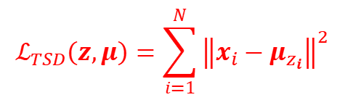
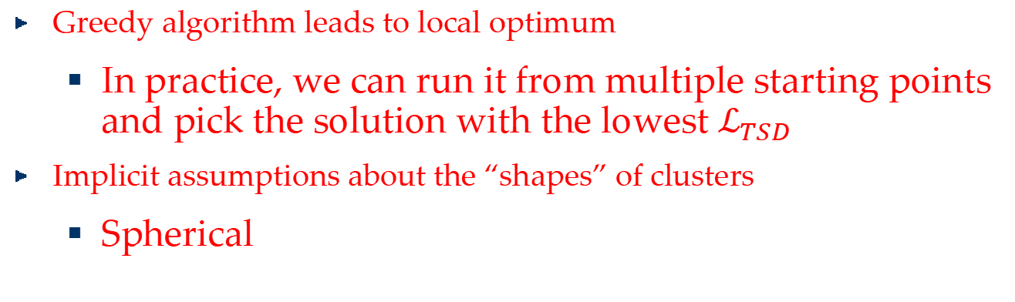


The K-Means Algorithm (MacQueen’67)
Given $K$, the k-means algorithm is performed:
Randomly pick $K$ data points as the seed points $μ_{k}$
Recursively run the following steps until converge
Assign each object to the cluster with the nearest seed point
Update the seed point for each cluster
$$z_{i}=\arg{\min_{k}{{\left\|x_{i}−μ_{k}\right\|}^{2}}}$$
$$μ_{k}=\frac{1}{N_{k}}\sum_{i=1}^{N_{k}}{x_{i}^{\left(k\right)}}$$
$$ℒ_{TSD}\left(z,μ\right)=\sum_{i=1}^{N}{{\left\|x_{i}−μ_{z_{i}}\right\|}^{2}}$$
Greedy algorithm leads to local optimum
In practice, we can run it from multiple starting points and pick the solution with the lowest $ℒ_{TSD}$
Implicit assumptions about the “shapes” of clusters
Spherical

Slide 8
Clustering with a input of distance matrix
Input: a pair-wise distance matrix
Kmeans cannot be applied, why?
The seed nodes of each cluster are virtual points
$$μ_{k}=\frac{1}{N_{k}}\sum_{i=1}^{N_{k}}{x_{i}^{\left(k\right)}}$$

Slide 9
Partitioning Around Medoids (PAM) Kaufman & Rousseeuw’87
The seeds in Kmeans:
Centroid: the “middle” of a cluster
Not necessarily a real point in a cluster
The seeds in Kmedoids
Medoid: the centrally located point in the cluster.
$$μ_{k}=\frac{1}{N_{k}}\sum_{i=1}^{N_{k}}{x_{i}^{\left(k\right)}}$$

Slide 10

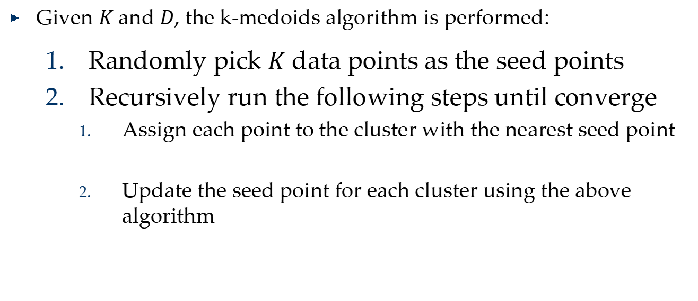

K-Medoids with $D$input
Input: the pairwise distances matrix $D$
Compute the row (or, column) sum of $D$, $d$
Finds the smallest entry in $d$
$$O\left(N^{2}\right)$$
Given $K$ and $D$, the k-medoids algorithm is performed:
Randomly pick $K$ data points as the seed points
Recursively run the following steps until converge
Assign each point to the cluster with the nearest seed point
Update the seed point for each cluster using the above algorithm

Slide 11
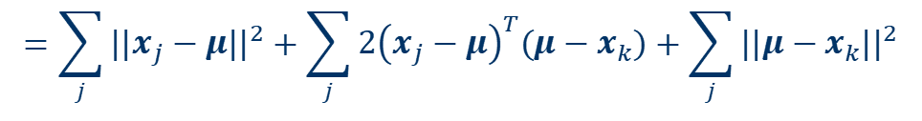
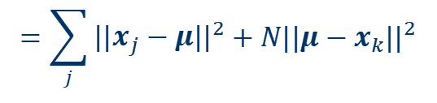
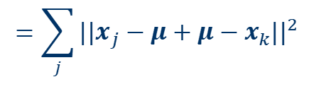


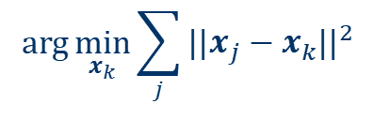
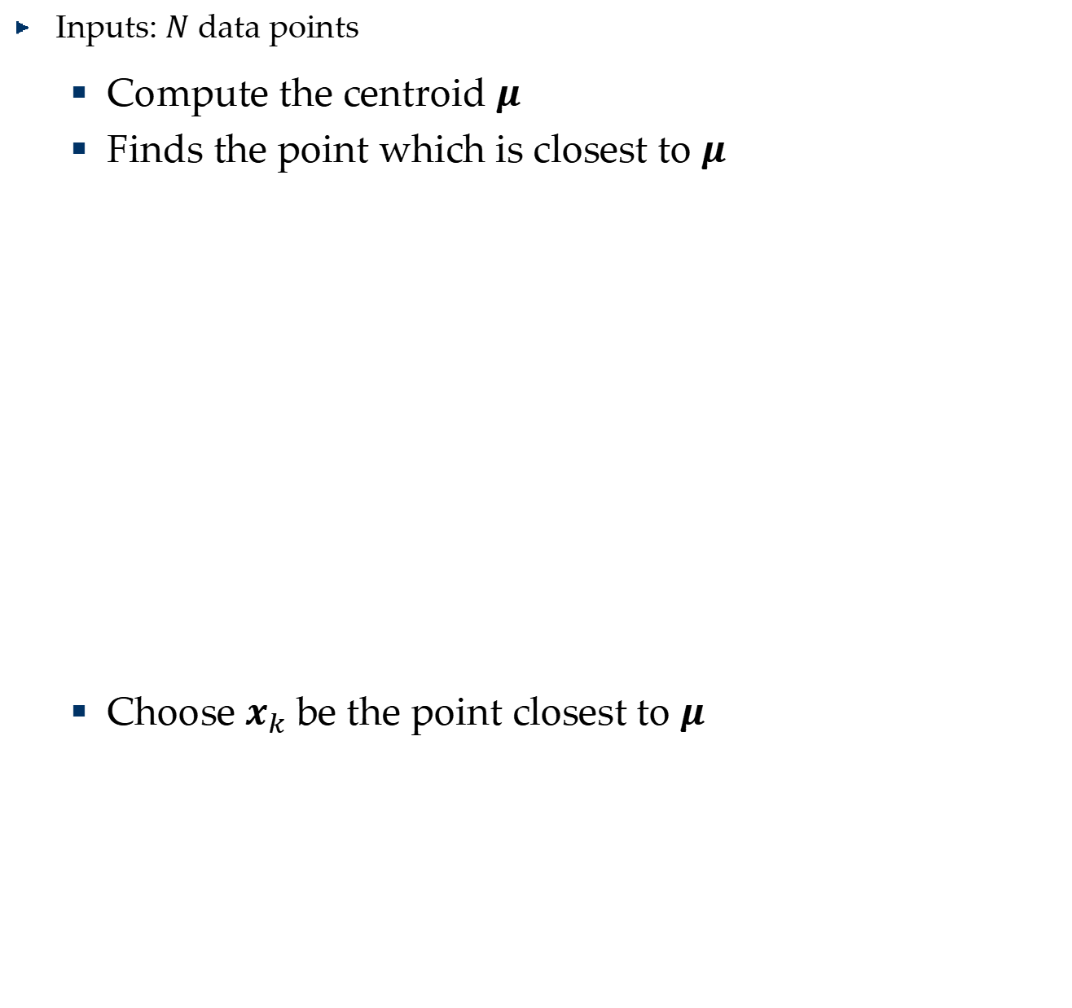
How to find the medoid
Inputs: $N$ data points
Compute the centroid $μ$
Finds the point which is closest to $μ$
Choose $x_{k}$ be the point closest to $μ$
$$\arg{\min_{x_{k}}{\sum_{j}{{||x_{j}−x_{k}||}^{2}} }}$$
$$μ=\frac{1}{N}\sum_{j}{x_{j}}$$
$$\sum_{j}{{||x_{j}−x_{k}||}^{2}}$$
$$=\sum_{j}{{||x_{j}−μ+μ−x_{k}||}^{2}}$$
$$=\sum_{j}{{||x_{j}−μ||}^{2}}+\sum_{j}{2{\left(x_{j}−μ\right)}^{T}\left(μ−x_{k}\right)}+\sum_{j}{{||μ−x_{k}||}^{2}}$$
$$=\sum_{j}{{||x_{j}−μ||}^{2}}+{N||μ−x_{k}||}^{2}$$

Slide 12


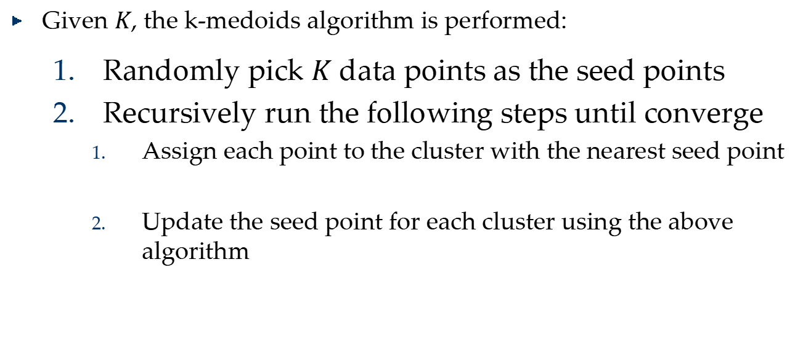
K-Medoids with vectors input
Inputs: $N$ data points
Compute the centroid $μ$
Finds the point which is closest to $μ$
Given $K$, the k-medoids algorithm is performed:
Randomly pick $K$ data points as the seed points
Recursively run the following steps until converge
Assign each point to the cluster with the nearest seed point
Update the seed point for each cluster using the above algorithm
$$t$$
$$d$$
$$K$$
$$N$$
$$d$$
$$N$$
$$O\left(tN\left(K+1\right)d\right)$$

Slide 13


Density Estimation
heat
$$P\left(x\right)$$
$$\left\{x_{1},x_{2},⋯,x_{n}\right\}$$
vibration
Anomaly detection

Slide 14
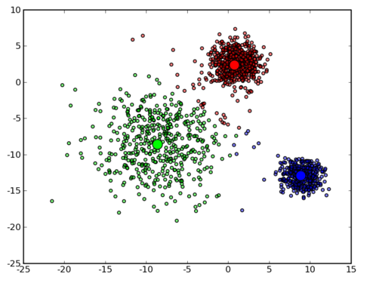
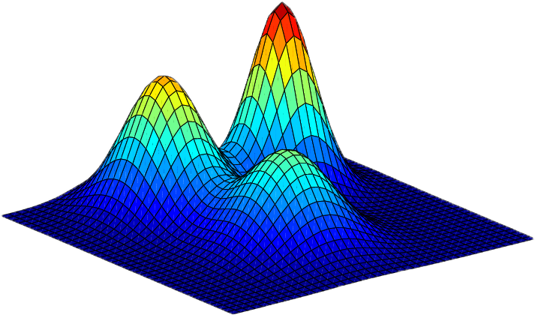
Gaussian Mixture Model
Gaussian Mixture Model (GMM) is one of the most popular clustering methods which can be viewed as a linear combination of different Gaussian components.

Slide 15
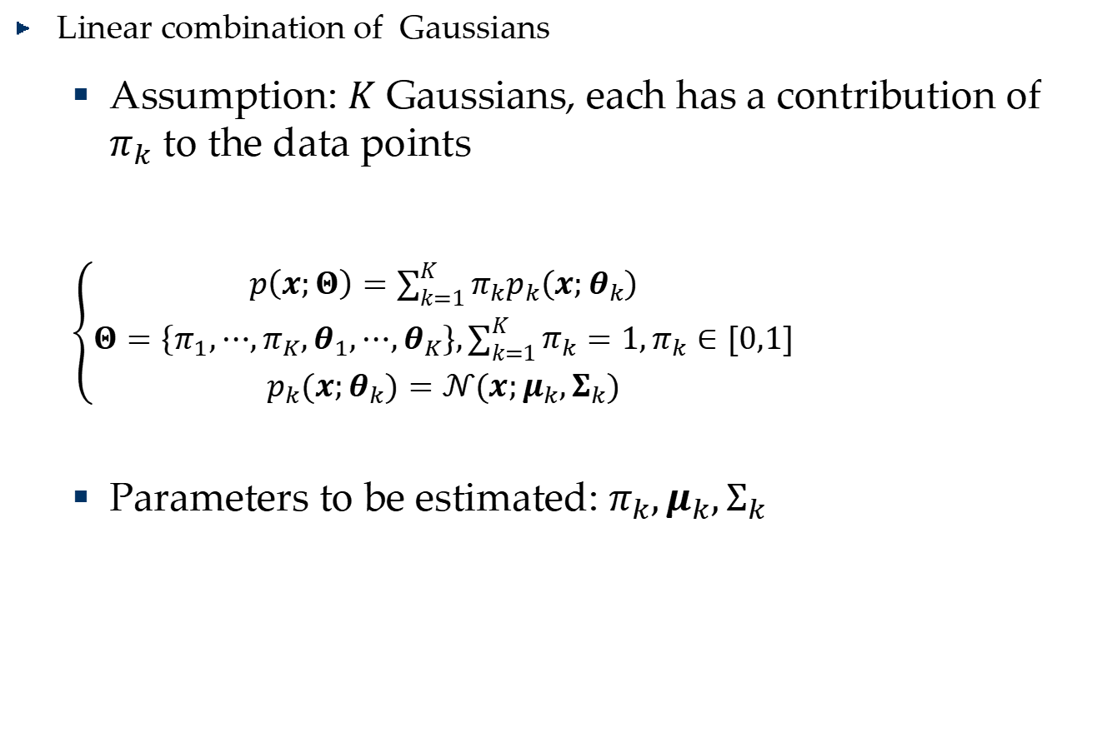
Gaussian Mixture Model
Linear combination of Gaussians
Assumption: $K$ Gaussians, each has a contribution of $π_{k}$ to the data points
$\left\{\begin{aligned}p\left(x;Θ\right)=\sum_{k=1}^{K}{π_{k}p_{k}\left(x;θ_{k}\right)} \\ Θ=\left\{π_{1},⋯,π_{K},θ_{1},⋯,θ_{K}\right\},\sum_{k=1}^{K}{π_{k}}=1,π_{k}∈[0,1] \\ p_{k}\left(x;θ_{k}\right)=𝒩\left(x;μ_{k},Σ_{k}\right)\end{aligned}\right.$
Parameters to be estimated: $π_{k},μ_{k},Σ_{k}$
Notes:
Simply speaking, the probability of generating each point $x$ is viewed as the contributions of $K$ Gaussian component with positive weight $π_{k}$

Slide 16
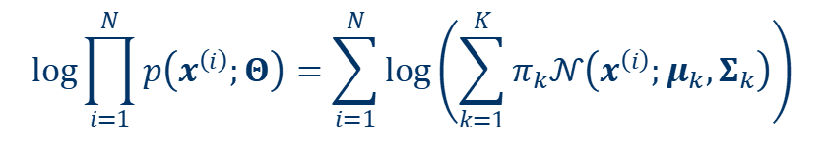
Parameters Estimation for GMM
The log-likelihood function:
How to find the parameters?
$$\log{\prod_{i=1}^{N}{p\left(x^{\left(i\right)};Θ\right)=\sum_{i=1}^{N}{\log\left(\sum_{k=1}^{K}{π_{k}𝒩\left(x^{\left(i\right)};μ_{k},Σ_{k}\right)}\right)}}}$$

Slide 17
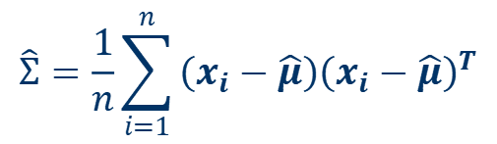

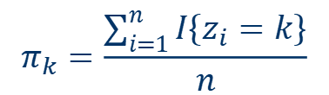
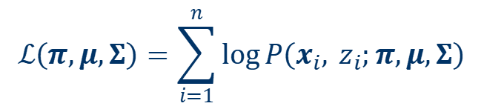
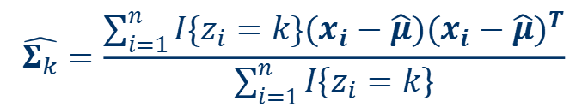
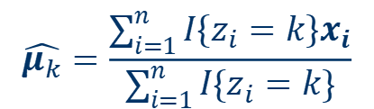



Gaussian Mixture Model
There is a latent (hidden/unobserved) random variable $z$
$z_{i}$ follows the multinomial distribution $P\left(z_{i}=k\right)=π_{k}$
$P\left(x_{i}|z_{i}=k\right)$, Gaussian $𝒩\left(μ_{k},Σ_{k}\right)$
If we know the variables $z_{i}$
$$P\left(x_{i}, z_{i}\right)$$
$$=P\left(x_{i}|z_{i}\right)P\left(z_{i}\right)$$
$$\hat{μ}=\frac{1}{n}\sum_{i=1}^{n}{x_{i}}$$
$$\hat{Σ}=\frac{1}{n}\sum_{i=1}^{n}{\left(x_{i}−\hat{μ}\right){\left(x_{i}−\hat{μ}\right)}^{T}}$$
$$ℒ\left(π,μ,Σ\right)=\sum_{i=1}^{n}{\log{P\left(x_{i}, z_{i};π,μ,Σ\right)}}$$
$$\hat{μ_{k}}=\frac{\sum_{i=1}^{n}{I\left\{z_{i}=k\right\}x_{i}}}{\sum_{i=1}^{n}{I\left\{z_{i}=k\right\}}}$$
$$π_{k}=\frac{\sum_{i=1}^{n}{I\left\{z_{i}=k\right\}}}{n}$$
$$\hat{Σ_{k}}=\frac{\sum_{i=1}^{n}{I\left\{z_{i}=k\right\}\left(x_{i}−\hat{μ}\right){\left(x_{i}−\hat{μ}\right)}^{T}}}{\sum_{i=1}^{n}{I\left\{z_{i}=k\right\}}}$$

Slide 18
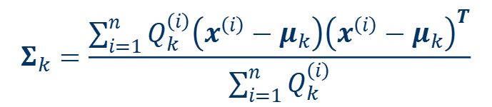
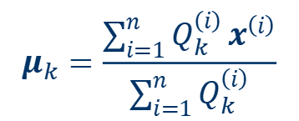




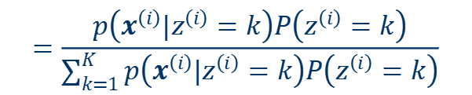
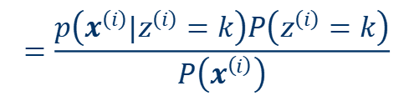
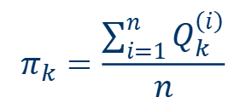

Parameters Estimation for GMM
$$Q_{k}^{\left(i\right)}≜$$
$$=\frac{p\left(x^{\left(i\right)}|z^{\left(i\right)}=k\right)P\left(z^{\left(i\right)}=k\right)}{P\left(x^{\left(i\right)}\right)}$$
$$P\left(z^{\left(i\right)}=k|x^{\left(i\right)}\right)$$
$$𝒩\left(μ_{k},Σ_{k}\right)$$
$$π_{k}$$
$$=\frac{p\left(x^{\left(i\right)}|z^{\left(i\right)}=k\right)P\left(z^{\left(i\right)}=k\right)}{\sum_{k=1}^{K}{p\left(x^{\left(i\right)}|z^{\left(i\right)}=k\right)P\left(z^{\left(i\right)}=k\right)}}$$
E-Step
$$P\left(z^{\left(i\right)}=k|x^{\left(i\right)}\right)=Q_{k}^{\left(i\right)}$$
M-Step
$$μ_{k}=\frac{\sum_{i=1}^{n}{Q_{k}^{\left(i\right)}}x^{\left(i\right)}}{\sum_{i=1}^{n}{Q_{k}^{\left(i\right)}}}$$
$$\hat{μ_{k}}=\frac{\sum_{i=1}^{n}{I\left\{z_{i}=k\right\}x_{i}}}{\sum_{i=1}^{n}{I\left\{z_{i}=k\right\}}}$$
$$Σ_{k}=\frac{\sum_{i=1}^{n}{Q_{k}^{\left(i\right)}\left(x^{\left(i\right)}−μ_{k}\right){\left(x^{\left(i\right)}−μ_{k}\right)}^{T}}}{\sum_{i=1}^{n}{Q_{k}^{\left(i\right)}}}$$
$$\hat{Σ_{k}}=\frac{\sum_{i=1}^{n}{I\left\{z_{i}=k\right\}\left(x_{i}−\hat{μ}\right){\left(x_{i}−\hat{μ}\right)}^{T}}}{\sum_{i=1}^{n}{I\left\{z_{i}=k\right\}}}$$
$$π_{k}=\frac{\sum_{i=1}^{n}{Q_{k}^{\left(i\right)}}}{n}$$
$$π_{k}=\frac{\sum_{i=1}^{n}{I\left\{z_{i}=k\right\}}}{n}$$

Slide 19
Expectation Maximization

Slide 20

Convex sets
A set $C$ is convex if the line segment between any two points in $C$ lies in $C$
For any $x_{1},x_{2}∈C$ and $θ$ with $0≤θ≤1,$ we have
$θx_{1}+\left(1−θ\right)x_{2}∈C$

Slide 21
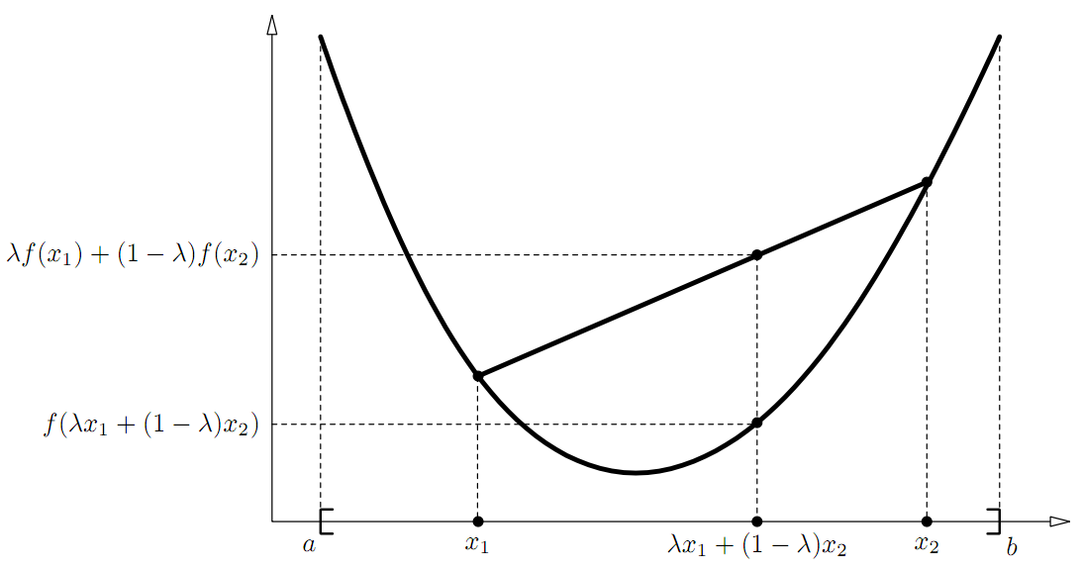
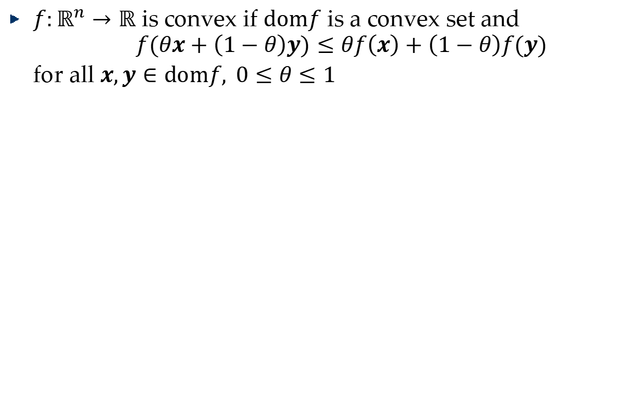
Convex functions
$f:ℝ^{n}→ℝ$ is convex if $\text{dom}f$ is a convex set and $$f\left(θx+\left(1−θ\right)y\right)≤θf\left(x\right)+\left(1−θ\right)f\left(y\right)$$ for all $x,y∈\text{dom}f, 0≤θ≤1$

Slide 22
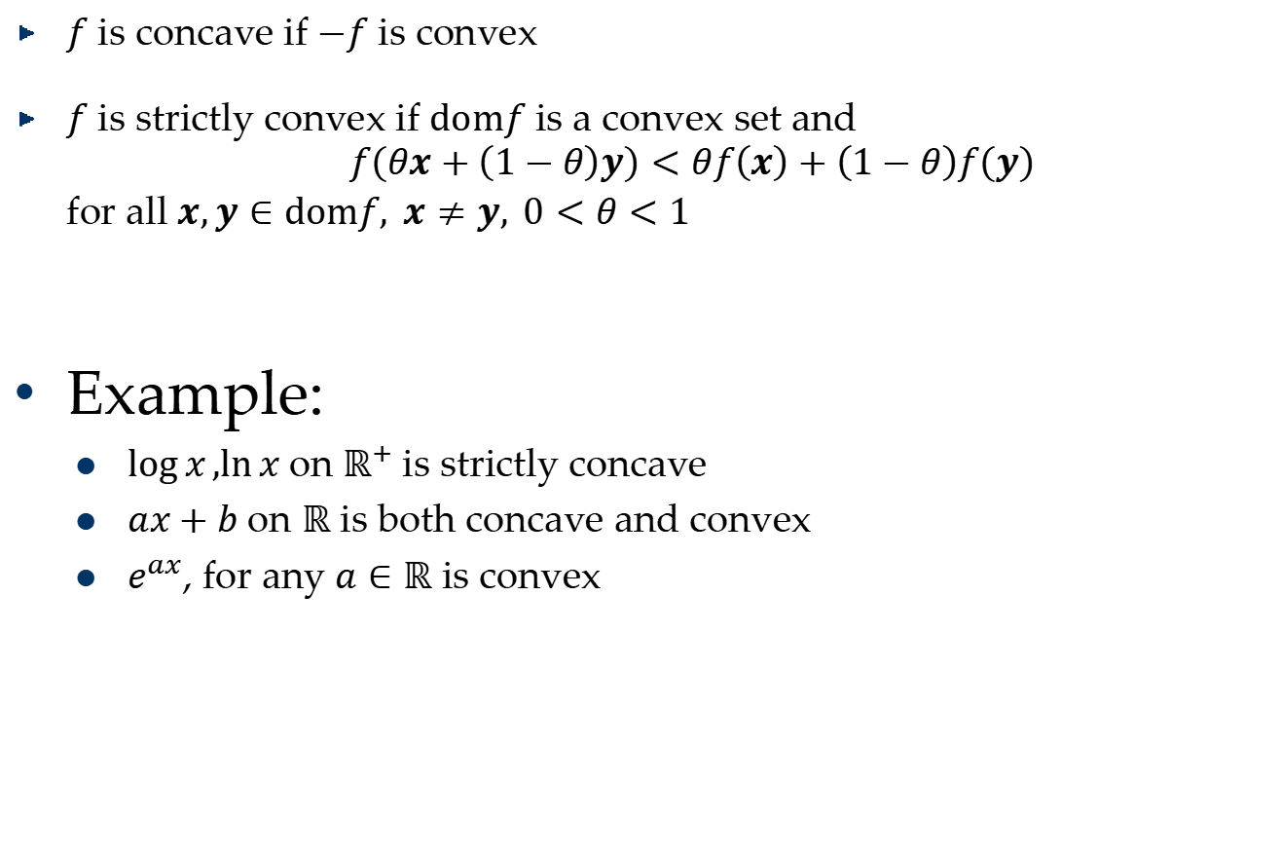
$f$ is concave if $−f$ is convex
$f$ is strictly convex if $\text{dom}f$ is a convex set and $$f\left(θx+\left(1−θ\right)y\right)<θf\left(x\right)+\left(1−θ\right)f\left(y\right)$$ for all $x,y∈\text{dom}f, x≠y, 0<θ<1$
Example:
$\log{x},\ln{x}$ on $ℝ^{+}$is strictly concave
$ax+b$ on $ℝ$ is both concave and convex
$e^{ax}$, for any $a∈ℝ$ is convex

Slide 23

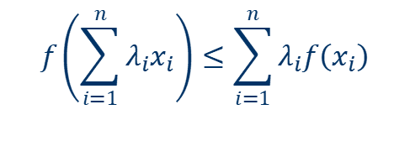


Jensen’s inequality
if $f$ is convex, then
for any random variable $X$
if $f$ is strictly convex, then $E\left[f\left(X\right)\right]=f\left(E[X]\right)$ holds true if and only if$\text{X}\text{=}E[X]$with probability 1 (i.e., if $\text{X}$ is a constant)
$\ln{x}$: strictly concave
$\ln\left(\sum_{i=1}^{n}{λ_{i}x_{i}}\right)≥\sum_{i=1}^{n}{λ_{i}\ln\left(x_{i}\right)}$
$$f\left(\sum_{i=1}^{n}{λ_{i}x_{i}}\right)≤\sum_{i=1}^{n}{λ_{i}f\left(x_{i}\right)}$$
$$λ_{i}≥0, \sum_{i}{λ_{i}}=1$$
$$f\left(E[X]\right)≤E[f\left(X\right)]$$
Notes:
named after the Danish mathematician Johan Jensen,
relating the
value of a convex function of an integral to the integral of the convex function
Jensen's inequality also holds for concave functions $f$, but with the direction of all the inequalities reversed

Slide 24







How EM works: an illustrative example
$$l\left(θ,θ_{2}\right)$$
$$l\left(θ,θ_{1}\right)$$
$$L\left(θ\right)$$
$$θ_{1}$$
$$θ_{2}$$
$$θ_{3}$$
$$⋯⋯$$

Slide 25
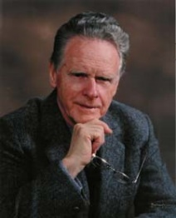
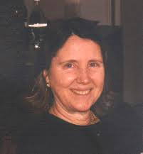
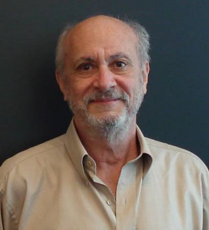


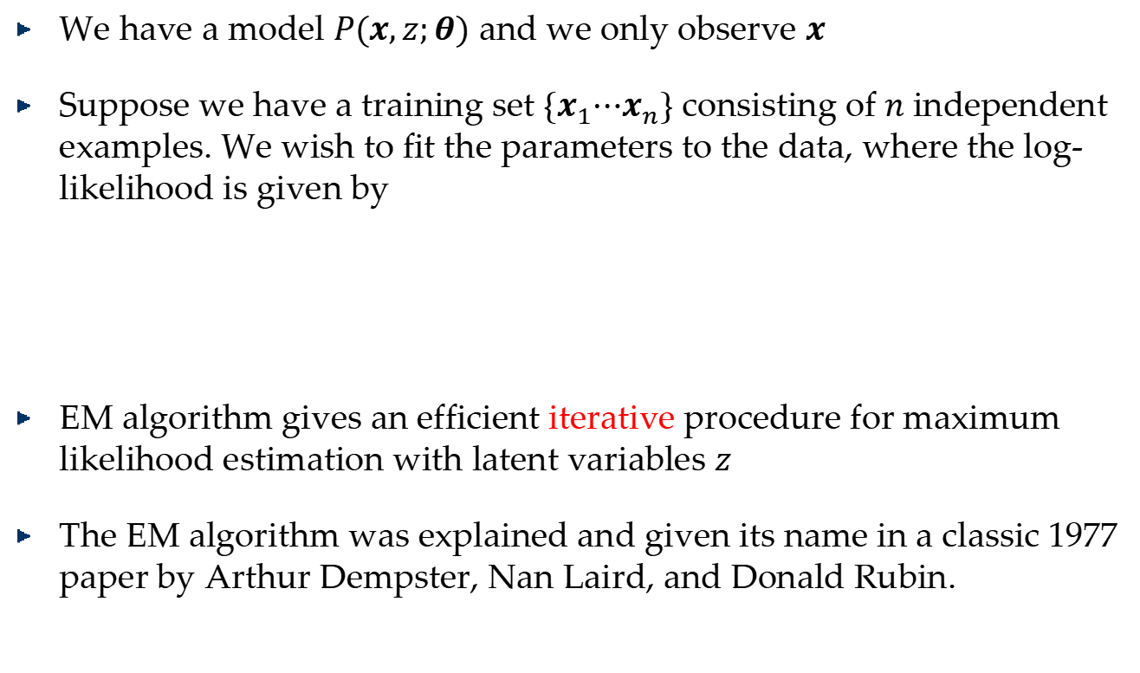
Problem Description
We have a model $P(x,z;θ)$ and we only observe $x$
Suppose we have a training set $\left\{x_{1}⋯x_{n}\right\}$ consisting of $n$ independent examples. We wish to fit the parameters to the data, where the log-likelihood is given by
EM algorithm gives an efficient iterative procedure for maximum likelihood estimation with latent variables $z$
The EM algorithm was explained and given its name in a classic 1977 paper by Arthur Dempster, Nan Laird, and Donald Rubin.
$$l\left(θ\right)=\sum_{i=1}^{n}{\log{P(x_{i};θ)}}$$
$$=\sum_{i=1}^{n}{\log{\sum_{z}{P(x_{i},z;θ)}}}$$
Non-concave function!
Arthur Dempster, Nan Laird, and Donald Rubin

Slide 26
EM algorithm
Each iteration of the EM algorithm consists of two processes: The Expectation-step, and the Maximization-step.
In the expectation, or E-step, the missing data are estimated given the observed data and current estimate of the model parameters.
In the M-step, the likelihood function is maximized under the assumption that the missing data are known. The estimate of the missing data from the E-step are used as the actual missing data.
Convergence is assured since the algorithm is guaranteed to increase the likelihood at each iteration.
Maximize a non-concave function
Find a tight lower bound concave function
Maximize the concave function

Slide 27
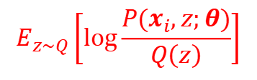
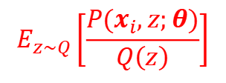

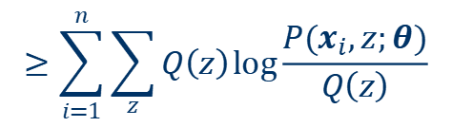











Details
$$\sum_{i=1}^{n}{\log{\sum_{z}{P(x_{i},z;θ)}}}$$
$$L\left(θ\right)=$$
Let $Q$ be some distribution over the $z$'s .
Note that $\sum_{z}{Q\left(z\right)=1}$, $Q\left(z\right)≥0$, we get:
$$E_{z\sim Q}\left[\frac{P(x_{i},z;θ)}{Q\left(z\right)}\right]$$
$$L\left(θ\right)=\sum_{i=1}^{n}{\log{\sum_{z}{P(x_{i},z;θ)}}}$$
$$=\sum_{i=1}^{n}{\log{\sum_{z}{Q\left(z\right)\frac{P(x_{i},z;θ)}{Q\left(z\right)}}}}$$
$$≥\sum_{i=1}^{n}{\sum_{z}{Q\left(z\right)\log{\frac{P(x_{i},z;θ)}{Q\left(z\right)}}}}$$
$$=l\left(θ\right)$$
$log$ is a strictly concave function
$$E_{z\sim Q}\left[\log{\frac{P(x_{i},z;θ)}{Q\left(z\right)}}\right]$$
If $f$ is strictly concave, then $E\left[f\left(X\right)\right]=f\left(E[X]\right)$ holds true if and only if$\text{X}\text{=}E[X]$with probability 1
$\frac{P(x_{i},z;θ)}{Q\left(z\right)}$ is a constant
$$\sum_{z}{Q\left(z\right)=1}$$
$$Q\left(z\right)=\frac{P(x_{i},z;θ)}{\sum_{z}{P(x_{i},z;θ)}}$$
$$Q\left(z\right)∝P(x_{i},z;θ)$$

Slide 28



Details
$$Q\left(z\right)=\frac{P(x_{i},z;θ)}{\sum_{z}{P(x_{i},z;θ)}}$$
$$=\frac{P(x_{i},z;θ)}{P(x_{i};θ) }$$
$$=P\left(z|x_{i};θ\right)$$
Satisfying the requirement:
$\frac{P(x_{i},z;θ)}{Q\left(z\right)}=\text{constant}$ that does not depend on $z$

Slide 29


























Proof of convergence
$$L\left(θ_{3}\right)$$
$$l\left(θ,θ_{1}\right)=\sum_{i=1}^{n}{\sum_{z}{Q_{1}\left(z\right)log\frac{p(x^{\left(i\right)},z;θ)}{Q_{1}\left(z\right)}}}$$
E-Step
$$l\left(θ_{3},θ_{2}\right)$$
M-Step
$$≤\sum_{i=1}^{n}{\sum_{z}{Q_{1}\left(z\right)log\frac{p\left(x^{\left(i\right)},z;θ_{2}\right)}{Q_{1}\left(z\right)}}}$$
$$L\left(θ_{2}\right)$$
$$=l\left(θ_{2},θ_{2}\right)$$
$$l\left(θ,θ_{2}\right)$$
$$=l\left(θ_{2},θ_{1}\right)$$
$$≤L\left(θ_{2}\right)$$
$$l\left(θ_{2},θ_{1}\right)$$
$$L\left(θ\right)=\sum_{i=1}^{n}{\log{\sum_{z}{p(x^{\left(i\right)},z;θ)}}}$$
$$=\sum_{i=1}^{n}{\log{\sum_{z}{Q\left(z\right)\frac{p(x^{\left(i\right)},z;θ_{1})}{Q\left(z\right)}}}}$$
$$L\left(θ_{1}\right)=\sum_{i=1}^{n}{\log{\sum_{z}{p(x^{\left(i\right)},z;θ_{1})}}}$$
$$=\sum_{i=1}^{n}{\log{\sum_{z}{Q\left(z\right)\frac{p(x^{\left(i\right)},z;θ)}{Q\left(z\right)}}}}$$
$$L\left(θ_{1}\right)$$
$$=l\left(θ_{1},θ_{1}\right)$$
$$l\left(θ,θ_{1}\right)$$
$$=\sum_{i=1}^{n}{\sum_{z}{Q_{1}\left(z\right)log\frac{p(x^{\left(i\right)},z;θ_{1})}{Q_{1}\left(z\right)}}}$$
$$≥\sum_{i=1}^{n}{\sum_{z}{Q\left(z\right)log\frac{p(x^{\left(i\right)},z;θ_{1})}{Q\left(z\right)}}}$$
$$≥\sum_{i=1}^{n}{\sum_{z}{Q\left(z\right)log\frac{p(x^{\left(i\right)},z;θ)}{Q\left(z\right)}}}$$
$$L\left(θ\right)$$
$$=l\left(θ_{1},θ_{1}\right)$$
$$θ_{1}$$
$$θ_{2}$$
$$θ_{3}$$
$$⋯⋯$$
$$Q_{1}(z)=P\left(z|x_{i};θ_{1}\right)$$

Slide 30

Algorithm Summary
Repeat until convergence {
(E-step) for each $i$ :
$Q\left(z\right)=P\left(z|x^{\left(i\right)};θ\right)$
(M-step) Set:
$θ≔\text{arg}\max_{θ}{\sum_{i=1}^{m}{\sum_{z}{Q\left(z\right)}log{\frac{p\left(x^{\left(i\right)},z^{\left(i\right)};θ\right)}{Q\left(z\right)}}}}$
}
Since the function is not convex, it is possible for the algorithm to converge to local minima or saddle points in unusual cases

Slide 31








Gaussian Mixture Model: An example

Slide 32

Distance versus connectivity based on density

Slide 33

Kmeans Output

Slide 34
Density-Based Clustering Methods
Clustering based on density (local cluster criterion), such as density-connected points
Major features:
Discover clusters of arbitrary shape
Handle noise
One scan
Need density parameters as termination condition
Several interesting studies:
DBSCAN: Ester, et al. (KDD’96)
OPTICS: Ankerst, et al (SIGMOD’99).
DENCLUE: Hinneburg & D. Keim (KDD’98)
CLIQUE: Agrawal, et al. (SIGMOD’98)

Slide 35
Density-Based Clustering: Basic Concepts
Two parameters:
Eps: Maximum radius of the neighborhood
MinPts: Minimum number of points in an Eps-neighborhood of that point
N_{Eps}(p): {q belongs to D | dist(p,q) ≤ Eps}
Directly density-reachable: A point p is directly density-reachable from a point q w.r.t. Eps, MinPts if
p belongs to N_{Eps}(q)
core point condition:
|N_{Eps} (q)| ≥ MinPts
p
MinPts = 5
Eps = 1 cm
q

Slide 36
Density-Reachable and Density-Connected
Density-reachable:
A point p is density-reachable from a point q w.r.t. Eps, MinPts if there is a chain of points p₁, …, p_{n}, p₁ = q, p_{n} = p such that p_{i+1} is directly density-reachable from p_{i}
Density-connected
A point p is density-connected to a point q w.r.t. Eps, MinPts if there is a point o such that both, p and q are density-reachable from o w.r.t. Eps and MinPts
p
p₁
q
p
q
o

Slide 37
DBSCAN: Density-Based Spatial Clustering of Applications with Noise
Relies on a density-based notion of cluster: A cluster is defined as a maximal set of density-connected points
Discovers clusters of arbitrary shape in spatial databases with noise
Outlier
Border
Eps = 1cm
MinPts = 5
Core

Slide 38
DBSCAN: The Algorithm
Arbitrary select a point p
Retrieve all points density-reachable from p w.r.t. Eps and MinPts
If p is a core point, a cluster is formed
If p is a border point, no points are density-reachable from p and DBSCAN visits the next point of the database
Continue the process until all of the points have been processed

Slide 39



DBSCAN: Sensitive to Parameters

