Slide 1
So Far…
It’s time for
Unsupervised learning
We are only given inputs
Goal: find “interesting patterns”
Discovering clusters
Clustering
Discovering latent factors
Dimensionality reduction
Topic modeling
Matrix factorization

Slide 2
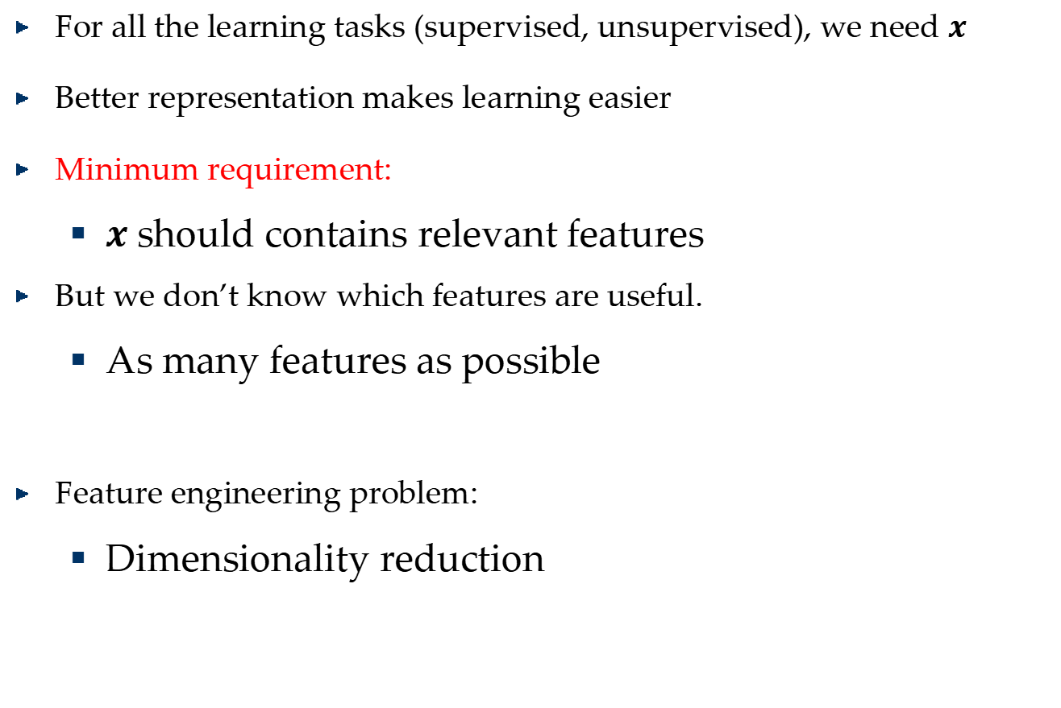
Feature Representation
For all the learning tasks (supervised, unsupervised), we need $x$
Better representation makes learning easier
Minimum requirement:
$x$should contains relevant features
But we don’t know which features are useful.
As many features as possible
Feature engineering problem:
Dimensionality reduction

Slide 3
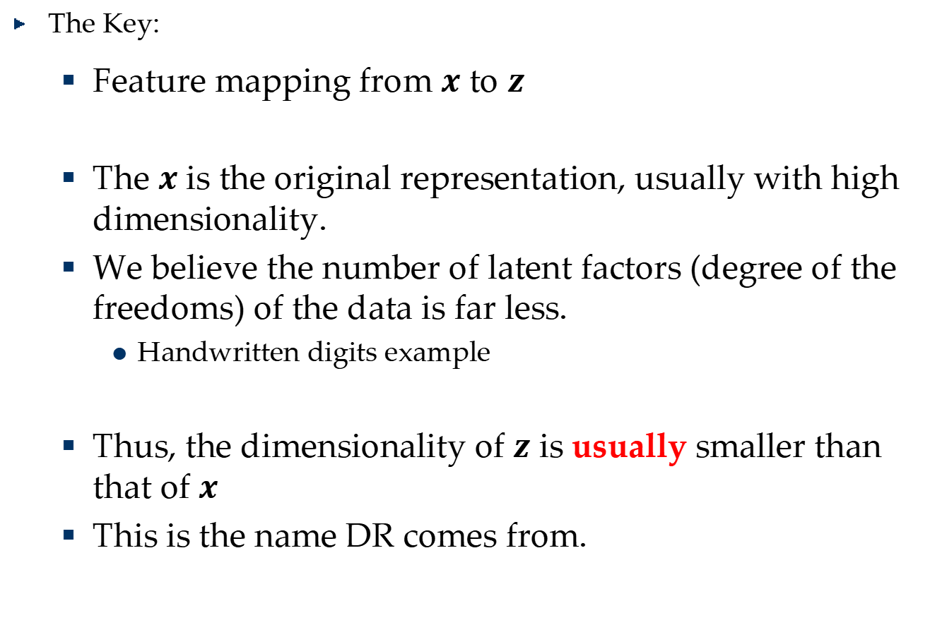
What is Dimensionality Reduction?
The Key:
Feature mapping from $x$ to $z$
The $x$ is the original representation, usually with high dimensionality.
We believe the number of latent factors (degree of the freedoms) of the data is far less.
Handwritten digits example
Thus, the dimensionality of $z$ is usually smaller than that of $x$
This is the name DR comes from.

Slide 4








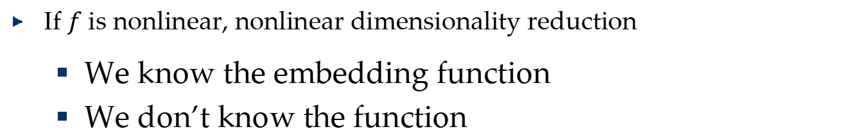
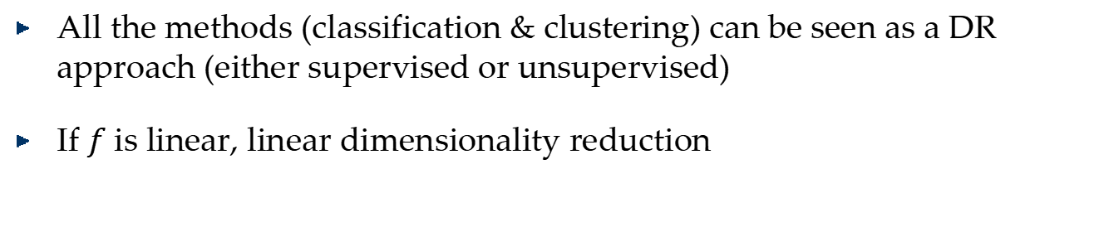
Linear and Nonlinear
$$ℱ\left(x∈R^{p}\right)=z∈R^{d}$$
$$f_{1}\left(x\right)=z_{1}$$
$$f_{i}\left(x\right)=z_{i}$$
$$f_{d}\left(x\right)=z_{d}$$
All the methods (classification & clustering) can be seen as a DR approach (either supervised or unsupervised)
If $f$ is linear, linear dimensionality reduction
$$a_{1}^{T}x=z_{1}$$
$$a_{i}^{T}x=z_{i}$$
$$A≜\left[a_{1},⋯,a_{d}\right]$$
$$A^{T}x=z$$
If $f$ is nonlinear, nonlinear dimensionality reduction
We know the embedding function
We don’t know the function

Slide 5



Linear Transformation
Linear transformation
$$A^{T}∈ℛ^{d×p}$$
Reduced data
$$z∈ℛ^{d}$$
Original data
$$x∈ℛ^{p}$$
$$A∈ℛ^{p×d}:x∈ℛ^{p}→z=A^{T}x∈ℛ^{d}$$

Slide 6
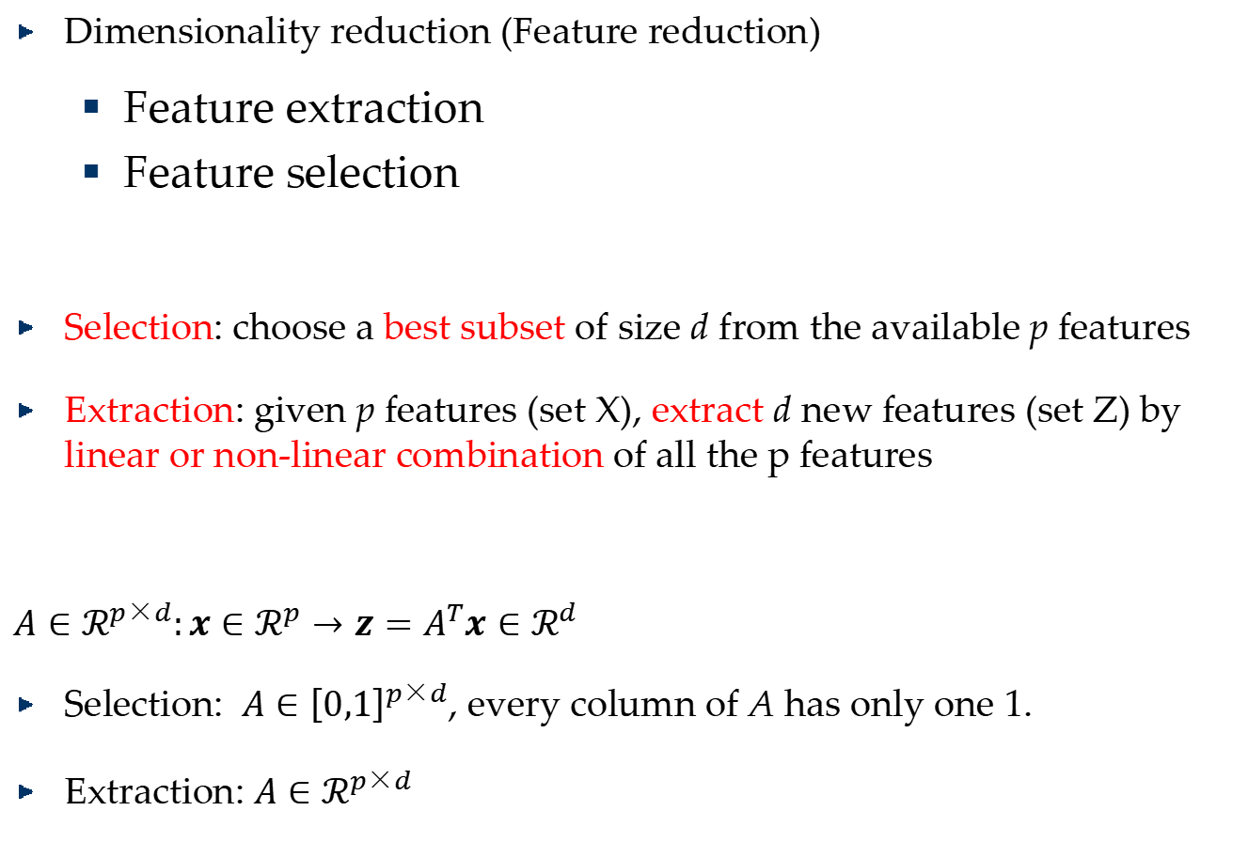
Feature Extraction vs Feature Selection
Dimensionality reduction (Feature reduction)
Feature extraction
Feature selection
Selection: choose a best subset of size d from the available p features
Extraction: given p features (set X), extract d new features (set Z) by linear or non-linear combination of all the p features
$A∈ℛ^{p×d}:x∈ℛ^{p}→z=A^{T}x∈ℛ^{d}$
Selection: $A∈{\left[0,1\right]}^{p×d}$, every column of A has only one 1.
Extraction: $A∈ℛ^{p×d}$

Slide 7
Dimensionality Reduction Algorithms
Unsupervised
Principal Component Analysis (PCA)
Supervised
Linear Discriminant Analysis (LDA)
Semi-supervised
Semi-supervised Discriminant Analysis (SDA)

Slide 8
Dimensionality Reduction Algorithms
Linear
Principal Component Analysis (PCA)
Linear Discriminant Analysis (LDA)
Nonlinear
Nonlinear feature reduction using kernels
Manifold learning

Slide 9
Algorithms
Linear Methods
Principal Component Analysis (PCA)
Linear Discriminant Analysis (LDA)
Locality Preserving Projections (LPP)
The framework of graph based dimensionality reduction.
Non-linear Methods
Kernel Extensions for nonlinear algorithms.
Manifold Learning
ISOMAP
Locally Linear Embedding
Laplacian Eigenmap

Slide 10
Linear Methods
Principal Component Analysis (PCA)
Linear Discriminant Analysis (LDA)
Locality Preserving Projections (LPP)
The framework of graph based dimensionality reduction.

Slide 11

Principal Component Analysis

Slide 12
What is Principal Component Analysis?
Principal component analysis (PCA)
Reduce the dimensionality of a data set by finding a new set of variables, smaller than the original set of variables
Retains most of the sample's information.
Useful for the compression and classification of data.
By information we mean the variation present in the sample, given by the correlations between the original variables.
The new variables, called principal components (PCs), are uncorrelated, and are ordered by the fraction of the total information each retains.
Notes:
Covariance of two random variables = 0

Slide 13




Algebraic Derivation of PCs
$$x$$
$$a$$
$$\left\|a\right\|=1$$
$$a^{T}x$$

Slide 14

Algebraic Derivation of PCs
Given a sample of n observations on a vector of p variables
$\left\{x_{1},…,x_{n}\right\}∈ℛ^{p}$
Define the first principal component of the sample by the linear transformation
$z_{i}^{\left(1\right)}=a_{1}^{T}x_{i}, i=1,⋯n$
is chosen such that $var\left(z^{\left(1\right)}\right)$ is maximum.

Slide 15

Algebraic Derivation of PCs
$var\left(z^{\left(1\right)}\right)=E\left({\left(z^{\left(1\right)}−{\overline{z}}^{\left(1\right)}\right)}^{2}\right)$
$=\frac{1}{n}\sum_{i=1}^{n}{{\left(a_{1}^{T}x_{i}−a_{1}^{T}\overline{x}\right)}^{2}}$
$=\frac{1}{n}\sum_{i=1}^{n}{a_{1}^{T}\left(x_{i}−\overline{x}\right){\left(x_{i}−\overline{x}\right)}^{T}a_{1}}=a_{1}^{T}Sa_{1}$
Where $S=\frac{1}{n}\sum_{i=1}^{n}{\left(x_{i}−\overline{x}\right){\left(x_{i}−\overline{x}\right)}^{T}}$
is the covariance matrix and $\overline{x}=\frac{1}{n}\sum_{i=1}^{n}{x_{i}}$ is the mean.

Slide 16

Algebraic Derivation of PCs
$\max_{a_{1}}{a_{1}^{T}Sa_{1}}$
$s.t. a_{1}^{T}a_{1}=1$
Let λ be a Lagrange multiplier
$L=a_{1}^{T}Sa_{1}−λ\left(a_{1}^{T}a_{1}−1\right)$
$\frac{∂L}{∂a_{1}}=2Sa_{1}−2λa_{1}=0$
$Sa_{1}=λa_{1}$
therefor, $a_{1}$is an eigenvector of $S$ corresponding to the largest eigenvalue $λ=λ_{1}$.

Slide 17

Algebraic Derivation of PCs
$\max_{a_{2}}{a_{2}^{T}Sa_{2}}$
$s.t. a_{2}^{T}a_{2}=1, cov\left(z^{\left(2\right)},z^{\left(1\right)}\right)=0$
$cov\left(z^{\left(2\right)},z^{\left(1\right)}\right)=a_{2}^{T}Sa_{1}=λa_{2}^{T}a_{1}=0$
$Sa_{2}=λa_{2}$
$a_{2}$ is an eigenvector of $S$ corresponding to the second largest eigenvalue $λ=λ_{2}$.
Notes:
Covariance

Slide 18

Algebraic Derivation of PCs
In general:
$var\left(z^{\left(k\right)}\right)=a_{k}^{T}Sa_{k}=λ_{k}$
The k^{th} largest eigenvalue of S is the variance of k^{th} PC.
The k^{th} PC $z^{\left(k\right)}$ retains the k^{th} greatest fraction of the variation in the sample.
Notes:
Covariance

Slide 19
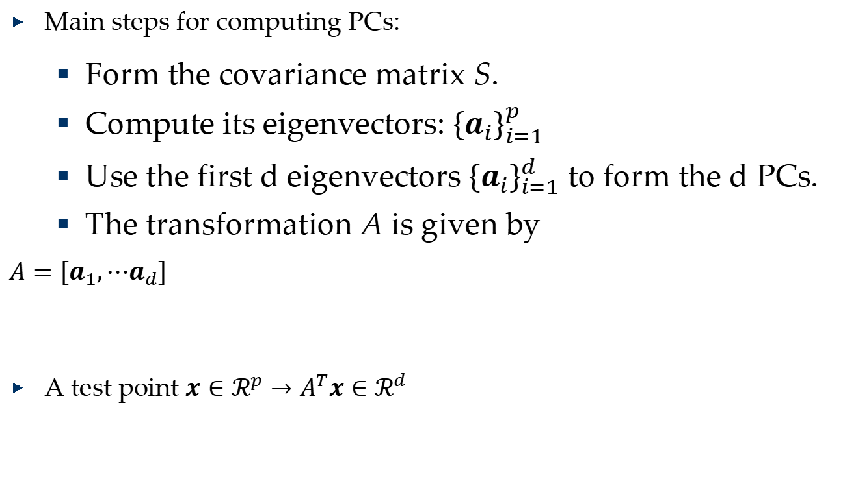
Principle Component Analysis
Main steps for computing PCs:
Form the covariance matrix S.
Compute its eigenvectors: ${\left\{a_{i}\right\}}_{i=1}^{p}$
Use the first d eigenvectors ${\left\{a_{i}\right\}}_{i=1}^{d}$ to form the d PCs.
The transformation A is given by
$A=\left[a_{1},⋯a_{d}\right]$
A test point $x∈ℛ^{p}→A^{T}x∈ℛ^{d}$
Notes:
Covariance

Slide 20
Common Pre-Processing of PCA

Slide 21
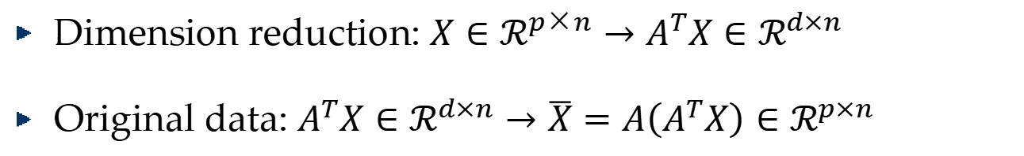
Optimality Property of PCA
Reconstruction
Dimension reduction: $X∈ℛ^{p×n}→A^{T}X∈ℛ^{d×n}$
Original data: $A^{T}X∈ℛ^{d×n}→\overline{X}=A\left(A^{T}X\right)∈ℛ^{p×n}$

Slide 22
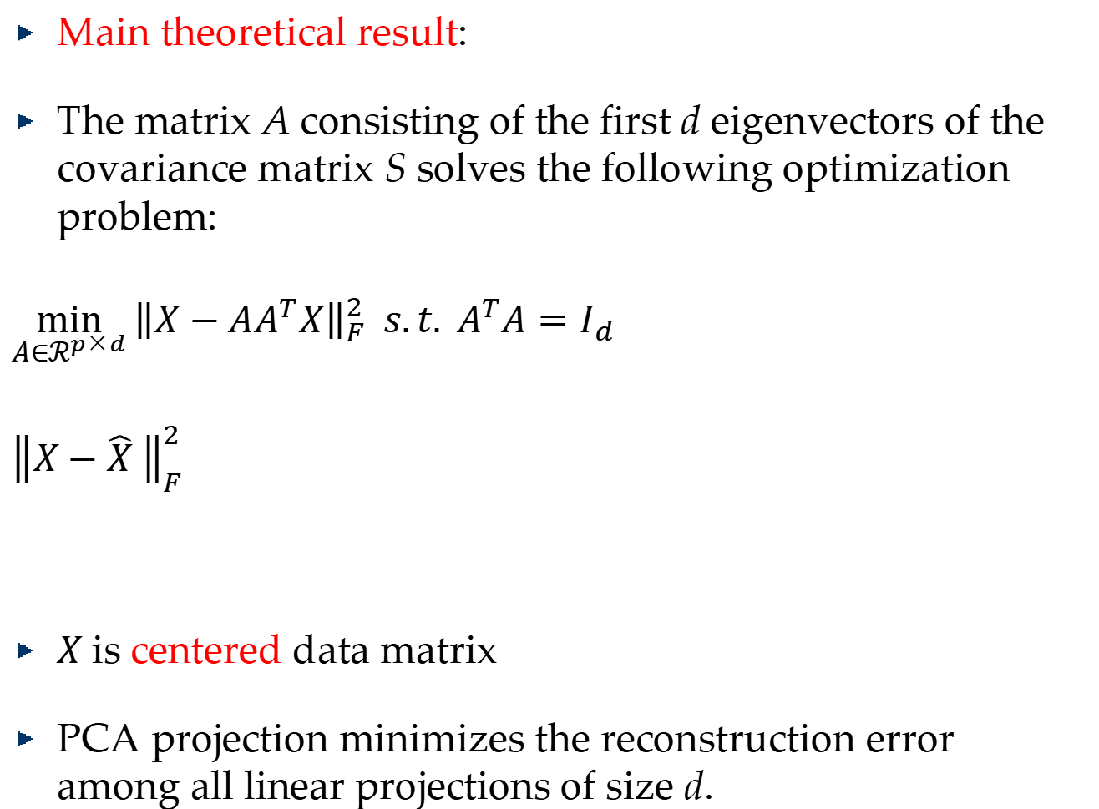
Optimality Property of PCA
Main theoretical result:
The matrix A consisting of the first d eigenvectors of the covariance matrix S solves the following optimization problem:
$\min_{A∈ℛ^{p×d}}{{\left\|X−AA^{T}X\right\|}_{F}^{2} s.t. A^{T}A=I_{d}}$
${\left\|X−\hat{X} \right\|}_{F}^{2}$
$X$is centered data matrix
PCA projection minimizes the reconstruction error among all linear projections of size d.
Reconstruction error

Slide 23
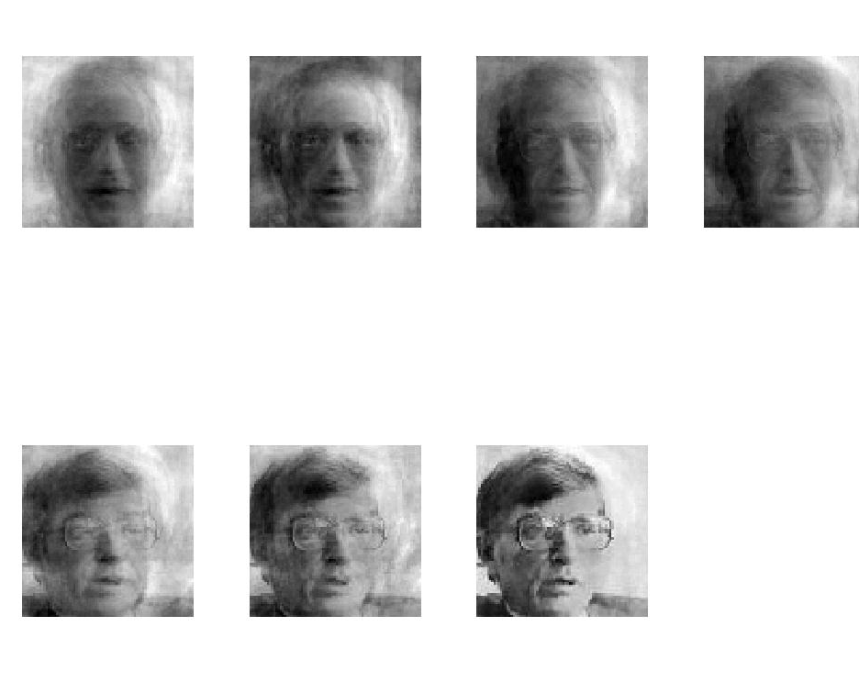
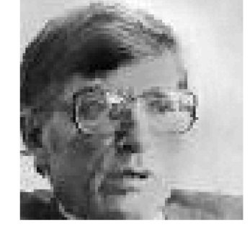
PCA for Image Compression
d=1
d=2
d=4
d=8
Original Image
d=16
d=32
d=64
d=100

Slide 24
Principal Component Analysis

Slide 25
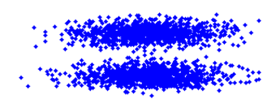
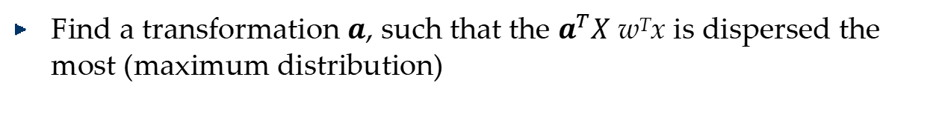
Principal Component Analysis
Find a transformation $a$, such that the $a^{T}X$ w^{T}x is dispersed the most (maximum distribution)

Slide 26
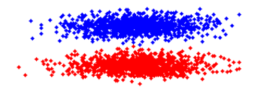
Principal Component Analysis

Slide 27
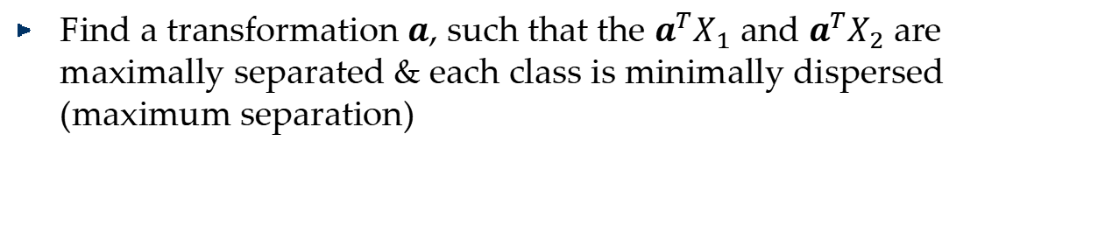
Linear Discriminant Analysis (Fisher Linear Discriminant)
Find a transformation $a$, such that the $a^{T}X_{1}$ and $a^{T}X_{2}$are maximally separated & each class is minimally dispersed (maximum separation)

Slide 28
Linear Discriminant Analysis
Perform dimensionality reduction “while preserving as much of the class discriminatory information as possible”.
Seeks to find directions along which the classes are best separated.
Takes into consideration the scatter within-classes but also the scatter between-classes.

Slide 29
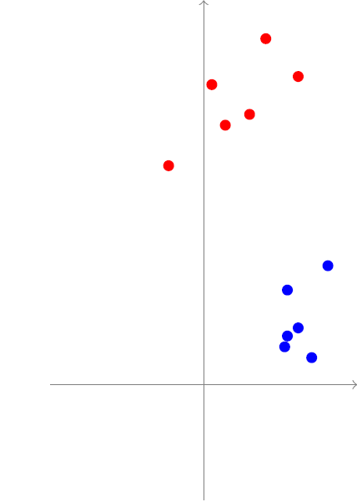
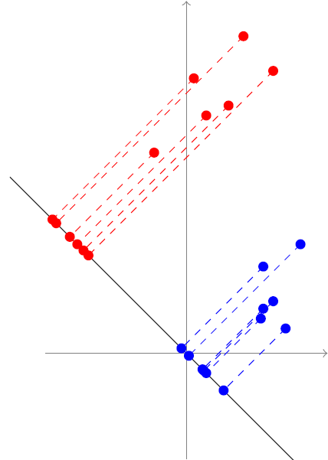

Linear Discriminant Analysis
Two Classes $ω_{1}, ω_{2}$
$z=a^{T}x$
${\tilde{μ}}_{i}=\frac{1}{n_{i}}\sum_{z∈ω_{i}}{z}$
$μ_{i}=\frac{1}{n_{i}}\sum_{x∈ω_{i}}{x},{\tilde{μ}}_{i}=a^{T}μ_{i}$
$\left|{\tilde{μ}}_{1}−{\tilde{μ}}_{2}\right|=\left|a^{T}\left(μ_{1}−μ_{2}\right)\right|$
${\tilde{s}}_{i}^{2}=\sum_{z∈ω_{i}}{{\left(z−{\tilde{μ}}_{i}\right)}^{2}}$
$\frac{1}{n}\left({\tilde{s}}_{1}^{2}+{\tilde{s}}_{2}^{2}\right)$
$J\left(a\right)=\frac{{\left({\tilde{μ}}_{1}−{\tilde{μ}}_{2}\right)}^{2}}{{\tilde{s}}_{1}^{2}+{\tilde{s}}_{2}^{2}}$
Notes:
Suppose that we have a set of n p-dimensional samples $x_{1},⋯x_{n}$, n₁ in the subset
D₁ labelled $ω_{1}$ and n₂ in the subset D₂ labelled $ω_{2}$.
Of course, to obtain good separation of the projected data we really want the difference
between the means to be large relative to some measure of the standard deviations for
each class. Rather than forming sample variances, we define the scatter for projected scatter
samples labelled $ω_{i}$ by

Slide 30



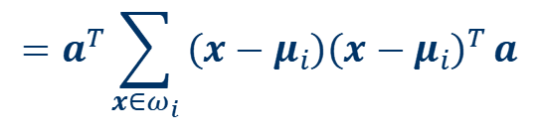
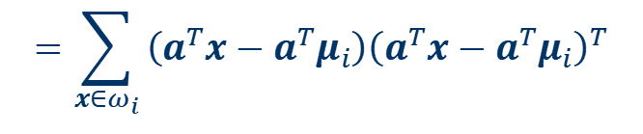
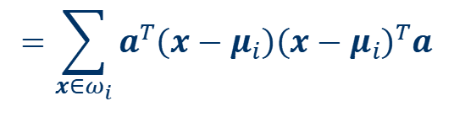
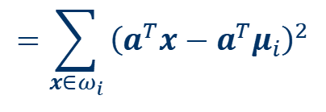






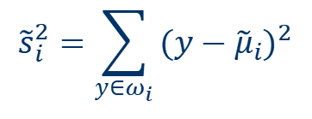
Linear Discriminant Analysis
$$J\left(a\right)=\frac{{\left({\tilde{μ}}_{1}−{\tilde{μ}}_{2}\right)}^{2}}{{\tilde{s}}_{1}^{2}+{\tilde{s}}_{2}^{2}}$$
$$=\frac{a^{T}S_{B}a}{a^{T}S_{W}a}$$
Two Classes
$${\tilde{s}}_{i}^{2}=\sum_{y∈ω_{i}}{{\left(y−{\tilde{μ}}_{i}\right)}^{2}}$$
$$=\sum_{x∈ω_{i}}{{\left(a^{T}x−a^{T}μ_{i}\right)}^{2}}$$
$$=\sum_{x∈ω_{i}}{\left(a^{T}x−a^{T}μ_{i}\right){\left(a^{T}x−a^{T}μ_{i}\right)}^{T}}$$
$$=\sum_{x∈ω_{i}}{a^{T}\left(x−μ_{i}\right){\left(x−μ_{i}\right)}^{T}a}$$
$$=a^{T}\sum_{x∈ω_{i}}{\left(x−μ_{i}\right){\left(x−μ_{i}\right)}^{T}}a$$
$$=a^{T}S_{i}a$$
$S_{i}$: scatter matrix
within-class scatter matrix: $S_{W}=S_{1}+S_{2}$
$${\tilde{s}}_{1}^{2}+{\tilde{s}}_{2}^{2}=a^{T}S_{W}a$$
$${\left({\tilde{μ}}_{1}−{\tilde{μ}}_{2}\right)}^{2}$$
$$={\left(a^{T}μ_{1}−a^{T}μ_{2}\right)}^{2}$$
$$=a^{T}\left(μ_{1}−μ_{2}\right){\left(μ_{1}−μ_{2}\right)}^{T}a$$
$$=a^{T}S_{B}a$$
between-class scatter matrix: $S_{B}=\left(μ_{1}−μ_{2}\right){\left(μ_{1}−μ_{2}\right)}^{T}$
Notes:
S_{W} is called the within-class scatter matrix.
It is proportional to the sample covariance matrix for the pooled p-dimensional data
It is symmetric and positive semi-definite, and is usually nonsingular if n > p
S_{B} is called the between-class scatter matrix.
It is also symmetric and positive semi-definite,
but because it is the outer product of two vectors, its rank is at most one.

Slide 31
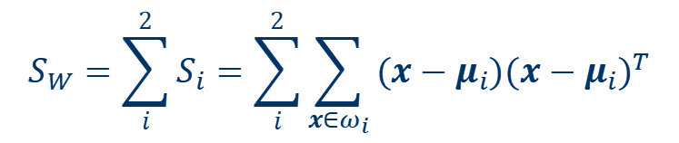
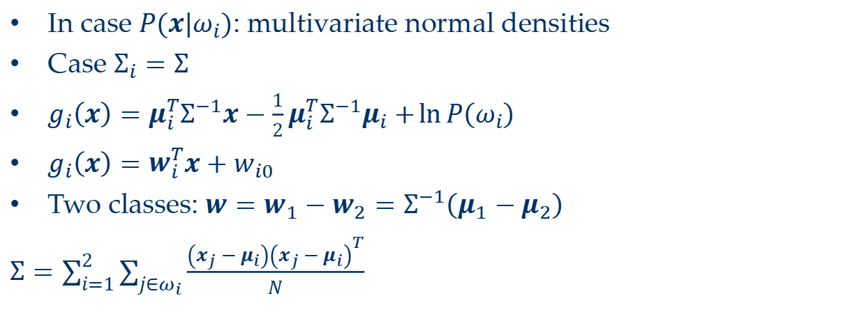



Linear Discriminant Analysis
$$J\left(a\right)=\frac{a^{T}S_{B}a}{a^{T}S_{W}a}$$
Two Classes
$$S_{B}a=λS_{W}a$$
$$a^{∗}=S_{W}^{−1}\left(μ_{1}−μ_{2}\right)$$
$$S_{W}=\sum_{i}^{2}{S_{i}}=\sum_{i}^{2}{\sum_{x∈ω_{i}}{\left(x−μ_{i}\right){\left(x−μ_{i}\right)}^{T}}}$$
In case $P\left(x|ω_{i}\right)$: multivariate normal densities
Case $Σ_{i}=Σ$
$g_{i}\left(x\right)=μ_{i}^{T}Σ^{−1}x−\frac{1}{2}μ_{i}^{T}Σ^{−1}μ_{i}+\ln{P\left(ω_{i}\right)}$
$g_{i}\left(x\right)=w_{i}^{T}x+w_{i0}$
Two classes: $w=w_{1}−w_{2}=Σ^{−1}\left(μ_{1}−μ_{2}\right)$
$Σ=\sum_{i=1}^{2}{\sum_{j∈ω_{i}}{\frac{\left(x_{j}−μ_{i}\right){\left(x_{j}−μ_{i}\right)}^{T}}{N}}}$
Notes:
All that remains is to find the threshold, i.e., the point along the one-dimensional subspace separating the projected points.

Slide 32
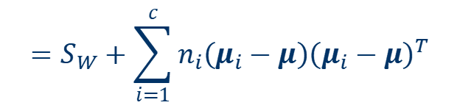
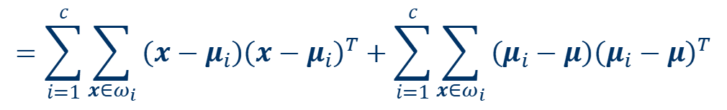
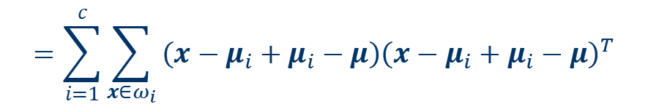
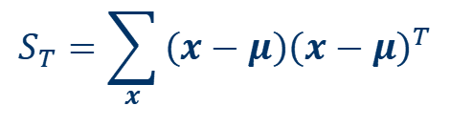
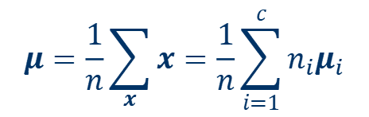

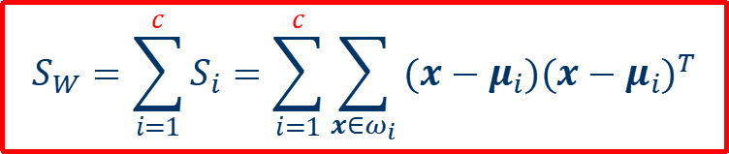
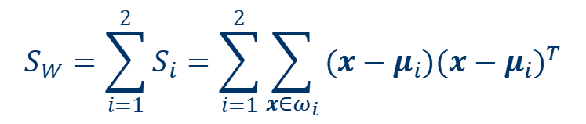


Linear Discriminant Analysis
$$μ=\frac{1}{n}\sum_{x}{x}=\frac{1}{n}\sum_{i=1}^{c}{n_{i}μ_{i}}$$
$$J\left(a\right)=\frac{a^{T}S_{B}a}{a^{T}S_{W}a}$$
Multi-classes
$$S_{W}=\sum_{i=1}^{2}{S_{i}}=\sum_{i=1}^{2}{\sum_{x∈ω_{i}}{\left(x−μ_{i}\right){\left(x−μ_{i}\right)}^{T}}}$$
$$S_{W}=\sum_{i=1}^{c}{S_{i}}=\sum_{i=1}^{c}{\sum_{x∈ω_{i}}{\left(x−μ_{i}\right){\left(x−μ_{i}\right)}^{T}}}$$
$$S_{B}=\left(μ_{1}−μ_{2}\right){\left(μ_{1}−μ_{2}\right)}^{T}$$
$$S_{T}=\sum_{x}{\left(x−μ\right){\left(x−μ\right)}^{T}}$$
$$=\sum_{i=1}^{c}{\sum_{x∈ω_{i}}{\left(x−μ_{i}+μ_{i}−μ\right){\left(x−μ_{i}+μ_{i}−μ\right)}^{T}}}$$
$$=\sum_{i=1}^{c}{\sum_{x∈ω_{i}}{\left(x−μ_{i}\right){\left(x−μ_{i}\right)}^{T}}}+\sum_{i=1}^{c}{\sum_{x∈ω_{i}}{\left(μ_{i}−μ\right){\left(μ_{i}−μ\right)}^{T}}}$$
$$=S_{W}+\sum_{i=1}^{c}{n_{i}\left(μ_{i}−μ\right){\left(μ_{i}−μ\right)}^{T}}$$
$$=S_{B}$$
$$S_{T}=S_{W}+S_{B}$$
Notes:
If we check the two-class case, we find that the resulting between-class scatter matrix
is $\frac{n_{1}n_{2}}{n}$ times our previous definition.

Slide 33
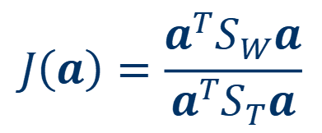
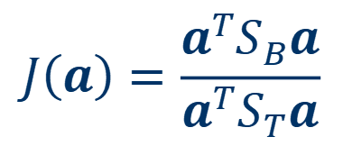
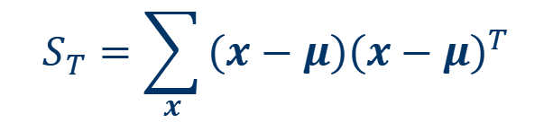

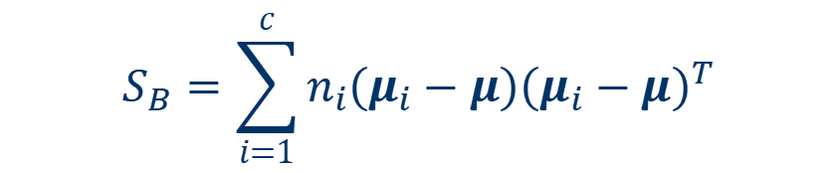

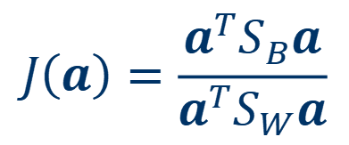
Linear Discriminant Analysis
Multi-classes
$$J\left(a\right)=\frac{a^{T}S_{B}a}{a^{T}S_{W}a}$$
$$S_{W}=\sum_{i=1}^{c}{S_{i}}=\sum_{i=1}^{c}{\sum_{x∈ω_{i}}{\left(x−μ_{i}\right){\left(x−μ_{i}\right)}^{T}}}$$
$$S_{B}=\sum_{i=1}^{c}{n_{i}\left(μ_{i}−μ\right){\left(μ_{i}−μ\right)}^{T}}$$
$$S_{T}=S_{W}+S_{B}$$
$$S_{T}=\sum_{x}{\left(x−μ\right){\left(x−μ\right)}^{T}}$$
$$J\left(a\right)=\frac{a^{T}S_{B}a}{a^{T}S_{T}a}$$
$$J\left(a\right)=\frac{a^{T}S_{W}a}{a^{T}S_{T}a}$$
Notes:
the determinant equals the product of the eigenvalues. Similarly, the trace equals the sum of the eigenvalues. Thus,
$det\left(e^{A}\right)=e^{tr\left(A\right)}$

Slide 34


Linear Discriminant Analysis
Multi-classes
$$J\left(a\right)=\frac{a^{T}S_{B}a}{a^{T}S_{W}a}$$
$$J\left(a\right)=\frac{a^{T}S_{B}a}{a^{T}S_{T}a}$$
$$S_{B}a=λS_{W}a$$
$$S_{B}a=λS_{T}a$$
Homework with extra credit: Prove the rank of S_{B} is at most c-1
Notes:
the determinant equals the product of the eigenvalues. Similarly, the trace equals the sum of the eigenvalues. Thus,
$det\left(e^{A}\right)=e^{tr\left(A\right)}$

Slide 35
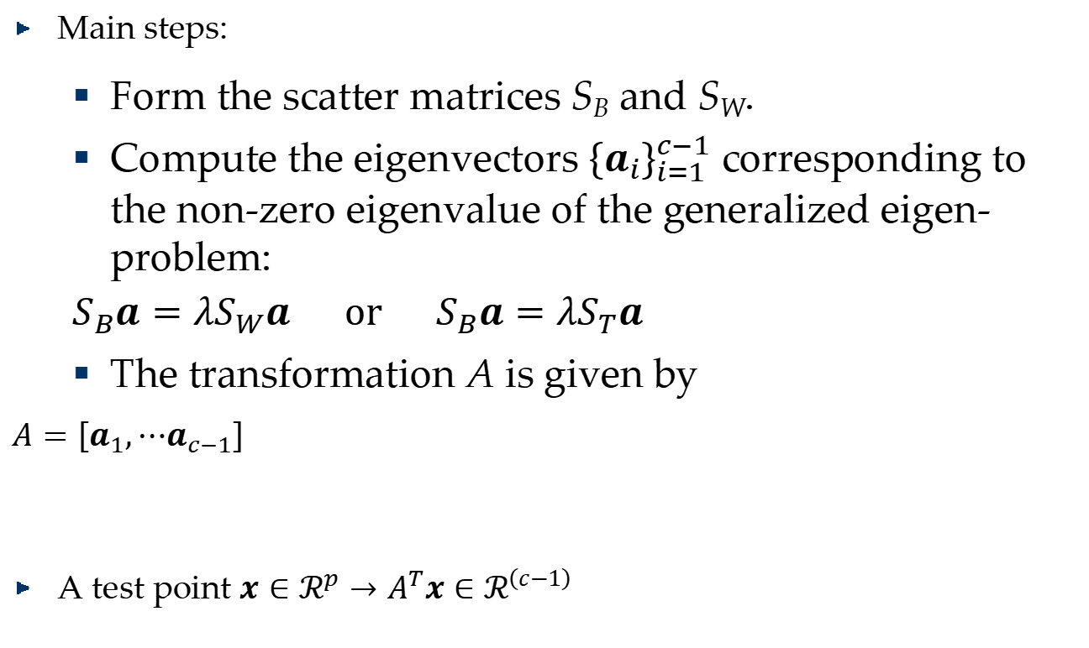
Linear Discriminant Analysis
Main steps:
Form the scatter matrices S_{B} and S_{W}.
Compute the eigenvectors ${\left\{a_{i}\right\}}_{i=1}^{c−1}$ corresponding to the non-zero eigenvalue of the generalized eigen-problem:
$S_{B}a=λS_{W}a or S_{B}a=λS_{T}a$
The transformation A is given by
$A=\left[a_{1},⋯a_{c−1}\right]$
A test point $x∈ℛ^{p}→A^{T}x∈ℛ^{\left(c−1\right)}$
Notes:
S_{W} S_{T} non-singular

Slide 36
PCA vs LDA
?

Slide 37
Locality Preserving Projections
Unsupervised, but it is very easy to have supervised (semi-supervised) extensions.

Slide 38
Locality Preserving Projections (LPP)
Basic idea: Locality Preserving

Slide 39
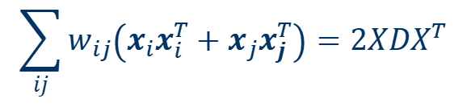

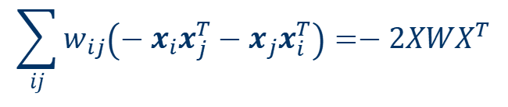
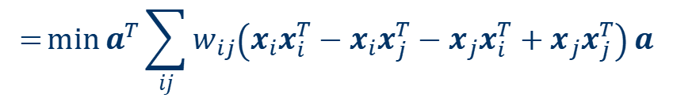
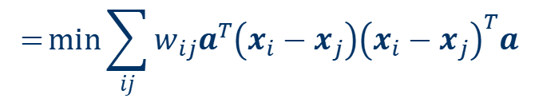
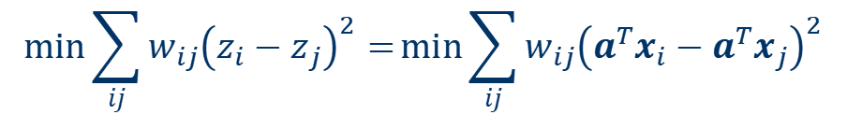







Locality Preserving Projections (LPP)
$$x∈ℛ^{p}$$
$$→a^{T}x=z$$
$$W∈ℛ^{n×n}, w_{ij}=\left\{\begin{matrix}1 & if x_{i} and x_{j} are neighbors. \\ 0 & otherwise\end{matrix}\right.$$
$$\min{\sum_{ij}{w_{ij}{\left(z_{i}−z_{j}\right)}^{2}}}=\min{\sum_{ij}{w_{ij}{\left(a^{T}x_{i}−a^{T}x_{j}\right)}^{2}}}$$
$$=\min{\sum_{ij}{w_{ij}a^{T}\left(x_{i}−x_{j}\right){\left(x_{i}−x_{j}\right)}^{T}a}}$$
Graph Laplacian
$$L=D−W$$
$$=\min{a^{T}\sum_{ij}{w_{ij}\left(x_{i}x_{i}^{T}−x_{i}x_{j}^{T}−x_{j}x_{i}^{T}+x_{j}x_{j}^{T}\right)}a}$$
$$=\min{2a^{T}X\left(D−W\right)X^{T}a}$$
$$=\min{a^{T}XLX^{T}a}$$
$$\sum_{ij}{w_{ij}\left(−x_{i}x_{j}^{T}−x_{j}x_{i}^{T}\right)}=−2XWX^{T}$$
$$\sum_{ij}{w_{ij}\left(x_{i}x_{i}^{T}+x_{j}x_{j}^{T}\right)}=2XDX^{T}$$
$$D=\left[\begin{matrix}d_{11} & ⋯ & 0 \\ ⋮ & ⋱ & ⋮ \\ 0 & ⋯ & d_{nn}\end{matrix}\right], d_{ii}=\sum_{j}{w_{ij}}$$
$$X=\left[x_{1},⋯,x_{n}\right]$$

Slide 40









Locality Preserving Projections
$$\min{a^{T}XLX^{T}a}$$
$$⇔\min{\frac{a^{T}XLX^{T}a}{a^{T}XDX^{T}a}}$$
$$s.t. a^{T}XDX^{T}a=1$$
$$s.t. a^{T}XX^{T}a=1$$
$$s.t. a^{T}a=1$$
$$XLX^{T}a=λXDX^{T}a$$
Therefor,$a$ is an eigenvector of the generalized eigen-problem corresponding to the smallest eigenvalue.
$$L=D−W$$
$$\min{a^{T}XLX^{T}a}$$
$$s.t. a^{T}XDX^{T}a=1$$
$$\max{a^{T}XWX^{T}a}$$
$$s.t. a^{T}XDX^{T}a=1$$
$$XWX^{T}a=λXDX^{T}a$$
$a$ is an eigenvector of the generalized eigen-problem corresponding to the largest eigenvalue.

Slide 41
















LPP vs. LDA
$$\max{\frac{a^{T}XWX^{T}a}{a^{T}XDX^{T}a}}$$
$$XWX^{T}$$
$$\max{\frac{a^{T}S_{B}a}{a^{T}S_{T}a}}$$
$$\max{\frac{a^{T}S_{B}a}{a^{T}S_{W}a}}$$
$$S_{B}$$
$$XDX^{T}$$
$$S_{T}$$
$$=$$
$$=$$
$$W_{k}=\left[\begin{matrix}\frac{1}{n_{k}} & ⋯ & \frac{1}{n_{k}} \\ ⋮ & ⋱ & ⋮ \\ \frac{1}{n_{k}} & ⋯ & \frac{1}{n_{k}}\end{matrix}\right]$$
$$W, w_{ij}=\left\{\begin{matrix}\frac{1}{n_{k}} & \begin{aligned}if x_{i} and x_{j} \\ \text{belong} \text{to} k\text{−}th class.\end{aligned} \\ 0 & otherwise\end{matrix}\right.$$
$$W=\left[\begin{matrix}W_{1} & ⋯ & 0 \\ ⋮ & ⋱ & ⋮ \\ 0 & ⋯ & W_{c}\end{matrix}\right]$$
$$S_{T}=\sum_{x}{\left(x−μ\right){\left(x−μ\right)}^{T}}$$
$$=\sum_{x}{\left(x\right){\left(x\right)}^{T}}$$
$$D=I$$
$$μ=\frac{1}{n}\sum_{x}{x}=0$$
$$=XDX^{T}$$

Slide 42








LPP vs. LDA
$$W_{k}=\left[\begin{matrix}\frac{1}{n_{k}} & ⋯ & \frac{1}{n_{k}} \\ ⋮ & ⋱ & ⋮ \\ \frac{1}{n_{k}} & ⋯ & \frac{1}{n_{k}}\end{matrix}\right]$$
$$W=\left[\begin{matrix}W_{1} & ⋯ & 0 \\ ⋮ & ⋱ & ⋮ \\ 0 & ⋯ & W_{c}\end{matrix}\right]$$
$$S_{B}=\sum_{i=1}^{c}{n_{i}\left(μ_{i}−μ\right){\left(μ_{i}−μ\right)}^{T}}$$
$$=\sum_{i=1}^{c}{n_{i}\left(μ_{i}\right){\left(μ_{i}\right)}^{T}}$$
$$=\sum_{i}^{c}{\frac{1}{n_{i}}\sum_{x∈ω_{i}}{x}\sum_{x∈ω_{i}}{x}}$$
$$=\sum_{i}^{c}{X_{k}W_{k}X_{k}^{T}}$$
$$=XWX^{T}$$
$$S_{B}=XWX^{T}$$
$$S_{T}=XDX^{T}$$
LPP is equivalent to LDA when a specifically designed supervised graph is used

Slide 43







LPP vs. PCA
$$\max{\frac{a^{T}XWX^{T}a}{a^{T}XDX^{T}a}}$$
$$XWX^{T}a=λXDX^{T}a$$
$$\max{\frac{a^{T}XWX^{T}a}{a^{T}XX^{T}a}}$$
$$XWX^{T}a=λXX^{T}a$$
$$W=X^{T}X$$
$$XX^{T}XX^{T}a=λXX^{T}a$$
$$XX^{T}a=λa$$
LPP is similar to PCA when an inner product graph is used.

Slide 44

Graph based Dimensionality Reduction
Given examples $x_{i}∈ℛ^{p}$, $i=1,⋯,n$
Construct a graph with weight matrix $W∈ℛ^{n×n}$
Solve the optimization problem:
$\max{\frac{a^{T}XWX^{T}a}{a^{T}XDX^{T}a}}$
$XWX^{T}a=λXDX^{T}a$
The transformation A is given by
$A=\left[a_{1},⋯a_{d}\right]$

Slide 45
Graph based Dimensionality Reduction Method
Locality Preserving Projection [He & Niyogi, 2003]
Linear Discriminant Analysis [Fisher, 1936]
Neighborhood Preserving Embedding [He et. al, 2005]
Marginal Fisher Analysis [Yan et. al, 2005]
Local discriminant embedding [Chen et. al, 2005]
Augmented Relation Embedding [Lin et. al, 2005]
Isometric Projection [Cai et. al, 2006]
Semantic Subspace Projection [Yu & Tian, 2006]
Locally Sensitive Discriminant Analysis [Cai et. al, 2007]
Semi-supervised Discriminant Analysis [Cai et. al, 2007]
……

Slide 46









Regularization on Graph based Dimensionality Reduction Methods
$$\max{\frac{a^{T}XX^{T}a}{a^{T}a}}$$
PCA: $XX^{T}a=λa$
LDA: $S_{B}a=λS_{W}a$ or $S_{B}a=λS_{T}a$
$S_{B}a=λ\left(S_{W}+γI\right)a$
$S_{B}a=λ\left(S_{T}+γI\right)a$
LPP: $XLX^{T}a=λXDX^{T}a$ or $XWX^{T}a=λXDX^{T}a$
$XWX^{T}a=λ\left(XDX^{T}+γI\right)a$
Regularization from Ridge idea: minimizing $a^{T}a$
$$\max{\frac{a^{T}S_{B}a}{a^{T}\left(S_{T}+γI\right)a}}$$
$$\max{\frac{a^{T}S_{B}a}{a^{T}\left(S_{W}+γI\right)a}}$$
$$\max{\frac{a^{T}S_{B}a}{a^{T}S_{T}a}}$$
$$\max{\frac{a^{T}S_{B}a}{a^{T}S_{W}a}}$$
$$×$$
$$\max{\frac{a^{T}XWX^{T}a}{a^{T}XDX^{T}a}}$$
$$\min{\frac{a^{T}XLX^{T}a}{a^{T}\left(XDX^{T}+γI\right)a}}$$
$$\max{\frac{a^{T}XWX^{T}a}{a^{T}\left(XDX^{T}+γI\right)a}}$$
$$\min{\frac{a^{T}XLX^{T}a}{a^{T}XDX^{T}a}}$$

