Slide 1

Salton’s Vector Space Model (Prior to 1988)
Represent each document by a high-dimensional vector in the space of words
Notes:
Gerard Salton (8 March 1927 in Nuremberg - 28 August 1995)
Salton was an ACM Fellow (elected 1995), received an Award of Merit from the American Society for Information Science (1989), and was the first recipient of the SIGIR Award for outstanding contributions to study of information retrieval (1983) -- now called the Gerard Salton Award.

Slide 2
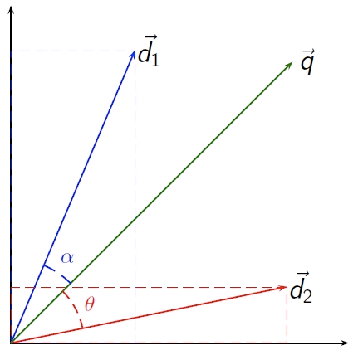
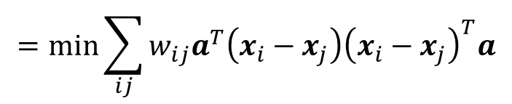
Query
Compute the similarity between queries(q) and documents(d)
$$\cos{(q,d)}=\frac{q^{T}d}{\left\|q\right\|\left\|d\right\|}$$
Simple, intuitive
Fast to compute, because both they are sparse
Retrieval Methods
Rank documents according to similarity with query
Term weighting schemes, for example, TF-IDF

Slide 3
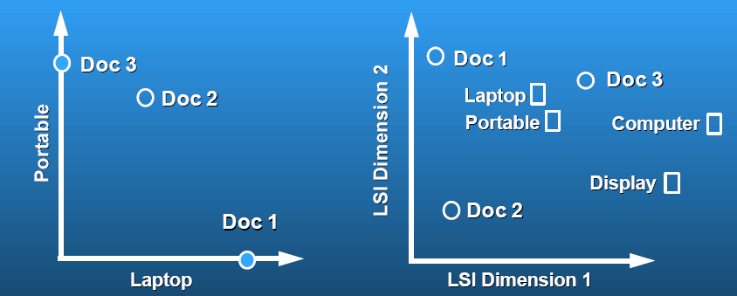
Problem of Vector Space Model
Possible Solution: Principle Component Analysis

Slide 4
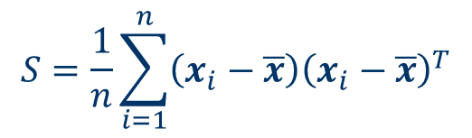


Problem of PCA
Main steps for computing PCs:
Form the covariance matrix S.
Computes the first d eigenvectors ${\left\{a_{i}\right\}}_{i=1}^{d}$.
The transformation A is given by
$$A=\left[a_{1},⋯a_{d}\right]$$
$$S=\frac{1}{n}\sum_{i=1}^{n}{\left(x_{i}−\overline{x}\right){\left(x_{i}−\overline{x}\right)}^{T}}$$
$$∈R^{m×m}$$
We have the computational problem if $m$ is very large.

Slide 5
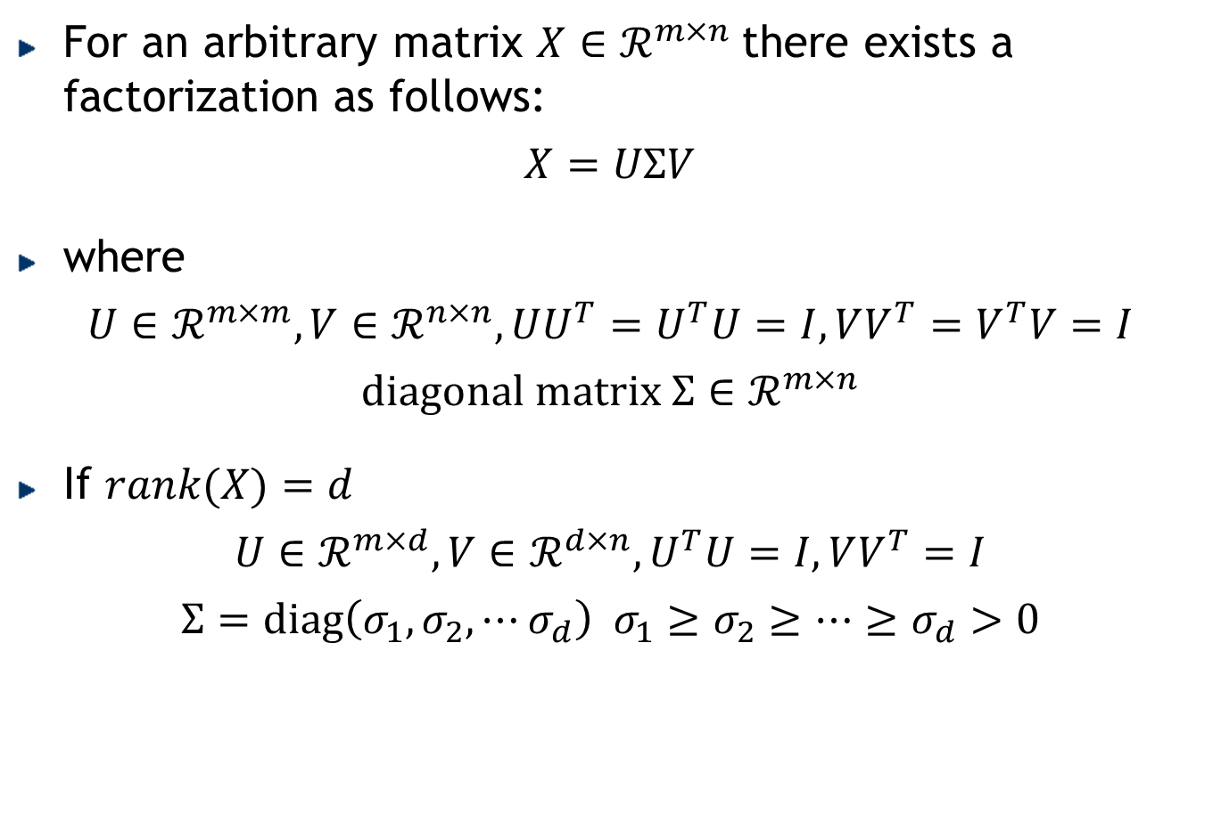
Singular Value Decomposition (SVD)
For an arbitrary matrix $X∈ℛ^{m×n}$ there exists a factorization as follows:
$$X=UΣV$$
where
$$U∈ℛ^{m×m},V∈ℛ^{n×n}, UU^{T}=U^{T}U=I, VV^{T}=V^{T}V=I$$
$$diagonal matrix Σ∈ℛ^{m×n}$$
If $rank(X)=d$
$$U∈ℛ^{m×d},V∈ℛ^{d×n}, U^{T}U=I, VV^{T}=I$$
$$Σ=diag\left(σ_{1},σ_{2},⋯σ_{d}\right) σ_{1}≥σ_{2}≥⋯≥σ_{d}>0$$

Slide 6

SVD: Low-rank Approximation
SVD can be used to compute optimal low-rank approximations.
Approximation problem:
Solution via SVD
$$X^{∗}=\underset{rank\left(\tilde{X}\right)=k}{\text{arg}min}{{\left\|X−\tilde{X}\right\|}_{F}^{2}}$$
$$X^{∗}=U\text{diag}\left(σ_{1},⋯,σ_{k},0,⋯,0\right)V$$
set small singular
values to zero
C. Eckart, G. Young, The approximation of a matrix by another of lower rank. Psychometrika, 1, 211-218, 1936.
Notes:
Forms the basics of LSI (Latent Semantic Indexing) in informational retrieval

Slide 7
Low rank approximation by SVD

Slide 8






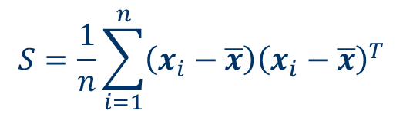






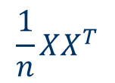


SVD Solution of PCA
$$\overline{x}=0$$
$$S=\frac{1}{n}\sum_{i=1}^{n}{\left(x_{i}−\overline{x}\right){\left(x_{i}−\overline{x}\right)}^{T}}$$
$$\frac{1}{n}XX^{T}$$
$$XX^{T}$$
$$∈R^{m×m}$$
$$n≪m$$
$$XX^{T}$$
$$=UΣV^{T}VΣ^{T}U^{T}$$
$$=U\left(ΣΣ^{T}\right)U^{T}$$
$$X^{T}X$$
$$=VΣ^{T}U^{T}UΣV^{T}$$
$$=V\left(Σ^{T}Σ\right)V^{T}$$
$$X=UΣV^{T}$$
$$XV=UΣV^{T}V$$
$$=UΣ$$
$$XVΣ^{−1}=U$$

Slide 9

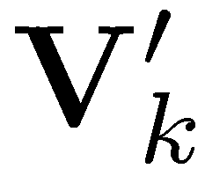



Latent Semantic Analysis (Indexing)
The Latent Semantic Analysis via SVD can be summarized as follows:
Document similarity
$\left\langle x_{i},x_{j}\right\rangle =\left\langle Σ_{k}v_{i},Σ_{k}v_{j}\right\rangle$
terms
...
LSA document
vectors
=
...
...
...
LSA term
vectors
documents
< , >
Notes:
Traditional term-matching method doesn’t work well in information retrieval
One term may have multiple meaning (polysemy)
Different terms may have the same meaning (synonymy)
We want to capture the concepts instead of words.

Slide 10
Latent Semantic Analysis
Latent semantic space: illustrating example

Slide 11
Matrix Factorization
Deng Cai (蔡登)
College of Computer Science Zhejiang University
dengcai@gmail.com

Slide 12



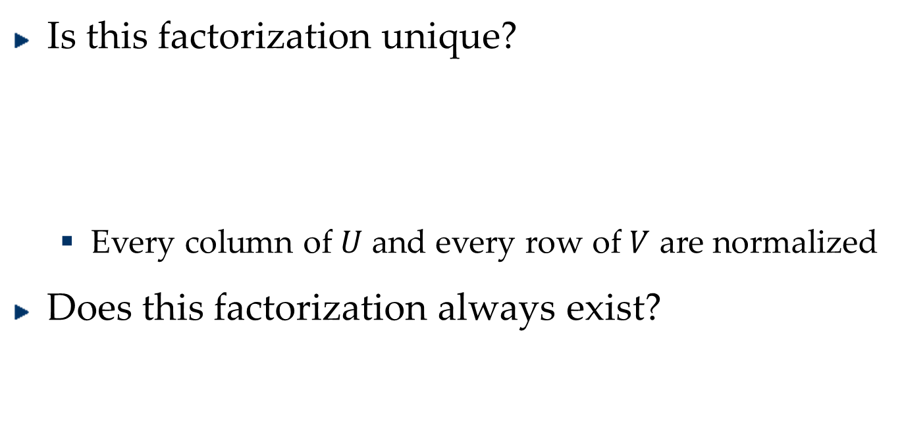





What Is Matrix Factorization?
$$X∈ℛ^{m×n}$$
$$UV=X$$
$$U∈ℛ^{m×k}, V∈ℛ^{k×n}$$
Is this factorization unique?
Every column of $U$ and every row of $V$ are normalized
Does this factorization always exist?
$$Σ∈ℛ^{k×k}$$
$$UΣΣ^{−1}V=X$$
$$UΣV=X$$
$$UV=\tilde{X}≈X$$
$${\left\|X−UV\right\|}_{F}^{2}$$

Slide 13
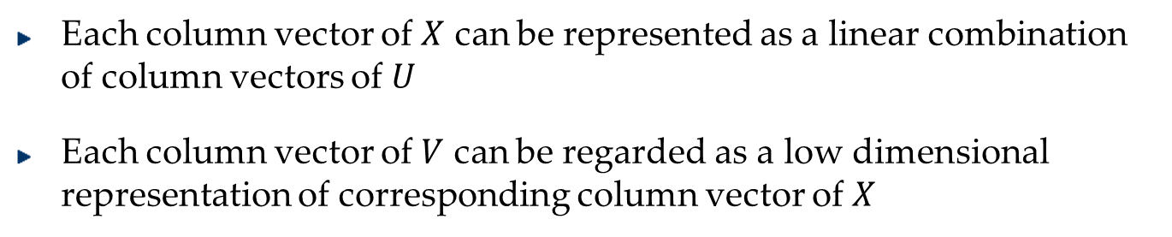


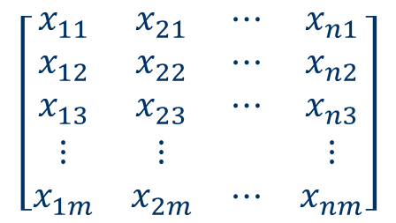
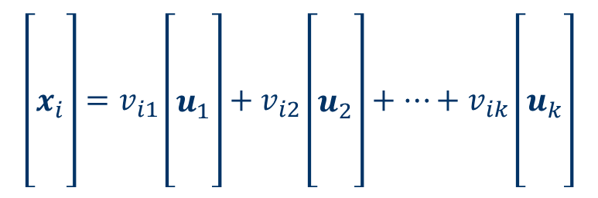

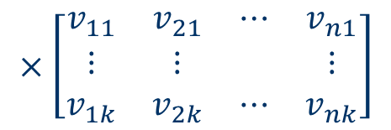
Why Matrix Factorization?
$$X=UV$$
$$\left[\begin{matrix}x_{11} & x_{21} & ⋯ & x_{n1} \\ x_{12} & x_{22} & ⋯ & x_{n2} \\ x_{13} & x_{23} & ⋯ & x_{n3} \\ ⋮ & ⋮ & & ⋮ \\ x_{1m} & x_{2m} & ⋯ & x_{nm}\end{matrix}\right]$$
$$\left[\begin{matrix}u_{11} & ⋯ & u_{k1} \\ u_{12} & ⋯ & u_{k2} \\ u_{13} & ⋯ & u_{k3} \\ ⋮ & & ⋮ \\ u_{1m} & ⋯ & u_{km}\end{matrix}\right]$$
$$×\left[\begin{matrix}v_{11} & v_{21} & ⋯ & v_{n1} \\ ⋮ & ⋮ & & ⋮ \\ v_{1k} & v_{2k} & ⋯ & v_{nk}\end{matrix}\right]$$
$$=$$
$$\left[\begin{matrix} \\ \\ x_{i} \\ \\ \end{matrix}\right]=v_{i1}\left[\begin{matrix} \\ \\ u_{1} \\ \\ \end{matrix}\right]+v_{i2}\left[\begin{matrix} \\ \\ u_{2} \\ \\ \end{matrix}\right]+⋯+v_{ik}\left[\begin{matrix} \\ \\ u_{k} \\ \\ \end{matrix}\right]$$
Each column vector of $X$ can be represented as a linear combination of column vectors of $U$
Each column vector of $V$ can be regarded as a low dimensional representation of corresponding column vector of $X$

Slide 14

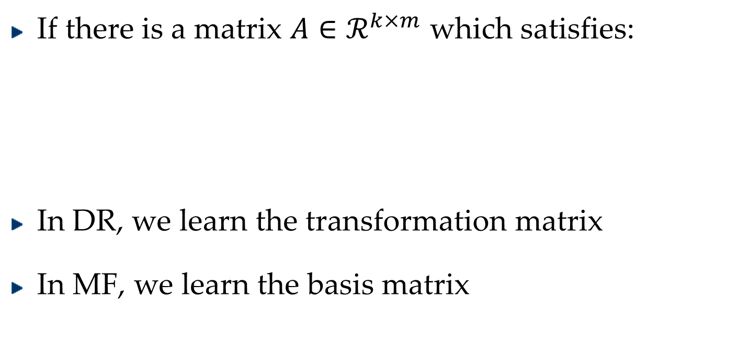



Relation to Dimensionality Reduction
$$X=\left[x_{1}, x_{2},⋯x_{n}\right]=UV=U\left[v_{1}, v_{2},⋯v_{n}\right]$$
$$x_{i}=Uv_{i}$$
$$x_{i}∈ℛ^{m}, v_{i}∈ℛ^{k}$$
If there is a matrix $A∈ℛ^{k×m}$ which satisfies:
In DR, we learn the transformation matrix
In MF, we learn the basis matrix
$$AU=I$$
$$Ax_{i}=v_{i}$$

Slide 15


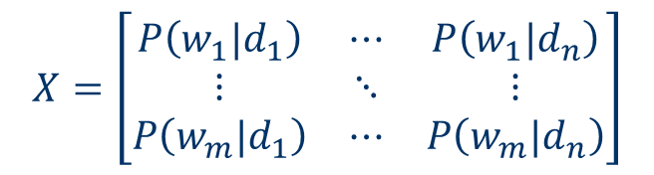
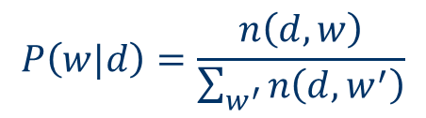
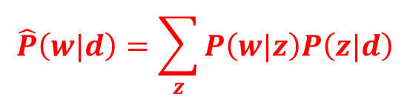
Relation to Topic Modeling
Documents
Documents
Terms
Terms
economic
imports
TRADE
trade
Latent
Concepts
$$P\left(w|d\right)=\frac{n\left(d,w\right)}{\sum_{w^{′}}{n\left(d,w^{′}\right)}}$$
$$\hat{P}\left(w|d\right)=\sum_{z}{P\left(w|z\right)P\left(z|d\right)}$$
$$X=\left[\begin{matrix}P\left(w_{1}|d_{1}\right) & ⋯ & P\left(w_{1}|d_{n}\right) \\ ⋮ & ⋱ & ⋮ \\ P\left(w_{m}|d_{1}\right) & ⋯ & P\left(w_{m}|d_{n}\right)\end{matrix}\right]$$

Slide 16

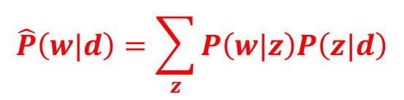

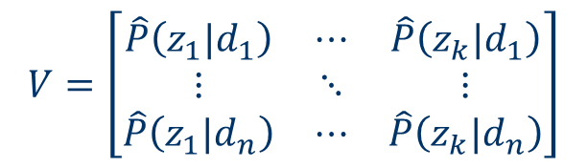


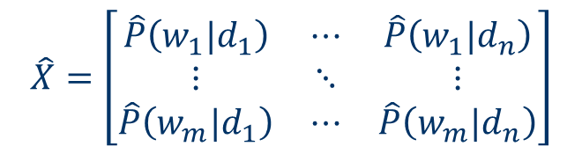
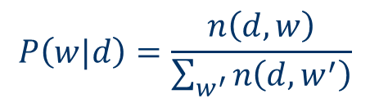
Relation to Topic Modeling
$$P\left(w|d\right)=\frac{n\left(d,w\right)}{\sum_{w^{′}}{n\left(d,w^{′}\right)}}$$
$$\hat{P}\left(w|d\right)=\sum_{z}{P\left(w|z\right)P\left(z|d\right)}$$
$$X=\left[\begin{matrix}P\left(w_{1}|d_{1}\right) & ⋯ & P\left(w_{1}|d_{n}\right) \\ ⋮ & ⋱ & ⋮ \\ P\left(w_{m}|d_{1}\right) & ⋯ & P\left(w_{m}|d_{n}\right)\end{matrix}\right]$$
$$U=\left[\begin{matrix}\hat{P}\left(w_{1}|z_{1}\right) & ⋯ & \hat{P}\left(w_{1}|z_{k}\right) \\ ⋮ & ⋱ & ⋮ \\ \hat{P}\left(w_{m}|z_{1}\right) & ⋯ & \hat{P}\left(w_{m}|z_{k}\right)\end{matrix}\right]$$
$$\hat{X}=\left[\begin{matrix}\hat{P}\left(w_{1}|d_{1}\right) & ⋯ & \hat{P}\left(w_{1}|d_{n}\right) \\ ⋮ & ⋱ & ⋮ \\ \hat{P}\left(w_{m}|d_{1}\right) & ⋯ & \hat{P}\left(w_{m}|d_{n}\right)\end{matrix}\right]$$
$$V=\left[\begin{matrix}\hat{P}\left(z_{1}|d_{1}\right) & ⋯ & \hat{P}\left(z_{k}|d_{1}\right) \\ ⋮ & ⋱ & ⋮ \\ \hat{P}\left(z_{1}|d_{n}\right) & ⋯ & \hat{P}\left(z_{k}|d_{n}\right)\end{matrix}\right]$$
$$X≈$$
$$\hat{X}=UV^{T}$$
T. Hofmann, Probabilistic Latent Semantic Analysis, UAI 1999.

Slide 17

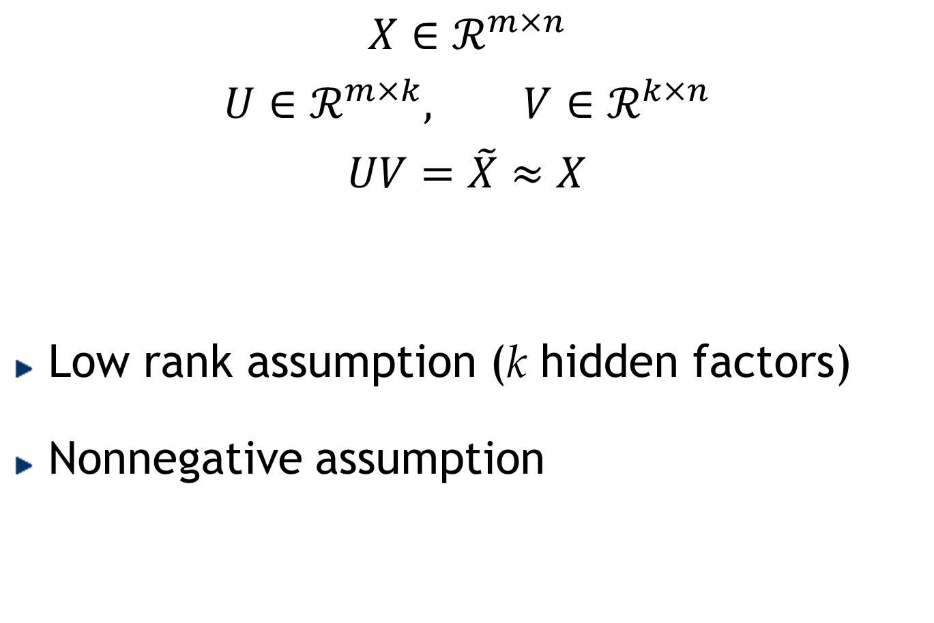
Nonnegative Matrix Factorization
$$X∈ℛ^{m×n}$$
$$U∈ℛ^{m×k}, V∈ℛ^{k×n}$$
$$UV=\tilde{X}≈X$$
Low rank assumption (k hidden factors)
Nonnegative assumption
$$u_{ij}≥0, v_{ij}≥0$$

Slide 18
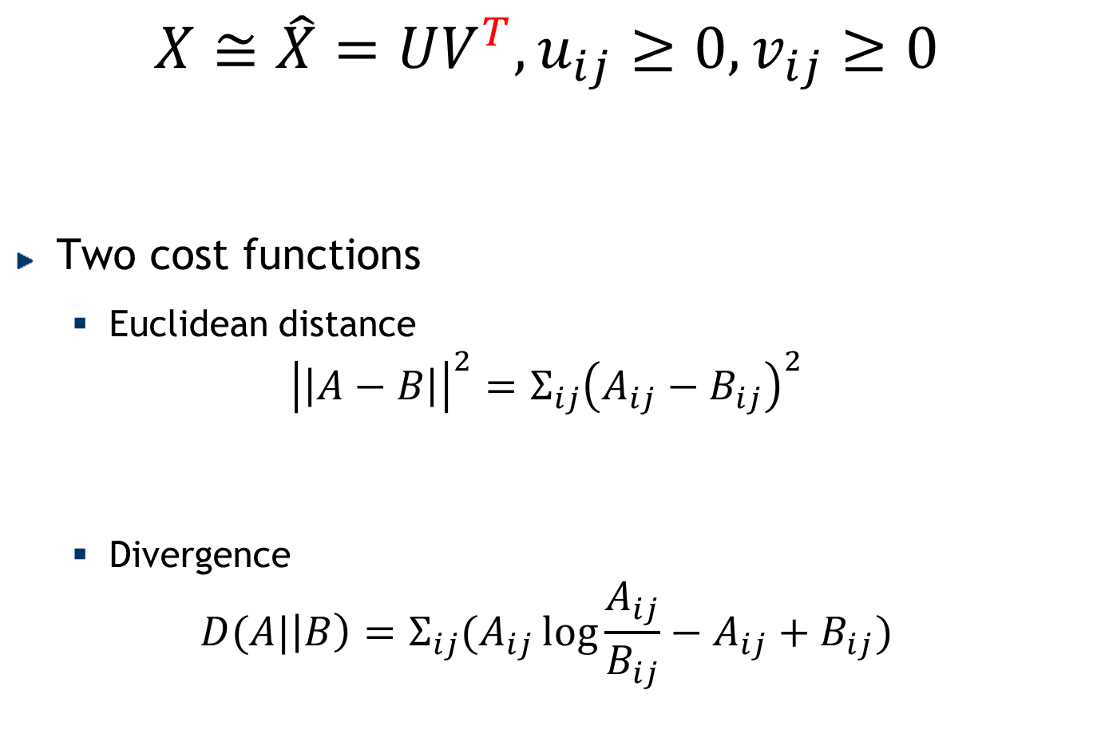
Non-negative Matrix Factorization
$$X≅\hat{X}=UV^{T}, u_{ij}≥0, v_{ij}≥0$$
Two cost functions
Euclidean distance
$${\left|\left|A−B\right|\right|}^{2}=Σ_{ij}{\left(A_{ij}−B_{ij}\right)}^{2}$$
Divergence
$$D(A|\left|B\right)=Σ_{ij}(A_{ij}\log{\frac{A_{ij}}{B_{ij}}−A_{ij}+B_{ij}})$$

Slide 19
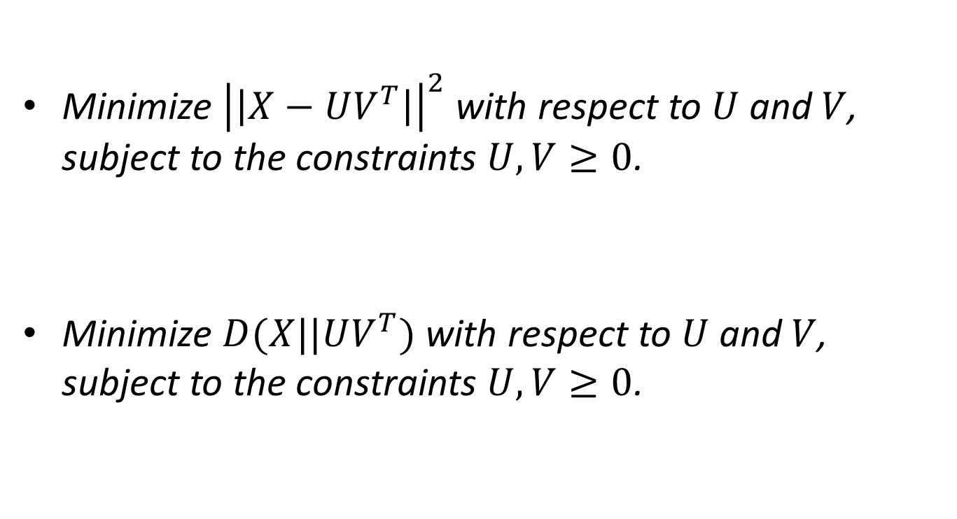
Optimization Problems
Minimize ${\left|\left|X−UV^{T}\right|\right|}^{2}$ with respect to $U$ and $V$, subject to the constraints $U,V≥0$.
Minimize $D(X||UV^{T})$ with respect to $U$ and $V$, subject to the constraints $U,V≥0$.

Slide 20







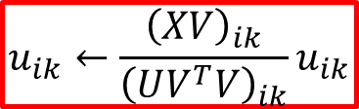








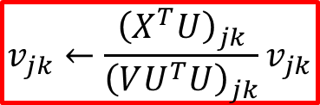
NMF Optimization (Euclidean Distance)
$$min{\left|\left|X−UV^{T}\right|\right|}^{2}, s.t. u_{ij}≥0, v_{ij}≥0$$
$$J={\left|\left|X−UV^{T}\right|\right|}^{2}$$
$$=tr\left({\left(X−UV^{T}\right)}^{T}\left(X−UV^{T}\right)\right)$$
$Γ$, same size as $U$
$$=tr\left(X^{T}X−X^{T}UV^{T}−VU^{T}X+VU^{T}UV^{T}\right)$$
$Φ$, same size as $V$
$$ℒ =tr\left(X^{T}X\right)−2tr\left(X^{T}UV^{T}\right)+tr\left(VU^{T}UV^{T}\right)$$
$+tr\left(ΓU^{T}\right)$+$tr\left(ΦV^{T}\right)$
$$\frac{∂ℒ}{∂U}=$$
$$−2XV$$
$$+2UV^{T}V$$
$$+Γ$$
$${\left(UV^{T}V\right)}_{ik}u_{ik}−{\left(XV\right)}_{ik}u_{ik}=0$$
$$u_{ik}←\frac{{\left(XV\right)}_{ik}}{{\left(UV^{T}V\right)}_{ik}}u_{ik}$$
$$\frac{∂ℒ}{∂V}=$$
$${\left(VU^{T}U\right)}_{jk}v_{jk}−{\left(X^{T}U\right)}_{jk}v_{jk}=0$$
$$−2X^{T}U$$
$$+2VU^{T}U$$
$$+Φ$$
$$v_{jk}←\frac{{\left(X^{T}U\right)}_{jk}}{{\left(VU^{T}U\right)}_{jk}}v_{jk}$$
Notes:
$Γ$: gamma
$Φ$: phi

Slide 21
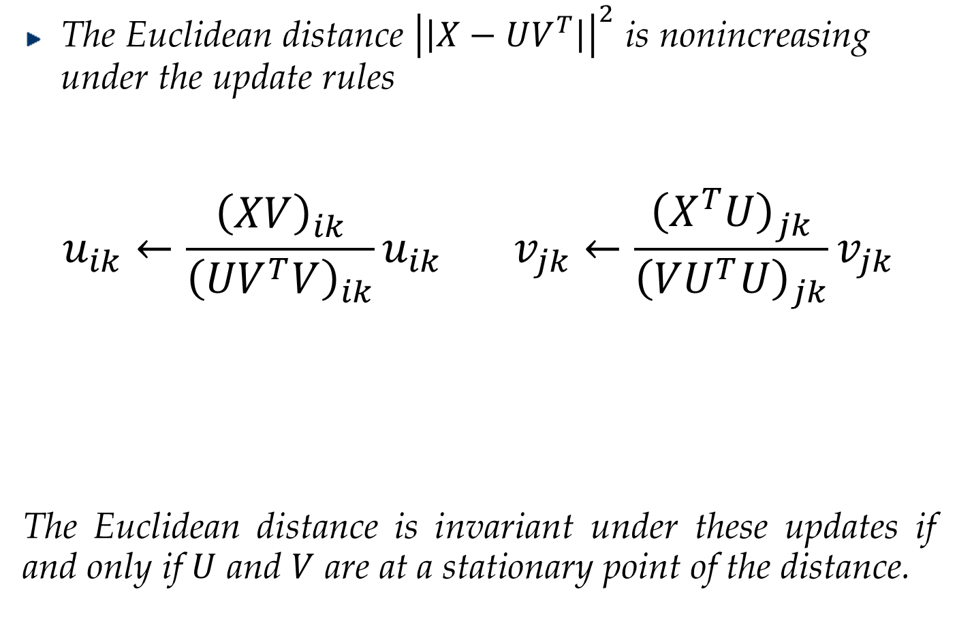
Multiplicative Update Rules
The Euclidean distance ${\left|\left|X−UV^{T}\right|\right|}^{2}$ is nonincreasing under the update rules
$$u_{ik}←\frac{{\left(XV\right)}_{ik}}{{\left(UV^{T}V\right)}_{ik}}u_{ik} v_{jk}←\frac{{\left(X^{T}U\right)}_{jk}}{{\left(VU^{T}U\right)}_{jk}}v_{jk}$$
The Euclidean distance is invariant under these updates if and only if $U$ and $V$ are at a stationary point of the distance.

Slide 22
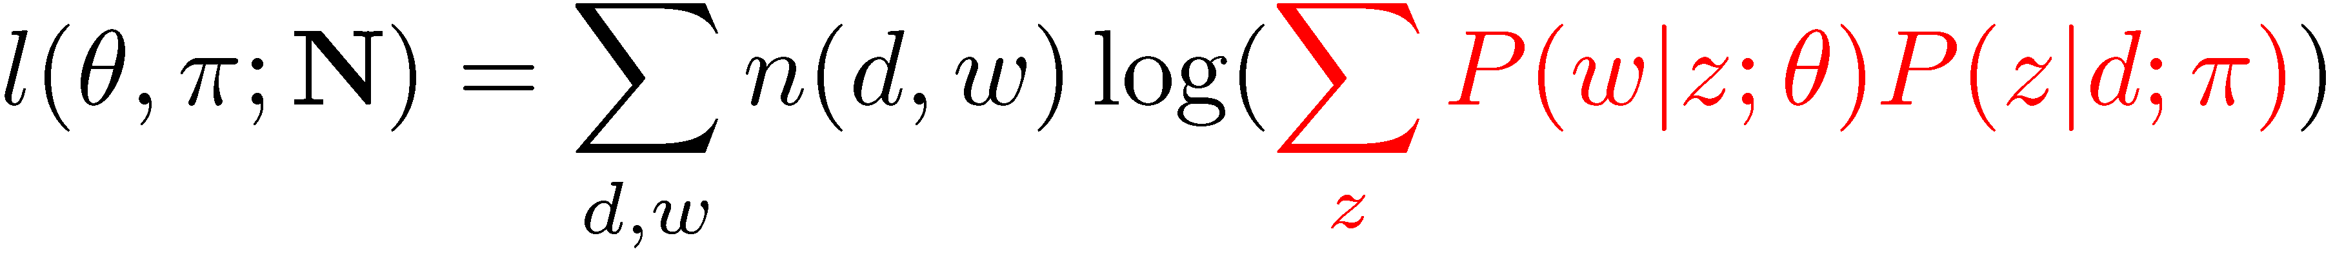
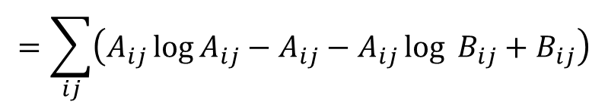
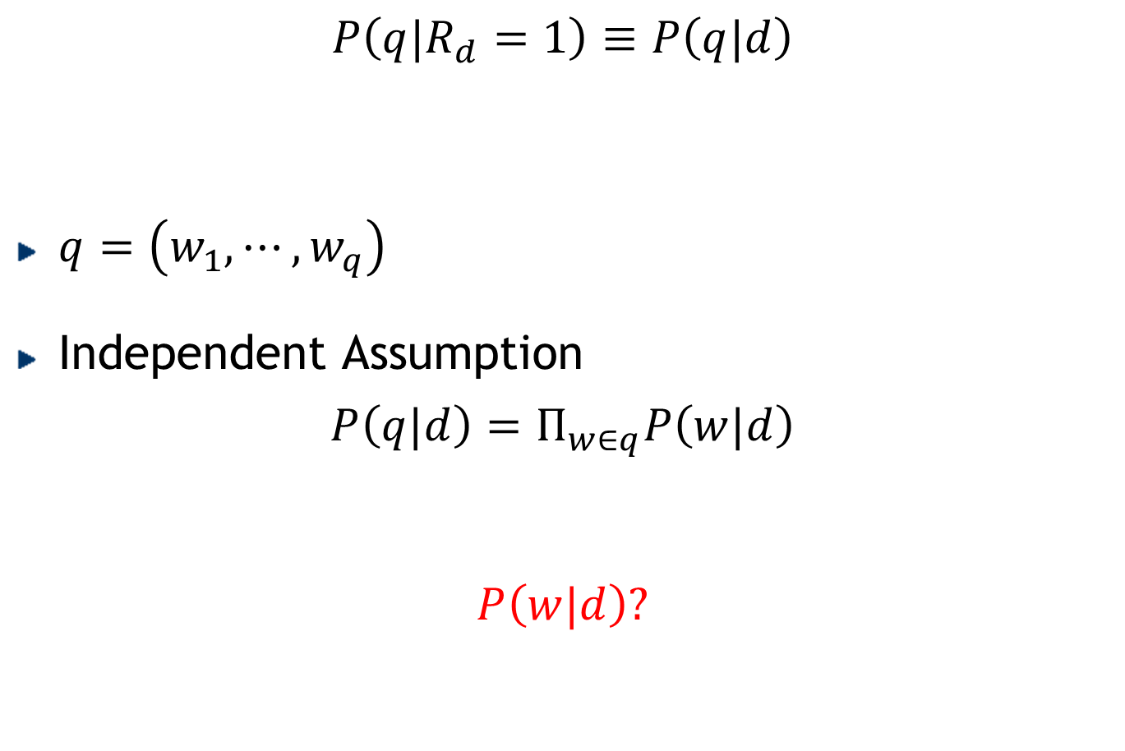
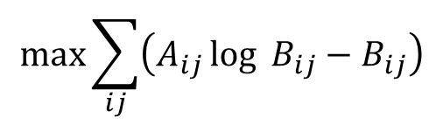


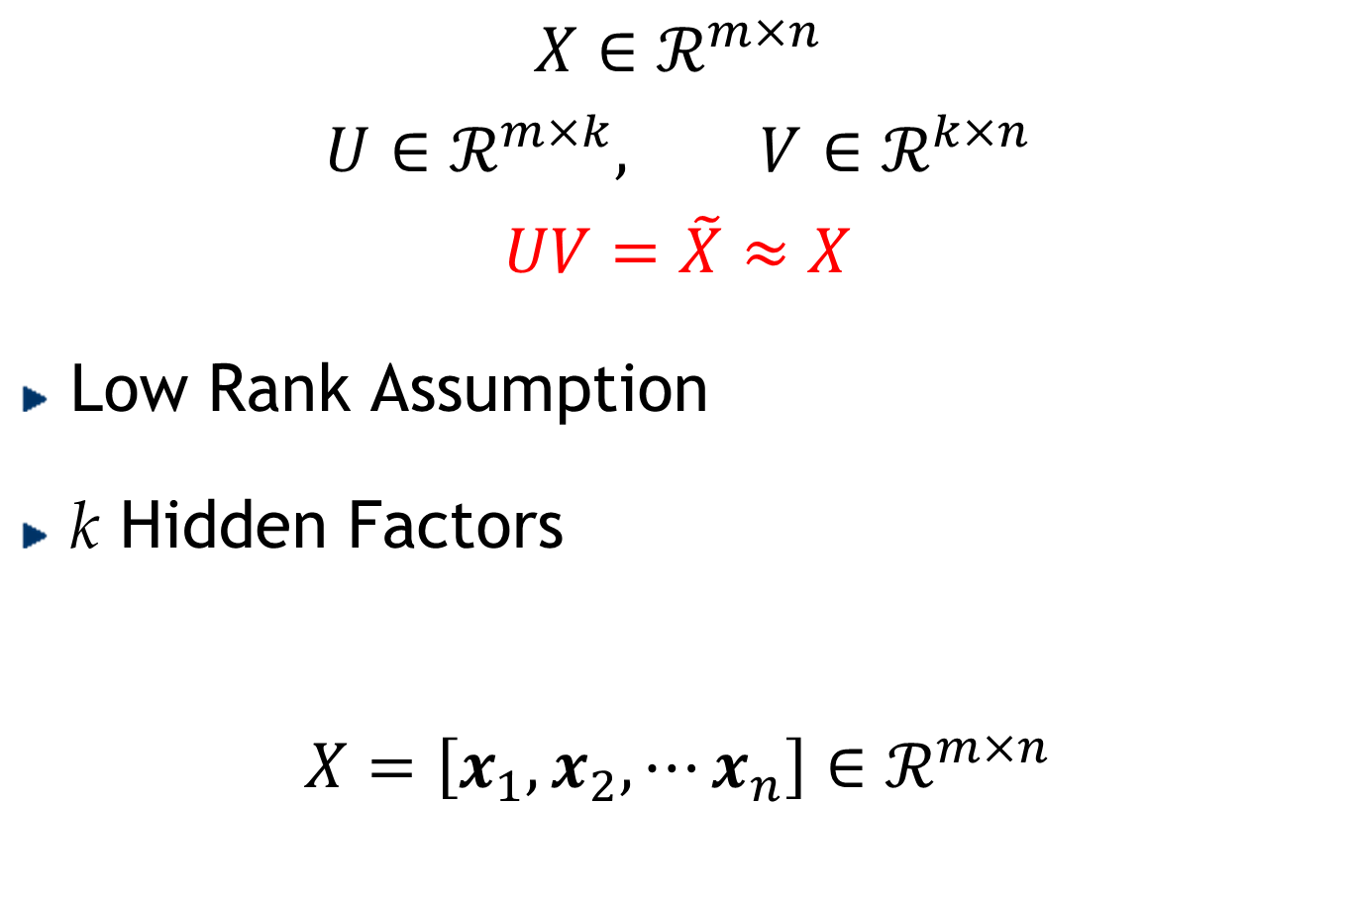
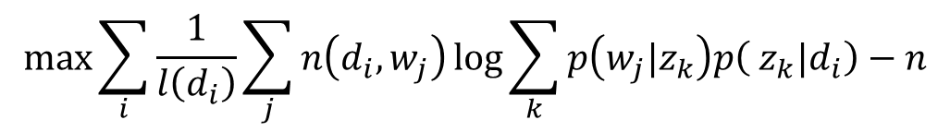
NMF vs PLSA
$X≅\hat{X}=UV^{T}, u_{ij}≥0, v_{ij}≥0$
$D(A|\left|B\right)=\sum_{ij}{\left(A_{ij}\log{\frac{A_{ij}}{B_{ij}}−A_{ij}+B_{ij}}\right)}$
$$=\sum_{ij}{\left(A_{ij}\log{A_{ij}}−A_{ij}−A_{ij}\log{B_{ij}}+B_{ij}\right)}$$
$$\max{\sum_{ij}{\left(A_{ij}\log{B_{ij}}−B_{ij}\right)}}$$
$$X=\left[n\left(d_{i},w_{j}\right)\right]×diag\left(\frac{1}{l\left(d_{i}\right)}\right)$$
$$U=\left[p\left(w_{j}|z_{k}\right)\right]$$
$$V^{T}=\left[p\left( z_{k}|d_{i}\right)\right]$$
$$\max{\sum_{i}{\frac{1}{l\left(d_{i}\right)}\sum_{j}{n\left(d_{i},w_{j}\right)\log{\sum_{k}{p\left(w_{j}|z_{k}\right)p\left( z_{k}|d_{i}\right)}}}}−n}$$

Slide 23
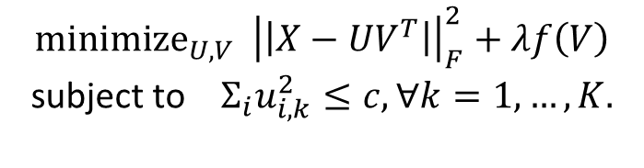

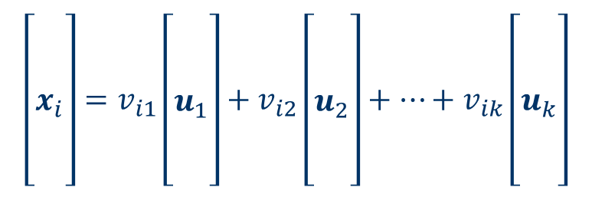
Sparse Coding
$$X≈\hat{X}=UV^{T}$$
$$\left[\begin{matrix} \\ \\ x_{i} \\ \\ \end{matrix}\right]=v_{i1}\left[\begin{matrix} \\ \\ u_{1} \\ \\ \end{matrix}\right]+v_{i2}\left[\begin{matrix} \\ \\ u_{2} \\ \\ \end{matrix}\right]+⋯+v_{ik}\left[\begin{matrix} \\ \\ u_{k} \\ \\ \end{matrix}\right]$$
$${minimize}_{U,V} {\left|\left|X−UV^{T}\right|\right|}_{F}^{2}+λf\left(V\right)$$
subject to $Σ_{i}u_{i,k}^{2}≤c, ∀k=1,…,K.$
Represent input vectors approximately as a weighted linear combination of a small number of “basis vectors.”
Notes:
Given a matrix that “encodes” data, e.g. co-occurrence counts
Potential problems
too large
too complicated
missing entries
noisy entries
lack of structure
...
Is there a simpler way to explain entries?
There might be a latent structure underlying the data.
How can we reveal or discover this structure?
I try to show that matrix factorization is a way to compress data (dimensionality reduction). We find a new space spanned by the column vectors in U and represent the data in this new space. The new space only has k basis, lead to a compression (comparing to the original m basis. )

Slide 24

Matrix Factorization: Summary
$$X∈ℛ^{m×n}$$
$$U∈ℛ^{m×k}, V∈ℛ^{k×n}$$
$$UV=\tilde{X}≈X$$
Low rank assumption (k hidden factors)
SVD
Nonnegative assumption
NMF
Sparseness assumption
Sparse Coding

