Slide 1
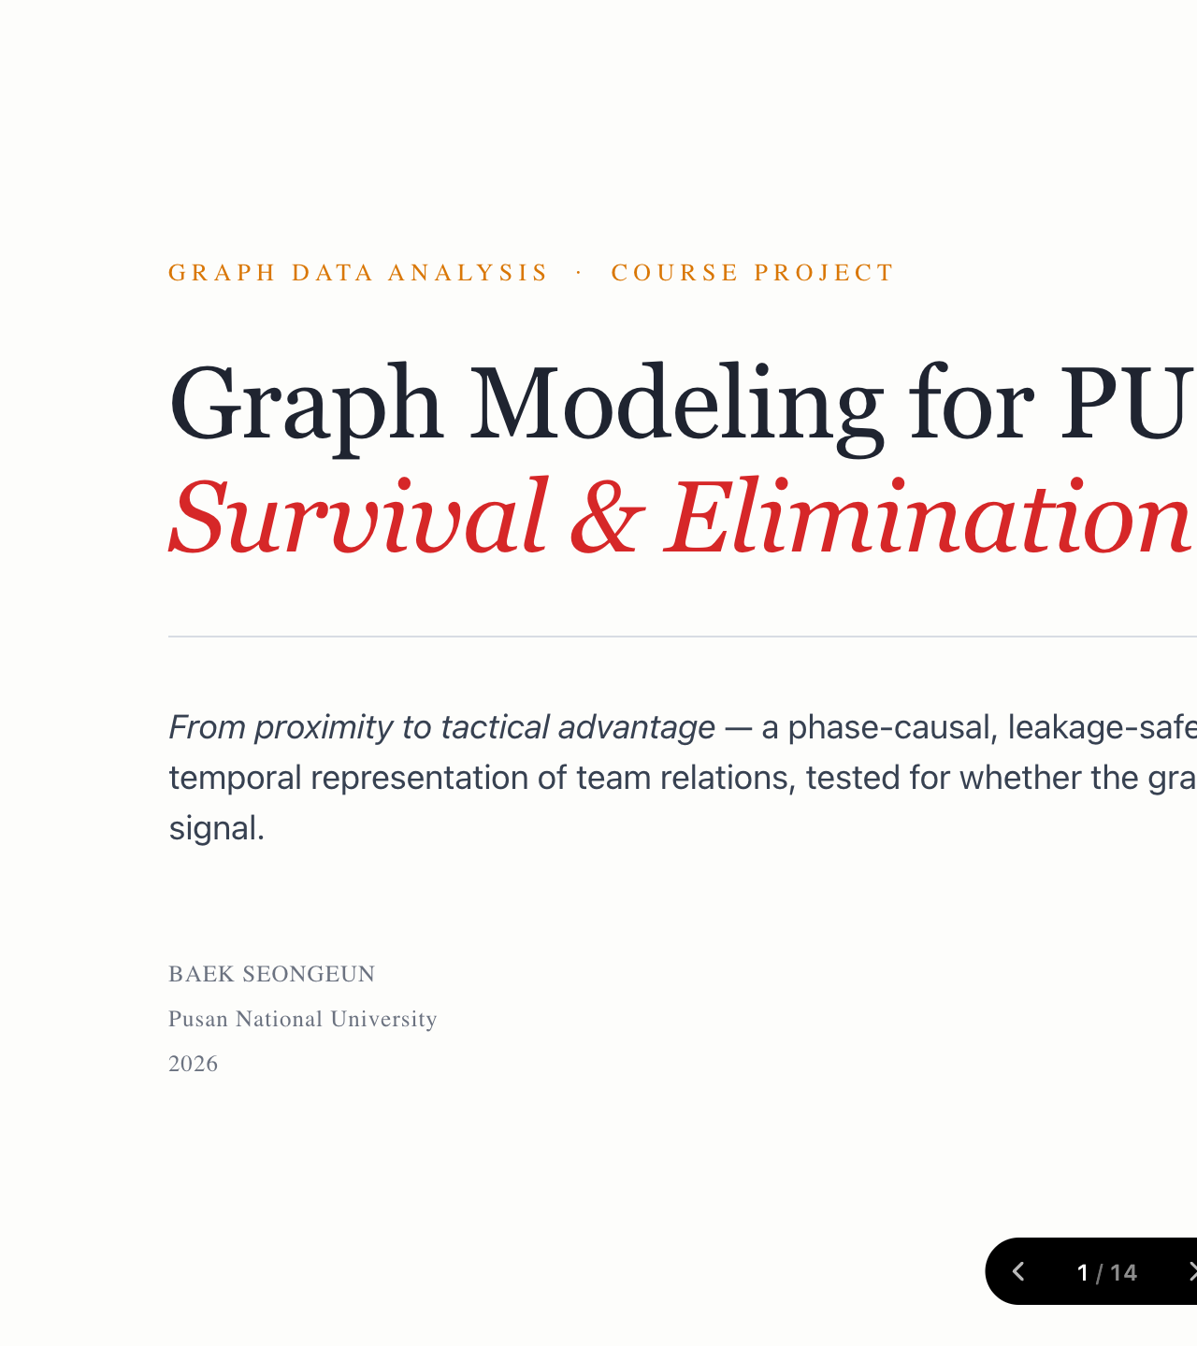
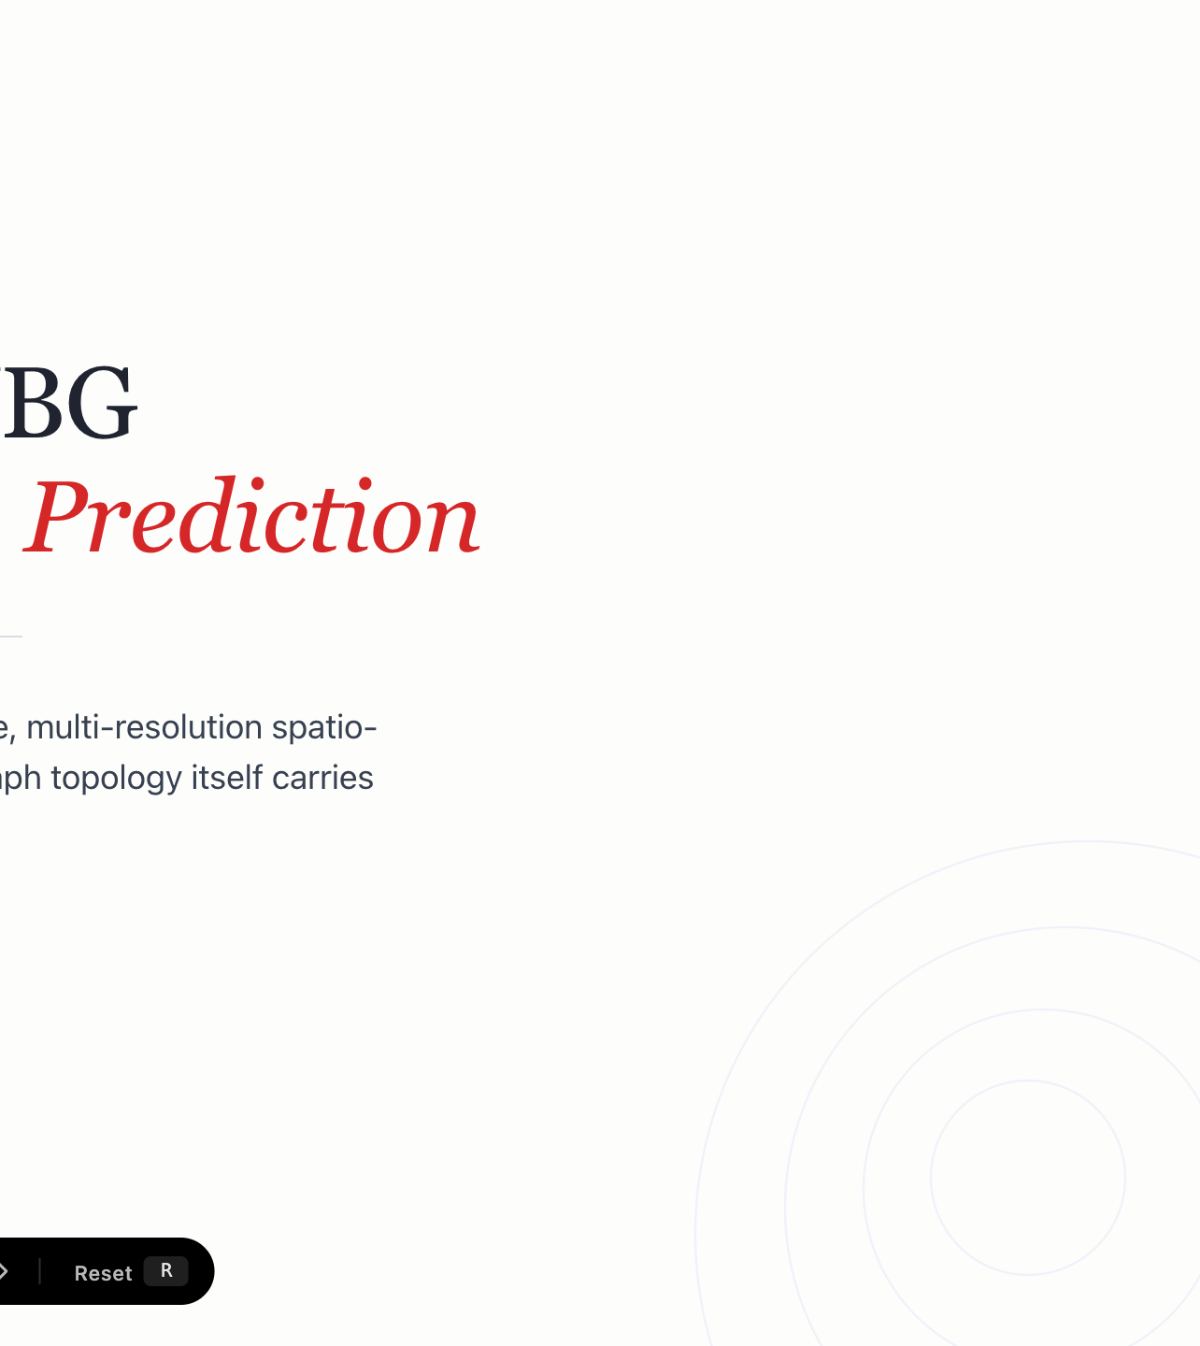
Notes:
This talk is about predicting survival in PUBG by modeling teams as a graph. The headline: how we wire the edges matters more than which GNN we use.

Slide 2
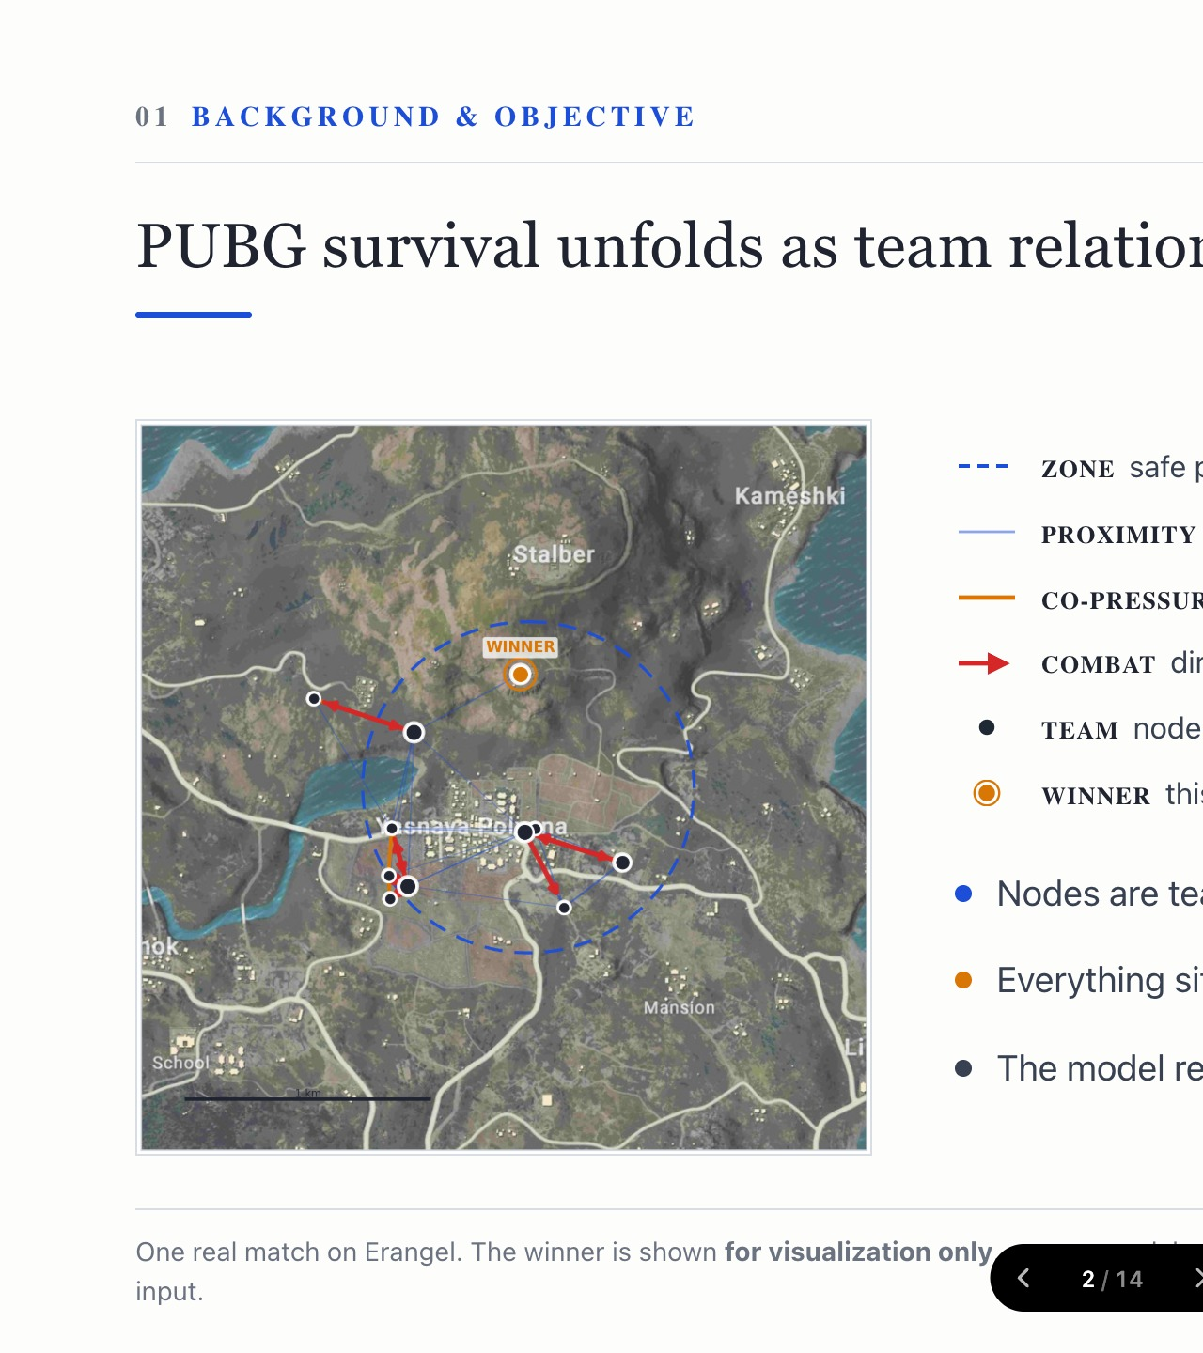
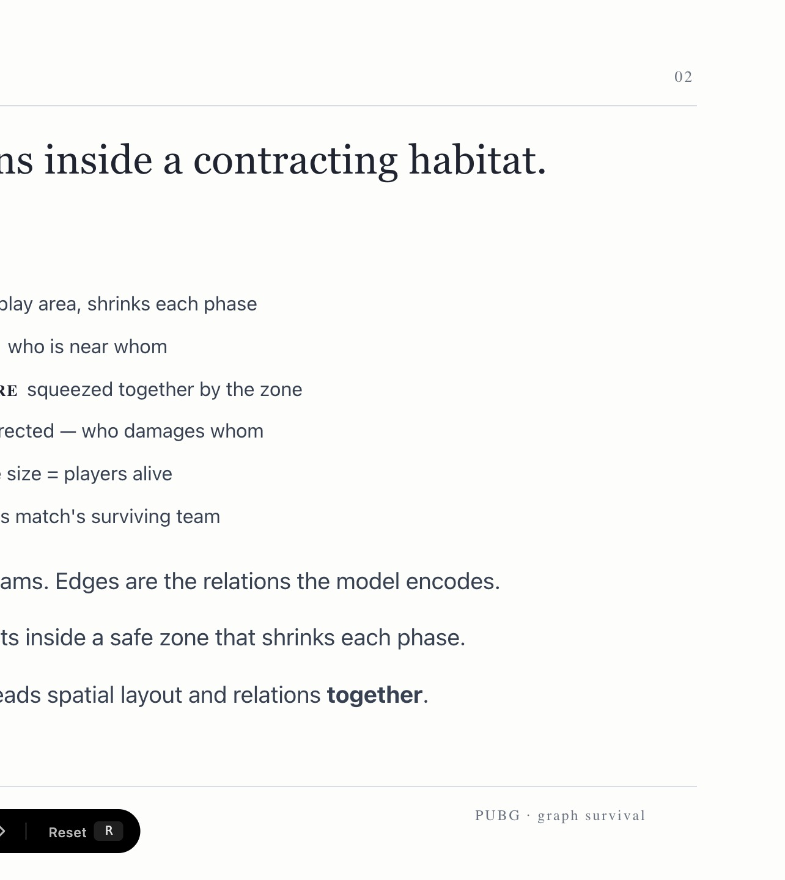
Notes:
A match is not isolated players. It is teams moving and fighting inside a shrinking safe zone. Nodes are teams; edges are proximity, combat, and co-pressure. The winner here is shown only for the picture, never a model input.

Slide 3
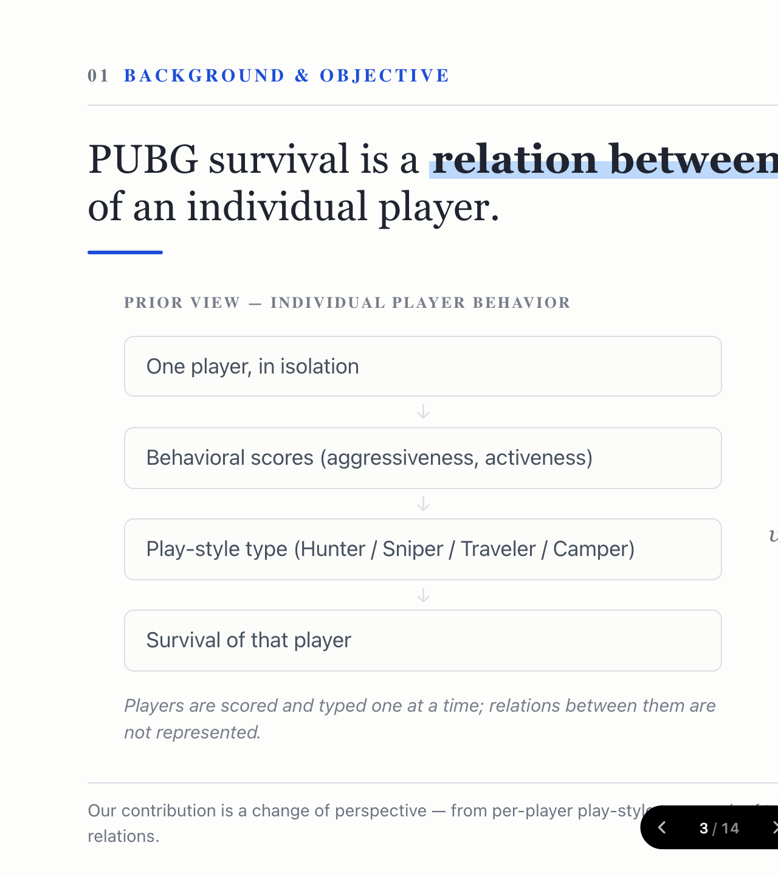
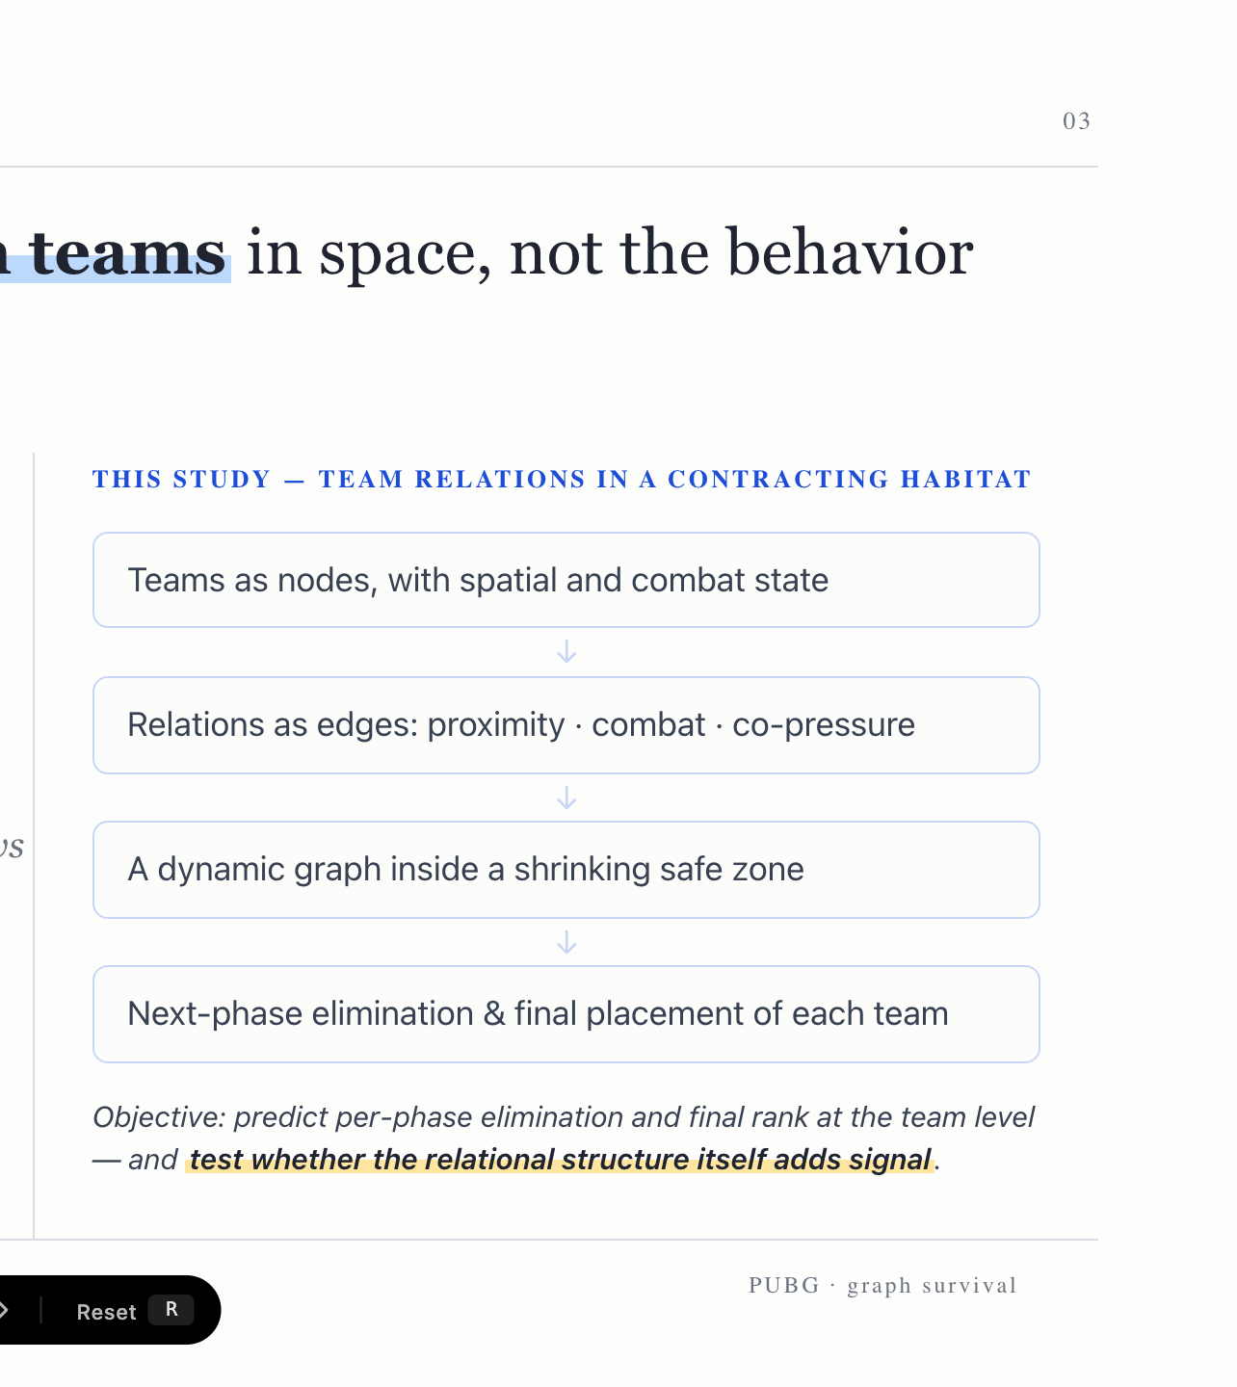
Notes:
Prior work scores one player at a time. We take the opposite view: teams as nodes, relations as edges, a dynamic graph inside a shrinking zone — and we test whether that relational structure actually carries signal.

Slide 4
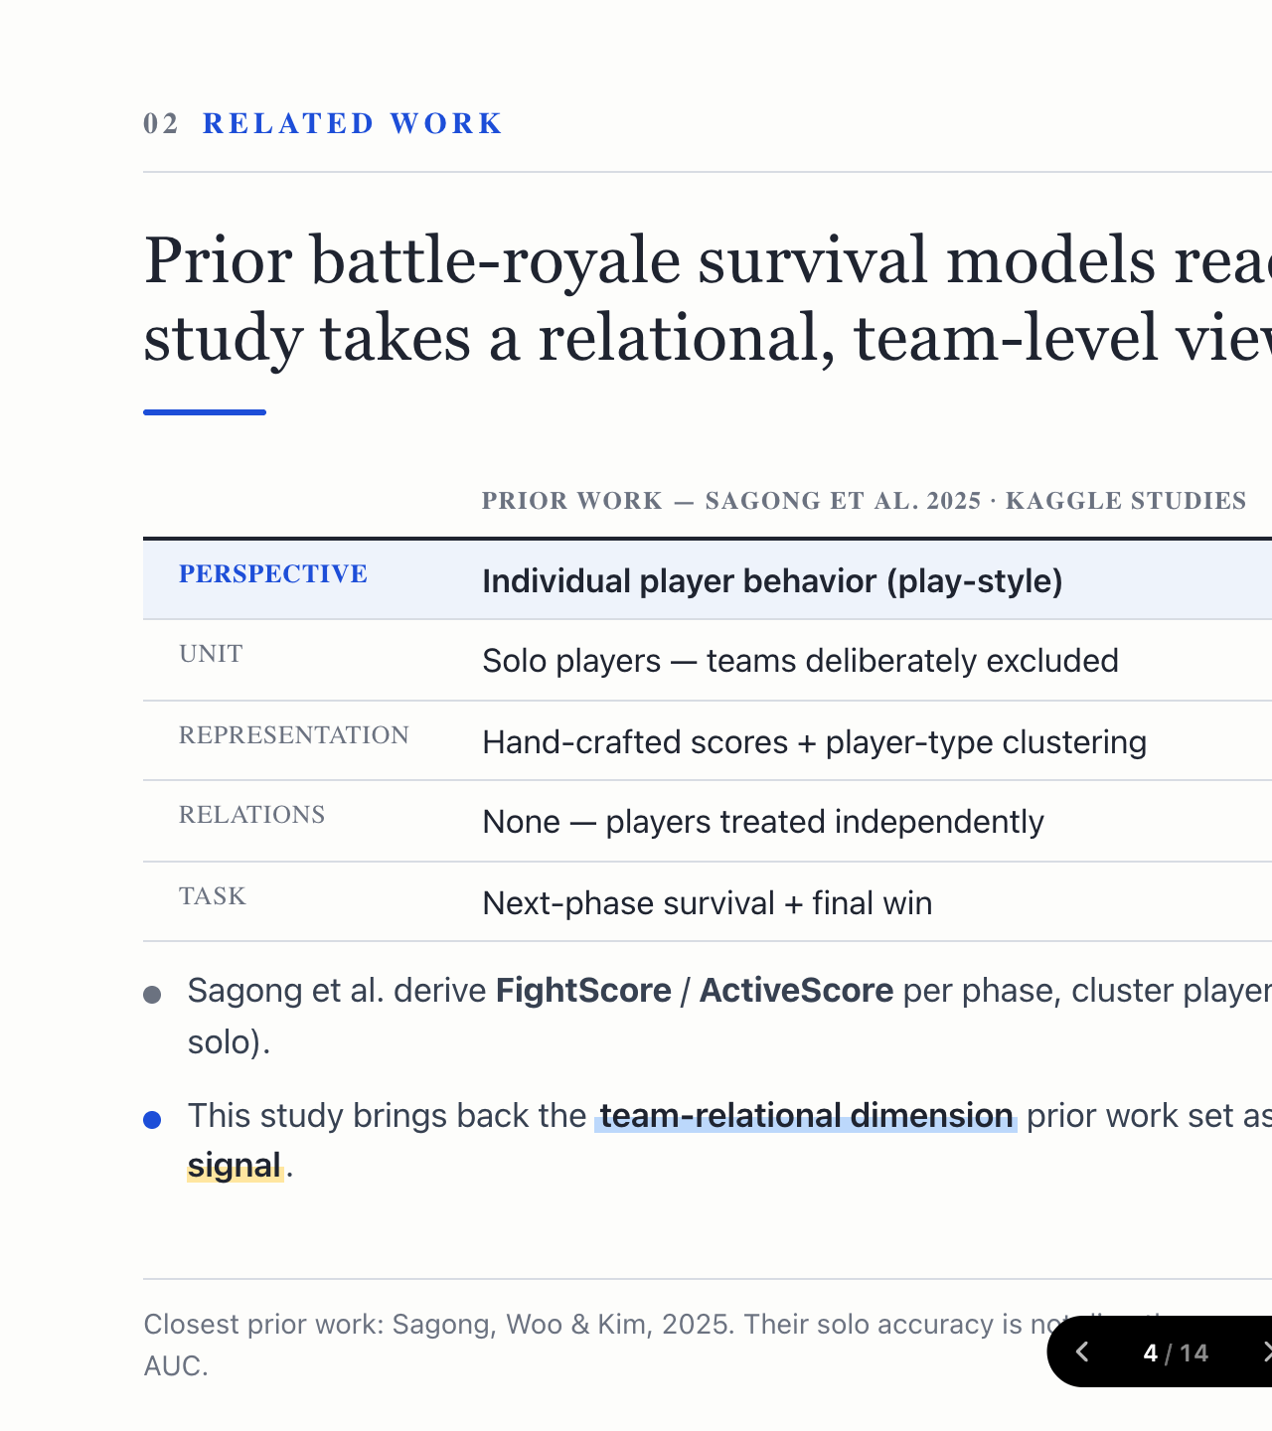
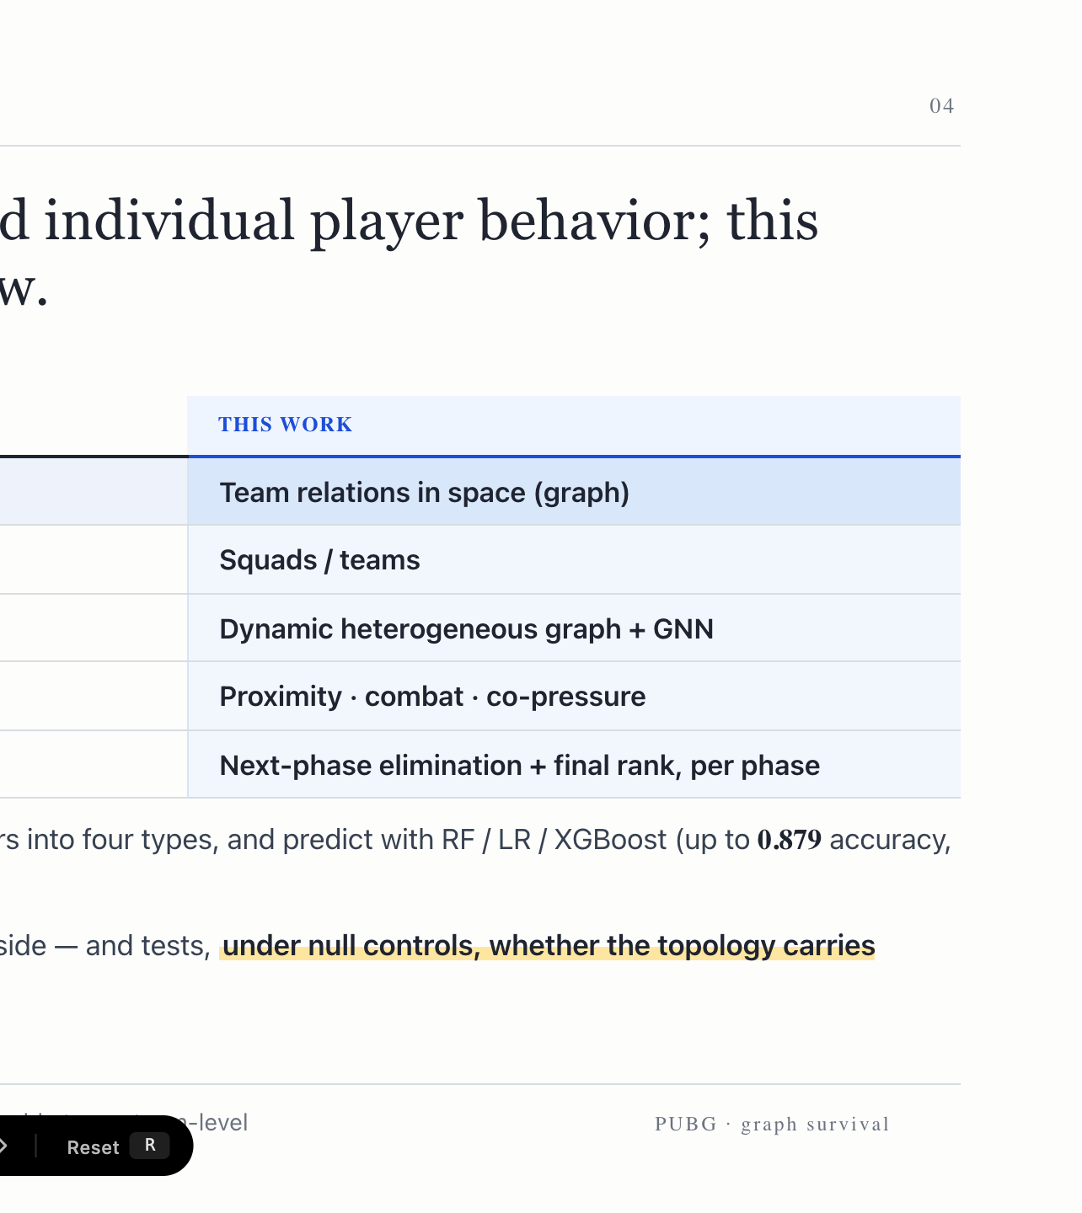
Notes:
The closest work, Sagong et al. 2025, clusters solo players into play-style types and predicts with tree models. They deliberately excluded teams. We bring the team-relational dimension back, and add null controls to test whether the topology carries signal.

Slide 5
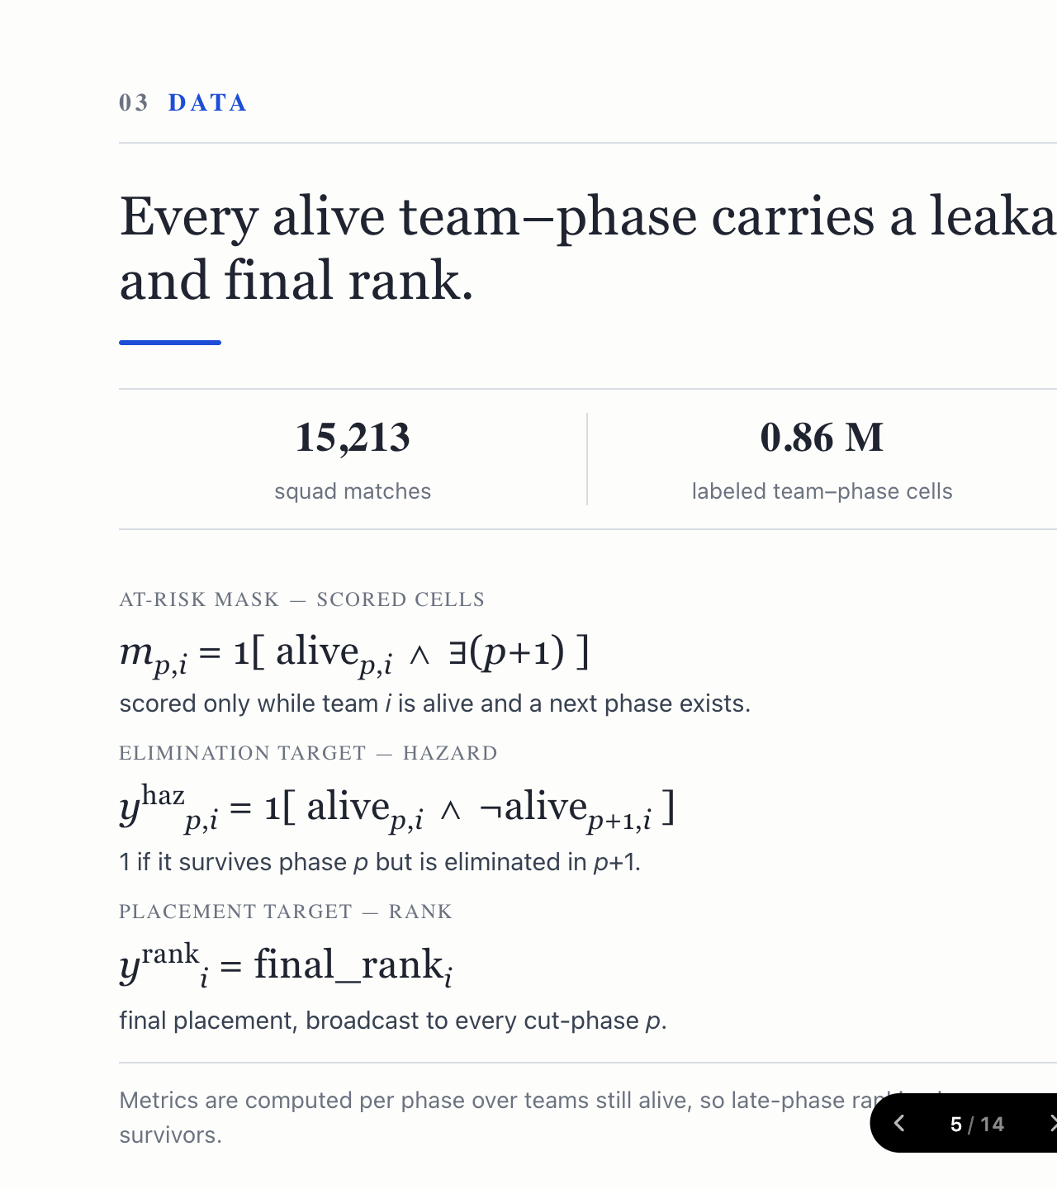
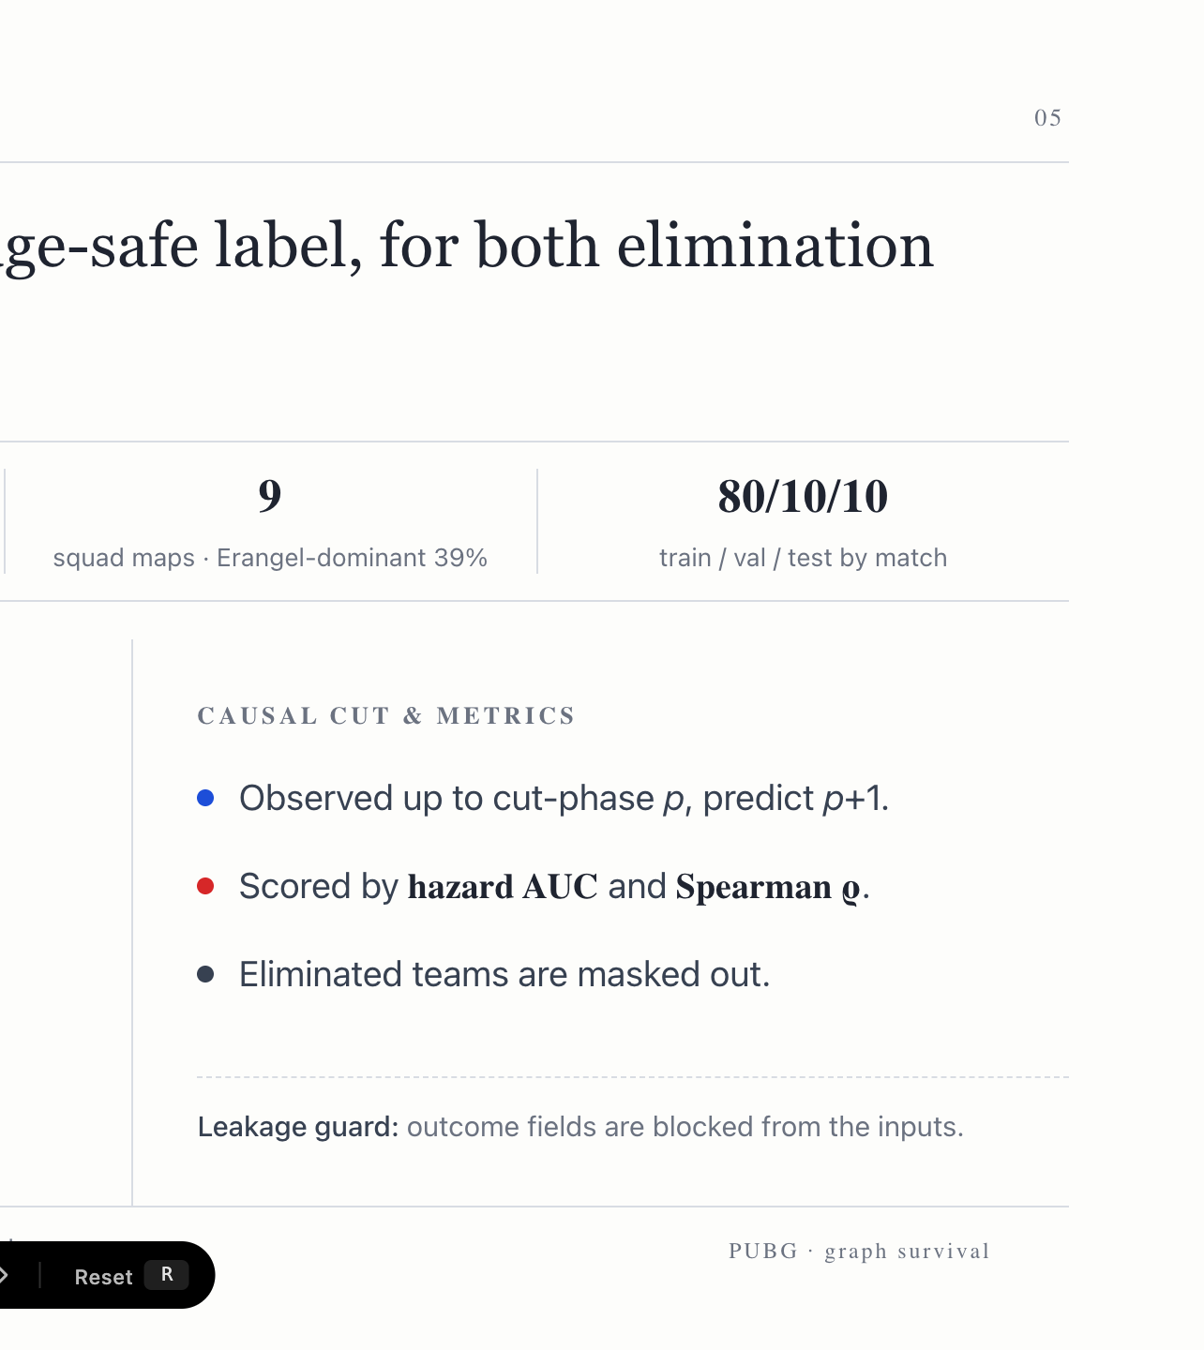
Notes:
Fifteen thousand squad matches, 0.86 million alive team-phase cells, split by match to prevent leakage. Each cell gets a leakage-safe hazard label and a final-rank label. We score hazard AUC and Spearman rho, only while a team is still alive.

Slide 6
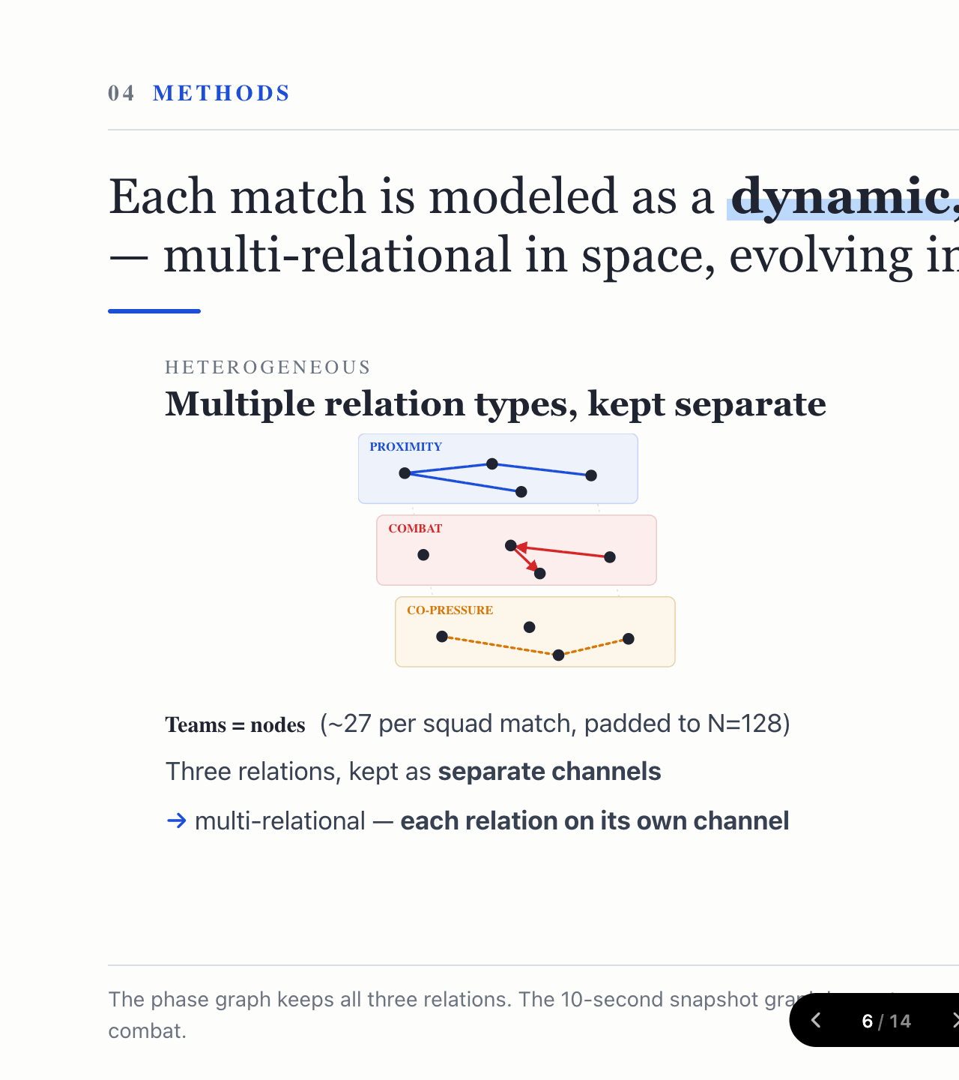
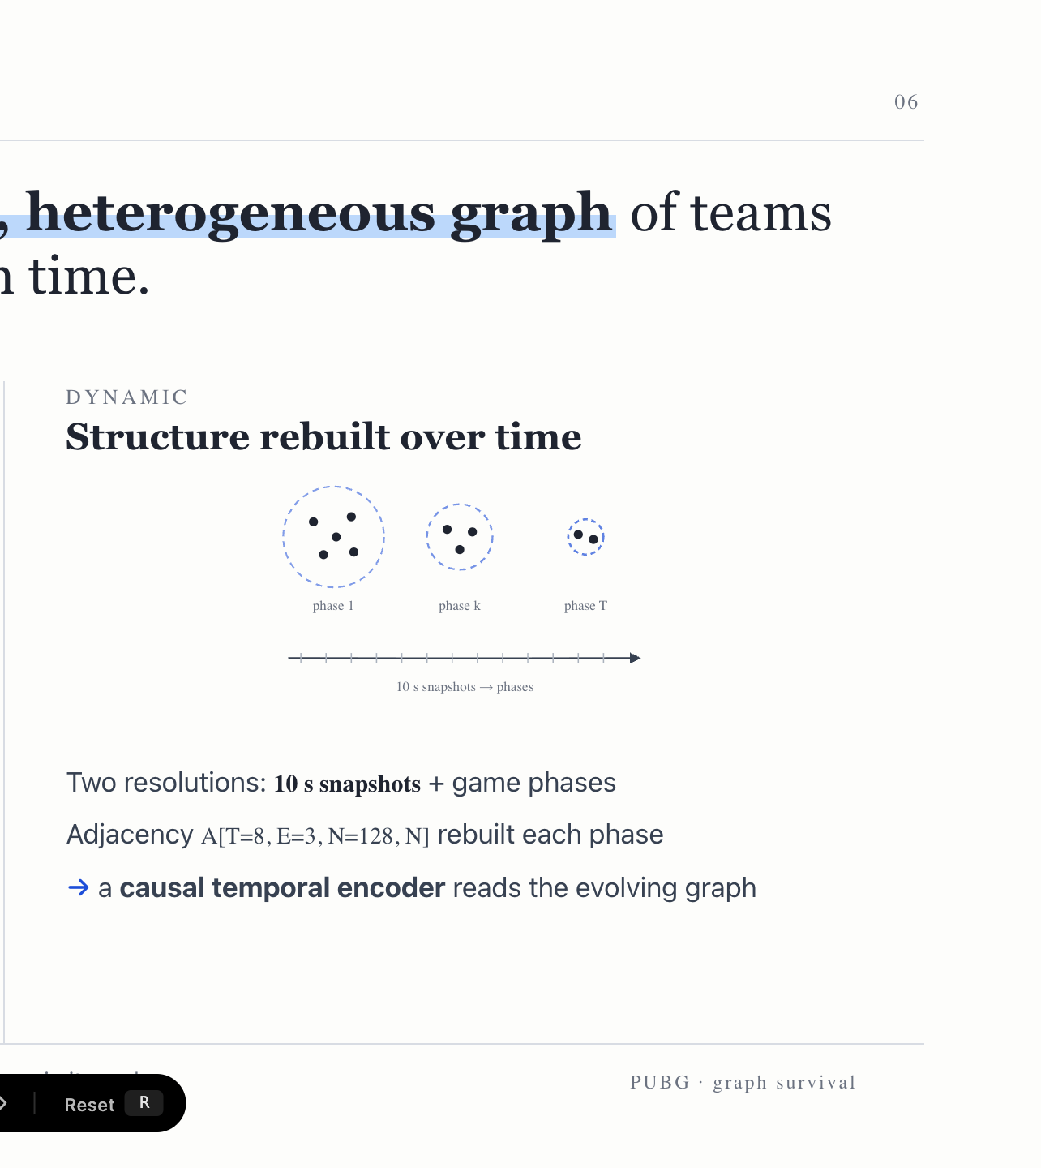
Notes:
Each match is a dynamic, heterogeneous graph. Heterogeneous because three relation channels are kept separate. Dynamic because the graph is rebuilt every phase and every ten-second snapshot, and a causal temporal encoder reads the evolving structure.

Slide 7
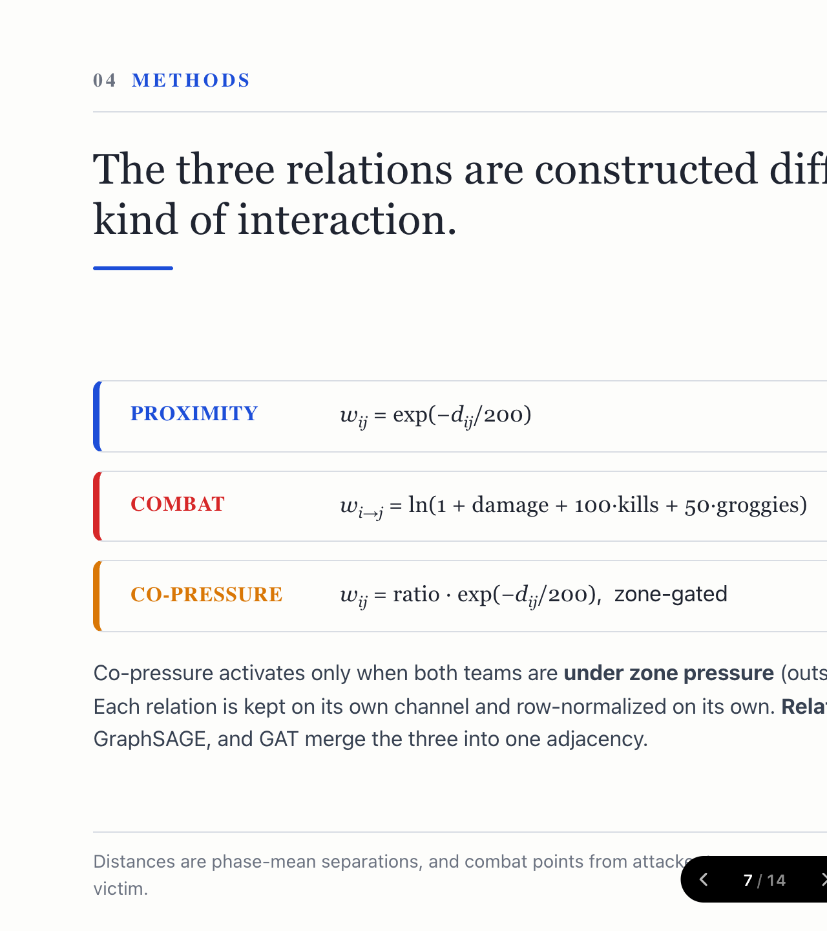
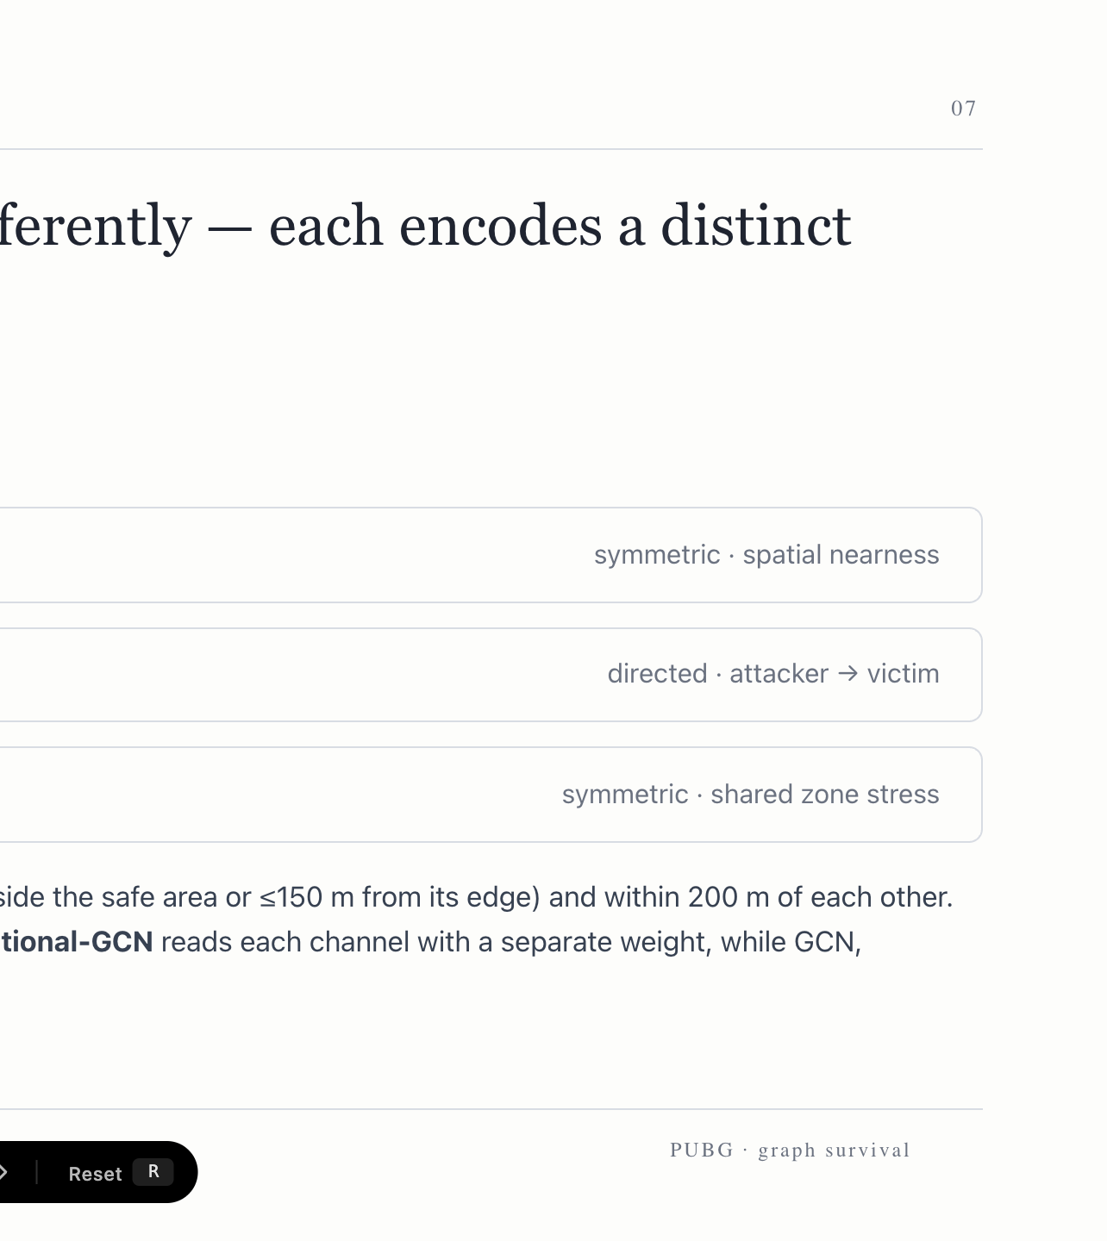
Notes:
The three relations are built differently. Proximity is a symmetric distance kernel. Combat is directed, from attacker to victim. Co-pressure activates only when the zone squeezes two nearby teams together. Relational-GCN reads each channel separately; the others merge them.

Slide 8
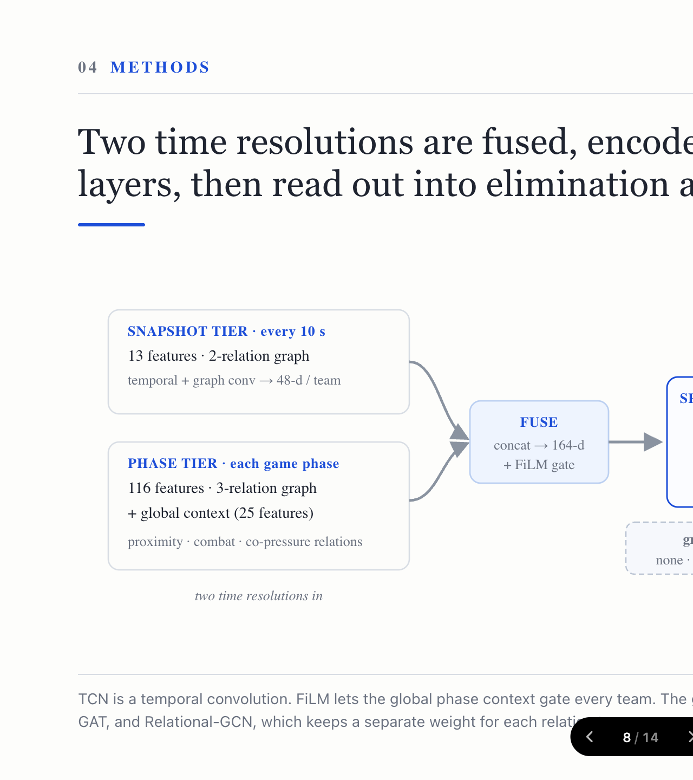
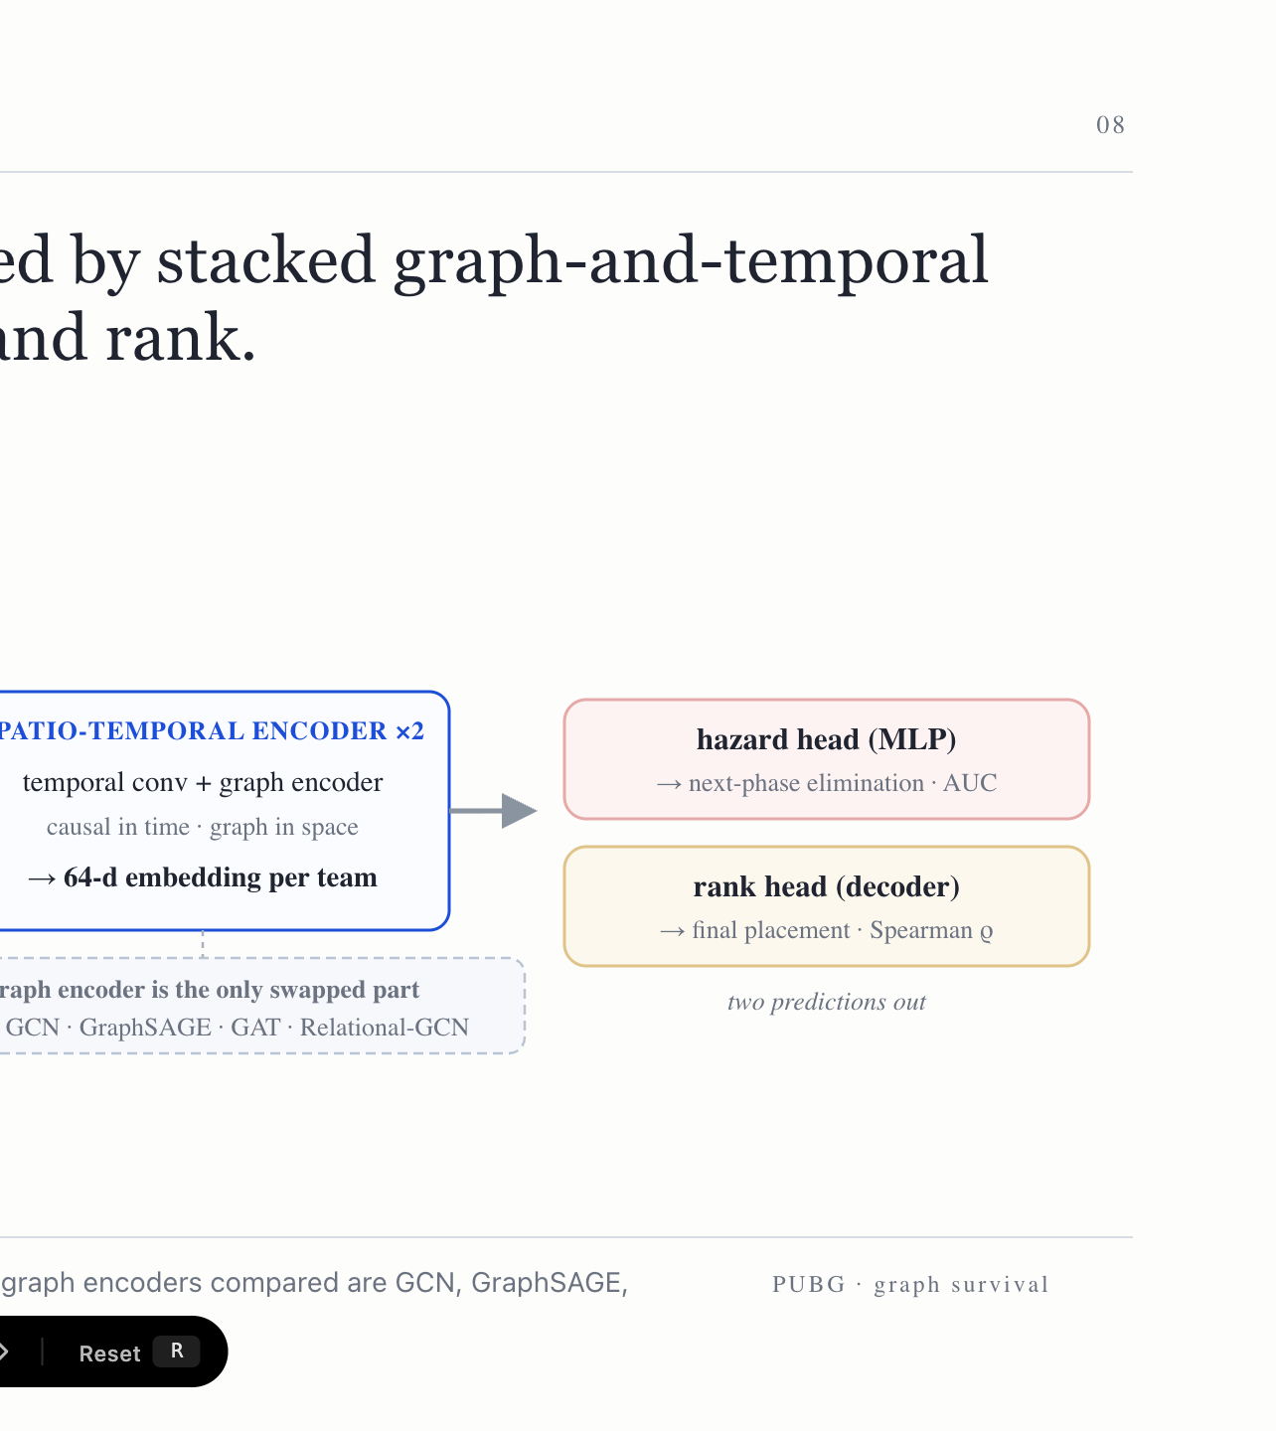
Notes:
Two time resolutions — ten-second snapshots and game phases — are fused with a FiLM gate, encoded by two spatio-temporal blocks, and read out into two heads: hazard and rank. The only swapped part across variants is the graph encoder.

Slide 9
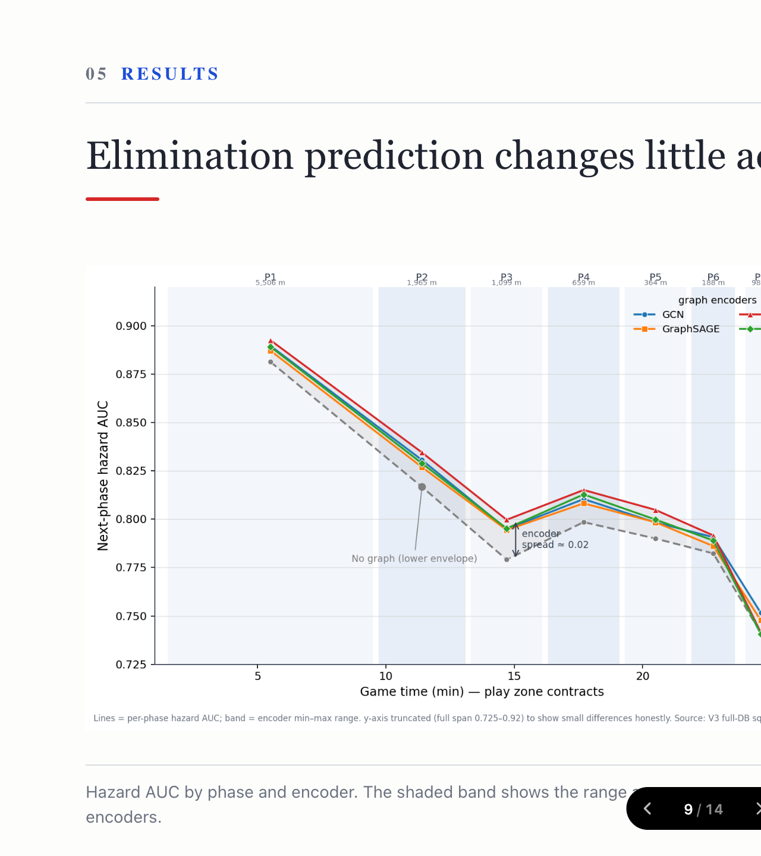
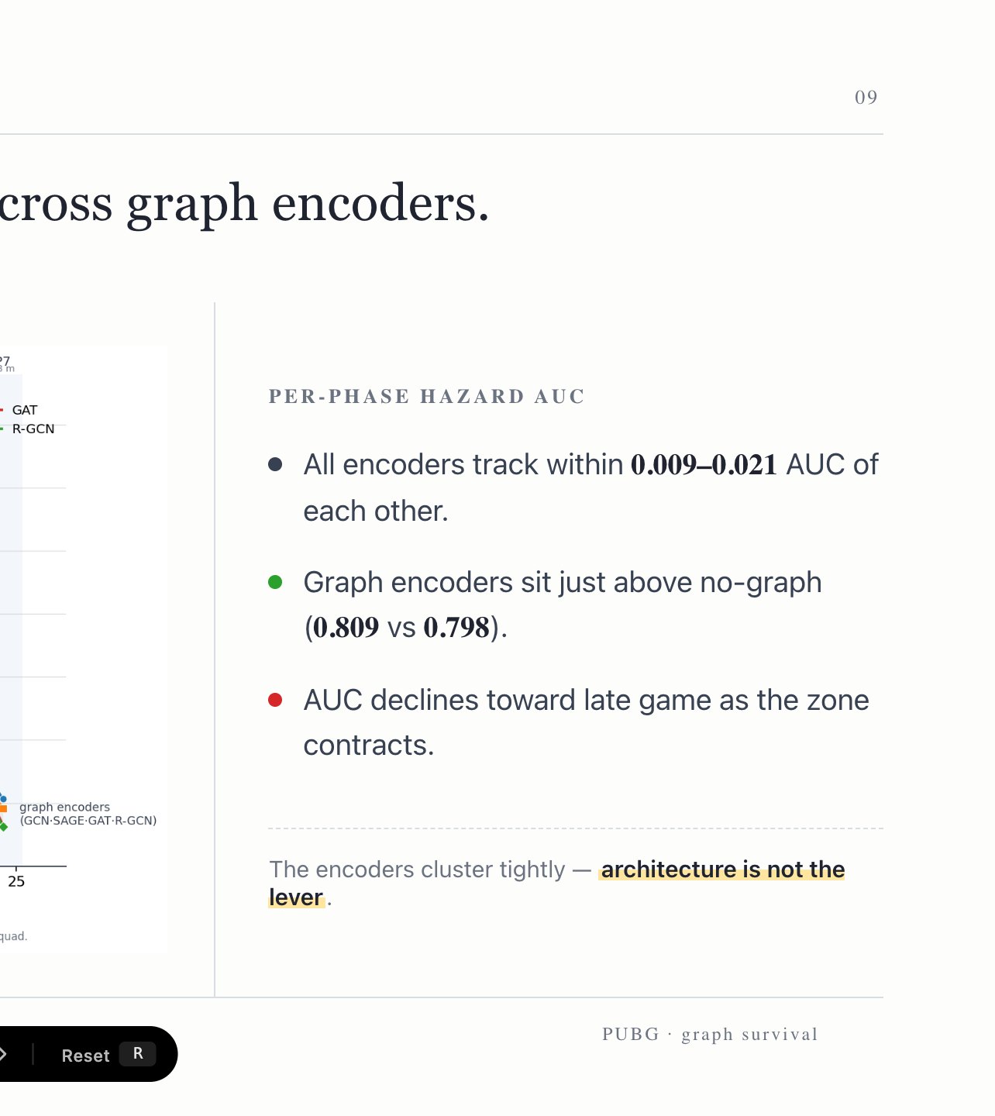
Notes:
First result. Across every graph encoder, next-phase hazard AUC tracks within about 0.02. The encoders cluster just above the no-graph baseline. The architecture is barely the lever — and AUC falls toward late game as the zone contracts.

Slide 10
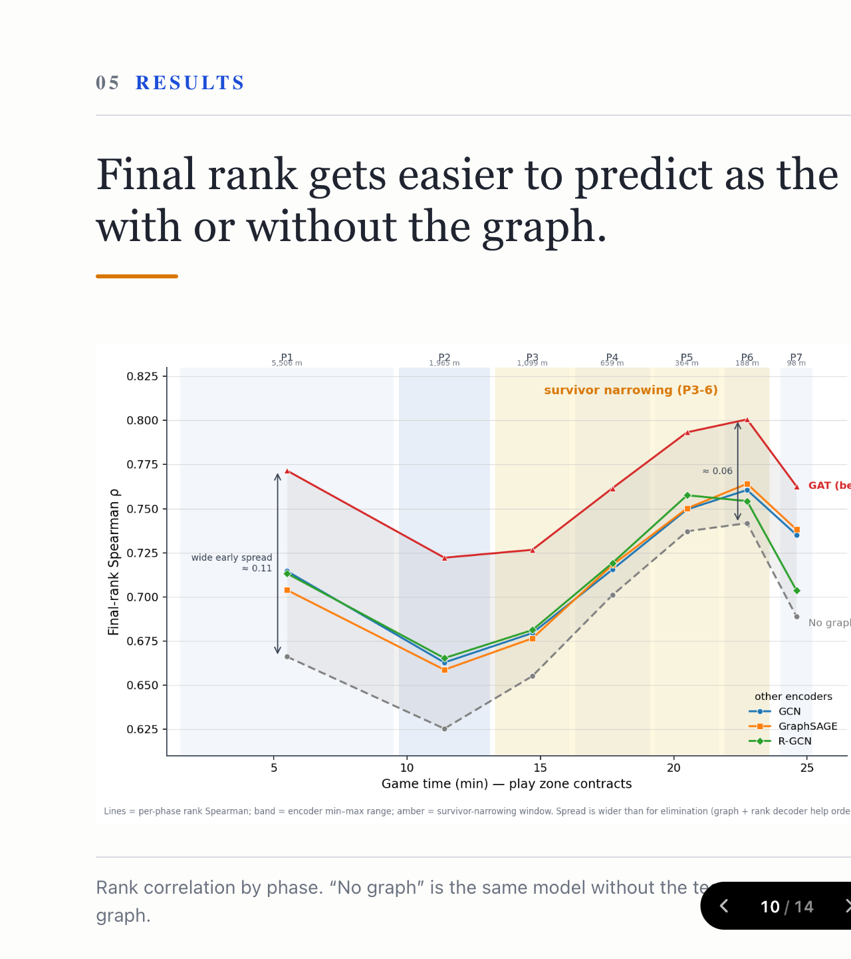
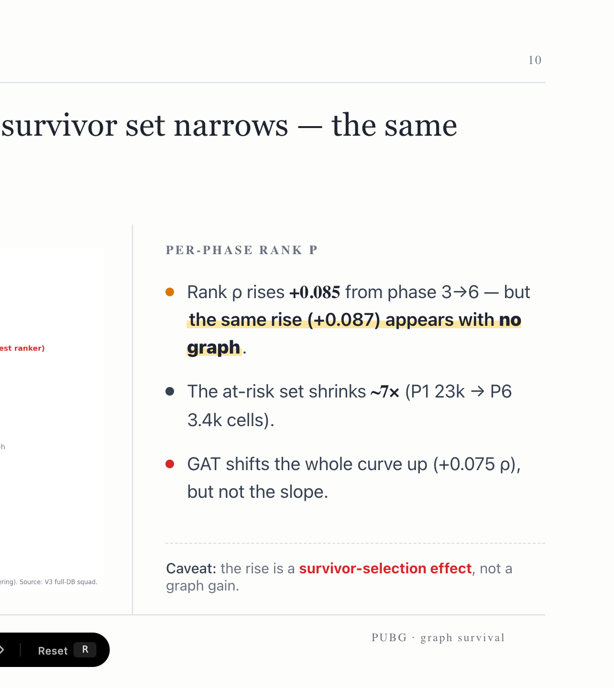
Notes:
Second result. Final rank gets easier to predict from phase 3 to 6. But the same rise, about +0.085, appears with no graph at all. So this is survivor narrowing — fewer teams are simply easier to order — not a graph gain. GAT lifts the whole curve, but not the slope.

Slide 11
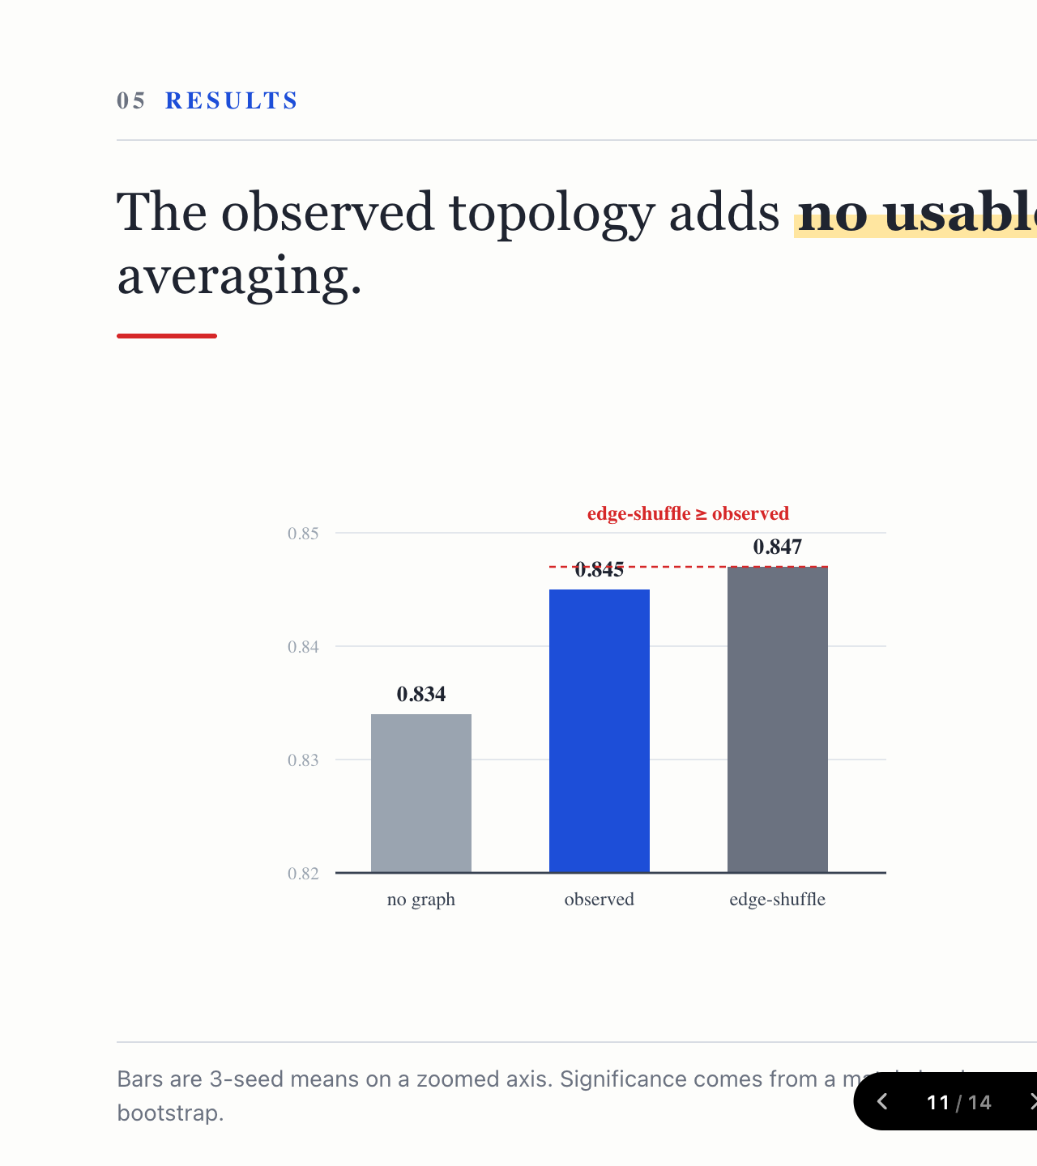
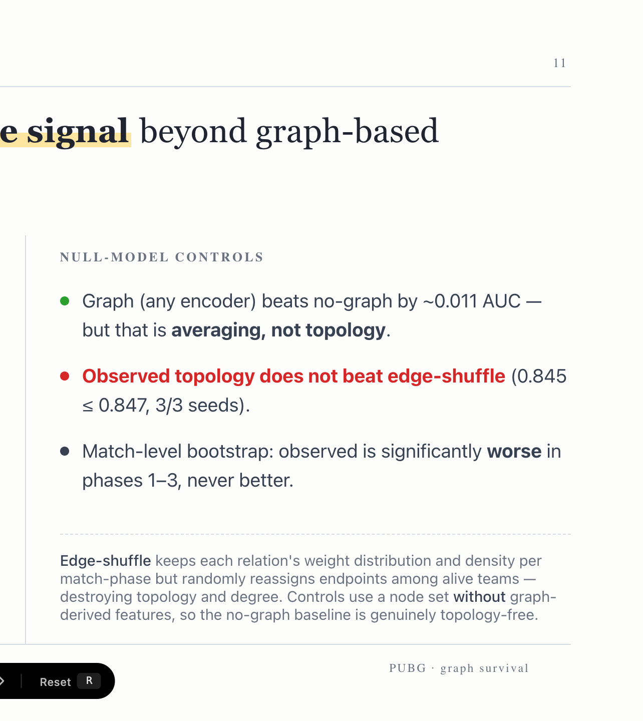
Notes:
This is the key result. We shuffle the edges — preserving every weight, just randomizing who connects to whom. Observed topology does not beat edge-shuffle: 0.845 against 0.847, and it is significantly worse early. So the graph helps only as averaging — smoothing — not as topology. The GNN acts as a low-pass filter.

Slide 12
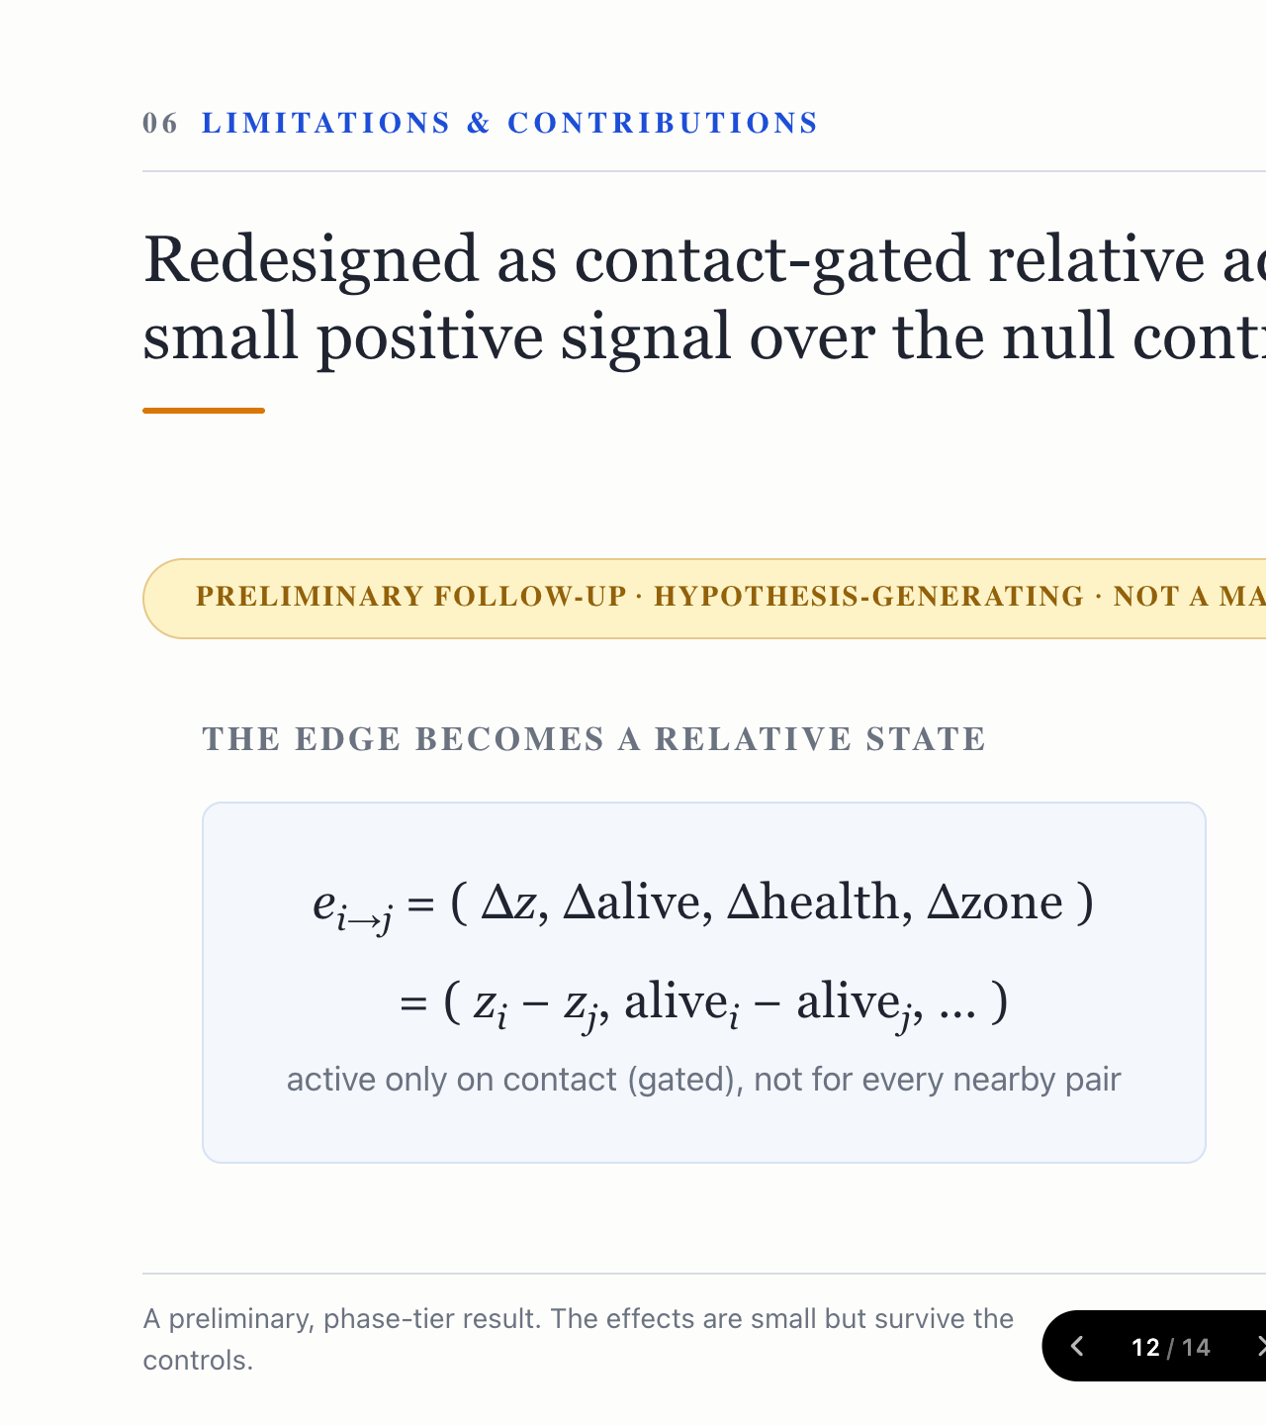
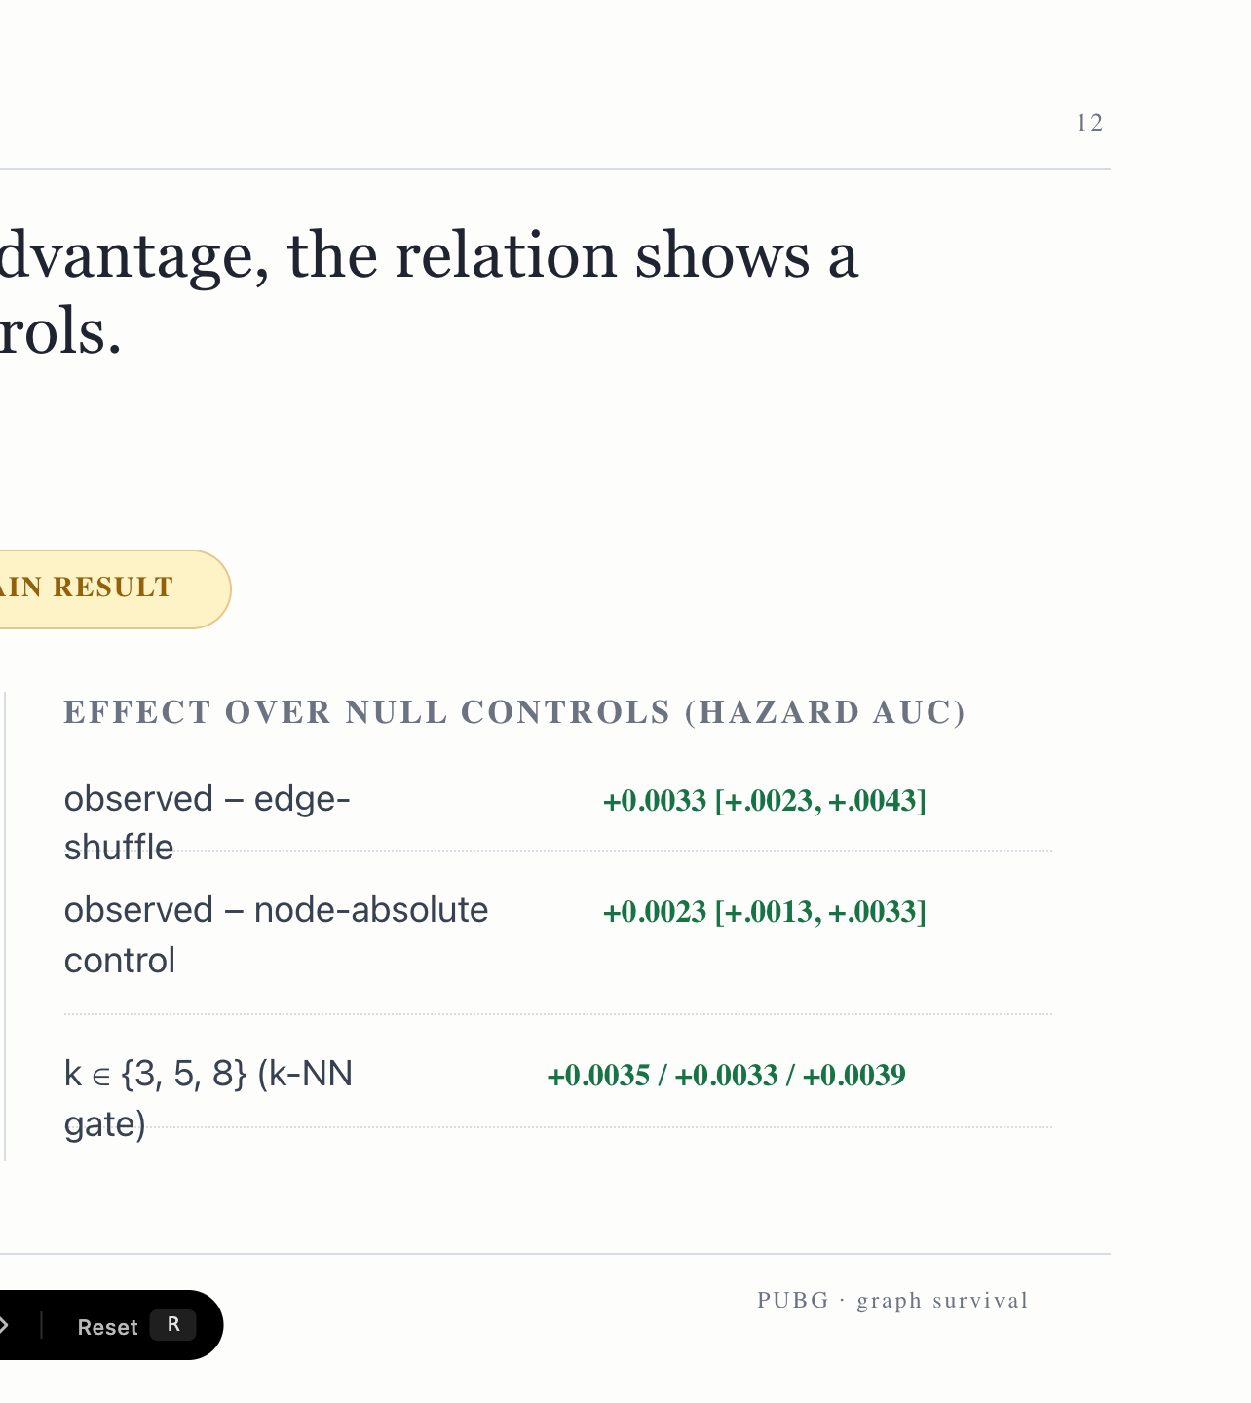
Notes:
So why do ordinary edges fail? They encode that an interaction exists, not who holds the advantage. We redesign the edge to carry relative advantage — elevation, numbers, health, zone — gated on contact. This shows a small but consistent positive signal over the null controls. Preliminary, but directionally right.

Slide 13
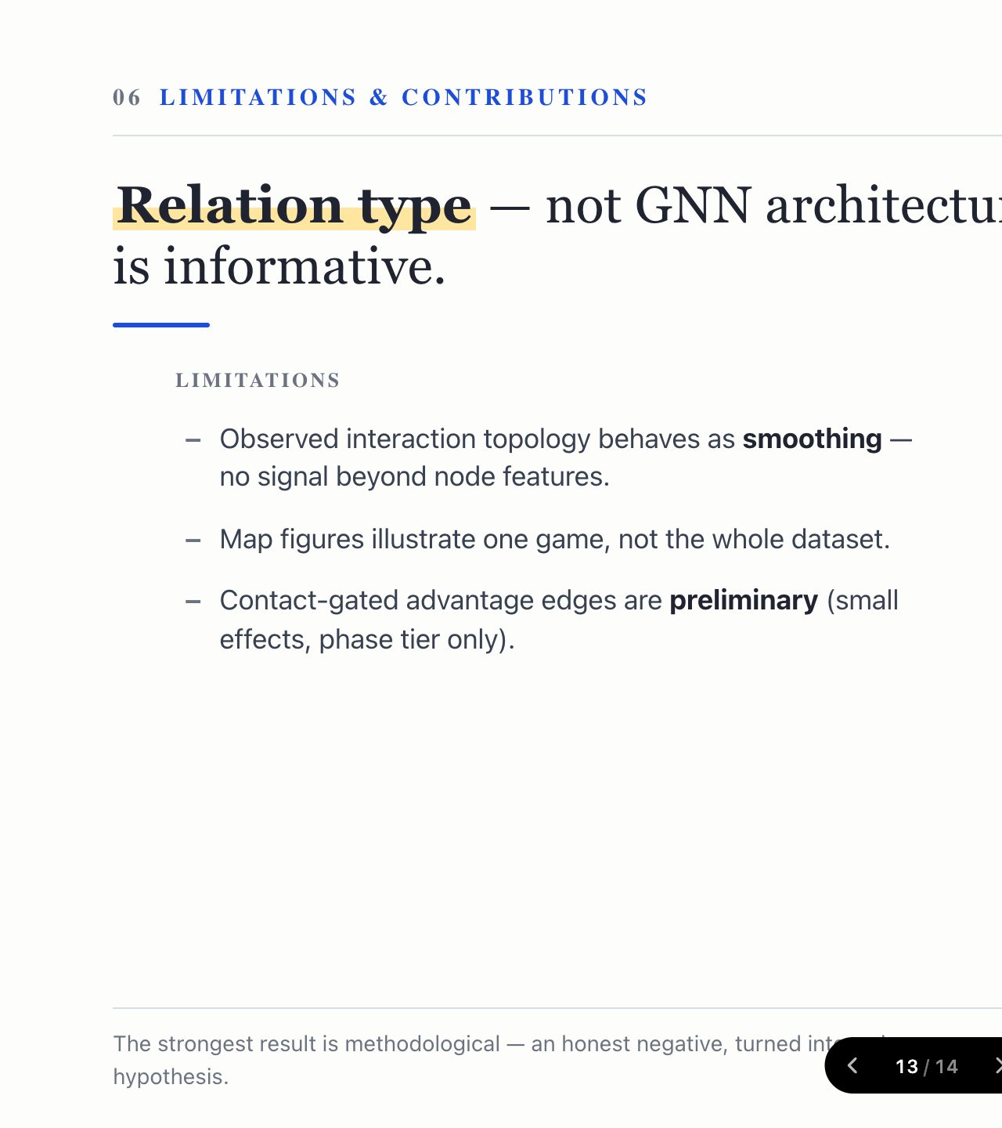
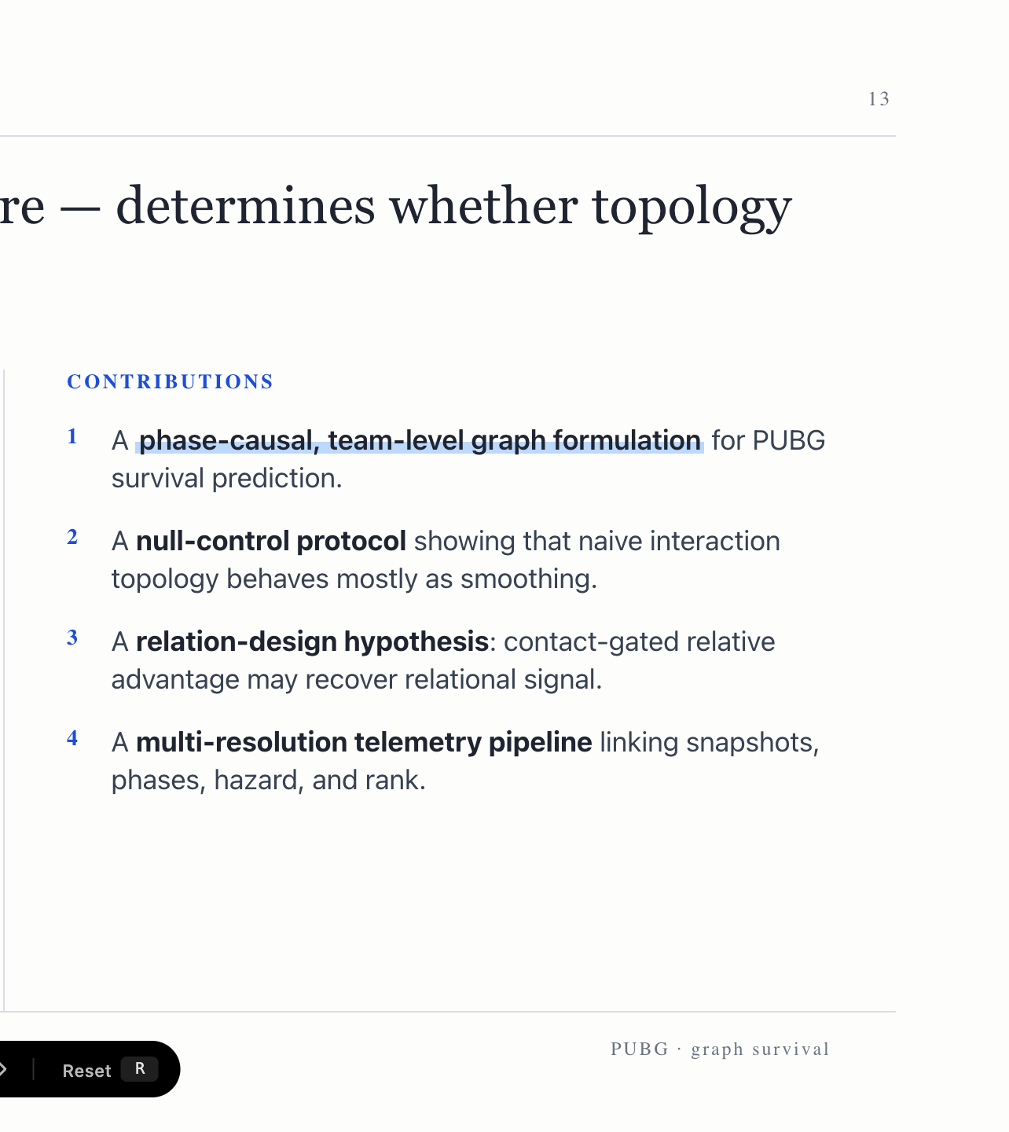
Notes:
To be honest about limits: ordinary interaction topology behaves as smoothing, the map figures show one game, and the advantage edge is preliminary. Our contributions are the team-level graph formulation, the null-control protocol that exposed the smoothing, the relation-design hypothesis, and the multi-resolution pipeline.

Slide 14
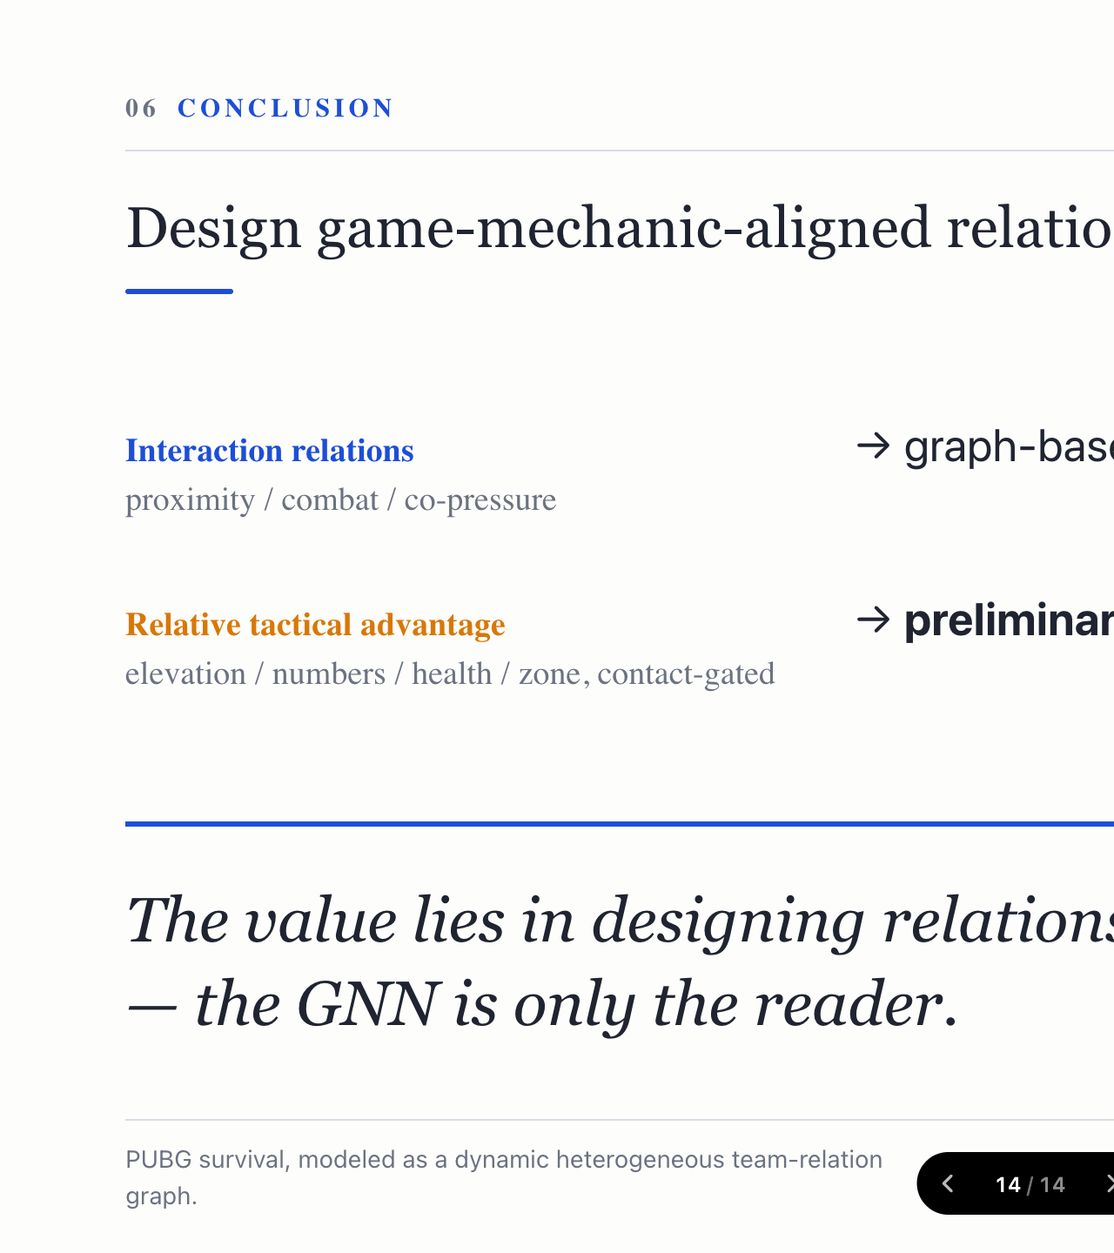
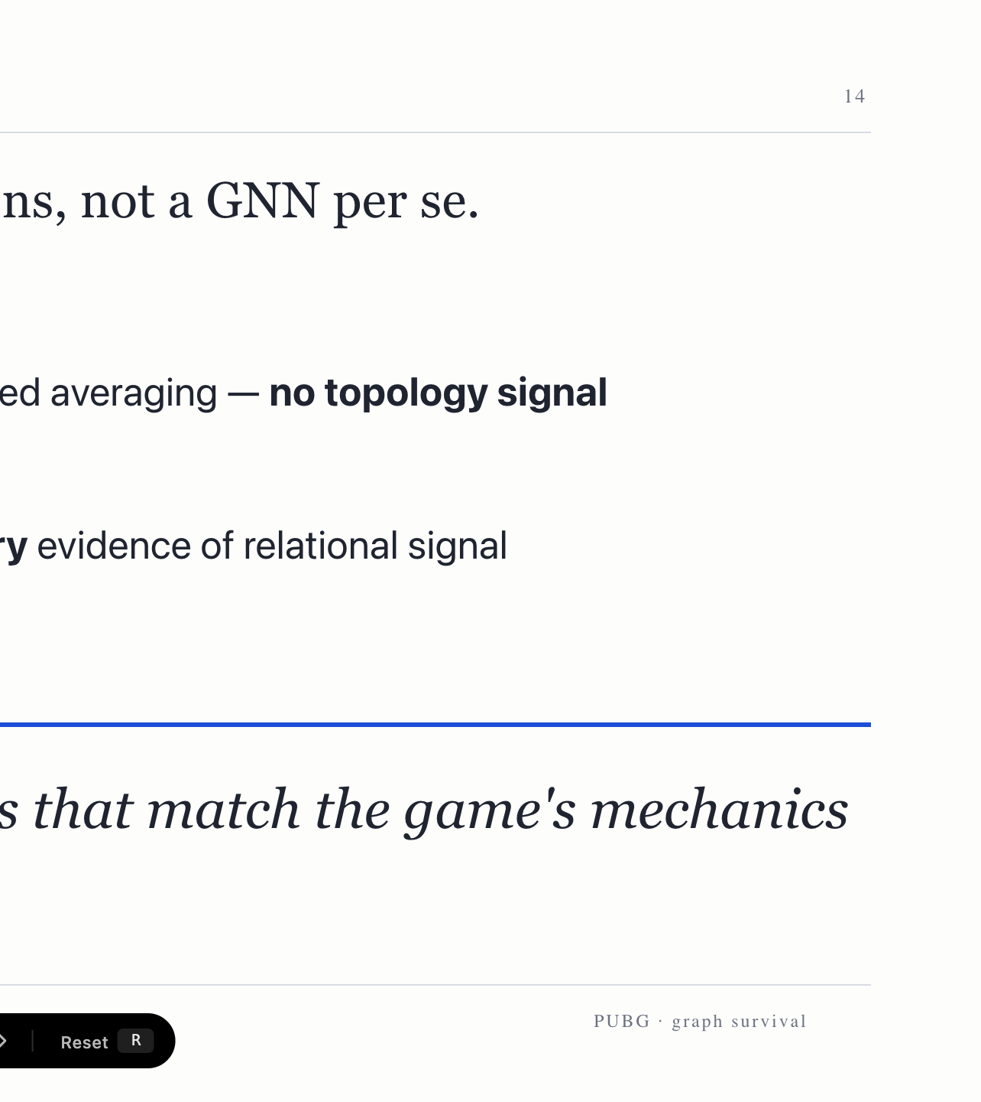
Notes:
The takeaway: relation type, not GNN architecture, decides whether topology helps. Interaction relations only smooth; relative tactical advantage shows preliminary relational signal. Design relations that match the game's mechanics — the GNN is only the reader. Thank you.

