Slide 1

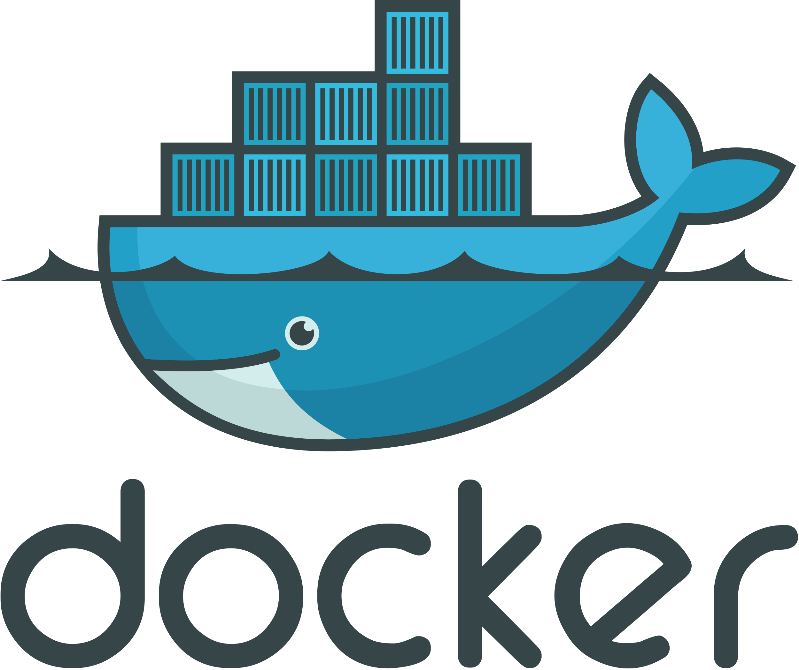

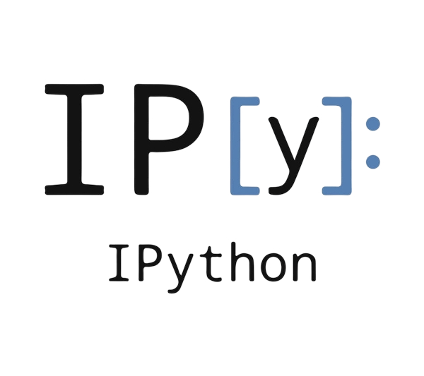
Dockyter
Semester project
Masserey Simon

Slide 2
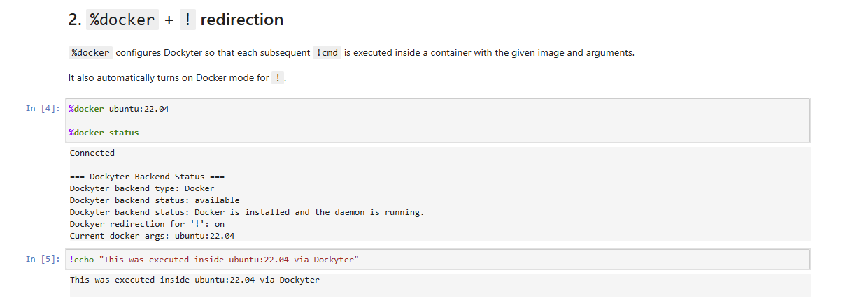
PROJECT DESCRIPTION

Slide 3
Target audience
Teams with heavy or internal tools
Students/teachers wanting reproducible notebooks
Teams requiring consistent environments across machines
Teams wanting to run container via a platform (JupyterHub/Binder)

Slide 4
What is Dockyter trying to solve ?
Run complex tools through Docker directly in notebook
Keep notebooks environment light
Reproducibility
Abstract the execution backend
Does not ensure safety !

Slide 5
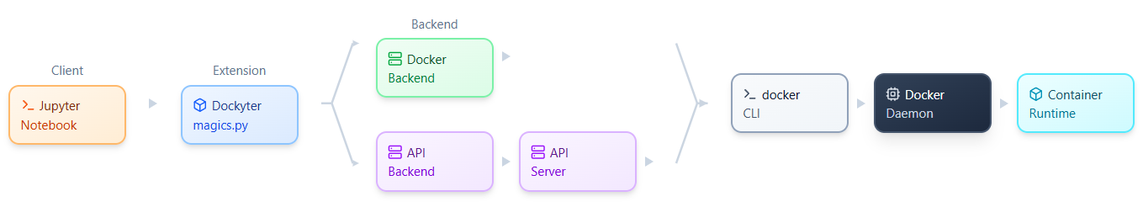
Overview

Slide 6
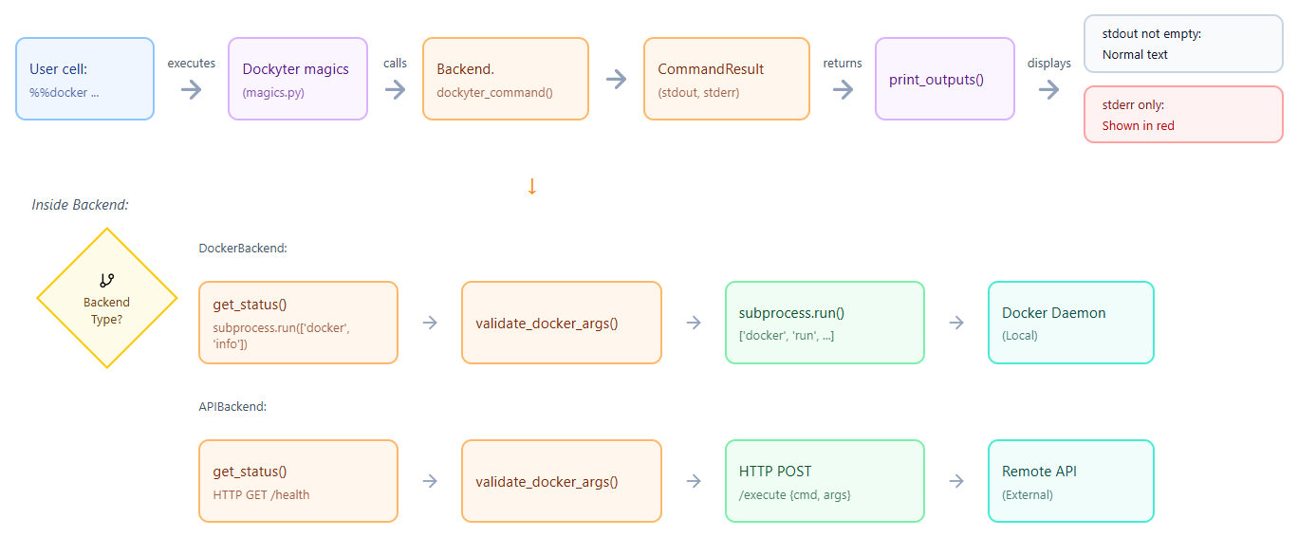
Overview

Slide 7
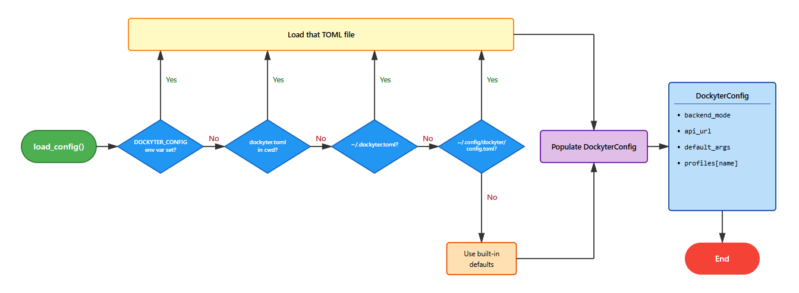
Config file & Profiles

Slide 8
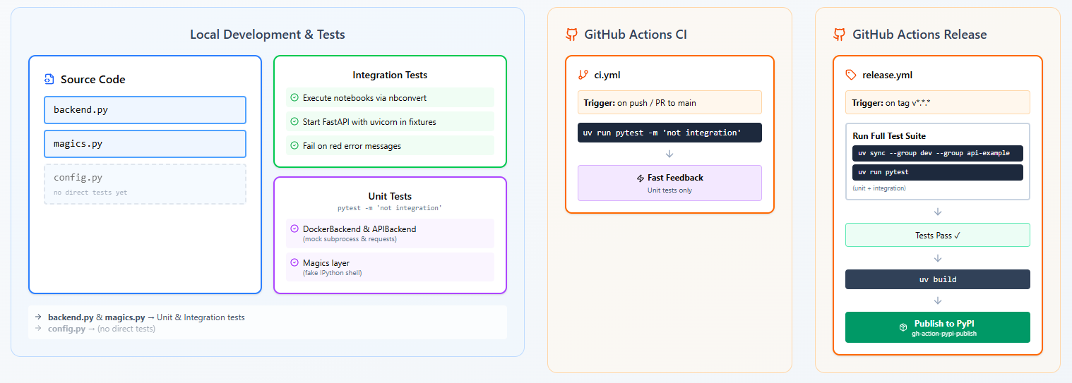
Tests and workflows

Slide 9
Security and API

Slide 10

CONCLUSION

Slide 11


QUESTIONS ?

