Slide 1
DSD Final MIPS G3
B07901010 范詠為
B07901013 林子軒
B07901019 吳隆暉

Slide 2
Outline
Baseline & Hazard handling
Branch prediction
L2 Cache

Slide 3
Baseline & Hazard Handling

Slide 4
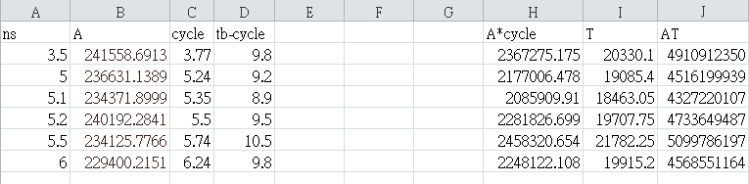
Baseline AT

Slide 6
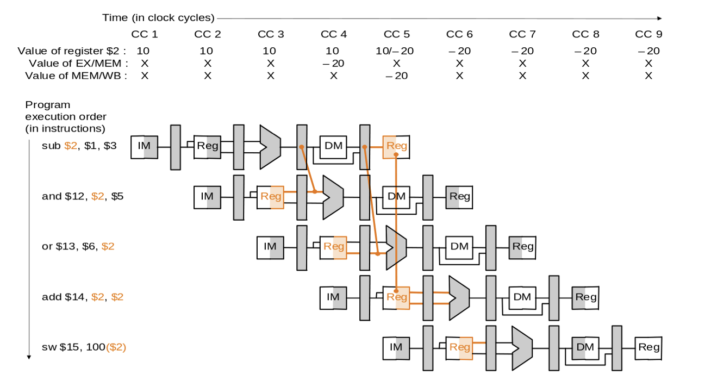
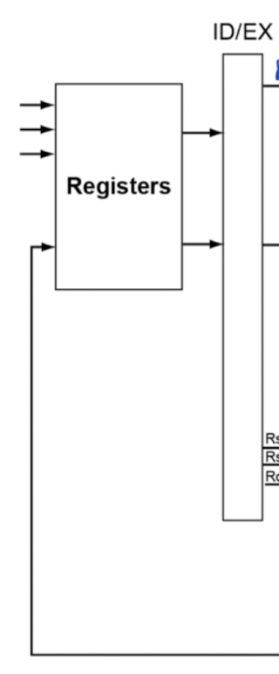
Forwarding Unit
Alu forwarding
Register file forwarding
Write data

Slide 7
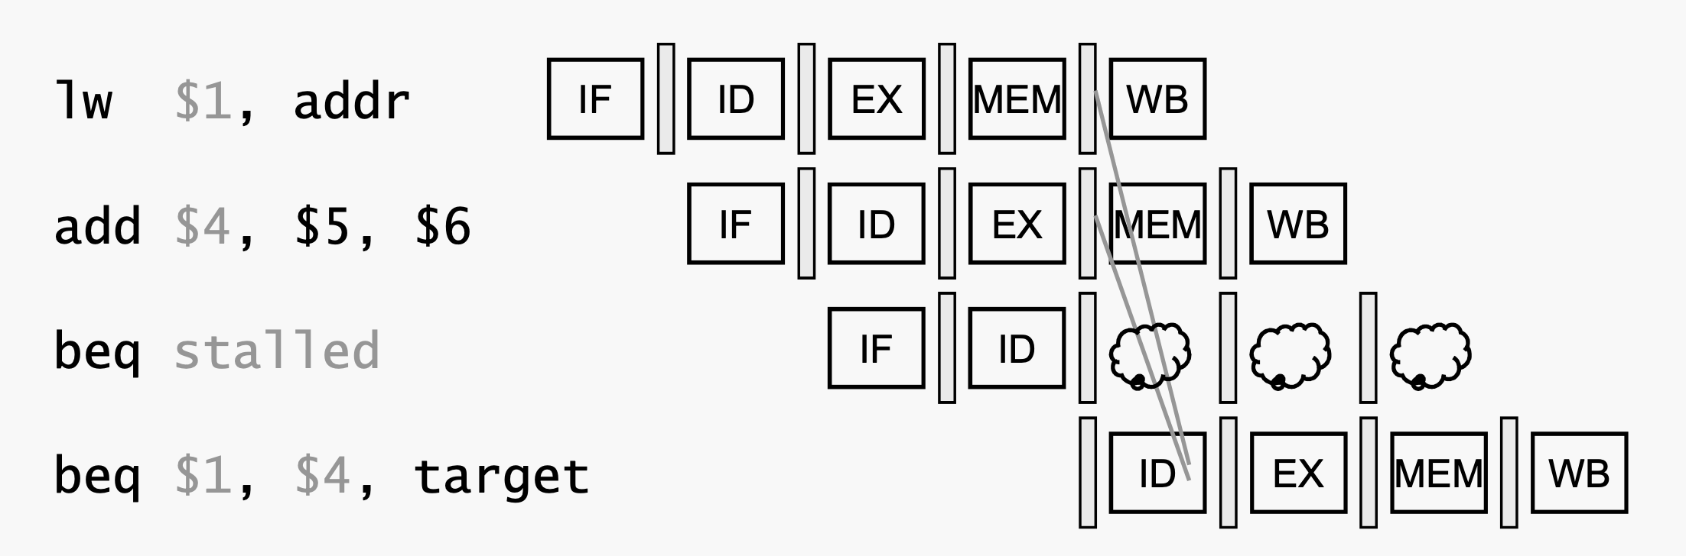
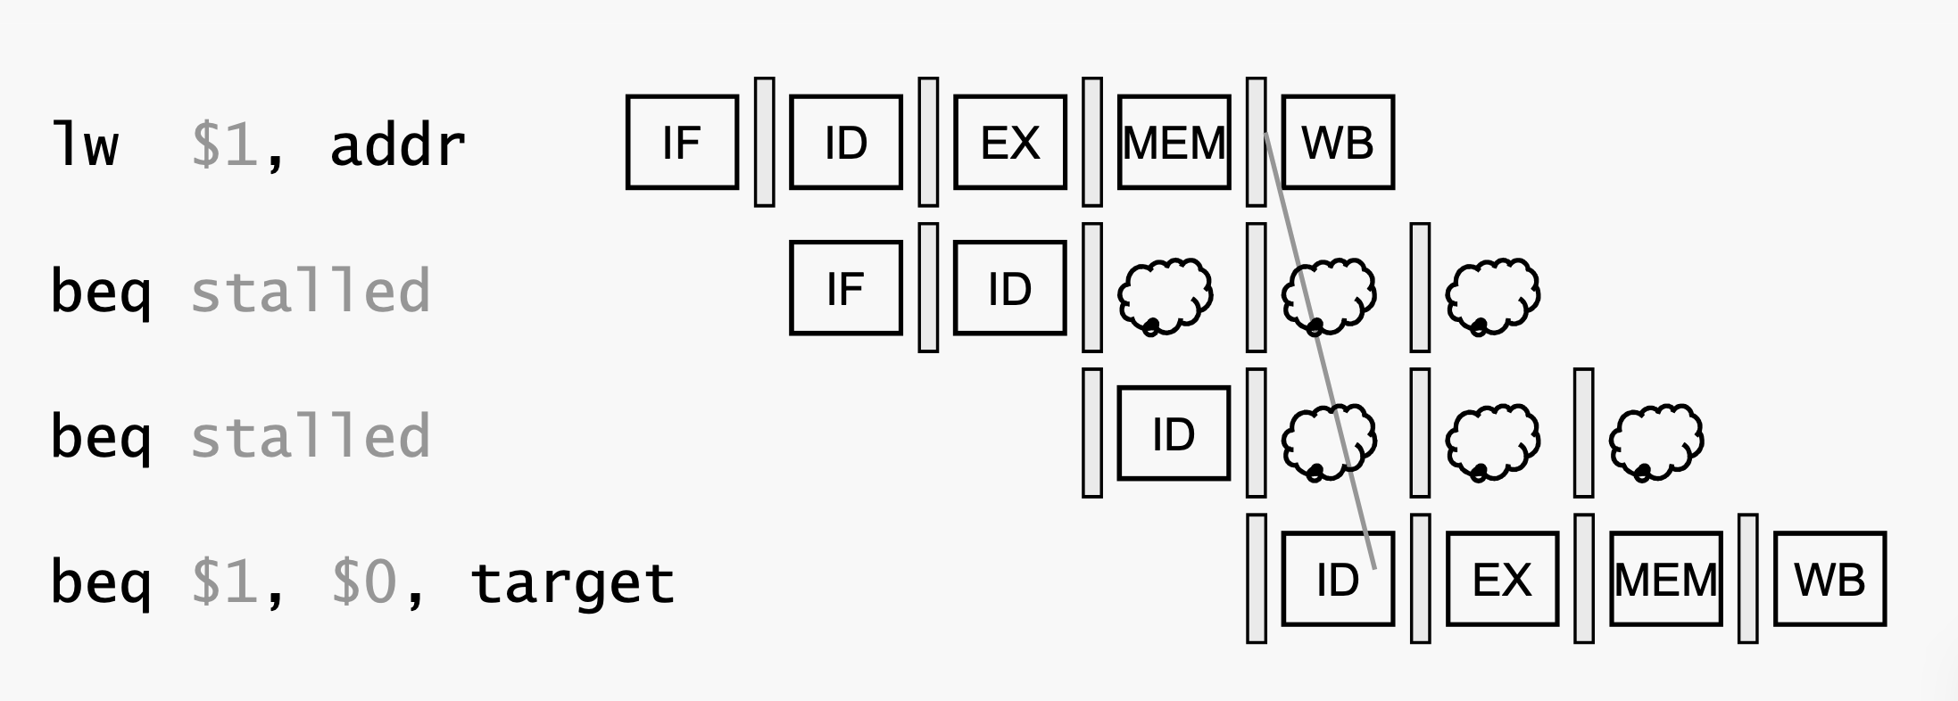
Forwarding Unit
Branch forwarding
-> Beq, Bne, Jr, Jalr
Since we move branch and jr determination from MEM to ID for fewer flush cycle, we needs to handle this.

Slide 8
Hazard Control
Data Hazard
-> load-use : stall 1 cycle
Data Hazard for branch
-> Beq, Bne, Jr, Jalr
-> Ex type: stall 1 cycle
-> Mem type: stall 2 cycle
Branch Hazard
-> flush 1 cycle

Slide 9
Extension

Slide 10
Branch Prediction
Structure
1-bit/2-bit Global Branch Predictor
1-bit/2-bit Local Branch Predictor
(m, n)-Correlated Branch Predictor
Experiment

Slide 11
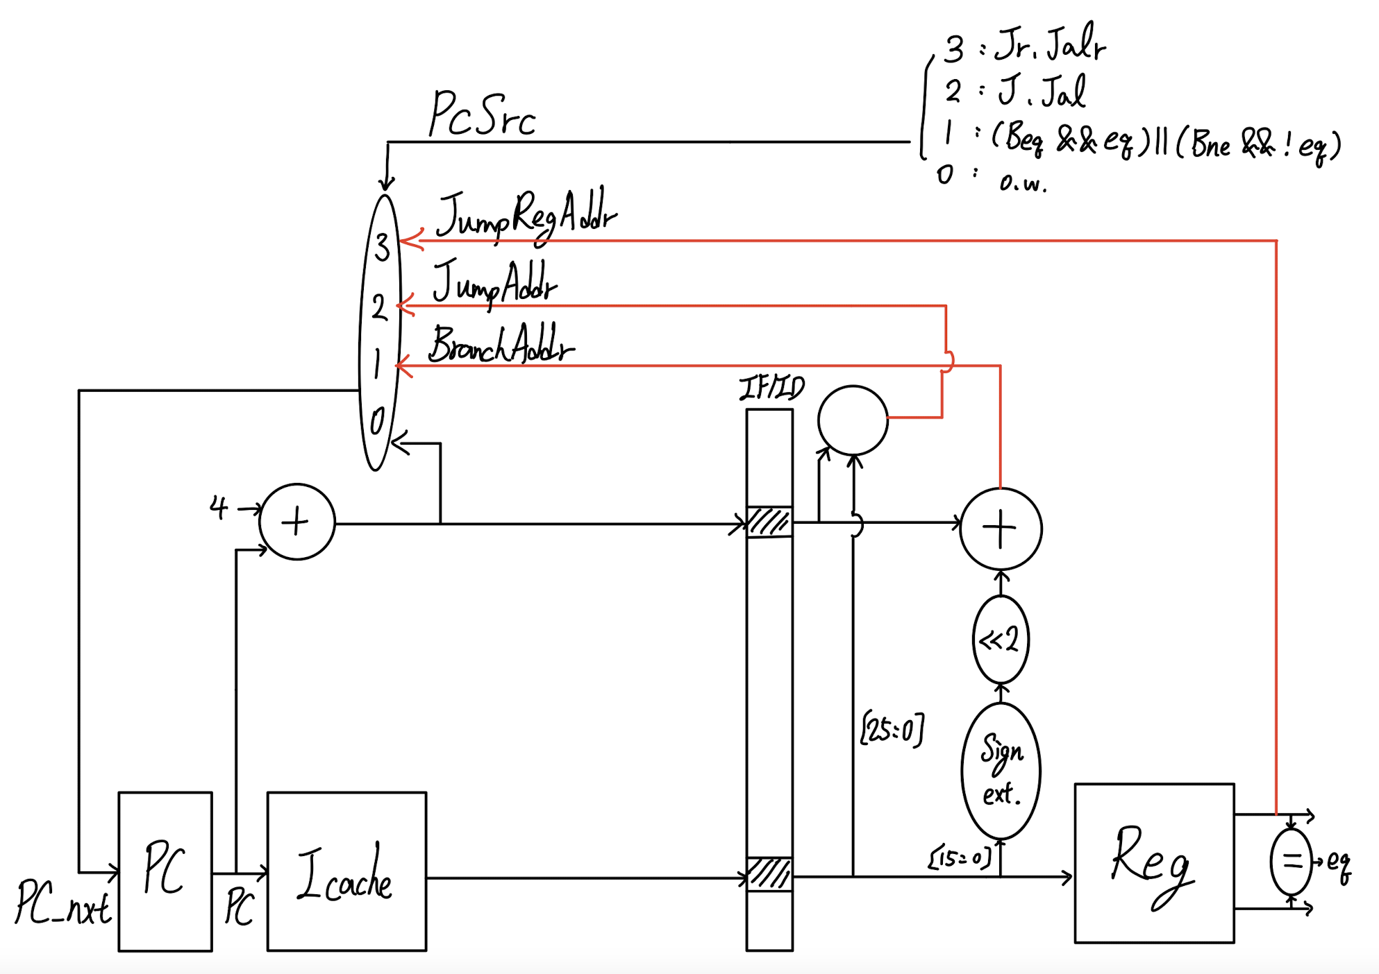
Structure - No BrPred(as NT)
Correct -> no penalty
Wrong -> 1 cycle penalty
Branch, J, Jal, Jr, Jalr are all calculated in ID stage

Slide 12
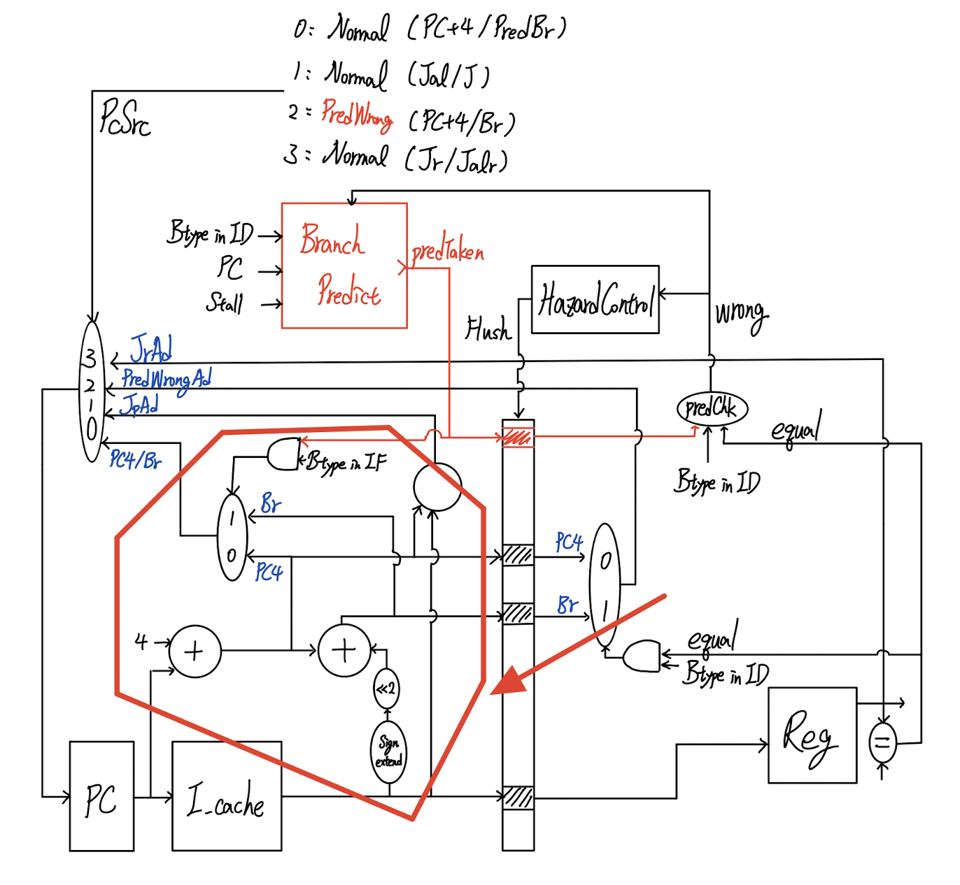
Structure - with BrPred
Only misprediction and jump reg instructions will have 1 cycle penalty.
mispred
Jr

Slide 13
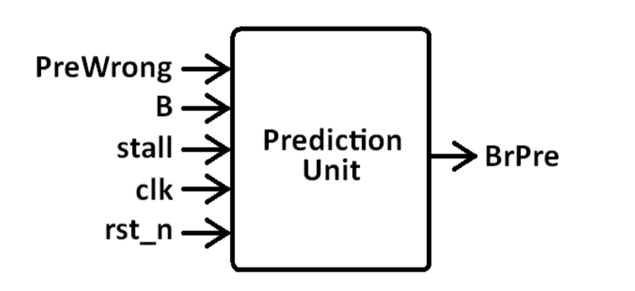
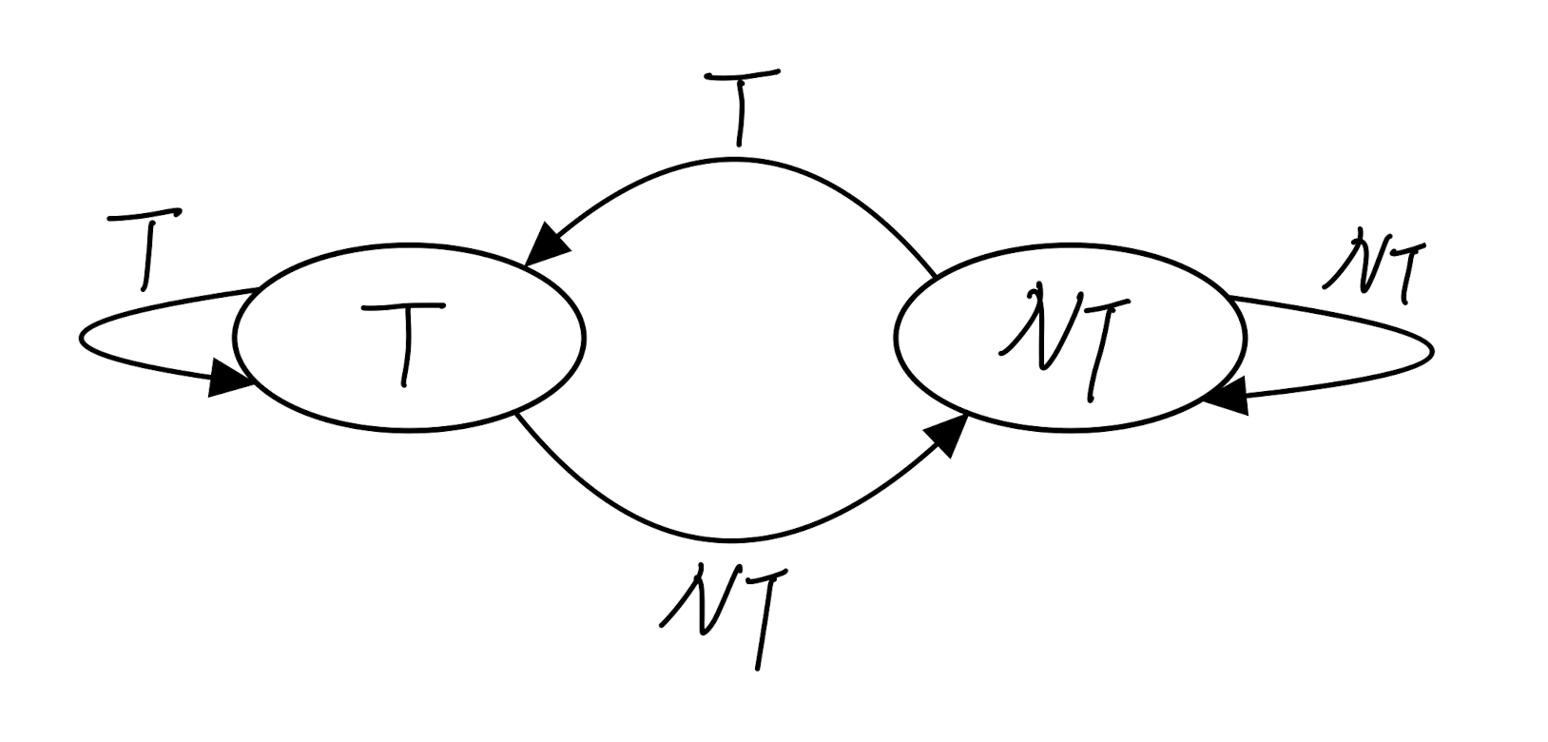
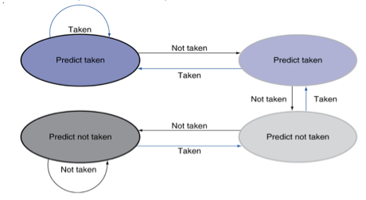
Global Branch Predictor (testbench)
All branch instructions use one global state
1-bits/2-bits

Slide 14
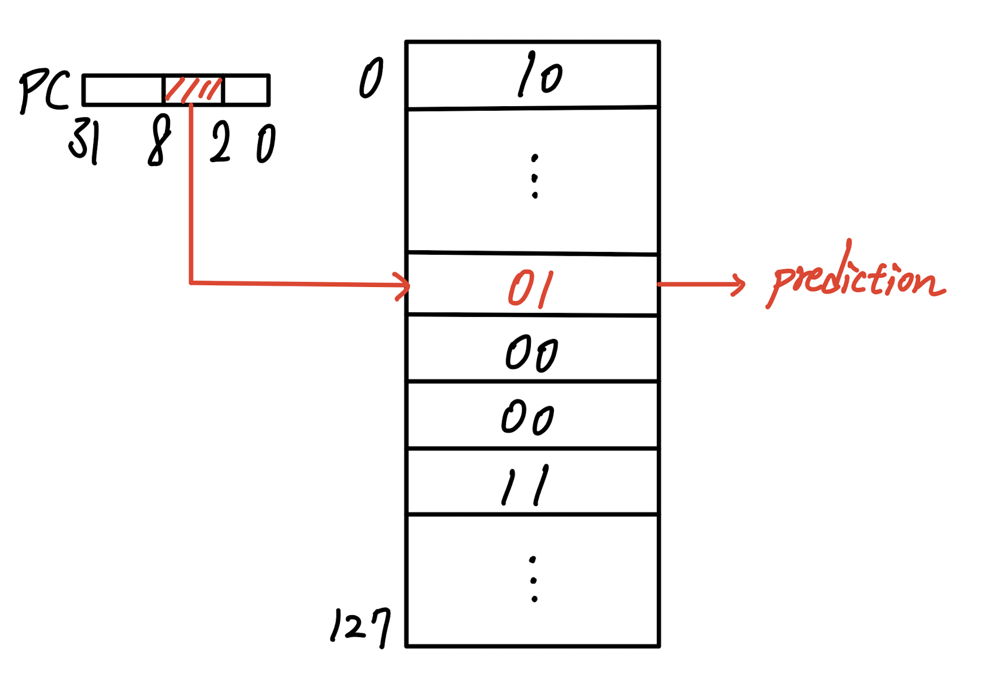
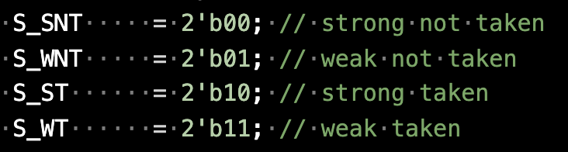
1-bit/2-bit Local Branch Predictor
Branch History Table (BHT)
-> 128*2bit (assume big enough)
Add/Sub 1 to change state

Slide 15
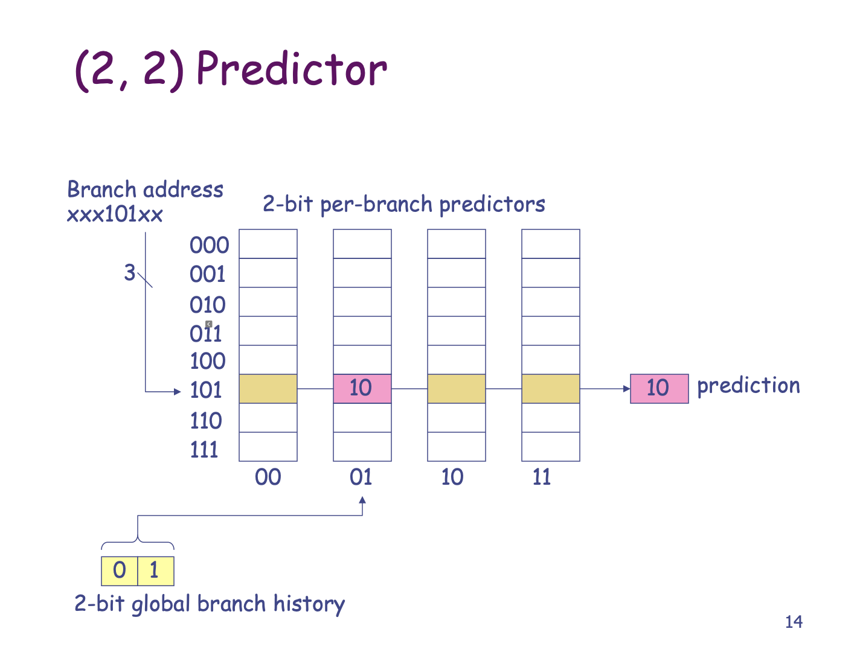
(m, n)-Correlated Branch Predictor
m : 2^m global state
n : n-bits predictor
Maintain a global state
Each branch instruction has m local n-bits predictors.

Slide 16
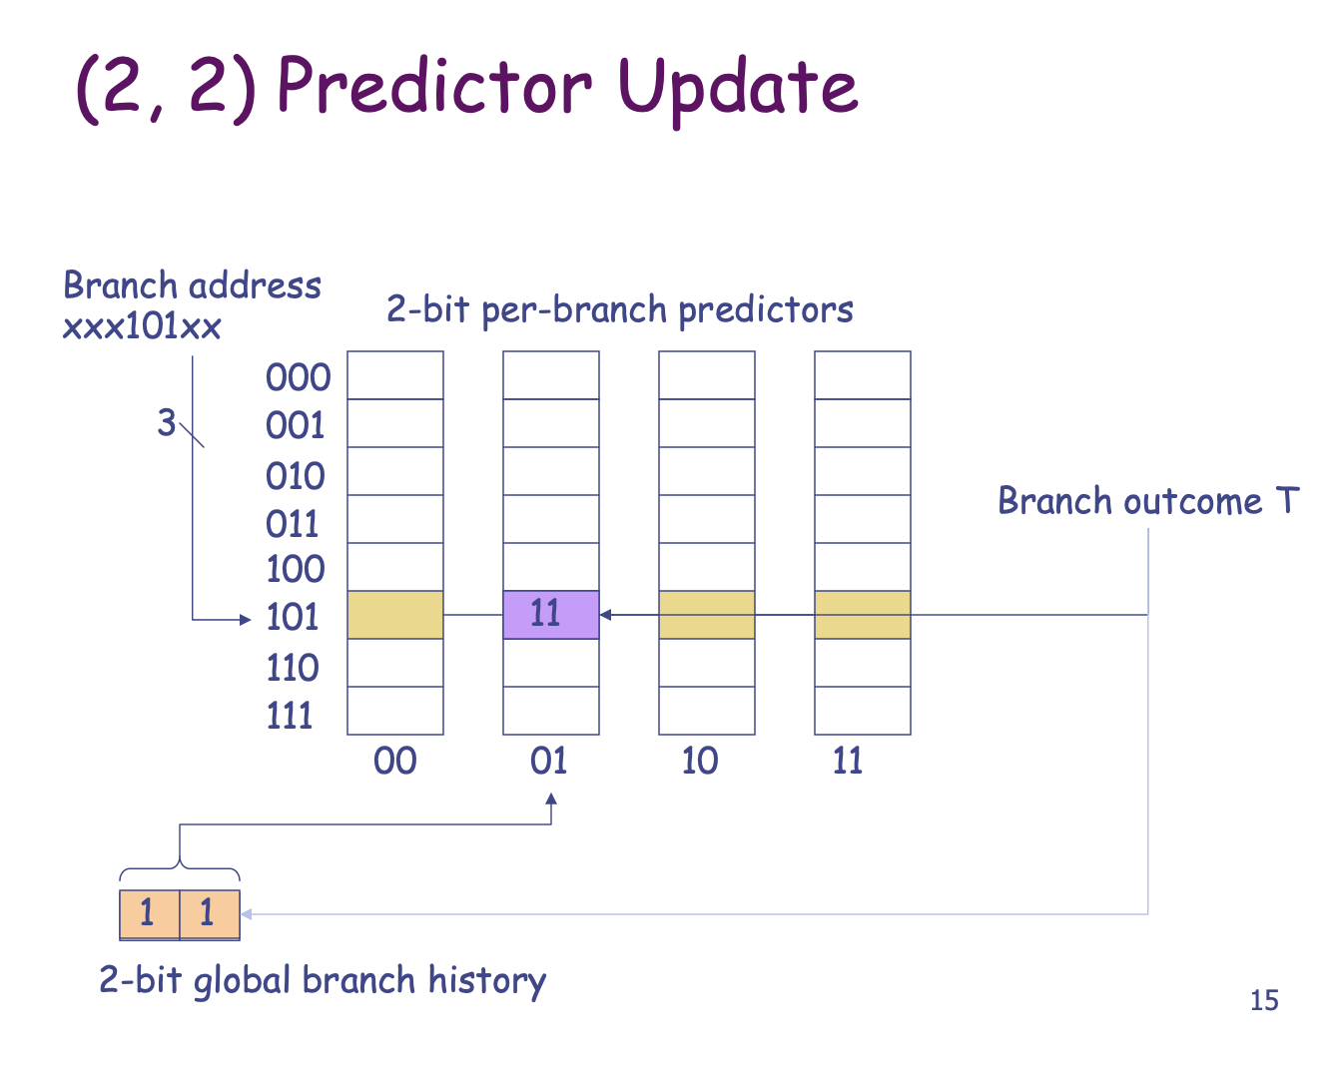
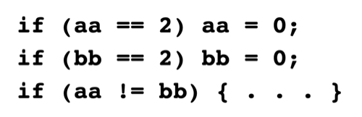
(m, n)-Correlated Branch Predictor
Global state = 2b’00 means consecutive two branch not takens.
Record correlation between 3 (i.e. m+1) branches.
1st, 2nd: NT -> 3rd:T

Slide 17
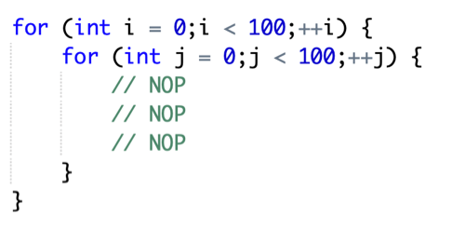
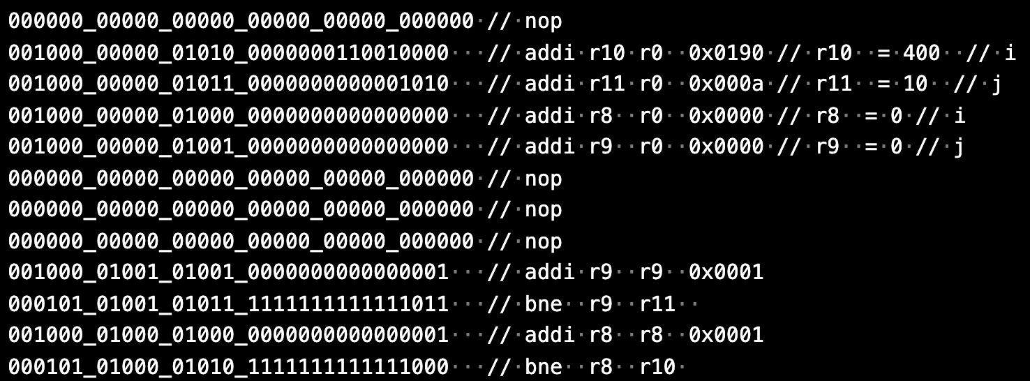
Experiment
Nested for loop

Slide 18
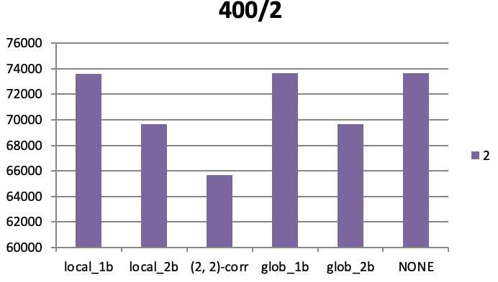
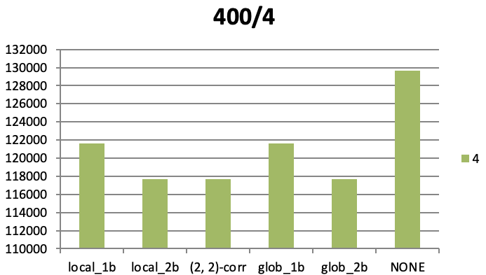
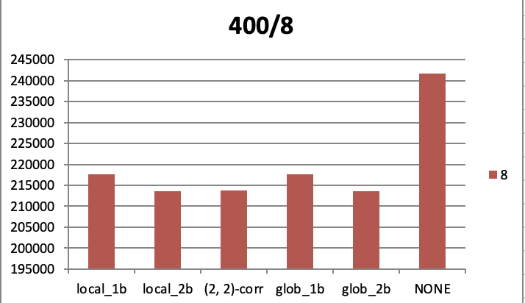
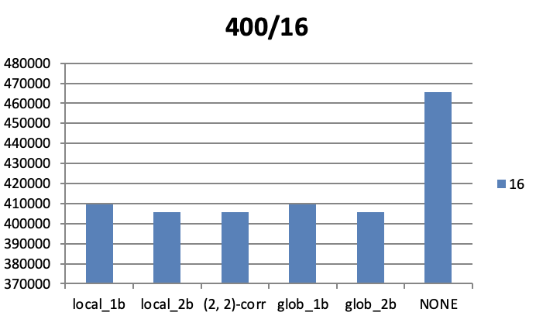
Experiment
Outer = 400
Inner = 16/8/4/2
Correlated predictor is the best

Slide 19
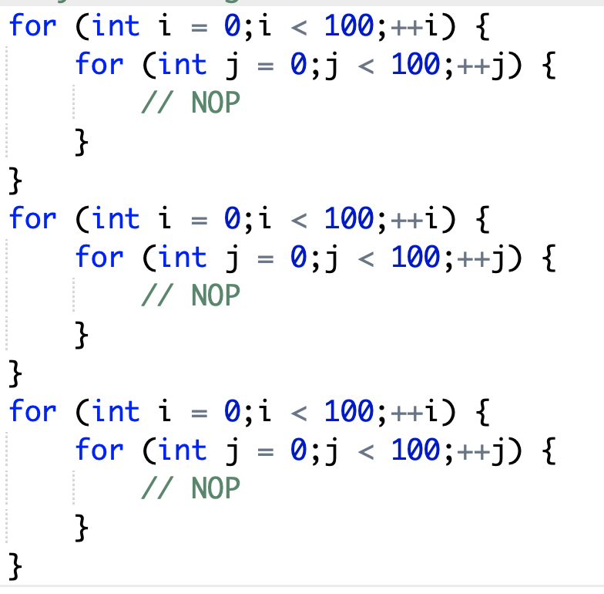
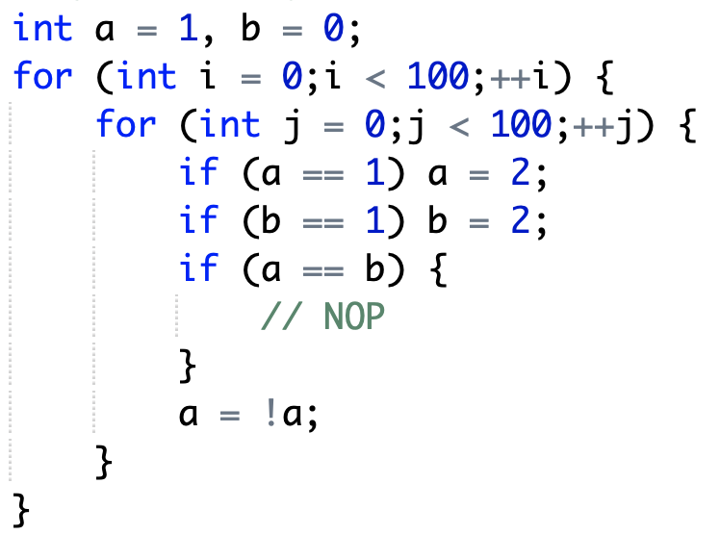
Experiment
More (ongoing…)
Global/Local
Correlated

Slide 20
L2 Cache
Encountered Troubles
Structure
FSM Design
Experiment & Observation

Slide 21

Encountered troubles
Originally, many next state logics are used in the cache design in HW3.
We hadn’t finished MIPS CHIP
So I finished many caches without thinking and testing
But pipeline MIPS needs fast response from memory
Disaster
Spent a lot of time adjusting the architecture and debugging
Lesson learnt: Better test and code simultaneously
And I suck so mush…

Slide 22
Structure
Based on separate L2 cache structure
Focus on performance with different combination of cache mapping
We want to check the connection of miss rate and associativity
L1 cache (256 words): Direct-mapped, 2 way set-associative
L2 cache (32 words): Direct-mapped, 2/4/8 way set-associative
L1_Dcache
L1_Icache
L2_Dcache
L2_Icache
Slow Memory

Slide 23
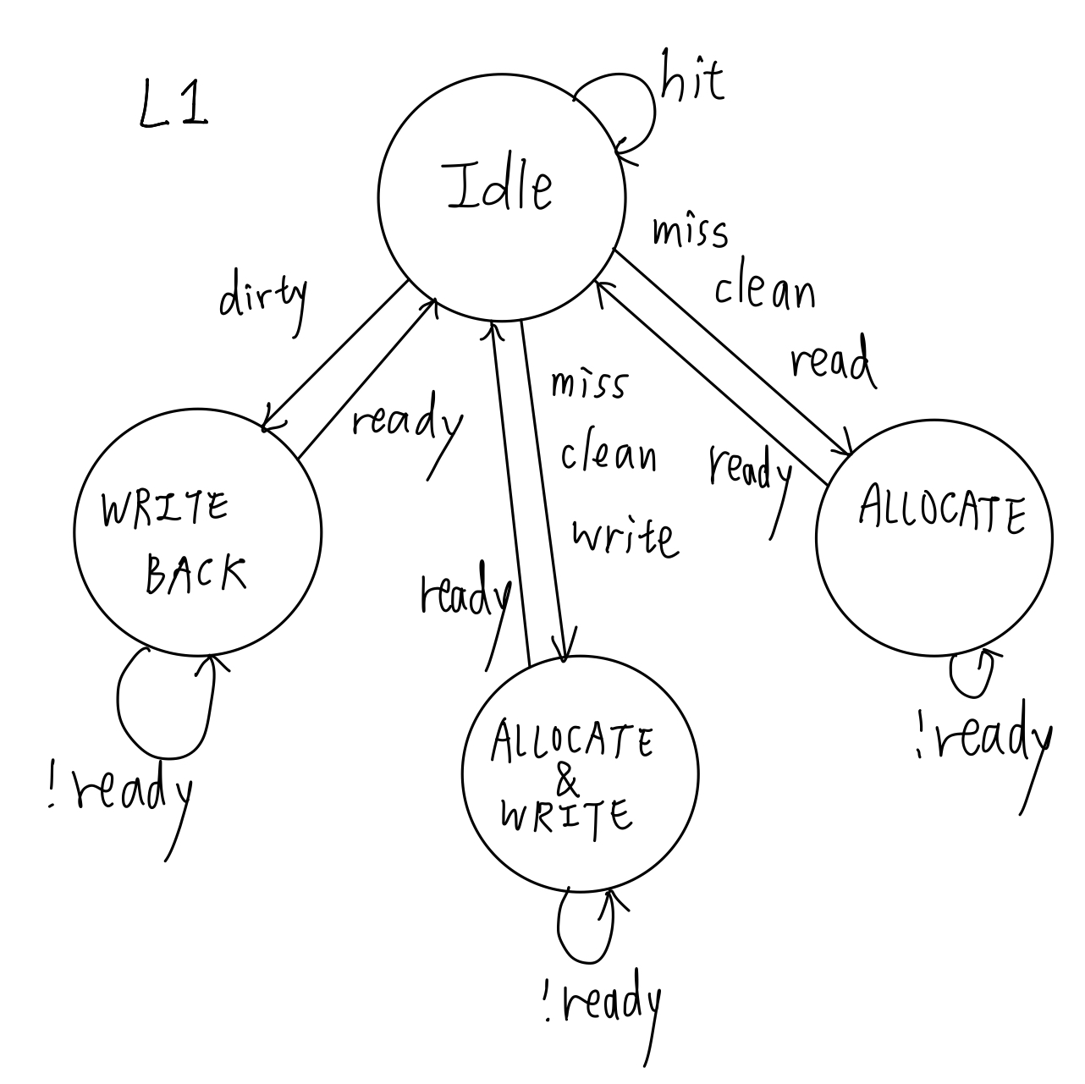
FSM
Writeback cache

Slide 24
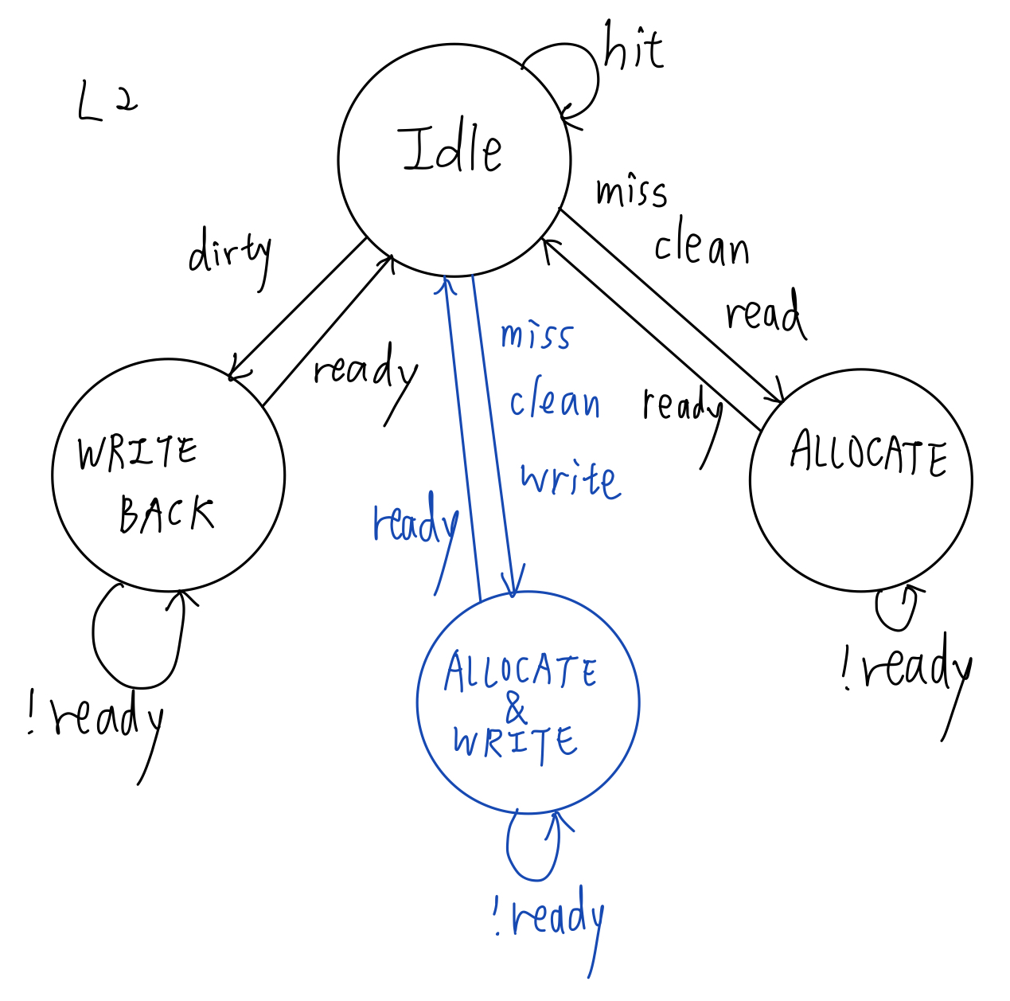
FSM

Slide 25
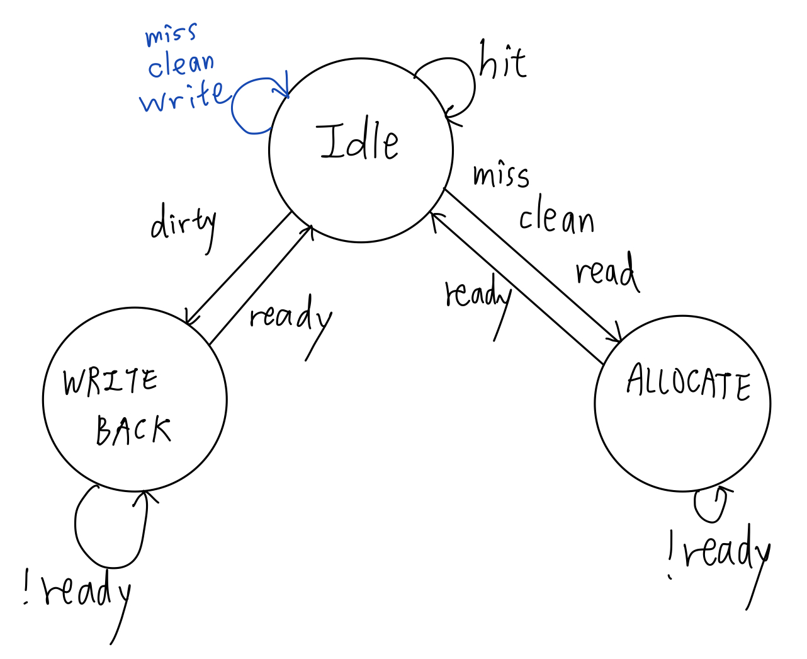
FSM
Reduce several times of access memory
Proportional to total size of the cache

Slide 26
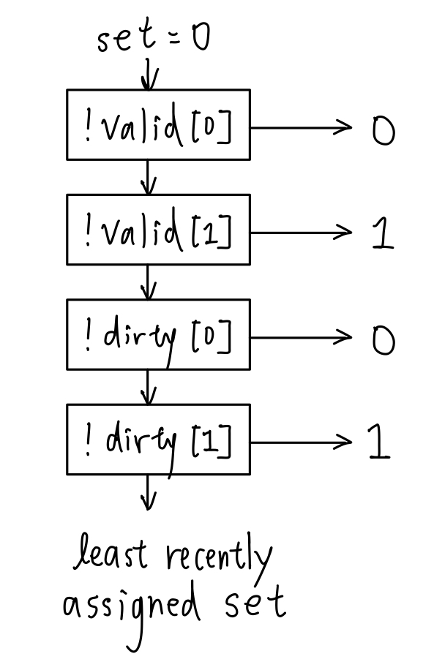
FSM: set-associative
Set determination of 2 way set-associative
Replacement policy(LRU)
Non valid set
Clean set
Least Recently used set
Numeric order

Slide 27
Experiment
Little difference under the original testbench due to the separate L2 cache design.
Possible reason: the miss ratio is low from the testbench itself
L1 | dm |  |  |  | 2way
L2 | dm | 2way | 4way | 8way | dm | 2way | 4way | 8way
L1 miss rate | 0.0521 |  |  |  | 0.1013
L2 miss rate | 0.3279 |  |  |  | 0.0160

Slide 28
Experiment
Based on read-write-read test from HW3
Observation:
Using more sets is not necessarily helpful.
Especially when the associativity of L2 grows overly larger than that of L1.

Slide 29
Further Research
More experiment:
Branch predictor
L2 cache
Discuss different cache size
Use other testbenches with strong locality

