Slide 1
MIPS Group 3 Final Proposal
B07901010 范詠為
B07901013 林子軒
B07901019 吳隆暉

Slide 2
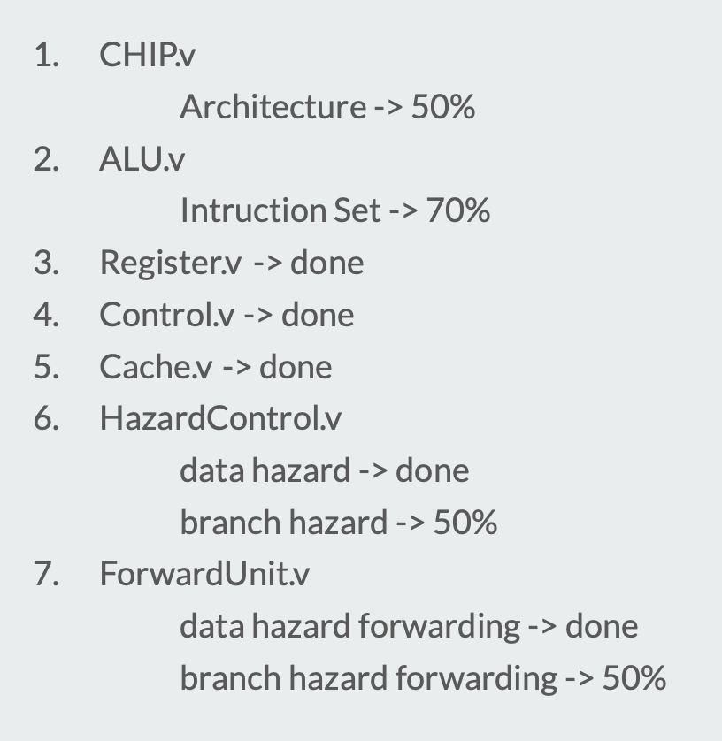
Current results

Slide 3
Future Plan
Baseline - RTL (6/7)
Branch Prediction (6/17)
Two Level Caches (6/17)
Optimization (6/17)
Multiplcation/Division (Optional)

Slide 4
1. Branch Prediction
1. 1-bit Branch-Prediction Buffer
2. 2-bit Branch-Prediction Buffer
3. Correlating Branch Prediction Buffer
4. Tournament Branch Predictor
5. Branch Target Buffer
6. Return Address Predictors
7. Integrated Instruction Fetch Units
ref:https://www.cs.umd.edu/~meesh/411/CA-online/chapter/dynamic-branch-prediction/index.html
Notes:
We will implement some of these predictors and do experiments on their performance on generated testcase

Slide 5
2. L2 Cache
3. MultDiv (Optional)
2-way set-associative L2 Cache
Location Cache
Residue Cache
https://dl.acm.org/doi/pdf/10.1145/1013235.1013271
https://dl.acm.org/doi/pdf/10.1145/2155620.2155670
http://meseec.ce.rit.edu/eecc551-fall2002/551-9-12-2002.pdf

Slide 6
Work Assignment
范詠為：
HazardControl
ForwardUnit
Branch Prediction
林子軒：
Control
Register
RTL Debug
吳隆暉：
ALU
Cache
L2 Cache
共同：
CHIP
Optimize

