Slide 1
Who?
Joe
Not a good programmer

Slide 2
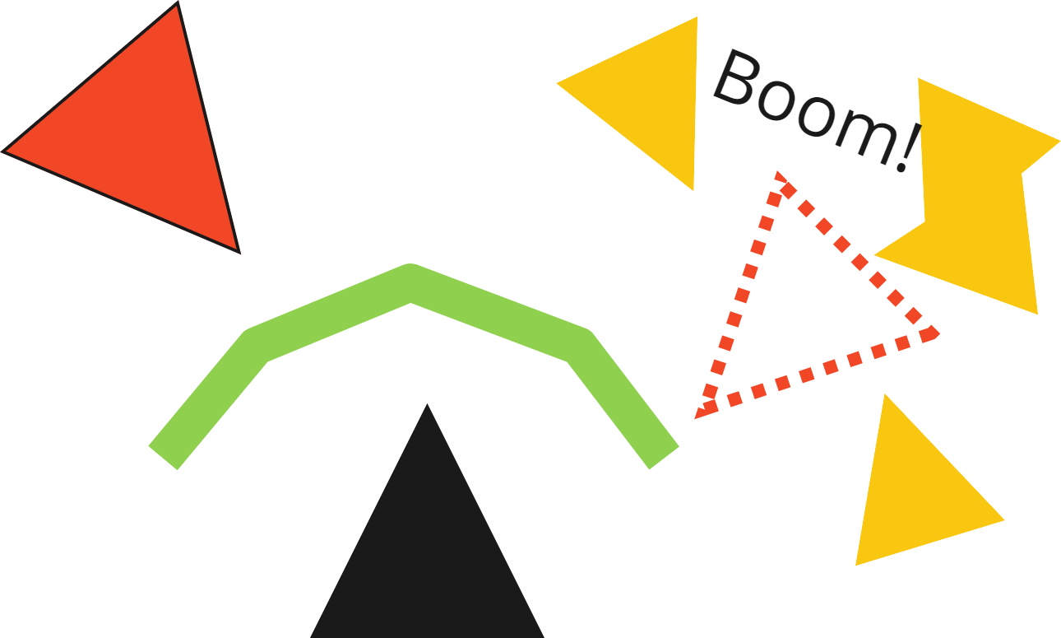
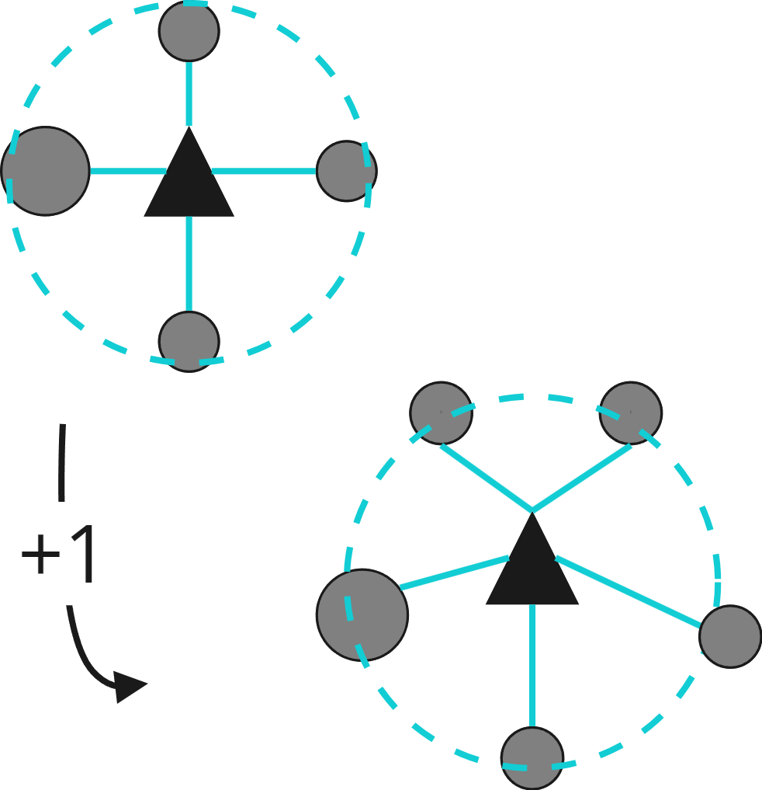
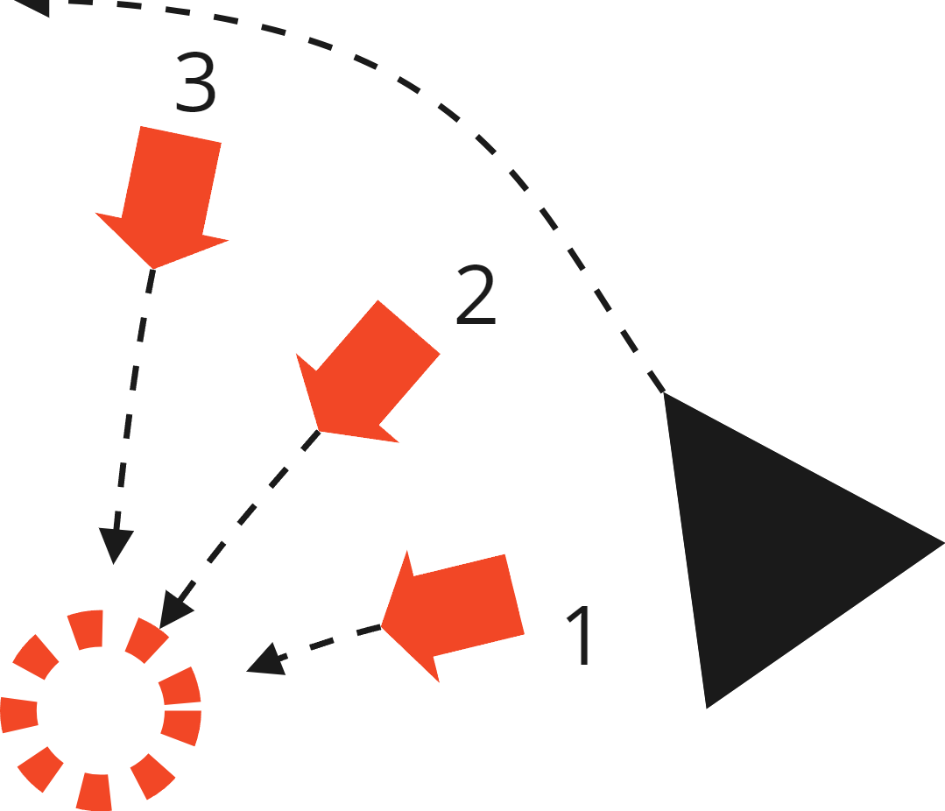
Plans
Projected shield using a modular shape generator
Asteroid Collector that attaches asteroids to points around the ship
Broadside missiles that fire out from the side to an offset position
Notes:
Projected shield using a shape generator and classic magnitude conditionals to destroy objects
Asteroid collector that attaches asteroids to the ship when close and increases with more asteroids
Broadside missile rack that fires a burst towards a uniform direction over a small burst of time.

Slide 3
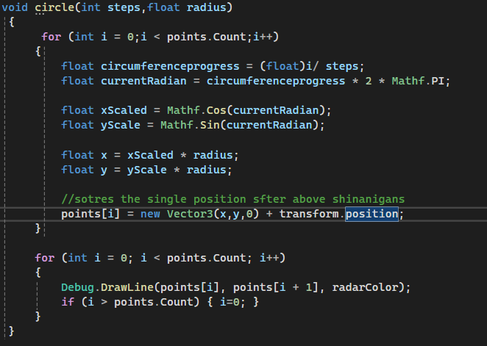
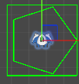
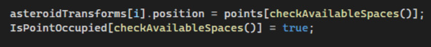
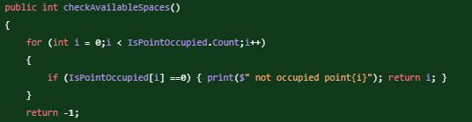
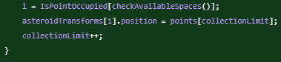
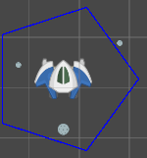
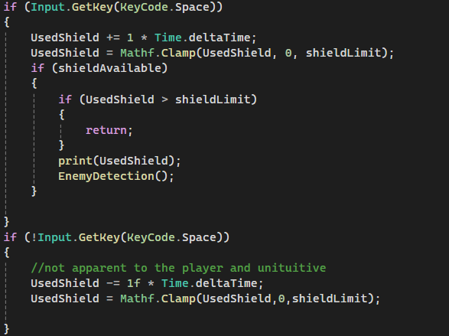
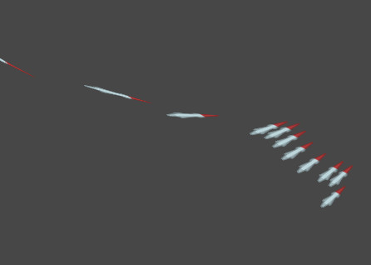

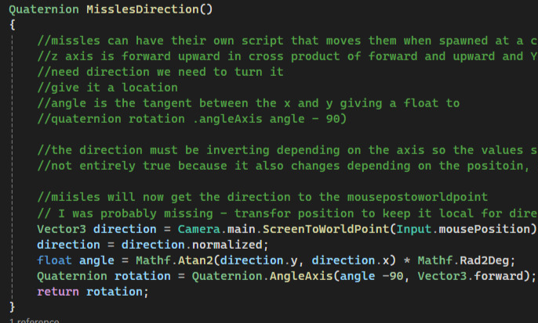
Process (45 seconds max)
Explain some aspect of your process work.
*Make sure that you've rehearsed this slide.*
Include visuals.
Notes:
For the shield the method I used to draw a “circle” worked and could detect objects based on magnitude and estroy them. Working as a pseudo collider
For the asteroid collector I tried saving the index of “collided” asteroids with a separate list of bools and then ints but it did not work so I simply attached the first on the back of the player.
For the broadside missles I took the direction to the mouse and made the mouse button shoot a burst towards the mouse, this was because movement did not rotate the player so the broadside idea was flawed initially

Slide 4
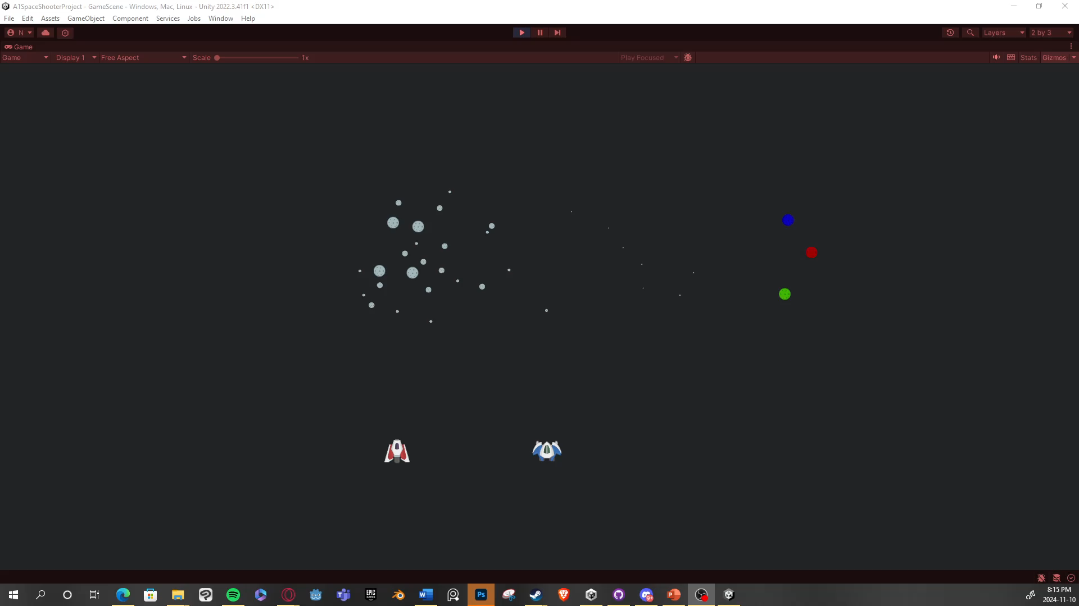
Demonstration (1 minute max)
Describe your final result.
Show some footage of where you got to with the implementation.

Slide 5
Take-away
What I learnt:
Colliders are cool Global managers are very useful
What I would do differently:
I would add more mechanics for gameplay and less around the cool shape generator
Journal and research more
Use git effectively
Notes:
Colliders and my brief knowledge of them make them incredibly useful have a global manager for the asteroids and control their spawn
Have the emeny move or be a threat or add more fundamental game mechanics

